Slide 1
DAA Assignment 2
Group-9
Vidushi Pathak (IIT2019027)
Shubham Netam (IIT2019028)
Puneet Singhwaiya (IIT2019029)
B.Tech. 4th semester, Department of Information Technology
Indian Institute Of Information Technology, Allahabad

Slide 2
Content
Problem statement
Introduction
Algorithm
Pseudo Code
Graph based on Apriori Analysis
Conclusion
References

Slide 3
Problem Statement
Prepare a matrix of random characters of size 50×50 and check for valid English words reverse diagonally.

Slide 4
Introduction
For solving our problem we have used a python library PyEnchant to check if a word is valid english word or not. PyEnchant is a spell checking library for Python, based on the excellent Enchant library. PyEnchant combines all the functionality of the underlying Enchant library with the flexibility of Python and a nice “Pythonic” object-oriented interface.For generating random characters we have used Python random.choice() function.Python random module‘s random.choice() function returns a random element from the non-empty sequence. we can use the random.choice() function for selecting a random password from word-list, Selecting a random item from the available data.

Slide 5
Algorithm
i.First we will create a matrix of size 50x50 of random characters by using random.choice function.
ii.Then we run a loop for 50 times in reverse diagonal direction for just getting a string from these random characters one by one.
iii.Then we check that if the size of the string is greater than one or if the string value is 'A', then only it is possible that the string is present in the dictionary.
iv.If present, then we directly print that string.

Slide 6
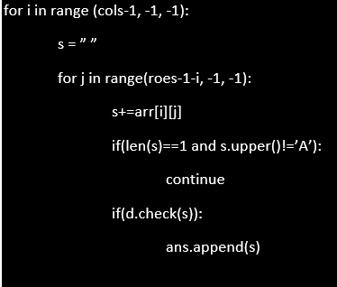
Pseudo Code

Slide 7
Complexity Analysis
Time Complexity: O(n*2)
Space Complexity:O(1)

Slide 8
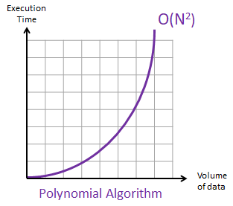
Graph based on Apriori Analysis

Slide 9
Conclusion
Through this assignment we have learnt about the PyEnchant library in python, and applied it, in finding of valid English words in reverse diagonal of matrix of randomly generated characters.

Slide 10
References
https://pyenchant.github.io/pyenchant
https://pyenchant.github.io/pyenchant/tutorial.html
https://pynative.com/python-random-choice

