Slide 1
Greetings!

Slide 2
Sales Analysis
for
E-Commerce

Slide 3
MAIN OBJECTIVES
Sales Trend Analysis
Profit over a Period | Analysing monthly profit
Profit trends | Analysing Various trends in profits
Priority customer groups | Classifying priority customer groups
Sales Target Analysis
Profit Targets | Analysing the fulfillment of various targets
Meaningful Insights
Other conclusions | Drawing out other valid conclusions
Correlation Matrix | Detailed Analysis of Correlation Matrix of Order Details
New Data Frame | Detailed Structure of required data frame
Successful Category/ Sub-Category | Analysing profit per category

Slide 4
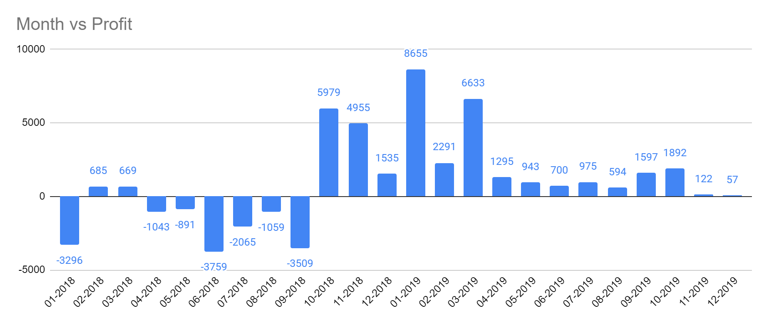
Sales analysis: Profit over a Period(Monthly)
Most Profitable Month:
January,
2019
Notebook - https://colab.research.google.com/drive/1_fGZtY5Z-pdxzV5bNOKewYsWTyDXk5Fq?usp=sharing

Slide 5
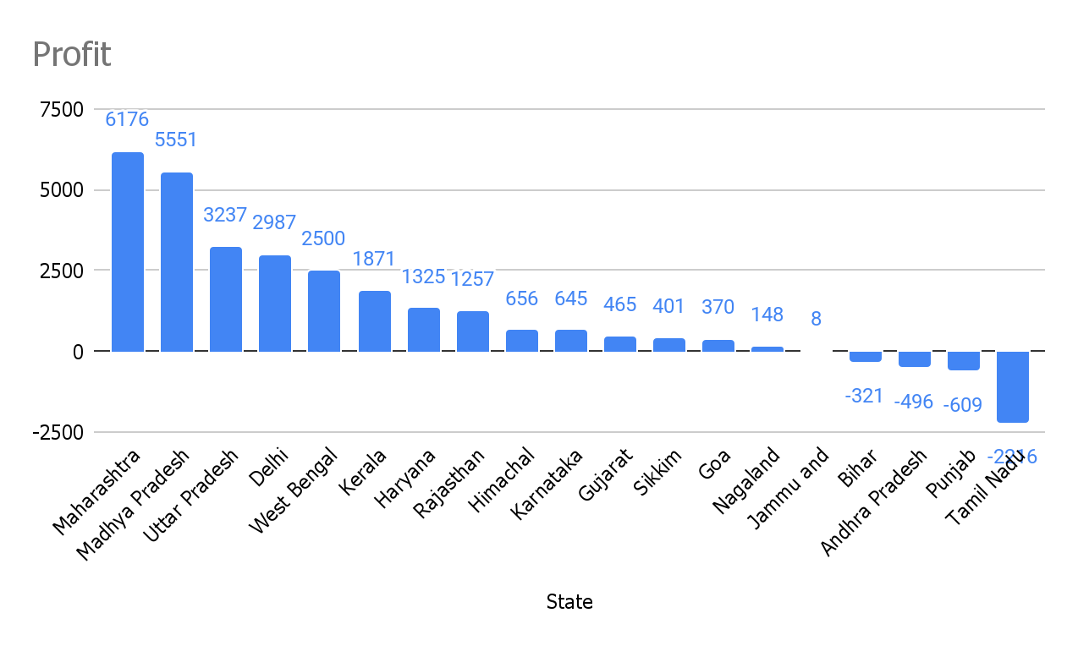
Sales analysis: Profit per State
Most Profitable State:
Maharashtra
Notebook - https://colab.research.google.com/drive/1_fGZtY5Z-pdxzV5bNOKewYsWTyDXk5Fq?usp=sharing

Slide 6
Sales analysis: Priority Customer groups
Customers whose purchases are causing losses
Loyal Customers
Regular customers who shop for everything from us and contribute to the profit.
The recurring customers whose orders are resulting in loss.
Reference - https://smallbiztrends.com/2016/09/how-to-identify-a-loyal-customer.html
Notebook - https://colab.research.google.com/drive/1_fGZtY5Z-pdxzV5bNOKewYsWTyDXk5Fq?usp=sharing

Slide 7
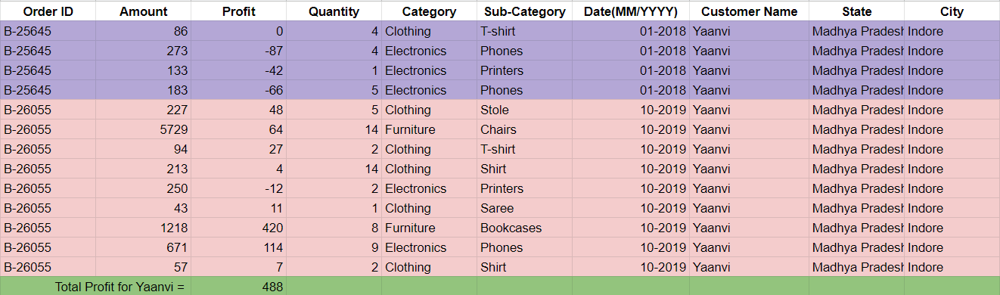
Loyal Customer Data:

Slide 8
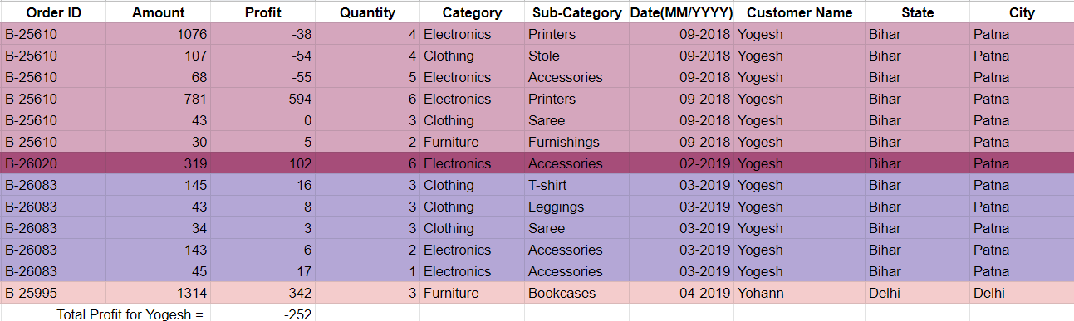
Recurring customer but causing loss :

Slide 9
Sales analysis: Category
Average Profit
ELECTRONICS
37.04
CLOTHING
11.76
FURNITURE
9.46

Slide 10
Sales analysis: Profit Trend Analysis
January ,2019 is the most profitable month owing to heavy purchases in clothing sub category
01
Best Sub - Category -> Printers
Worst Sub - Category -> Tables
Maharashtra has the highest Total Profit
03
02

Slide 11
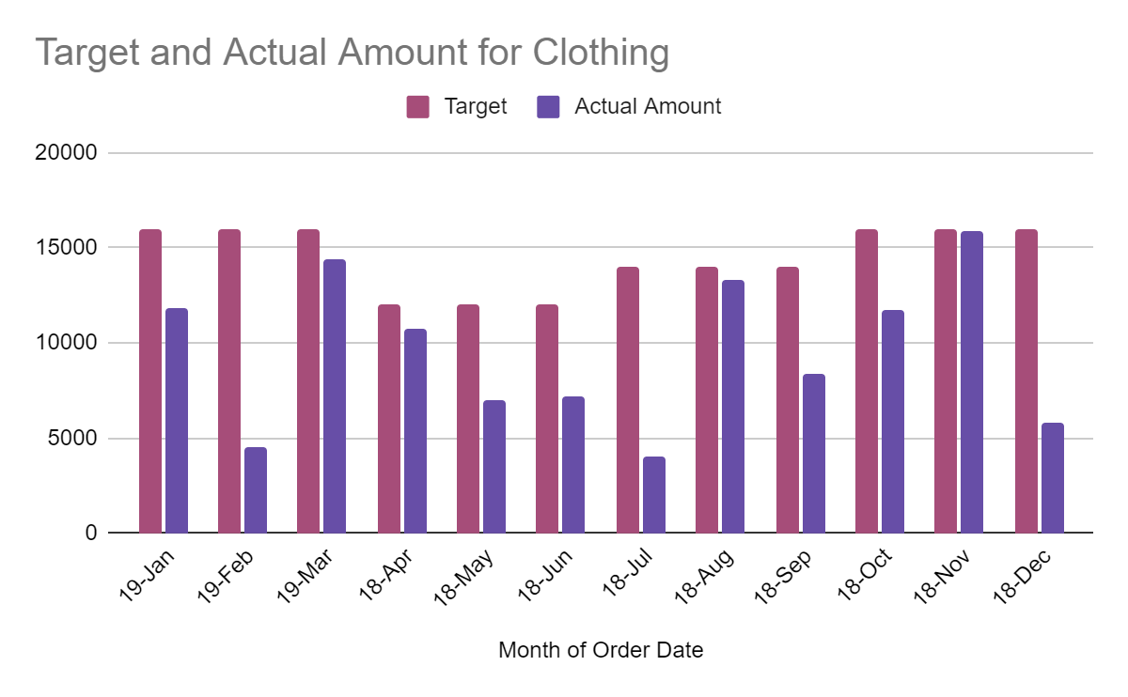
Sales Target Analysis

Slide 12
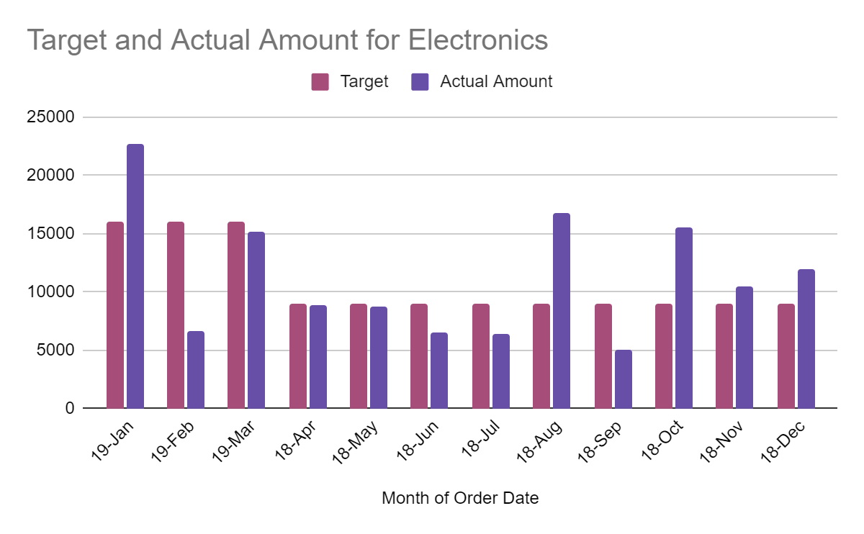
Sales Target Analysis

Slide 13
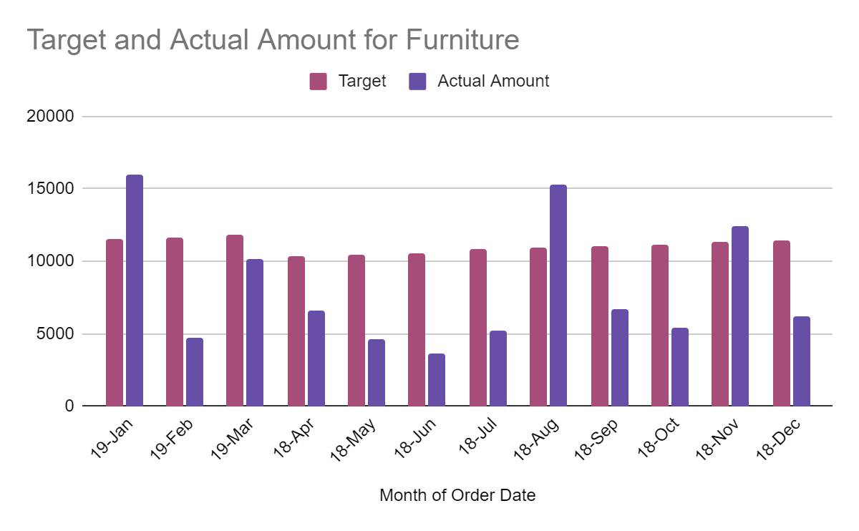
Sales Target Analysis

Slide 14
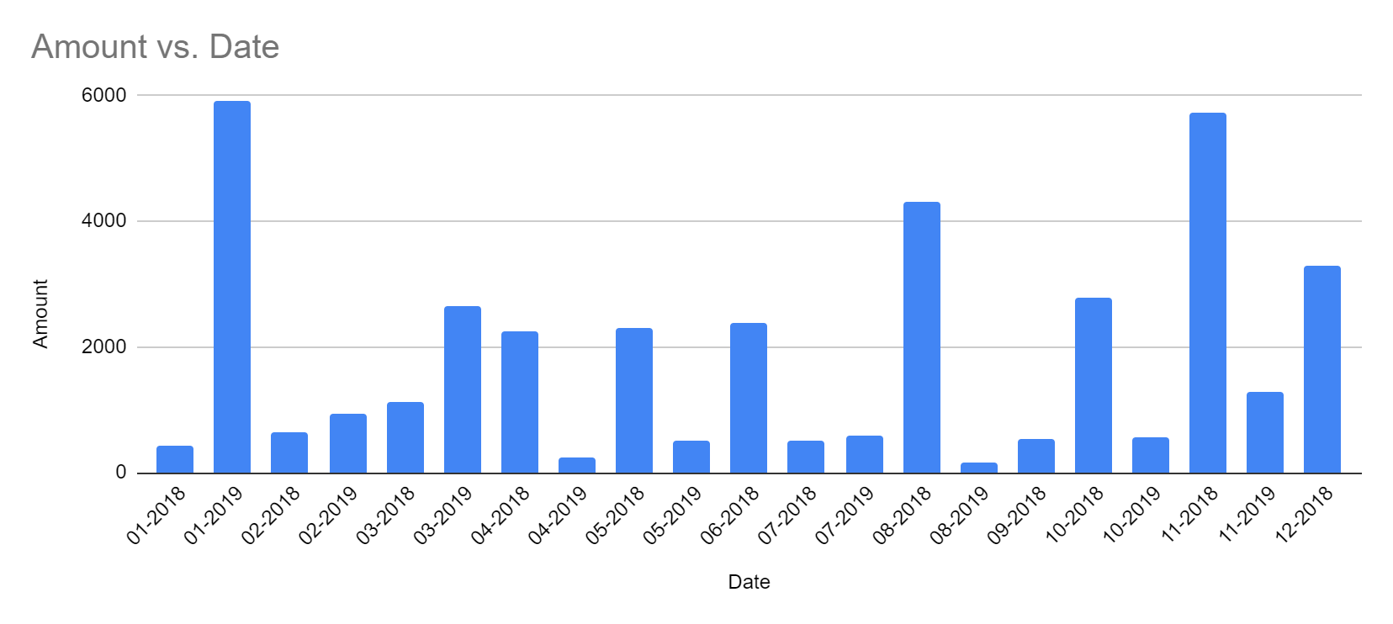
Sales analysis: Meaningful Insights
01
Sale of Clothing is directly proportional to change in weather.
02
Sale of Electronic Games
4
Strengths
Mercury is the closest planet to the Sun

Slide 15
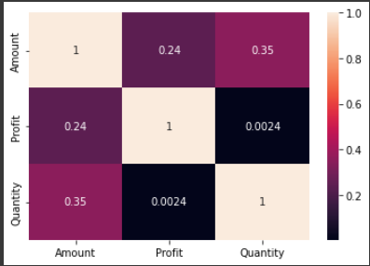
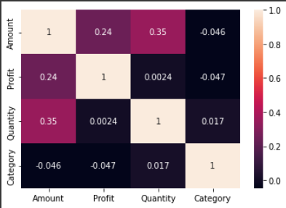
Heatmap Visualization of Correlation Matrix
Notebook - https://colab.research.google.com/drive/1Ss4b_4WsHK0bXYgfvh88zpllC3krhsCt?usp=sharing

Slide 16
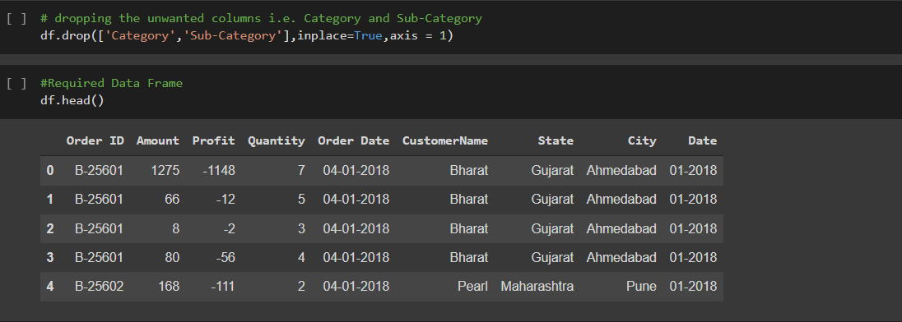
Final Data Frame

Slide 17
Thank you!
Any Questions ?

