Slide 1
GIT Branching

Slide 2
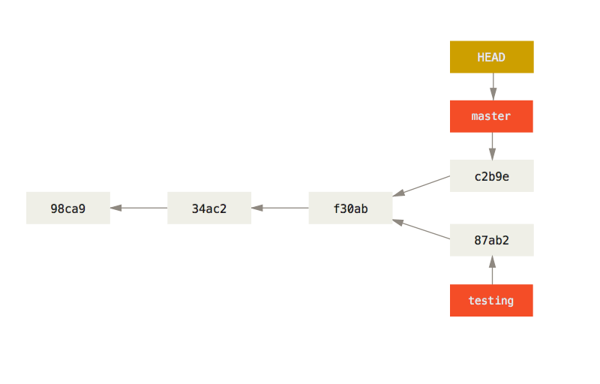
In a nutshell
Branching means diverging from the main line of development and continue working without changing the code in it.

Slide 3
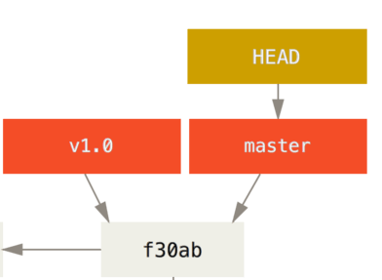
The Head
HEAD points to the current branch you are working at and in most projects in happens to be on the “master” branch
The “master” branch in Git is not a special branch.
“master” is also a pointer similar to HEAD

Slide 4
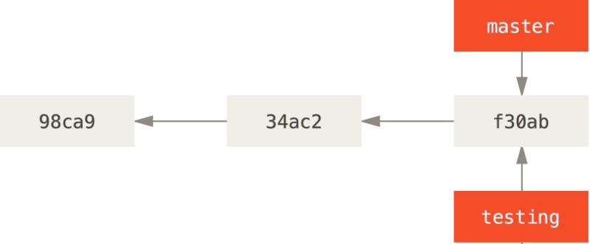
Creating a new branch
Creating a new branch is creating a new pointer for you to move around and direct your development
The command is: git branch <branchname>

Slide 5
the role of the head
This is a pointer to the local branch you’re currently on. In this case, you’re still on master. The git branch command only created a new branch — it didn’t switch to that branch.
You can see this by running git log --oneline –decorate

Slide 6
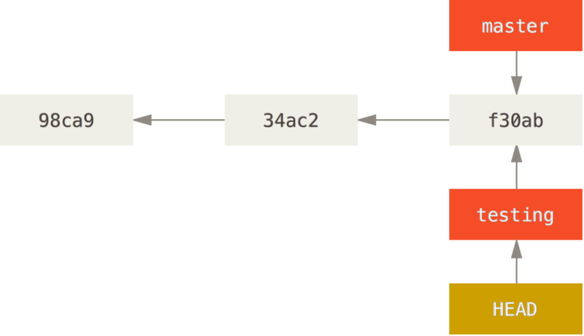
Moving the head
To switch to an existing branch, you run another command called git checkout
Ex: git checkout testing

Slide 7
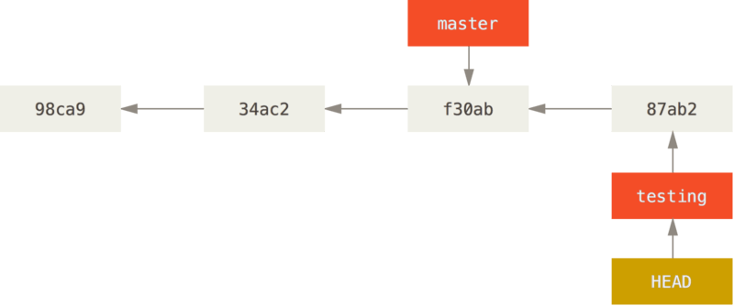
effects
Commit your changes and then you will have this

Slide 8
Advancing
Now to see what happens when you commit something to the “master” branch
Remember, first you need to move your HEAD ( git checkout master)
Now commit something

Slide 9
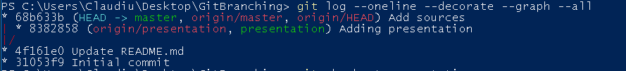
Checking the branches
There is a way to see your branches inside the console with:
git log --oneline --decorate --graph --all

Slide 10
Notes
Git won’t let you switch branches if your working directory or staging area has uncommitted changes that conflict with the branch you’re checking out to.
When you switch branches, Git resets your working directory to look like it did the last time you committed on that branch.

Slide 11
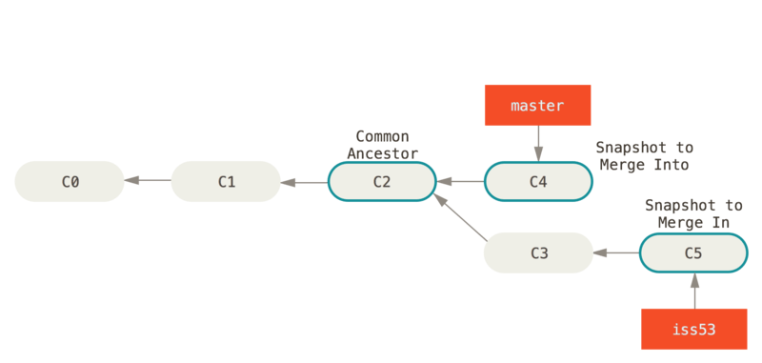
Branching and merging
Now you are done and want to bring everything in “master”. What do you do?
You merge them
All you have to do is check out the branch you wish to merge into and then run the git merge <branchname>

Slide 12
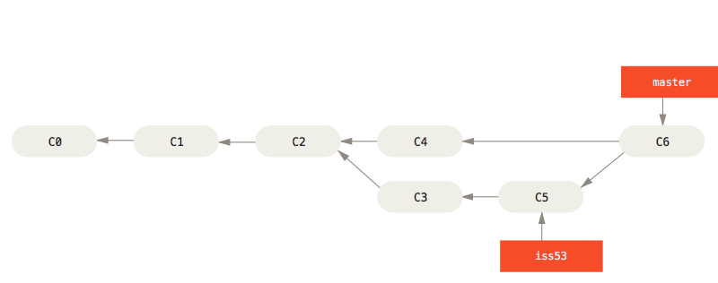
result

Slide 13
Deleting a branch
Now that you are done merging you can delete the branch. In this picture you can do it with git branch -d iss53

Slide 14
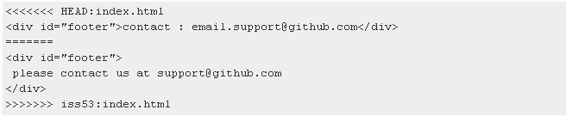
Merge conflicts
You will sometimes get conflicts. Git pauses the merge commit until the issue is resolved
To see any unmerged files run git status
Git adds standard conflict-resolution markers to the files that have conflicts. Your file contains a section that looks something like this:

Slide 15

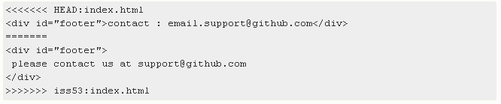

Meaning of the markers
This means the version in HEAD is the top part of the block, while the other version is on the bottom part.
To resolve the issue you must choose one
EX:

Slide 16
Git mergetool
If you want to use a graphical tool to resolve these issues, you can run git mergetool, which fires up an appropriate visual merge tool and walks you through the conflicts
After you exit the merge tool, Git asks you if the merge was successful. If you tell the script that it was, it stages the file to mark it as resolved for you. You can run git status again to verify that all conflicts have been resolved

