Slide 1
nlp = spacy.load("en_core_web_sm", max_length=1529140)
This line of code loads the model that will be used in tokenization
Statistical model used by Spacy https://spacy.io/models
A parameter that ensures that we don’t work with files too big. If there are problems, the number should be increased. This means more resources used.

Slide 2
tokenizer = Tokenizer(nlp.vocab)
This line of code creates the tokenizer based on the vocabulary available in the model. It helps in tokenization because you are telling the computer that word constructs like “don’t” exist.
Bonus: It makes the code run faster because we are using only parts of Spacy

Slide 3
result = list()
Creates an empty list and stores it in result. This is where we will keep our tokens before we save them.

Slide 4
for tokens in tokenizer.pipe(findTxts('TextFiles'), batch_size=50):
A for loop helps us go over a list of items. A list of items is generated by the pipe method in tokenizer.
The pipe method receives 2 parameters. A list of texts and how many texts to process at once.
A for loop works by accessing each element of a list one at a time.
for i in [1,2,3]:
print(i)
Will result in:
1
2
3
The pipe method waits for the function inside the brackets to be finished before executing
The findTxts function receives a String path where are the text files are stored. Using this path, it will create a list of texts out of the texts in the Annual Reports

Slide 5
for tokens in tokenizer.pipe(findTxts('TextFiles'), batch_size=50): result.extend(tokens.to_array("ORTH"))
We are going to add the tokens we found to the list that will hold all the tokens in the end. We must do this because we are going one at a time through each processed file.
I will talk in detail about what this does at the end
Due to the nature of spacy, the tokens are stored as positions pointing to the words in vocabulary. Every word in the vocabulary has a number as an identifier. “ORTH” is just telling spacy to give us the positions because it can do a lot more!

Slide 6
pos_counts = Counter(result)
Counter is a type of dictionary in python. It receives a list as an argument and then counts how often each element occurs.
A dictionary is a key:value pair.
Example:
{‘apple’:1,’car’:2}
This means that if I write dictionary[‘apple’] it will give me the value 2.

Slide 7
with open("Counts/CSRWordFreqDict.csv", mode="w+", newline="", encoding='utf-8') as csv_file:
In Python, when you work with files you must open and then close them. This is a shorter syntax for that. When the code that runs inside this syntax is done, it will close the file. The open function receives a path, a mode, a newline and a type of encoding. At the end it generates an object to be used to write.
If you write a line, what it should input
Object used to write
w+ means opens a file for both writing and reading. Overwrites the existing file if the file exists. If the file does not exist, it creates a new file for reading and writing.
Makes special characters that are not useful be ignored

Slide 8
csv_file.write("%s,%s\n" % ('word', 'count'))
The write method is used with a special syntax that helps in writing to files. It can be used in other scenarios also.
print(“%s” % (‘apple’))
“%s” is the pattern
% is the link
(‘apple’) is the word that falls into the pattern. If I were to put a number, it would throw an error.

Slide 9
for orth_id, count in pos_counts.most_common(): csv_file.write("%s, %d\n" %(tokens.vocab.strings[orth_id], count))
The most_common method generates a sorted list. The sorting is done based on the count. The most common element is the first one.
In this case it will return a list formed of tuples. The tuples are formed of the position and the count.
Tuples are group of elements. (1,2) is a tuple made from 1 and 2.
A list of tuples looks like this:
list = [(1,2),(5,5),(3,2)]
At position 0 you get (1,2). This can be accessed by asking for the its position. list[0][0] gives 1 and list[0][1] gives 2.
Splits the tuple in 2 for us
Searches in the vocabulary for the word at the position and returns it

Slide 10
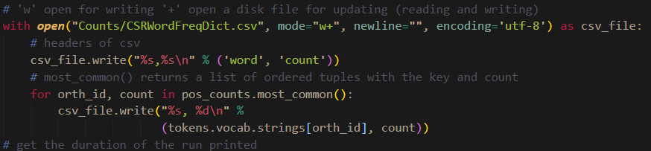
Putting it all together

Slide 11
The following slides are functions defined outside the main code that are used throughout all the code.

Slide 12
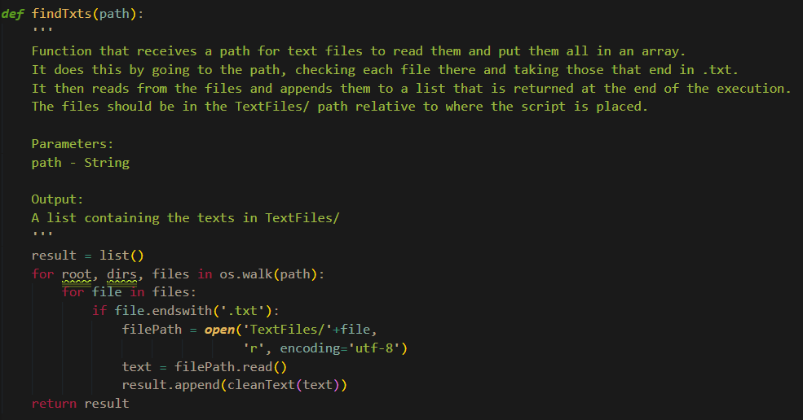

Slide 13
def findTxts(path): result = list() for root, dirs, files in os.walk(path): for file in files: if file.endswith('.txt'):
os.walk returns the directory path, directory names, and file names. It scans all the directories and subdirectories bottom-to-up.
Because we use only one directory, we go through the files in it and check if the files end in .txt
More details about os.walk() at https://www.tutorialspoint.com/python/os_walk.htm

Slide 14
filePath = open('TextFiles/'+file,'r', encoding='utf-8') text = filePath.read() result.append(cleanText(text)) return result
os.walk returns the directory path, directory names, and file names. It scans all the directories and subdirectories bottom-to-up.
Because we use only one directory, we go through the files in it and check if the files end in .txt
This is the mode. ‘r’ is for mode set to reading.
Reads the whole document
Returns result of function and exists findTxts
Function that cleans the text

Slide 16
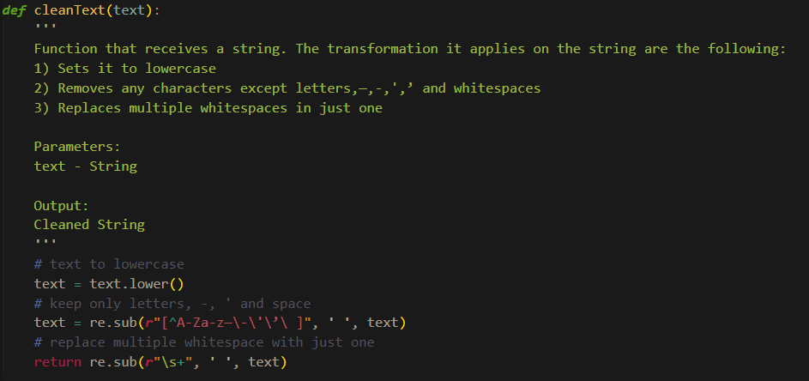

Slide 17
def cleanText(text): text = text.lower() text = re.sub(r"[^A-Za-z—\-\'\’\ ]", ' ', text) return re.sub(r"\s+", ' ', text)
We are using the default RegularExpression library in python. RegularExpression are a way of finding pattern in text and doing different operations with it.
https://regexr.com/ is a good website for trying out regex
Replaces all characters matching this pattern. In this case the pattern describes all the characters that are not letters, —, -, ‘, ’ or whitespace
Sets the text to lowercase
Replace multiple instances of whitespace with just one

Slide 18
NPs

Slide 19
for doc in nlp.pipe(findTxts('TextFiles'),batch_size=25,n_process=2: count.extend(doc.noun_chunks)
noun_chunks will access the base NPs found in the text. The extracted NPs are of type base noun phrase, or “NP chunk”, which is a noun phrase that does not permit other NPs to be nested within it – so no NP-level coordination, no prepositional phrases, and no relative clauses
2 processes will run at the same time to process text

Slide 20
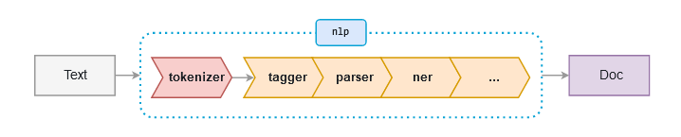
Spacy (https://spacy.io/usage/spacy-101 )
In texToDict.py we are using only the tagger. In a complete pipe, there are multiple phases. The tokenizer is always the first step. Then it is followed by the tagger, parser, etc. For example, the tagger detects which part of speech it is and then the parser will make the link between the different parts of speech in the sentence.
After the whole pipe is done, then the result is the doc object that can be used to extract the information from.

Slide 21
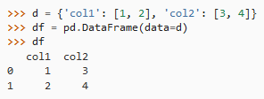
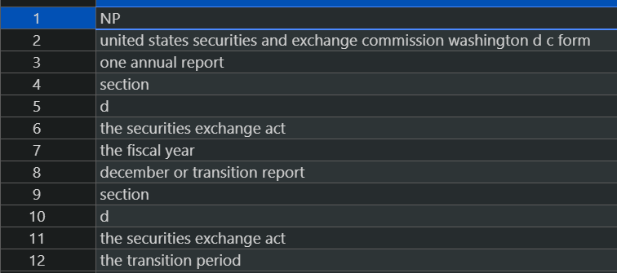
df = pd.DataFrame({'NP': count})
A dataframe is a data structure that holds tabular data. Due to a problem in comparing the different strings that came as a result from noun_chunks, we will save the results in a dataframe and then count up each unique NP.
A dataframe receives a dictionary as the definition for its structure.
The result of this is a table that contains each NP

Slide 22
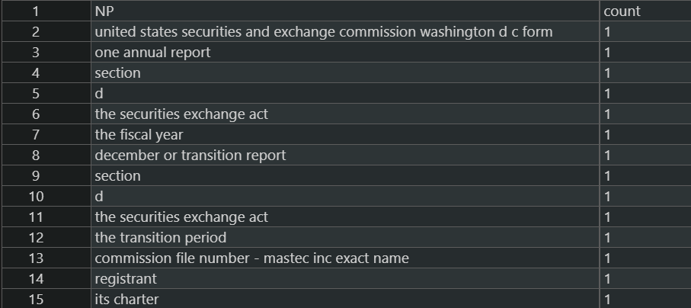
df['count'] = 1
We want two column in the dataframe. One with the NP and one with the count. To achieve this, we set the next column to be 1 for row in the first column
When a dataframe receives between square brackets a string that doesn’t exist in the column list, it will create a new column that receives the value assigned.
The result of this is a table that contains each NP

Slide 23
df.to_csv('Counts/TestSpacyNP.csv', index=False)
We then save the dataframe to a csv so we can avoid the issue where similar values are not recognized as such. The to_csv method receives a path and then other optional parameters. In this case we tell it to save it without the index.
This would be the index column

Slide 24
df = pd.read_csv('Counts/TestSpacyNP.csv', header=0)
The dataframe is read from the file we just saved it in while mentioning that the header is the first column. This means that the name of the columns are put in the first row in the csv.

Slide 25
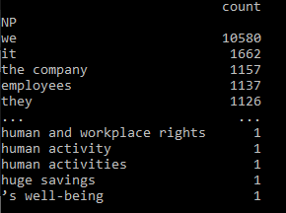
dfAgg = df.groupby(['NP']).sum()
It groups each unique NP and then sums up the value in the other columns, meaning that each 1 will be summed depending on how often the NP occurs. After the group by, the NP is the index.

Slide 26
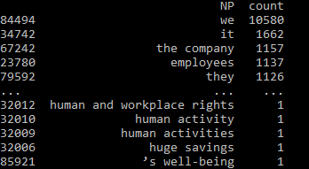
dfAgg.reset_index().sort_values(by='count', ascending=False).to_csv( 'Counts/CSRNPWordFreqDict.csv', index=False)
Resetting the index will have NP as a column again. The sort_values method will receive a column and which type of sorting it should be. We then save it to a new csv file.

Slide 27
VPs

Slide 28
pattern = [{'POS': 'VERB', 'OP': '?'}, {'POS': 'ADV', 'OP': '*'}, {'POS': 'VERB', 'OP': '+'}]
To identify verb phrases, we must define our own pattern. It consists of an optional VERB, 0 or multiple ADVERBs and at least a VERB.
POS stands for part of speech
OP stands for operator.

Slide 29
pattern = [{'POS': 'VERB', 'OP': '?'}, {'POS': 'ADV', 'OP': '*'}, {'POS': 'VERB', 'OP': '+'}]
To identify verb phrases, we must define our own pattern. It consists of an optional VERB, 0 or multiple ADVERBs and at least a VERB.
POS stands for part of speech
OP stands for operator

Slide 30
matcher = Matcher(nlp.vocab) matcher.add("Verb phrase", None, pattern)
To identify phrases with Spacy, we will make use of its Matcher class. At creation it receives the vocabulary we are using. To add the pattern we just have defined, we use the add method that receives 3 parameters. A name is given to the pattern, a None is given because there is no callback needed and then the pattern is provided.

Slide 31
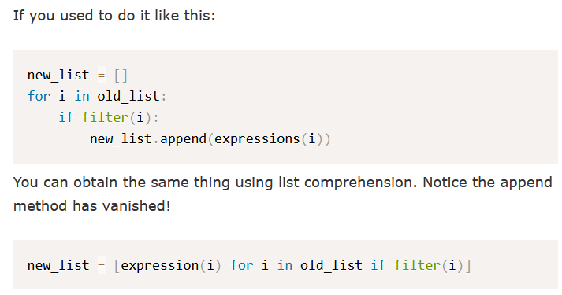

for doc in nlp.pipe(findTxts('TextFiles'), batch_size=25, n_process=2): spans = [doc[start:end] for _, start, end in matcher(doc)]
Matcher returns a list of tuples that contains the doc and the start and end of the phrase matched. To get the matched phrases, a list comprehension is used to shorten the code.
A list comprehension is a shorter way of writing a for loop to generate a list https://www.pythonforbeginners.com/basics/list-comprehensions-in-python

