Slide 1

HEALTHCARE: PERSISTENCY OF DRUG
INTERN TRAINEE :VIDYA GANESAN
BATCH NUMBER: LISU06
PROJCET REVIEWER: DATA GLACIER
LOCATION: UNITED ARAB EMIRATES
DATE: 25-04-2022

Slide 2
Background
One of the challenge for all Pharmaceutical companies is to understand the persistency of drug as per the physician prescription.
To solve this problem, ABC pharma company is seeking to automate this process of identification.

Slide 3
Problem Statement
ABC pharma company has a challenge in understanding drug persistency as per physician prescription and to solve this problem it wants to automate the process of identification.
Objective is to build a classification model for drug persistency identification.
This will automate the process of identifying drug persistency for ABC pharma company thus helping the company to understand drug persistency as per physician prescription.

Slide 4
Data Analysis Approach
Problem and data understanding.
Prepare and clean the data and Feature Engineering.
Analyze the data and find the features/variables that affects drug persistency.
Give recommendations for the classification model that is to be built to automate the process of drug persistency identification.
Report the accuracy precision and report ROC-AUC.

Slide 5
Data Exploration
One file used for the dataset
3,424 data points
75 features/variables (6 derived)

Slide 6
DATA VISUALISTION
EXPLORATORY DATA ANALYSIS

Slide 7
ANALYSIS OF NUMERIC VALUES IN THE DATASET
There are two numeric columns present in the entire dataset.
Dexa_freq_during_rx
Counts_of_risk

Slide 8
This descriptive analysis of dexa_freq_during_rx and count_of _risks with persistency _flag which is depicted in boxplot.
In Dexa _freq_during_rx the minimum frequency is 0 and the maximum is 140 which is highly skewed.
In Counts _of _risks the minimum and maximum is 0 and 7 which is slightly skewed.

Slide 9
ANALYSIS OF CATEGORICAL FEATURES IN THE DATASET

Slide 12
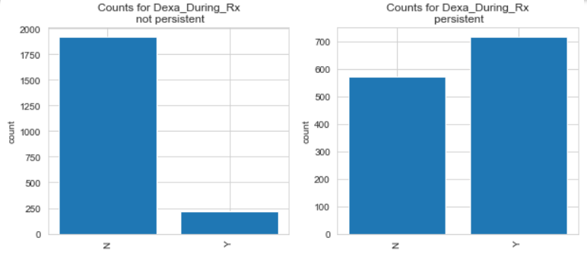

Slide 13
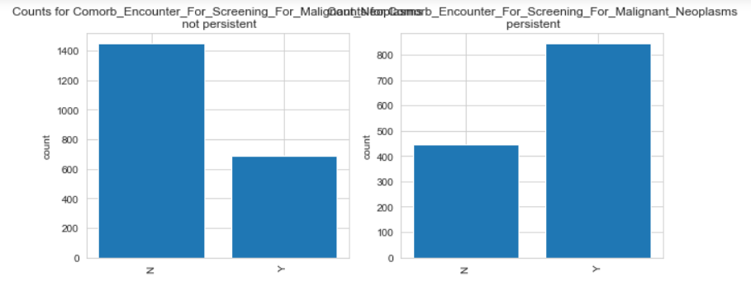

Slide 14
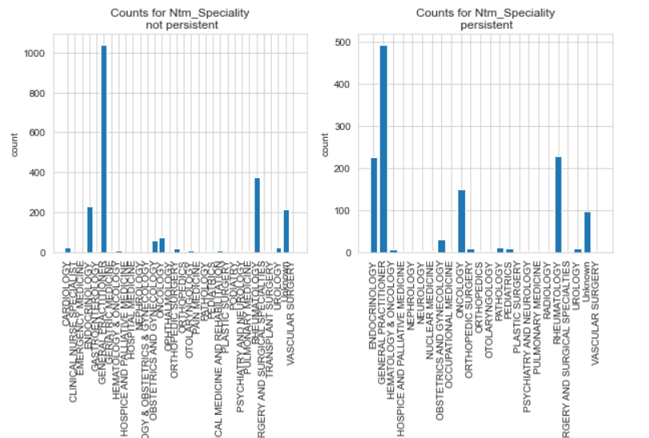

Slide 15
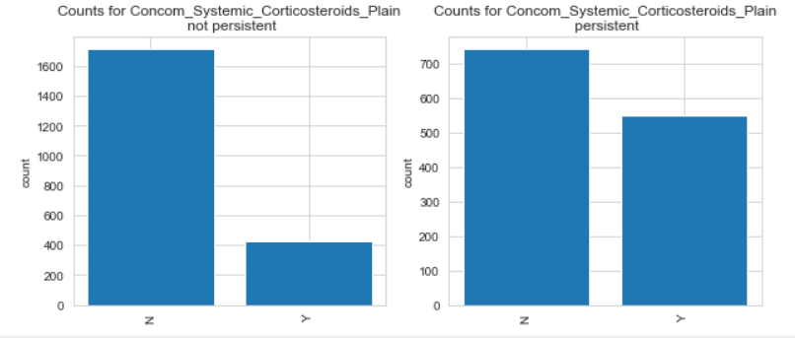

Slide 16
FEATURE ENGINEERING

Slide 17
• If the input variable is categorical and the output variable is also categorical then we will
use the Mutual Classifier Method
• Scikit library provides a class known as SelectKbest when we use Mutual Classifier
Method

Slide 18
Exploratory data analysis summary
From the Exploratory Data Analysis done, we are able to find how the different features/variables affects drug persistency.
The categorical variables that have higher MI scores have a greater effect in the drug persistency as compared to those that have low MI scores.
Dexa scan frequency during prescription correlates more with the target variable as compared to count of risks, thus it has effect on drug persistency as compared to count of risks.

Slide 19
Recommendations
For the purpose of automating the process of drug persistency identification, the following machine learning models can be used:
Logistic regression – It is a type of linear model that is used for binary classification. It predicts output which is a categorical dependent variable. Such predictions are like yes or no, A or B, etc.
The AOU curve is 0.85 and F1 score is 0.70.

Slide 20
THANK YOU

