Slide 1
Retrieval of formulas from ARQMath challenge dataset using joint embeddings
Vidya Chandrashekar
Master Thesis Defense
Major : Computational Logic
Date : 27-January-2022
Supervised by:
Dr.-Ing. Claudio Hartmann
Prof. Dr.-Ing. Wolfgang Lehner
Mentored by
Dipl.-Inf. Anja Reusch

Slide 2
Overview
Introduction
Data
ARQ Data Set
Methods
Using tokens
Using the whole formula
Joint Embedding method
Experimental setup
Evaluation
Conclusion

Slide 3
Introduction

Slide 4
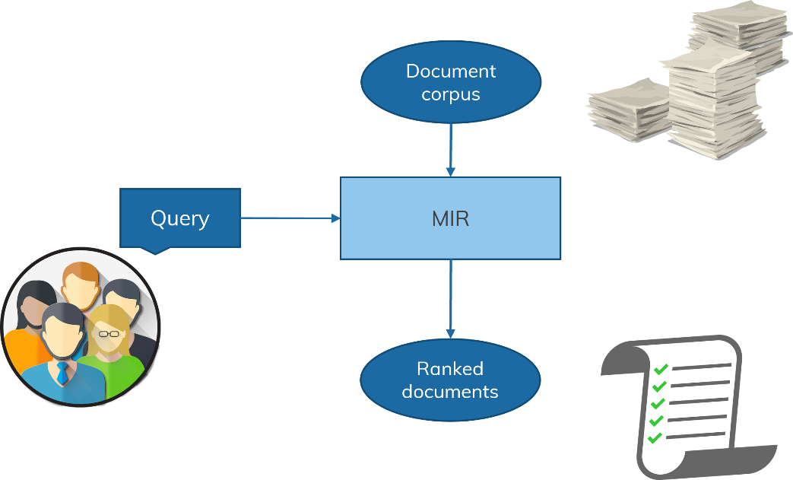
Introduction
Mathematical formulas
Intuitive understanding of formulas is necessary
Analyzing and understanding scientific literature
Common qualities with natural language (terms, symbols, grammatical rules)
Mathematical Information Retrieval (MIR)
Searching for mathematical concept expressed using math formulas
Focuses on retrieving mathematical formulas
It is a non-trivial problem - context-dependent.
Retrieve all forms irrespective of the notations.
2x+xy+1 = z
Notes:
The Web is a rich repository of mathematical information
Mathematical formulas play an essential role in communicating scientific information
As the
world of information technology grows, searching data of interest has become one of the most
critical tasks.
Mathematics can describe complex relations in a more straightforward and understandable way
through mathematical expressions.
formula, y = 2x is totally
different from the formula y = mx + c.

Slide 5
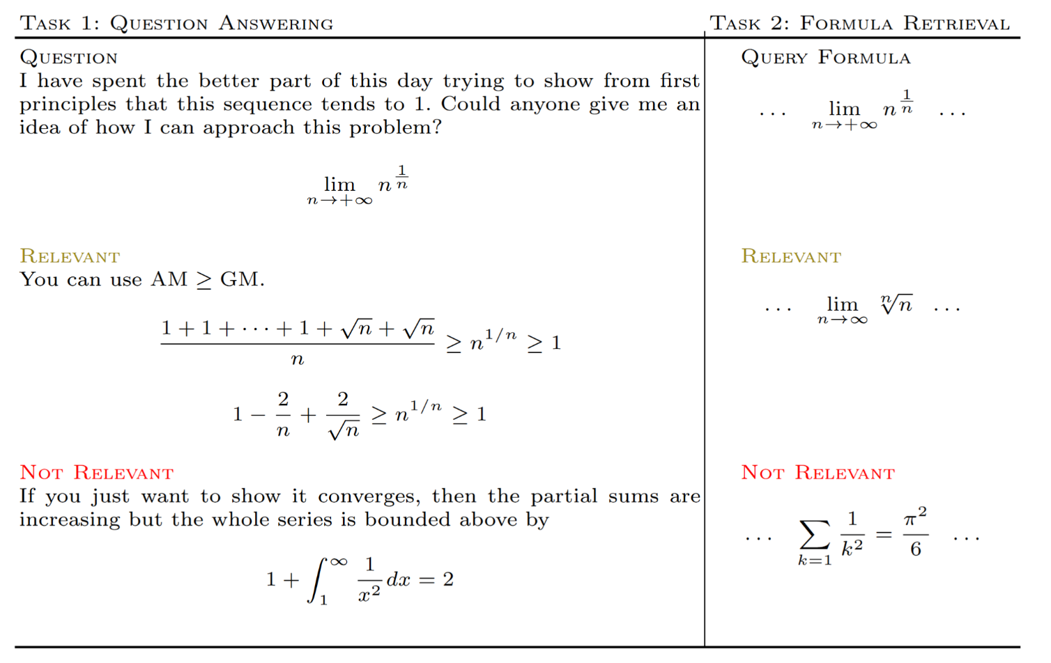
ARQMath Challenge
Notes:
This gives the opportunity to develop a math-based search engine that processes formulas and keywords effectively to provide more accurate and better results.
To address
this, the ARQMath evaluation exercise was introduced, aiming to search advanced math-related
queries to analyze and understand the semantics
ARQMath has two tasks, (i) answer retrieval and (ii) formula retrieval. However, the tasks are
challenging because both questions and answers can be a combination of natural language and
mathematical language

Slide 6
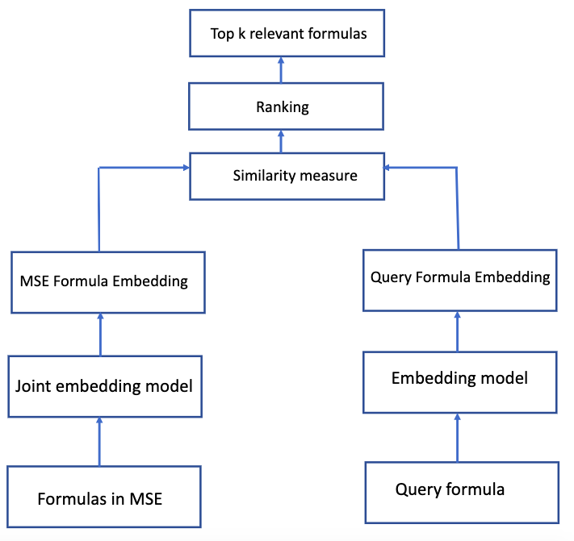

Goal
Focused on Task 2 of ARQMath Challenge
Retrieving relevant formulas in LATEX notation
A graded relevance scale is used (0-3)
Evaluation metrics : nDCG, mAP, and p@10

Slide 7
Data

Slide 8
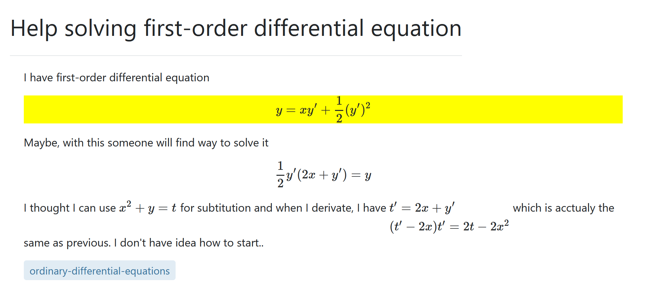
Training data
Final collection contains roughly 1 million questions and 28,320,920 formulas.
Query topics was built from questions asked in 2019 (Test data).
Training data was built on content from 2018 and earlier.
Posts file was about 4 GB size.
Training time was about 8 hour and 34 minute.

Slide 9
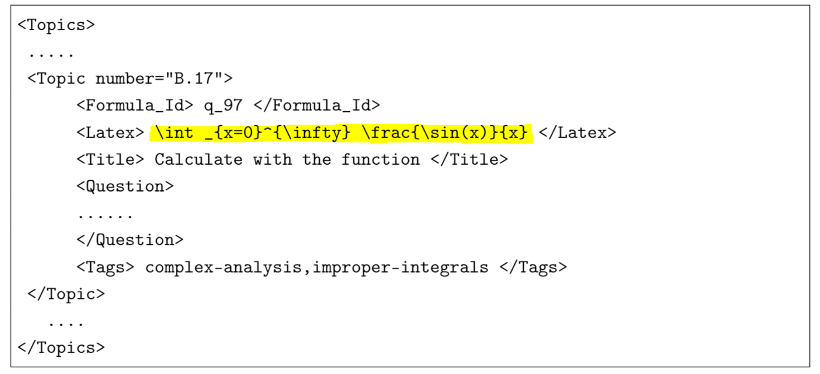
Test data
Topic file had 98 formulas which is used as query formulas.

Slide 10
Relevance score
Score | Rating | Definition
3 | High | As good as finding an exact match to the query formula
2 | Medium | Useful but not as good as the original formula
1 | Low | Some chance of being useful
0 | Not relevant | Completely different than the query formula

Slide 11
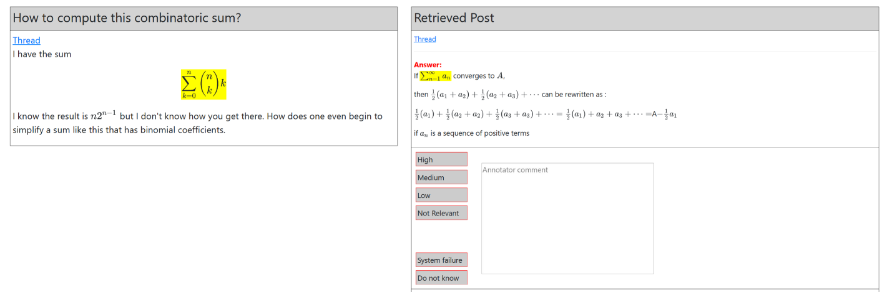
Gold dataset - Qrel
It contains a set of human assessed documents for each query in the query set
Pooling
Annotation
Query ID | Iteration | Formula ID | Relevance
Notes:
’System failure’
indicates system issues such as wrong rendering of formulas or the thread link not working.
’Do not know’ indicates that the assessors were not able to decide the relevance degree.
Leave relevant comments

Slide 12
Methods

Slide 13
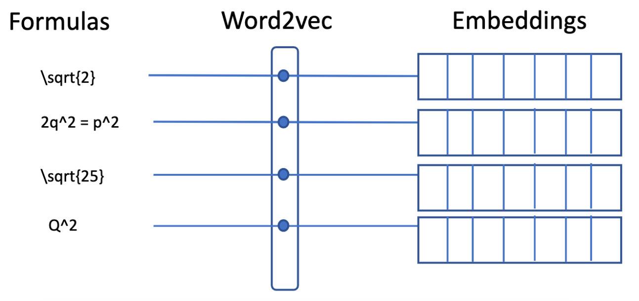
Proposed methods
Formula embedding model using tokens - alternate
Formula embedding model using whole formula as words - alternate
Joint embedding model using Translational vector model – primary
Notes:
Word embeddings are
vector representations of words by embedding semantic and syntactic meanings obtained from
a large corpus.
They
generate the dense word embeddings for each word in the vector space. The performance of
word2vec varies with the number of epochs.

Slide 14
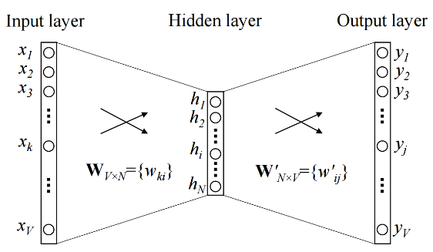
Word2vec model
Input
Output
Cat Friday is the best day
Cats in the boxes
Cats on the head
Cats are playing
Cats 0.438 0.345 0.312
Fridays 0.123 0.212 0.324
Best 0.762 0.564 0.612
Word2Vec
Center word
Cat
Friday
is
the
best
day
Context window (size =1)
Notes:
two ways:
Continuous Bag-of-Words (CBOW) and Skip-Gram (SG).
CBOW predicts the current word based on the given context
Skip-Gram predicts the context given
the target word.

Slide 15
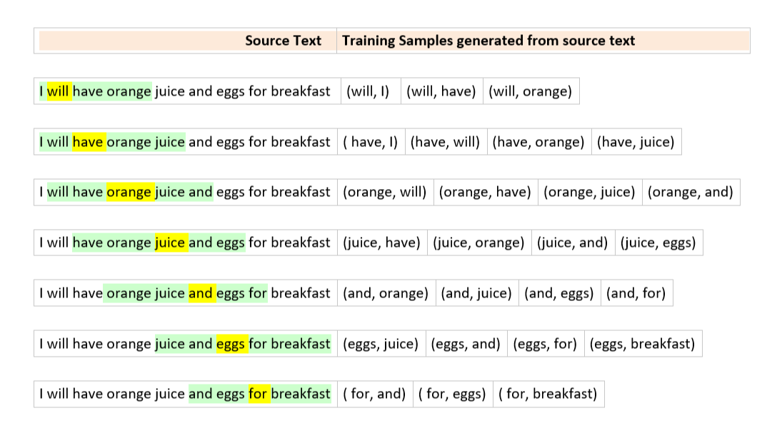
Examples

Slide 16
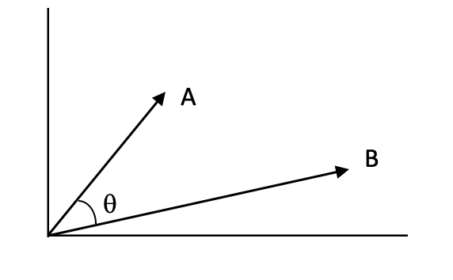
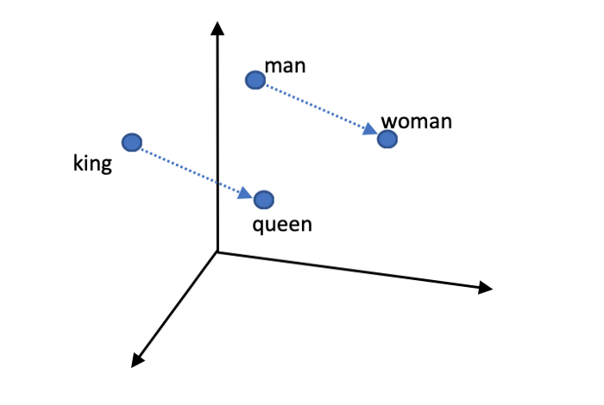
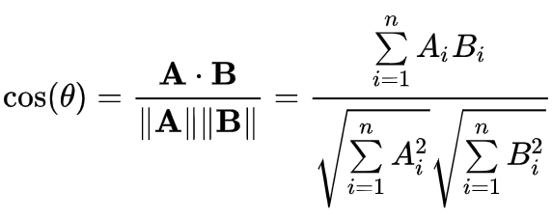
Cosine Similarity

Slide 17
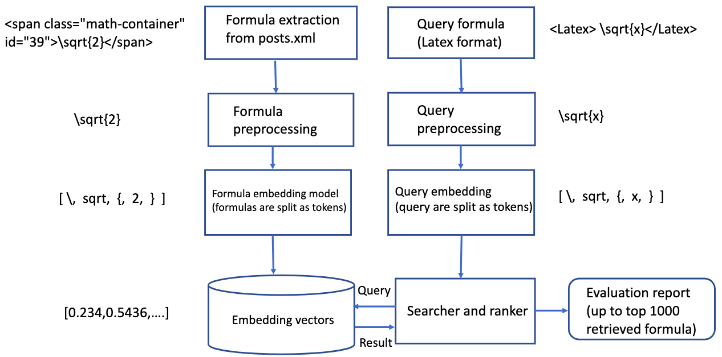
Formula embedding model using tokens
Word2vec model
Word2vec model
Run file

Slide 18
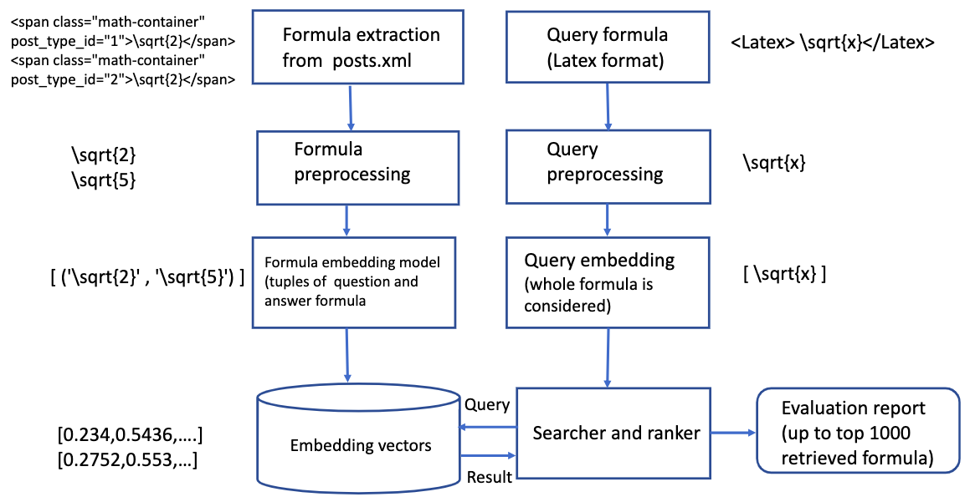
Formula embedding model using whole formula
Word2vec model
Word2vec model
Run file

Slide 19
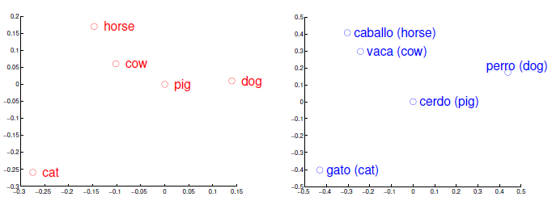
Translational model
Produce a translation matrix to translate words from one language to another
Uses standard nearest neighbor method
Learns a linear mapping from the source language representation to the target language representation.
Projects the input word to be translated into the target space and returns words with a representation closest in the target space.

Slide 20
Translational model for formulas
Formula
Context words
sqrt{2)
square, proof
2x+y
sum, equation
3y/4x
fraction, rational
Using translational model
Resulting embedding
sqrt{5)
Query
5x+3y
y/x

Slide 21
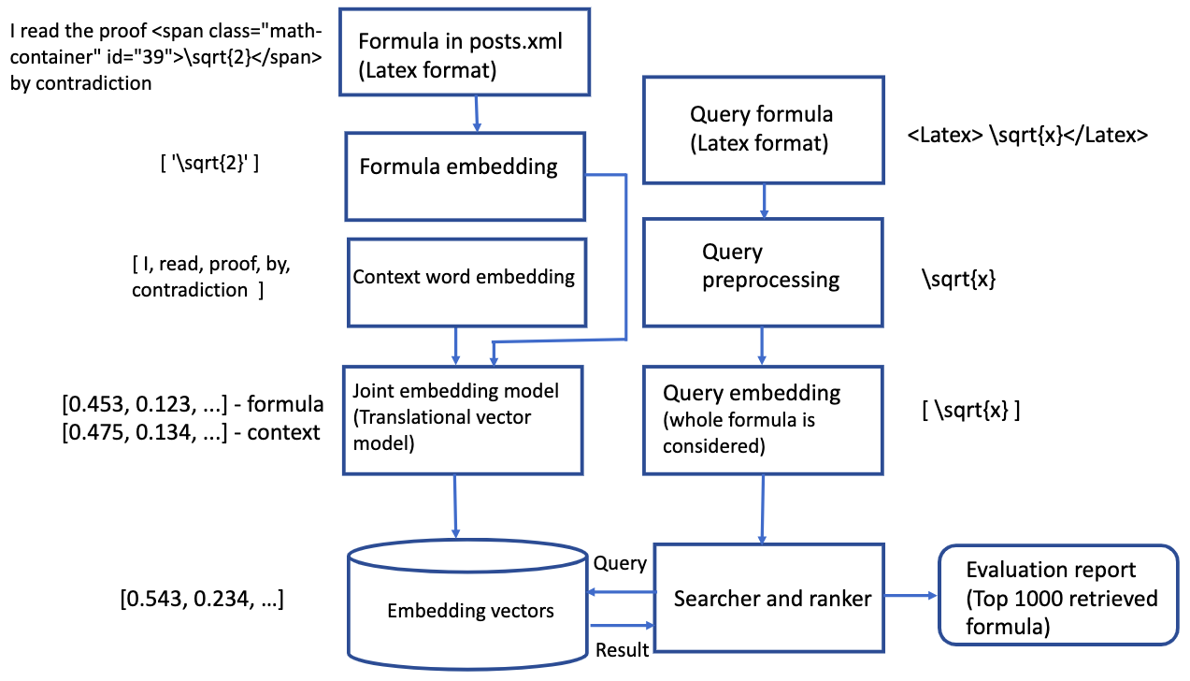
Joint embedding model using Translational vector model
Word2vec model
Word2vec model
Run file

Slide 22
Experimental setup

Slide 23
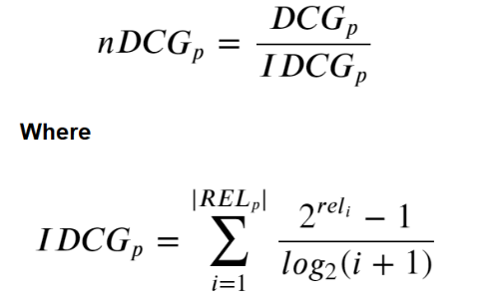
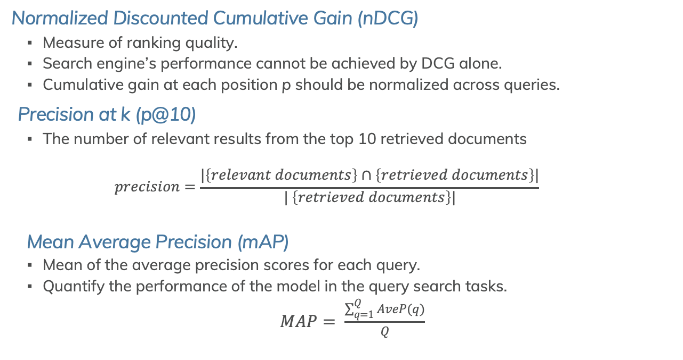
Evaluation metrics
Normalized Discounted Cumulative Gain (nDCG)
Measure of ranking quality.
Search engine’s performance cannot be achieved by DCG alone.
Cumulative gain at each position p should be normalized across queries.
Precision at k (p@10)
The number of relevant results from the top 10 retrieved documents
$$precision=\frac{|\left\{relevant documents\right\}∩\left\{retrieved documents\right\}|}{| \left\{retrieved documents\right\}|}$$
Mean Average Precision (mAP)
Mean of the average precision scores for each query.
Quantify the performance of the model in the query search tasks.
$MAP= \frac{\sum_{q=1}^{Q}{AveP(q)}}{Q}$
Notes:
Ranking plays a vital role in the Formula Retrieval task.
Users inspect only the top
few results returned by a query search and therefore precision and relevance factors strongly
determines the ranking function.
This can be achieved by
sorting all relevant documents by their relative relevance.
Then, produce the maximum possible
DCG through its position p, called Ideal DCG (IDCG).
Precision is defined as the ratio of the retrieved documents that are relevant to user’s query over the retrieved
documents.

Slide 24
Other participating teams
Baseline (Tangent -S)
Document and Pattern Recognition Lab from the Rochester Institute of Technology (DPRL Systems)
Tangent-CFT
Tangent-CFT-Plus
Tangent-CFT with Tree Edit Distance.
MIRMU

Slide 25
Run files
Run files generated from the three proposed methods:
Thesis-tokens
Thesis-whole-formulas
Thesis-JointEmbedding
Query_Id​ | Formula_Id​ | Post_Id​ | Rank​ | Score​ | Run_Number​
B.1 ​ | 282​ | 24312​ | 1​ | 0.98​ | Run_0​
B.1​ | 398​ | 7623​ | 2​ | 0.95​ | Run_0​
B.1 ​ | 405​ | 8508​ | 3​ | 0.81​ | Run_0​

Slide 26
Evaluation

Slide 27
Results and Analysis

Slide 28
Analysis
Best retrieved results
Joint embedding method produced the best formula retrieval results for topic B.14
Topic Id​ | Query formula​ | Retrieved Formulas ​
B.14​ | y = xy'+ \frac{1}{2}(y')^{2}​ ​ | frac{1}{2}y'+(2x+y') = y ​ ​ y = xy'+\frac{2}{3}​ ​ y = y'+ \frac{1}{2}​ ​ (t'-2x)t'=2t-2x^2​ ​ x^2+y=t​

Slide 29
Analysis
Partial retrieved results
Results for topic B.24 was retrieved using the tokens method
Topic Id​ | Query formula​ | Retrieved Formulas ​
B.24​ | \sqrt{2i-1}​ ​ ​ ​ | b=\sqrt{4}+2i​ ​ \sqrt{2}+\sqrt{5}​ ​ \sqrt{5}​ ​ a^2=b^{-2}​ ​ 2i-1 = 2xy+x​

Slide 30
Analysis
Irrelevant results
Whole formula embedding approach for topic B.30
Topic Id​ | Query formula​ | Retrieved Formulas ​
B.30​ | a^3+b^3+c^3-3abc​ ​ ​ ​ ​ | (a)\ 1​ ​ a,b​ ​ 3+2i​ ​ \frac{3i}​ ​ b = (c \sin(18) - a)^{3} ​

Slide 31

Observations
Primary method - joint embedding method did not not outperform the other runs.
Instead, the alternative run token based has performed comparatively well in all evaluation measures.
Retrieved formula is either present in its exact form or present as a sub-formula
Word2vec model did not detect the semantics behind the formula and failed to return as relevant formulas.
In some cases, even if the scores are low, better results was retrieved.
Translational vector models are used for language translation tasks.
Showed promising results in fetching sub-formulas to query formulas.

Slide 32
Conclusion

Slide 33
Conclusion
Main goal
Retrieve a ranked list of relevant formulas for Task 2 of the ARQMath 2020 Challenge.
Proposal
Novel formula embedding approach called joint embedding using translational vector model with two alternate methods.
Results
Retrieved formulas were ranked based on the relevance score.
Results evaluated against the gold dataset (qrel dataset) using the metrics of nDCG’, mAP and p@10.
Proposed methods showed the competence in retrieving exact query formulas, parent formulas, sub-formulas and similar formulas.

Slide 34

Future work
Optimization:
To reduce the searching and retrieval time, index optimization can be applied.
Optimizing hyperparameters like context window, embedding size, sub sampling, etc - improve the performance of the model.
Choosing the right formula size from the dataset might be a better approach.
Other approaches:
Variations of the existing task - specific types of formulas, text queries to find math, etc.

Slide 35
Thank you

