Slide 1
Hotstar Segment Prediction

Slide 2
Agenda
Problem Statement
Feature Engineering
EDA
Machine Learning Models
Summary

Slide 3
Problem Statement
Media companies need to target their advertisements to the right customers. In this presentation we will present our key findings on the demographics of customers that make them most likely to respond to advertisement.
To this end, Hotstar’s customer demographic data has been used as our dataset

Slide 4
Feature Engineering
Weekday
Weekend
Original Features
Cities
Genres
Day of the Week
Titles
Time of Day
No. of Titles Watched
No. of Genres
Total Viewing Time
Metro
Non Metro
Sports
TV
Movies
Morning Viewers
Afternoon Viewers
Evening Viewers
Night Viewers

Slide 5
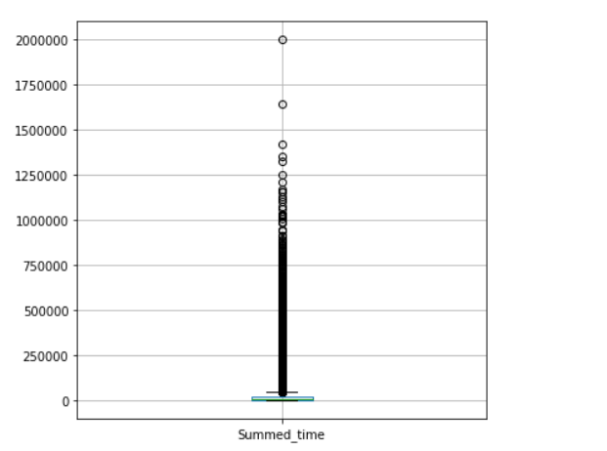
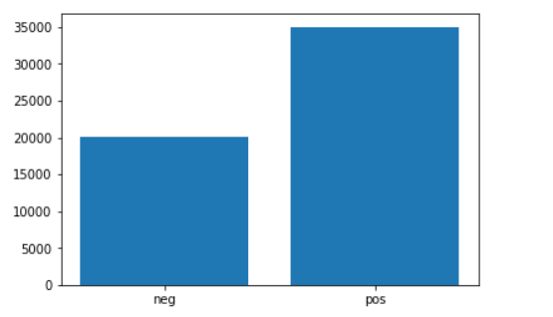
Total Viewing Time
High presence of outliers in this column- 10% of the data
High presence of the positive class in the outliers
The positive class users have a higher mean total viewing time

Slide 6
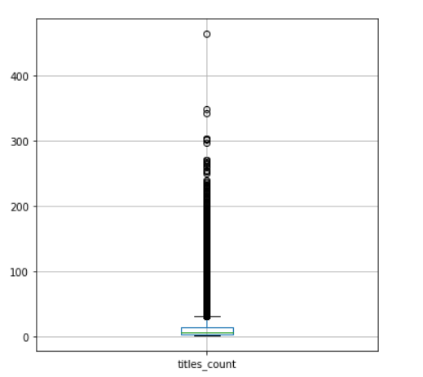
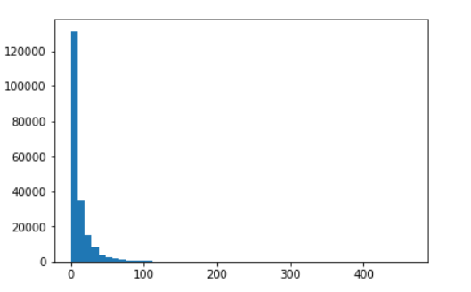
No. of Titles Watched
High presence of outliers in this column- 8% of the data
Low presence of the positive class in the outliers
Data is skewed to the right

Slide 7
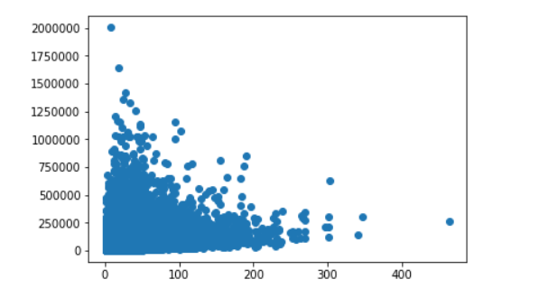
No. of Titles Watched vs. Total Viewing Time

Slide 8
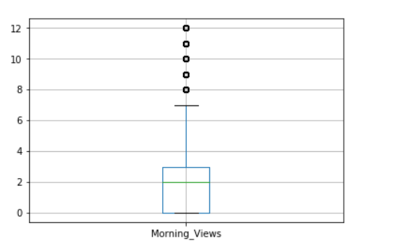
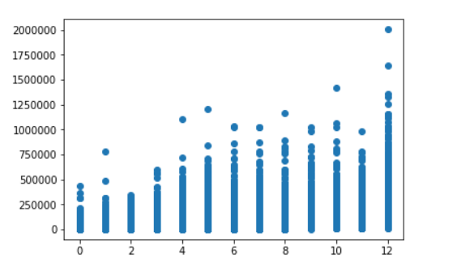
No. of Morning Views vs. Total Viewing Time
No. of Morning Views

Slide 9
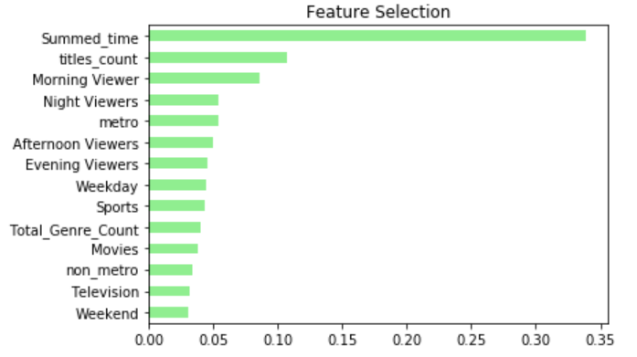
Random Forest for Feature Selection

Slide 10
Model Results
Test
Train
Model | ROC_AUC (TEST) (%) | Accuracy (TEST) (%) | Precision (TEST) (%) 0 1 |  | Recall (TEST) (%) 0 1 |  | ROC_AUC (TRAIN) (%) | Accuracy (TRAIN) (%) | Precision (TRAIN) (%) 0 1 |  | Recall (TRAIN) (%) 0 1
XGBoost | 75.38% | 75.5%% | 96 | 17 | 77 | 59 | 90.78% | 82.21% | 86 | 79 | 77 | 88
Logistic Regression | 74.15% | 72.29% | 96 | 16 | 73 | 61 | 77.04% | 69.13% | 68 | 71 | 73 | 65
Naïve Bayes | 66.13% | 37.53% | 97 | 10 | 33 | 87 | 76.26% | 63.63% | 85 | 58 | 33 | 94
Random Forest | 58.80% | 84.03% | 94 | 19 | 88 | 32 | 99.99% | 98.29% | 99 | 99 | 99 | 99
DTC | 58.80% | 80.11% | 94 | 15 | 84 | 34 | 99.99% | 99.5% | 99 | 100 | 100 | 99

