Slide 1

Quora Question pairs

Slide 2

Problem Statement
People may ask similar questions
• Important interest to detect duplicated questions
‣ Prediction problem : from a question pair, predict whether questions are the same or not

Slide 3
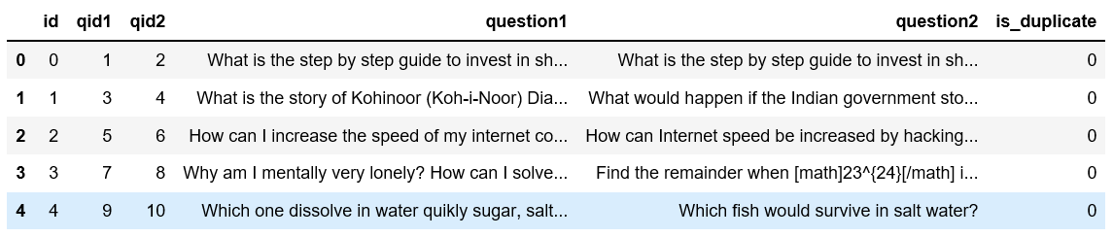
Data Overview

Slide 4
Text Pre-processing
Text cleaning: Tokenization, convert all tokens to lower case, remove punctuations, special tokens, etc.
Text normalization: Restore abbreviations (e.g. "What's" to "What is", "We're" to "We are", etc.) using regular expression, replace number-like string with "number" and replace currency symbols with "USD" abbreviation.

Slide 5
Summary Statistics:
Exploratory Data Analysis

Slide 6
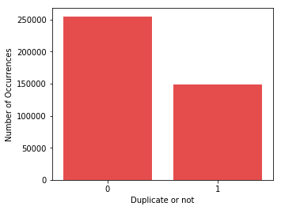
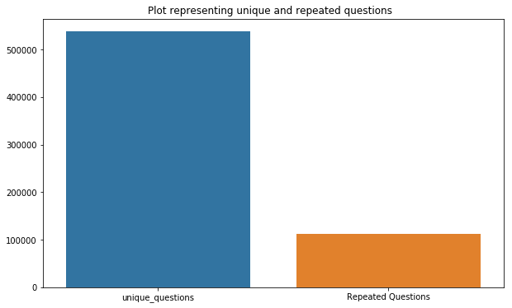
Exploratory Data Analysis
63% of the questions are not duplicate.
Most of the questions are unique.

Slide 7
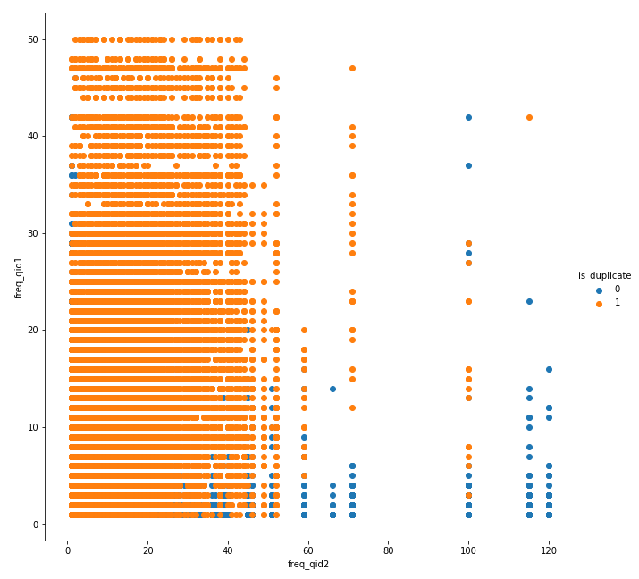
Frequency of repetition of questions(freq q1 vs freq q2)
If the frequency of qid1 and qid2 > 15 (approx.) , then its a high chance that the questions are duplicates.

Slide 8
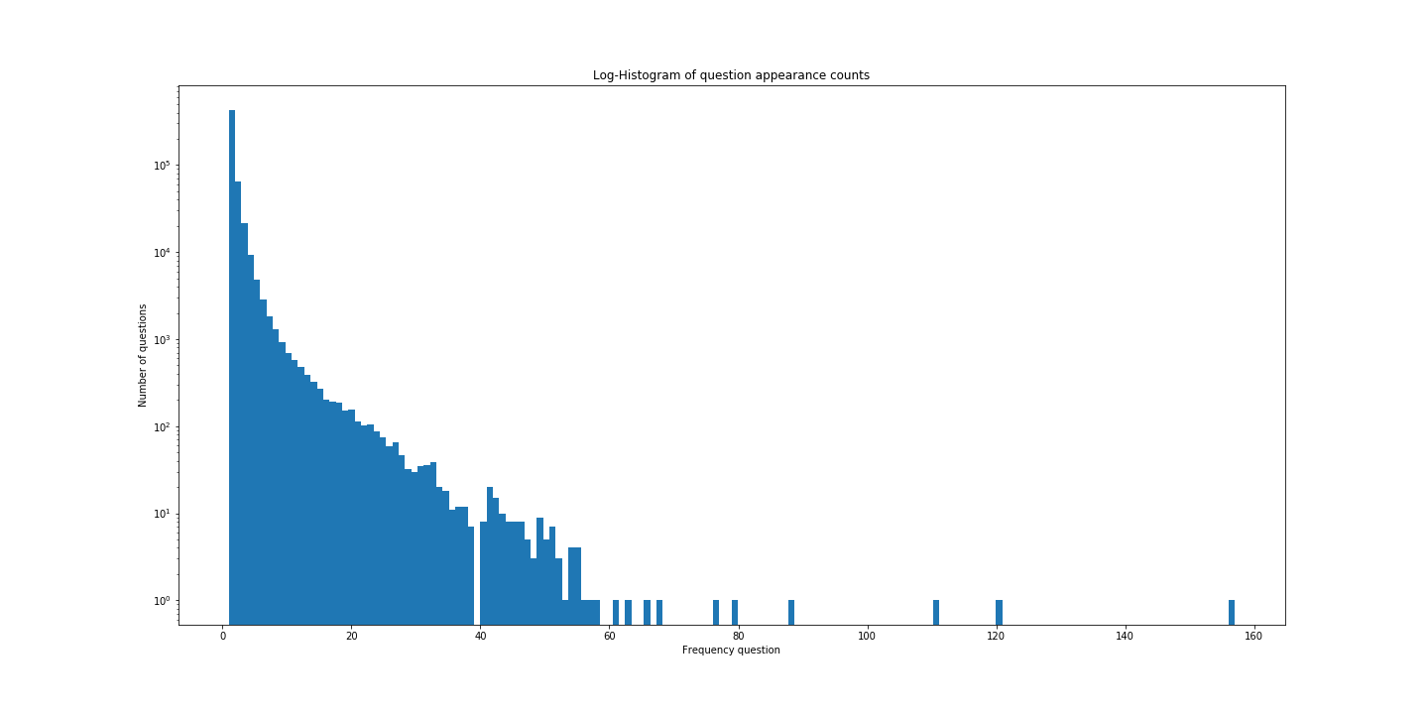
Log Histogram of question appearance counts
The minimum no of times question has appeared is one and maximum number is 158.

Slide 9
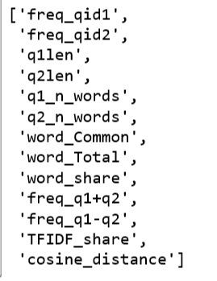
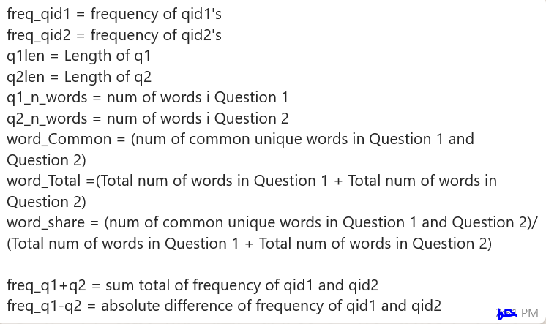
Derived Features

Slide 10
Modelling
Models
Random Forest
XG Boost
Stochastic Gradient Descent
Evaluation Metrics:
ROC Curve
Confusion Matrix
Accuracy Score
Random Forest-80%
XG Boost-66%
SGD-72%

Slide 11
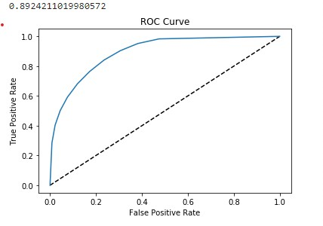
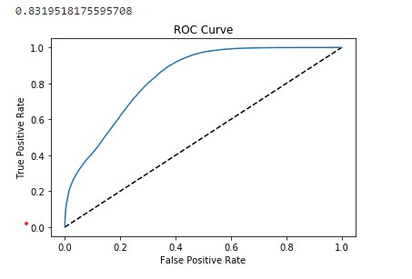
ROC Curve-Random Forest & SGD

Slide 12
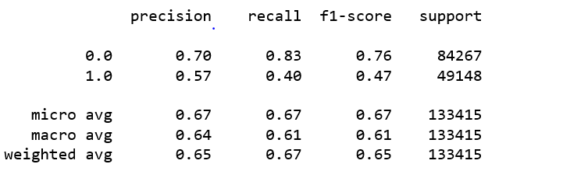
Classification report-XG Boost

Slide 13
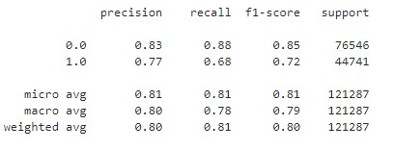
Classification report-Random Forest

Slide 14
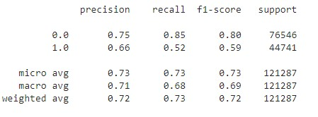
Classification report-SGD

Slide 15
Conclusion
All the models decision are based on TF-IDF or they are just matching words with consideration of lemmatization and stemming.
No sentimental analysis has been considered(Deep Learning).

Slide 16
Thank You

