Slide 1
Lecture - 2
Introduction to Unified Modeling Language

Slide 2
Introduction
  Concepts of modeling in general and object-oriented modeling.
  Use case diagrams
  Class diagrams
  Sequence diagrams
  Statechart diagrams
  Activity diagrams

Slide 3
Introduction
  Functional model: represented by use case diagrams → describes the functionality of the system from the user’s point of view.
  Object model: represented by class diagrams → describes the structure of the system in terms of objects, attributes, associations, and operations.
  Dynamic model: represented by interaction diagrams, state machine diagrams, activity diagrams → describes the internal behavior of the system.

Slide 4
Introduction
Use case diagrams
  Describe the functional behavior of the system as seen by the user.
Class diagrams
  Describe the static structure of the system: Objects, attributes, associations.
Sequence diagrams
  Describe the dynamic behavior between objects of the system.
Statechart diagrams
  Describe the dynamic behavior of an individual object.
Activity diagrams
  Describe the dynamic behavior of a system, in particular the workflow.

Slide 5
Use Case Diagrams
  Used during requirements elicitation and analysis to represent the functionality of the system.
  Focuses on the behavior of the system from an external point of view.
  Describes a function provided by the system that yields a visible result for an actor.
  Identification of actors and use cases results in the definition of the boundary of the system.

Slide 6
Use Case Diagrams
Visible from the outside of the system.
An Actor represents a role, that is, a type of user of the system
Passenger
A use case represents a class of functionality provided by the system
Use case model:
  The set of all use cases that completely describe the functionality of the system.
PurchaseTicket

Slide 7
Actors
An actor is a model for an external entity which interacts (communicates) with the system:
  User
  External system (Another system)
  Physical environment (e.g. Weather)
An actor has a unique name and an optional description
Examples:
  Passenger: A person in the train
  GPS satellite: An external system that provides the system with GPS coordinates.
Passenger
Optional
Description
Name

Slide 8
Use Case
• A use case represents a class of functionality provided by the system
• Use cases can be described textually, with a focus on the event flow between actor and system
• The textual use case description consists of 6 parts:
  Unique name
  Participating actors
  Entry conditions
  Exit conditions
  Flow of events
  Special requirements.
PurchaseTicket

Slide 9
Textual Use Case
Description Example
Passenger
PurchaseTicket
1. Name: Purchase ticket
2. Participating actor: Passenger
3. Entry condition:
Passenger stands in front of ticket distributor
Passenger has sufficient money to purchase ticket
4. Exit condition:
Passenger has ticket
5. Flow of events:
  1. Passenger selects the number of zones to be traveled
  2. Ticket Distributor displays the amount due
  3. Passenger inserts money, at least the amount due
  4. Ticket Distributor returns change
  5. Ticket Distributor issues ticket
6. Special requirements: None.

Slide 10
Uses Cases can be related
Extends Relationship
  To represent seldom invoked use cases or exceptional functionality.
Includes Relationship
  To represent functional behavior common to more than one use case.

Slide 11
The <<extends>> Relationship
<<extends>> relationships model exceptional or seldom invoked cases
The exceptional event flows are factored out of the main event flow for clarity
The direction of an <<extends>> relationship is to the extended use case
Use cases representing exceptional flows can extend more than one use case.
Passenger
PurchaseTicket
<<extends>>
<<extends>>
<<extends>>
OutOfOrder
<<extends>>
TimeOut
Cancel
NoChange

Slide 12
The <<includes>> Relationship
<<includes>> relationship represents common functionality needed in more than one use case
<<includes>> behavior is factored out for reuse, not because it is an exception
The direction of a <<includes>> relationship is to the using use case (unlike the direction of the <<extends>> relationship).
Passenger
PurchaseMultiCard
PurchaseSingleTicket
<<includes>>
<<includes>>
<<extends>>
CollectMoney
<<extends>>
<<extends>>
NoChange
Cancel
Cancel

Slide 13
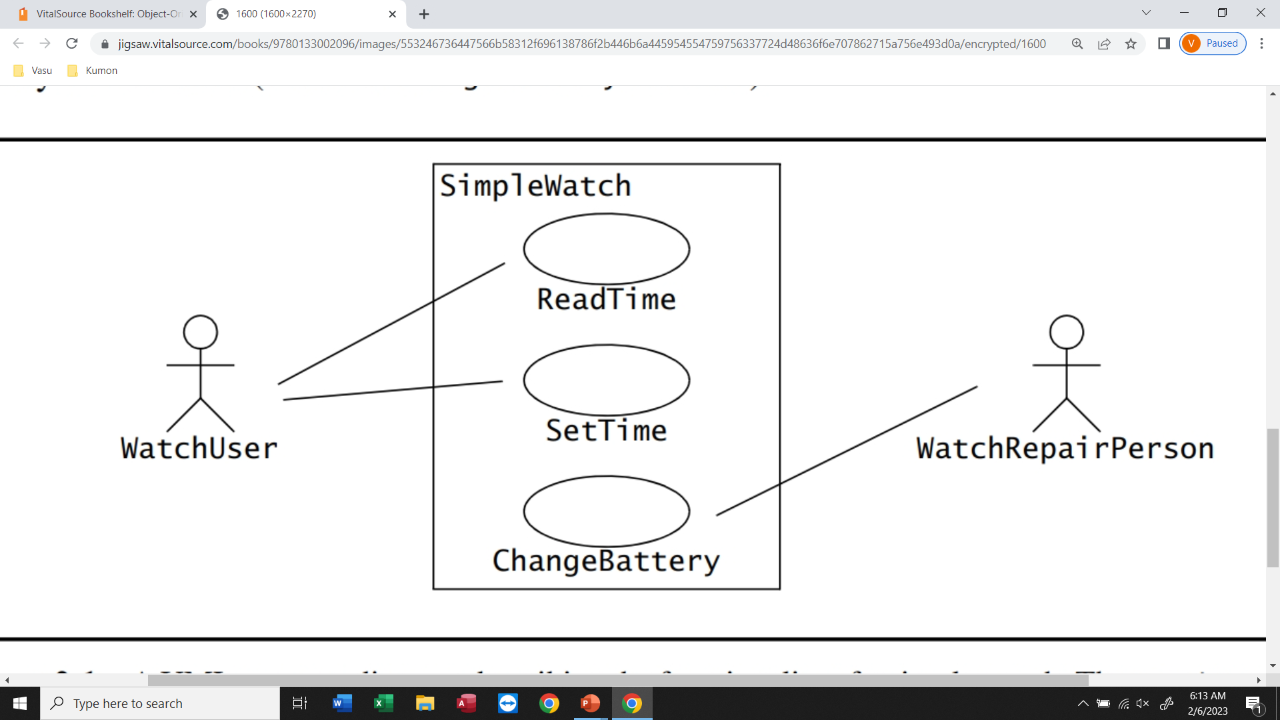
Use Case Diagrams

Slide 14
Class Diagrams
  Used to describe the structure of the system.
  Classes are abstractions that specify the common structure and behavior of a set of objects.
  Objects are instances of classes that are created, modified, and destroyed during the execution of the system.
  An object has state that includes the values of its attributes and its links with other objects.

Slide 15
Class Diagrams
Used
  during requirements analysis to model application domain concepts.
  during system design to model subsystems.
  during object design to specify the detailed behavior and attributes of classes.
TarifSchedule
Trip
Table zone2price
Enumeration getZones()
Price getPrice(Zone)
zone:Zone
Price: Price
*
*

Slide 16
Classes
Type
TarifSchedule
Table zone2price
Enumeration getZones()
Price getPrice(Zone)
Name
TarifSchedule
Attributes
Signature
zone2price
getZones()
getPrice()
Operations
TarifSchedule
A class represents a concept
A class encapsulates state (attributes) and behavior (operations)
Each attribute has a type
Each operation has a signature
The class name is the only mandatory information

Slide 17
Instances
tarif2006:TarifSchedule
:TarifSchedule
zone2price = {
{‘1’, 0.20},
{‘2’, 0.40},
{‘3’, 0.60}}
zone2price = {
{‘1’, 0.20},
{‘2’, 0.40},
{‘3’, 0.60}}
An instance represents a phenomenon
The attributes are represented with their values
The name of an instance is underlined
The name can contain only the class name of the instance (anonymous instance)

Slide 18
Actor vs Class vs Object
Actor
  An entity outside the system to be modeled, interacting with the system (“Passenger”).
Class
  An abstraction modeling an entity in the application or solution domain.
  The class is part of the system model (“User”, “Ticket distributor”, “Server”).
Object
  A specific instance of a class (“Joe, the passenger who is purchasing a ticket from the ticket distributor”).

Slide 19
Associations
TarifSchedule
TripLeg
Enumeration getZones()
Price getPrice(Zone)
*
Price
Zone
*
Associations denote relationships between classes.
The multiplicity of an association end denotes how many objects the instance of a class can legitimately reference.

Slide 20
1-to-1 and 1-to-many Associations
Country
1
1
City
name:String
name:String
1-to-1 association
Point
Polygon
*
x: Integer
draw()
y: Integer
1-to-many association

Slide 21
Many-to-Many Associations
Company
*
*
StockExchange
tickerSymbol

Slide 22
From Problem Statement To Object Model
Problem Statement: A stock exchange lists many companies. Each company is uniquely identified by a ticker symbol
Class Diagram:
StockExchange
*
*
Company
Lists
tickerSymbol

Slide 23
From Problem Statement to Code
Pr
oblem Statement
:
A
stock exchange lists many companies.
Each company is identified by a ticker symbol
Class Diagram:
*
*
Company
StockExchange
Lists
tickerSymbol
Java Code
public class StockExchange
{
private Vector m_Company = new Vector();
Associations
are mapped to
Attributes!
};
public class Company
{
public int m_tickerSymbol;
private Vector m_StockExchange = new Vector();
};

Slide 24
Aggregation
An aggregation is a special case of association denoting a “consists-of” hierarchy
The aggregate is the parent class,
the components are the children classes
Exhaust system
1
0..2
Muffler
Tailpipe
diameter
diameter
A solid diamond denotes composition: A strong form of aggregation where the life time of the component instances is controlled by the aggregate. That is, the parts don’t exist on their won (“the whole controls/destroys the parts”)
TicketMachine
3
ZoneButton

Slide 25
Qualifiers
Without qualification
1
*
File
Directory
filename
With qualification
1
0..1
Directory
filename
File
Qualifiers can be used to reduce the multiplicity of an association.

Slide 26
Qualification: Another Example
Company
*
Lists
*
StockExchange
tickerSymbol
*
Lists
1
*
Company
StockExchange
tickerSymbol

Slide 27
Inheritance
Button
CancelButton
ZoneButton
Inheritance is another special case of an association denoting a “kind-of” hierarchy.
Inheritance simplifies the analysis model by introducing a taxonomy.
The children classes inherit the attributes and operations of the parent class.

Slide 28
Packages
Packages help you to organize UML models to increase their readability.
We can use the UML package mechanism to organize classes into subsystems.
Any complex system can be decomposed into subsystems, where each subsystem is modeled as a package.
Account
Bank
Customer

Slide 29
Object Modeling in Practice
Foo
Amount
Is Foo the right name?
CustomerId
Deposit()
Withdraw()
GetBalance()
Class Identification: Name of Class, Attributes and Methods

Slide 30
Object Modeling in Practice: Brainstorming
“Dada”
Foo
Amount
Amount
CustomerId
CustomerId
Deposit()
Deposit()
Withdraw()
Withdraw()
GetBalance()
GetBalance()
Account
Amount
CustomerId
Deposit()
Is Foo the right name?
Withdraw()
GetBalance()

Slide 31
Object Modeling in Practice: More classes
Account
Amount
Customer
Bank
AccountId
CustomerId
Name
Name
Deposit()
CustomerId
Withdraw()
GetBalance()
1) Find New Classes
2) Review Names, Attributes and Methods

Slide 32
Object Modeling in Practice: Associations
Account
?
*
Amount
*
Customer
Bank
AccountId
owns
has
CustomerId
AccountId
Name
Deposit()
2
Name
CustomerId
Withdraw()
GetBalance()
1) Find New Classes
2) Review Names, Attributes and Methods
3) Find Associations between Classes
4) Label the generic assocations
5) Determine the multiplicity of the assocations
6) Review associations

Slide 33
Practice Object Modeling: Find Taxonomies
Account
Bank
Customer
*
Amount
*
Name
Has
Name
AccountId
CustomerId
AccountId
Deposit()
Withdraw()
GetBalance()
CustomerId()
Savings
Account
Checking
Account
Mortgage
Account
Withdraw()
Withdraw()
Withdraw()

Slide 34
Practice Object Modeling: Simplify, Organize
Account
Amount
Show Taxonomies
separately
AccountId
CustomerId
AccountId
Deposit()
Withdraw()
GetBalance()
Savings
Account
Checking
Account
Mortgage
Account
Withdraw()
Withdraw()
Withdraw()

Slide 35
Class Diagrams
Association
Class
Multiplicity
SimpleWatch
1
1
1
1
2
1
2
1
PushButton
Display
Battery
Time
Class diagrams represent the structure of the system

Slide 36
Class Diagrams
Association
Class
Multiplicity
Watch
1
1
1
1
2
1
2
1
PushButton
state
LCDDisplay
Battery
Load
Time
Now
push()
release()
blinkIdx
blinkSeconds()
blinkMinutes()
blinkHours()
stopBlinking()
referesh()
Operations
Attribute

Slide 37
Sequence Diagrams
  Used to formalize the dynamic behavior of the system and to visualize the communication among objects.
  Useful for identifying additional objects that participate in the use cases.
  Objects involved in a use case are called participating objects.
  Sequence diagrams represent the interactions that take place among these objects.

Slide 38
Sequence Diagrams
Focus on
Controlflow
Used during analysis
  To refine use case descriptions
  to find additional objects (“participating objects”)
Used during system design
  to refine subsystem interfaces
Instances are represented by rectangles. Actors by sticky figures
Lifelines are represented by dashed lines
Messages are represented by arrows
Activations are represented by narrow rectangles.
Passenger
TicketMachine
selectZone()
TicketMachine
insertCoins()
zone2price
selectZone()
insertCoins()
pickupChange()
pickUpTicket()
Messages ->
Operations on
participating Object
pickupChange()
pickUpTicket()

Slide 39
Sequence Diagrams can also model the Flow of Data
Passenger
ZoneButton
TarifSchedule
Display
selectZone()
lookupPrice(selection)
price
Dataflow
displayPrice(price)
…continued on next slide...
The source of an arrow indicates the activation which sent the message
Horizontal dashed arrows indicate data flow, for example return results from a message

Slide 40
Sequence Diagrams: Iteration & Condition
…continued from previous slide...
Passenger
ChangeProcessor
CoinIdentifier
Display
CoinDrop
*
insertChange(coin)
lookupCoin(coin)
Iteration
price
displayPrice(owedAmount)
Condition
[owedAmount<0] returnChange(-owedAmount)
…continued on next slide...
Iteration is denoted by a * preceding the message name
Condition is denoted by boolean expression in [ ] before the message name

Slide 41
Creation and destruction
…continued from previous slide...
ChangeProcessor
Creation of Ticket
Passenger
createTicket(selection)
Ticket
print()
free()
Destruction of Ticket
Creation is denoted by a message arrow pointing to the object
Destruction is denoted by an X mark at the end of the destruction activation
  In garbage collection environments, destruction can be used to denote the end of the useful life of an object.

Slide 42
Sequence Diagram Properties
UML sequence diagram represent behavior in terms of interactions.
Useful to identify or find missing objects.
Time consuming to build, but worth the investment.
Complement the class diagrams (which represent structure).

Slide 43
Sequence Diagrams
Actor
Message
Object
Lifeline
:WatchUser
:Watch
:LCDDisplay
:Time
pressButton1()
blinkHours()
pressButton1()
blinkMinutes()
pressButton2()
incrementMinutes()
refresh()
pressButton1and2()
commitNewTime()
stopBlinking()
Activation
Sequence diagrams represent the behavior of a system
as messages (“interactions”) between different objects

Slide 44
State Machines
  Describes the dynamic behavior of an individual object as a number of states and transitions between these states.
  A state represents a particular set of values for an object.
  Given a state, a transition represents a future state the object can move to, and the conditions associated with the change of state.

Slide 45
State Machines
Event
Initial state
button1&2Pressed
button2Pressed
Blink
Increment
Hours
Hours
Transition
button1Pressed
button1&2Pressed
Blink
button2Pressed
Increment
State
Minutes
Minutes
button1Pressed
button2Pressed
Stop
Blink
Increment
Blinking
Seconds
Seconds
Final state
Represent behavior of a single object with interesting dynamic behavior.

Slide 46
Activity Diagrams
An activity diagram is a special case of a state chart diagram.
The states are activities (“functions”).
An activity diagram is useful to depict the workflow in a system.

Slide 47
Activity Diagrams can model Concurrency
Synchronization of multiple activities.
Splitting the flow of control into multiple threads.
Splitting
Synchronization

Slide 48
Activity Diagrams: Grouping of Activities
Activities may be grouped into swimlanes to denote the object or subsystem that implements the activities.
Allocate
Dispatcher
Resources
Open Incident
Coordinate
Archive
Resources
Incident
Field Officer
Document
Incident

