Slide 1
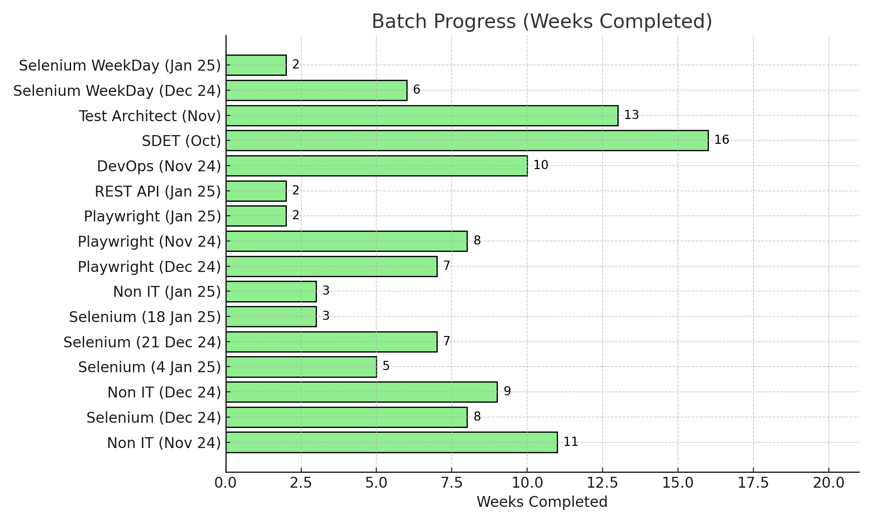
Batch Progress Report

