Slide 1
Selenium WebDriver
Handling Dropdown

Slide 2
The Golden Rule
What
How
How to handle dropdown?
Using Select Class
When
Why
When to use?
Selenium is an open source framework and encourages testers to write a script one programming language and run(re-use) same test scripts on multiple browser platforms.
Element in the DOM is identified with <select>
How it is performed?
How
Why
Selenium automations done with the help of webdriver

Slide 3
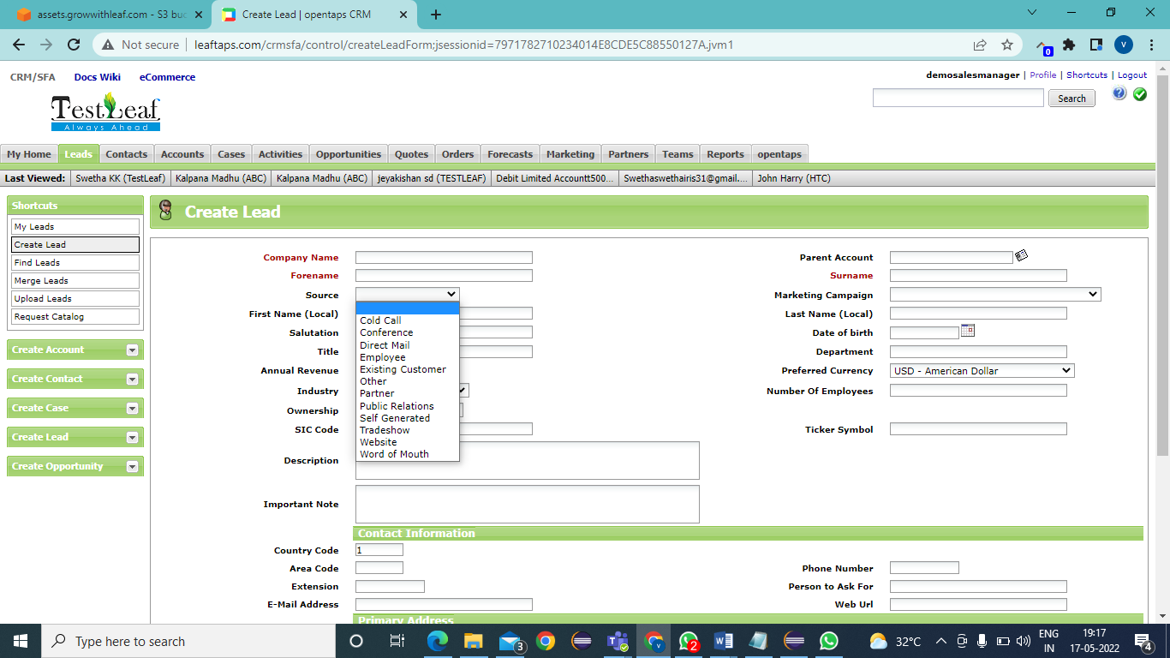
How to handle Dropdown?
Dropdown elements are designed to select an option under a particular category.
To handle dropdown , Selenium provides special class called Select class

Slide 4
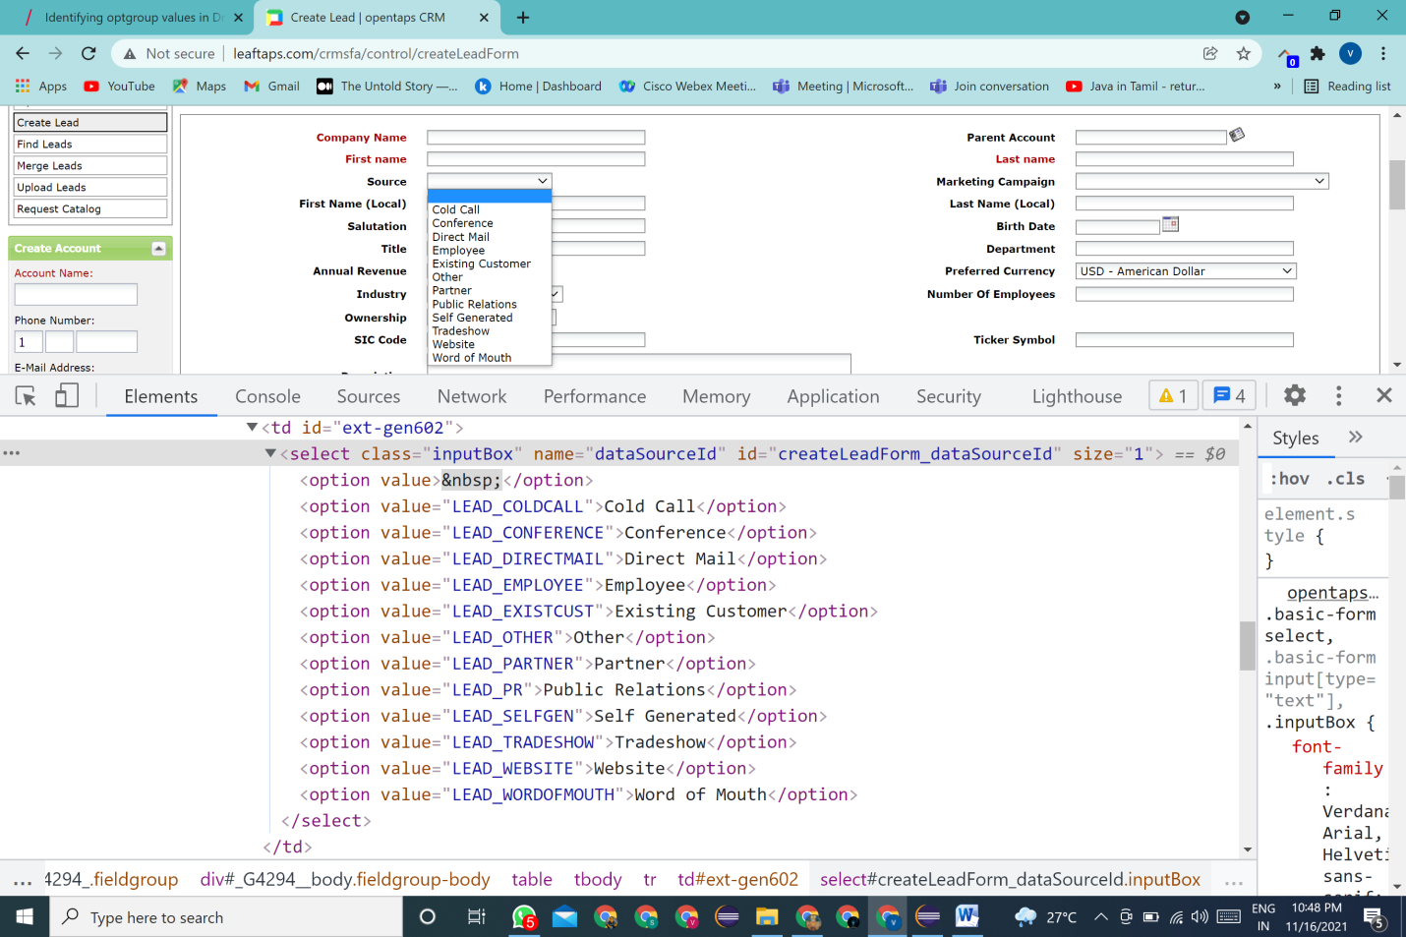
<select> structure in DOM
Represent the dropdown element
Represents the options to select under the given dropdown element

Slide 5
How to use Select class?
Identify the element and confirm with <select>
Instantiate the Select class by passing the WebElement as argument to the constructor
Syntax: Select options =new Select (WebElement);
(Select class should be imported from selenium.support.ui.Select)

Slide 6
Helper Methods
Select Class provides different methods to select the options from the dropdown
M1: selectByIndex(index) ;
->uses index as input argument to select the option and the index starts from 0
M2: selectByVisibleText(“text”);
->uses the text (black colour) from DOM of that particular option
M3: selectByValue(“value”);
->uses value of the value attribute as input argument to the method

Slide 7
Quick Recall
DOM Structure-DOM
HTML Tags
Locators and When to use?
How to handle dropdown element

