Slide 1
Selenium WebDriver Training
Target Locators
Alert

Slide 2
The Golden Circle
What
What is an Alert?
Alert is an information or message from the application
Why
Why do we need to handle it?
Alert prevents to access the other elements in the webpage if not handled
How to handle alert?
How
Transfer the driver control to alert box

Slide 3
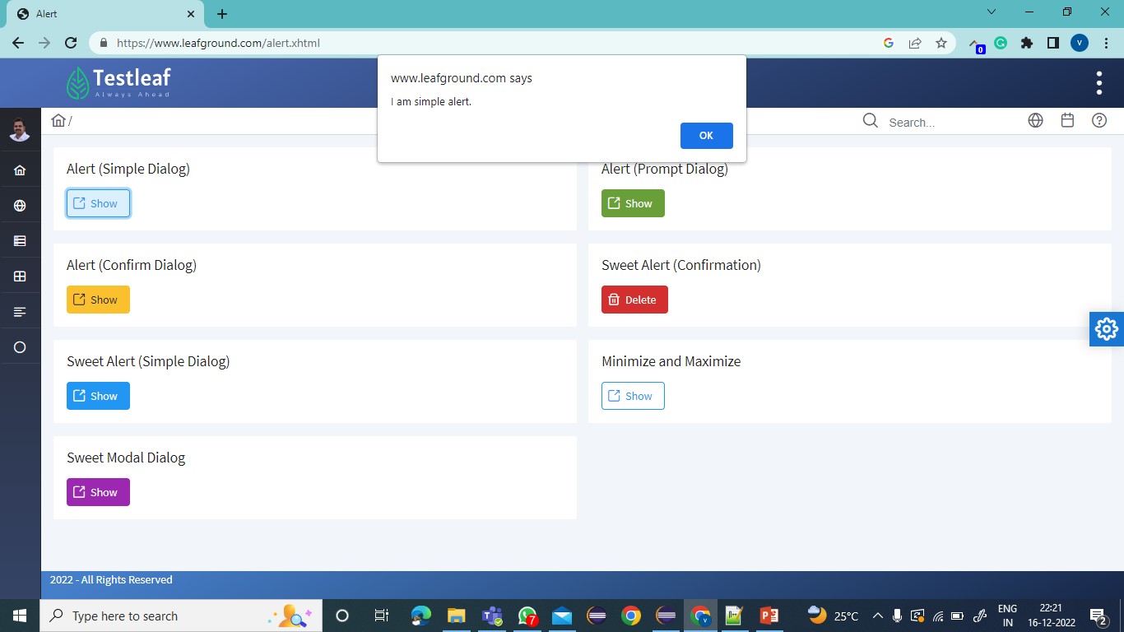
More about Alert..
Alert is an application pop up/ dialog box
Alerts are JavaScript function
To confirm the pop up as an alert, check the element that
-is not inspectable ..
-cannot be ignored

Slide 4
How to Handle it ?
To handle alert
Transfer the driver focus to alert box
syntax:
driver.switchTo().alert();
Note: Return type of it is Alert interface and the implementation class is RemoteAlert
Primitive

Slide 5
Actions allowed in Alert interface
void accept();
-to accept the alert
void dismiss();
-to cancel the alert
String getText();
-to get the text from the alert box
void sendKeys(String keysToSend);
-to enter the text into the alert box

Slide 6
Types of Alert
Modal Alert
Simple Alert
Confirmation Alert
Prompt Alert
Non –Modal Alert
Sweet Alert

Slide 7
Simple Alert
-allows you to do one single action
-to accept the information
-allows to get the text form the dialog box

Slide 8
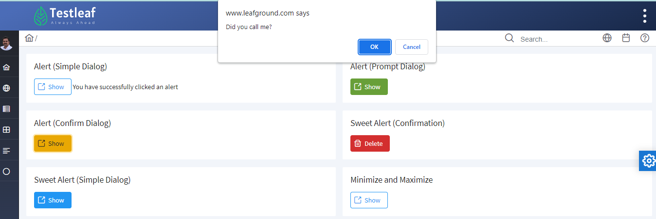
Confirmation Alert
-allows you to choose any one action
-to accept /reject the dialog
-allows to get the text form the dialog box

Slide 9
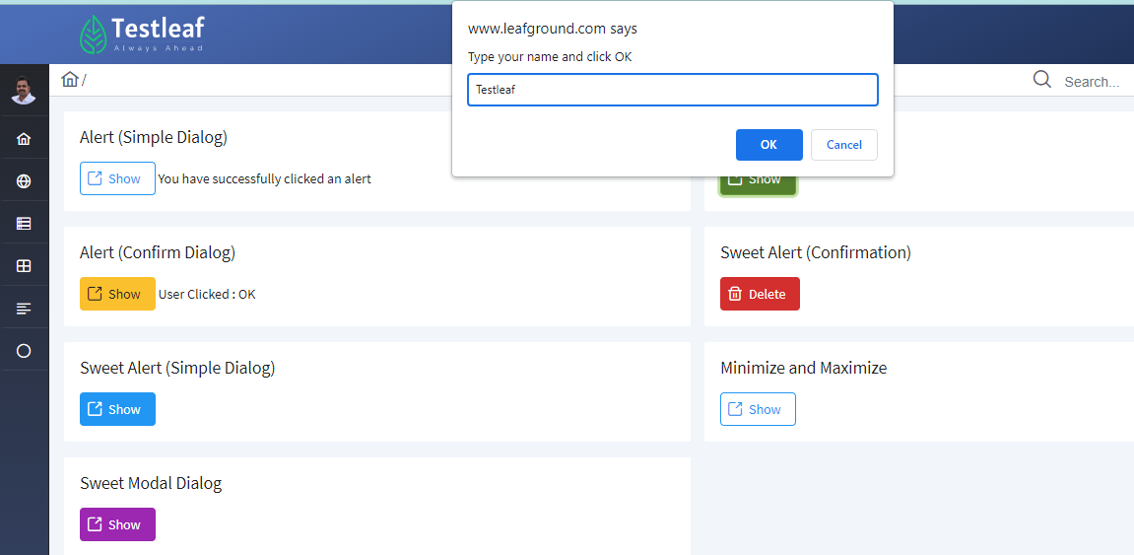
Prompt Alert
-allows you to choose any one action
-to accept /reject the dialog
-allows to get the text form the dialog box
-allows to give user input into the alert box

Slide 10
LeafGround Application
Launch https://leafground.com/alert.xhtml
Click on the Show button next to Simple Dialog
Switch the driver focus to alert box
Accept the alert

Slide 11
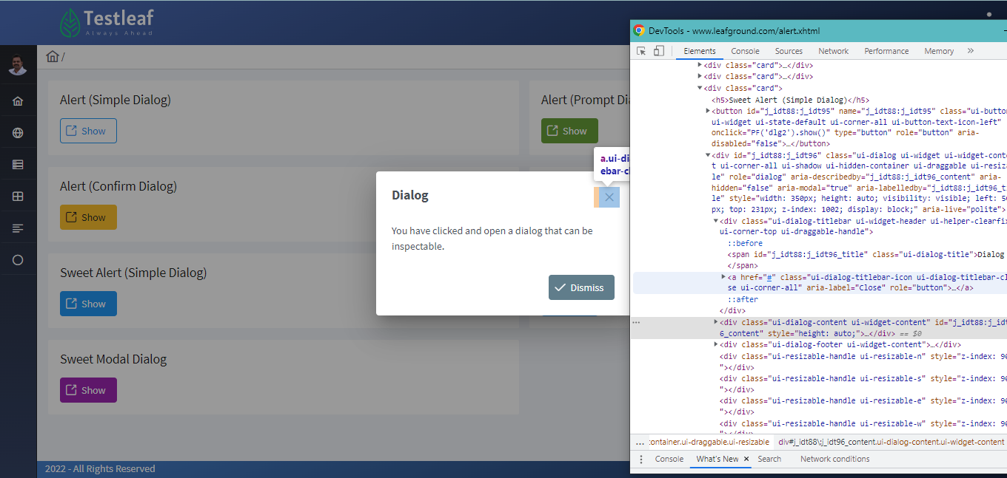
Sweet Alert
- handled as like normal web element
- it is inspectable
- cannot be ignored

Slide 12
Summary
Alerts are pop message from web application
It is not inspect able and can’t be ignored
Alerts are of two types
- Modal → Simple, Prompt, Confirmation Alert
-Non-modal Alert → Sweet Alert
Four actions are allowed
-accept the alert
-dismiss the alert
-get the text from the alert
-type data into alert

Slide 13
Classroom(Breakout)
Testcase:
Launch https://leafground.com/alert.xhtml
Click on the Show button next to Prompt Dialog
Switch the driver focus to alert
Enter the text in the alert text box
Accept the alert
Confirm the text entered is displayed in the webpage

