Slide 1
Selenium WebDriver Training
Target Locators
Frame

Slide 2
The Golden Circle
What
What is a Frame?
Frames are like another DOM embedded inside the DOM
Why
Why do we need to handle it?
To act on any element inside the frame
How to handle iframe?
How
Transfer the driver focus to frame

Slide 3
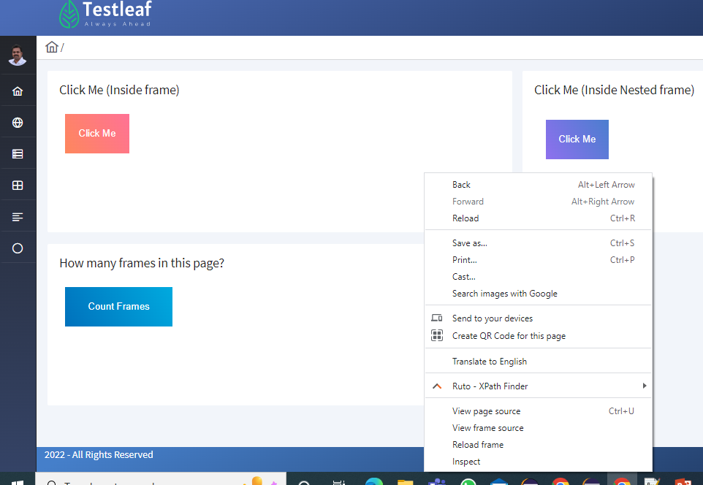
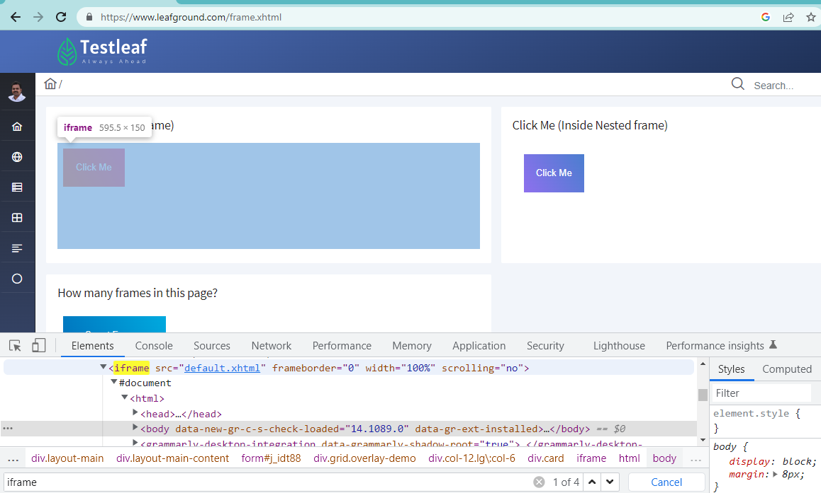
How to identify iframe..
Iframes->inline frame are identified in two ways
By right click on Webpage→ frame source
By searching //frame in DOM

Slide 4
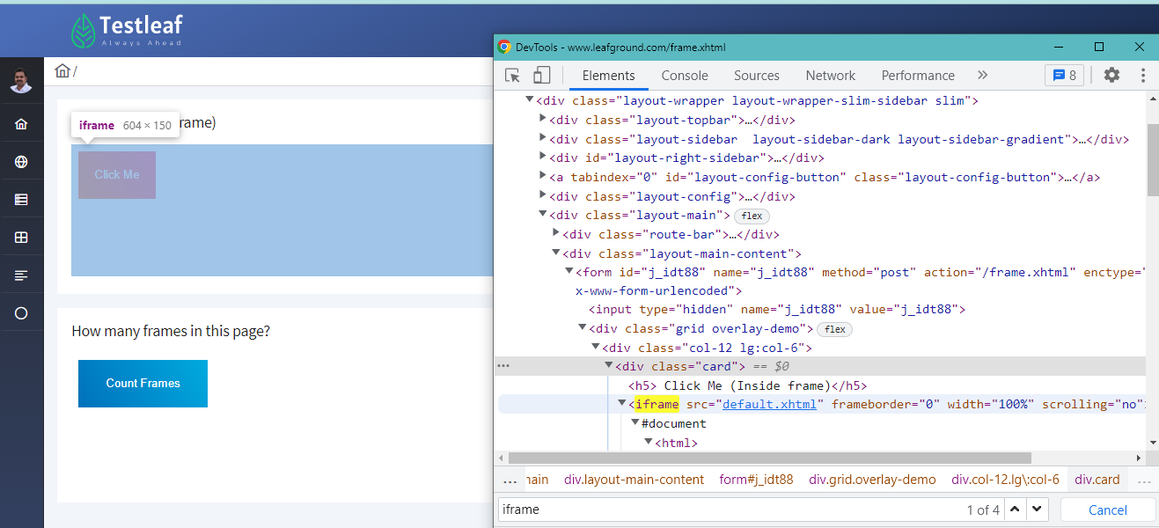
Structure of frame..
Contd..

Slide 5
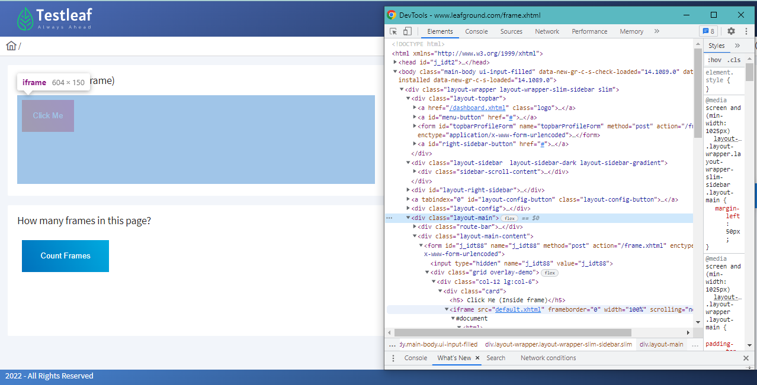
Structure of iframe..
HTML inside the other HTML

Slide 6
How to Handle it ?
To handle alert
Transfer the driver focus into frame
syntax:
driver.switchTo().frame(args);
Note: Return type of it is WebDriver interface and the implementation class is RemoteWebDriver
Primitive

Slide 7
Ways to SwitchTo frame
Using Index
driver.switchTo().frame(int index)
Index starts with 0
Using id/name attribute
driver.switchTo().frame(String id/Attribute);
Using WebElement
driver.switchTo().frame(driver.findElement(WebElement)

Slide 8
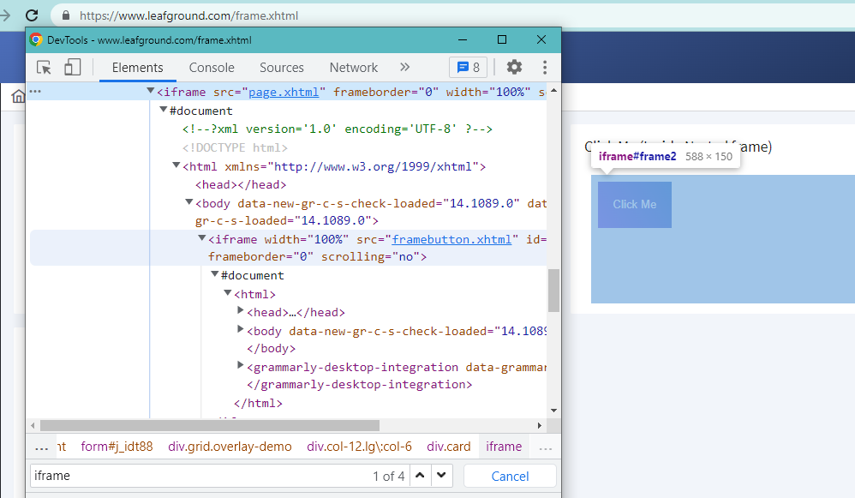
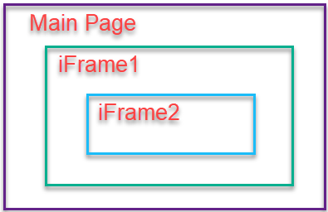
Nested Frames
Frame inside another frame

Slide 9
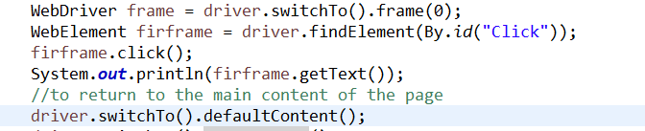
How to handle nested frame
-possible to switch between the frames using index, String id/name or WebElement
-take the driver focus to the main content of Webpage driver.switchTo().defaultContent();
-take the driver focus to the immediate parent frame driver.switchTo(). parentFrame();

Slide 10
Summary
Iframes-HTML inside another HTML
Handled by switching driver focus into to the frame
Three ways to switch into frame
-using index
-using frame attribute value (Id/name)
-using frame as WebElement

Slide 11
Classroom(Breakout)
Testcase :
Launch the https://www.w3schools.com/js/tryit.asp?filename=tryjs_confirm
Click Try It Button
Click OK/Cancel in the alert
Confirm the action is performed correctly by verifying the text !!
Hint
Switch to the frame
Then click Try It with xpath
Switch to the alert and Enter your name in alert box
Then perform accept / dismiss
Get the text using id Verify the text based on the action

