Slide 1
Selenium WebDriver Training
WebTable

Slide 2
The Golden Circle
What
What is Webtable?
Data/Information structured as tabular format in a web application
Why
Why do we need to handle it?
To retrieve/act on the information in the table
How to handle webtable?
How
Can be accessed through Webelement functions

Slide 3
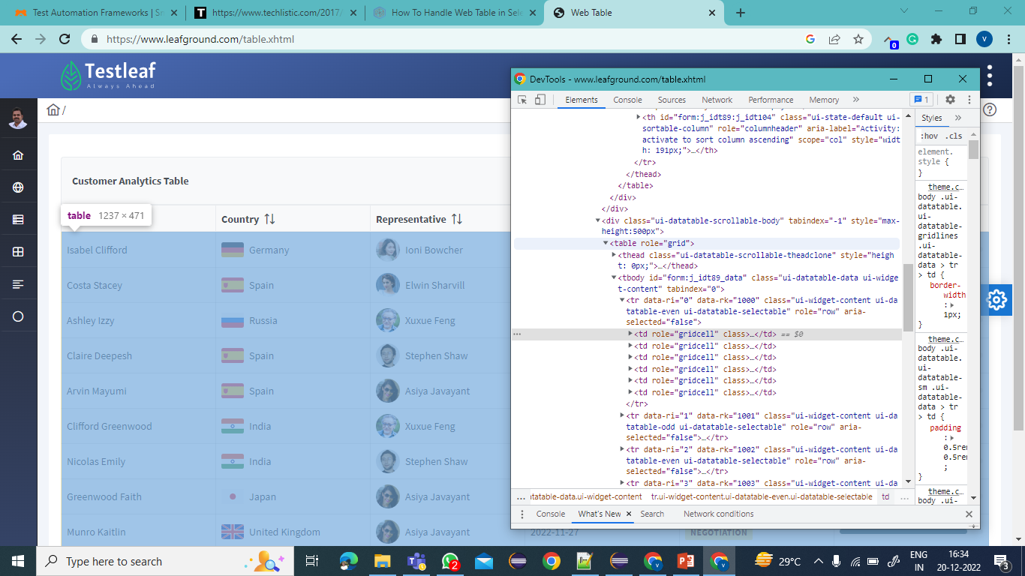
How to identify Web table?
Web table is identified with the tagname <table>
Search in the dom as //table

Slide 4
Know about WebTable elements
<table> - table name and information
<thead> - table header
<tr> </tr> - represents the row data of the
table
<th></th> - represents the table header data
<tbody> - table body
<tr> </tr>- represents the row data of the table
<th></th> - header information of the table
<td></td> - represents column data of the table
Contd..

Slide 5
Structure of WebElement
<table>
<thead>
<tr>
<th></th>
<th></th>
</tr>
</thead>
<tbody>
<tr>
<td></td>
<td></td>
<td></td>
</tr>
<tr>
<td> </td>
</tr>
<tr>
<td> </td>
</tr>
</tbody>
</table>
Primitive
Contd..

Slide 6
Understand the webtable elements
The relationship between the Webtable Elements in order to locate the elements in the dom
<table> and <th> is Grand Parent to Grand Child
<tr> and <td> is Parent to Child
<table>
<thead>
<tr>
<th></th>
<th></th>
<th></th>
</tr>
</thead>
<tbody>
<tr>
<td></td>
<td></td>
<td></td>

Slide 7
Webtable Types
Based on the data placed in the table, It’s of two types
Static table
Rows and columns of the table will be fixed.
Fetching data from the table will be easy and can be automated using XPath
Dynamic table
Rows and columns are dynamic
Cannot be handled easily as the rows and columns are changes according to the application requirement

Slide 8
Steps to handle Webtable
Step:1
Identify the table in the dom using <table>
Step:2
To access the row values, identify the row using <tr> to travel through the table -Use List to get the number of rows to be iterated
Step:3
To access the column values, identify the column using <th>/<td> to travel through the table -Use List to get the number of columns to be iterated
Step:4 -Act on the elements in the table with using WebElement function by iterating through the rows and columns

Slide 9
Summary
Webtable –Elements placed in DOM in tabular structure
Webtable –Static and Dynamic table

Slide 10
Summary
Testcase
Step:1-Launch the url (https://erail.in/)
Step:2-Enter From as MAS
Step:3-Enter To as MDU
Step:4-Uncheck sort on Date
Step:5-Get the Train Names DataTable TrainList TrainListHeader stickyTrainListHeader-TableName
Ensure whether there are duplicate train names
Hint:use size() to check duplicate

