Slide 1
Selenium WebDriver Training
Target Locators
Window Handling

Slide 2
The Golden Circle
What
What is WindowHandle?
Holds unique address of browser window /tab
Why
Why do we need to handle it?
To switches between the multiple windows
How to handle alert?
How
Transfer the driver control to child window

Slide 3
More about window handling..
-to handle multiple windows scenarios in selenium ,window handler is used .
-Window handles holds the address of the each opened browser window/tab
-Window handles are unique for each window/tab and
returns the address of each window as alphanumeric characters. Ex:CDwindow-BD4E4EE55706D7CB7EA652049B03B152
CDwindow-B795D2AA615D39AFC20F6D2D904412DF

Slide 4
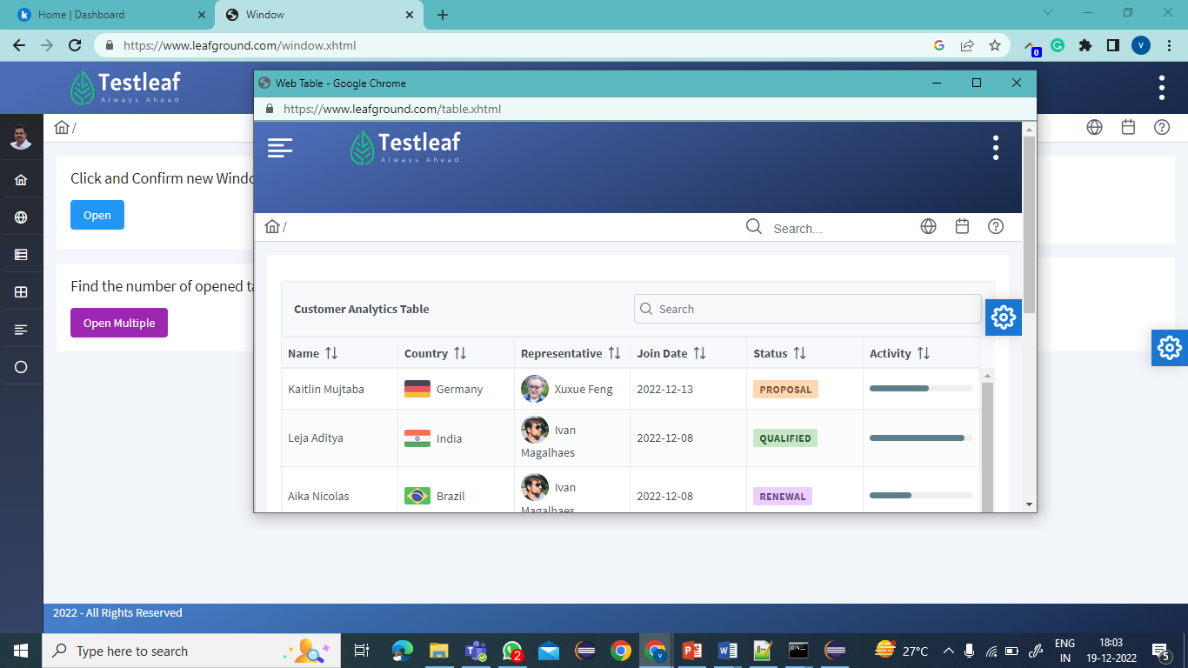
Window Handle
To get the address of opened windows, the selenium
provides two methods.
getWindowHandle() -> to get the current window id
as a string
getWindowHandles ()->returns the set of all the opened windows /tab as Set<string>

Slide 5
How to Handle it ?
To handle alert
Transfer the driver focus to child window
syntax:
driver.switchTo().Window(Windowname);
Note: Return type of it is webdriver interface and the implementation class is RemoteWebDriver
Primitive

Slide 6
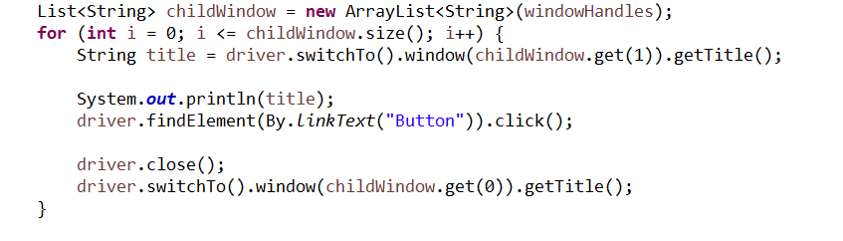
Steps to handle multiple windows
Step:1
Get the window Handles Set<String> windowHandles= driver. getWindowHandles();
Step:2
Convert the set to list
Step:3
Use SwitchTo method to switch between the windows using the Windowhandle

Slide 7
Summary
Window handle holds unique address of each window/tab
To handle multiple windows/tab –Switch focus of the driver to the child windows
Using getWindowHandles()

Slide 8
Classroom (Breakout)
Testcase:
Navigate to https://www.irctc.co.in/
Click Ok in the alert
Click on FLIGHTS link
Switch to the Flights window
Print the Title of the Flights window
Close the Flights window alone
Print the Train search window title (First window)

