Slide 1

Food Diary
Sharing Recipes…
Amir Madoo-20104013
Manashree Chavan-20104028
Darpan Mhatre-20104019
Madhu Gage-20104037
Project Guide
Prof. Vidya Shet

Slide 2
Contents
Introduction
Objectives
Scope
Features / Functionality
Project Outcomes
Technology Stack
Block Diagram if applicable

Slide 3
1. Introduction
Versatility of the Application
Problem Identified :
    People find it hard to get new inspiration and are often left clueless on what to cook.
    The age old, traditional recipes are overlooked or almost forgotten.
Solution Proposed :
    The application offers it’s users wide range of recipes.
    It also allows them to introduce the once lost recipes and also share their own customised recipes .

Slide 4
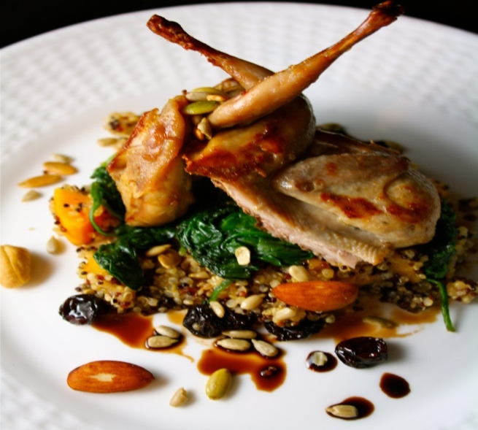
2. Objectives
The User can
Add the recipes
Edit the added recipes
Update the recipes
Save the recipes
Search for recipes

Slide 5

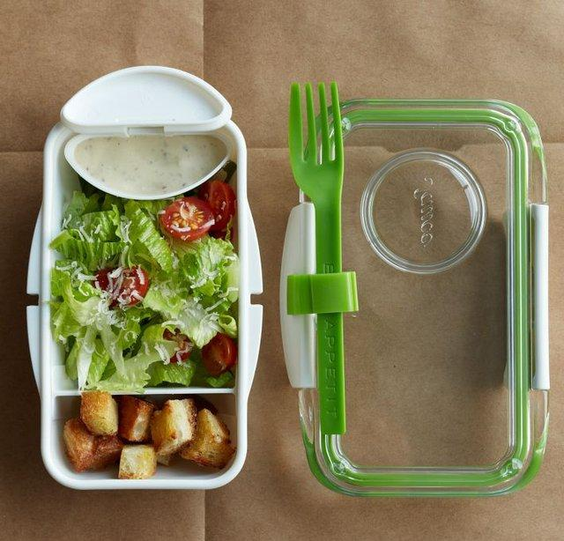
3. Scope
Can be used by a broad range of users.
Can be used by Parents.
Can be used to save recipes.
Can be used by people trying to improve their cooking.

Slide 6
4. Feature /Functionality
Registration and Login option :
    User have to register for the first time and login next time.
Add the Recipe :
    Users can add recipes.
    3. Viewing Recipes:
    Users can view recipes.
    4. Updating Recipes:
    Users can update recipes.

Slide 7
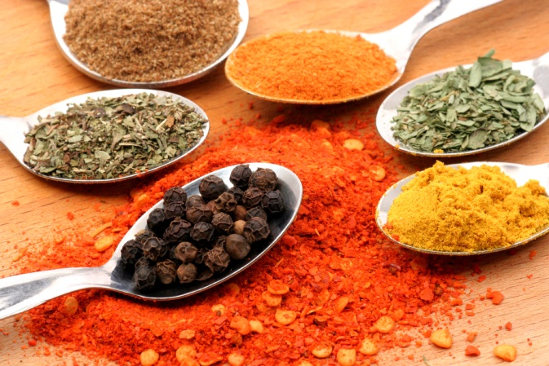

5. Outcome of Project
User Can log in.
User can view for other user’s recipes.
User can add a recipe by providing the following:
      Ingredients.
      Procedure.

Slide 8




6. Technology Stack
Programming language : Java
Operating System: Windows 10
Development Environment : Apache Netbeans
Database : MySQL

Slide 9
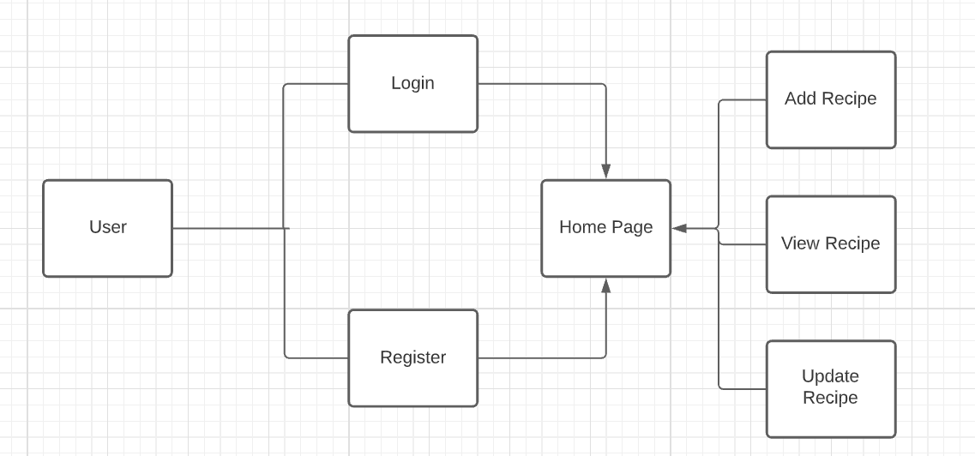
7. Block Diagram

Slide 10
Thank You...!!

