Slide 1
PREDICTING AN IDEAL SYDNEY SUBURB FOR PROPERTY PURCHASE
IBM Data Science Professional certificate
Capstone Project – Battle Of The Neighborhoods
February 2021
Vidyadhari Prerepa

Slide 2
OBJECTIVE AND INTEREST
The main objective of this project is to predict an ideal suburb in which a property purchase would yield maximum profit to the purchaser
This is important for those who are willing to purchase a property but are unsure about the uncertain factors related to rent or people’s preferences
Predicting an ideal suburb will give the owner a general idea of the types of suburbs in Sydney and how weekly rent differs in each of them

Slide 3
DATA ACQUISITION AND CLEANING
Sydney suburbs – Using web scraping of Wikipedia source containing a bullet list of suburbs in alphabetical order (https://en.wikipedia.org/wiki/Category:Suburbs_of_Sydney)
Suburbs postcodes : Downloaded a dataset from Kaggle from which suburb postcodes were extracted (https://www.kaggle.com/htagholdings/nsw-suburb-median-price-years-20072020)
Unit/House in each suburb : Extracted this information from a dataset containing weekly rents which was available publicly on NSW communities & justice (https://www.facs.nsw.gov.au/resources/statistics/rent-and-sales/dashboard)
First, Median, Third Quartile weekly rent : Extracted from the dataset available on NSW communities & justice (https://www.facs.nsw.gov.au/resources/statistics/rent-and-sales/dashboard)
Train stations in each suburb : Using web scraping of Wikipedia source containing a table of train stations in Sydney (https://en.wikipedia.org/wiki/List_of_Sydney_Trains_railway_stations)
Supermarkets in each suburb : Used Foursquare API to get the latitude, longitude of each suburb and sent the venue request to get a boolean result of the presence of Woolworths or Coles within 1km.

Slide 4
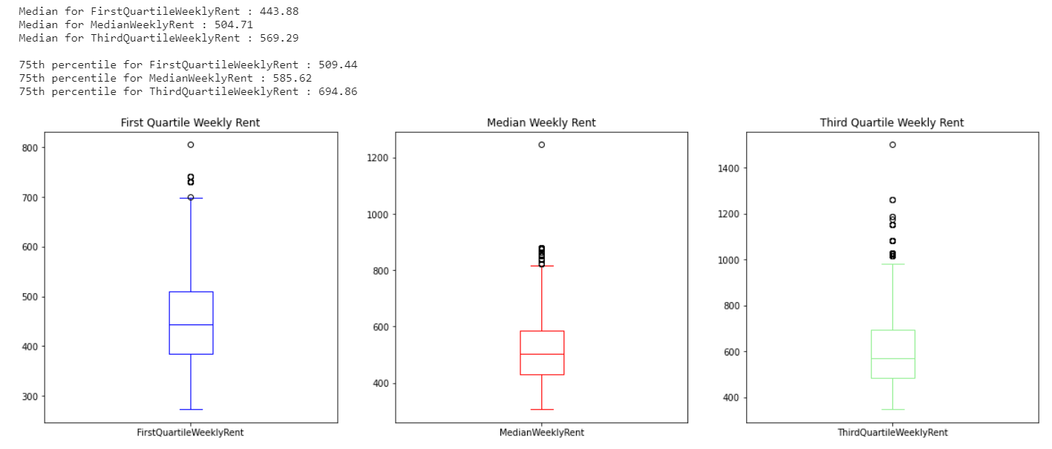
PLOT OF WEEKLY RENT IN DIFFERENT SUBURBS
This box plot gives an idea of the median and 75th percentile of weekly rent in all quartiles of an year from the year 2009 to 2020

Slide 5
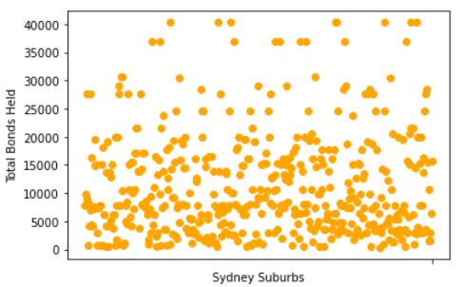
SCATTER PLOT OF TOTAL NUMBER OF BONDS LODGED IN EACH SUBURB
This box plot gives an idea of the total bonds signed in each suburb. Each datapoint is a suburb and for further analysis, we will consider the suburbs which have total number of bonds lodged > 35000

Slide 6
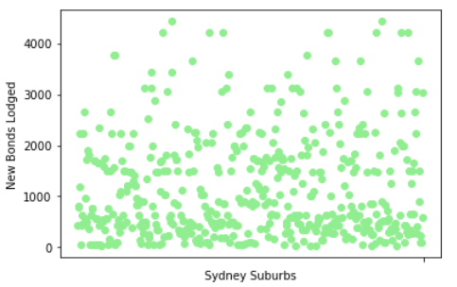
SCATTER PLOT OF NEW BONDS LODGED IN EACH SUBURB
This box plot gives an idea of the new bonds lodged in each suburb. Each datapoint is a suburb and for further analysis, we will consider the suburbs which have new bonds lodged > 4000

Slide 7
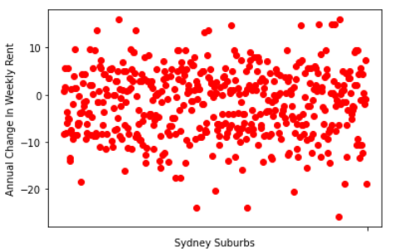
SCATTER PLOT OF ANNUAL CHANGE IN WEEKLY RENT IN EACH SUBURB
This box plot gives an idea of the annual change (positive or negative) in weekly rent in each suburb. Each datapoint is a suburb and for further analysis, we will consider the suburbs which have a positive change of > 10 %

Slide 8
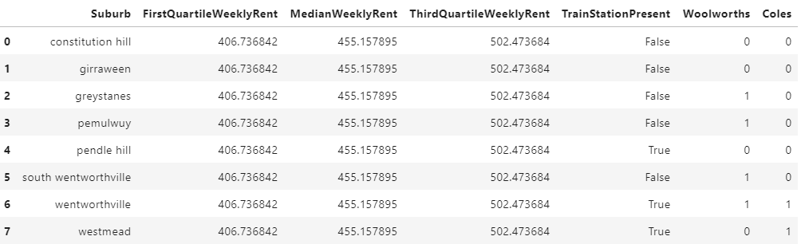
RESULTS
Following dataframe is the filtered final dataset that clearly let’s us decide the ideal suburb to solve the problem. “Wentworthville” the best suburb
If the purchaser is looking for a property with high positive change in annual rent, then the ideal suburb would be Richmond

