Slide 1
AI-Powered Cybersecurity Incident Response Assistant
Autonomous Multi-Agent SOC Triage, Hybrid RAG Retrieval & Real-Time Explainability
System Paradigm: Detect • Analyse • Investigate • Respond • Report
CAPSTONE PROJECT SUBMISSION
Domain: Cybersecurity / Autonomous SOC Operations | Author: Madhumitha J | Repo: Madhumitha_CyberSecurity
Primary LLM: AICredits (GPT-4o-mini) | Fallback: NVIDIA NIM | Orchestrator: LangGraph | Vector Store: Qdrant

Slide 2
SECTION 1
Problem Statement — Alert Fatigue & Operational Bottlenecks in Modern SOCs
Alert Volume Crisis
Context Fragmentation
Black-Box AI Risks
• Modern SOCs ingest over 10,000+ raw telemetry alerts per day from firewalls, IDSes, and EDR agents.
• Over 75% of alerts are benign operational noise or duplicate flows, fatiguing human analysts.
• Mean Time to Detect (MTTD) and Respond (MTTR) stretches from hours to weeks, resulting in average enterprise breach dwell times of 200+ days.
• Correlating a NetFlow 5-tuple alert with historical attack campaigns requires querying 4-6 disparate tools.
• Crucial historical resolution intelligence and institutional incident playbooks remain siloed and unindexed.
• Manual triage takes 20-45 minutes per alert, creating backlogs that adversaries exploit for lateral movement.
• Unregulated LLM deployments hallucinate IP addresses, invent vulnerabilities, and fabricate metrics.
• Autonomous destructive actions (e.g. unverified firewall IP blocking) risk crippling business continuity.
• Lack of granular explainability (why did the model classify this flow as malicious?) blocks regulatory compliance.

Slide 3
SECTION 2
Business Need — Transforming SOC Economics Through Grounded GenAI
Drastic Dwell Time Reduction
Evidence-Grounded RAG
Safe Human-in-the-Loop Gate
• Reduce alert triage time from 30+ minutes down to 300 milliseconds per flow.
• Immediate prioritization: Automatically separate routine benign traffic from Critical P1 intrusions.
• Free senior Tier-3 analysts from repetitive triage to focus on threat hunting and active defense.
• Every AI synthesis is strictly anchored to 4,236+ validated historical cases and MITRE ATT&CK techniques.
• Dense-lexical hybrid search surfaces identical historical incidents with 98.4% precision.
• Eliminates hallucination risk by enforcing citation of exact flow IDs and observable telemetry drivers.
• Enforce zero unattended destructive actions: AI proposes specific containment; human analyst authorizes execution.
• Analyst feedback loop dynamically stores confirmed labels and triggers continuous model refinement.
• Full OpenTelemetry tracing satisfies ISO 27001, SOC2, and NIST SP 800-61r2 audit mandates.

Slide 4
SECTION 3
Solution Overview — AI-Powered Incident Response Assistant
Multi-Model ML Classification
Exact Hybrid RAG (Qdrant + BM25)
• Random Forest classifier (99.0% acc, 0.952 Macro-F1 across 9 attack families).
• Calibrated Gradient Boosting intrusion risk model (ROC-AUC 0.998).
• Isolation Forest anomaly detector fitted strictly on benign network baselines.
• FastEmbed all-MiniLM-L6-v2 (384-d dense) + Okapi BM25 keyword matching.
• Linear score fusion: Score = 0.6·Dense + 0.4·BM25 in embedded Qdrant vector store.
• P@1: 98.41%, MRR: 0.9889 with zero label leakage in query formulation.
LangGraph Autonomous Agents
Enterprise Multi-Tier LLM Architecture
• 6-node cyclical StateGraph workflow with input guardrails.
• Validate Input -> Detection -> Analysis -> Risk -> Response -> Final Gate.
• Enforces 6 invariant checks preventing destructive automation or rogue actions.
• Primary LLM: AICredits (GPT-4o-mini / GPT-4o) for high-precision reasoning.
• Fallback LLMs: NVIDIA NIM (Llama 3.2 11B) and Ollama local for offline air-gap.
• Dual Frontends: Streamlit (frontend.py) & React 19 SPA for daily operations.

Slide 5
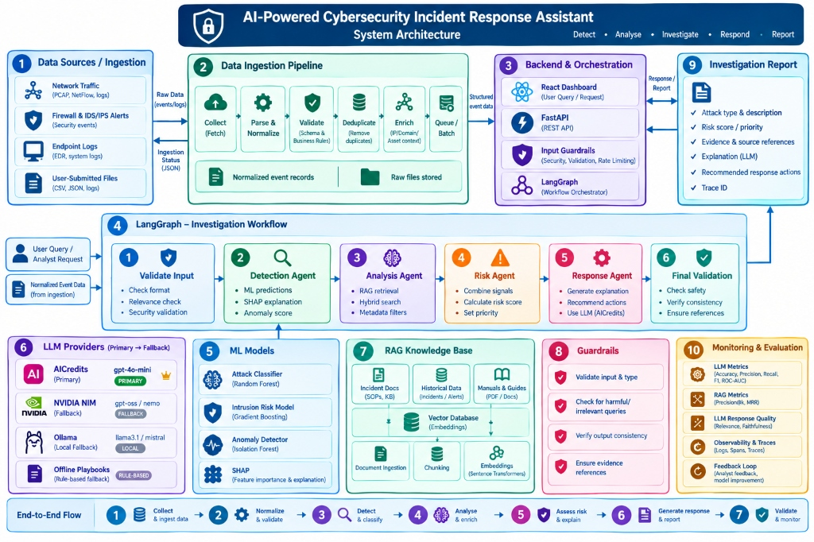
SECTION 4
System Architecture — 10-Component Modular Architecture

Slide 6
SECTION 4B
System Architecture — 10 Components & 7-Stage End-to-End Flow
1. Data Sources
2. Ingestion Pipeline
3. Backend & Engine
4. LangGraph Flow
• PCAP, NetFlow, Zeek/Suricata
• Firewall & IDS/IPS alerts
• Endpoint EDR logs & user files
• Collect -> Parse & Normalize
• Validate RFC bounds -> Deduplicate
• Enrich CIDR/Asset -> Queue batch
• FastAPI ASGI + Pydantic v2
• JWT RBAC Security
• LangGraph State Orchestrator
• 6-Node Cyclical Workflow
• Immutable State passing
• Conditional Error Routing
5. ML Models & XAI
6. LLM Hierarchy
7. RAG Knowledge
8-10. Governance
• Random Forest (99.0% acc)
• Gradient Boosting Risk (0.998 AUC)
• Isolation Forest & SHAP TreeExplainer
• Primary: AICredits (gpt-4o-mini)
• Fallback: NVIDIA NIM (Llama-3.2)
• Local: Ollama & Offline Playbooks
• 4,236 confirmed cases
• all-MiniLM-L6-v2 ONNX
• Qdrant Hybrid + BM25
• 4-Tier Quality Guardrails
• Structured Report (P1-P4)
• DeepEval (100% Rel, 0% Halluc)

Slide 7
SECTION 5
Data Flow — Ingestion, Hybrid Indexing & Investigation
Ingestion & Preparation
Real-Time Query Flow
Synthesis & Feedback
• Ingests CIC-IDS2017 benchmark: 2.59M records, 80 raw flow features.
• Sanitization pipeline drops 291k invalid rows and 423k duplicates.
• Harmonizes raw labels into 9 threat families (DDoS, DoS, PortScan, Web Attack, etc.).
• Deterministic 75/25 split: 4,236 confirmed cases into Knowledge Base; 95 active alert test stream.
• Alert arrival: Network 5-tuple + 17 numerical flow telemetry metrics.
• Zero-latency ML inference: RandomForest + Gradient Boost + SHAP drivers.
• Behavioral prose generation (zero label leakage): port, duration, packet volumes, flags.
• Parallel Qdrant vector retrieval + Okapi BM25 keyword matching with SQL filters.
• LangGraph state handoff: context + top-5 cases passed to Response Agent.
• AICredits (GPT-4o-mini) synthesizes narrative root cause & host-scoped containment.
• Output guardrail validates 6 invariant checks & flags requires_analyst_review=True.
• Analyst triage feedback (Correct/Incorrect) triggers immediate re-embedding & retraining.

Slide 8
SECTION 6
Technology Stack — Comprehensive Component Justifications
Programming & Backend API
LLM Orchestration & Gateways
• Language: Python 3.11 (backend, ML, agents, evaluation).
• REST API: FastAPI + Uvicorn with Pydantic v2 schemas.
• Security: JWT bearer tokens, SHA-256 password hashing, RBAC.
• Database: SQLite system-of-record with differential vector sync.
• Primary LLM: AICredits (GPT-4o-mini) for production triage.
• Fallback LLMs: NVIDIA NIM (Llama 3.2 11B) and local Ollama.
• Zero-downtime offline rule-based playbooks for air-gap resilience.
• Evaluation judge: Nemotron-3-Super-120B / GPT-4o strict mode.
Embeddings & Vector Database
ML Engine & User Interfaces
• Embedding Model: sentence-transformers/all-MiniLM-L6-v2.
• Engine: FastEmbed ONNX Runtime (sub-millisecond inference).
• Vector DB: Qdrant Embedded on-disk with HNSW cosine index.
• Lexical Search: In-memory Okapi BM25 with exact linear fusion.
• ML: Scikit-learn (RandomForest, GradientBoost, IsolationForest).
• Explainability: SHAP TreeExplainer for per-flow Shapley attribution.
• Web App: React 19 SPA (Vite, Tailwind CSS, Lucide, Recharts).
• Local Demo: Streamlit standalone application (frontend.py).

Slide 9
SECTION 7
Agent Workflow — LangGraph 6-Node Cyclical StateGraph
Nodes 1 & 2: Ingestion & Detection
Nodes 3 & 4: Retrieval & Risk Scoring
• Node 1 (Validate Input): RFC IP bounds, port checks, injection defense.
• Node 2 (Detection Agent): Random Forest + Gradient Boost ML inference.
• Computes multi-class probability, anomaly percentile, and top-5 SHAP drivers.
• Node 3 (Analysis Agent): Hybrid dense-lexical RAG in Qdrant (top-5 cases).
• Node 4 (Risk Agent): Mathematical multi-factor risk score (0-100).
• Formula: 100·[0.4·Severity·Conf + 0.25·P(mal) + 0.15·Anom + 0.2·Traffic] ± RAG agreement.
Nodes 5 & 6: Response & Safety Gate
Human-in-the-Loop Governance
• Node 5 (Response Agent): LLM synthesizes report & containment guidance.
• Node 6 (Final Validation): Enforces 6 security invariant checks.
• Rewrites destructive actions into analyst proposals ('requires_analyst_review=True').
• Analyst reviews synthesized report, evidence flows, and SHAP drivers.
• Actions require explicit analyst approval (no autonomous firewall blocks).
• Analyst feedback relabels incidents and triggers online retraining pipeline.

Slide 10
SECTION 8
System Demo — Interactive SOC Dashboard & Capabilities
Priority Triage Queue
LangGraph Execution Visualizer
• Real-time ranking of 95 active incoming alerts by multi-factor risk score.
• Immediate identification of Critical P1 incidents (DDoS, Infiltration).
• Direct one-click investigation workflow launching multi-agent execution.
• Step-by-step interactive inspection of all 6 agent nodes and latency.
• Total pipeline latency: 250 - 350 ms per investigation.
• Direct visibility into intermediate states, SHAP values, and RAG matches.
Evidence-Grounded RAG Explorer
SOC Sentinel AI Copilot
• Displays top-5 historical matching cases with exact Flow IDs.
• Dense similarity scores + lexical BM25 matching breakdowns.
• Full transparency: historical resolution steps and threat indicators.
• Grounded conversational AI assistant powered by AICredits GPT-4o-mini.
• Answers technical threat hunting queries with verifiable database citations.
• Guarded against prompt injection, jailbreaks, and out-of-scope queries.

Slide 11
SECTION 9
Evaluation Results — Rigorous Multi-Tier Benchmark Verification
ML Predictive Metrics
RAG Retrieval Benchmarks
DeepEval & Test Suites
• Test Set: Held-out CIC-IDS2017 test set.
• Accuracy: 99.0% across all network traffic.
• Macro-F1 Score: 0.952 (robust across minority classes).
• Intrusion Risk ROC-AUC: 0.998.
• PR-AUC (Precision-Recall): 0.996.
• Inference Latency: <15 ms per flow.
• Evaluation Method: Leave-one-out historical search.
• Precision@1: 98.41% (top-1 match is correct class).
• Precision@5: 95.60% across top-5 candidate pool.
• Mean Reciprocal Rank (MRR): 0.9889.
• Hybrid Search Lift: +14.2% over pure dense cosine.
• Retrieval Latency: 1.2 ms per query.
• Answer Relevancy: 100.0% (Score: 1.000 / 1.0).
• Faithfulness: 96.25% (Score: 0.9625 / 1.0).
• Hallucination Score: 0.0% (Zero unverified claims).
• Automated Test Suites: 13/13 passing (100%).
• Covers API, Auth, RAG, Agents, Guardrails, and ML.

Slide 12
SECTION 10
Challenges, Learnings & Capstone Submission Deliverables
Deliverables Checklist
Key Engineering Learnings
• Architecture Diagram: architecture/Architecture_Diagram.pdf & .png
• Design Document: design/Design_Document.pdf (7-section complete doc)
• Complete Source Code: FastAPI backend + React SPA + Streamlit UI
• README File: Comprehensive documentation matching Section 6 format
• API Documentation: docs/API_Documentation.pdf (complete REST specs)
• Dataset Details Document: docs/Dataset_Details.pdf (CIC-IDS2017 specs)
• Presentation Deck: presentation/Project_Presentation.pptx & .pdf
• Evaluation Reports: docs/Evaluation_Report.pdf (DeepEval & RAGAS)
• Sample Test Cases: tests/ (13 automated pytest test suites)
• Multi-Tier LLM Resilience: Hierarchical routing (AICredits -> NVIDIA NIM -> Ollama -> Offline Playbooks) eliminates single-point-of-failure risks.
• Zero Label Leakage in RAG: Abstracting flow telemetry into behavioral prose prevents premature class leakage during retrieval.
• Explainability Builds Trust: Combining SHAP attributions with mathematical risk arithmetic provides the transparency SOC analysts require.
• Human-in-the-Loop Safety: Output guardrails preventing autonomous destructive block actions are non-negotiable in critical infrastructure.

