Slide 1
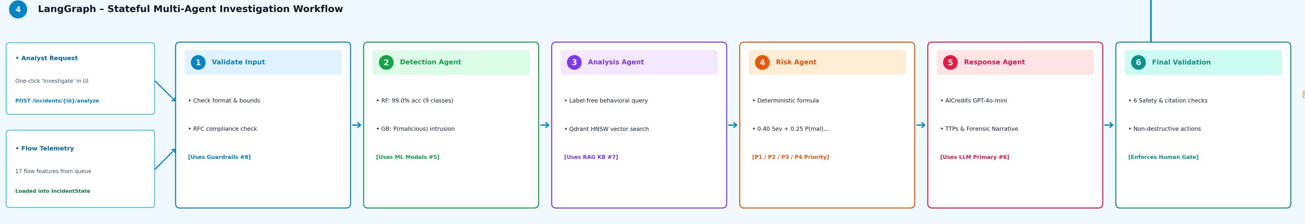
AI-Powered Cybersecurity
Incident Response Assistant
Multi-agent triage, hybrid RAG and explainable risk scoring for SOC analysts.
Project review, 10 minutes
Notes:
0:30. One sentence: this system takes a raw network flow and returns an explained, prioritised incident report, with a human approving any containment. The strip below is the real agent workflow from our architecture diagram; we will walk through it in slide 5.

Slide 2
Alert volume outruns analysts
30 min
500 to 1,000 alerts per shift
Over 85% of triage time goes to benign noise.
to triage one incident by hand
No historical context
Recurring threats are investigated from scratch.
5 sec
Unsafe LLM output
Hallucinated CVEs and unreviewed network changes.
target with the assistant
Incident Response Assistant
2
Notes:
1:00. Frame the pain: hundreds of alerts per shift, most of them noise, each taking half an hour to investigate by hand. The target is under five seconds, with the safety constraint that an LLM must never act on its own.

Slide 3
Five layers, loosely coupled
Interface
React 19 single-page app and Streamlit console
API
FastAPI with JWT roles, input guardrails and trace IDs
Orchestration
LangGraph state machine with six nodes
Intelligence
ML models
Hybrid RAG
LLM chain
Random Forest, Gradient Boosting, Isolation Forest, SHAP
MiniLM embeddings in Qdrant, fused with BM25
AICredits, NVIDIA NIM, Ollama, offline playbooks
Data
SQLite or PostgreSQL system of record, embedded Qdrant index, versioned model store
Incident Response Assistant
3
Notes:
1:15. Walk top to bottom. Interface and API are standard: React and Streamlit call FastAPI, which handles auth, guardrails and tracing. LangGraph owns the workflow. The intelligence layer is where the three kinds of AI live: classical ML, retrieval, and an LLM. Everything persists in a relational database plus an embedded Qdrant index.

Slide 4
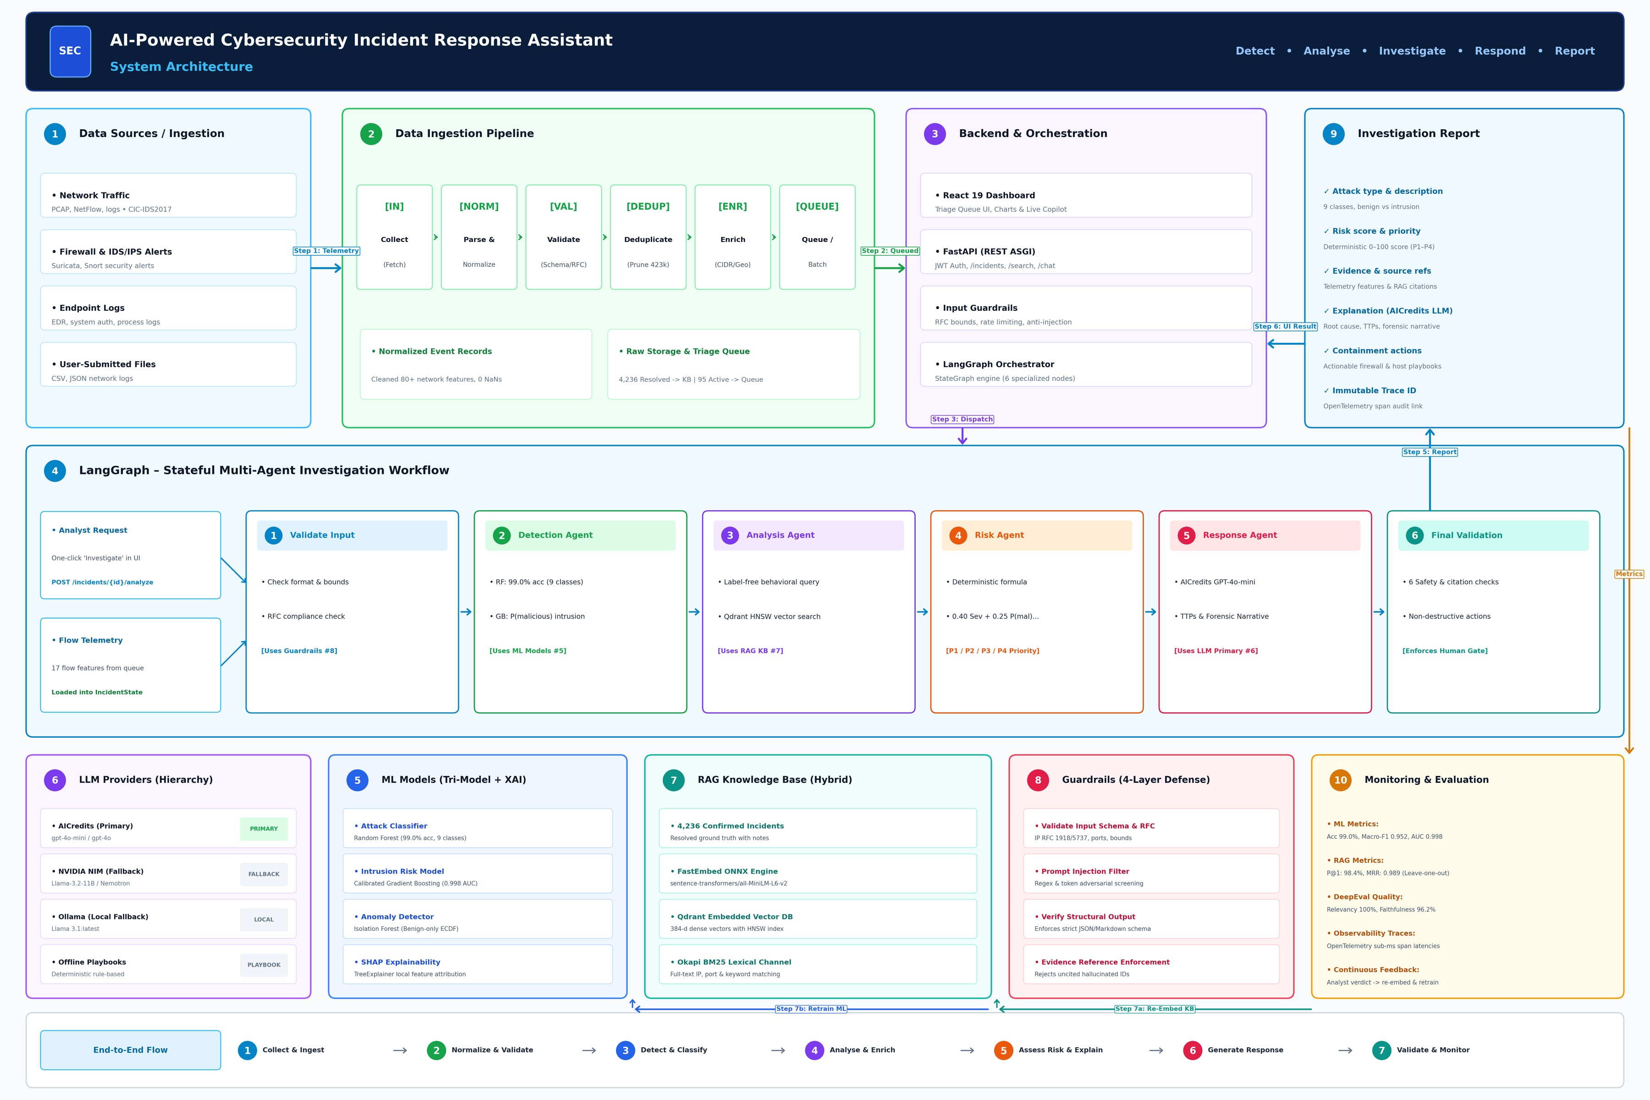
The full picture
10
components in one lifecycle
Detect
Analyse
Investigate
Respond
Report
Incident Response Assistant
4
Notes:
0:45. This is the reference diagram from the repo. Do not read it out. Point to the lifecycle on the right: Detect, Analyse, Investigate, Respond, Report, and note the ten components map onto the layers we just saw.

Slide 5
Six steps from alert to report
Validate
Detect
Analyse
Score
Respond
Verify
Schema, IP and port bounds, injection screen
Attack family, intrusion and anomaly scores, SHAP drivers
Hybrid search across 4,236 past incidents
Weighted 0 to 100 risk, priority P1 to P4
LLM drafts the report and containment playbook
Six output checks, analyst approval gate
In
Shared state
Out
Analyst clicks Investigate
One IncidentState carries evidence between nodes
Report, risk priority and a trace ID
Incident Response Assistant
5
Notes:
1:45. This is the core slide. The analyst clicks Investigate, which posts to the analyze endpoint. A shared IncidentState flows through six LangGraph nodes. Validate can short-circuit straight to the final gate if input is invalid. Detect runs the three models plus SHAP. Analyse retrieves similar past incidents. Score applies the weighted formula. Respond asks the LLM for a report and playbook. Verify runs six output checks before anything reaches the analyst.

Slide 6
What powers each decision
Detect
Retrieve
99.0%
98.4%
Dense vectors in Qdrant fused with BM25 keyword match across 4,236 confirmed incidents.
Precision@1
accuracy on 31,675 unseen flows
Random Forest classifies nine attack families
Respond
Gradient Boosting calibrates intrusion probability
AICredits → NVIDIA NIM → Ollama → offline playbooks
Isolation Forest flags zero-day anomalies
SHAP shows the features behind each call
Automatic fallback, so an outage never blocks the analyst.
Incident Response Assistant
6
Notes:
1:30. Three engines. Detect: three complementary models, so the system catches known families, calibrates intrusion risk, and flags zero-day anomalies, with SHAP explaining each prediction. Retrieve: dense plus keyword search; hybrid beats either alone and reaches 98% precision at one. Respond: a provider chain, so an outage degrades gracefully down to offline playbooks instead of failing.

Slide 7
A risk score you can audit
40%
25%
15%
20%
Severity × confidence
Intrusion probability
Anomaly
Traffic signals
How bad the family is, and how sure we are
Calibrated Gradient Boosting
Isolation Forest
Rates, SYN, ports
Priority bands
Policy floors
P1
P2
P3
P4
Confident Heartbleed or Infiltration is always Critical. Botnet is never below High. Confirmed benign flows stay P4.
Critical
High
Medium
Low
75+
55+
35+
below 35
Incident Response Assistant
7
Notes:
1:15. The score is a transparent weighted sum, not a black box: attack severity times confidence 40, calibrated intrusion probability 25, anomaly 15, traffic indicators 20, plus a small plus-or-minus six point nudge from retrieval agreement. Policy floors guarantee that confident Heartbleed or Infiltration is always Critical. Thresholds: 75, 55, 35.

Slide 8
Built so analysts can trust it
Four guardrail layers
No containment without a human
Schema bounds
IP, port and range checks on every flow
Firewall blocks and host isolation are drafted, never executed. 0% unsafe actions measured.
Injection filter
Screens text for adversarial prompts
Output structure
Feedback loop
Enforces the four-section report format
Analyst verdict → re-embed in Qdrant → retrain on drift
Evidence check
Rejects incident IDs that were never retrieved
Every request is traced end to end with a trace ID.
Incident Response Assistant
8
Notes:
1:00. Four guardrail layers: input schema, prompt-injection filtering, structured output checks and evidence-reference checks that reject invented incident IDs. The hard rule is on the right: nothing destructive is executed without an analyst. Below that, the feedback loop: analyst verdicts re-embed the case into Qdrant and trigger retraining when models drift. Every request carries a trace ID with span timings.

Slide 9
Measured on CIC-IDS2017
99.0%
0.997
intrusion ROC-AUC
86.6% detection at 1% false positives
98.4%
retrieval Precision@1
attack classifier accuracy
Leave-one-out over 4,235 incidents
Macro-F1 0.952 across nine classes on unseen flows.
0%
hallucinations
Independent judge, 100% answer relevancy
Incident Response Assistant
9
Notes:
0:45. Headline numbers, all measured on held-out data. Classifier accuracy 99 percent with macro-F1 0.95. Intrusion model ROC-AUC 0.997. Retrieval precision at one 98.4 percent, leave-one-out. An independent judge model found zero hallucinations and 100 percent answer relevancy. Caveat to volunteer: judge scores are signals, not ground truth.

Slide 10
Limits, and how to run it
Known limits
Run it
Rare classes
setup.bat
start.bat
Heartbleed has 11 flows and Infiltration 36, so policy floors guarantee escalation.
Embedded Qdrant
Run setup once to install everything, download CIC-IDS2017, train the models and build the index. Then start each day.
Single process. Set QDRANT_URL for a distributed cluster.
Judge scores
Open localhost:5173 and sign in as analyst, admin or viewer.
LLM judges are signals, backed by deterministic guardrail tests.
Incident Response Assistant
10
Notes:
0:45. Be upfront about limits: rare classes like Heartbleed and Infiltration have very few training flows, so we rely on policy floors; embedded Qdrant is single-process; judge scores are signals. To run: setup.bat once, start.bat after. Three roles: analyst, admin, viewer. Open for questions.

