Slide 1

Agenda
What are Abstract classes in Java?
Why we need Abstract classes in Java?
Rules for Abstract classes in Java
How to use Abstract Classes in Java
Practical Examples
What is Interface in Java?
Why we need interface in Java?
Rules for interface in Java
Practical Example
Abstract Class Vs Interface

Slide 2
What is Abstraction

Slide 3
What is Abstraction
Abstraction is a process of hiding the implementation details and showing only the functionality to the user.
The process of Abstraction in Java can be achieved by
Abstract Class (partially abstraction)
Interface (fully abstraction)

Slide 4
What is Abstract Class

Slide 5

What is Abstract class
Abstract class in Java acts as a boundary between the implementation method and its functionality.
It is used to exchange the functionality between the concrete class members and the Abstract Class method.

Slide 6
What is Abstract Class

Slide 7
Rules for Abstract Classes in Java
It cannot be instantiated
It can have final methods
An Abstract class must be declared using Abstract keyword.
It can have abstract and non-abstract methods
It can have constructors and static methods

Slide 8
Why we need Abstract Class
Abstract class is used to provide common method implementation to all the subclasses or to provide default implementation.
It provides flexibility to the software for any future modification
It provides the Default Functionality of the defined method for all the Sub-Classes
Abstract classes provide a Template for future specific classes
The abstract class allows Code Re-usability

Slide 9

Syntax
Abstract Class:
Abstract Method:
abstract class class_name { }
abstract method ( );

Slide 10
Practical Examples
Consider we want to start a VehicleRegistration service, where we verify the vehicle details, calculate the road tax and issue the vehicle number to the customer from various states like Karnataka, Odisha, AndhraPradesh, Delhi etc.
For verifying the vehicle details we don’t rely on respective states it can be verified against documents provided by the customer.
But for calculating road tax and to issue the vehicle number we need to follow the govt rules which will be vary from state to state.

Slide 11



Some methods I know. Some methods I don’t know, and I will depend upon you to provide
Some methods I know. Some methods I don’t know, and I will depend upon you to provide

Slide 12
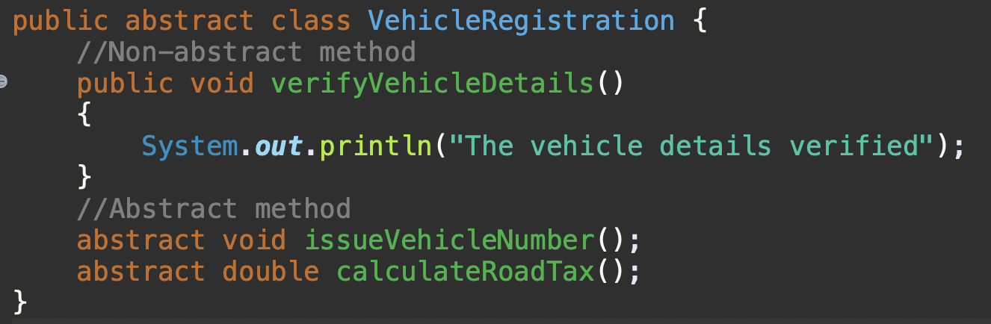
Practical Examples
VehicleRegistration Abstract class

Slide 13
What is Java Interface
An interface is a shared boundary across which two or more separate components of a computer system can exchange information.
Java interface is an abstract type that is used to specify a behavior that all classes must implement.

Slide 14
Why we need Java Interface
Interface is used in a situation, When you know the contract methods but don't know anything about the implementation.
Your contract implementation can change in future.
You want to achieve dynamic polymorphism and loose coupling that is by just changing one line of code, you should be able to switch between contract implementer.

Slide 15
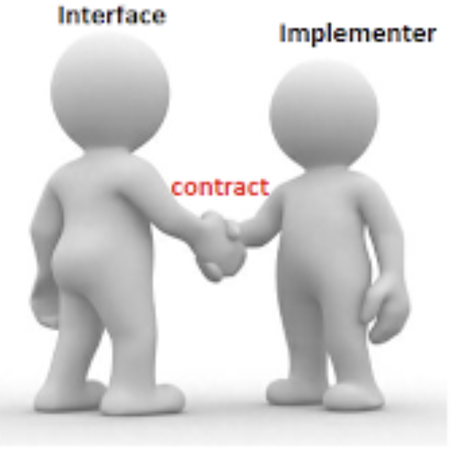
Interface helps in polymorphism
I only know the method names that I will require for my job to be done. You must provide body for those methods
Sure, I will provide body to all your methods but in my way

Slide 16


Interface helps in extensibility and loose coupling
I may use you
I may use you
I may use you

Slide 17
Syntax to declare interface in Java
Syntax:
The keyword “implement” used by a class to implement an interface.
Class must implement all methods declared in an interface, or else it must be declared as an Abstract class.
interface <interface_name> {
//constant fields
// abstract methods
}

Slide 18
Practical Example
Let's say we want to start a service like ”Zomato" or ”swiggy", where we are responsible for displaying the food items from various restaurants and place an order from customer. Let's keep our service as simple as, Displaying food items available from restaurants like ”A2B", ”Punjabi Dhaba" and ”KFC".
Place and order for food to respective customer.
Remember, In this application, we don't own any restaurant. we are just a middleman/aggregator. Let's see how to design it.

Slide 19
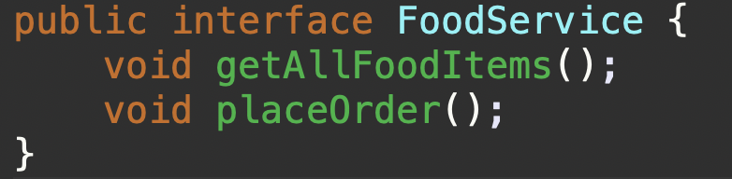
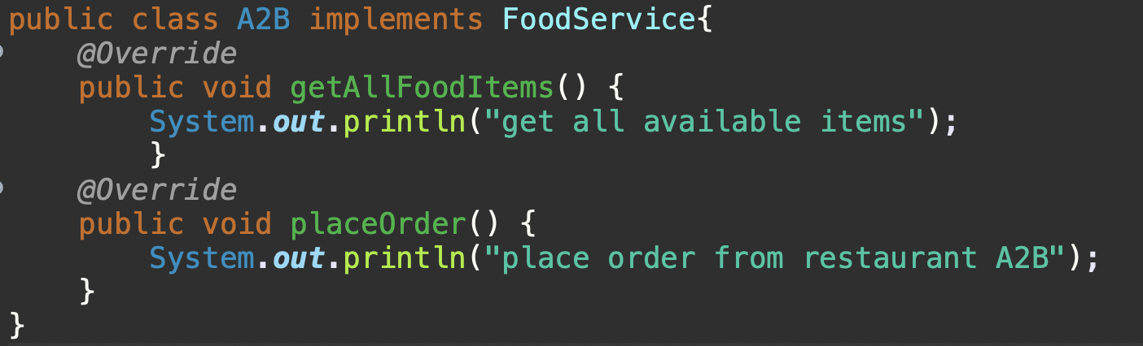
Practical Example
FoodService interface
A2B Implementation

Slide 20
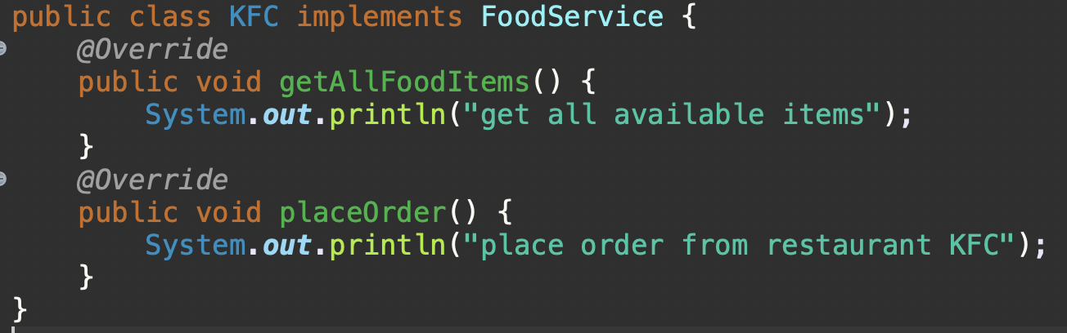
Practical Example
KFC Implementation

Slide 21
Try it Yourself
Let's say we have a requirement to Sort array but don't know which sorting algorithm to use because it depends on the nature of array. If the data set is small and nearly sorted, then Insertion sort works well.
If we are working on big size array and have space constraint, then Merge sort works very well.
So, each sorting algorithm is fit for particular use cases. How to design our sorting application which helps other application to sort integer array.

Slide 22
Extending an Interface
Java Interface is capable to extend any number of Interfaces but can never implement one.
A Java class can implement any number of Interfaces.
Java Class cannot implement Interfaces with the same method name and different return type.
If there are two or more methods with the same method name, are existing in multiple interfaces, then implementing the method for once is enough.

Slide 23
Advantages
Java Interface supports Multiple Inheritance.
Java Interface enables programmers to break up the complex programming approaches and simplify the dependencies between the objects.
Java Interface makes the data members and methods in an application to be loosely coupled.

Slide 24
Disadvantages
Use of Java Interface brings down the execution speed of the application.
Java Interfaces in the application are either used repeatedly at large extent or hardly used at all.

Slide 25
Abstract class v/s Interface
Abstract class can have abstract and non-abstract methods.
Abstract class has static, non-static, final, non-final variables
Abstract class is implemented using “extends” keyword.
Members can be private and protected in Abstract class
Interface can have only abstract methods.
Interface can have only static and final variables.
Interface is implemented using “implements” keyword.
Members are public by default in an interface.

Slide 26
When to use Abstract class Vs Interface
Interface is used when you want to define a contract and you don't know anything about implementation. (here it is total abstraction as you don't know anything.)
Abstract class is used when you know something and rely on others for what you don't know.(here it is partial abstraction as some of the things you know and some you don't know.)

Slide 27

Thank You

