Slide 1


Spotify Music Recommendation
ME228 Course Project
Nikhil Meena (22B2263)
Vidyanand Kumar (22B2171)
Notes:
NK

Slide 2
Table of contents
01
02
03
04
Project Outline
ML Model
Aim and major considerations of the project
The model with all assumptions and limitations stated
Results
Learning
Results from the learning
Our personel learnings from the project
Notes:
NK

Slide 3
01
Project Outline
Spotify Music Recommendation Model
Notes:
NK

Slide 4
Introduction
In the era of streaming services like Spotify, personalized music recommendations have become essential for enhancing user experience and engagement. This project aims to implement a comprehensive approach utilizing various machine-learning techniques to provide personalized music recommendations on Spotify.
Notes:
NK

Slide 5
Learning
Data Pre-Processing
For the classification aspect, algorithms such as PLA, Pocket, and SVM will be employed to classify users into different segments based on their music preferences.
Regression techniques will then be utilized to predict real-valued outputs such as user ratings or the likelihood of enjoying a particular song or genre.
Shallow and deep neural networks will be trained to perform classification tasks and highly accurately predict user preferences.
The project will proceed by first acquiring a large dataset containing user preferences, listening history, and music attributes. This dataset will be preprocessed to handle missing values, normalize features, and encode categorical variables.
Notes:
NK

Slide 6
The Dataset details
Source: Kaggle.com
Process: Extensive search led to Kaggle.com, where we found the suitable dataset for our project.
Reason for Selection: Kaggle is renowned for its vast collection of datasets and robust community support, making it an ideal platform for sourcing high-quality data for machine learning project
Dataset Overview:
Content: The dataset contains 18 columns such as "Valence," "Year," "Acousticness," "Artists," "Danceability," "Duration_ms," "Energy," "Explicit," "ID," "Instrumentalness," "Key," "Liveness," "Loudness," "Mode," "Name," "Popularity," "Release_date," "Speechiness," and "Tempo."
Notes:
NK

Slide 7
Navigating the Project
Pre-Planning
Proof
Implementing
Cleaning the dataset and deciding the algorithms to implement based on learning needs
Prove why the assumptions are valid using either domain knowledge or mathematics
Designing the models with suitable assumptions
Notes:
NK

Slide 8
02
ML Model
Regression, Learning Algorithms, Classification Algorithms, Neural Networks

Slide 9
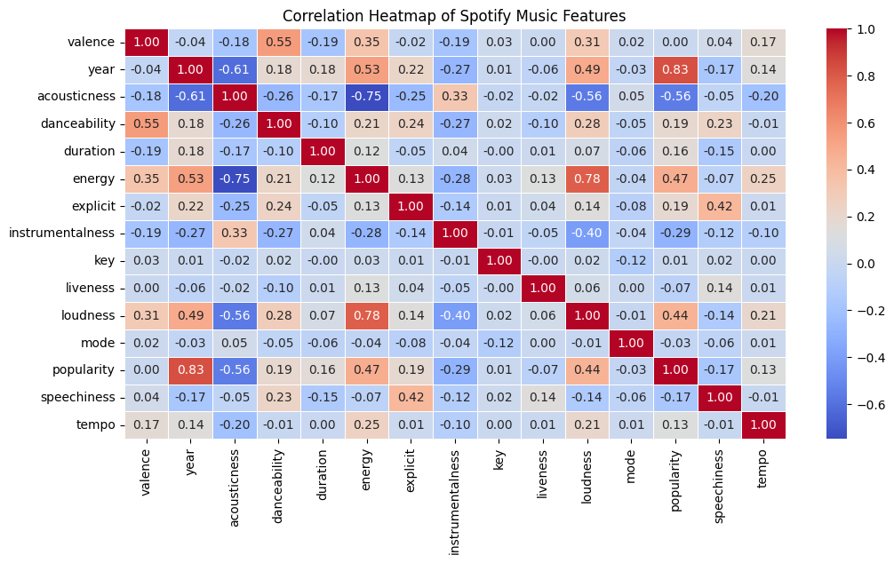
Exploratory Data Analysis
Correlation Analysis:-

Slide 10
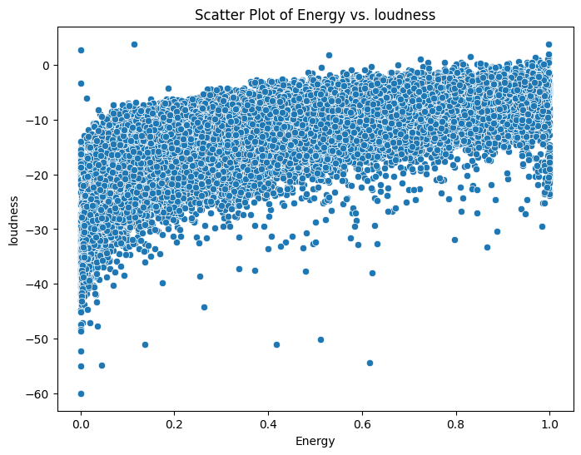
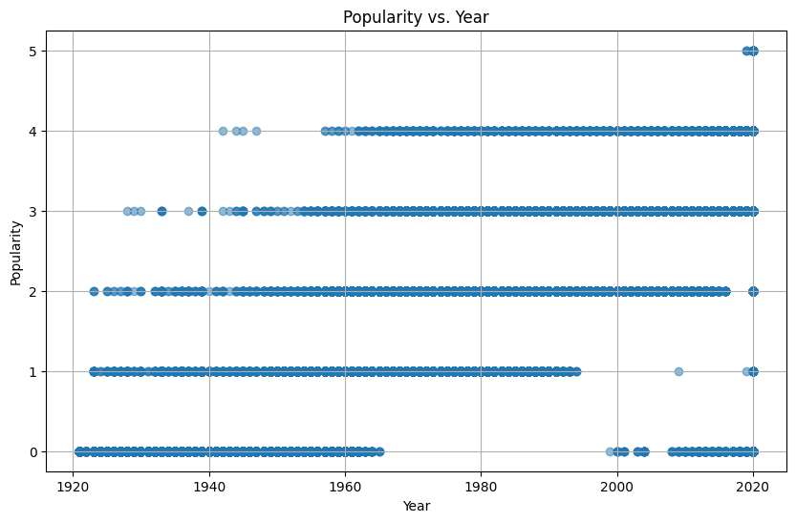
Exploratory Data Analysis
Relationship Between Features:-
We can see that energy and loudness has a very high positive correlation,
Energy and acousticness has a very very high negative correlation
And, Popularity and year has a very high positive correlation, which we also see by various plot

Slide 11
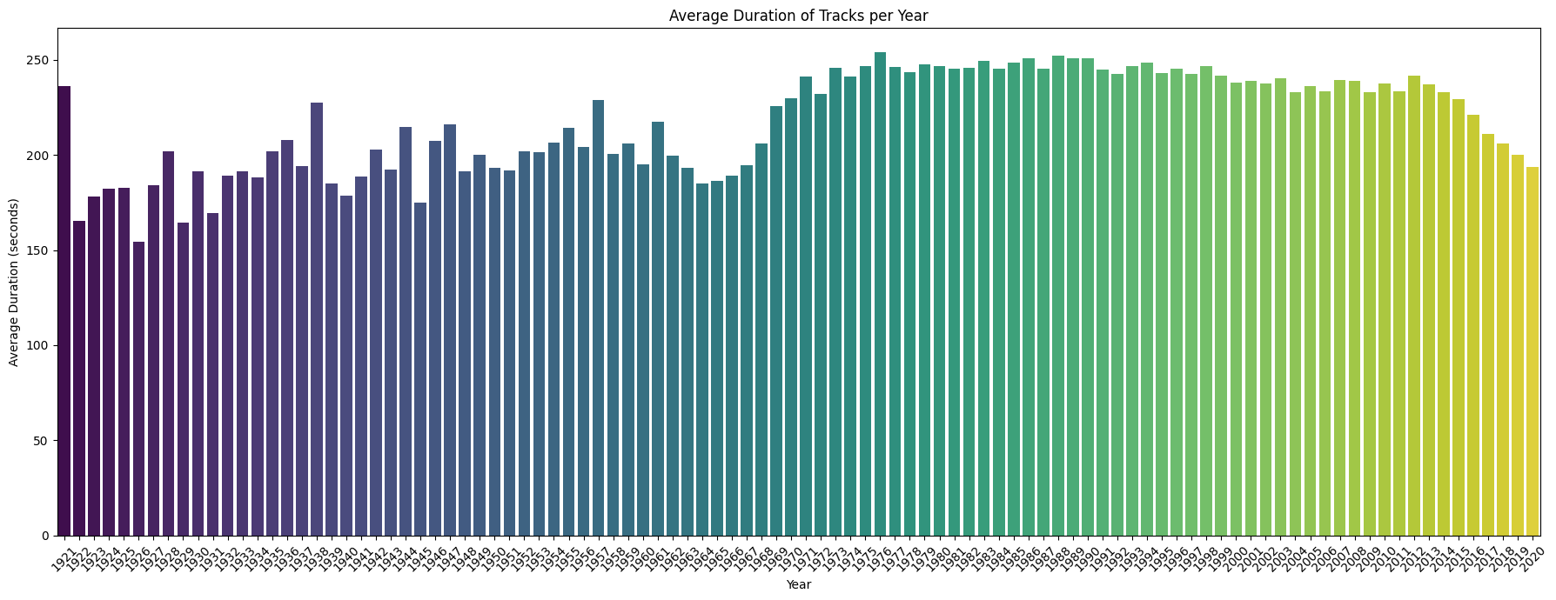
Exploratory Data Analysis
Coorelation Analysis:-We can see that before 1964, average duration of song keep fluctuating between 150-220 seconds , but after 1964, duration keeps on increasing and became constant for sometime and after 2012 average duration again decreases

Slide 12
Data Cleaning & Pre- Processing
We started with cleaning the data,i.e. –
First : Deleting the repeated data points
Second : There was an anomaly in one data (date) as in some cases it was years and in some it was the date, to solve this, we shifted to years only
Third : we normalized the dataset for learning
Fourth : We also scale the data, specifically the features such as 'Duration of the music,' which was initially in milliseconds. We converted it to seconds. Additionally, we scale the 'Popularity' feature, which ranges from 0 to 100. We adjusted its range to 0 to 5 by dividing by 20, and we named this modified feature 'Rating'.

Slide 13
Additions to Dataset
There was no user data in the dataset we found (Spotify can’t make user data public) which is why we had to make our own target function.
We chose to go ahead with a Boolean data type where
True – Recommend the song
False – Do not recommend the song
For the target function, we decided to go ahead with a linearly separable dataset. This data was made using a random number generator and it changes every time the code runs.
Notes:
nk

Slide 14
Assumptions and Justification
We decided to not use some parameters of the data from the learning algorithm, as mentioned below with the reason/justification why
Song id - it’s a variable introduced in the data by Spotify to recognize a song and is a function of other parameters
Genre – It is highly dependent on other parameters which is proved using Neural Network.
Artist Name – Mostly, particular artists are associated with a particular genre. (we did not have a dataset big enough (i.e. no. of songs in the list by 1 artist) to prove this.)
Song Name – Very subjective, repetitive, and does not affect the first impression a listener has of the song unless they have heard of the name beforehand which can not be signified using the name or any other parameters in the dataset.
Notes:
nk

Slide 15
Training
We split the data into training and testing sets using the rule of thumb K=N/5 as prescribed in class, i.e., allocating 80% for training and 20% for testing
We train our data using various models such as Regression, PLA, Pocket, SVM, and Neural networks
We then test the obtained models on the test dataset. By comparing the predicted values generated by our trained models with the actual values from the dataset, we calculate errors such as MSE (Mean Squared Error). This process is repeated for each model
We also visualize the errors by creating plots such as bar plots, histograms, and scatter plots using Python libraries such as Seaborn and Matplotlib

Slide 16
Model Training and Validation
Regression:
We only Selected features such as (valence, year, acousticness, danceability, duration, energy, explicit, instrumentalness, key, liveness, loudness, mode, year, speechiness, tempo) as predictors and (rating) as the target variable
We then created a Linear Regression model using the LinearRegression class from sklearn and trained it on the training data using the fit method.
We then generated predictions on the testing data using the predict method of the regression model
We Calculated the MSE between the actual popularity values and the predicted popularity values and then printed the calculated MSE

Slide 17
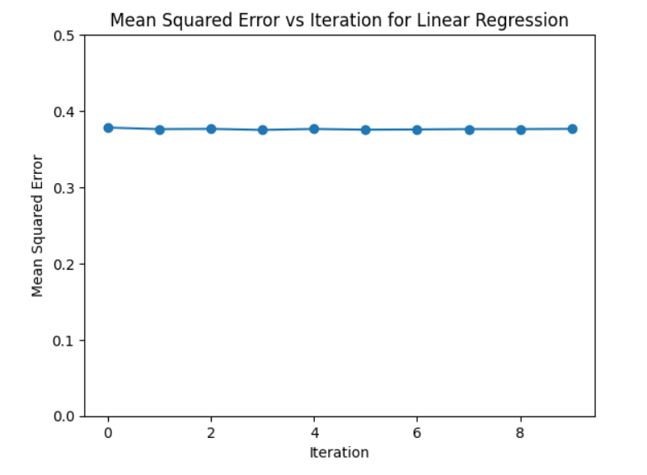
Model Training and Validation
Regression Plots: SHOWS MODEL’S STABILITY IN MULTIPLE ITERATIONS

Slide 18
Model Training and Validation
PLA:
We Initiated a Perceptron model.
We train the Perceptron model using training data (X_train, y_train).
Then, calculate the error rate of the Perceptron model on the test data (X_test, y_test).
Perceptron Error: 0.07417105534143398

Slide 19
Model Training and Validation
SVM:
We Initiated an SVM model.
Then, We train the SVM model using training data (X_train, y_train).
And, then calculate the error rate of the SVM model on the test data (X_test, y_test).
SVM Error: 0.00035305540027652516

Slide 20
Model Training and Validation
Pocket:
We first defined a class named Pocket Algorithm. We Initialize attributes: w_pocket (to hold the best weights) and errors (to track errors during training).
And then, fit the Pocket Algorithm model using training data (X_train, y_train), with a maximum number of iterations specified.
During training, iterate through the specified number of iterations, randomly generating weights and updating the best weights if errors decrease.
Then, calculating the error rate of the Pocket Algorithm model on the test data (X_test, y_test).
pocket error: 0.4998676042248963

Slide 21
Model Training and Validation
Neural Networks:
We defined a neural network model using the Keras Sequential API.
- The model consists of three dense (fully connected) layers:
- The first layer has 128 neurons with ReLU activation function and expects input data with a shape determined by the number of features in the scaled training data.
- We then Apply a dropout regularization with a rate of 0.2 after the first dense layer.
- The second layer has 64 neurons with ReLU activation function.
- Then applying a dropout regularization again with a rate of 0.2 after the second dense layer.
- The output layer consists of a single neuron, used for regression tasks (as there is no activation function specified)

Slide 22
Model Training and Validation
Neural Networks:
We then compile the neural network model using the Adam optimizer and mean squared error loss function.
- Train the compiled model on the scaled training data for 50 epochs, with a batch size of 32 and 20% validation split.
- Store the training history for analysis.
- Evaluate the trained model's performance on the scaled test data using the mean squared error (MSE) metric and print the result.

Slide 23
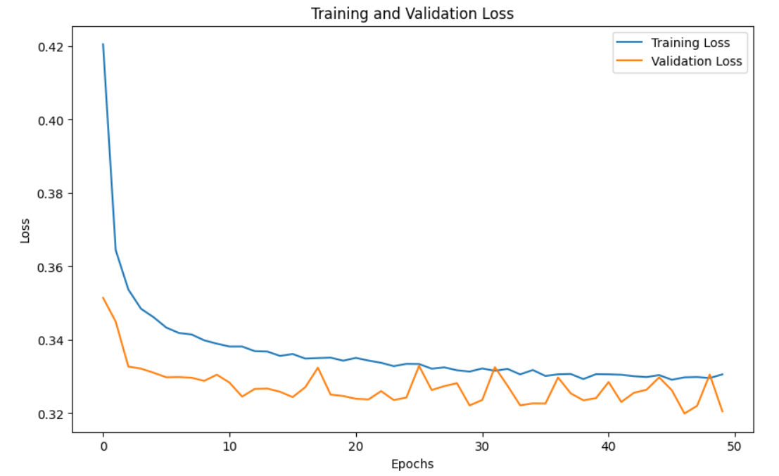
Model Training and Validation
Neural Networks Plots:

Slide 24
Learnings:
Data Analysis
ML algorithms
A lot can be seen just by analysing the data
For linearly separable data. Eg- PLA, Pocket, etc
Neural network
Model designing
Very strong model, works on wide variety of data as we did
How to take proper assumptions to keep the model accurate

Slide 25
Thank You

