Slide 1

Li-Fi Technology
light fidelity
A visible light communication
Notes:
NOTE:
To change the image on this slide, select the picture and delete it. Then click the Pictures icon in the placeholder to insert your own image.

Slide 2
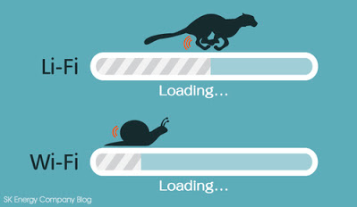
About
Li-Fi can be thought of as a light-based Wi-Fi
Li-Fi would use transceiver-fitted LED lamps that can light a room as well as transmit and receive information.
LED transmits a different data stream.

Slide 3

Genesis of Li-Fi
Harald Haas, a professor at the University of Edinburgh who began his research in the field in 2004

Slide 4
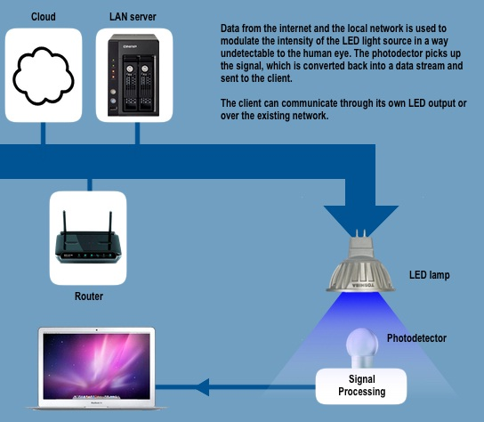
How do Li-Fi Devices Work
Li-Fi is typically implemented using white LED light bulbs at the downlink transmitter.
This very property of optical current is used in Li-Fi setup.
The operational procedure is very simple-, if the LED is on, you transmit a digital 1, if it’s off you transmit a 0.
Li-Fi consider an IR remote.

Slide 5
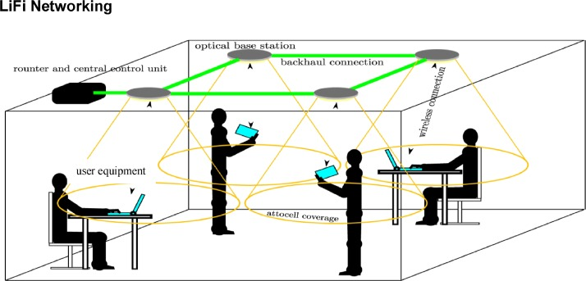
Benefits of the Li-Fi Technology
1
Enhanced wireless infrastructures Task description
2
Enabling very high peak data rates (10 Gbps)
3
The enabling of the Internet-of-Things
4
Reduced interception of signals

Slide 6
Future of Li-Fi
Li-Fi would be able to combine illumination and wireless data transmission to accelerate the relay of data across the globe.
It can be considered as incredible companion of wifi technology.

Slide 7

Advantages of LI-Fi
Increased Efficiency
Cost
Availability
Security

Slide 8

Application of Li-Fi
Underwater Communication
Internet of Things
Li-Fi Enabled Street Lights
Car-to-car Communication
Security
Traffic Lights

