Slide 1
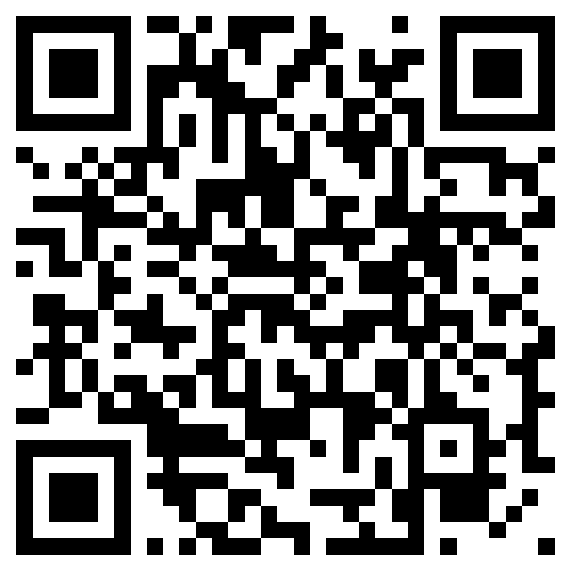
HackersMang · AI Talks · 19 Sep 2026
Break My API
Can AI find the bugs I forgot to test?
FAIL quantity: -5
FAIL SPEAKER100 x2
FAIL role: admin
PASS happy path
Vidyarathna B
Software Engineer · Soult Digital
github.com/vidyarathna/break-my-api
Notes:
00:00. Terminal already open behind the slides, API running, happy-path curl typed but not run. Don't introduce yourself at length: switch to the terminal within 30 seconds.

Slide 2
This works. I tested it.
REQUEST
RESPONSE
201 Created
POST /orders
Authorization: Bearer MTp1c2Vy
{"ticket_id": 1, "quantity": 2}
{
"total_charged": 4000.0,
"credits_earned": 400.0,
"credit_balance": 1400.0
}
Every test I wrote passes. That's the problem.
Notes:
Run the curl live. Two tickets, 4000 charged, 400 back, balance 1400. 'Correct. I wrote this, I tested it.' Then: for the next 25 minutes a model takes it apart, and then three bugs that weren't in its case set.

Slide 3
My tests check what I imagined
What I tested
What callers actually send
PASS
log in with the right password
????
"quantity": -5
PASS
search for "GENERAL"
????
q = %' OR published = 0 ...
????
Bearer OTphZG1pbg==
PASS
buy 2 tickets
????
SPEAKER100, twice
????
20 buyers, 5 seats, same second
Happy-path tests prove the code does what I meant. They say nothing about what I didn't think of.
Notes:
Don't explain each right-hand line yet: they come back in the demo. The point: nobody writes these tests because nobody imagines them.

Slide 4
ConfBadge: a small ticket shop
4 endpoints
5 rules
POST
/auth/login
1
Everyone holds a prepaid credit balance
email + password to token
2
Each purchase earns 10% of the price back as credits
GET
/tickets?q=
search published tickets
3
Credits are spendable. Credits are money.
POST
/orders
buy from your credit balance
4
SPEAKER100 is 100% off and single use
GET
/orders/{id}
5
Maximum 10 tickets per order
read one order
GENERAL 2000 · STUDENT 500 · WORKSHOP 3500 (5 seats) · STAFF (unpublished)
Notes:
Read the rules properly. Say 'hold on to rule three, it comes back.' /me and /_reset exist but are helpers; don't mention them.

Slide 5
Don't ask it to write tests. Ask it to break things.
1
You are a senior security engineer doing a
black-box review of an internal API.
Attacker framing
"Write tests for this" gets you the happy path, because that's what most test files look like.
Assume the developer was competent but rushed.
Assume the obvious validation is present and
1
the non-obvious validation is missing.
2
List five assumptions this API makes about its
callers. Then write cases that violate each one.
An oracle, not a mirror
expect_status = what a CORRECT implementation
Without this line the model writes down what the API does, and every test passes.
2
returns, not what you predict this one returns.
Notes:
Two ideas only: the attacker framing and the 'correct, not predicted' oracle. Describe the assumptions line as intent, not a proven improvement, unless you compared runs.

Slide 6
Three jobs, three different ways to fail
Model
Runner
Human
guesses
measures
decides
Writes test cases as JSON. Fast, cheap, and sometimes wrong.
Sends each request, compares the status. Dumb on purpose.
Triages every red line. Knows the rules and the priorities.
{ "id": "TC-011",
Only the bright lines ever execute.
A hallucinated endpoint fails loudly with 404. A hallucinated reason never touches the wire: it's there for triage.
"method": "GET", "endpoint": "/me",
"auth": "forged_admin",
"expect_status": [401],
"reason": "token looks like base64, not a signature" }
Notes:
This answers 'what about hallucinations?' before anyone asks. Then: let's run it.

Slide 7
DEMO 1 / 4
Generate the attack
$ python ai/generate.py --prompt 2
WATCH FOR
The five assumptions it thinks the API makes
One full case: payload, auth, and what a correct API should return
Don't read every case. Under three minutes.
Notes:
06:00-09:00. Generate live only if it took under ~40 s in rehearsal; otherwise open ai/generated_cases.json and say it was generated last night with the same prompt.

Slide 8
DEMO 2 / 4
Run every guess
$ python -m tests.runner
WATCH FOR
TC-001: minus five tickets, 201 Created, negative charge
TC-011: a token I made up returns role: admin
TC-006 green, TC-007 red: same idea, one payload lied
Notes:
09:00-14:00. Every case starts from a freshly reset database, so re-running one case gives the same verdict. Point at the 'Candidate defects - a human still has to triage these' footer.

Slide 9
DEMO 3 / 4
Chain two small bugs
$ python demo/money_loop.py
WATCH FOR
TC-012: the single-use coupon accepted twice
credits_earned uses the list price, not the amount paid
Ask the room to guess the final balance first
Notes:
14:00-18:30, the wow moment. Show the one line in app/main.py before running. Say only what your real Prompt 3 run found: see TALK-PACKET section 9, Demo 3, for the three versions.

Slide 10
Nothing was invalid. The balance still grew.
0.00
paid on every order
5 × 201
every request accepted
+9,000
credits created from nothing
Notes:
Use this after the money loop runs, or instead of it if the terminal fails. It's capped at 5 rounds only because the ticket stock runs out.

Slide 11
DEMO 4 / 4
Outside the case set
$ python demo/race.py
WATCH FOR
20 buyers, 5 seats, all 20 orders accepted
A couple of seats still 'remaining': arithmetically impossible
Then: buy the student ticket as alice@corp.example
Notes:
18:30-23:00. If you're behind at 18:00, skip the student ticket and say it in one sentence on the next slide.

Slide 12
Where the model stopped
race.py
STUDENT 201
TC-006 PASS
It couldn't express it
It couldn't know it
Green isn't proof
One request and one expected status can't say "twenty at once". That's a limit of the harness, not of intelligence.
Student pricing needs a verified student address. That rule lives in a policy doc, so nobody reading the repo can confirm the 201 is wrong.
Same injection idea, two payloads. One passed, one leaked a hidden ticket. A pass only means that guess wasn't confirmed.
Want these found? Give the harness a way to say "run these together", and write the rules where a reader can find them.
Notes:
Be precise: many models will suggest testing concurrency or the student ticket. The claim is that it couldn't run the race in this format, and couldn't know the pricing rule. Don't say 'AI can't find these'.

Slide 13
AI generates hypotheses.
Execution provides evidence.
Humans decide what is a defect.
model
runner
human
Notes:
23:00. Say the sentence verbatim, slowly. Don't paraphrase it anywhere else in the talk.

Slide 14
The honest numbers
16
10
6
3
hypotheses
came back red
worth filing today
not in the case set
2
real, but arguable (a doc-vs-code mismatch, empty orders)
2
guesses that were simply wrong
1
green result that hid a real injection
One prompt · one small API · saved case set
Notes:
REPLACE these numbers with your real ai/generate.py run before presenting. Never cut this slide.

Slide 15
Try it on Monday
1
Commit the generated cases
Review them in a PR like any other test suite.
2
Run them as a separate CI job
Non-blocking until a human has triaged the reds once.
3
Regenerate when the spec changes
Not on every run, or the suite will flap.
Break it yourself.
4
Write business rules into the spec
github.com/vidyarathna/break-my-api
Every rule a reader can find is a rule this can test.
Vidyarathna B · Thank you
Notes:
End on point 4. Stay on this slide for Q&A.

