Slide 1



Break My API: Can AI Find the Bugs I Forgot to Test?
Vidyarathna B
Software Engineer · Soult Digital
Notes:
Opening: Today's theme is 'beyond the prompt'. My talk is a small, real example: the prompt got AI to suggest attacks, but it was the engineering around it, running every idea and checking the evidence, that told me which ones were true. Keep this short; the terminal is ready behind the slides with the API running.

Slide 2
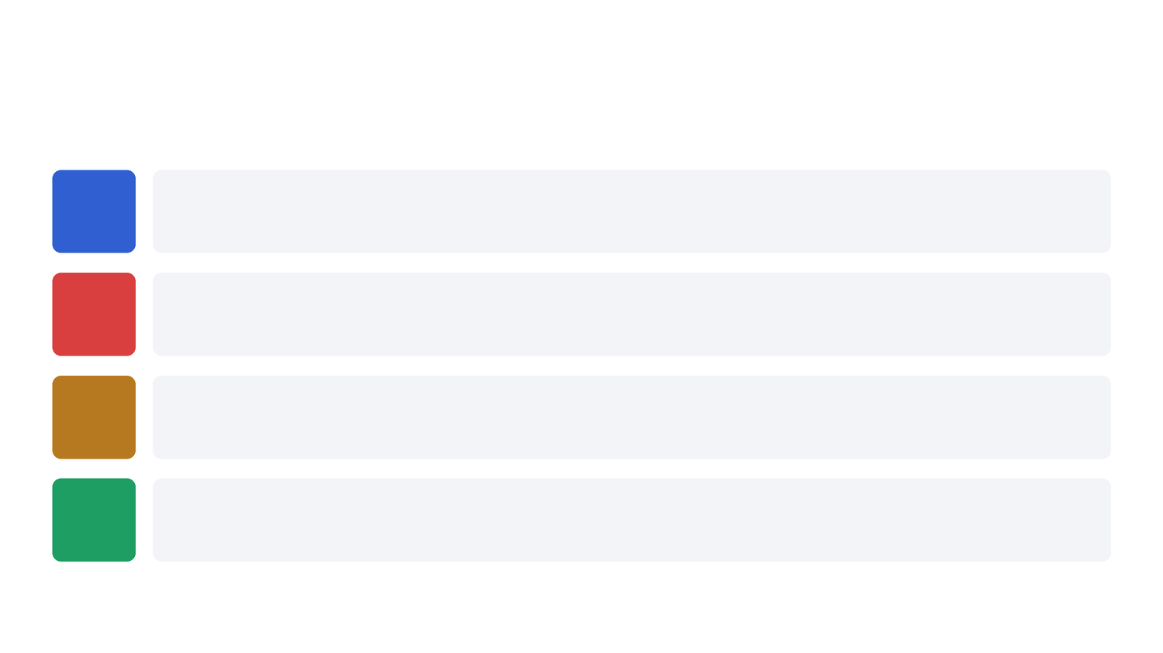
@hackersmang #HMSep26
TODAY
What we'll do in 30 minutes
1
Build
A small ticket-shop API with 10 bugs planted on purpose
2
Attack
Ask a local AI model to act as an attacker and write test cases
3
Check
Run every AI guess against the API and look at the evidence
4
Judge
Decide which results are real bugs, and see what the AI missed
2
Notes:
Say: most of us use AI to write code. Today I'll use it to break code, and then check whether it was right. Four steps on screen.

Slide 3

@hackersmang #HMSep26
THE PROBLEM
My tests only check what I imagined
Happy path: we test the one normal way the feature is used.
Curse of knowledge: the author shares every assumption the code makes, so those assumptions never get tested.
Real traffic is different: confused users, double-clicks, retries, attackers, 100 people at once.
What I tested
POST /orders {"quantity": 2}
What people actually send
{"quantity": -5}
{"quantity": 10} (docs say max 10)
coupon SPEAKER100, twice
a token I made up myself
20 buyers, 5 seats, same second
3
Notes:
Say: when I write quantity: int, my brain fills in 'a positive number'. I test with 2, it passes. The assumption was never written down, so it was never tested. Attackers and real users take the other roads.

Slide 4

@hackersmang #HMSep26
THEORY · 1 MINUTE
What an API is, and how it answers
API: the way one program asks another for something. Like a waiter between you and the kitchen.
Request: a method (GET = read, POST = create), a path, headers (who you are), and a JSON body.
Response: a status code plus JSON data.
2xx It worked
200 OK, 201 Created. Dangerous when it's a lie: "201" for minus five tickets.
4xx You asked wrong
400, 401, 403, 404. The API refused politely. This is what we want for bad input.
5xx The server broke
500. If bad user input causes a 500, that is almost always a bug.
4
Notes:
Quick theory for anyone new. An API is a menu of requests a program accepts. The status code is its one-word verdict. Most of today's tests just ask: when I send something wrong, do I get a 4xx?

Slide 5

@hackersmang #HMSep26
THE API UNDER TEST
ConfBadge: a small conference ticket shop
Endpoints
POST /auth/login log in → token
GET /tickets?q= search tickets
POST /orders buy tickets
GET /orders/{id} read one order
Python · FastAPI · SQLite
1. Everyone has a prepaid credit balance.
2. Buying a ticket takes the price from your balance.
3. Every purchase gives 10% back as credits. Credits are money.
4. SPEAKER100 coupon = 100% off, single use.
5. Maximum 10 tickets per order.
Tickets: GENERAL 2000 · STUDENT 500 · WORKSHOP 3500 (5 seats) · STAFF (hidden)
5
Notes:
Read the rules properly. Pause on rule 3: credits are money. Say 'hold on to that, it comes back'.

Slide 6

@hackersmang #HMSep26
LIVE · TERMINAL
This works. I tested it.
$ curl -X POST localhost:8000/orders \
-H "authorization: Bearer $TOKEN" \
-d '{"ticket_id": 1, "quantity": 2}'
201 Created
{ "total_charged": 4000.0,
"credits_earned": 400.0,
"credit_balance": 1400.0 }
Everything is correct
2 tickets × 2000 = 4000 charged.
10% back = 400 credits.
5000 − 4000 + 400 = 1400.
Every test I wrote passes. That's the problem.
6
Notes:
Run the curl live. Two tickets, 4000 charged, 400 back, balance 1400. Say: correct. I wrote this, I tested it, the tests pass. That's the problem.

Slide 7

@hackersmang #HMSep26
THE IDEA
Don't ask AI to write code. Ask it to break it.
1 · AI model
Guesses what might break.
Fast and cheap.
Sometimes wrong.
2 · Test runner
Sends every guess to the real API and records what came back.
Dumb on purpose.
3 · Human
Decides which red lines are real bugs.
Knows the business rules and the priorities.
AI generates hypotheses. Execution provides evidence. Humans decide what is a defect.
7
Notes:
Say the three roles. The model guesses, the runner checks, a human decides. Each fails in a different way, which is why you need all three.

Slide 8

@hackersmang #HMSep26
HOW TO PROMPT AN ATTACKER
Four rules that turn "write tests" into attacks
1 · Ask it to break, not to test
"Assume the developer was rushed and the non-obvious validation is missing."
2 · Ask for the correct answer
"expect_status = what a CORRECT API returns, not what this one returns."
3 · Give it real context
The endpoint list, the business rules, a real login token.
4 · Force structured output
JSON with fixed fields, so every guess can be run as a test.
8
Notes:
The most important one is rule 2. Without it, the model writes down what the API currently does, and every test passes: a green suite that certifies your bugs.

Slide 9

@hackersmang #HMSep26
ONE AI-GENERATED TEST CASE
Every guess becomes something we can run
{
"method": "GET",
"endpoint": "/orders/1",
"auth": "bob",
"expect_status": [403],
"objective": "Read another user's order",
"reason": "A2: assumes callers have permission",
"severity": "high"
}
Executed
method, endpoint, auth, payload, expected status. These hit the real API.
Read by humans
objective, reason, severity. Never executed. A wrong reason costs a sentence, not a false result.
9
Notes:
Point at the bright lines: only method, endpoint, auth, payload and expected status are executed. The reason and severity are for humans. So if the model hallucinates an endpoint, it fails loudly with a 404.

Slide 10

@hackersmang #HMSep26
BEYOND THE PROMPT
The prompt is the easy part. Engineering makes it useful.
1 Prompt
attacker instructions + real API context
2 AI model
writes test ideas as JSON
3 Validate
broken AI output rejected automatically
4 Run
every idea sent to the real API
5 Evidence
PASS / FAIL with the real response
6 Human
decides which reds are real bugs
Structured output: JSON with fixed fields, so every AI idea becomes a runnable test.
Validation: malformed ideas are rejected before they run (1 of 9 today).
Execution: results come from the real API, not from what the AI claims.
Human review: the AI's idea of "correct" is checked, like any production AI system.
10
Notes:
This is the theme of today's event. The model only gives ideas. Everything around it (structured output, validation, execution, human review) is what turns those ideas into trustworthy results.

Slide 11

@hackersmang #HMSep26
DEMO 1 · TERMINAL
What the AI wrote
$ python -m json.tool ai/run_prompt2.json | head -40
Model: qwen2.5-coder:7b running locally with Ollama. No internet, no paid API.
Time: 91 seconds to generate. Too slow to do live, so this is last night's unedited output.
Output: 9 test cases. 1 was rejected automatically (it put a raw token where a user name belongs). 8 run.
Its 5 assumptions: tokens are valid · callers have permission · input is clean · numbers are in range · things are used once.
11
Notes:
Don't generate live: it took 91 seconds. Say: I ran this prompt last night on a local 7B model, no internet. This is the unedited output. Read the assumptions, then show one case.

Slide 12

@hackersmang #HMSep26
DEMO 2 · TERMINAL
Run every guess against the API
$ python -m tests.runner --cases ai/run_prompt2.json
Each case: reset the database, send the request, compare the status with what the AI said is correct.
PASS means this guess was not confirmed. It does not mean "no bug".
FAIL means a candidate defect. The AI's idea of "correct" can be wrong.
Result: 8 cases · 3 PASS · 5 FAIL
12
Notes:
Run it. Pause. Then say: eight guesses, five came back red. Now let's decide which of those five are real.

Slide 13
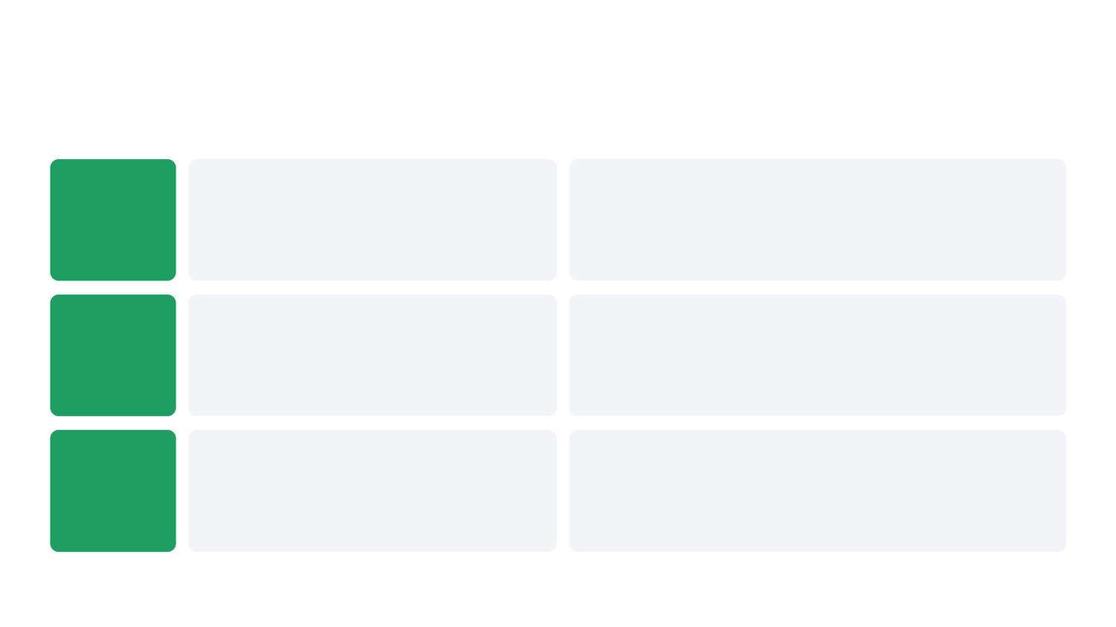
@hackersmang #HMSep26
3 REAL BUGS
What the AI got right
TC-002
Broken token → server crash
Expected 401, got 500 with Python's internal error text.
Bad input should get a polite 4xx. A 500 leaks details and triggers false alarms in monitoring.
TC-004
Fake token → admin access
Expected 401, got 200.
The token is just base64 of "user_id:role". Anyone can write "9:admin" and encode it. Not signed.
TC-005
Bob reads Alice's order
Expected 403, got 200.
IDOR: the API checks you're logged in, not that the order is yours. Change /orders/1 → someone else's data.
13
Notes:
Read expected, then got, for each. TC-002: a bad token crashed the server and leaked Python's error. TC-004: a token I made up gives admin. TC-005: Bob reads Alice's order by changing a number.

Slide 14

@hackersmang #HMSep26
2 FALSE ALARMS
What the AI got confidently wrong
TC-006 · SQL injection
The AI said a correct API should return 500 for an injection attempt.
Wrong: a crash is never the correct answer. The API returned 200 with normal results. The test went red for the wrong reason.
TC-009 · EARLYBIRD coupon
The AI tested EARLYBIRD as a "use once" coupon and expected a rejection.
Wrong: the docs say EARLYBIRD is unlimited. The single-use coupon is SPEAKER100. It mixed them up.
5 red lines → 3 real bugs. Every red line needs a human to check it.
14
Notes:
This is the most credible moment of the talk. Both results look like findings. Both are wrong. That's why the runner says candidate defects, and why the last step is a person.

Slide 15
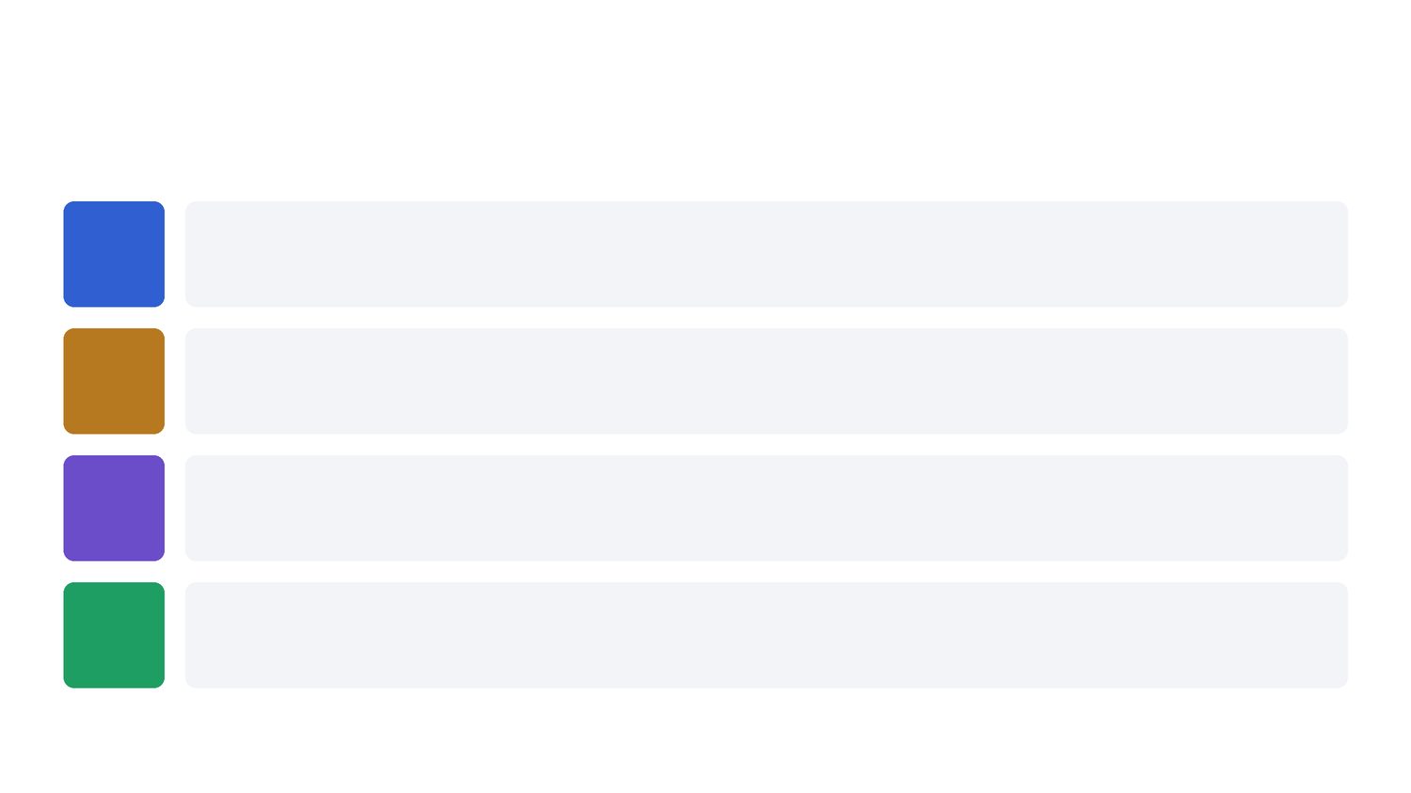
@hackersmang #HMSep26
THEORY · TRIAGE
Four questions for every red line
1
Does the endpoint exist?
If not, the AI hallucinated. In another run it invented /buy_ticket, which returned 404.
2
Is the AI's "correct" really correct?
TC-006 expected a 500. TC-009 misread the coupon rules. Check the docs.
3
Does it happen again after a reset?
If not, it's a test setup problem, not a bug.
4
Does it matter to users or money?
Real but minor goes to the backlog. Real and serious gets fixed first.
15
Notes:
The model can't answer these reliably. Someone who knows the system can answer all four in a minute or two.

Slide 16

@hackersmang #HMSep26
DEMO 3 · THE MONEY LOOP
Two small bugs, one big problem
$ grep -n -E '^\s+(total|credits_earned) = ' app/main.py
139: total = price × quantity × (100 − discount)%
151: credits_earned = price × quantity × 10%
Bug 1 · coupon reuse
SPEAKER100 is documented as single use, but nothing records that it was used. It works every time.
Bug 2 · credits from list price
You earn 10% of the full price, not of what you paid. With a 100% coupon you pay 0 and still earn credits.
16
Notes:
Show the two lines. Line 139 is what you pay after the discount. Line 151 is what you earn: from the full list price. Then remind them SPEAKER100 can be reused. Ask the room: five rounds from 5000, where does the balance end?

Slide 17

@hackersmang #HMSep26
DEMO 3 · TERMINAL
Nothing was invalid. The balance still grew.
$ python demo/money_loop.py
start
5,000
order 1
6,800
order 2
8,600
order 3
10,400
order 4
12,200
order 5
14,000
Paid: 0.00 on every order. Earned: 1,800 every time. +9,000 credits from nothing.
Every request returned 201. Nothing looked wrong. A dashboard would show a happy customer.
The AI didn't find this. I asked it to attack the money rules: it tested "buy 11 tickets", four times.
17
Notes:
Run money_loop.py and stay quiet while it prints. Then: every request returned 201. Nothing was invalid. The model did not find this; I did, because I know credits are money here.

Slide 18

@hackersmang #HMSep26
DEMO 4 · RACE CONDITION
20 buyers, 5 seats, the same second
$ python demo/race.py
orders accepted (201): 20
orders rejected (409): 0
seats remaining after: 3
*** oversold by 15 seats ***
What happens: each request reads "5 seats", waits for payment, then writes "4". They all read before anyone writes.
Why tests miss it: every single request is valid. The bug is in the timing between requests.
Why the AI missed it: its test format is one request, one expected answer. It can't say "twenty at once".
Fix: one atomic database update: only subtract if stock is still enough.
18
Notes:
Run race.py. Then explain: everyone reads 5 seats before anyone writes 4. Every request is valid; the bug is in the timing between them. The AI's test format is one request and one expected answer, so it cannot express this.

Slide 19

@hackersmang #HMSep26
DEMO 4 · THE UNWRITTEN RULE
Is this a bug? You can't tell.
$ curl ... POST /orders {"ticket_id": 2} (as alice@corp.example)
201 Created
{ "ticket": "STUDENT-2026", "total_charged": 500.0 }
The rule: student price needs a verified student email. That rule is in a pricing document, not in the code.
The AI: might guess to try it, but it can't know the 201 is wrong. Neither can a new developer reading the code.
The lesson: write business rules where a reader can find them: API docs, schema, tests.
19
Notes:
Reset first so the numbers are clean. Buy the student ticket as Alice with a corporate email: 201. Then state the policy. The gap between the screen and the policy is the whole argument.

Slide 20

@hackersmang #HMSep26
BEYOND THE PROMPT
What the engineering caught
Execution caught the mistakes
Two confident but wrong results (a 500 called "correct", mixed-up coupons). Running them against the real API exposed both.
A better harness handles timing
The race condition needs "twenty requests at once". Add that to the test format and it becomes testable.
Written rules become testable
The student-pricing rule lived only in a document. Write it into the API docs and the AI can test it too.
The money loop needed business knowledge: a human connected the two bugs.
20
Notes:
Positive framing: each of these is handled by the engineering around the model, not by a better prompt. Say 'this model, this format', never 'AI can't'.

Slide 21

@hackersmang #HMSep26
THE HONEST NUMBERS
Real run: qwen2.5-coder:7b, local, unedited
8
tests run
5
came back red
3
real bugs
2
false alarms
0 findings on the money bugs
1 case rejected as malformed before running
91 seconds to generate on a laptop
60% of red lines were real bugs (3 of 5)
2nd prompt (input checks): 10 more tests. 8 confirmed the API rejects bad input types, 2 arguable, 0 new bugs.
21
Notes:
Five red, three real, two confidently wrong, zero on the expensive bug. Then the second prompt: its tests confirmed the input checks work, which is useful too; it found nothing new. Never cut this slide.

Slide 22

@hackersmang #HMSep26
SO, CAN AI FIND THE BUGS I FORGOT TO TEST?
AI + engineering: fast, useful, trustworthy.
What the AI brought
• 3 real bugs my own tests missed
• Attack ideas in about 90 seconds
• Common attacks: fake tokens, other users' data, crashes
• Checks that confirm the basics work
• A reason for every test
What engineering + people brought
• Structured output so ideas can run
• Automatic rejection of broken output
• Real evidence from the real API
• Judgement on what "correct" means
• Business knowledge: the money loop
22
Notes:
This is the answer to the title. Yes: 3 real bugs my tests missed, in 90 seconds, on a laptop, for free. The engineering around it is what makes those results trustworthy.

Slide 23
@hackersmang #HMSep26
AI generates hypotheses.
Execution provides evidence.
Humans decide what is a defect.
The prompt is the easy part. The engineering around it makes AI useful.
23
Notes:
Say it slowly, word for word. Pause between lines.

Slide 24
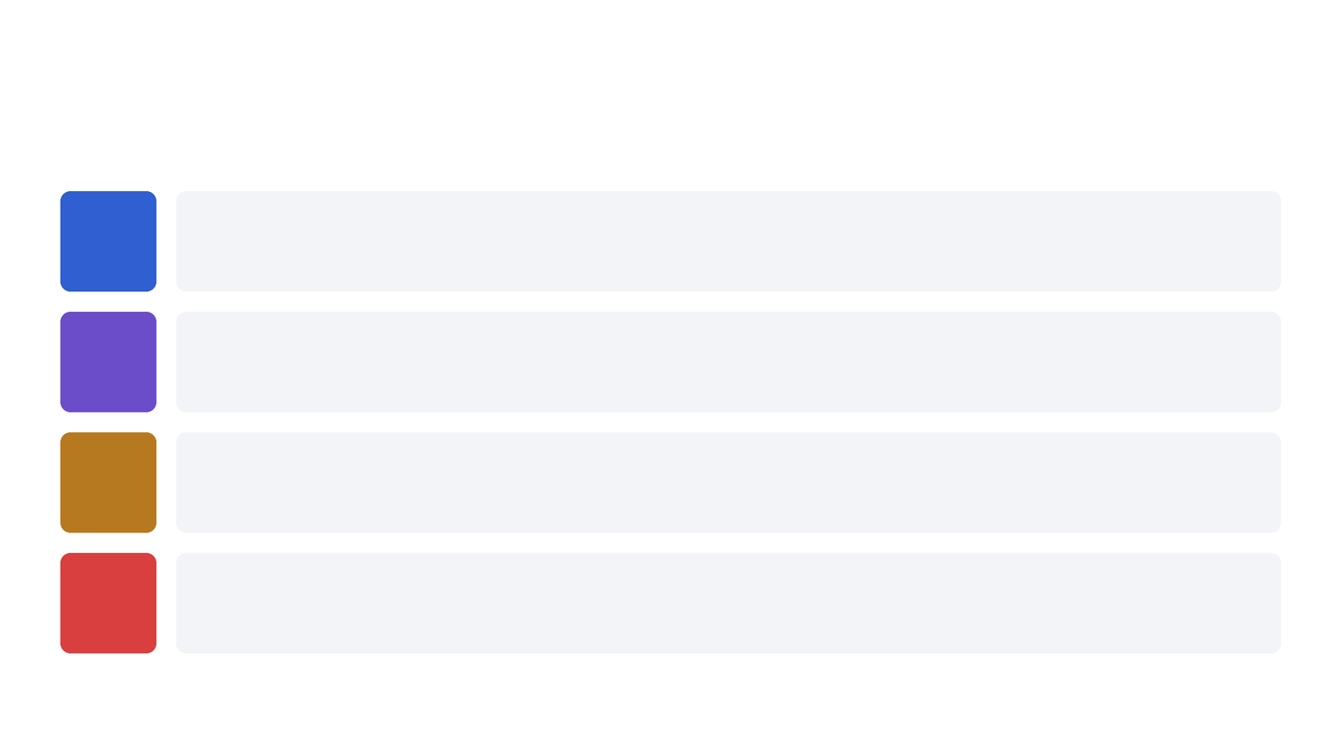
@hackersmang #HMSep26
TRY IT ON MONDAY
Four things you can do at work
1
Pick one important endpoint
Orders, payments, permissions. Run a test environment you can reset.
2
Save the AI's test cases in the repo
Review them like code. Don't regenerate them on every build.
3
Run them in CI as a separate job
Non-blocking until a human has checked the red lines.
4
Write your business rules down
Every rule a reader can find is a rule a tool can test.
24
Notes:
End on point 4.

Slide 25

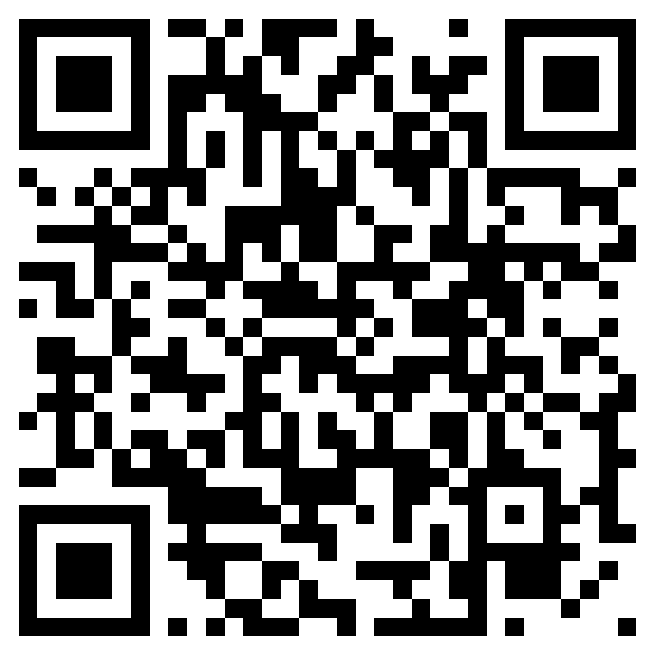
@hackersmang #HMSep26
Thank you. Break it yourself.
Everything runs locally: Python, FastAPI, SQLite, Ollama. No paid APIs.
In the repo: the API, prompts, real AI output, test runner, demos, and a full PDF guide.
Questions?
github.com/vidyarathna/break-my-api
Vidyarathna B · Soult Digital
25
Notes:
Stay on this slide for questions.

Slide 26

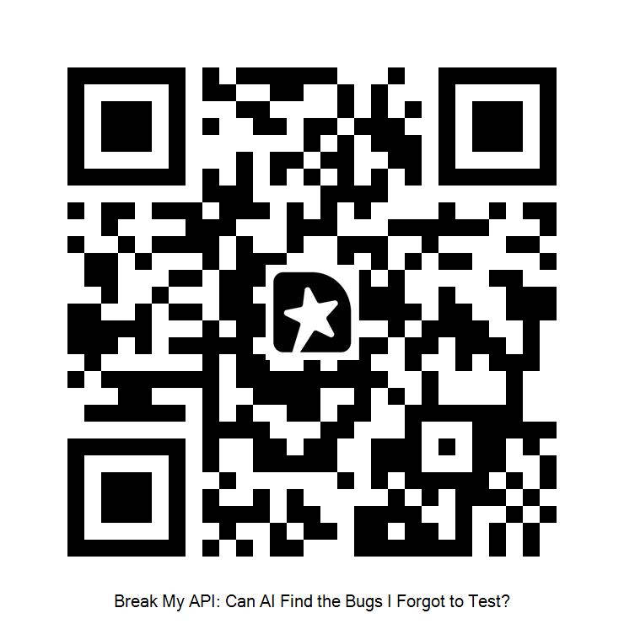
@hackersmang #HMSep26
FEEDBACK
How was this talk?
Scan the QR code to share your feedback.
It takes under a minute.
Tell me: what worked, what didn't, and what you'd like to see next.
Thank you for listening!
26
Notes:
Leave this slide up while people scan. Say: it takes under a minute, and it genuinely helps me improve the next one.

Slide 27
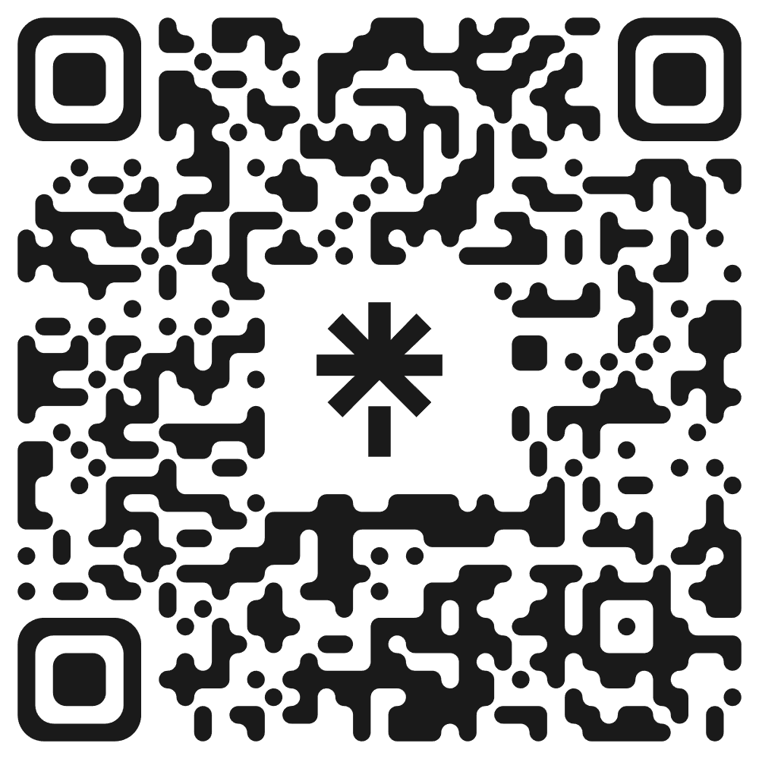
Stay Connected with @hackersmang
#HMSep26
Notes:
HackersMang closing slide from the official template.

