Slide 1
BuildFlow AI
AI-Based Project Planning Assistant
Mini Project
AJAY M (23TD0003)
SHAFI AHMED F (23TD0076)
VIDYASAAGAR M (23TD0091)
Guide: Dr. R. G. Suresh Kumar
Department of Computer Science and Engineering
Rajiv Gandhi College of Engineering and Technology

Slide 2





Problem Statement
2
Students and early-stage developers struggle to bridge the gap between project ideas and structured technical documentation — leading to poorly planned projects and wasted development time.
No structured approach to convert ideas into BRD, SRS, or Roadmaps
AI tools like ChatGPT lack project memory and context continuity
Manual documentation is time-consuming and error-prone
Developers lack stage-by-stage guidance and implementation prompts

Slide 3





Motivation
3
Rise of AI Tools
Academic Need
Productivity Gap
LLMs can guide structured conversations to produce technical artifacts
Students need step-by-step support from idea to deployable project
95% of developers skip formal documentation in early stages
Knowledge Gap
Accessible Platform
Lack of domain-specific planning tools for software projects
Cloud-native AI makes intelligent assistants affordable and scalable

Slide 4
Objectives
4
01
Collect and structure project requirements through guided AI conversation stages
02
Maintain persistent blueprint memory across all planning stages
03
Generate professional documents: BRD, SRS, Roadmap, and To-Do List
04
Produce stage-specific implementation prompts for development guidance
05
Provide export capabilities in Markdown and PDF formats

Slide 5
Existing Systems & Limitations
5
ChatGPT / Gemini
Trello / Notion
Manual Planning
No project memory
No AI assistance
Time-consuming
No document export
Manual data entry
Error-prone process
Generic responses
No code prompt gen
No structure enforced
No stage guidance
Complex onboarding
No AI integration

Slide 6
Proposed Solution
BuildFlow AI
A web-based, AI-powered project planning assistant that guides users through structured planning stages to produce professional documentation, implementation prompts, and exportable artifacts — all within a single unified platform.
🤖
Stage-Based AI Chat
Blueprint Memory
Document Generation
BuildFlow AI
Intelligent Planning
Prompt Engine
PDF / MD Export

Slide 7








Key Features
7
User Authentication
Project Management
Stage-Based AI Chat
Blueprint Memory
Secure Firebase login & signup
Create, manage, organize projects
5-stage guided chatbot planning
Persistent context across stages
Document Generation
Prompt Generation
Markdown & PDF Export
Light / Dark Themes
BRD, SRS, Roadmap, To-Do List
Dev prompts for all tech layers
Download ready artifacts
Modern responsive UI

Slide 8
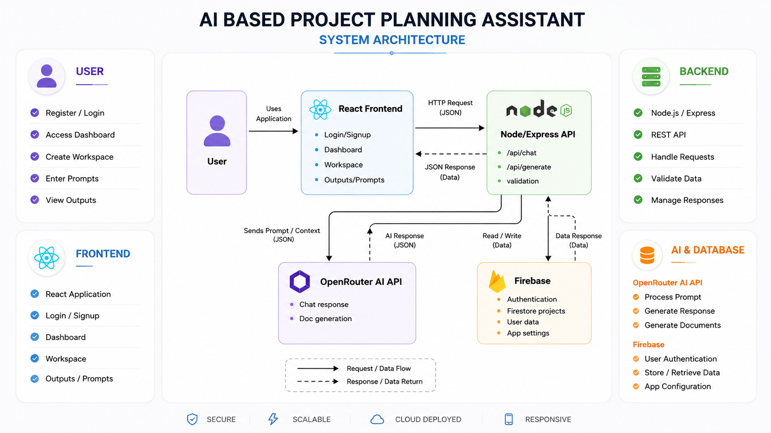
System Architecture
8

Slide 9









Technology Stack
9
Frontend
Backend
Auth & DB
React.js • Vite • Tailwind CSS
Node.js • Express.js
Firebase Auth • Firestore
AI Engine
Deployment
OpenRouter API
Vercel • Render

Slide 10







Module Description
10
Authentication
Dashboard
Workspace
AI Chat
Login/signup via Firebase
Project overview & management
AI chat staging environment
Stage-based guided prompting
Blueprint
Outputs
Prompts
Settings
Context memory persistence
BRD, SRS, Roadmap, To-Do
Dev prompts by tech layer
Theme & preferences

Slide 11
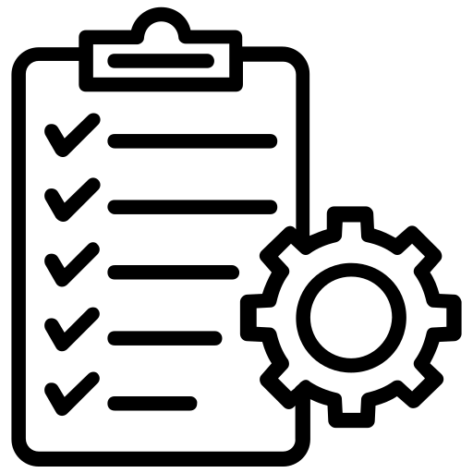


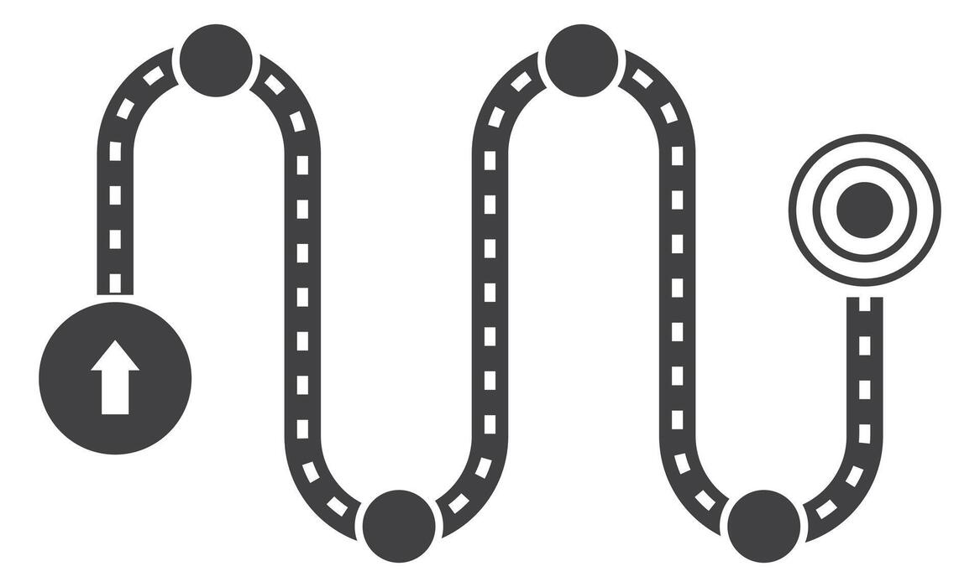

AI Planning Stages
11
Stage
Stage
Stage
Stage
Stage
1
2
3
4
5
Project Overview
Requirements
Architecture
Roadmap & Tasks
Validation
Define project title, domain, goals, and target users
Gather functional and non-functional requirements
Select tech stack, system architecture, and data flow
Create milestones, sprints, and task breakdown
Review, finalize blueprint, and generate all outputs

Slide 12
Blueprint & Memory
12
Blueprint Memory
Stage 1 Input
Stage 2 Input
The Blueprint is a persistent JSON object maintained across all 5 AI planning stages. It captures:
• Project title, domain & goals
• Functional & non-functional requirements
• Tech stack decisions
• Roadmap and task list
• Final validation summary
Every AI prompt in subsequent stages includes the full blueprint context — ensuring continuity and coherent document generation.
Stage 3 Input
Stage 4 Input
Unified
Blueprint
Context
Stage 5 Input
Blueprint JSON

Slide 13




Document Generation
13
BRD
SRS
Roadmap
To-Do List
Business Requirements Document
Software Requirements Specification
Project Roadmap
Development Task List
Executive Summary
Functional Requirements
Phase Breakdown
Priority Tasks
Business Goals
Non-Functional Req.
Milestones
Sprint Planning
Stakeholder Needs
Use Cases
Timeline Estimates
Module Assignments
Scope & Constraints
Assumptions
Deliverables
Acceptance Criteria

Slide 14




Prompt Generation
14
Frontend
React component structures, UI flows, routing logic, state management patterns
Backend
Express API routes, middleware, controller logic, authentication handlers
Database
Firestore schema design, collection structures, security rules
Testing
Unit test cases, integration tests, test data and validation criteria
Deployment
CI/CD pipeline, Vercel/Render config, environment variable setup

Slide 15
Comparison with Existing Tools
15
Feature | ChatGPT / Gemini | Trello / Notion | BuildFlow AI
Stage-based Planning | ✗ | ✗ | ✓
Project Memory | ✗ | Partial | ✓
Document Generation | ✗ | ✗ | ✓
Implementation Prompts | ✗ | ✗ | ✓
PDF / MD Export | Partial | ✓ | ✓
AI Integration | ✓ | ✗ | ✓
Single Platform | ✗ | ✗ | ✓

Slide 16
Testing & Validation
16
18/18
Unit Testing
PASSED
Component & function level tests
12/12
Integration Testing
PASSED
API and Firebase integration
10/10
AI Response Testing
PASSED
Stage prompt accuracy and memory
8/8
UI/UX Testing
PASSED
Responsiveness and theme switching
6/6
Export Testing
PASSED
PDF and Markdown output validation
Total: 54 test cases executed • 54 PASSED • 0 FAILED • 100% Pass Rate

Slide 17
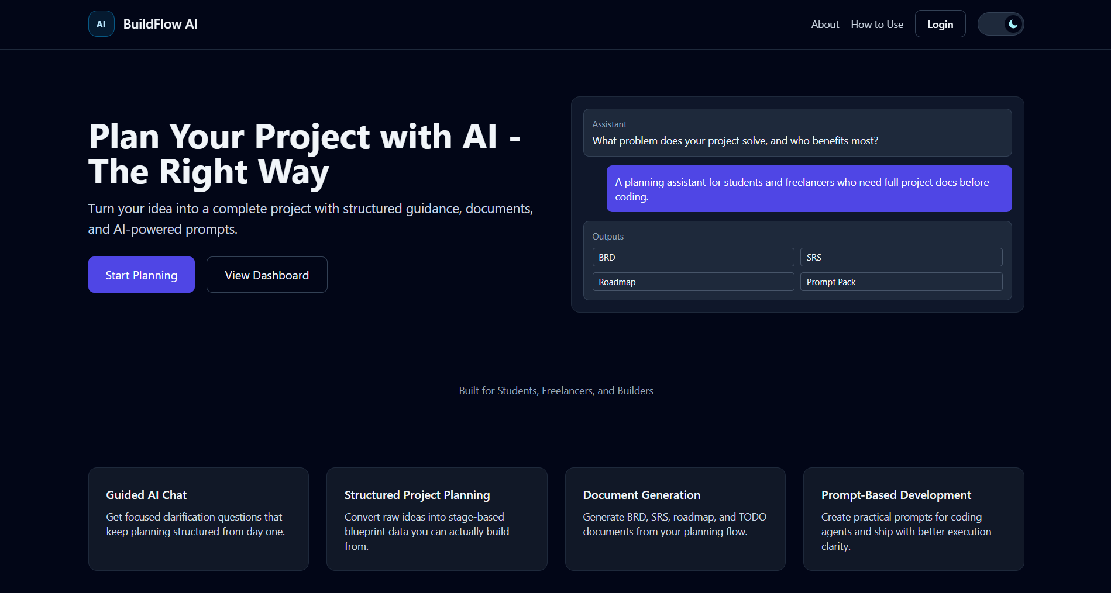
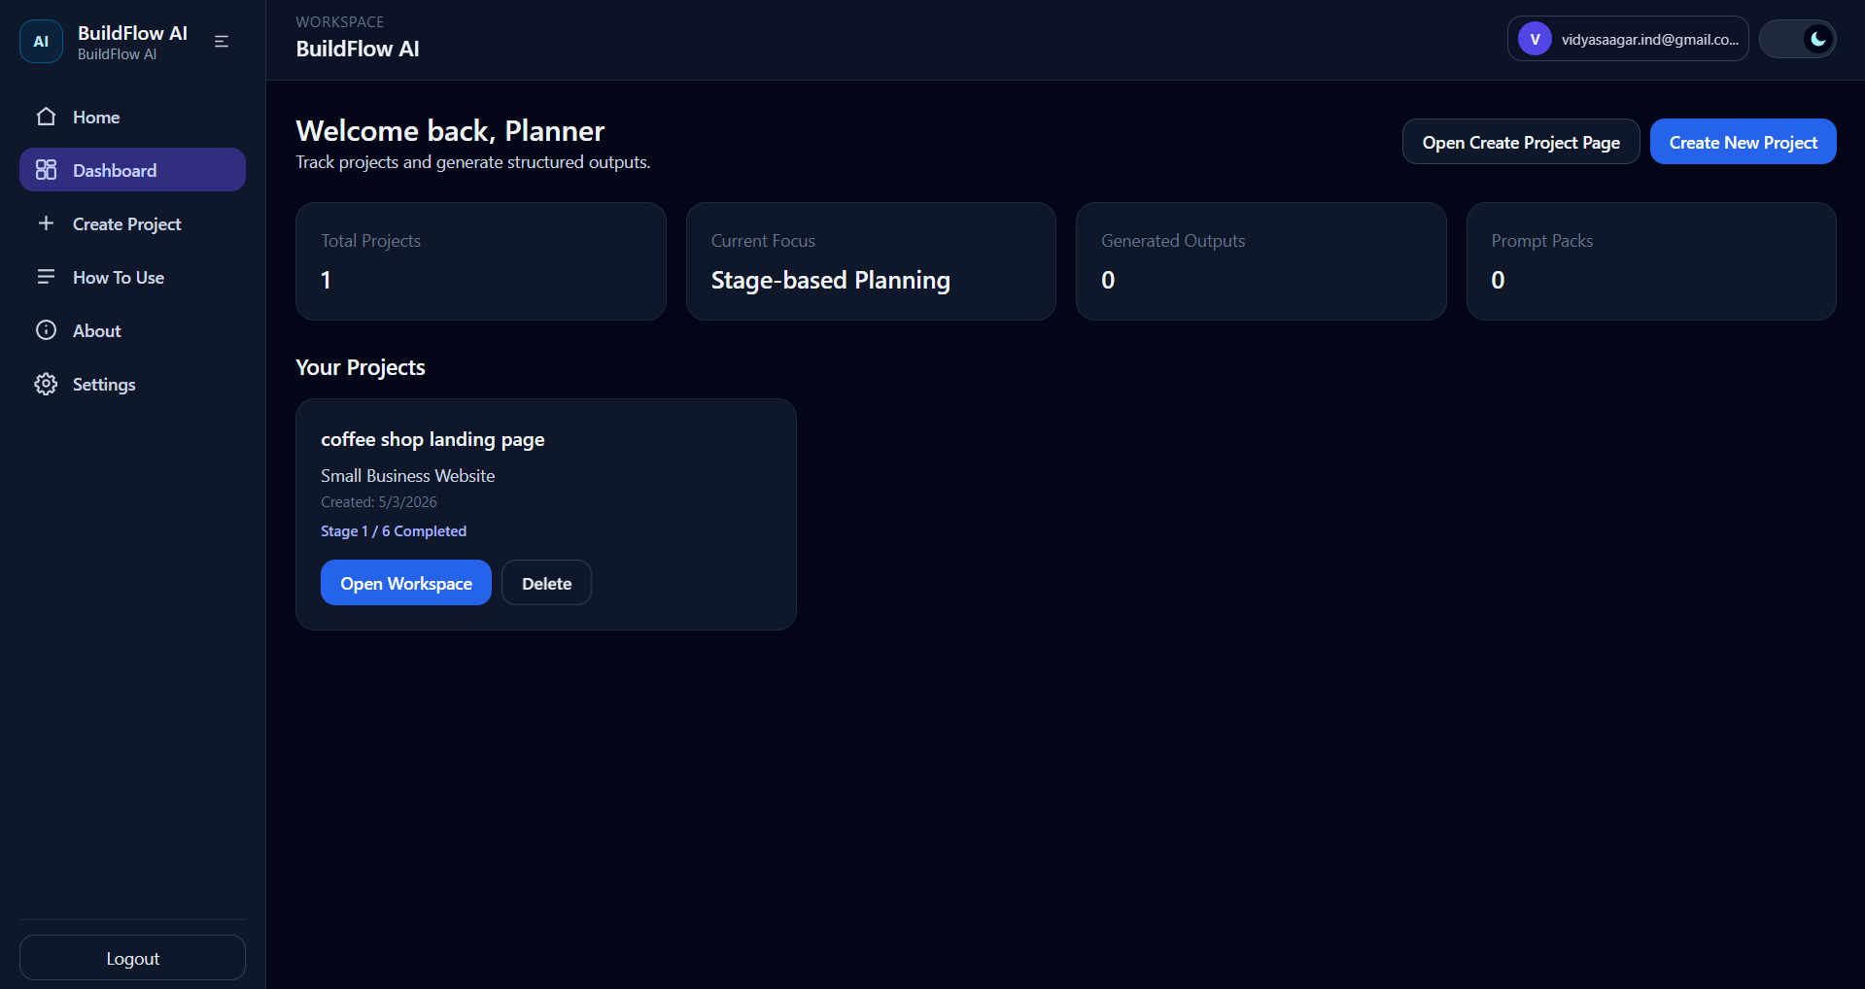
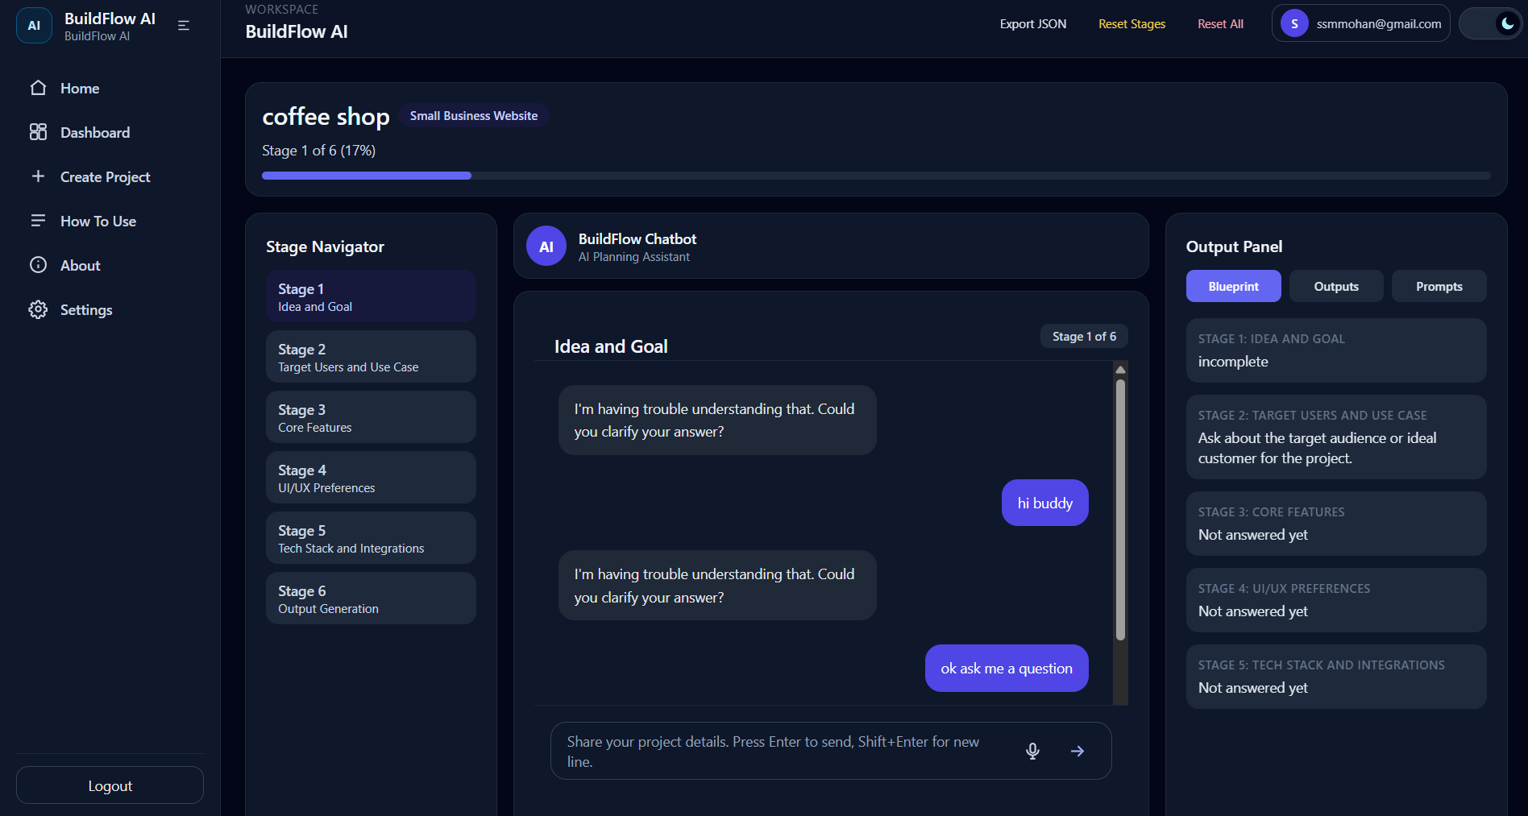
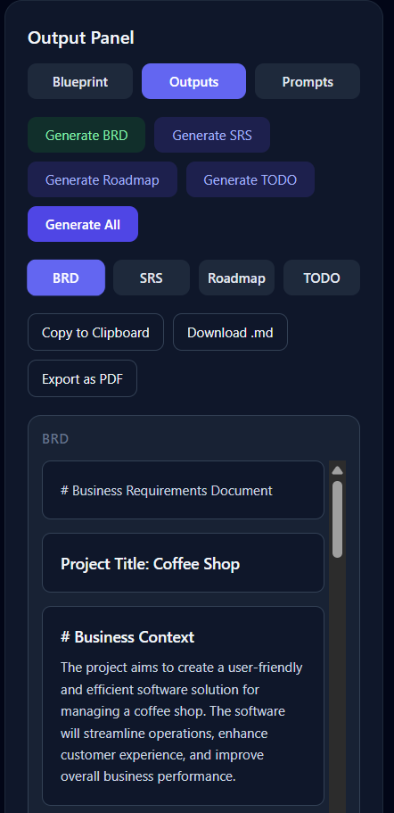
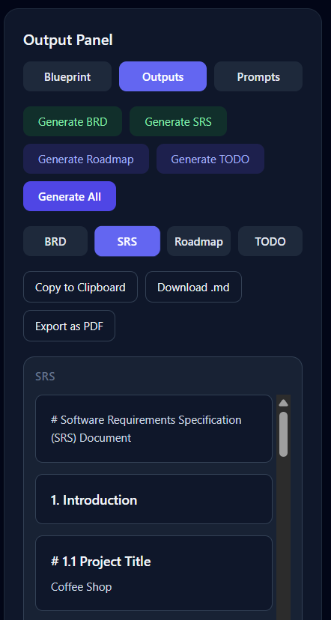
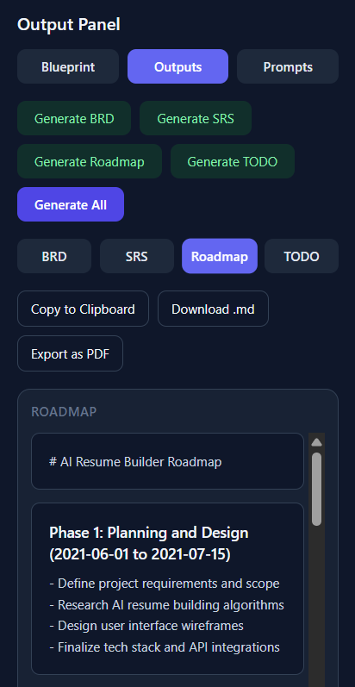
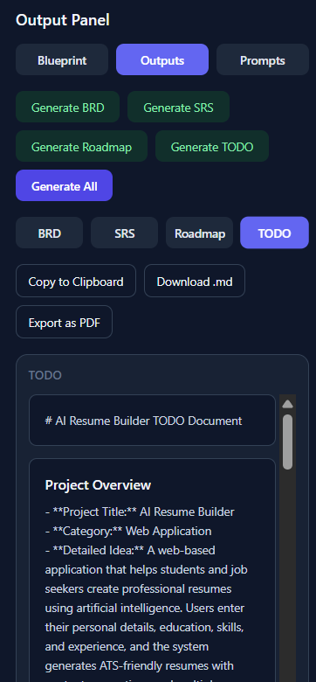
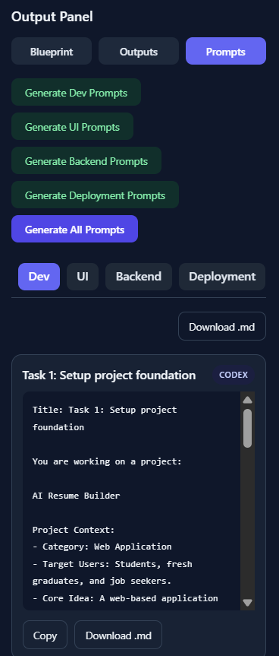
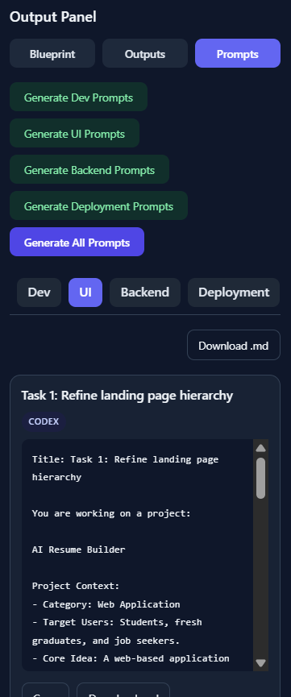
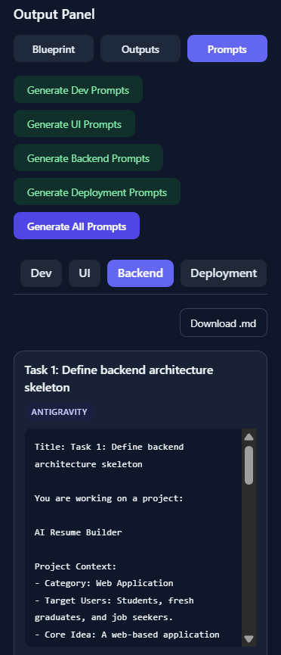
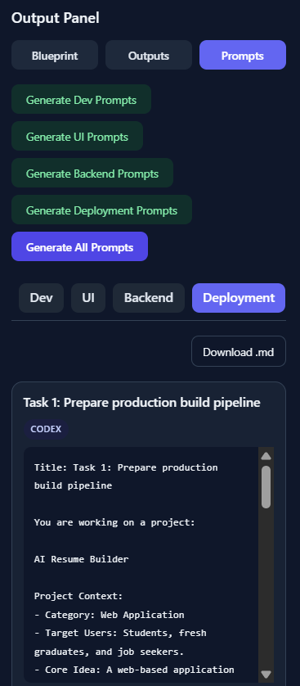
Application Screenshots
17
Landing Page
Dashboard
Workspace / AI Chat
BRD, SRS, ROADMAP, TO-DO Document (Output Panel)
Prompt Panel

Slide 18


Results & Benefits
18
70%
5×
100%
Time Saved
Faster Docs
Pass Rate
vs manual documentation
compared to scratch writing
across all test cases
Accelerates project documentation from hours to minutes
Maintains full context continuity across all planning stages
Ensures structured, professional-grade documentation output
Bridges the gap between planning and implementation with targeted prompts

Slide 19





Future Enhancements
19
Team Collaboration
UML Diagram Generation
DOCX / PPT Export
Multi-user project workspaces with role-based access and real-time co-editing
Automatic generation of class diagrams, ER diagrams, and sequence diagrams
Export generated documents directly as Microsoft Word or PowerPoint files
Voice Input
Version History
Advanced Analytics
Voice-to-text integration for hands-free project planning input
Track blueprint changes and revert to previous planning versions
Project health metrics, completion predictions, and AI usage insights

Slide 20
Conclusion
BuildFlow AI successfully transforms raw project ideas into complete, development-ready planning artifacts through a structured, memory-aware AI conversation interface.
Addresses the real gap between ideation and documentation in software development
Delivers BRD, SRS, Roadmap, To-Do List, and implementation prompts on a single platform
Blueprint memory ensures consistent, context-aware AI responses across all 5 stages
Built with modern, production-grade technologies for scalability and reliability
Validated with 54/54 test cases and ready for real-world academic project use

Slide 21
Thank You!
Questions & Discussion
AJAY M (23TD0003)
SHAFI AHMED F (23TD0076)
VIDYASAAGAR M (23TD0091)
Guide: Dr. R. G. Suresh Kumar | Dept. of CSE | RGCET

