Slide 1
Redux
A Redux is a predictable state container for JavaScript apps.

Slide 2
Three Principles
The state of your whole application is stored in an object tree within a single store.
This makes it easy to create universal apps, as the state from your server can be serialized and hydrated into the client with no extra coding effort. A single state tree also makes it easier to debug or introspect an application; it also enables you to persist your app's state in development, for a faster development cycle.

Slide 3
State is read-only
The only way to change the state is to emit an action, an object describing what happened.

Slide 4
Changes are made with pure functions
To specify how the state tree is transformed by actions, you write pure reducers.
Reducers are just pure functions that take the previous state and an action, and return the next state. Remember to return new state objects, instead of mutating the previous state. You can start with a single reducer, and as your app grows, split it off into smaller reducers that manage specific parts of the state tree. Because reducers are just functions, you can control the order in which they are called, pass additional data, or even make reusable reducers for common tasks such as pagination.

Slide 5
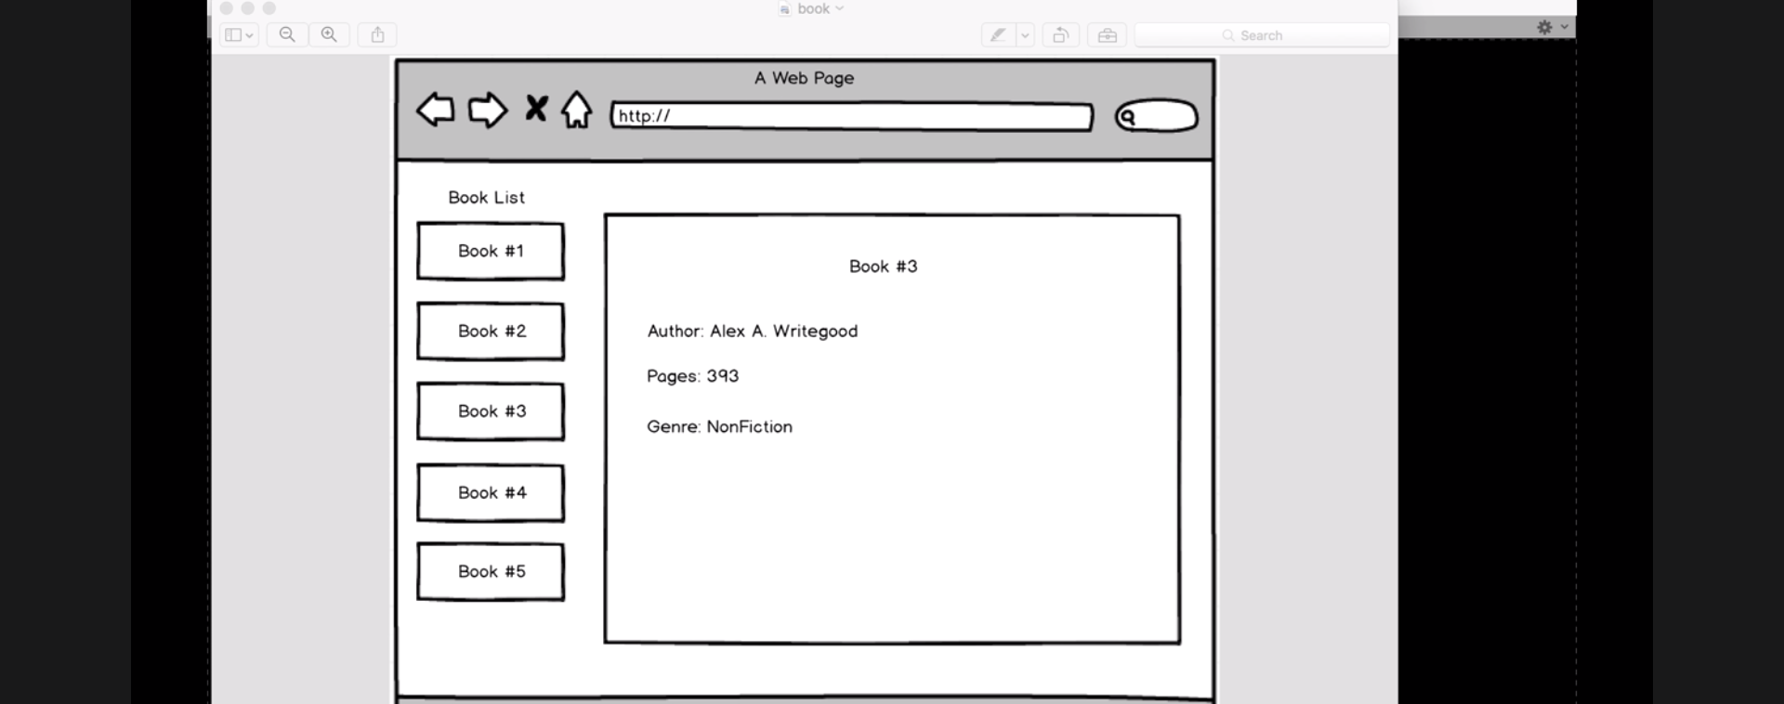

Slide 6
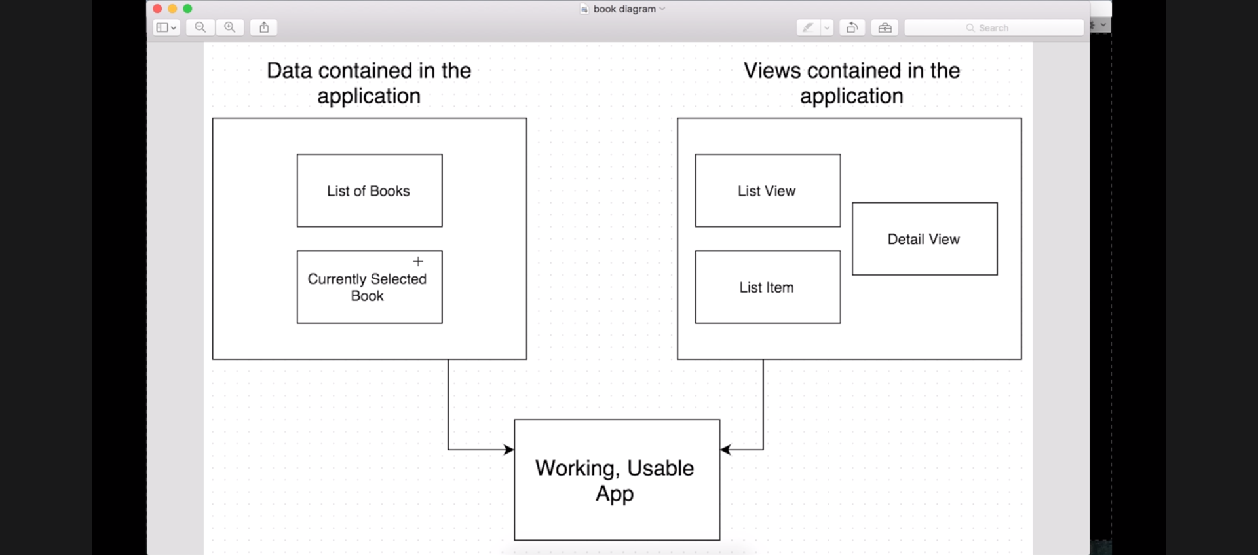

Slide 7
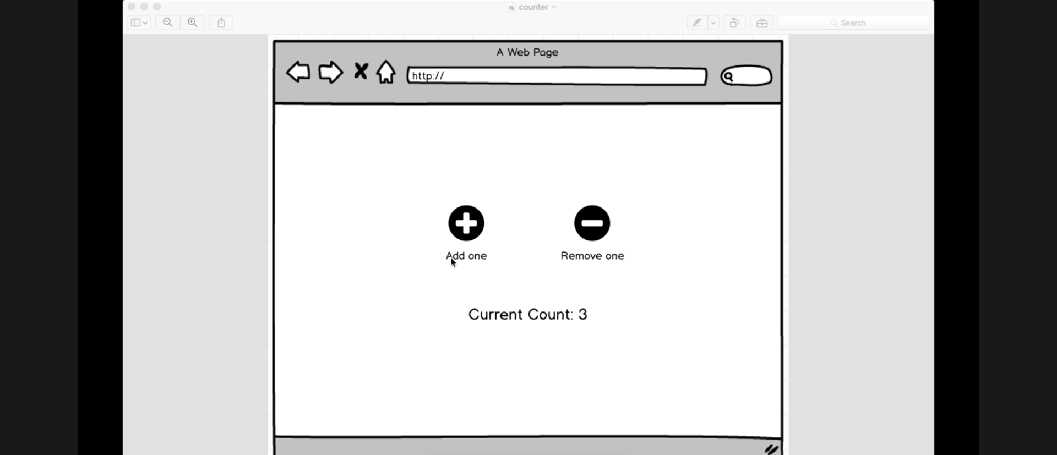

Slide 8
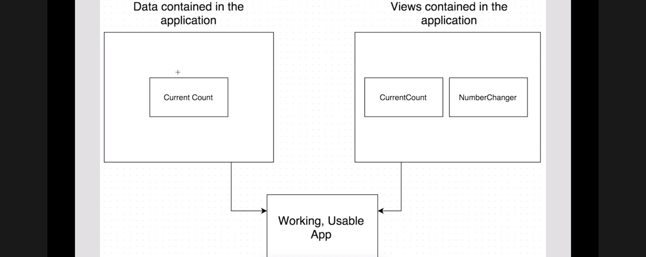

Slide 9
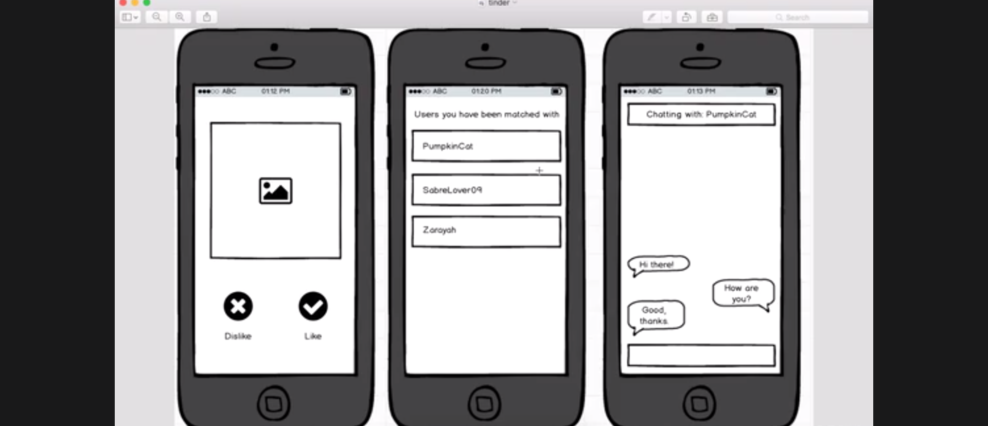

Slide 10
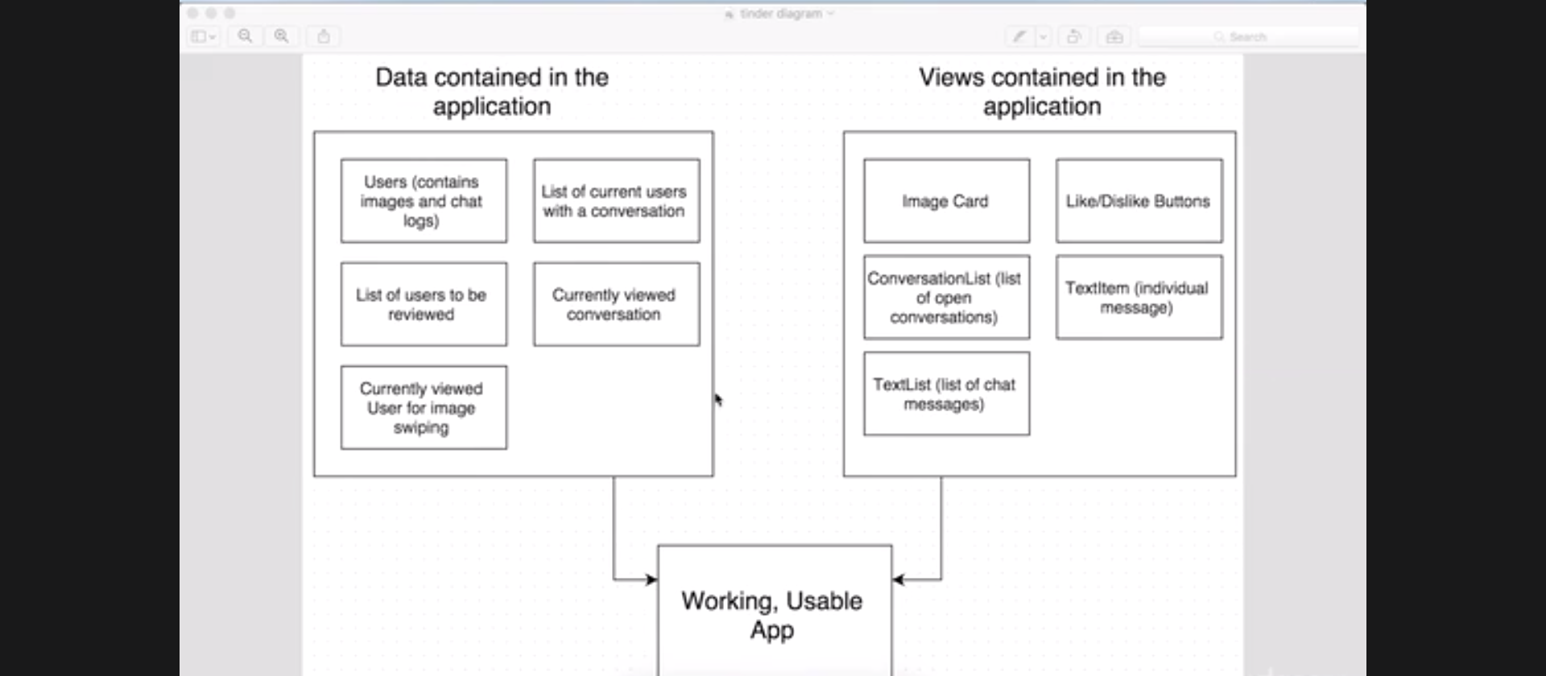

Slide 11
What was wrong with the original MVC frameworks?
Originally, there were many MVC frameworks out there of different sizes and shapes, but generally can be either categorized as MVCs or an extension of MVC. Flux/Redux attempts to resolve the problem where bugs are difficult to trace when a model has been continuously updated as an app is being used.

Slide 12
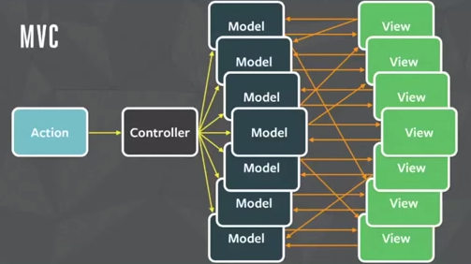

Slide 13
The problem with this is when there are many views and models and one of the model’s state changed into something we didn’t expect, we are unable to efficiently trace which view or which model caused the problem, since there are way too many possibilities.

Slide 14
How does Redux Work?
Redux can be broken down into the following:
– store: manages the states. Mainly there is a dispatch method to dispatch an action. In a Redux app, you can obtain its states via store.getState()
– action: a simple, plain JavaScript object. An action can also be considered as a command to change a state.
– reducer: decides how to change a state after receiving an action, and thus can be considered the entrance of a state change. A reducer is comprised of functions, and it changes states by taking an action as an argument, in which it then returns a new state.
– middleware: the middleman between a store.dispatch() and a reducer. Its purpose is to intercept an action that has been dispatched, and modify or even cancel the action before it reaches the reducer.

Slide 15
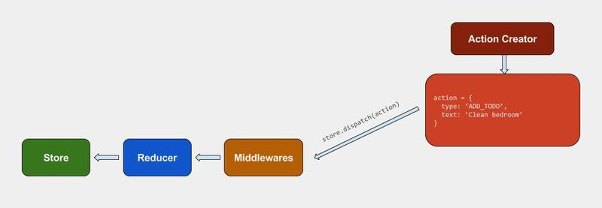

Slide 16
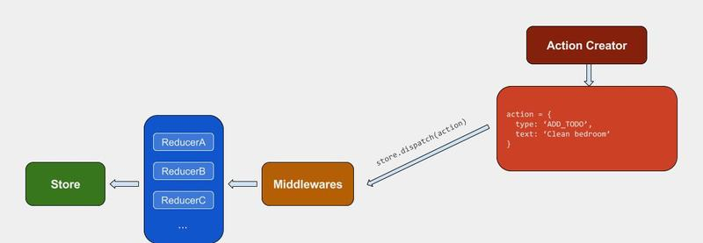
In a more complex app, we will need to split up a store’s state into different pieces like we’d do when namespacing. You can do this in Redux by creating different reducers to manage different areas of a state, and then merge them together through combineReducers.

Slide 17
Async & Middleware
We’ve already introduced state updating, but a front-end app is never that simple
Here we’ll go over how to handle asynchronous behavior in a Redux app. In this section, we’ll examine the process of sending an HTTP request to understand how async works in Redux.

Slide 18
The Sample Situation
Let’s say we have an app that a list called questions. At some point (e.g. a user clicks a button), we will need to send a request to our server to obtain the data in questions. While sending this request, we need to reflect the sending state in our store, and if the request has been made successfully, we will need to put the data of questions in our store. If the HTTP request failed, we will need to reflect the failure info in our store.

Slide 19
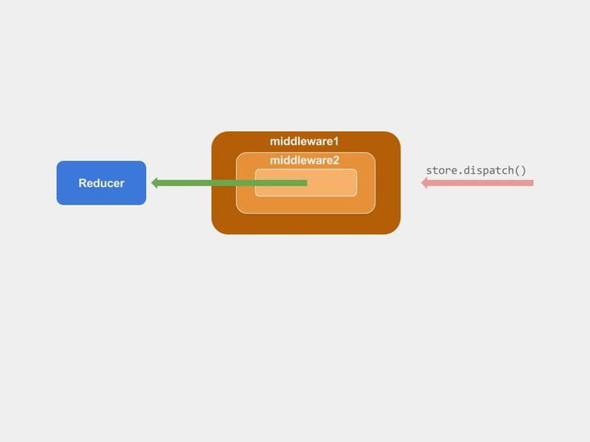
What is a Middleware?
in Redux a middleware is like the negotiator between store.dispatch and reducer. To be more specific, the store.dispatch() we call is actually comprised of layers of middleware, and the reducer is in the innermost layer.

Slide 20
Through a middleware, we can extract the above-mentioned asynchronous API request and place them in the same middleware. In other words, when sending an API request, we will need to dispatch an action of a specific type, and then let our middleware intercept such types of actions to send the respective API request.
The middleware will intercept any action with the CALL_API key, and then send an API request based on the method, path, query, successType, etc stored inside the action.
This way, when we really need to send a request, we won’t have to deal with asynchronous logic and we’ll only need to dispatch an action that has CALL_API.

Slide 21
he middleware will intercept any action with the CALL_API key, and then send an API request based on the method, path, query, successType, etc stored inside the action.
This way, when we really need to send a request, we won’t have to deal with asynchronous logic and we’ll only need to dispatch an action that has CALL_API.

