Slide 1


Full Stack Development Tools Overview
Postman | Eclipse | Java | HTML
| CSS | GitHub | MySQL
Presented by:
Institute: CEC
VIDYASHREE V
V S SPOORTHY
Date: 8/10/2025

Slide 2







Our Journey Through Full Stack Tools
This presentation outlines the essential tools and technologies required for modern full-stack development, covering front-end, back-end, database, and collaboration.
Introduction S Overview
Postman
API Testing & Development
Eclipse IDE
The Developer Environment
Java
Robust Backend Logic
HTML S CSS
Front-end Presentation
GitHub
Version Control & Collaboration
MySQL
Data Persistence
Project S Summary

Slide 3

Introduction to Full Stack Development
The Foundation of Modern Applications
Full-stack development involves working with both the front-end (user interface) and the back-end (server-side logic and database). It demands proficiency across the entire application stack.
Front-end
The client-side code that users interact with directly (HTML, CSS).
Back-end
The server-side application logic, databases, and APIs (Java, MySQL).
Tooling
The development environment and utilities (Eclipse, Postman, GitHub).
Our core toolkit ensures we can efficiently develop, test, deploy, and maintain a complete, scalable application.

Slide 4


Postman
Mastering API Testing and Development
Postman is a powerful collaboration platform for API development. It allows us to design, test, document, and monitor APIs easily, which is crucial for integrating our Java back-end with the front-end.
API Execution
Send HTTP requests (GET, POST, PUT, DELETE) and
inspect responses in detail.
Test Automation
Write automated tests to ensure API reliability and performance before deployment.
Documentation
Generate and publish comprehensive API documentation automatically from collections.

Slide 5
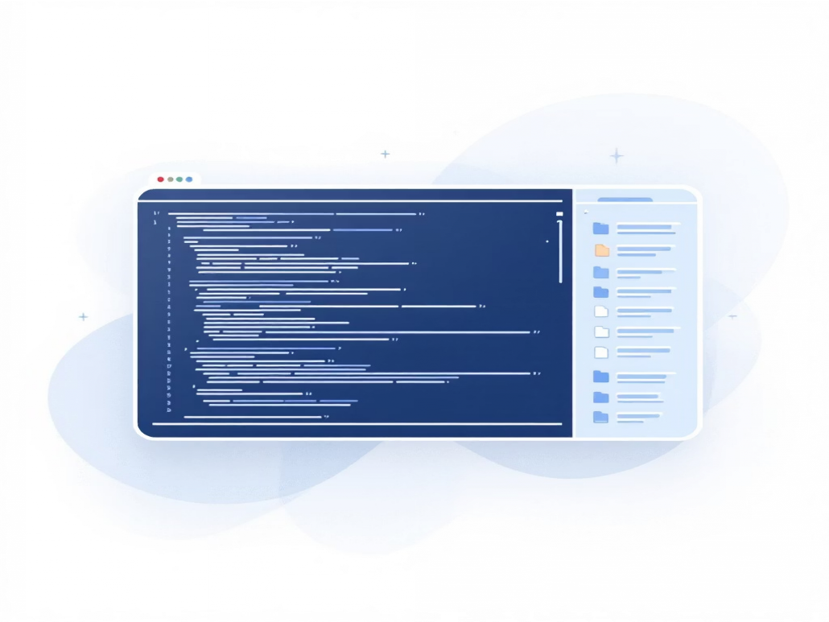
Eclipse IDE
Your Integrated Development Powerhouse
Eclipse is the primary Integrated Development Environment (IDE) used for building our Java applications. It provides a robust, feature-rich environment essential for large-scale enterprise development.
Code Editor
Intelligent code completion, syntax highlighting, and refactoring tools.
Debugging
Advanced debugging capabilities to step through code and inspect variables.
Project Management
Integrated tools for managing large
projects, dependencies, and build processes
(e.g., Maven/Gradle).
Extensibility
A vast ecosystem of plugins supports various languages and frameworks beyond core Java.

Slide 6



Java
The Backbone of Robust Backend Applications
Java is a leading language for building scalable and high-performance server-side applications. Its platform independence and strong ecosystem make it ideal for enterprise projects.
Performance
Known for fast execution speed due to compiled bytecode running on the Java Virtual Machine (JVM).
Object-Oriented
Facilitates modular, reusable, and maintainable code structure.
Security
Features like memory management and built-in security APIs reduce vulnerabilities.
We leverage Java with frameworks like Spring Boot to accelerate development of RESTful APIs.

Slide 7

HTML S CSS
Crafting Engaging User Interfaces
HTML (HyperText Markup Language) provides the structure of web content, while CSS (Cascading Style Sheets) controls the visual presentation and layout.
HTML: The Structure
Defines the elements–text, images, forms–that appear on the page.
CSS: The Style
Handles aesthetics, including colors, fonts, spacing, and responsive design for different screen sizes.
User Experience
A clean, well-styled interface built with robust HTML/CSS ensures optimal user experience and accessibility.

Slide 8




GitHub
Collaborative Code Management and Version Control
GitHub, built on Git, is essential for team collaboration. It manages changes to our source code, tracks revisions, and facilitates seamless integration between developer contributions.
Version Control
Allows tracking every change, enabling developers to revert to previous versions or fix errors efficiently.
Collaboration
Features like pull requests, code reviews, and issue tracking streamline teamwork and quality assurance.
Centralized Repository
Provides a secure, cloud-hosted location for all project code, accessible from anywhere.

Slide 9

MySQL
Relational Database Management for Data Persistence
MySQL is the world's most popular open-source relational database. We rely on it to store, manage, and retrieve all application data reliably and efficiently.
Structured Data Storage
Scalability S Speed
Optimized for high-volume transactions and fast data retrieval using SQL queries.
Uses tables, rows, and columns to ensure data integrity and define relationships between different datasets.
ACID Compliance
Ensures transactions are Atomic, Consistent, Isolated, and Durable, guaranteeing reliability.

Slide 10











Project Showcase S Key Takeaways
Bringing It All Together
The integration of these tools allows us to execute a complete development lifecycle, from front-end design to secure back-end data management.
Eclipse/Java
Backend Logic
MySQL
Data Layer
Full Stack Harmony
Seamless Integration
6
HTML/CSS
User Interface
GitHub
Collaboration
Postman
API Testing
QSA and Next Steps
Thank you for your attention. I am now open to any questions regarding the tools or the project implementation.

