Slide 1
ClaimContact Widgets
13 October 2020
Notes:
Guidewire training materials contain Guidewire proprietary information that is subject to confidentiality and non-disclosure agreements. You agree to use the information in this manual solely for the purpose of training to implement Guidewire software solutions. You also agree not to disclose the information in this manual to third parties or copy this manual without prior written consent from Guidewire. Guidewire training may be given only by Guidewire employees or certified Guidewire partners under the appropriate agreement with Guidewire.

Slide 2
Lesson objectives
By the end of this lesson, you should be able to:
Describe the behavior of ClaimContact widgets
Configure ClaimContact widgets
This lesson uses the notes section for additional explanation and information. To view the notes in PowerPoint, choose View→Normal or View→Notes Page. If you choose to print the notes for the lesson, be sure to select “Print hidden slides.”

Slide 3
Lesson outline
ClaimContact widget basics
Configuring ClaimContact widgets

Slide 4
Review: The ClaimCenter data model
Recall the Guidewire platform includes functionality on which ClaimCenter is built
ClaimCenter base application contains certain user interface controls that facilitate business process in ClaimCenter alone
ClaimCenter
Data Model
User Inter.
Bus. Rules
Int. APIs
Guidewire Platform, with a common technology for configuring...
Data Model
User Interface
Business Rules
Integration APIs
Notes:
Review: The Guidewire platform includes four main areas of technology. There is one area for configuring:
The data model, which defines the structure of the data.
The user interface, which defines the forms and fields the end user interacts with. This lesson covers ClaimContact widgets, which are used to control Contact editing, creation and selection. Previously, this course covered Wizards (such as the New Claim Wizard and the Payment Wizard), which are also unique user interface elements to ClaimCenter. Detail Views, List Views, ListDetail Views, and so on are platform user interface elements.
The business rules, which define and enforce business logic.
The integration APIs, which connect a given application to external applications, such as a reporting system or check printing system.
Every application uses this common technology to define its own data model, user interface, business rules, and integration APIs. Each application is distinct, but every application shares common abilities and configuration techniques with all the other applications.

Slide 5
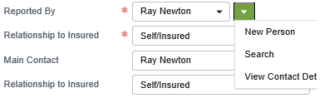

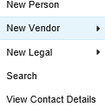

ClaimContact widgets
ClaimContactInput
ClaimContactCell
Contact "Picker Menu"
Contacts on Claim
Widget used to either select existing contact on claim or to add contact to claim
ClaimContact widget dropdowns list all contacts of given subtype (or its child subtypes) already associated to claim
Contact "Picker Menu"
Contacts on Claim
Notes:
The ClaimContactInput and ClaimContactCell widgets are special widgets designed to let end users select existing contacts or create new contacts which are associated to a given claim or its subobjects. Because they have been designed for a specific purpose, they have more "built-in" functionality than a simple TypeKeyInput or RangeInput widget. They are only available in ClaimCenter.
A "picker menu" contains the small circular arrow icon beside the picklist. It allows creating a new contact, searching for an existing contact, or viewing details about the referenced contact, and is specified by the ClaimContact widget’s newContactMenu attribute.
In a ClaimContact widget's picker menu, the Search and View Contact Details menu items come "automatically" with the widget, though you can hide the Search option through the showSearchInMenu attribute. The remaining menu items (the "New..." menu items) appear based on how the widget is configured.

Slide 6
Lesson outline
ClaimContact widget basics
Configuring ClaimContact widgets

Slide 7
Configuring a ClaimContact widget
Create the widget
Configure the widget's attributes
Widget value
Dropdown contents
Picker menu
Contact subtype

Slide 8
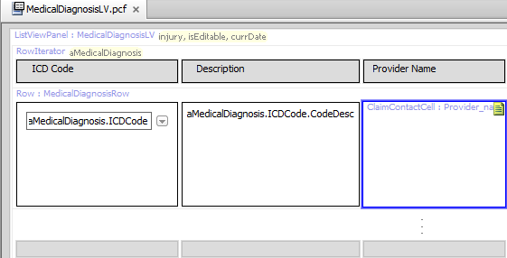
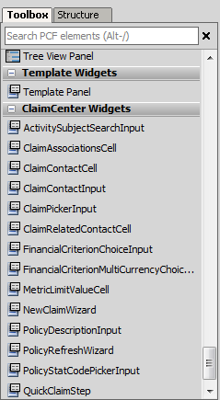
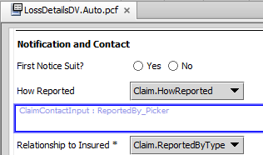
Step 1: Create the widget
Notes:
The ClaimContact widgets have their own category at the bottom of the list of PCF elements. The examples above show two uses of ClaimContact widgets in the base application.
Note the listing of all ClaimCenter Widgets in the screenshot at right, including the NewClaimWizard.

Slide 9
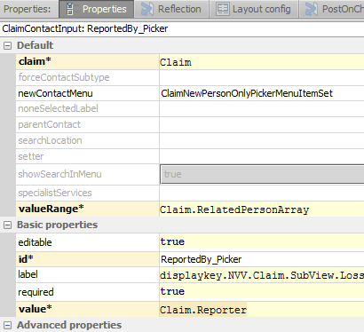
Step 2: Configure the widget’s attributes
Four attributes to configure
value
valueRange
newContactMenu
forceContactType
If forceContactType is left blank, ContactInput type is determined by type of value attribute
Notes:
There are four attributes involved in standard configuration of a ClaimContact widget: value, valueRange, newContactMenu, and forceContactSubtype.
The forceContactSubtype attribute forces the type of this ContactInput to be the specified expression.
Typically this field is left blank. This lets the type of this ContactInput be determined by the type of the value attribute, which is potentially limited to a Contact subtype in the entityroleconstraints-config.xml file with a ContactRoleTypeConstraint.

Slide 10
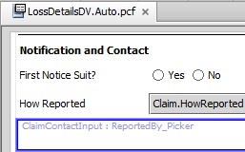
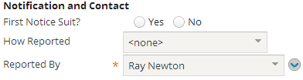

Step 2A: Configure the value attribute
contact on claim with role "reporter"
Notes:
Recall that "Related to" entities have properties for each role an entity can own. The value attribute of a ClaimContact widget is set to one of these properties. When you do this, any contact selected by the widget through the dropdown or picker menu is associated to the claim and given that role. (In the example above, the ReportedBy_Picker widget is a ClaimContactInput widget whose value attribute is set to Claim.reporter and whose value is Ray Newton. Therefore, the Ray Newton contact is added to the claim and is assigned the role of "reporter".)

Slide 11
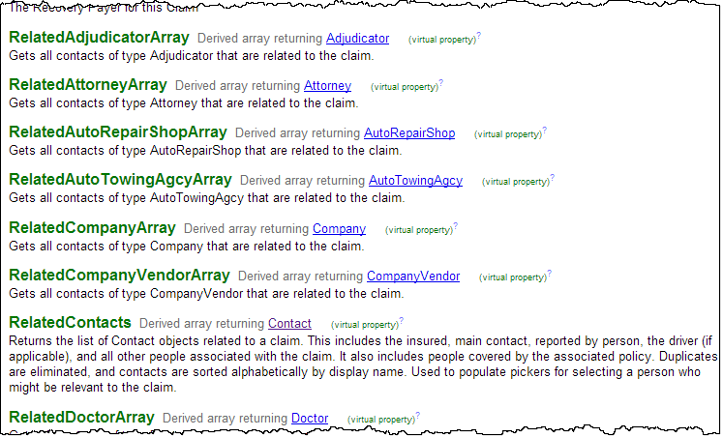
Arrays of related contacts
Claim entity has set of functions, one for each contact subtype, which return all contacts of that subtype on claim (regardless of role)
Named Related<Subtype>Array
Appear in the data dictionary as arrays
Useful when configuring ClaimContact widgets
Notes:
Examples:
aClaim.RelatedContacts returns all related contacts of type Contact (in other words, all contacts) associated to aClaim
aClaim.RelatedLawFirmArray returns all related contacts of type LawFirm associated to aClaim
aClaim.RelatedPersonArray returns all related contacts of type Person associated to aClaim

Slide 12
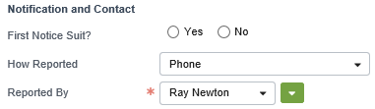
Step 2B: Configure the dropdown contents
Notes:
The valueRange attribute determines the related contacts array used by the ClaimContact widget to display the list of contacts in the dropdown. In the example above, the attribute is set to Claim.RelatedPersonArray. This means that the contacts listed in the dropdown are all the contacts of subtype Person related to the claim.
Note that this field implies that we expect the reporter to be a Person.

Slide 13
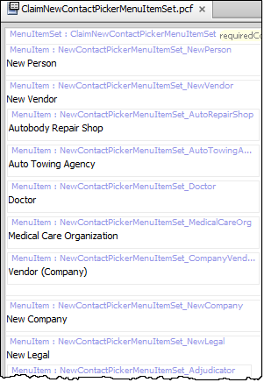

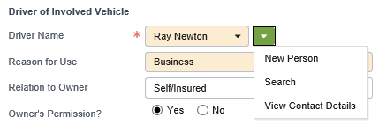
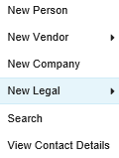
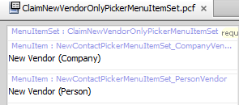
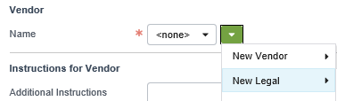
Contact picker menu item sets
ClaimNewContactPickerMenuItemSet
ClaimNewPersonOnlyPickerMenuItemSet
ClaimNewVendorOnlyPickerMenuItemSet
Notes:
These menu item sets are used to create new contacts of any type or of a specific type such as a Person or Vendor.
As mentioned before, note that the "Search" and "View Contact Details" menu items do not appear in the menu item sets. These menu items are added automatically to the picker menu of any ClaimContact widget.
The base application comes with eight menu item sets:
ClaimNewContactPickerMenuItemSet (this is the default menu item set, which ClaimCenter will use if you do not specify a different one)
ClaimNewPersonOnlyPickerMenuItemSet
ClaimNewCompanyOnlyPickerMenuItemSet
ClaimNewDoctorOnlyPickerMenuItemSet
ClaimNewRepairShopOnlyPickerMenuItemSet
ClaimNewServiceRequestSpecialistPickerMenuItemSet
ClaimNewTowingOnlyPickerMenuItemSet
ClaimNewVendorOnlyPickerMenuItemSet
You can configure other menu item sets for your implementation.

Slide 14
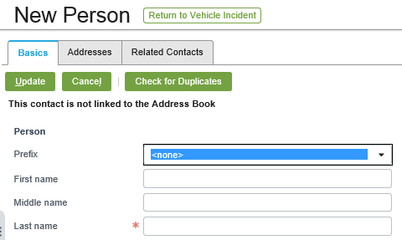
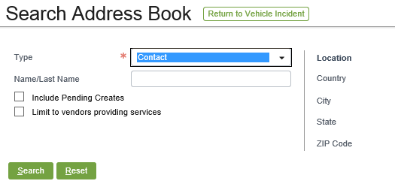
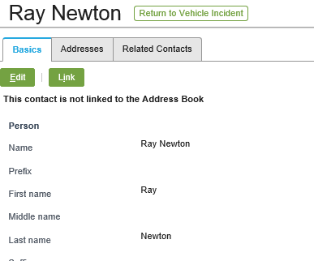

Picker menu popups
Each contact picker menu item navigates to a popup location
NewContactPopup(Person)
AddressBookPickerPopup
ContactDetailPopup
If you create a custom menu, you may also need to create popups for it
Notes:
If you choose to create your own ClaimContact menu item set, you must create popups as needed and configure the menu items to navigate to the popups.
Recall that the action attribute for a navigation widget takes the form of <Location>.<method>(<requiredObjectsOrValues). For example, the New Person menu item shown above has an action attribute of:
NewContactPopup.push(typekey.Contact.TC_PERSON, parentContact, claim)
This identifies that the menu item navigates to the NewContactPopup location using the push method (which lets the user navigate back to the original page after the new page is dismissed), and three values are passed: the code for the type of contact, the contact (referred to as the parent contact, as other contacts may be referenced in the popup), and the claim.

Slide 15
Step 2C: Identify the new picker menu
Notes:
The newContactMenu attribute determines which menu appears as the picker menu.
You can set the newContactMenu attribute to one of the base menu item sets or one which you have configured yourself.
If you leave the newContactMenu attribute value blank, then the ClaimNewContactPickerMenuItemSet (which lists all possible contacts) is used.
In the example above, the attribute is set to ClaimNewPersonOnlyPickerMenuItemSet. This menu item set contains a single "New Person" menu item. (The Search and View Contact Details menu items are automatically assigned to any ClaimContact picker menu.)
Note that this field implies that we expect the reporter to be a Person, since we are limiting the options in the dropdown to be Persons.

Slide 16
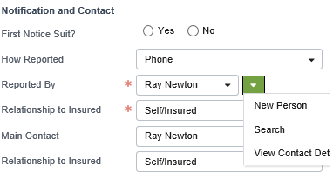
Restricting a picker from creating new contacts
BlankNewContactPickerCellMenuItemSet
Provides Search and View Contact Details only
Prevents users from creating new Contacts
Notes:
If you want to display Search and View Contact Details as the only options, specify BlankNewContactPickerCellMenuItemSet in the newContactMenu property. ClaimCenter will not display any new contact options such as "New Person", "New Vendor", and so on.

Slide 17
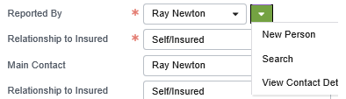
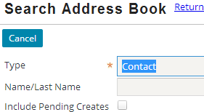

Summary: ClaimContact widget configuration

Slide 18
Lesson objectives review
You should now be able to:
Describe the behavior of ClaimContact widgets
Configure ClaimContact widgets

Slide 19
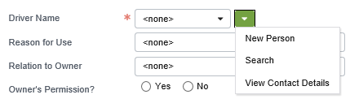
Review questions
Name two functions which return contacts and are listed in the data dictionary as if they were properties.
If you wanted to configure this widget so that it listed and created only contacts of subtype doctor (who could be the claim.reporter), what would you need to do?
What do you need to do to a ClaimContact widget so that the "Search" and "View Contact Details" options appear in the picker menu?
Notes:
Answers
1. Possible answers: Any of the "role" functions on the "Related To" entities, such as Claim.reporter or Exposure.claimant; any of the related contact subtype arrays on claim, such as RelatedContactArray, RelatedCompanyArray, or RelatedAdjudicatorArray.
2. a. Configure the value range to use the RelatedDoctorArray.
b. Create a new picker menu item set specific to doctors (perhaps called ClaimNewDoctorOnlyPickerMenuItemSet) to be used for the picker dropdown.
c. Configure the forceContactSubtype to be Doctor to force the search to only select contacts of type Doctor.
3. The "Search" option is controlled by the “showSearchInMenu” property, which defaults to true. "View Contact Details" options are inherently part of a ClaimContact widget's picker menu.

Slide 20
Review questions (cont.)
The statement below is false. Name a counter-example which proves the statement is false.
Every user interface element in ClaimCenter comes from the platform and is used by all Guidewire applications.
Notes:
4. Possible counter-examples: New Claim Wizard, Payment Wizard, ClaimContactInput, ClaimContactCell

Slide 21
Notices
Copyright © 2001-2014 Guidewire Software, Inc. All rights reserved.
Guidewire, Guidewire Software, Guidewire ClaimCenter, Guidewire PolicyCenter, Guidewire BillingCenter, Guidewire Reinsurance Management, Guidewire ContactManager, Guidewire Vendor Data Management, Guidewire Client Data Management, Guidewire Rating Management, Guidewire InsuranceSuite, Guidewire ContactCenter, Guidewire Studio, Guidewire Product Designer, Guidewire Live, Guidewire DataHub, Guidewire InfoCenter, Guidewire Standard Reporting, Guidewire ExampleCenter, Guidewire Account Manager Portal, Guidewire Claim Portal, Guidewire Policyholder Portal, ClaimCenter, BillingCenter, PolicyCenter, InsuranceSuite, Gosu, Deliver Insurance Your Way, and the Guidewire logo are trademarks, service marks, or registered trademarks of Guidewire Software, Inc. in the United States and/or other countries.
All other trademarks are the property of their respective owners.
This material is confidential and proprietary to Guidewire and subject to the confidentiality terms in the applicable license agreement and/or separate nondisclosure agreement.
This file and the contents herein are the property of Guidewire Software, Inc. Use of this course material is restricted to students officially registered in this specific Guidewire-instructed course, or for other use expressly authorized by Guidewire. Replication or distribution of this course material in electronic, paper, or other format is prohibited without express permission from Guidewire.
Guidewire products are protected by one or more United States patents.

