Slide 1
Introduction to Transaction Rules
16 October 2020
Notes:
Guidewire training materials contain Guidewire proprietary information that is subject to confidentiality and non-disclosure agreements. You agree to use the information in this manual solely for the purpose of training to implement Guidewire software solutions. You also agree not to disclose the information in this manual to third parties or copy this manual without prior written consent from Guidewire. Guidewire training may be given only by Guidewire employees or certified Guidewire partners under the appropriate agreement with Guidewire.

Slide 2
Lesson objectives
By the end of this lesson, you should be able to:
Describe the different sets of transaction rules
Describe the transaction data model
Work with transactions in Gosu
Use the Financial Calculations library
This lesson uses the notes section for additional explanation and information. To view the notes in PowerPoint, choose View→Normal or View→Notes Page. If you choose to print the notes for the lesson, be sure to select “Print hidden slides.”

Slide 3
Lesson outline
Transaction basics
Transaction data model
Transactions and Gosu
The financial calculations library

Slide 4
Review: Objects that implement financials
Exposure
Reserve Line
Check
Payee
+$3000
-$3000
Reserve transaction
Payment transaction
Exposure tracks payment from coverage to claimant
Reserve line is money set aside for exposure payments
Reserve transactions typically add money to it
Payment transactions move money to checks
Checks transfer money from carrier to payee
Notes:
An exposure is a set of data used to track a potential payment from one coverage to one claimant.
A reserve line is an amount of money set aside for expected payments related to a given exposure. Every exposure ultimately has one or more reserve lines. transactions modify the amount of money in a reserve line.
A reserve transaction modifies the amount of money set aside for the reserve line.
A payment transaction moves money from a reserve line to a payment to a claimant or other party.
A check is a single transfer of money from one or more reserve lines to one or more individuals or organizations.
A payee is a person to whom a check is made payable. Payees include both claimants and people who provided services for the claim (such as inspectors).

Slide 5
Review: transactions
reserve transaction
+$2000
-$1850
payment transaction
"Non-recovery" reserve line
recovery reserve transaction
+$3500
-$3500
recovery transaction
"Recovery" reserve line
Transactions modify amount of money in reserve line
Four types of transactions
Remainder of the course focuses on reserve and payment transactions
Notes:
A reserve transaction modifies the amount of money set aside for the reserve line. In most cases, a reserve transaction can be thought of as adding money to a reserve line. (However, there are circumstances where the amount of money set aside may have been deemed too high, and a reserve will be used to subtract money from a reserve line without actually paying that money to a claimant or other party.)
A payment transaction moves money from a reserve line to a payment to a claimant or other party. In most cases, a payment transaction can be thought of as subtracting money from a reserve line. (However, there are circumstances where a payment transaction credits money to a reserve line, possibly because an error occurred and the payee returned the money to the carrier.)
A recovery reserve transaction denotes money which the carrier expects to get from subrogation or salvage.
A recovery transaction denotes money which has been collected from subrogation or salvage.
Recall the following definitions:
Recovery is a general term that refers to all forms of recouping some of the payments made on a claim. There are two primary forms of recovery: subrogation and salvage.
Subrogation is the act of the carrier getting financial reimbursement from a 3rd party when someone insured by the carrier suffers a loss and it is not the insured's fault. For example, if Jim Means is insured by Acme Insurance and his car is hit by Florence Rigby, then Acme Insurance can attempt to collect money from Florence Rigby's insurance company to cover the money which Acme must pay to Jim Means for his loss. Subrogation is relevant only when there is a 3rd party who is responsible for the loss.
(continued)

Slide 6
(Notes only slide)
Notes:
Salvage is the act of the carrier paying the full value of damaged property, taking possession of it, and then attempting to recoup some of the cost by reselling the property (or portions of it). For example, if Jim Means has an insured car which is damaged in a collision to the point where it can no longer be driven, Acme Insurance could pay the full value of the car to Jim Means, take possession of it, and then sell any salvageable parts to a scrap yard.
The example shown above is for a collision exposure in which the vehicle is a total loss. The carrier plans to pay the insured for the full value of the vehicle, which is $3500. The carrier then expects to be able to sell the vehicle to a salvage yard and recoup $3500.
A single reserve line can include both recovery and non-recovery transactions.

Slide 7
Transaction rules
(unique to setup)
(used during and outside setup)
Pre-setup
Pre-update
TransApproval
Post-setup
Validation
Appr. Routing
Six rule set categories which trigger off transaction event
Which rules get executed and order of execution varies based on the type of transaction and type of activity (creation, modification, approval)
Notes:
Introduction to Transaction Rules - 7
The rules executed for each new transaction:
Transaction Pre-setup
Transaction Approval rules
Approval rules (in Approval Routing rule set category)
Transaction Post-setup
Claim Pre-update
Transaction Pre-update
Claim Validation rules
Transaction Validation rules
Event Fired

Slide 8
Pre-/Post- rules
(unique to setup)
(used during and outside setup)
Pre-setup
Pre-update
TransApproval
Post-setup
Validation
Appr. Routing
Execute work unrelated to validation or approval
Pre-/post-setup - executed only when transaction is created
Pre-update - executed when transaction is created or modified
Covered in this lesson
Notes:
The decision about where to write a given transaction rule should be determined by when the rule should be run.
If the rule should only be run when a transaction is created (and not every time the transaction is modified), then it should be in a pre-setup or post-setup rule.
If the rule should be run when a transaction is created and every time the transaction is modified, then it should be in a pre-update rule.

Slide 9
Approval rules
(unique to setup)
(used during and outside setup)
Pre-setup
Pre-update
TransApproval
Post-setup
Validation
Appr. Routing
Transaction approval - determine if transaction requires approval
Approval routing - if approval needed (based on approval rules or authority limits), route approval activity
Covered in the "Transaction Approval rules" lesson
Notes:
Transaction Approval rules are run when a transaction is created and when it is edited or approved. (A transaction might require multiple approvals. Therefore, approval rules are run even when a transaction is approved.)
Approval Routing rules are run whenever a transaction is designated as requiring approval.

Slide 10
Validation rules
(unique to setup)
(used during and outside setup)
Pre-setup
Pre-update
TransApproval
Post-setup
Validation
Appr. Routing
Determine if transaction is valid and committable
Can raise warnings or return errors (which prevent transaction from being saved)
Covered in the "Transaction Validation Rules" lesson
Notes:
Validation rules are called both when a transaction is created and when it is edited or approved.

Slide 11
Transaction pre-setup vs. post-setup
(unique to setup)
(used during and outside setup)
Pre-setup
Pre-update
TransApproval
Post-setup
Validation
Appr. Routing
Pre-setup - rules which run just before any transaction set or check set is committed
Post-setup - rules which run after a transaction set is approved
Notes:
Introduction to Transaction Rules - 11
Technically, transaction post-setup rules are run after a transaction set is approved, after a check is voided, stopped, or escalated, and after other similar events.

Slide 12

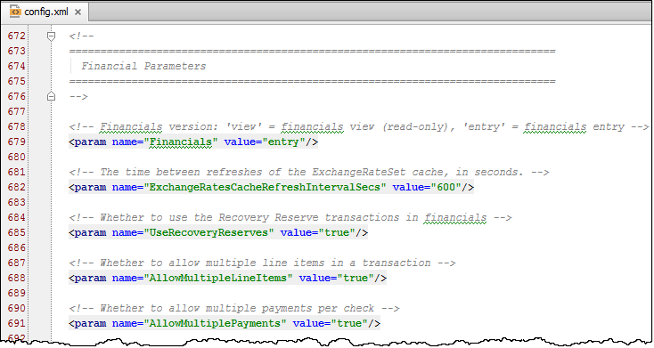
Financials and config.xml
Certain financial behaviors are controlled by parameters in config.xml
Several are listed on the next slide, with defaults in black

Slide 13
Financial behaviors governed in config.xml
Multiple line items {are | are not} allowed in a transaction.
Multiple payments {are | are not} allowed per check.
Authority limits {are | are not} checked automatically
Users {cannot | can} submit payments that exceed available reserves {. | up to the PaymentsExceedReserves authority limit.}
Payments above {500} are logged.
When final payment is made, exposure {is | is not} automatically closed.
When final payment closed last open exposure, claim {is | is not} automatically closed.
Notes:
In each statement above, there is a "{ | }" set of characters. The text within the "{ |" (which appears in black) lists the out-of-box behavior of one of the financial parameters in config.xml. The text within the "| }" (which appears in gray) lists the non-default behavior of that financial parameter, but you can switch the parameter to this behavior simply by changing the parameter's value.
If payments can exceed authority limits but the PaymentsExceedReserves authority limit is not set for a user, that user can make payments exceeding reserves without limit.
Some financial parameters in config.xml have been omitted from the list above. For the complete list, consult the config.xml file itself.

Slide 14
Lesson outline
Transaction basics
Transaction data model
Transactions and Gosu
The financial calculations library

Slide 15
Transaction sets and transactions
TransactionSet
Transaction
Amount Subtype ... Transactions
ReserveLine Status Subtype TransactionAmount ...
Transaction data model is heavily subtyped
At top level, transactionSet and transaction
Notes:
There are three primary entities: transactionSet (which is subtyped as ReserveSet and CheckSet), transaction (which is subtyped as Reserve and Payment) and Check.
A transaction does not exist in isolation. Every transaction is part of a transaction set. In some cases, there may be only one transaction in the transaction set (such as a single reserve transaction creating a new reserve line, or a single check being issued with a single payment transaction from a single reserve line). In other cases, there may be multiple transactions in the transaction set (such as two reserve transactions creating two new reserve lines at one time, or three checks being issued, two of which have two payment transactions from different reserve lines).
The information stored at the transaction level is information generic to all transactions, such as which reserve line it is associated to, what its status is, and what the transaction amount is.
The information stored at the transactionSet level is information generic to all transaction sets, such as what the total amount is, and the array of transactions in the transaction set.

Slide 16
Entities for reserves
TransactionSet
Transaction
Amount Subtype ... Transactions
ReserveLine Status Subtype TransactionAmount ...
ReserveSet
Reserve
Reserves
...
Notes:
When a reserve is created, the transactionSet objects is subtyped as a ReserveSet and the transaction object is subtyped as a Reserve.
The Reserve subtype tracks information unique to reserve transactions. In the base application, there is a small number of fields at this level which are complex in nature (such as TotalIncurredGross, which is the total incurred gross for the given reserve).
The ReserveSet subtype tracks information unique to transaction sets which contain only reserves. In the base application, there is a single array key in this subtype, the Reserves field which contains an array of Reserve objects.

Slide 17
Entities for payments
TransactionSet
Transaction
Amount Subtype ... Transactions
ReserveLine Status Subtype TransactionAmount ...
CheckSet
Check
Payment
PaymentsAmount Recurring ... Checks
CheckNumber IssueDate PaymentMethod ... Payments
Check CloseExposure PaymentType ...
Notes:
When a check is created, the transactionSet objects is subtyped as a CheckSet, the transaction object is subtyped as a Payment, and a third entity - the Check entity - becomes relevant.
The Payment subtype tracks information unique to payment transactions. In the base application, this includes a foreign key to the Check object which the payment belongs to, the CloseExposure boolean, which indicates whether the payment should or did close the associated exposure, and the payment type (partial, final, or supplemental).
The CheckSet subtype tracks information unique to transaction sets which contain checks. In the base application, this includes a PaymentsAmount which totals all the checks, a Recurring boolean indicating the check is single or recurring, and an array of Checks.
The Check entity includes information specific to the process of transferring money from the carrier to the payee. This includes the check number, the issue date, the payment method (check, EFT, or manual check), and an array of payment transactions which are contained within the check.
Eroding and Non-Eroding Payments in the data model
If a payment is "non-eroding", then the payment does not cause the amount of money in the reserve line to decrease. In this case, the only transactions that are created are payments. Carriers use non-eroding payments when they want to use reserves as an estimate of money needed, but they do not track payments and remaining reserves at a granular level.
If a payment is "eroding", then the payment causes the amount of money in the reserve line to decrease. This means that each payment transaction requires a matching reserve transaction. (If the payment transaction is for $1000, then a reserve transaction must be created with an amount of -$1000 to reflect a $1000 decrease in the reserve line.) The payments are linked to the CheckSet through the Check entity as shown in the diagram above. The reserves are linked to the CheckSet through an array in the CheckSet subtype called Reserves. This is an array of CheckSetReserves. A CheckSetReserve is an object which links an automatically generated reserve transaction to a CheckSet.
(continued)

Slide 18
(Notes only slide)
Notes:
To summarize this:
A transactionSet of type ReserveSet maps only to reserve transactions.
A transactionSet of type CheckSet maps only to payment transactions when none of the payments are eroding.
A transactionSet of type CheckSet maps to payment transactions and (automatically generated) reserve transactions when any of the payments are eroding.
The CheckSet subtype's Reserves array has been omitted from the diagram because, from a scripting standpoint, one rarely has to check the information in this array of CheckSetReserves. In almost all cases, the required information is in or connect to the Checks array.

Slide 19
Transaction data model: Review
TransactionSet
Transaction
Amount Subtype ... Transactions
ReserveLine Status Subtype TransactionAmount ...
ReserveSet
Reserve
Reserves
...
CheckSet
Check
Payment
PaymentsAmount Recurring ... Checks
CheckNumber IssueDate PaymentMethod ... Payments
Check CloseExposure PaymentType ...

Slide 20
Beyond the transaction data model
Claim
ReserveLine
Exposures
Claim Exposure
Exposure
Claim
ReserveLines
Check
Claim
TransactionSet
Transaction
Claim
Exposures
LineItems
Claim Exposure ReserveLine
Two-way reference
One-way reference
Notes:
The transactionSet, transaction, and Check entities are connected to other major entities in the ClaimCenter data model (Claim, Exposure, and ReserveLine). However, all of the references from the "transaction-type" entities are one-way. In other words, from a transactionSet, transaction, or Check, you can often navigate to the related Claim, Exposure, or ReserveLine. But, you cannot navigate easily from a Claim, Exposure, or ReserveLine to all of its transactionSets, transactions, or Checks. For rules, it is much better to use one of the getxxxxIterator() methods to retrieve all transactions related to an object (such as claim.getChecksIterator()). (For the user interface, it is much better to use one of the getxxxxQuery() methods to retrieve all transactions or a specific subtype of transactions.)
TransactionSet has an array key to Exposure, not a single foreign key. This is because a single transaction set could contain a check with payments from reserve lines associated to different exposures. For example, if a claim had a collision exposure and a bodily injury exposure with the same claimant, and a single check was issued to that claimant, then the check would involve payments from the reserve lines of two different exposures, but it would be in a single transaction set.
The transactionSet entity has a number of arrays which link to objects with information relevant to financial processing. For example:
The Exposures array points to a set of exposures. Each exposure has a foreign key to the associated coverage. Each coverage has an ExposureLimit field, identifying the maximum amount of loss covered on the policy.
The LineItems array points to a set of line items. Each line item has a line category, which is typically used by the check processing system to identify what the line item is for.

Slide 21
Lesson outline
Transaction basics
Transaction data model
Transactions and Gosu
The financial calculations library

Slide 22
Transactions and Gosu
TransactionSet and transaction are subtyped entities, and most critical information is at the subtype level
Therefore, transaction rules typically involve casting
Reserves, payments, and checks are stored in arrays
Therefore, transaction rules typically involve for loops
Transaction rules often use specific numeric amounts, but these amounts may change over time
Therefore, transaction rules often involve script parameters

Slide 23
Review: Casting
Contact
if ((Contact as Person).CellPhone is null) {
...
...
}
ID Subtype
CellPhone
Person
Casting is a technique used with supertype objects to reference fields and methods that exist only at the subtype level
Syntax:
(objectLevel as subtypeLevel)
Notes:
Working with subtyped entities can be difficult, because sometimes you have an object declared at the supertype level but you need to access fields and methods found only at the subtype level. "Casting" is a coding technique where you create a second handle for an object at the supertype level which lets you access subtype fields.

Slide 24
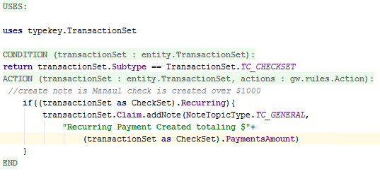
Example of transaction rule casting
Notes:
In the example above, the rule creates a note whenever a recurring payment is issued which identifies the total amount of all payments.
In the rule condition, line 1 checks to see if the transactionSet is a CheckSet. If it isn't, then there is no need to execute further processing.
In the rule action:
Line 2 needs to access the Recurring attribute. This attribute exists only at the CheckSet subtype level. Therefore, the transactionSet object is cast as a CheckSet object.
Lines 3 and 4 creates a note for the transactionSet's claim. The Claim foreign key exists at the transactionSet level. Therefore, the transactionSet object does not need to be cast in this case.
Line 5 adds the PaymentsAmount value to the note text. Once again, this attribute exists only at the CheckSet subtype level. Therefore, the transactionSet object is cast as a CheckSet object.

Slide 25
Review: for loops
Exposure
for (exp in aClaim.Exposures) {
if exp.Segment == "complex"
aClaim.Segment = "complex" }
Claim
Exposure
Exposures
Exposure
In Gosu, for loops are typically used to perform a set of actions over every element in an array
For Loop syntax:
for ( loopIdentifier in arrayOrSet)
{
block_that_makes_use_of_loopIdentifier
}
Notes:
For loops are not, by definition, a feature exclusive to arrays. However, the vast majority of ClaimCenter code that uses for loops uses them in conjunction with arrays. This is because a for loop is designed to execute the same steps multiple times, and the processing of an array usually involves several items and the notion that you want to do the same thing to each item.
The arrayOrSet in the in clause must evaluate to one of the following:
An array
A Java List (or any Java collection)
A Java Iterator
A string (as a list of characters)

Slide 26
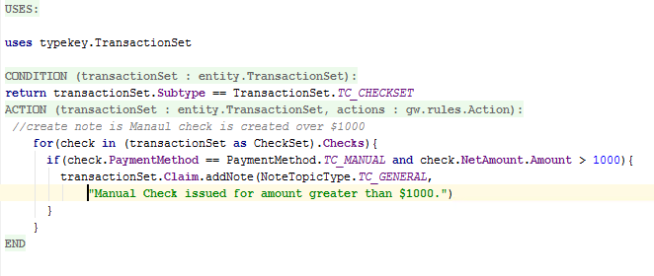
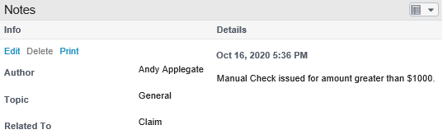
Example of transaction rule for loops
Notes:
In the example above, the rule creates a note whenever a manual check is issued for an amount over $1000.
In the rule condition, line 1 checks to see if the transactionSet is a CheckSet. If it isn't, then there is no need to execute further processing.
A check set contains array of checks. There may be only one check, but there could be several. Consequently, in the rule action, the code that interacts with individual checks must make use of a loop.
Line 2 of the rule action creates the for loop. "check" is arbitrary name used to reference the check currently being processed. The for statement also specifies the array which the loop processes. Because the Checks array exists only at the CheckSet subtype level, the transactionSet must be cast as a CheckSet.
Line 3 checks if the payment method for the current check is "manual" and if the net amount for the current check is greater than $1000. If it is true, then on lines 4 and 5 and note is created.
Strictly speaking, the curly braces in lines 2 and 6 are not needed. Curly braces are needed only if the for loop contains multiple statements. (This loop contains a single if statement with an embedded addNote statement.) However, in most cases, multiple lines are executed within the loop. Some programmers consider it good practice to always include the braces, even if the loop has only one line, to avoid compile errors if additional lines are added.

Slide 27
Review: Script parameters
SIU_Threshold
5
if aClaim.SIScore >= ScriptParameters.SIU_Threshold
aClaim.createActivityFromPattern(null,
ActivityPattern.finder.
getActivityPatternByCode("SI_review")
Script parameters are used to reference "hard-coded" values which could change infrequently over time
Syntax:
ScriptParameters.parameterName
Notes:
Script parameters are not unique to arrays and loops. They can be used anywhere a relatively static or slowly changing value is required.

Slide 28
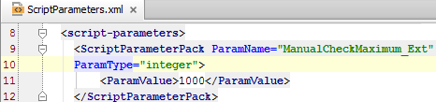
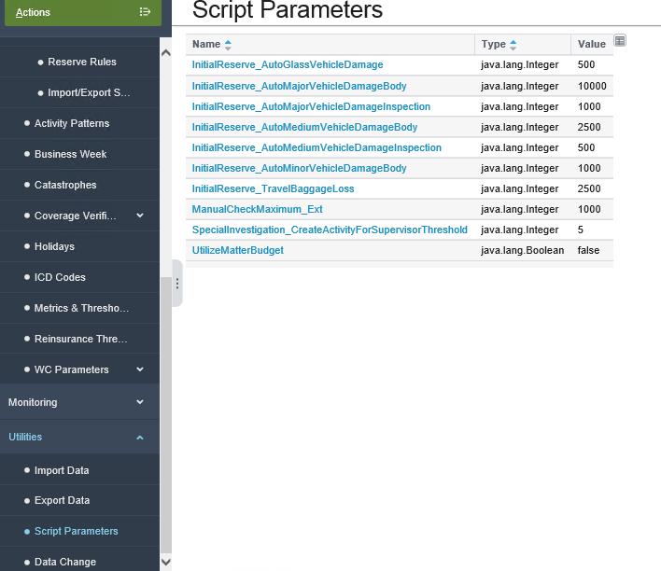
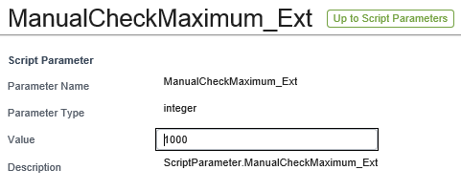
Example of transaction script parameters
Notes:
Review: Script Parameters are created in ScriptParameters.xml in Studio. In the example above, a script parameter called ManualCheckMaximum_Ext is created as an integer with an initial value of 1000. Once it has been deployed, administrators can modify the value from the Administration tab's Script Parameters menu link.

Slide 29
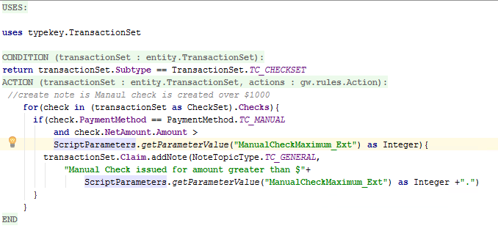
Example of transaction script parameters in rules
Notes:
The example above is identical to the loop example, except that the hard-coded value of 1000 has been parameterized.
Lines 5 and 8 of the Action reference the parameter using "ScriptParameters.ManualCheckMaximum_Ext". Now, the rule will react to whatever value is specified in ClaimCenter's Script Parameters screen (on the Administration tab), both in terms of the condition and the note text.

Slide 30
Transaction data model and Gosu
Root Entity
for loops
TransactionSet
Transaction
Amount Subtype ... Transactions
ReserveLine Status Subtype TransactionAmount ...
for (txn in Transactions)
ReserveSet
Reserve
casting
...
(TransactionSet as CheckSet)
(Transaction as Payment)
Reserves
CheckSet
Check
Payment
PaymentsAmount Recurring ... Checks
CheckNumber IssueDate PaymentMethod ... Payments
Check CloseExposure PaymentType ...
for (check in Checks)
for (payment in Payments)
Notes:
The root entity for all transaction rules is transactionSet. Typically, the information you need is not in the transactionSet entity itself, but rather in ReserveSet, CheckSet, Check, transaction, Reserve, or Payment.
To move from an array to the objects contained in an array (in other words, to move across the diagram), you must use a for loop. For example, to examine all the checks in a checkset, code such as (check in Checks) would be needed.
To move from a supertype to one of its subtypes (in other words, to move down the diagram), you must use casting. For example, to examine all a CheckSet from the root entity transactionSet, code such as (TransactionSet as CheckSet) would be needed.
To move diagonally, you must use loops and casting. For example, to examine all the Checks in a transactionSet, code such as for (check in (TransactionSet as CheckSet).Checks) would be needed.
The word "transaction" is often abbreviated in code as "txn".

Slide 31
Lesson outline
Transaction basics
Transaction data model
Transactions and Gosu
The financial calculations library

Slide 32
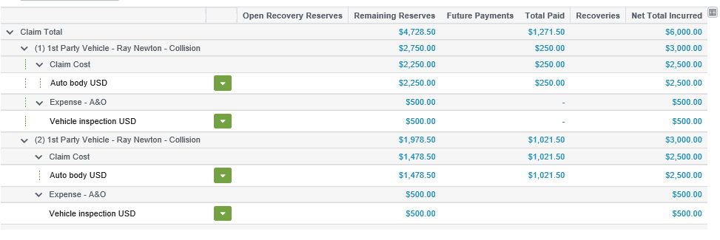
Measuring a claim's financials
Insurance carriers use a set of measures to describe and act on a claim, such as the base application measures: Total Reserves = all approved reserves Open Reserves = Total Reserves - Past Payments Remaining Reserves = Open Reserves - Future Payments Available Reserves = Remaining Reserves - Pending Approval Payments Gross Total Incurred = Open Reserves + Past Payments Net Total Incurred = Gross Total Incurred - Recoveries
Notes:
The terms used to describe the finances for a claim are completely configurable. The definitions provided above are listed only to help identify the calculations already executed in the base application.
Available reserves does not appear on the summary screen in the base application, but it appears on screens in the payment wizard and it is used by business rules. Therefore, it is defined in the slide above.
A reserve can be either approved or pending approval. The approval status effects whether it is included in open and remaining reserves.
A payment can be either in the past (it has already taken place) or in the future (it is scheduled to take place, which could include single future payments or recurring payments). The status of a payment affects the calculation for in open reserves, remaining reserves, and available reserves.
(continued)

Slide 33
(Notes only slide)
Notes:
TotalReserves = Sum of all approved reserves (excludes only PendingApproval and earlier statuses)
TotalReservesWithPending = TotalReserves + PendingApprovalReserves
OpenReserves = TotalReserves - all eroding Payments made today or earlier
RemainingReserves = OpenReserves - all eroding Payments to be made after today [can be <0*]
AvailableReserves = RemainingReserves - PendingApprovalErodingPayments [can be <0*]
TotalPayments = Sum of all approved payments with scheduled send date today or earlier
FuturePayments = Sum of all approved payments with a scheduled send date after today
TotalPaymentsWithPending = TotalPayments + FuturePayments + PendingApprovalPayments
GrossTotalIncurred = OpenReserves + TotalPayments, or equivalently,
TotalReserves + Sum of all approved non-eroding payments
NetTotalIncurred = GrossTotalIncurred - TotalRecoveries
TotalIncurredNetRecoveries = GrossTotalIncurred - TotalRecoveries (the same as NetTotalIncurred)
TotalIncurredNetRecoveryReserves = GrossTotalIncurred - TotalRecoveryReserves
TotalRecoveryReserves = Sum of all recovery reserves (unlike reserves, they need no approval)
TotalRecoveries = Sum of all recoveries with submitted status (all recoveries received up to now)
OpenRecoveryReserves = TotalRecoveryReserves - TotalRecoveries
PendingApprovalErodingPayments = Sum of all eroding payments with pending approval status
PendingApprovalNonErodingPayments = Sum of all non-eroding payments with pending approval status
PendingApprovalPayments = PendingApprovalErodingPayments + PendingApprovalNonErodingPayments
PendingApprovalReserves = Sum of all reserves with pending approvalstatus
ForeignExchangeAdjustments = The sum of all exchange rate adjustments, both those made to eroding and to non-eroding payments.
ErodingPaymentsForeignExchange- Adjustments = The sum of all exchange rate adjustments made to eroding payments.
NonErodingPaymentsForeignExchange- Adjustments = The sum of all exchange rate adjustments made to non-eroding payments.

Slide 34
Transaction rules and financial measures
getTotalPayments()
withClaim(aClaim).Amount
Financial Calculation (cache reader object)
$1500
Transaction rules need to reference financial measures
Accomplished through financial calculations library methods
Each method returns a "cache reader" object which can be used to retrieve financial measures

Slide 35
Financial calculation library methods
Syntax:
gw.api.financials.FinancialsCalculations.method
Returns object of type FinancialCalculation
Commonly used methods
getAvailableReserves()
getOpenReserves()
getRemainingReserves()
getTotalIncurredNet
getTotalReserves()
getTotalPayments()
Notes:
To see all the available methods, type
gw.api.financials.FinancialsCalculations.
into Studio, and then CTRL-spacebar. Studio will display the list of available methods.

Slide 36
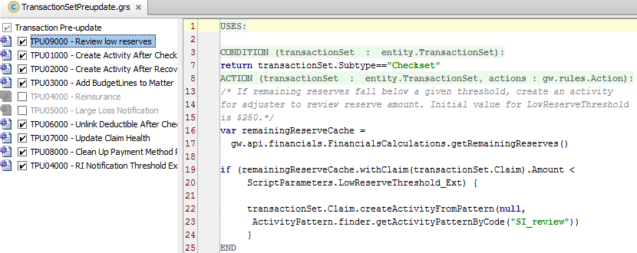
Methods on FinancialCalculation objects
Commonly used syntax
withClaim(Claim).Amount
withExposure(Exposure).Amount
withCostType(CostType).Amount
withCostCategory(CostCategory).Amount
Notes:
The FinancialCalculations object has an Amount field that contains the monetary value of the object.
The FinancialCalculations object also has several methods on it that allow you to limit the result to only include certain passed-in parameters. These methods take the form of “with<object>(objectReference)” or “with<typelist>(typelistValue)”. Some examples are withClaim(), withExposure(), withCostType(), and withCostCategory(). These methods return another FinancialCalculation object, and are therefore stackable. You can write code like
finCalc.withClaim(claim).withCostType(“claimcost”).Amount in order to limit the amount to only include the passed-in parameters.
In the example above, the rule creates an activity when the remaining reserves fall below a threshold amount (which is specified through a newly created script parameter).
In the rule condition, line 7 checks to see if the transactionSet is a CheckSet. If it isn't, then there is no need to execute further processing.
In the rule actions, lines 16 and 17 create a cache reader object which can be used to get remaining reserve amounts.
Line 19 gets the remaining reserves for the transactionSet's claim.
Lines 19 and 20 check to see if that amount is below the threshold amount ($250). If so…
Lines 23 and 23 create an activity to have an adjuster review the low reserve amount.

Slide 37
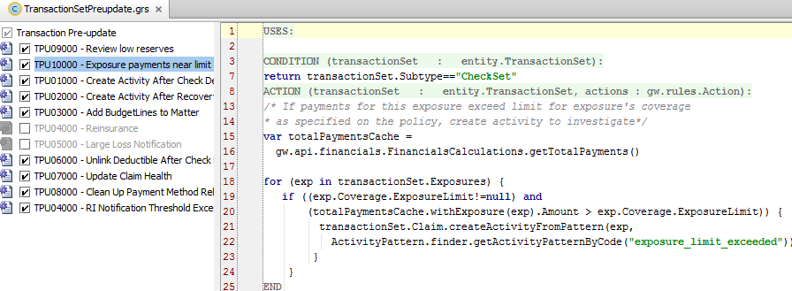
Using financial calculations library: Examples
Line 15 creates cache reader object
For each exposure, line 20 retrieves total payments for that exposure and compares it to coverage’s exposure limit
Notes:
In the example above, the rule creates an activity when the payments for an exposure exceed the limit of the coverage as specified by the policy.
In the rule condition, line 7 checks to see if the transactionSet is a CheckSet. If it isn't, then there is no need to execute further processing.
In the rule actions, lines 15 and 16 create a cache reader object which can be used to get total payment amounts.
Line 18 initiates a for loop to process each exposure.
Lines 19 and 20 check to see if the current exposure's limit is non-null and if the total payment amount is above the exposure limit. If it is...
Lines 21 and 22 create an activity to have an adjuster review what to do about the exceeded limit.

Slide 38
Lesson objectives review
You should now be able to:
Describe the different sets of transaction rules
Describe the transaction data model
Use the Financial Calculations library
Work with transactions in Gosu

Slide 39
Review questions
What are the two primary subtypes of transactionSet?
What are the two primary subtypes of transaction?
Which primary entity in the transaction data model is neither a subtype of transactionSet or transaction? Under what circumstances is this entity relevant?
Why do transaction rules frequently make use of:
Casting?
Loops?
Script parameters?
When would one use the methods in the Financial Calculations library?
Notes:
Answers
1. ReserveSet and CheckSet
2. Reserve and Payment (not Check...Check is not a subtype of transaction)
3. Check. When payments are made.
4. a) The transactionSet and transaction entities are subtyped, and casting is needed to access fields and methods at the subtype level.
b) Checks, reserves, and payments are all stored in arrays. For loops are needed to process these arrays.
c) transaction rules often reference specific values, but these values may change over time and should not require changes to the code. Script parameters lets you change these values without changing the code.
5. These methods are used when one needs to use a common financial measurement (such as open reserves or total payments) in a transaction rule.

Slide 40
Notices
Copyright © 2001-2014 Guidewire Software, Inc. All rights reserved.
Guidewire, Guidewire Software, Guidewire ClaimCenter, Guidewire PolicyCenter, Guidewire BillingCenter, Guidewire Reinsurance Management, Guidewire ContactManager, Guidewire Vendor Data Management, Guidewire Client Data Management, Guidewire Rating Management, Guidewire InsuranceSuite, Guidewire ContactCenter, Guidewire Studio, Guidewire Product Designer, Guidewire Live, Guidewire DataHub, Guidewire InfoCenter, Guidewire Standard Reporting, Guidewire ExampleCenter, Guidewire Account Manager Portal, Guidewire Claim Portal, Guidewire Policyholder Portal, ClaimCenter, BillingCenter, PolicyCenter, InsuranceSuite, Gosu, Deliver Insurance Your Way, and the Guidewire logo are trademarks, service marks, or registered trademarks of Guidewire Software, Inc. in the United States and/or other countries.
All other trademarks are the property of their respective owners.
This material is confidential and proprietary to Guidewire and subject to the confidentiality terms in the applicable license agreement and/or separate nondisclosure agreement.
This file and the contents herein are the property of Guidewire Software, Inc. Use of this course material is restricted to students officially registered in this specific Guidewire-instructed course, or for other use expressly authorized by Guidewire. Replication or distribution of this course material in electronic, paper, or other format is prohibited without express permission from Guidewire.
Guidewire products are protected by one or more United States patents.

