Slide 1
Transaction Validation Rules
16 October 2020
Notes:
Guidewire training materials contain Guidewire proprietary information that is subject to confidentiality and non-disclosure agreements. You agree to use the information in this manual solely for the purpose of training to implement Guidewire software solutions. You also agree not to disclose the information in this manual to third parties or copy this manual without prior written consent from Guidewire. Guidewire training may be given only by Guidewire employees or certified Guidewire partners under the appropriate agreement with Guidewire.

Slide 2
Lesson objectives
By the end of this lesson, you should be able to:
Describe the life cycle of transactions and checks
Describe how transactions are validated
Write transaction validation rules
This lesson uses the notes section for additional explanation and information. To view the notes in PowerPoint, choose View→Normal or View→Notes Page. If you choose to print the notes for the lesson, be sure to select “Print hidden slides.”

Slide 3
Lesson outline
Transaction and check life cycles
Transaction validation basics
Transaction validation rules

Slide 4
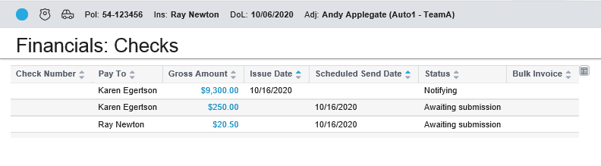
Transaction and check life cycles
Each transaction and check goes through its own life cycle
Two life cycles are similar
At each stage of the life cycle, object has status which determines where it is and what can be done with it

Slide 5

Multiple systems manage life cycle
Initially, object's state is managed entirely by ClaimCenter
Object eventually handed off to general ledger or check processing system
At this point, external system manages state and reports it to ClaimCenter
General Ledger System
Check Processing System

Slide 6
The life cycle of a transaction
Pending Approval
Draft
Rejected
Awaiting Submission
(payment transactions only)
Pending Void/Stop
Submitting
Denied
Submitted
General Ledger System
Voided
Stopped
Notes:
Transactions commonly move through the following states:
Draft - The transaction is being created. It has not been committed yet.
Pending Approval - The transaction is saved, but either authority limits and/or transaction approval rules determine that approval is needed.
Rejected - The transaction which required approval has been rejected.
Awaiting Submission - Transactions in this state either did not require approval or required and received approval. They remain in this state until their "due date", the date at which they are sent to the external system.
Submitting - Transactions are placed in this state immediately before ClaimCenter sends information about the transaction to the external system. They remain in this state until ClaimCenter receives information from the external system identifying how the transaction was processed.
Denied - The transaction was denied by the external system.
Submitted - The transaction was received by the external system.
Pending Void - This status is used for transactions which have been submitted to an external system which a user wants to void. (Prior to Submitting, a user can simply delete the transaction.)
Voided - This status indicates the external system has voided the transaction. A voided transaction is one which corresponds to a check which was never given to the payee.
Pending Stop - This status is used for transactions which have been submitted to an external system which a user wants to stop. (Prior to Submitting, a user can simply delete the transaction.)
Stopped - This status indicates the external system has stopped the transaction. A stopped transaction is one which corresponds to a check which was given to the payee, but was not honored when the institution which cashed the check attempts to collect the funds.
(continued)

Slide 7
(Notes only slide)
Notes:
There are additional statuses not shown in the diagram above, which have been omitted from the diagram for simplicity’s sake: Pending Transfer and Transferred. Both are similar to Pending Void and Voided. There are also additional nuances regarding when and how a transaction can move from one state to another. For a more exhaustive discussion, refer to the ClaimCenter Application Guide.

Slide 8
The life cycle of a check
Pending Approval
Deviations between transactions and checks noted in red
Draft
Rejected
Awaiting Submission
Pending Void/Stop
Requesting
Denied
Requested
Check Process. System
Issued
Voided
Cleared
Stopped
Notes:
Checks commonly move through the following states:
Draft - The check is being created. It has not been committed yet.
Pending Approval - The check is saved, but transaction approval rules determine that approval is needed.
Rejected - The check which required approval has been rejected.
Awaiting Submission - checks in this state either did not require approval or required and received approval. They remain in this state until their "due date", the date at which they are sent to the external system.
Requesting - checks are placed in this state immediately before ClaimCenter sends information about the check to the external system. They remain in this state until ClaimCenter receives information from the external system identifying how the check was processed.
Denied - The check was denied by the external system.
Requested - The check was received by the external system.
Issued – The check was created by the external system.
Cleared – The check was cashed (reported back to ClaimCenter by the external system.)
Pending Void - This status is used for checks which have been submitted to an external system which a user wants to void. (Prior to Requesting, a user can simply delete the check.)
Voided - This status indicates the external system has voided the check. A voided check is a check which is never given to the payee and never will be.
(continued)

Slide 9
(Notes only slide)
Notes:
Pending Stop - This status is used for checks which have been submitted to an external system which a user wants to stop. (Prior to Submitting, a user can simply delete the check.)
Stopped - This status indicates the external system has stopped the check. A stopped check was given to the payee, but was not and will not be honored when the institution which cashed the check attempts to collect the funds.
There are additional statuses not shown in the diagram above, which have been omitted from the diagram for simplicity sake: Notifying (which is the analog of Requesting, but it is used only for manual checks), Pending Transfer and Transferred (both of which are similar to Pending Void and Voided), and Pending Recode and Recoded (both of which are also similar to Pending Void and Voided). There are also additional nuances regarding when and how a check can move from one state to another. For a more exhaustive discussion, refer to the ClaimCenter Application Guide.

Slide 10

Edits during the life cycle
Pending Approval
Draft
Rejected
Awaiting Submission
Transactions and checks can be modified while object is in any status listed here
Whenever transaction or check is created or changed, data must be validated before it is written to database
Denied
Submitted
Cleared
Notes:
A transaction cannot be edited if it has a status of: Submitting, Pending Void, Pending Stopped, Voided, Stopped.
A check cannot be edited if it has a status of: Requesting, Requested, Issued, Pending Stopped, Voided, Stopped.
Attempting to void or stop an object is not considered an edit to the object. If a user needs to edit a transaction or check which is in an uneditable status, the only option is to attempt to void or stop the object.

Slide 11
Lesson outline
Transaction and check life cycles
Transaction validation basics
Transaction validation rules

Slide 12
Review: Transaction rules
(unique to setup)
(used during and outside setup)
Pre-setup
Pre-update
Approval
Post-setup
Validation
Appr. Routing
Transaction validation rules determine if transaction is valid and committable
Notes:
A table listing the rules executed for each type of transaction setup appears below (which is visible if you view PowerPoint in Notes view (View > Notes Page)).

Slide 13
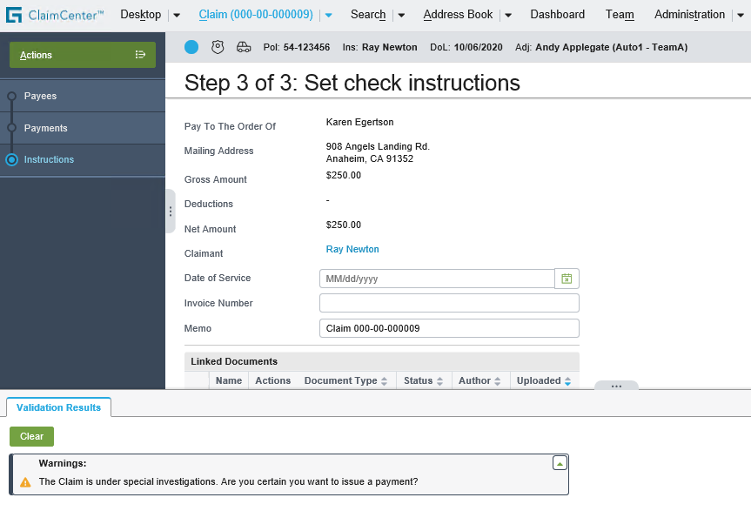
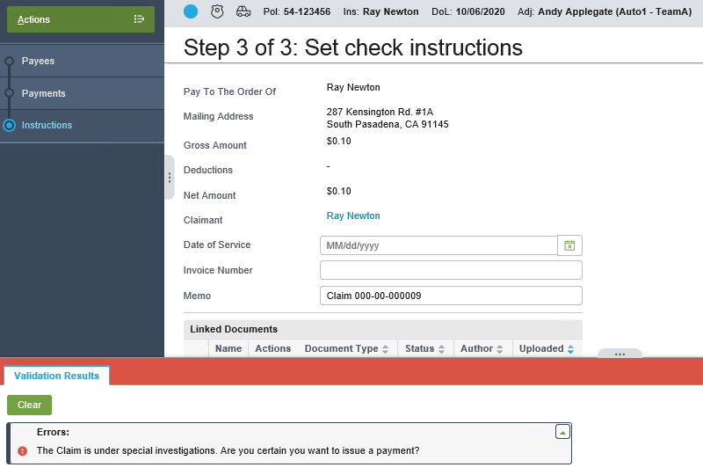
Transaction validation: Examples
Generate a Warning (But Let Transaction Be Created/Modified)
Generate an Error (Transaction Cannot Be Created/Modified)
Notes:
The options for transaction validation outcomes are identical to that of claim validation.

Slide 14
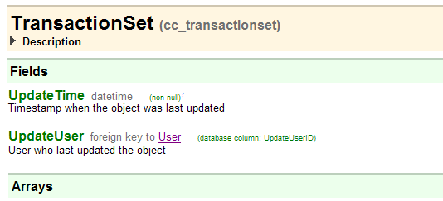
Validation levels for transactions
Transaction set objects and transaction objects do not have validation levels, but they use same validation mechanism as claims and exposures
Therefore, transaction validation rules must reference validation level, but level is ignored
Notes:
Technically speaking, a transaction set has no validation level. However, it may be easier to think of a transaction set as always being at the highest level of validation (which, in the base application, is "ability to pay"). Therefore, every validation rule will be relevant for a given transaction set, regardless of the level at which the rule is written.
Because the level is arbitrary, it may be easiest to write all transaction validation rules at a single level, such as "payment".

Slide 15
Lesson outline
Transaction and check life cycles
Transaction validation basics
Transaction validation rules

Slide 16
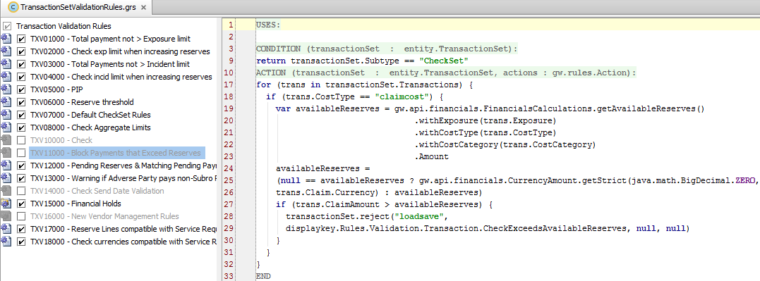
Transaction validation rules
Organized in same manner as claim validation rules – as a list
No use of actions.exit()
Contain base financials functionality in addition to examples
Notes:
All rules shown above are shipped with the base application.
Because you need to apply all or many of the rules to the data requirements of a TransactionSet, you do not use actions.exit() to terminate the ACTION of a transaction validation rule.
Key parts of financials functionality is included here (for example, TXV01000, which checks coverage limits on an exposure). Consult the ClaimCenter documentation (ClaimCenter Configuration Guide) for more details on all the rules shown here.

Slide 17


The reject() method
Syntax: transactionSet.reject ( errorLevel, errorText, warnLevel, warnText)
Method only on transactionSet (not Transaction or check)
Because transaction sets do not have maturity levels, there is no practical purpose to having warning and error in same rule
Warning
Error
Notes:
If you include a warning and an error in the same rule, then whenever the reject statement is executed, ClaimCenter will see two messages in the same statement and the error will take precedence. In this case, the warning would never be seen.

Slide 18
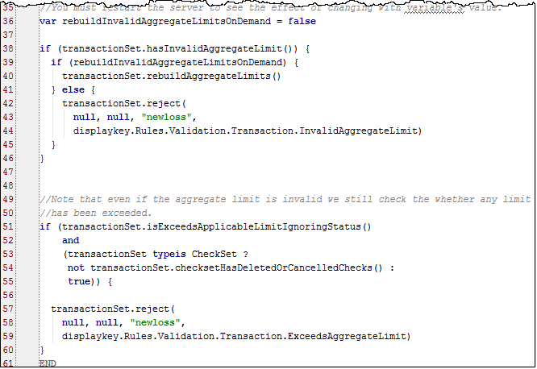
Validation example: Warning
Notes:
This rule is shipped with the base application.
The full rule is not displayed in the screenshot above, instead, only the rule actions. The rule’s condition returns true and there are copious comments at the beginning of the action that define and explain potential problems with invalid aggregate limits.

Slide 19
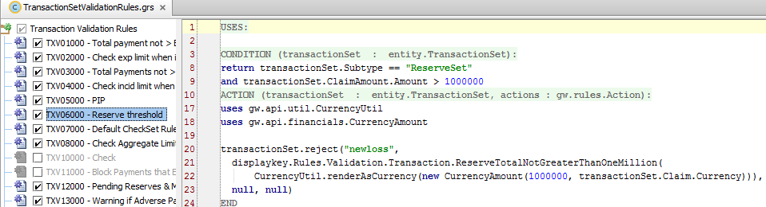
Validation example: Error
If the transaction set is a reserve set for over $1,000,000:
An error message is displayed
The save is prevented
Notes:
This rule is shipped with the base application.

Slide 20
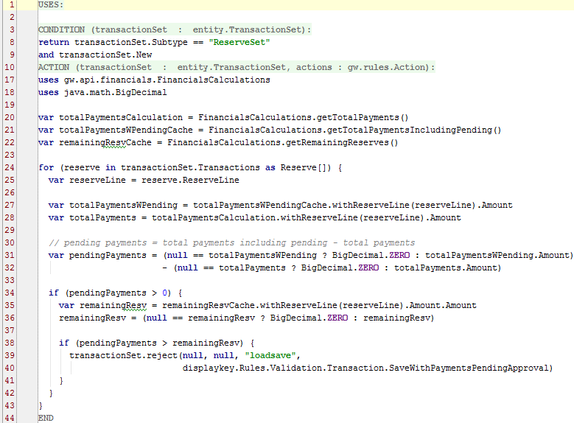
Validation example with financial measures
Newly created object (boolean)
Notes:
This rule is shipped with the base application.
The rule above makes use of a claim's financial measures.
On line 9, note the use of transactionSet.New, a boolean. Use .New as a condition to validate only upon creation, not when objects change state (are edited).
On lines 17 through 22, three cache reader objects are created, one for total payments, one for payments including pending, and one for remaining reserves. These values are retried in lines 27-32.

Slide 21
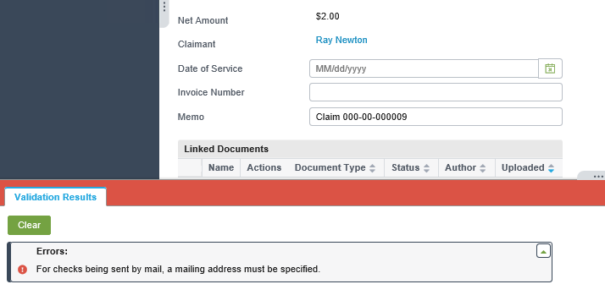
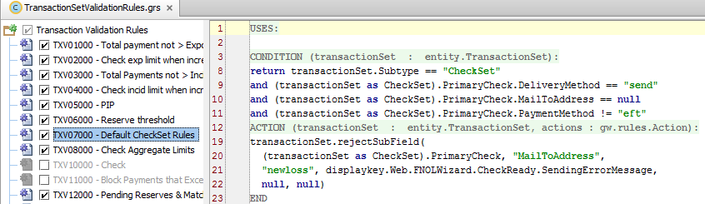
Uses of rejectField() and rejectSubField()
Notes:
TransactionSet entity also has rejectField() and rejectSubField() methods, which can be used to highlight the single field which is the source of the issue. These methods are discussed in detail in the “Introduction to Transaction Rules” lesson.

Slide 22
Lesson objectives review
You should now be able to:
Describe the life cycle of transactions and checks
Describe how transactions are validated
Write transaction validation rules

Slide 23



Review questions
What is the functional difference (if any) between these two reject statements:
What is the functional difference (if any) between these two reject statements:
Notes:
Answers
1. The first statement returns a warning. The second statement returns an error.
2. There is no functional difference between the two reject statements. The validation level must be supplied (because transaction validation uses the same framework as claim and exposure validation), but the level is ignored.

Slide 24
Notices
Copyright © 2001-2014 Guidewire Software, Inc. All rights reserved.
Guidewire, Guidewire Software, Guidewire ClaimCenter, Guidewire PolicyCenter, Guidewire BillingCenter, Guidewire Reinsurance Management, Guidewire ContactManager, Guidewire Vendor Data Management, Guidewire Client Data Management, Guidewire Rating Management, Guidewire InsuranceSuite, Guidewire ContactCenter, Guidewire Studio, Guidewire Product Designer, Guidewire Live, Guidewire DataHub, Guidewire InfoCenter, Guidewire Standard Reporting, Guidewire ExampleCenter, Guidewire Account Manager Portal, Guidewire Claim Portal, Guidewire Policyholder Portal, ClaimCenter, BillingCenter, PolicyCenter, InsuranceSuite, Gosu, Deliver Insurance Your Way, and the Guidewire logo are trademarks, service marks, or registered trademarks of Guidewire Software, Inc. in the United States and/or other countries.
All other trademarks are the property of their respective owners.
This material is confidential and proprietary to Guidewire and subject to the confidentiality terms in the applicable license agreement and/or separate nondisclosure agreement.
This file and the contents herein are the property of Guidewire Software, Inc. Use of this course material is restricted to students officially registered in this specific Guidewire-instructed course, or for other use expressly authorized by Guidewire. Replication or distribution of this course material in electronic, paper, or other format is prohibited without express permission from Guidewire.
Guidewire products are protected by one or more United States patents.

