Slide 1
Configuring Financial Holds
19 October 2020
Notes:
Guidewire training materials contain Guidewire proprietary information that is subject to confidentiality and non-disclosure agreements. You agree to use the information in this manual solely for the purpose of training to implement Guidewire software solutions. You also agree not to disclose the information in this manual to third parties or copy this manual without prior written consent from Guidewire. Guidewire training may be given only by Guidewire employees or certified Guidewire partners under the appropriate agreement with Guidewire.

Slide 2
Lesson objectives
By the end of this lesson, you should be able to:
Describe the motivation behind financial holds
Add or remove reasons that a claim’s coverage is in question
Ensure that initial reserves are not created when financial holds are in effect
Add or remove reasons for placing financial holds
This lesson uses the notes section for additional explanation and information. To view the notes in PowerPoint, choose View→Normal or View→Notes Page. If you choose to print the notes for the lesson, be sure to select “Print hidden slides.”

Slide 3
Lesson outline
Financial holds
Configuring coverage in question
Financial holds and initial reserve rules
Configuring financial holds

Slide 4
Financial holds
Why financial holds?
Some claims are recorded and tracked, but the carrier does not want to make any indemnity payments
Why not just keep these claims from getting to ability to pay?
Expense payments may still be required
Base configuration
No indemnity payments or claim cost reserves if …
Coverage is in question
Claim is incident only
Claim’s policy is unverified
Factors affecting financial holds are configurable

Slide 5
When financial holds are applied
Transaction | Initial Reserve rules | Validation rules
Claimcost reserves | Prevented | Prevented
Expense reserves | Allowed | Allowed with warning
Claimcost payments | n/a | Prevented
Expense payments | n/a | Allowed with warning
!
!
Notes:
NOTE: Validation rules do not prevent recoveries or recovery reserves

Slide 6
Lesson outline
Why financial holds
Configuring coverage in question
Financial holds and initial reserve rules
Configuring financial holds

Slide 7

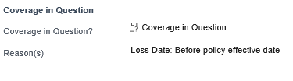
Setting coverage in question automatically
CiQ set automatically based on configurable settings
In base ClaimCenter configuration, CiQ is automatically set to true if any of the following are true:
Loss date is before policy effective date
Loss date is after policy expiration date
Policy status something other than "In force" or "Archived"
Examples
Claim with loss date before policy expiration date
Claim with loss date after policy expiration date
Notes:
Claims flagged as CiQ are also identified with the “Question Mark” icon in the Info Bar.

Slide 8

Configuring coverage in question
Developers can add or remove the criteria that ClaimCenter considers when determining if coverage is in question by configuring an enhancement and Preupdate rules
Controlled by:
GWClaimFinancialsHoldsEnhancement
Specifies criteria that are considered when determining coverage in question status
CPU 20000 – Claim Preupdate Rules
Specifies set of actions to take when coverage in question is true
Set coverage in question field to true (if it has not yet been set to true)
Create appropriate activities
Create claim history entries

Slide 9
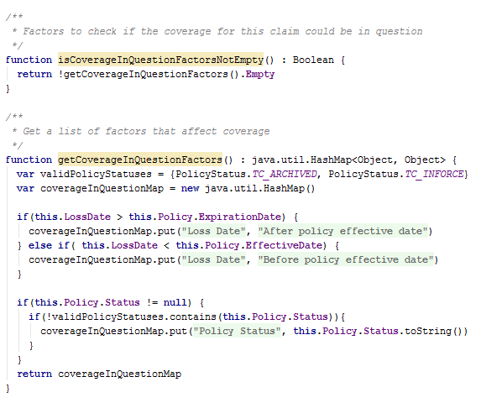
Configuring coverage in question
Modify GWClaimFinancialsHoldsEnhancement.gsx methods
Determine if
coverage is in question
Set factors to consider
Notes:
The screenshot above shows the base enhancement.

Slide 10
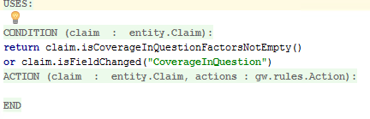

Pre-update check for CiQ
Executes every time a claim is updated
Claim Pre-update gatekeeper rule (20000) checks:
isCoverageInQuestionFactorsNotEmpty() returns true
Whether the user changed the CoverageInQuestion field
Child rules execute if either condition is true
Claim Pre-update “gatekeeper” logic:
Notes:
The CPU20000 Ruleset examples shown here and on the following slides are taken from the base application, and no configurations were made.

Slide 11
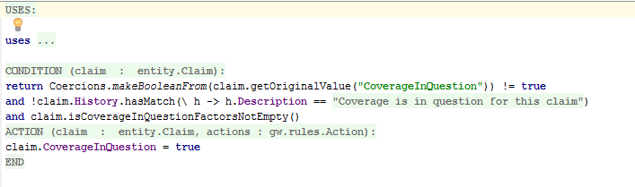
CiQ preudate rule (CPU20100 – Set CiQ)
CoverageInQuestion field set to true if:
Prior value of the CoverageInQuestion field is false
Claim history has no entry indicating that coverage was ever in question
isCoverageInQuestion() method returns true
Notes:
CPU20100 determines if the coverage in question was ever true before setting that field to true because the only way that CiQ can go from true to false is if it was overridden by a user whose role grants the authority to override that setting. Once the setting has been overridden, it is important that it not be reset automatically.

Slide 12
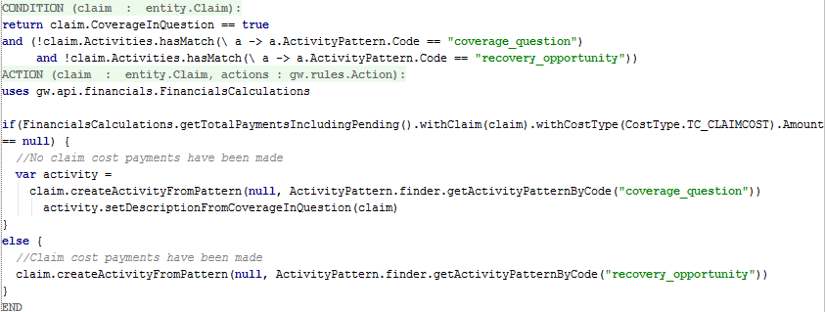
Activity Pre-update rule (CPU20200 – Activities)
Creates a “Review coverage in question” activity if no claim cost payments have been made; otherwise, it creates a “Recovery” activity if these checks return true:
CoverageInQuestion field is true,
No “Review coverage in question” or “Verify coverage & determine if opportunity for recovery” activities exist on the claim

Slide 13
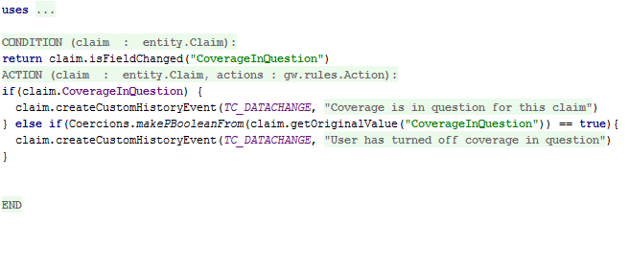
Create History Pre-update rule (CPU20300-Create History)
Creates a history record if the CoverageInQuestion field has changed

Slide 14
Lesson outline
Why financial holds
Configuring coverage in question
Financial holds and initial reserve rules
Configuring financial holds

Slide 15
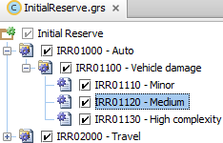
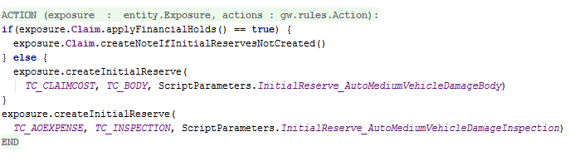
Financial holds affect initial reserve rules
Base application rules provide examples of how to integrate financial holds functionality into initial reserve rules
Wraps all claimcost initial reserve creation logic in a test that ensures financial holds are “off” before initial reserves are created
Notes:
The example code above (from the actions of IRR01120), determines whether financial holds are “on” before creating the claimcost initial reserves.
If financial holds are on, a note is created on the claim to explain why the claimcost initial reserves will not be automatically created.
If financial holds are not on, the initial reserves are created as usual.
In either case, expense reserves are created as they are unaffected by whether or not financial holds apply.
It is critical that claimcost initial reserve creation code be done only in the case where no financial holds apply. If this test is not done property or does not exist, ClaimCenter creates the reserves in this rule set, but rejects them in the transactionset validation rule set. As the reserve and the new exposure are in the same bundle, a user will not be able to save the new exposure.

Slide 16
Lesson outline
Why financial holds
Configuring coverage in question
Financial holds and initial reserve rules
Configuring financial holds

Slide 17
Configuring financial holds
Configure financial holds to specify
Factors that automatically trigger financial holds
TransactionSets subject to financial holds
Factors specified in GWClaimFinancialsHoldsEnhancement.gsx
Steps in configuring financial holds
Establish factors that trigger a hold
Configure transaction set types subject to financial holds
Specify action to take for each financial hold type
Notes:
Recall that if you use CTRL+click on the function name (in a ruleset), Studio opens the gosu enhancement file where the function is defined.

Slide 18
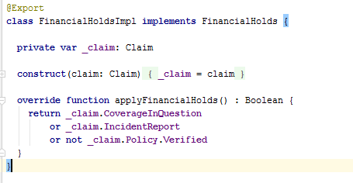
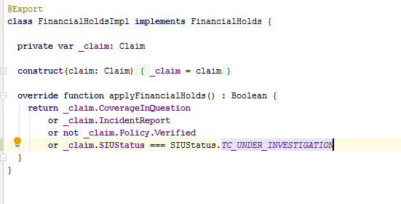
Step 1: Establish factors that trigger a hold
Edit applyFinancialHolds() function to alter conditions under which it returns true
Base configuration:
Configured function to trigger hold for claims in “Under Investigation” SIU status:
Notes:
NOTE: applyFinancialHolds() is defined in the file FinancialHoldsImpl.gs

Slide 19
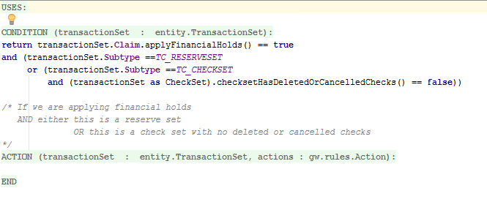
Step 2: Configure transaction set types
Transaction Set Validation Rule (TXV15000) serves as gatekeeper
If all of the following checks return true, child rules are evaluated:
Are financial holds “on” for this claim?
Is this a CheckSet or ReserveSet?
If a CheckSet, are none of the checks deleted or cancelled?
Notes:
Edit the rule conditions for TXV15000 to change the types of transaction sets to which financial holds will be applied when “on”

Slide 20


Step 3: Create rule for each hold type
Hold types …
… correspond to child rules
Notes:
TXV15100, TXV15200 , and TXV15300 all have the same actions for different conditions. If the coverage is in question, the claim is incident-only, or the claim policy is unverified (respectively), these rules check if any transaction in the TransactionSet has a claimcost cost type. If so, the transaction set is rejected. Otherwise, the transaction is allowed with a warning. All three rules have unique rejection/warning messages.
(Note that TXV15300 is inactive in the base configuration. This is solely because the ClaimCenter QA team uses unverified policies in automated testing. Activating this rule breaks many internal tests.)

Slide 21
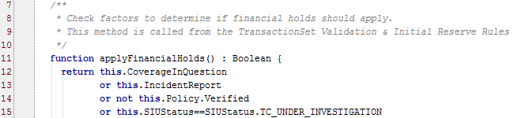

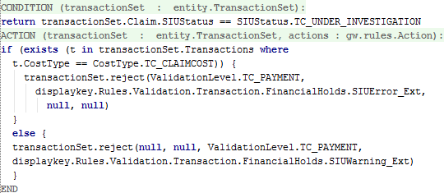
Example: SIU status is under investigation
Add a hold for SIU status under investigation:
Create the associated Transaction Set Validation subrule:
Notes:
The addition of the logic regarding SIU “Under Investigation” status was shown previously (Step 1).

Slide 22
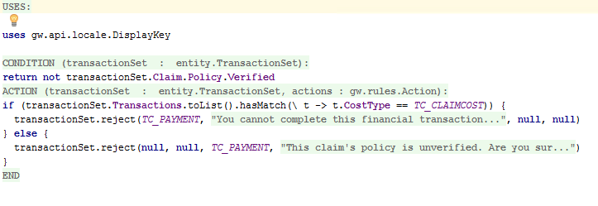
Using transactionSet.reject()
TXV15300 applies to policies that are not verified
Claim cost payment is rejected with an error
Payments other than claim cost result in warning
Error
Warning

Slide 23
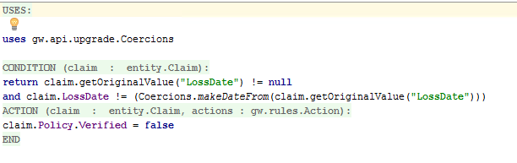
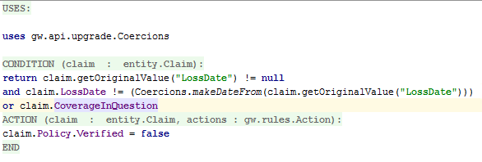
Unverify Policy if Loss Date Changed Pre-update rule (CPU21000)
Configure this base rule’s condition to implement any modifications or additions to logic that unverifies policies
Base configuration (Unverify if Loss Date has changed):
Configured ruleset (Unverify if Loss Date has changed or if CiQ is true):

Slide 24
Lesson objectives review
You should now be able to:
Describe the motivation behind financial holds
Add or remove reasons that a claim’s coverage is in question
Ensure that initial reserves are not created when financial holds are in effect
Add or remove reasons for placing financial holds

Slide 25
Review questions
What method is updated to change the conditions under which financial holds are applied?
What rule set determines whether holds apply to given transaction set type?
What method is used to display an error or a warning about a transaction set subject to a financial hold?
What rule set establishes the factors that determine a policy’s coverage in question (CiQ) status?
Should initial reserves be created if financial holds apply?
Notes:
Answers
applyFinancialHolds()
Transaction Set Validation Rules
transactionSet.reject()
Claim Pre-update
No. If initial reserves are created and a financial hold applies, the Transaction Set Validation rule set rejects the initial reserves making it impossible to create the associated exposure.

Slide 26
Notices
Copyright © 2001-2014 Guidewire Software, Inc. All rights reserved.
Guidewire, Guidewire Software, Guidewire ClaimCenter, Guidewire PolicyCenter, Guidewire BillingCenter, Guidewire Reinsurance Management, Guidewire ContactManager, Guidewire Vendor Data Management, Guidewire Client Data Management, Guidewire Rating Management, Guidewire InsuranceSuite, Guidewire ContactCenter, Guidewire Studio, Guidewire Product Designer, Guidewire Live, Guidewire DataHub, Guidewire InfoCenter, Guidewire Standard Reporting, Guidewire ExampleCenter, Guidewire Account Manager Portal, Guidewire Claim Portal, Guidewire Policyholder Portal, ClaimCenter, BillingCenter, PolicyCenter, InsuranceSuite, Gosu, Deliver Insurance Your Way, and the Guidewire logo are trademarks, service marks, or registered trademarks of Guidewire Software, Inc. in the United States and/or other countries.
All other trademarks are the property of their respective owners.
This material is confidential and proprietary to Guidewire and subject to the confidentiality terms in the applicable license agreement and/or separate nondisclosure agreement.
This file and the contents herein are the property of Guidewire Software, Inc. Use of this course material is restricted to students officially registered in this specific Guidewire-instructed course, or for other use expressly authorized by Guidewire. Replication or distribution of this course material in electronic, paper, or other format is prohibited without express permission from Guidewire.
Guidewire products are protected by one or more United States patents.

