Slide 1
V10 Configuration - New and Changed
28 October 2020
Notes:
Guidewire training materials contain Guidewire proprietary information that is subject to confidentiality and non-disclosure agreements. You agree to use the information in this manual solely for the purpose of training to implement Guidewire software solutions. You also agree not to disclose the information in this manual to third parties or copy this manual without prior written consent from Guidewire. Guidewire training may be given only by Guidewire employees or certified Guidewire partners under the appropriate agreement with Guidewire.

Slide 2
Lesson objectives
By the end of this lesson, you should be able to:
Describe the Creation, import and export of Business Rules
Changes to Display key
JSON Support
Changes to new Claim Creation Wizard
Theme changes
Changes in Getters and Setters
This lesson uses the notes section for additional explanation and information. To view the notes in PowerPoint, choose View→Normal or View→Notes Page. If you choose to print the notes for the lesson, be sure to select “Print hidden slides.”

Slide 3
Lesson outline
Business Rules
Display key Changes
JSON Support
Changes in New Claim Wizard
Theme Changes
Getter and setter changes

Slide 4
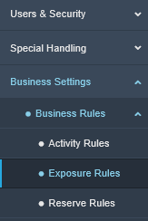
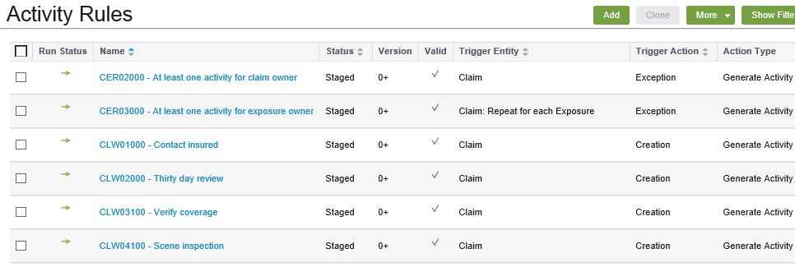
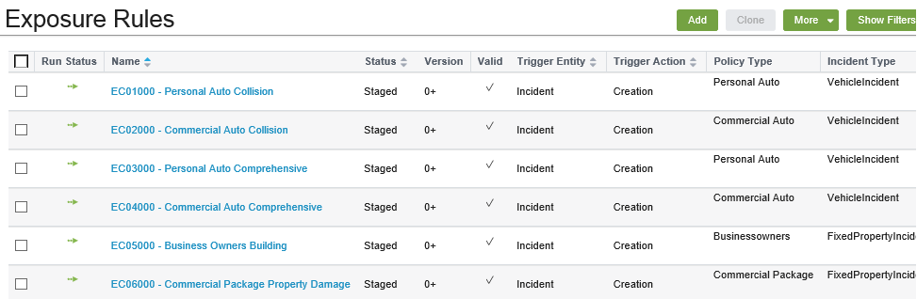
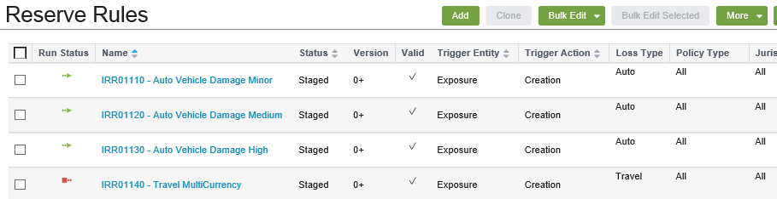
Business Rules
Business Rules Types
Activity Rules
Exposure Rules
Reserve Rules
Notes:
ClaimCenter provides a management tool that enables business analysts and administrators to create various claim components using business Rules. Business rules are executed at different stages of the application to generate activities, exposures and reserves.
We can access and Manage business rules in Administration tab using the Business Settings -> Business Rules menu link.
The following types of business rules can be accessed in this menu:
Activity Rules
Exposure Rules
Reserve Rules

Slide 5
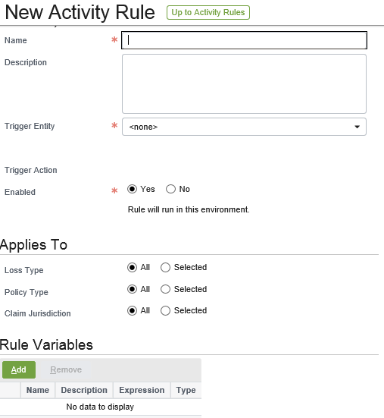
Creating new Business Rule
Click on Add Button in the Business Rule.
Enter the Name, Description, Trigger Entity, Trigger Action, Enabled, Applies to Rule Condition and Actions.
Save the Rule.
Notes:
Below are the steps to Create the New Activity Rule
Click Add to create a new Activity Rule
In the topmost section of the screen, enter following information.
Name – Enter a name.
Description – Enter the description of the Rule.
TriggerEntity – Specify the object that acts as the trigger for the Rule. E.g., Claim or Exposure.
TriggerAction – select the action that activates the rule. You can choose from Creation, Update or Exception.
Enabled – Specify if the rule will be executed in the current environment.
3. In the Applies To section, select the applicability criteria for the rule.
4. In the Rule Condition section, specify the conditions that must be fulfilled for this Rule to run.
5. In the Actions section, specify the conditions that needs to be performed when rule conditions are met and rule is executed.
Three choice for Actions
Generate Activity
Generate History Event
Set field
6. click save and the new rule is saved in Draft status.
7. Edit the rule to go back and fix validation rules.

Slide 6
(Notes only slide)
Notes:
Below are the steps to Create the New Exposure Rule
Click Add to create a new Exposure Rule
In the topmost section of the screen, enter following information.
Name – Enter a name.
Description – Enter the description of the Rule.
TriggerEntity – Specify the object that acts as the trigger for the Rule. E.g., Incident.
TriggerAction – select the action that activates the rule. In OOTB it is defaulted to Creation.
Enabled – Specify if the rule will be executed in the current environment.
3. In the Applies To section, select the applicability criteria for the rule. E.g., Policy type, Incident Type, Loss Cause, Loss type, Loss Party Type and Claim Jurisdiction.
4. In the Rule Variables section, add variables, if needed.
5. In the Rule Condition section, specify the conditions that must be fulfilled for this Rule to run.
6. In the Actions section, specify the conditions that needs to be performed when rule conditions are met and rule is executed. Default action type is Exposure Creation. You can specify two other fields.
Coverage Type
Coverage Subtype
7. click save and the new rule is saved in Draft status.
8. Edit the rule to go back and fix validation rules.

Slide 7
(Notes only slide)
Notes:
Below are the steps to Create the New Reserve Rule
Click Add to create a new Reserve Rule
In the topmost section of the screen, enter following information.
Name – Enter a name.
Description – Enter the description of the Rule.
TriggerEntity – Specify the object that acts as the trigger for the Rule. It is set to Exposure and not editable.
TriggerAction – select the action that activates the rule. In OOTB it is defaulted to Creation.
Enabled (Required) – Specify if the rule will be executed in the current environment.
3. In the Applies To section, select the applicability criteria for the rule. E.g., Loss type (required),Policy type, Claim Jurisdiction, Exposure Type and Exposure Segment.
4. In the Rule Variables section, add variables, if needed.
5. In the Rule Condition section, specify the conditions that must be fulfilled for this Rule to run.
6. In the Actions section, specify the conditions that needs to be performed when rule conditions are met and rule is executed.
Cost Type
Cost Category
Respect Financial Holds
Amount
Currency
Comments
7. click save and the new rule is saved in Draft status.
8. Edit the rule to go back and fix validation rules.

Slide 8
Rule Promotion Stages
Draft
Newly Created rules are in Draft Status
Rules are promoted from Draft to Staged
Staged
Rules are promoted from Staged to Approved
Approved
Rules that are once promoted to one stage cannot be moved to previous Stage

Slide 9
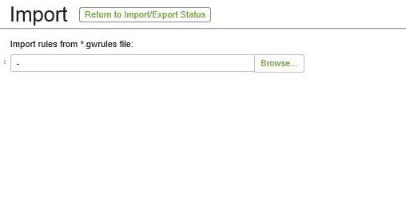
Importing Business Rules
Browse the file with .gwRules and import the newly Created Activities in the specific evironments.

Slide 10
Lesson outline
Business Rules
Display key Changes
JSON Support
Changes in New Claim Wizard
Theme Changes
Getter and setter changes

Slide 11
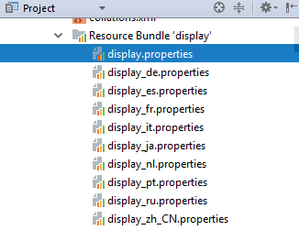
Display Key Changes
All language translations that Guidewire supports are provided directly in Guidewire Studio localization files at the time ClaimCenter becomes generally available.

Slide 12
Lesson outline
Business Rules
Display key Changes
JSON Support
Changes in New Claim Wizard
Theme Changes
Getter and setter changes

Slide 13
Transaction validation: Examples
Gosu has native support for JavaScript Object Notation (JSON) data format.
JSON is an open-standard form that uses human-readable text to transmit data objects consisting of attribute-value pairs, hierarchical data structures, and arrays.
Creation of JSON data and parsing can be implemented in any language or operating system and is especially popular due to efficient web browser client-side parsing in JavaScript.

Slide 14
Lesson outline
Business Rules
Display key Changes
JSON Support
Changes in New Claim Wizard
Theme Changes
Getter and setter changes

Slide 15
Changes to the New Claim wizard
The New Claim Wizard for the following lines of business has been updated from the classic version.
Business Owners
Commercial Package
Commercial Property
Farmowners
General Liability
Inland Marine
Personal Umbrella
Professional Liability
Notes:
Note : The Associated PCF files have changed as well. Ensure that you review them before creating new claims with these Policy types.

Slide 16
Lesson outline
Business Rules
Display key Changes
JSON Support
Changes in New Claim Wizard
Theme Changes
Getter and setter changes

Slide 17
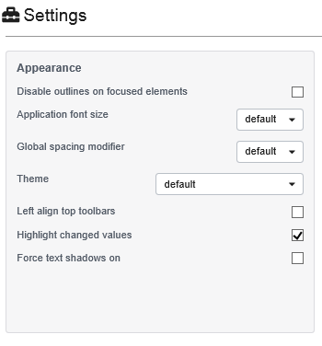
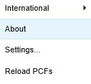

Changing Themes
Options
Notes:
On the top tab bar, in the Options menu, click settings.
In the Appearance section, in the Theme drop-down list, click the theme to use.

Slide 18
Lesson outline
Business Rules
Display key Changes
JSON Support
Changes in New Claim Wizard
Theme Changes
Getter and setter changes

Slide 19
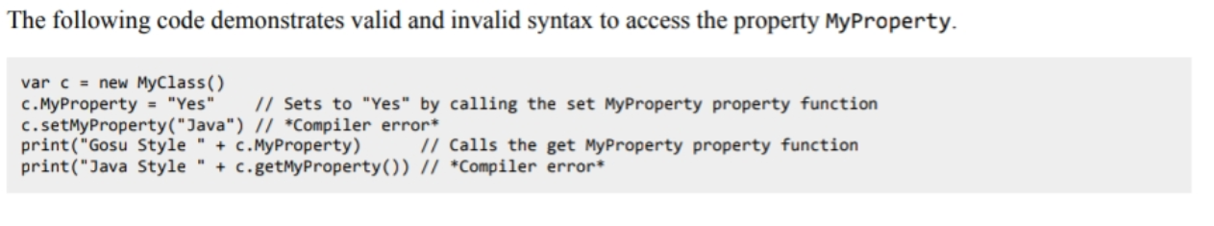
Getter and Setter Changes
In Previous Releases, for Java Compatibility, Gosu supported getXXX and setXXX to set the values for a property XXX in gosu Class. This syntax is not supported.
Dot Notation should be used to get and set the values of the property.

Slide 20
Lesson objectives review
You should now be able to:
Describe the Creation, import and export of Business Rules
Changes to Display key
JSON Support
Changes to new Claim Creation Wizard
Theme changes
Changes in Getters and Setters

Slide 21
Notices
Copyright © 2001-2014 Guidewire Software, Inc. All rights reserved.
Guidewire, Guidewire Software, Guidewire ClaimCenter, Guidewire PolicyCenter, Guidewire BillingCenter, Guidewire Reinsurance Management, Guidewire ContactManager, Guidewire Vendor Data Management, Guidewire Client Data Management, Guidewire Rating Management, Guidewire InsuranceSuite, Guidewire ContactCenter, Guidewire Studio, Guidewire Product Designer, Guidewire Live, Guidewire DataHub, Guidewire InfoCenter, Guidewire Standard Reporting, Guidewire ExampleCenter, Guidewire Account Manager Portal, Guidewire Claim Portal, Guidewire Policyholder Portal, ClaimCenter, BillingCenter, PolicyCenter, InsuranceSuite, Gosu, Deliver Insurance Your Way, and the Guidewire logo are trademarks, service marks, or registered trademarks of Guidewire Software, Inc. in the United States and/or other countries.
All other trademarks are the property of their respective owners.
This material is confidential and proprietary to Guidewire and subject to the confidentiality terms in the applicable license agreement and/or separate nondisclosure agreement.
This file and the contents herein are the property of Guidewire Software, Inc. Use of this course material is restricted to students officially registered in this specific Guidewire-instructed course, or for other use expressly authorized by Guidewire. Replication or distribution of this course material in electronic, paper, or other format is prohibited without express permission from Guidewire.
Guidewire products are protected by one or more United States patents.

