Slide 1
Wizards
22 October 2013
Notes:
Guidewire training materials contain Guidewire proprietary information that is subject to confidentiality and non-disclosure agreements. You agree to use the information in this manual solely for the purpose of training to implement Guidewire software solutions. You also agree not to disclose the information in this manual to third parties or copy this manual without prior written consent from Guidewire. Guidewire training may be given only by Guidewire employees or certified Guidewire partners under the appropriate agreement with Guidewire.

Slide 2
Lesson objectives
By the end of this lesson, you should be able to:
Describe the architecture of a wizard
Configure existing wizards
Create and modify wizard steps
This lesson uses the notes section for additional explanation and information. To view the notes in PowerPoint, choose View→Normal or View→Notes Page. If you choose to print the notes for the lesson, be sure to select “Print hidden slides.”

Slide 3
Lesson outline
Wizard basics
Wizard configuration
Wizard step configuration

Slide 4
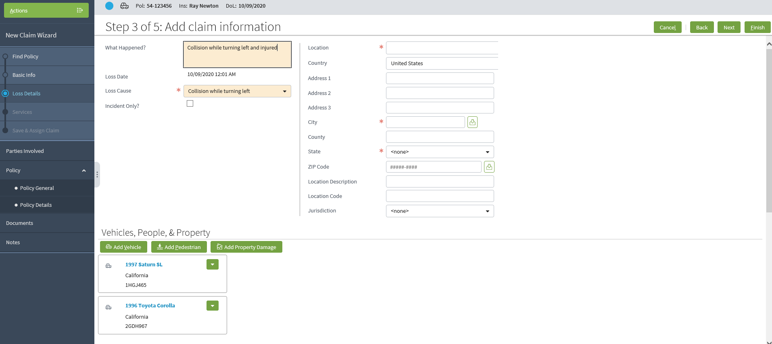
Wizards
A wizard is a location that contains multiple screens in a specific order and a toolbar to work through the wizard
Notes:
A wizard has multiple screens, but only one screen is displayed at a time. The screens in a wizard have an order (though it may be possible for a user to traverse the screens out of order).

Slide 5
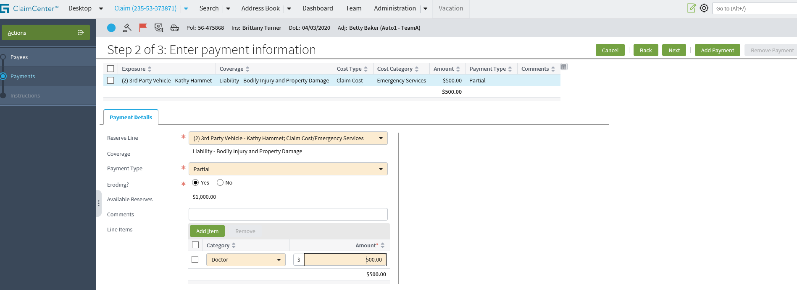
Wizards in the base application
FNOL (New Claim) Wizard
1
2
3
1
2
3
Normal Create Check Wizard
Notes:
The ClaimCenter base application comes with eight wizards. The two most frequently used wizards are arguably the FNOL Wizard (also commonly referred to as the "New Claim Wizard" or the "NCW") and the Normal Create Check Wizard (also commonly referred to as the "Payment Wizard"). The FNOL wizard contains all the screens for all lines of business (such as “Auto”, “Homeowners”, “Travel”, “WC”, etc.) and all levels of detail (such as the full wizard, the quick wizard, and the Auto line of business's "First and Final" wizard).
The base application also includes:
The Import Wizard (used on the Administration screen for importing data)
The Clone Check Wizard
The Edit Check Wizard
The Edit Recurrence Check Wizard
The Manual Create Check Wizard
The Quick Create Check Wizard

Slide 6
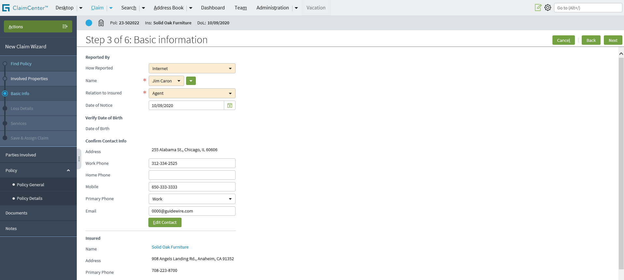
Comparing wizards and location groups
Both are assigned to a single tab
Both reference multiple screens
Both can have a set of screens that have no inherent order
Both have a shared info bar, actions menu, and side bar

Slide 7
Contrasting wizards and location groups
1 2 3 4 5
screen ref
Wizards have a toolbar specifically for navigating through the screens
Wizard access screens directly (as opposed to using pages)
Wizards have a set of screens which have an inherent vertical order
Wizard screen availability can be tied to where you are in the wizard
Notes:
The independent screens (such as the Parties Involved, Policy General, and Documents screen in the example above) are accessible regardless of what step you are at in the wizard.
A distinction needs to be made between menu link availability and menu link visibility. Visibility controls whether a menu link appears or not. This functionality is available to both wizard and non-wizard menu links. Availability controls whether a visible menu link is available or not. This functionality is also available to both wizard and non-wizard menu links. However, availability for a wizard menu link is typically based on where a user is it within the wizard. Location within a wizard does not typically change a menu link's visibility.

Slide 8
Wizard's UI components
wizard infobar
wizard toolbar
dependent steps
actions menu
independent steps
screen (which defines the UI contents of one step)
Notes:
The following UI elements can be thought of as "building blocks" that are used to render a wizard:
Actions menu
Dependent steps, which are an ordered set of labels, each of which represents a single wizard step and maps to a single screen. Some steps may not be accessible until a given step is complete.
Independent steps, which are a set of labels, each of which maps to a single screen. Independent steps do not have a logical order and can be accessed at any time, regardless of what steps have been completed in the wizard.
Wizard infobar, which lists information about the policy, the insured, or the claim.
Wizard toolbar, which contains Back and Next buttons to navigate through the wizard as well as other buttons relevant to the current step.
Screens (for each step of the wizard).

Slide 9
Lesson outline
Wizard basics
Wizard configuration
Wizard step configuration

Slide 10
Internal architecture
Tab
1 2 3
Wizard
WizardStep
screen
WizardStepSet
WizardStep
screen
WizardStep
screen
Notes:
The architecture of a wizard is more simplistic than that of a location group. A wizard's architecture consists of wizard steps, and each wizard step points directly to a screen. Often, wizard steps are grouped together into wizard step sets. Wizard step sets let developers specify logic which is identical for multiple steps. For example, if there was a series of wizard steps relevant only for property claims, they could be grouped into a wizard step set which had a visibility condition of "visible if the claim's loss type is property".

Slide 11
Wizard and wizard step configuration
Two levels of configuration
Wizard-level
Entry point and navigation to wizard
Permissions to visit and edit
Wizard-step-level
Screen that a step renders
Step logic (visibility, editability, next step)
Step order
Independent steps
1 2 3
Wizard
WizardStep
screen
WizardStep
screen
WizardStep
screen
Notes:
The next section of this lesson discusses wizard-level configuration. The section after that discusses wizard-step-level configuration.

Slide 12

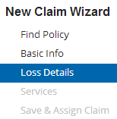
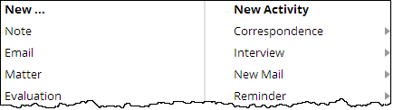
Information in wizard PCF file
FNOLWizard.pcf
info bar
Entry Point
menu actions
Wizard PCF file contains:
Entry point and required objects
Steps which point to screens
Attributes that point to separate files for info bar and menu actions

Slide 13
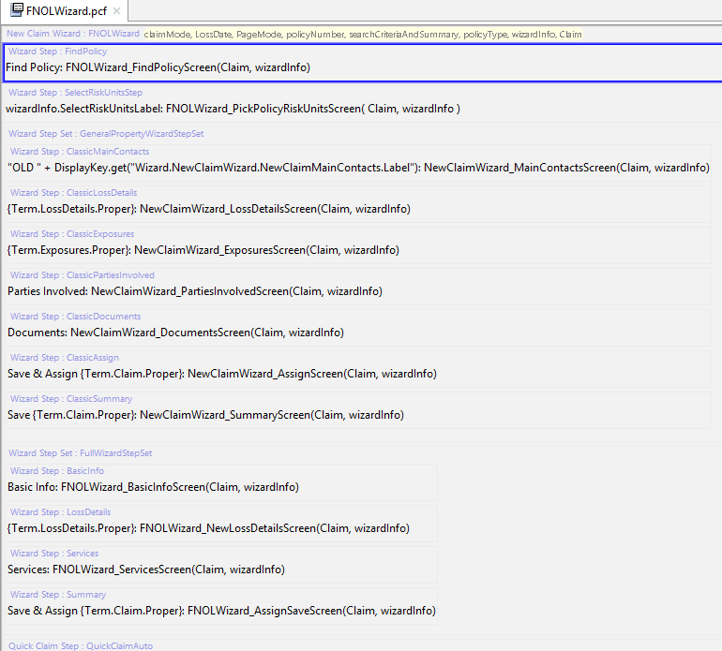
Example PCF file: FNOLWizard (1 of 2)
"Ordered" steps for full wizard
Notes:
The PCF file for a wizard consists of steps (either on their own on in step sets). Each step points to a screen.
The steps of a wizard are listed in the following order:
Ordered steps (and which screens they navigate to) for full wizards
(Continued on next slide)

Slide 14
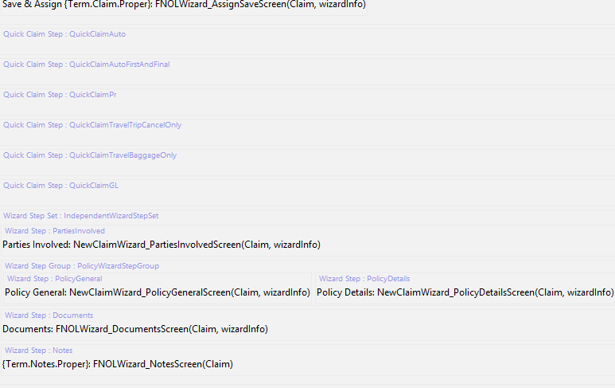
Example PCF file: FNOLWizard (2 of 2)
"Ordered" steps for LOB-specific quick wizards
Step set for independent steps
Notes:
2. Ordered steps (and which screens they navigate to) for quick wizards (for each LOB)
3. Independent steps (and which screens they navigate to) organized into a Step set “IndependentWizardStepSet”

Slide 15
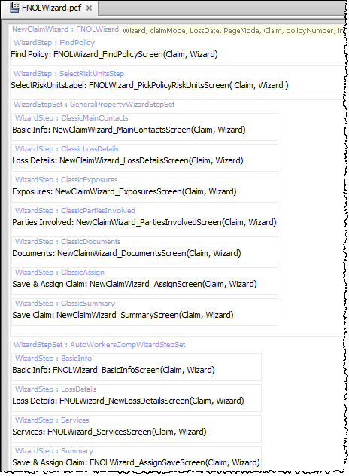
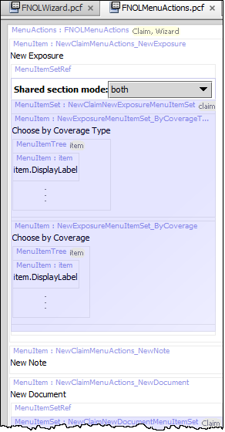
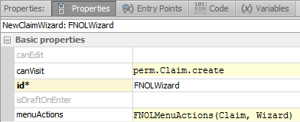
Wizard menu actions
Notes:
The wizard's menuActions property specifies the file to use for contents of the Actions menu. Recall you may use CTRL+N to search for PCF files in Guidewire Studio.

Slide 16
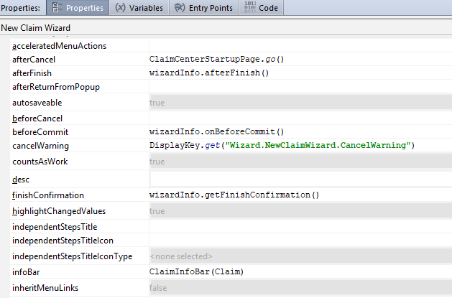
Wizard info bar
Notes:
The wizard's infoBar property specifies the file to use for contents of the info bar. Note that, in the base application, the Claim location group and FNOLWizard wizard use the same info bar.

Slide 17
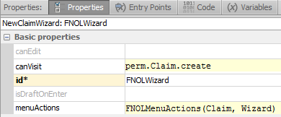
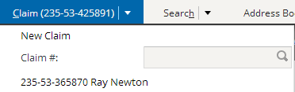

canVisit and canEdit properties
true
false
Notes:
The canEdit attribute determines whether a user can edit the information in the wizard. In some situations, you may want to let a user review the information entered in a wizard at some previous point in time without being able to edit that information. In this case, you would want a canEdit condition which returned false under the appropriate circumstances. (There may be few or no circumstances for this type of functionality in ClaimCenter, but it is used frequently within PolicyCenter to let users view information gathered by an underwriter to create, change, or cancel a policy.)
The canVisit attribute determines whether a user can visit the wizard. If blank, the attribute evaluates to true. When the attribute evaluates to false, any widget navigating to the wizard is not rendered. (This is shown in the example above. The screenshot on the lower left is the Claim tab as seen by an adjuster, who can create claims. The screenshot on the lower right is the Claim tab as seen by a user with the “Viewer” role, who cannot create claims.

Slide 18
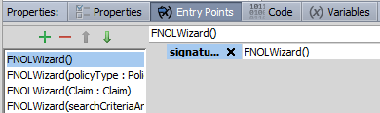
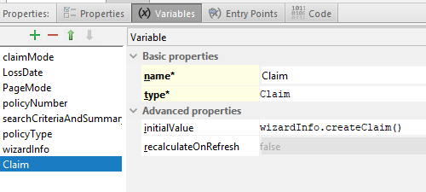
Entry points
Recall that entry point is name for location used by navigation widgets
Each object expected in each entry point must be declared on variable tab
entry point name
object name
object type
Notes:
In the example above, the FNOLWizard wizard has four entry points. The third entry point has a name of "FNOLWizard". It expects a single object of type claim which is referred to within the PCF page as "Claim".
Locations can have multiple entry points. This is useful when a single location can be referenced from different places with different known pieces of information. For example, the FNOLWizard can be accessed with no object (as seen in the first entry point), with a set of information including a PolicyType object (as seen in the second entry point), with a claim (as seen in the third entry point), or with a search criteria (as seen in the fourth entry point).

Slide 19
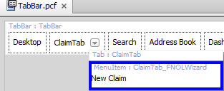
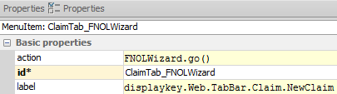
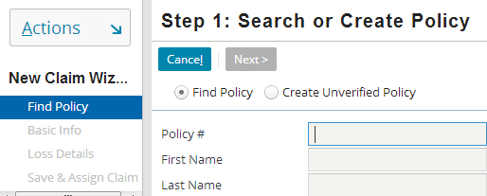
Navigating to wizards
Navigation uses "go()"
Syntax:
EntryPointOfLocation.go(objectsToPass)
Notes:
Most navigation widgets have an action attribute, which defines where to navigate to when the widget is clicked. The syntax for an action attribute which navigates to a location is:
pcf.LocationEntryPoint.method(objectList), where
LocationEntryPoint is (one of) the location entry point(s) defined on the destination location's Entry Points tab.
method is the method used to navigate to the location (which, for location groups, is almost always "go").
objectList is a comma-delimited list of zero to many objects. This list must match the number of objects and the type which are expected by the location entry point.
In the example above, the Claim tab has a New Claim menu item. This menu item has an action of "FNOLWizard.go()". The go method indicates that clicking the menu item should navigate the user to that location. (The empty parentheses indicate that no object is to be passed to that location.) The location to navigate to is the one that has an entry point of "FNOLWizard".
The FNOLWizard PCF file has an Entry Points tab. From this tab, four entry points have been defined, including one which is "FNOLWizard" with no arguments. Because this corresponds to the menu item, this is the location to which the user will be navigated when the user clicks the menu item.

Slide 20
Lesson outline
Wizard basics
Wizard configuration
Wizard step configuration

Slide 21

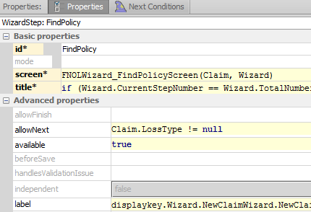
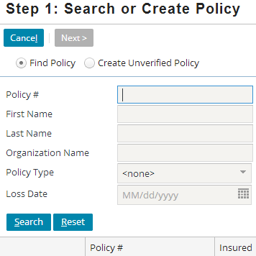
Screens are referenced by steps
When clicked, what screen is displayed?
Notes:
Each wizard step has a screen attribute. This specifies the screen which the step points to. If the destination screen requires one or more objects, then the screen attribute must specify which objects to pass.

Slide 22
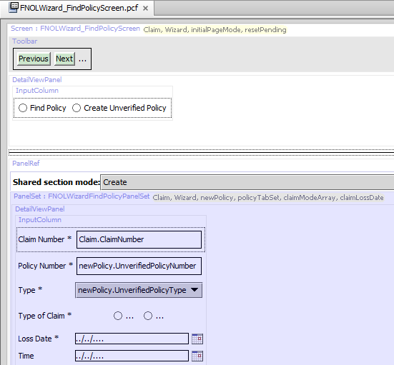
Screen PCFs
Screen PCF file contains references to all embedded content

Slide 23
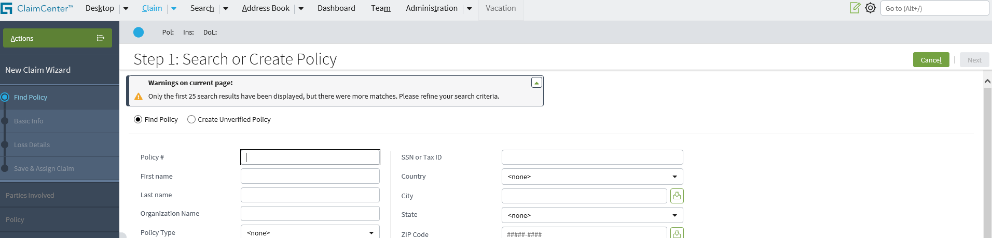
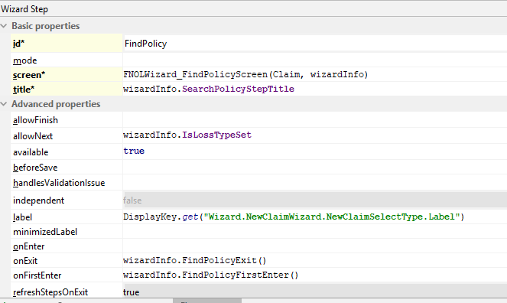
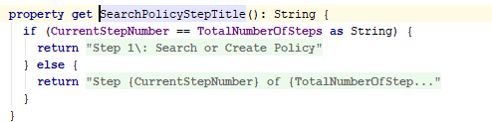
Screen-related labels
Notes:
The wizard step's title attribute determines the text displayed in the title bar for the given step. In the example above, the attribute is set to a condition. If the current step number equals the total number of steps (which would be true if the wizard was a one-step wizard, then the display key "Wizard.NewClaimWizard.NewClaimSelectType.OneStep" is displayed, which in the English locale is set to "Step 1: Search or Create Policy". Otherwise, the display key "Wizard.NewClaimWizard.NewClaimSelectType.Step" is used, which in the English locale is set to "Step {0} of {1}: Search or Create Policy". Two arguments are passed in and occupy the positions {0} and {1}.
The title attribute code shown above has been enhanced to include word wrap, for better legibility.
The step's label attribute determines the text displayed in the sidebar for the given step. In the example above, the attribute is set to the display key "Wizard.NewClaimWizard.NewClaimSelectType.Label", which in the English (en_US) locale is set to "Find Policy".

Slide 24
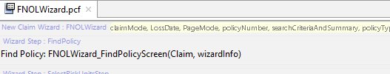
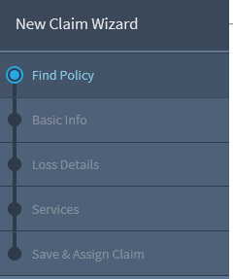
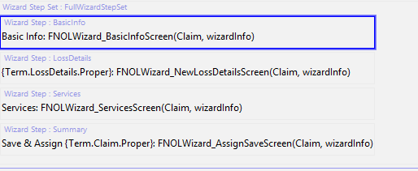
Order of wizard steps
StepSet
1
2
1 2 3 4 5
3
4
5
Determined by order in which they appear in PCF file
Wizard displays all visible steps in order declared
Dependent steps are always in top box of sidebar
Independent steps are always in bottom box of sidebar
Notes:
The “Find Policy” step is at the top of the pcf file, and applies to claims of most all LOBs. Steps 2 and onwards are determined by the LOB. More will be discussed on this later in the lesson.

Slide 25
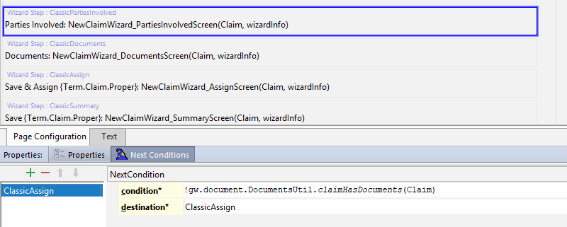
Next steps
if claim does not have documents, go to ClassicAssign
Wizard step can have a "next" condition
When false, wizard advances to next step in sequence
When true, wizard advances to specified step
Notes:
In the example above, the ClassicPartiesInvolved step has a next condition. The condition's logic is, essentially, "if the claim does not have documents, use ClassicAssign as the destination step". If a claim has documents, it advances to the next step in order, ClassicDocuments. If the claim does not have documents, it advances to the destination step, ClassicAssign, thereby skipping over ClassicDocuments.

Slide 26
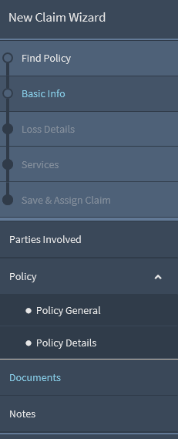
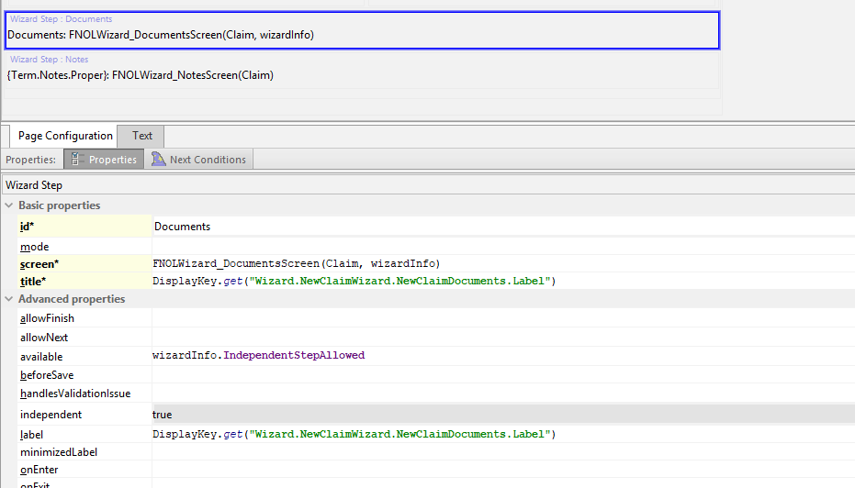
Independent wizard steps
To make a step independent, set independent attribute to true

Slide 27
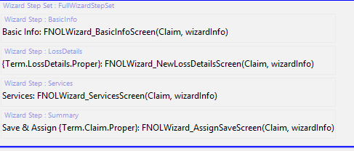
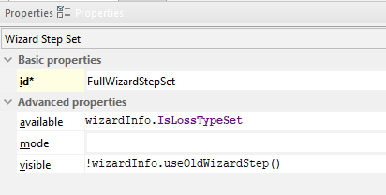

Wizard step sets
A wizard step set is a set of wizard steps which have shared logic (visible, available, mode) and can be inserted into a wizard as a group
Notes:
In the ClaimCenter base application, there is one set of wizard steps used for auto, workers' comp, travel, and homeowners' claims and a different set of wizard steps used for other property and liability claims.
The availability and visibility logic for a wizard step set is accessible in the properties window. In the base application, the step set shown above makes use of a "useNewWizardStep" function, which is declared on the FNOLWizard.pcf's Code tab.

Slide 28
Wizard step groups
A wizard step group is a set of wizard steps which:
Are indented
Have a single parent label
Notes:
Wizard step groups have a visible attribute, but they do not have an available attribute. Wizard step groups are intended for creating a collection of "child" steps or "sub" steps, as opposed to wizard step sets, which are intended to gather a set of steps which should be treated as a logical unit.

Slide 29
Lesson objectives review
You should now be able to:
Describe the architecture of a wizard
Configure existing wizards
Create and modify wizard steps

Slide 30
Review questions
Name three things that are true of a wizard that are not true of a location group.
Why would you want to put wizard steps into a step set? A step group?
What attribute controls the order of appearance of wizard steps in the user interface?
How does a step behave differently if you set its independent attribute to true?
What is a wizard's entry point? What other elements of the user interface reference a wizard's entry point?
Notes:
Answers
1. Possible answers:
Wizard screens are ordered.
Wizards have toolbars used to navigate through the ordered screens.
Wizard screen toolbars can have buttons that execute workflow triggers.
Wizard screens can have conditional availability tied to where you are at in the wizard.
2. You might put steps into a step set when you want to control the visibility or availability of multiple steps with a single condition. You might put steps into a step group when you want the steps to be indented with a single label displayed over all of them.
3. There is no attribute that controls the order of appearance. Order of appearance is based on the order in which the wizard steps are listed in the PCF file.
4. If a step is independent, then it is listed at the bottom and it cannot be navigated to using the Back/Next toolbar buttons.
5. A wizard's entry point is the internal name for the wizard. It is used by navigation widgets which navigate to the wizard when clicked.

Slide 31
Notices
Copyright © 2001-2014 Guidewire Software, Inc. All rights reserved.
Guidewire, Guidewire Software, Guidewire ClaimCenter, Guidewire PolicyCenter, Guidewire BillingCenter, Guidewire Reinsurance Management, Guidewire ContactManager, Guidewire Vendor Data Management, Guidewire Client Data Management, Guidewire Rating Management, Guidewire InsuranceSuite, Guidewire ContactCenter, Guidewire Studio, Guidewire Product Designer, Guidewire Live, Guidewire DataHub, Guidewire InfoCenter, Guidewire Standard Reporting, Guidewire ExampleCenter, Guidewire Account Manager Portal, Guidewire Claim Portal, Guidewire Policyholder Portal, ClaimCenter, BillingCenter, PolicyCenter, InsuranceSuite, Gosu, Deliver Insurance Your Way, and the Guidewire logo are trademarks, service marks, or registered trademarks of Guidewire Software, Inc. in the United States and/or other countries.
All other trademarks are the property of their respective owners.
This material is confidential and proprietary to Guidewire and subject to the confidentiality terms in the applicable license agreement and/or separate nondisclosure agreement.
This file and the contents herein are the property of Guidewire Software, Inc. Use of this course material is restricted to students officially registered in this specific Guidewire-instructed course, or for other use expressly authorized by Guidewire. Replication or distribution of this course material in electronic, paper, or other format is prohibited without express permission from Guidewire.
Guidewire products are protected by one or more United States patents.

