Slide 1
Claim Setup Rules
24 January 2014
Notes:
Guidewire training materials contain Guidewire proprietary information that is subject to confidentiality and non-disclosure agreements. You agree to use the information in this manual solely for the purpose of training to implement Guidewire software solutions. You also agree not to disclose the information in this manual to third parties or copy this manual without prior written consent from Guidewire. Guidewire training may be given only by Guidewire employees or certified Guidewire partners under the appropriate agreement with Guidewire.

Slide 2
Lesson objectives
By the end of this lesson, you should be able to:
Describe the business rule set categories in ClaimCenter
Describe how claim setup rules execute claim setup
Write presetup rules
Write segmentation rules
Write workplan rules
Manage activity patterns
Describe the rules executed for exposure and activity setup
This lesson uses the notes section for additional explanation and information. To view the notes in PowerPoint, choose View→Normal or View→Notes Page. If you choose to print the notes for the lesson, be sure to select “Print hidden slides.”

Slide 3
Lesson outline
Business Rules in ClaimCenter
Claim setup basics
Presetup rules
Segmentation rules
Workplan rules
Exposure and activity setup

Slide 4
ClaimCenter business rules
Business Rules are part of the Guidewire Platform capabilities
ClaimCenter business rules execute business logic required for claims processing
Written in Gosu (an open source programming language)
ClaimCenter
Data Model
User Inter.
Bus. Rules
Int. APIs
Guidewire Platform, with a common technology for configuring...
Data Model
User Interface
Business Rules
Integration APIs
Notes:
For information on the basics of working with rules, consult the “Business Rules” lesson of the Configuration Fundamentals course, which is a prerequisite to this course.

Slide 5
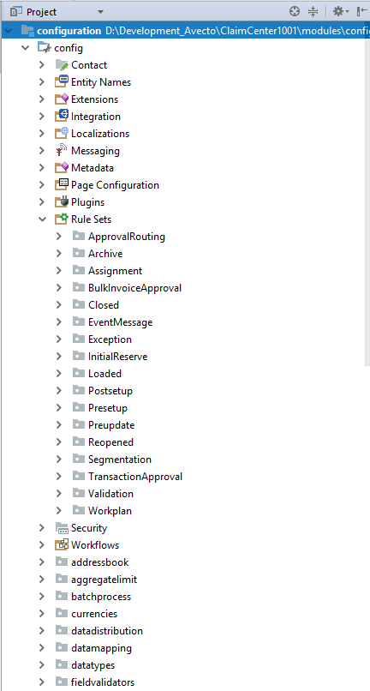


Business rule set categories
Business rule sets are grouped into logical rule set categories
Within each category are one or more rule sets, i.e. ClaimSegmentationRules in the Segmentation category
Rule set categories
Rule sets

Slide 6
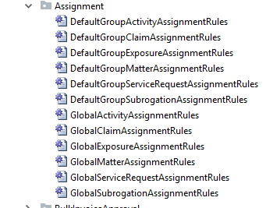
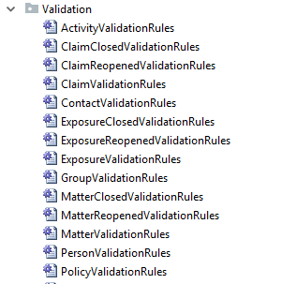
Business rule sets
A business rule set is a set of rules which enforce a specific category of business logic
Examples:
Assignment - assign ownable objects to groups and users
Validation - verify changes being made to object are valid before data is committed to database
Notes:
As indicated in the screenshot, there are several other Validation rules in ClaimCenter in addition to the ones shown.

Slide 7

Business rule triggers
Claim Preupdate
Claim Validation
Event Fired
When a claim is updated...
... these rule sets are executed in the order shown
Every rule set is automatically executed when some predetermined condition (rule trigger) is met
Most triggers relate to the creation of or change to an instance of a given entity
Some rule sets can be called manually
Notes:
The behavior described above is true for all business rules in ClaimCenter, but it is not true for all business rules in all Guidewire applications. For example, PolicyCenter Renewal rules are never called automatically but instead are called explicitly by Gosu code inside jobflows when it needs to decide whether to accept or reject a renewal request.
Claim Preupdate rules execute any work that needs to be done against the claim before it is validated.
Claim Validation rules determine whether or not the claim is still valid and the changes (either from the user and/or from the Preupdate rules) can be written to the database.
Guidewire ClaimCenter uses events and messaging to communicate with external systems. Event fired rules create message “payloads” in response to specific events.
Note: Event Fired rules performs actions when ClaimCenter fires an integration event. The rules can receive the event and generate the event message that ClaimCenter sends to its destination. Event Fired rules are found in the “EventMessage” category.
Event Fired rules are discussed in the Guidewire 8.0 Integration Fundamentals course in the “Message Payloads” lesson.

Slide 8
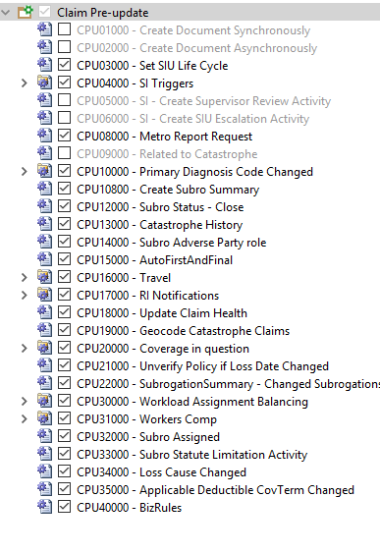
Business rule set execution order
Rule sets contain multiple rules
Rules in a set execute sequentially unless a rule contains a command that terminates processing of subsequent rules in the set upon successful completion of the rule’s actions
Disabled rules do not execute
disabled
1 2
3
4 5 6 7 8
…
Notes:
Claim Preupdate rules and other validation rules do not make use of actions.exit() and other similar Gosu code that prevents the execution of subsequent rules in the rule set. Segmentation rules, which are discussed in this lesson, do make use of actions.exit(). Segmentation rules are discussed later in this lesson. The Assignment rule set also uses actions.exit() to terminate rule execution once an activity, claim, assignment, or matter has been assigned. Assignment rule sets are discussed in a “Further Study” lesson of this course.

Slide 9
Business functions trigger rule set categories
Categories triggered varies by business process
Order in which categories execute is predetermined
For example, new claim creation triggers these rule sets:
Presetup (set of automatic actions)
Segmentation (categorize)
Assignment (determine responsible party)
Workplan (add initial activities)
Postsetup (set of automatic actions)
Validation (check for missing info or invalid data)
In contrast, updating existing claim triggers:
Preupdate (set of automatic actions)
Validation (check for missing info or invalid data)
Notes:
See the “Gosu Business Rules” chapter in “The ClaimCenter Rules Guide” documentation resource for more detailed information on rules sets categories, their function and triggering business processes.
Note: The following rule set categories are not discussed in this class:
Archive rules mark claims for archiving
Closed rules execute logic when a claim, exposure, activity or matter is closed
EventMessage rules execute logic when an integration event occurs
Loaded rules execute logic when a claim or exposure is imported from FNOL application
Reopened rules execute logic when a claim, exposure, or matter is reopened
Bulk InvoiceApproval rules execute logic when Bulk Invoices are created

Slide 10
Lesson outline
Business Rules in ClaimCenter
Claim setup basics
Presetup rules
Segmentation rules
Workplan rules
Exposure and activity setup

Slide 11
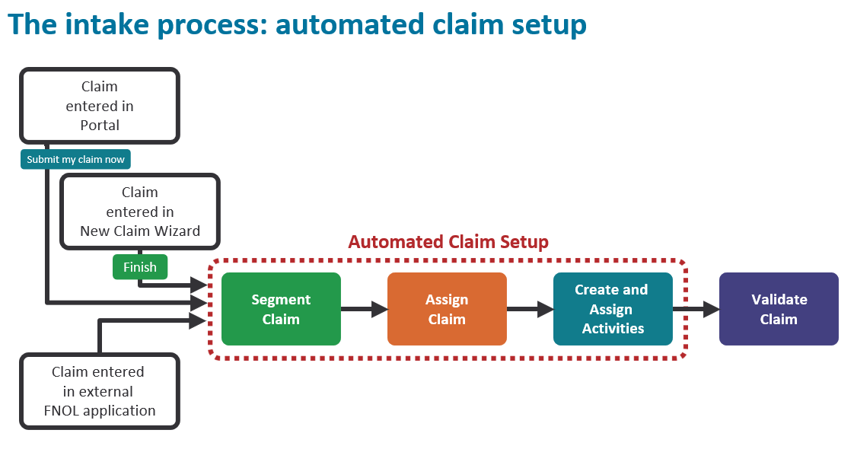
Rules triggered by claim import or completion of new claim wizard
Prepare claim for adjudication
Notes:
Once the claim has been created or imported, it enters the automated claim setup process. There are three primary things that occur during claim setup. First, the claim is segmented. Segmentation is the process of determining the strategy for how the claim should be processed. (For example, is the claim straight-forward or is it complex and will it require adjusters with special expertise.) Then, the claim is assigned. Assignment is the act of determining who is responsible for the claim. The user creating the claim can specify who it should be assigned to, or the assignment could be determined using automated rules. Finally, a series of activities known as the "workplan" are created and assigned. These activities identify the work that must be done to process the claim and who must do it.
Claim setup is run only when the NCW completes, or when you call the addFNOL() method from the web services API. You cannot invoke setup from rules.

Slide 12
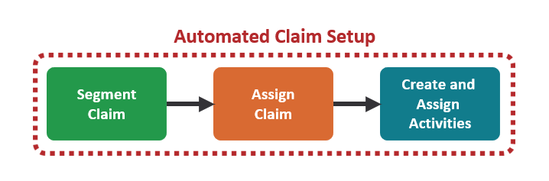
Automated claim setup
A series of rules designed to:
Execute any work required for the claim that can be done automatically (such as generating a list of activities to complete)
Ensure that the claim is ready for adjudication
Sometimes referred to as “SAW”
Segment
Assign
Workplan

Slide 13

The intake process: automated claim setup: Configurator view
Claim is entered in New Claim Wizard
Preupdate + validate claim
Automated Claim Setup
Presetup
Create and assign activities
Postsetup
Initial Reserve
Segment claim
Assign claim
import
Loaded
Rules triggered by claim import or completion of new claim wizard
Prepare claim for adjudication
Claim is entered in external FNOL application

Slide 14
Claim setup rules
Loaded
Series of rules executed to complete claim setup
For most rules, there are both Claim-level and exposure-level rules
In most cases, claim-level rules run before exposure-level rules
Presetup
Some are exclusive to setup; others are also used outside setup
Segmentation
unique to setup
Assignment
used outside setup
Workplan
activity rules
Postsetup
Initial Reserve
Preupdate
Validation
Notes:
The only rule set which doesn't have both claim- and exposure-level rules is Initial Reserve. (These are only exposure-level rules.)
The only time claim-level rules are not run first is Segmentation. (Exposure-level segmentation rules are executed first.)
The rules engine runs all of the rule sets listed on the slide above, with the possible exceptions:
Loaded rules are executed only if the claim entered the system through an FNOL import.
Assignment rules are executed only if the user chooses to use automated assignment rules for the claim.
If the Claim Workplan rule set does not create any activities, then the activity rules (presetup, assignment, postsetup) immediately following it are not run. The same is also true for the Exposure Workplan rule set.
The rules that are executed during claim setup have been somewhat simplified in the diagram above. The next page shows the complete list of rules in the order they are executed.

Slide 15
(Notes only slide)
Notes:
Notes are visible if you view PowerPoint in Notes view (View > Notes Page).

Slide 16
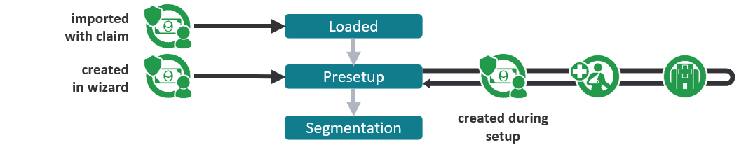
Exposure in claim setup
Can exist at the start of setup
Created during new claim wizard
Imported with imported claim
Can be created during setup
Typically in Presetup rules
May not be present at all
If no exposures exist, exposure-level rules are skipped
Notes:
The way in which a claim is segmented is often heavily dependent on its exposures. Therefore, if exposures are created during set-up, it typically occurs in Presetup rules, which are the rules that immediately precede segmentation.

Slide 17
Loaded rules
Claim Exposure
Loaded
Executed only for imported claims and exposures
Purpose
Execute actions related to import
Example
Log information about every claim received via FNOL import
Presetup
Segmentation
Assignment
Workplan
activity rules
Postsetup
First Notice Application
Initial Reserve
Preupdate
Validation
Notes:
Claim Loaded rules execute when a new claim is loaded through the FNOL import interface. ClaimCenter executes Loaded rules when it finishes importing or “loading” a claim from an external FNOL source. The purpose of this rule category is to make any changes necessary to convert initial claim data from an external format into a suitable structure for ClaimCenter. In addition, you can create Loaded rules to record the import of claims.
You can create whatever rules are appropriate to handle the import of new claims:
Sanity checks
Data aggregations and transformations
Data and naming reconciliations
Claim import logging

Slide 18
Presetup rules
Loaded
Purpose
Execute actions that must occur at beginning of setup process, particularly before segmentation
Examples
Create "automated" exposures where need for exposure can be inferred
Example: If loss cause is "collision with vehicle", create vehicle collision exposure
Set deductible status to "unpaid"
Presetup
Claim Exposure
Segmentation
Assignment
Workplan
activity rules
Postsetup
Initial Reserve
Preupdate
Validation
Notes:
Presetup rules are used to take action on a claim or exposure before it is segmented. This is particularly important since the segmentation (and therefore assignment) of exposures and claims might depend on work performed in the presetup rules.

Slide 19
Segmentation rules
Loaded
Purpose
"Segment" the object (identify high-level strategy for processing object)
Examples
In workers' comp claim, if injury severity is "fatal", segment exposure as "complex"
In auto claim, if auto damage is only "broken windshield", segment claim as "simple - glass"
Exposure-level rules execute before claim-level rules
Presetup
Segmentation
Exposure Claim
Assignment
Workplan
activity rules
Postsetup
Initial Reserve
Preupdate
Validation
Notes:
Exposure-level segmentation is done before claim-level segmentation because claim segmentation often depends on the outcome of exposure segmentation.
Segments are high-level categorizations that are used to simplify logic in later rule sets, such as:
Assignment routing
Activity creation
Initial reserves

Slide 20
Assignment rules
Loaded
Purpose
Assign claim to group and user
Assign each exposure to group and user
Examples
Assign workers' comp claim with segment "complex" to national "complex WC" group
Assign auto claims with segment "simple - auto glass" to auto glass group in same region as insured's address
Presetup
Segmentation
Assignment
Claim Exposure
Workplan
activity rules
Postsetup
Initial Reserve
Preupdate
Validation
Notes:
Assignment rules are run when a claim (or exposure) is created and the "use automatic assignment" option is chosen.
The claim is assigned first, and then its exposures. The exposure owner is not necessarily the same as the claim owner. However, unless it meets a special circumstance, each exposure is typically assigned to the same group and user as the claim.
Assignment rules are also run outside of setup when a claim or exposure is reassigned and the reassigning user selects the "use automatic assignment" option.
Assignment rules are discussed in detail in the "Assignment Rules: Advanced Assignment" lesson in the "Further Study” lessons of this course.

Slide 21
Contrasting segmentation and assignment
easy
medium
hard
Segmentation:
Determines the strategy for processing the object
Is done only for claims and exposures
Sets a single field on the object to a value from a predefined list
Is only done once for a given object
Assignment:
Determines the group and owner of the object
Is done for claims, exposures, activities, and matters
Associates object to group and user (chosen from existing groups and users)
Could occur many times for a given object
Notes:
The primary purpose of segmentation is to categorize a claim or exposure with regards to the strategy for processing the claim. This categorization is a simple field value. It may or may not be used by assignment rules, and it may or may not be used in other aspects of claim processing. (For example, certain line items might be written to the claim's history based on its segment, such as details to changes in the parties involved if and only if the claim has a segment of "complex").
The primary purpose of assignment is to determine the owner of an assignable object, which includes activities and matters. The assignment is two foreign keys, one pointing to an existing group and one pointing to an existing user. Assignment may or may not be based on segment.

Slide 22
Workplan rules
Loaded
Purpose
Create initial claim workplan (list of activities for claim and each exposure)
Examples
Create "contact insured" activity
If owner of claim is low experience user, create "verify coverage" activity
If claim is auto, create "scene inspection" activity
For each activity created: presetup, assignment, and postsetup rules executed
Presetup
Segmentation
Assignment
Claim
Workplan
activity rules
Exposure
Postsetup
Initial Reserve
Preupdate
Validation
Notes:
Workplan rules are used to create initial activities for a claim (first) and then the exposure. For example:
Investigate accident scene (claim level)
Get police report (claim level)
Contact claimant (exposure level)
Get damage estimates for vehicle (exposure level)
Each new activity is run through its own Presetup, Assignment and Postsetup rule set.
Activities can also be created for a claim after it has completed setup. These activities also go through the activity rule sets.

Slide 23
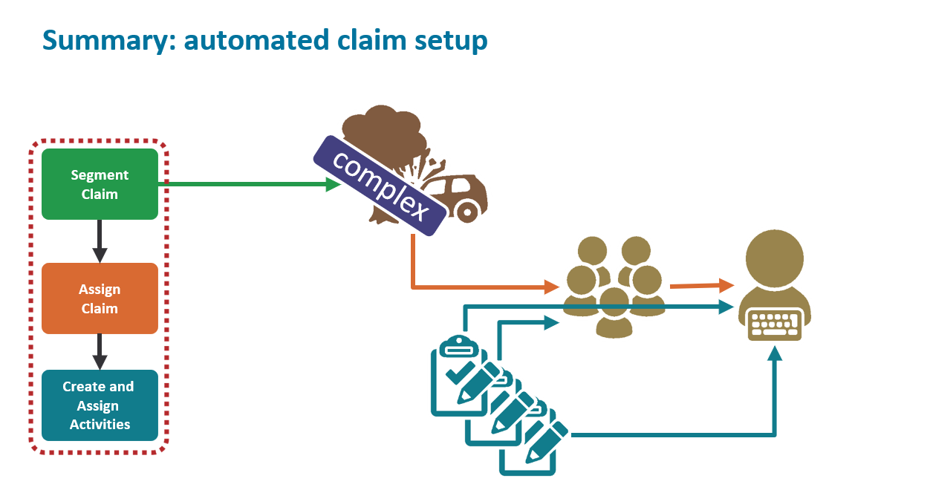

Slide 24
Postsetup rules
Loaded
Purpose
Execute actions that must be done at end of claim setup
Examples
If a Fraud Review activity was created, set the Claim SIU Status field to “Under Investigation”.
If a matter is created, set the Claim’s Litigation Status field to “In litigation”
Presetup
Segmentation
Assignment
Workplan
activity rules
Postsetup
Claim Exposure
Initial Reserve
Preupdate
Validation

Slide 25
Initial reserve rules
Loaded
Purpose
Set initial reserves for existing exposures
Examples
For low-complexity collision exposures, set reserve to $1000
No claim-level initial reserve rules
Presetup
Segmentation
Assignment
Workplan
activity rules
Postsetup
Initial Reserve
Exposure
Preupdate
Validation
Notes:
Initial reserve rules are discussed in detail in the documentation as well as in the “Financial Holds” lesson of this course.

Slide 26
Preupdate and validation rules
Loaded
Purpose
Executed for all validatable objects (including claims and exposures) whenever the object is created or changed
Preupdate rules
Make changes or additions to object before validating and saving
Validation rules
Reject object if data is not correct and/or complete
Presetup
Segmentation
Assignment
Workplan
activity rules
Postsetup
Initial Reserve
Preupdate
Claim Exposure
Validation
Notes:
Preupdate rules are discussed in detail in the Configuration Fundamentals course (Business Rules lesson).
Validation rules are discussed in detail in the "Validation Rules" lesson of this course.
reject() functions are never called in Preupdate rules.
Changes or additions are never made in validation rules.

Slide 27
Preupdate and validation rules examples
Loaded
Preupdate example:
Create SIU review activity if changes to claim cause it to cross fraud detection threshold
Validation example:
Reject creation of claim if loss cause is theft and loss location's street value is null
Presetup
Segmentation
Assignment
Workplan
activity rules
Postsetup
Initial Reserve
Preupdate
Claim Exposure
Validation
Notes:
Preupdate rules are discussed in detail in the Configuration Fundamentals course (Business Rules lesson).
Validation rules are discussed in detail in the "Validation Rules" lesson of this course.
reject() functions are never called in Preupdate rules.
Changes or additions are never made in validation rules.

Slide 28
Claim setup rules: review
Loaded
Unless noted:
Rules at both claim level and exposure level
Claim-level rules run first
Rules in yellow rectangles are...
Rules in orange rounded rectangles are...
Presetup
Segmentation
Exposure Claim
Assignment
unique to setup
activity rules
Workplan
Postsetup
used outside setup
Exposure only
Initial Reserve
Preupdate
Validation

Slide 29

Rule Sets Covered in Training
Loaded
This lesson discusses:
Presetup
Segmentation
Workplan
There are separate lessons in this course for:
Assignment Rules
Initial Reserve Rules
Validation Rules
Remaining rule sets not covered in this course
Presetup
this lesson
Segmentation
this lesson
Assignment Rules: Advanced Assignment
Assignment
Workplan
this lesson
Postsetup
Initial Reserve
Financial Holds
(Fundamentals: Business Rules)
Preupdate
Validation
Validation Rules
Notes:
Assignment rules are included in the Further Study modules for this course. Initial Reserve rules are covered in the Financial Holds lesson. Validation rules are covered in the Validation Rules lesson.
Loaded rules are not discussed in this course for time reasons. They are well documented and relevant more for FNOL application integration than they are as configuration issues.
There is very little to say about postsetup rules. There are no special points of discussion, and the little that there is to say is well documented.
In ClaimCenter, Preupdate rules work in conjunction with Validation Rules, and allow modification to objects just prior to Validation.
The basics of Preupdate rules are discussed in the “Business Rules” lesson of the Configuration Fundamentals course, which is a prerequisite to this course.

Slide 30
Rule Sets in Studio
Loaded
All rules are found in the “Rule Sets” node, under several categories
Remember to run “make project” or “reload changed classes” when testing changes to rules (assuming DCEVM is enabled)
Each category generally has a corresponding prefix for rule sets in the category:
CLV: Claim Validation
EXV: Exposure Validation
CSG: Claim Segmentation
Presetup
Segmentation
Assignment
Workplan
Postsetup
Initial Reserve
Preupdate
Validation
Notes:
The basics of working with rules, including naming conventions, Preupdate rules and other best practices are discussed in the ClaimCenter Configuration Fundamentals course (Business Rules lesson). This slide is meant to help developers navigate to the correct category when configuring rules in Studio.

Slide 31
Lesson outline
Business Rules in ClaimCenter
Claim setup basics
Presetup rules
Segmentation rules
Workplan rules
Exposure and activity setup

Slide 32
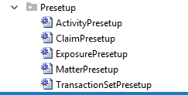
Presetup rules
Five entities have presetup rules
Executed whenever object of that type is created
During claim setup:
Claim presetup rules are run
Exposure and activity presetup are run for each exposure and activity created during setup

Slide 33
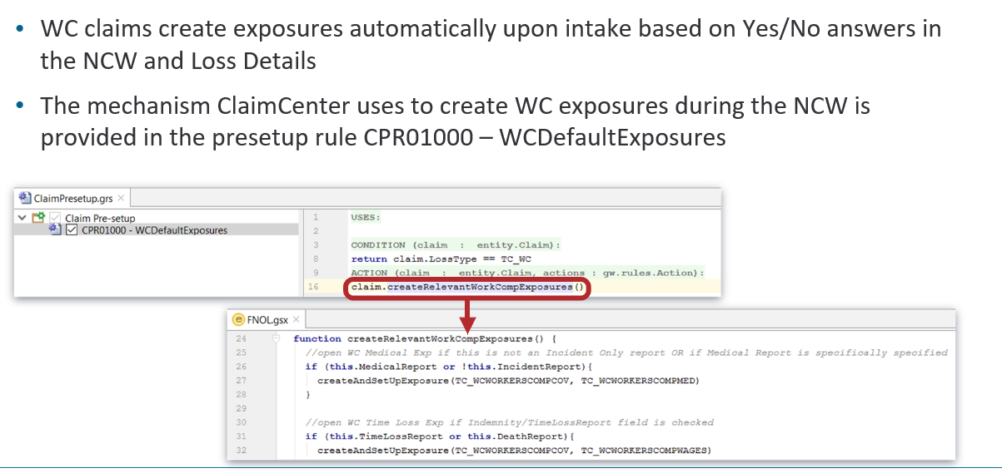
Claim presetup rules: example

Slide 34
Lesson outline
Business Rules in ClaimCenter
Claim setup basics
Presetup rules
Segmentation rules
Workplan rules
Exposure and activity setup

Slide 35
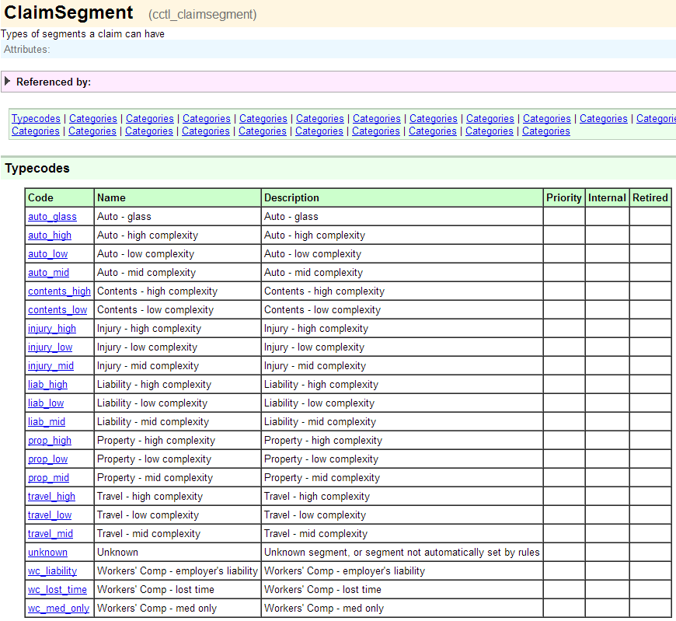
Segment fields
Segment
Segment
Notes:
Both the Claim and Exposure entities have a field named Segment which is a typekey to the ClaimSegment typelist.
If you want to create rules that assign or react to segments not found in the base application, you must first modify the ClaimSegment typelist. Recall that Studio caches typelist values during start-up. So if you create new segments and wish for Studio to be aware of them, you must stop and restart Studio after the typelist is extended.

Slide 36
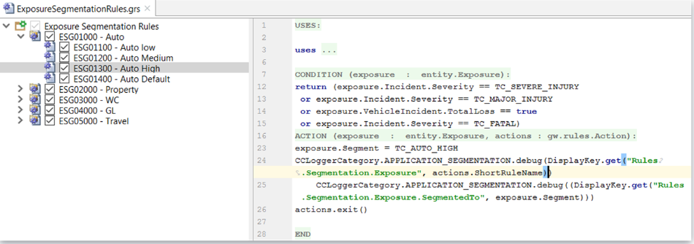
Exposure segmentation rules: example
If exposure's incident's severity is "severe-injury", "major-injury", or "fatal", or if exposure's incident is a vehicle incident which is a total loss, set segment to "auto_high"
Notes:
This rule set as shown comes with the base application.

Slide 37
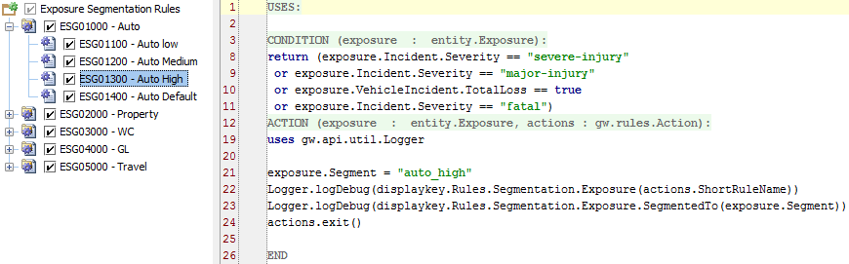
Exit after segmenting claim or exposure
Once a claim or exposure segment value is set, you must exit entire rule set
exposure.Segment = “<segment>”
…
actions.exit()
Notes:
Once you have set the value of the object’s Segment, there is no reason to continue in the ruleset. Furthermore, there is some risk that a rule further down in the list will reset your segmentation value in a way that you do not want. Therefore, it is important to execute the actions.exit() method in the ACTION as soon as the object has an appropriate segment. This method exits the entire rule set.
In the example above, if the CONDITION returns true, the Segment value of “auto_high” is set and the rule set is exited. If the CONDITION returns false, the “Auto Default” segmentation executes (ESG01400), which would apply to any exposure with a Segment value of “null”. In the base application, the value of “auto_mid” is set.
As stated earlier, the sequential execution of rules proceeds vertically from top to bottom until a CONDITION returns true and actions.exit() at the end of the ACTION terminates execution.

Slide 38
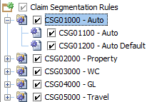
Claim segmentation rules in base application
for auto claims...
if exposures exist, set claim segment to highest exposure segment
otherwise, set claim segment to "auto_low"
One common practice is to set claim segment to highest exposure segment

Slide 39
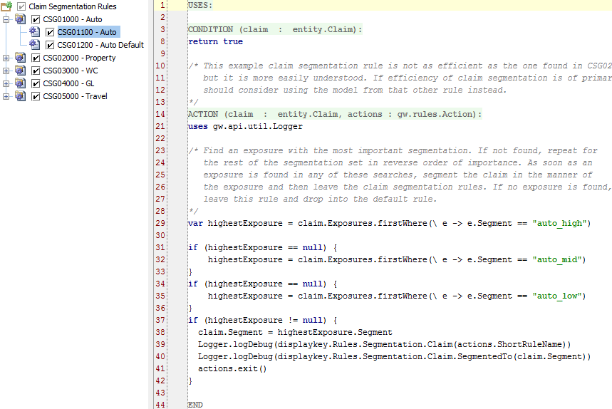
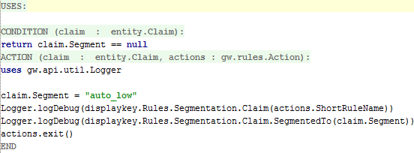
Base Auto Claim segmentation rule: example
if exposures exist, set claim segment to highest exposure segment
otherwise, set claim segment to "auto_low"
Notes:
If a claim has no exposures, then the Auto rule's Actions code will not get executed. Therefore, the claim's segment will not have been set. In these circumstances, the Auto Default rule executes.
Aside from correcting some typographic errors in the comments, the code shows is identical to the code in the base application for these rule sets.

Slide 40
Lesson outline
Business Rules in ClaimCenter
Claim setup basics
Presetup rules
Segmentation rules
Workplan rules
Exposure and activity setup

Slide 41
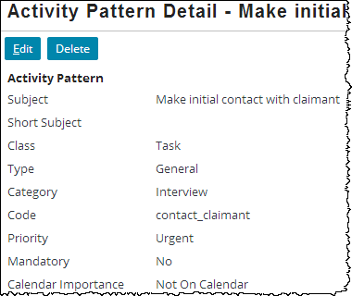
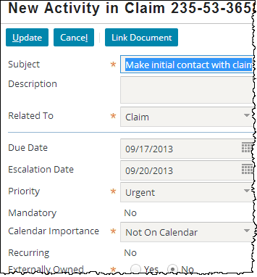
Workplan rules and activity patterns
Workplan rules create activities by referencing a pattern from which the new activity is created
Create "contact claimant" activity for this claim
Notes:
Before you can create a workplan rule which will create a certain type of activity, you must create the pattern for that type of activity. NOTE: The activity pattern and rule set used in this example come with the base application (no need to load sample data). Therefore you would not need to create this particular activity pattern, and this example is used for instructional purposes.

Slide 42
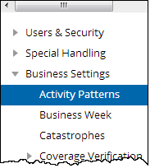
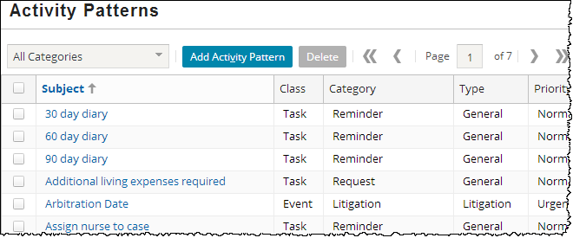
Activity patterns
administrator
Notes:
Activity patterns are typically created and modified only by administrators. A user with sufficient permissions to view and edit activity patterns can navigate to the Activity Patterns list by going to the Administration tab and clicking the Activity Patterns menu link.

Slide 43
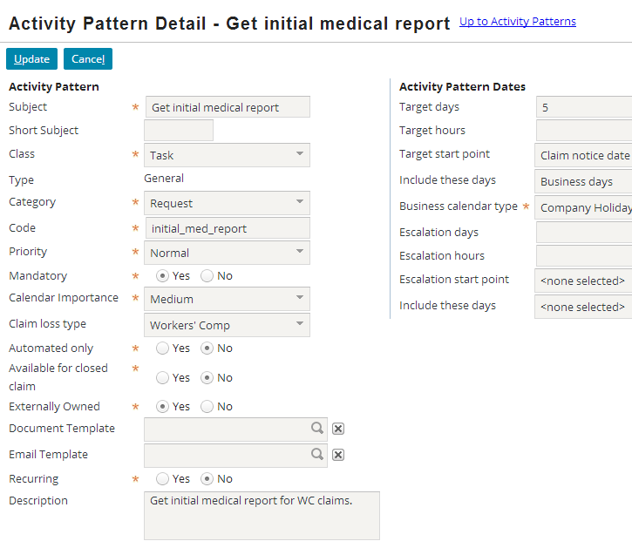
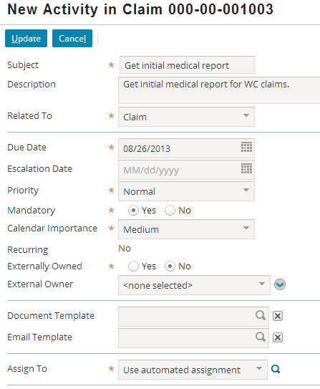
Attributes of an activity pattern
Notes:
The attributes of an activity pattern determine the behavior and default values of the activities created from it.
Many of the attributes listed above are self-explanatory. Those that are not are defined below.
Short Subject - This is a brief description of the activity used on small areas of the UI such as a calendar event entry.
Class - If the activity is a task or event. A task can have a due date whereas an event cannot.
Type - Whether the activity is a general activity (which is closed by being completed or skipped) or an approval activity (which is closed by being approved or denied).
Category - The category of the activity, which determines where in the "New Activity" page action menu the activity pattern appears.
Code - The internal name for the pattern, which is used by business rules when creating activities or checking to see which pattern an activity was created from.
Mandatory - Whether a user can skip this activity.
Claim Loss Type - The line of business for which this activity is available. (If no value is specified, it is available for claims on any line of business.)
Automated Only - Whether this pattern is hidden from manual activity creation and used only by business rules
Closed Claim Available - Whether the activity can exist on or be added to a closed claim, meaning the activity could be performed on a closed claim.
(continued)

Slide 44
(Notes only slide)
Notes:
Externally Owned - Whether the activity can be owned by an external user
Document Template - If the user should be able to create a document from a template while completing this activity, this specifies the document template to use.
Recurring - Whether the activity is likely to recur on a regular schedule. (For example, a 30 day reminder activity means that the user should check the object every 30 days.)
Description - This describes what is expected in the completion of this activity. It is visible to users only when looking at the details of the activity.
Target days/hours – The number of days/hours from the start point for the target date for activity completion
Target start point – The starting point from which the target date should be calculated. Options are activity creation date, claim loss date, and claim notice date.
Include these days – Include all calendar days or just business days.
Escalation days/hours – The number of days/hours from the start point for the escalation date for activity completion
Escalation start point – The starting point from which the escalation date should be calculated. Options are activity creation date, claim loss date, and claim notice date.
Include these days – Include all calendar days or just business days.

Slide 45
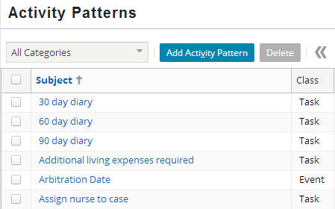
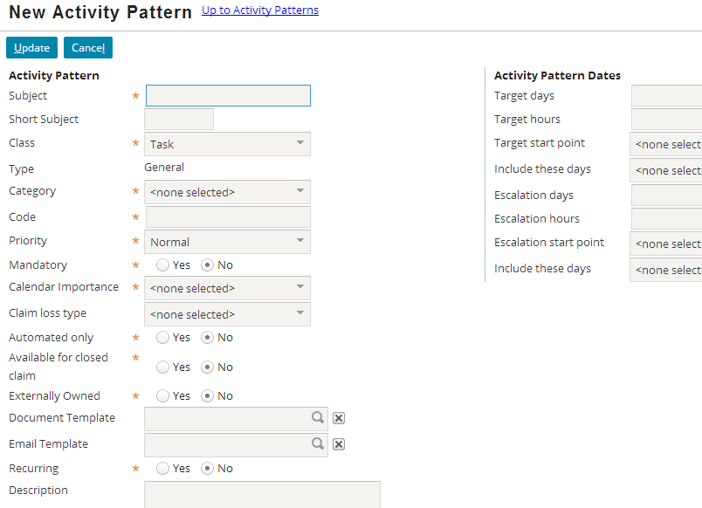
Creating new activity patterns
Notes:
To create a new activity pattern, click the Add Activity Pattern button, specify the attributes for the activity pattern, and click Update.
To edit an existing activity pattern, click the name of the activity pattern in the list. Modify the attributes as appropriate and click Update. Changes to an activity pattern affect only activities from that point forward. No changes are made to activities that have already been created from that pattern.

Slide 46

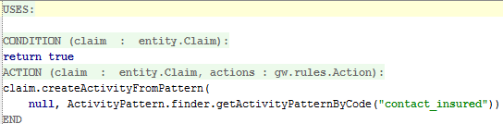
Creating activities through Gosu
Syntax:
claim.createActivityFromPattern ( RelatedExposure, ActivityPattern)
claim is the current claim
RelatedExposure is null (for claim-level activities) or the related Exposure object (for exposure-level activities)
ActivityPattern specifies the activity pattern
Notes:
In the example above from the base application, an activity is created for the Claim object using the "contact_insured" activity pattern. This activity is a claim-level activity. It is not associated to any exposure.
Note that when you need to pass an ActivityPattern object to a Gosu function, you need to use the finder (as demonstrated in the rule above) to get the object by its code. The code can be found on the activity pattern admin screen (see screenshot on previous slide – “Code” field).

Slide 47

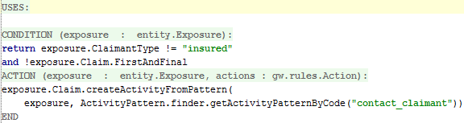
Creating activities: examples
Claim workplan rule
Exposure workplan rule
Notes:
In the claim workplan rule, the root object is a claim. The activity is a claim-level activity, so the first argument of the createActivityFromPattern method is null.
In the exposure workplan rule, the root object is an exposure. Therefore, the Gosu expression must navigate to the exposure's claim to reference the createActivityFromPattern method. The activity is an exposure-level activity, so the exposure is referenced in the first argument of the createActivityFromPattern method.

Slide 48

Identifying the activity pattern
Replace pattern argument with Activity pattern finder
Syntax:
ActivityPattern.finder.getActivityPatternByCode("code")
Notes:
You must use the ActivityPattern.finder.getActivityPatternByCode() method to supply the correct code identifying the activity pattern. Previous methods such as using public IDs are no longer available in ClaimCenter 8.0.

Slide 49
Lesson outline
Business Rules in ClaimCenter
Claim setup basics
Presetup rules
Segmentation rules
Workplan rules
Exposure and activity setup

Slide 50
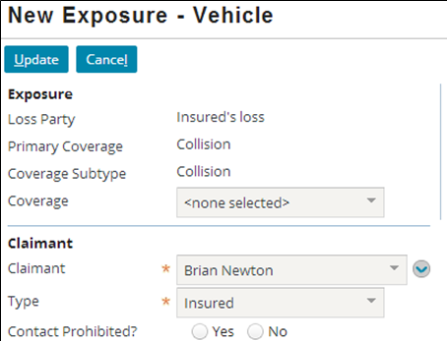
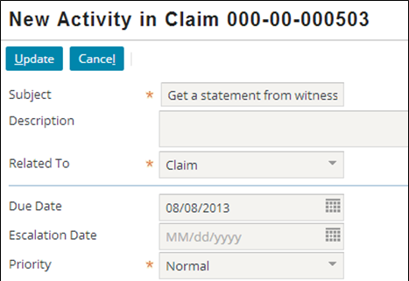
Exposure and activity setup
Claim setup only occurs at the time a claim is created
Only once at the start of the claims process
Exposure and Activity setup occurs upon Exposure and Activity creation
Multiple times during the claims process
Notes:
Matters and transactions also have setup rules.
The rules executed for matter setup are identical to those of exposures, except matters are not segmented and have no reserves.
Transaction setup is more complex as it can vary based on the transaction type.

Slide 51

Exposure setup rules
Presetup
Segmentation
After claim setup, when an exposure is created, this series of rules is executed
All are exposure-level (except the activity rules)
Assignment
Workplan
activity rules
Postsetup
Initial Reserve
Preupdate
Validation
Notes:
Recall that the yellow rectangles represent rules exclusive to setup. The orange rounded rectangles represent rules that are also executed outside of setup.

Slide 52

Activity setup rules
Presetup
After claim setup, when an activity is created, this series of rules is executed
All are activity-level
Note that activities are not segmented, have no workplan, and no reserves
Assignment
Postsetup
Preupdate
Validation
Notes:
Recall that the yellow rectangles represent rules exclusive to setup. The orange rounded rectangles represent rules that are also executed outside of setup.

Slide 53
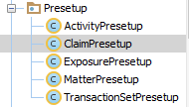


Review: Rule Sets in Studio discussed in this lesson
Location and Category Names | Rule set acronym prefix
 | CPR
 | CSG ESG
 | CLW EXW

Slide 54
Lesson objectives review
You should now be able to:
Describe the business rule set categories in ClaimCenter
Describe how claim setup rules execute claim setup
Write presetup rules
Write segmentation rules
Write workplan rules
Manage activity patterns
Describe the rules executed for exposure and activity setup

Slide 55
Notices
Copyright © 2001-2014 Guidewire Software, Inc. All rights reserved.
Guidewire, Guidewire Software, Guidewire ClaimCenter, Guidewire PolicyCenter, Guidewire BillingCenter, Guidewire Reinsurance Management, Guidewire ContactManager, Guidewire Vendor Data Management, Guidewire Client Data Management, Guidewire Rating Management, Guidewire InsuranceSuite, Guidewire ContactCenter, Guidewire Studio, Guidewire Product Designer, Guidewire Live, Guidewire DataHub, Guidewire InfoCenter, Guidewire Standard Reporting, Guidewire ExampleCenter, Guidewire Account Manager Portal, Guidewire Claim Portal, Guidewire Policyholder Portal, ClaimCenter, BillingCenter, PolicyCenter, InsuranceSuite, Gosu, Deliver Insurance Your Way, and the Guidewire logo are trademarks, service marks, or registered trademarks of Guidewire Software, Inc. in the United States and/or other countries.
All other trademarks are the property of their respective owners.
This material is confidential and proprietary to Guidewire and subject to the confidentiality terms in the applicable license agreement and/or separate nondisclosure agreement.
This file and the contents herein are the property of Guidewire Software, Inc. Use of this course material is restricted to students officially registered in this specific Guidewire-instructed course, or for other use expressly authorized by Guidewire. Replication or distribution of this course material in electronic, paper, or other format is prohibited without express permission from Guidewire.
Guidewire products are protected by one or more United States patents.

Slide 56
Review questions
Loaded
Which rule set does not have both claim-level and exposure-level rules?
For which rule set do exposure-level rules run before claim-level rules? Why?
What type of objects are most likely to be created in presetup rules? Workplan rules?
Which claim-level rule sets are also executed outside of claim setup? For each, give a non-claim setup example of when they might run.
What rule sets are in "activity rules"?
Presetup
Segmentation
Assignment
Workplan
activity rules
Postsetup
Initial Reserve
Preupdate
Validation
Notes:
Answers
1. Initial Reserve, which have only exposure-level rules.
2. Segmentation. Exposure-level rules are run first because claim segmentation often depends upon the outcome of exposure segmentation.
3. Exposures. Activities.
4. Assignment - When a claim is reassigned using assignment rules.
Preupdate - When a claim is created/modified.
Validation - When a claim is created/modified.
"activity rules" – Whenever a new activity is created.
5. Activity Presetup, Activity Assignment, Activity Postsetup

