Slide 1

Earning and Tracking Commissions
Editable List View

Slide 2
Lesson objectives
By the end of this lesson, you should be able to:
Map a carrier's commission schedule to a BillingCenter commission plan
Describe how commission is tracked

Slide 3
Lesson outline
Setting up commission structure
Tracking commissions

Slide 4

Commission setup
A commission is a fee paid to a producer, usually as a percentage of the policy premium
Setting up commission structure involves:
Mapping carrier's commission schedule to BillingCenter commission plans
Configuring commission plans
Creating producers with producer codes that associate each producer with a commission plan
Commission
Producer
Notes:
If BillingCenter is integrated with PolicyCenter and no third party system is used for maintaining producers, then PolicyCenter is the system of record for producers. However, BillingCenter is the system of record for commission plans. When you add a producer code in PolicyCenter, you can explicitly assign a BillingCenter commission plan to the code (otherwise, the first commission plan found in BillingCenter is assigned).
Frequently carriers use a third party such as a producer administration system to manage producers and be the system of record for producers. The system is used to track producer-related detains such as appointment by the carrier, licensing, valid states, lines of business, and so on.

Slide 5
Example of a carrier's commission schedule
All Brokers Insurance Group has two underwriting companies, each operating in two states
Commission rates vary by state, underwriting company, line of business, and term
Underwriting Company | State | Term | Rate
Commercial Property Coverage
Acme | AL | Initial | 16 %
Acme | AL | Renewal | 10%
Acme | GA | Initial | 17%
Acme | GA | Renewal | 11%
Fifth Wheel | AL | Initial | 14%
Fifth Wheel | AL | Renewal | 8%
Fifth Wheel | GA | Initial | 16%
Fifth Wheel | GA | Renewal | 10%
Business Automobile Coverage
Fifth Wheel | AL | Initial | 15%
Fifth Wheel | GA | Initial | 16%
Business Owners Coverage
Fifth Wheel | AL | Renewal | 12%
Fifth Wheel | GA | Renewal | 13%
Notes:
All Brokers Insurance Group is a fictional company that does business in Alabama and Georgia.
Often, large insurance companies are actually groups of underwriting companies. Each underwriting company is licensed to write policies for one or more lines of business.
BillingCenter handles basic commission schedules. Implementing more complex commission schedules such as premium tiers (where the commission rate depends on the size of the premium) requires either configuration or integration with a third-party agency management system. Some carriers allow the PAS to set the rate instead of the billing system.

Slide 6
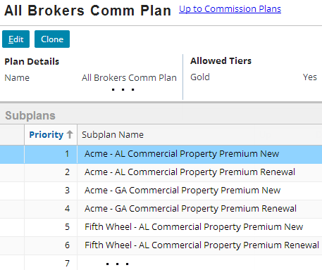
Implementing the commission schedule in BillingCenter
All Brokers Insurance Group created 1 commission plan with 16 subplans
Underwriting Company | State | Term | Rate
Commercial Property Coverage
Acme | AL | Initial | 16 %
Acme | AL | Renewal | 10%
Acme | GA | Initial | 17%
Acme | GA | Renewal | 11%
Fifth Wheel | AL | Initial | 14%
Fifth Wheel | AL | Renewal | 8%
Fifth Wheel | GA | Initial | 16%
Fifth Wheel | GA | Renewal | 10%
Business Automobile Coverage
Fifth Wheel | AL | Initial | 15%
Fifth Wheel | GA | Initial | 16%
Business Owners Coverage
Fifth Wheel | AL | Renewal | 12%
Fifth Wheel | GA | Renewal | 13%
Determines order in which BillingCenter evaluates subplans to decide which one to use
Notes:
The screenshot shows 6 of the subplans in the All Brokers Insurance Group commission plan. Not shown on the slide are the other 6 subplans. Also not shown is the Default subplan, which is a required part of every commission plan.
There are various ways to map a carrier's commission schedule to commission plans in BillingCenter. All Brokers Insurance Group is simply one example of how some Guidewire customers have implemented their commission schedules.

Slide 7
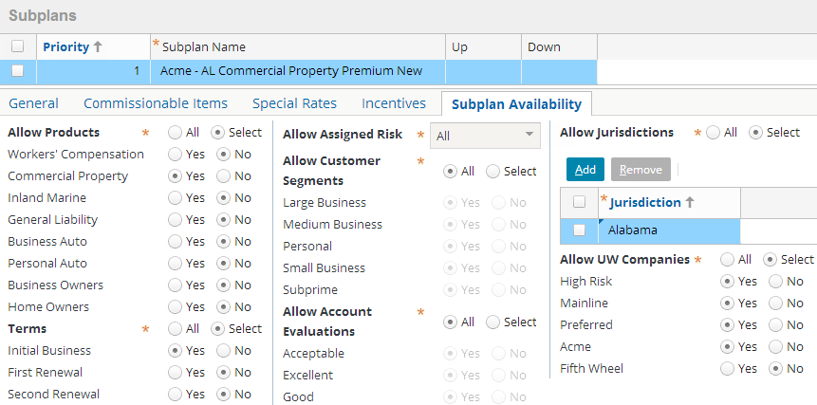
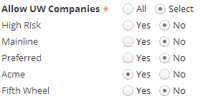
Subplan Availability tab All Broker Group's commission plan
Each subplan for All Broker Group restricts use by product, term (initial or renewal), state, and underwriting company
Restrictions for this subplan
Default criteria settings
Notes:
The Subplan Availability tab defines the characteristics of the policies that will have commission paid under this subplan. The screenshot shows the "Acme – AL Commercial Property Premium New" subplan, which restricts its use to new commercial property policies in the state of Alabama where Acme is the underwriting company. The companies listed in the Allow UW Companies are typekeys in the UWCompany typelist.
The Default subplan (which is not shown in the screenshot) does not have an availability tab because it will always be used if the policy fails to meet the availability criteria for all the other subplans.

Slide 8

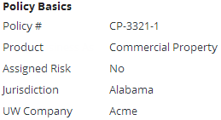

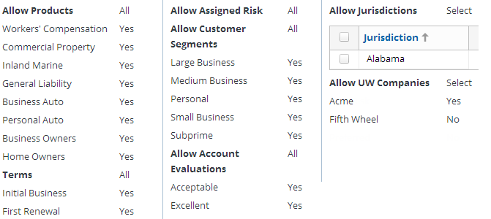
Subplan Availability tab sources of availability criteria values
Account Summary
Policy Summary
Account Evaluation
Notes:
The values that control subplan availability come from account, policy, and policy term attributes.
Account Evaluation
The AccountEvaluationCalculator plugin determines the account evaluation based on the number of delinquencies for the account. You can configure the plugin to implement a custom evaluation. You can also add custom typekeys to the AccountEvaluation typelist. In the base application, the account evaluation value (for example, "Acceptable" and "New Account") is shown in three places: on the Account→Evaluation, Account→Delinquencies, and Policy→Delinquencies screens.
Assigned Risk
"Assigned risk" designates policies assigned to a carrier by insurance regulators. The policies need to be assigned because obtaining the insurance is required by law, but the policyholders are unable to obtain insurance coverage through the voluntary market. An example is auto liability coverage for individuals who are categorized as reckless drivers due to recent tickets or accidents. They are unable to buy conventional insurance policies because of their poor driving records. A commercial lines example is workers' compensation insurance for a company with historically high losses.
The carrier is allowed to apply higher rates and can impose tighter credit and delinquency terms to assigned risk policies.

Slide 9
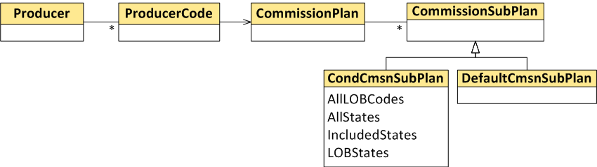
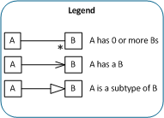
Subplan Availability tab determining which subplan to use
Every commission plan has a default subplan and 0 or more conditional subplans
Conditional subplans have availability criteria
Conditional subplan availability criteria are evaluated in priority order against account, policy, policy period, and producer
First matching subplan is used
If no match, default subplan is used
Notes:
The conditional subplans have availability criteria, which are checked against the policy (LOB code), policy period (term number, assigned risk, state), and account (evaluations, customer segments). The allowed UW Companies are checked against the producer associated with this commission plan. Every commission plan must have a default commission subplan, which is used if none of the conditional subplans satisfy the evaluation.

Slide 10
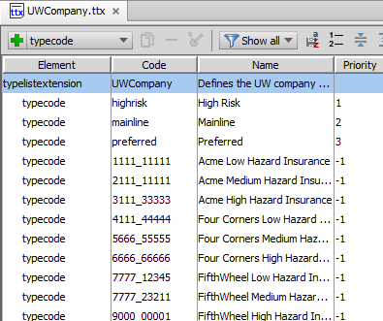
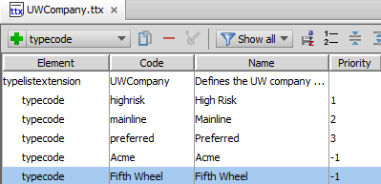

Setting up underwriting companies
Modify list of companies in UWCompany typelist
Replace existing underwriting companies with carrier's underwriting companies

Slide 11
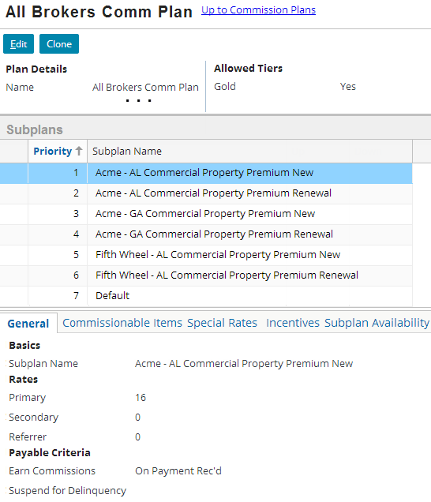
General tab of commission plan
Subplans
Details for selected subplan
A policy can have up to three producers
Commission % for each producer role
When commission will be earned
Notes:
In the All Brokers Comm Plan, only the primary producer earns commission. A policy can have up to three producers, each earning a different commission rate. Sometimes the same producer has more than one role on a policy. The commission for each role is tracked separately.

Slide 12
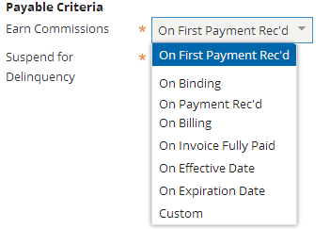
Specifying when commission will be earned
Earn Commissions field on commission plan controls when commission is earned
General tab of commission subplan
Earned pro-rata
Earned after event occurs and Commission Payable Calculation batch process is run
Evaluated when policy is bound and also whenever Commission Payable Calculation batch process runs
Notes:
Commission can be earned (released to the producer’s commissions payable T-account) based on different options. This example earns the commission as each payment has been received against the policy transaction (such as a down payment premium). Premiums can be earned as payment is received, on binding, when billed, when coverage becomes effective, when it expires, or when the invoice that has commissionable charges is fully paid. (This is irrelevant in agency bill, where the producer collects the premium and passes the net payment—payment minus commission—to the insurer.)
In most cases, commission is earned and becomes payable as soon as the payable criterion occurs. The criterion such as receiving a payment or billing an invoice serves as a triggering event to make commission immediately payable. Other criteria do not automatically trigger commission earning. For these, the Commission Payable Calculation ("CmsnPayable") batch process is required to move the relevant commission amount from the policy’s Commissions Reserve to policy’s Commissions Payable T-account.
The Custom earning criterion provides configuration developers a way to configure a custom approach to releasing commission. The Custom criterion is evaluated on bind, in case the custom logic indicates the commission should be earned immediately. After that, it is evaluated only when the Commission Payable Calculation batch process is run.

Slide 13
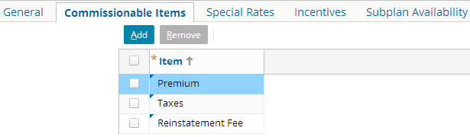
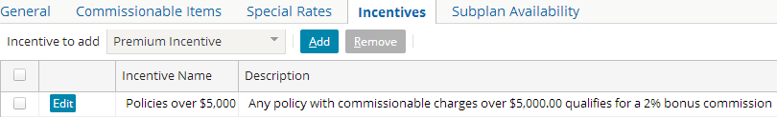
Commissionable Items and Incentives tabs
Only items listed on Commissionable Items tab earn commission
Incentives tab allows extra commission to be paid for some policies
You must add items—no items are listed by default
Notes:
The "Commissionable Items" tab lists charges on which commission is paid (typically premium, but not taxes).
The Incentives tab allows you to enable extra commission to be paid on high cost policies or for any other reason deemed applicable to the carrier.
The "Special Rates" tab in the commission subplan is discussed on the next slide.

Slide 14
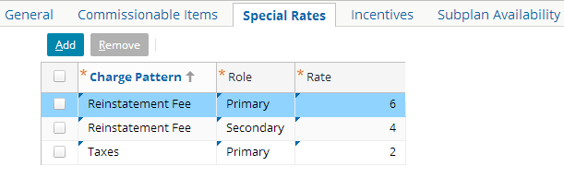
Special Rates tab
Special Rates tab of commission subplan lets you override commission rate by charge type and role
Rates listed here override the default rates on the General tab
Notes:
The rates on the General tab apply to all charge types for a given role. The "Special Rates" tab in the commission subplan allows you to vary the commission rate for a particular charge type and producer role. For example, on the plan showed on this slide, Reinstatement fees will pay primary 6% and secondary 4% versus the default rates specified on the General tab. Taxes for the primary producer pay 2%.

Slide 15
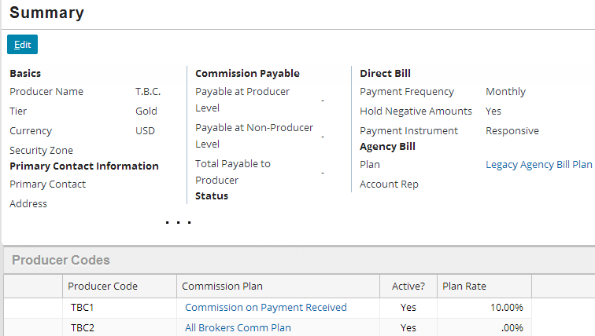
Setting up producer codes
001
002
Add a different code for each applicable commission plan
Producer tab→Summary
Producer code associates producer with commission plan
Plan Rate shows rate for Default subplan
001
002
Notes:
Note that the Plan Rate listed for a producer code isn’t necessarily the actual commission rate that the producer will earn. The Plan Rate always shows the rate for the primary producer on the Default subplan, but the producer could be the secondary or referrer for a policy. In the example, TBC2 has a plan rate of 0%. This is because the Default subplan will never be used. Instead, the applicable conditional subplan will be used in every case.

Slide 16
Lesson outline
Setting up commission structure
Tracking commissions

Slide 17
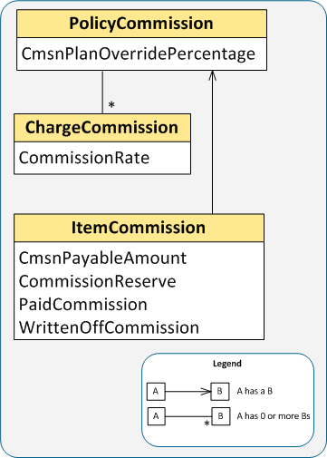
Tracking commissions
Commission balances are tracked and managed at item commission level
For each item, amounts are tracked by producer code and role
Policy commission is the total of item commissions for a policy period
Charge commission is the total of item commissions for a charge
Account-level charges are not commissionable

Slide 18
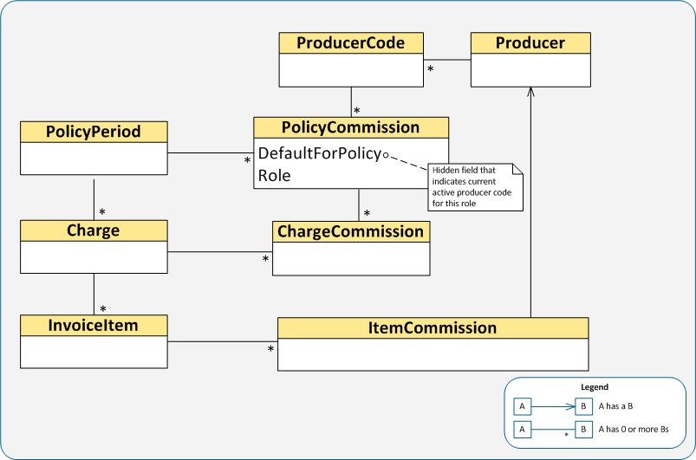
Commission data model
Notes:
ChargeCommission is the T-account owner that contains all commission-related transactions. ChargeCommission has several derived fields including AmountToWriteOff, AmountWrittenOff, CommissionExpenseBalance, CommissionPayableBalance, and CommissionReserveBalance. These derived fields reflect the calculated balances of the corresponding T-account types. For example, CommissionExpenseBalance gets the current balance of the "Commissions Expense" T-account for the producer code for the policy period.
All commission earning and commission writeoffs are at the item level so the granularity of the related commission transactions is item level. Charge-level commission is a rollup of item-level commissions.
PolicyCommission joins together a policy period with the producer codes for a given role. A producer code can have up to three roles on a policy period: primary, secondary, and referrer. If the producer code is the currently active primary, secondary, or referrer producer code, then PolicyCommission.DefaultForPolicy is true for that producer code's role on that policy period (in other words, the producer code is the active producer for that role on the policy period). For every policy period for a role, only one PolicyCommission.DefaultForPolicy can be true. When a policy is transferred from one producer code to another for a given role (for example, the primary role on a policy period is transferred from Producer A to Producer B), a new PolicyCommission is created for Producer B. Producer B's PolicyCommission will be used to create new charge commissions. Producer A's PolicyCommission.DefaultForPolicy is now false.

Slide 19
Commission earning lifecycle
ChargeCommission
Producer
Commissions Reserve
Commissions Payable
Commissions Expense
Commissions Payable
1
300
300
2
30
30
30
CR
3
30
4
30
5
270
Positive Commission Adjustment
Negative Commission Adjustment
Cash
1
2
3
4
30
5
270
Notes:
The circled numbers in the slide indicate the following sequence of events:
The policy is issued. $300 is the total commission that will be earned by the producer.
A payment is received for the down payment. $30 of commission becomes payable because subplan rate is 10% and earning condition is "On payment rec’d".
The producer’s "commission day of month" is reached. The Producer Payment batch process moves the $30 from the policy’s Commissions Payable T-account to the producer’s Commissions Payable T-account. Note that the batch process sweeps the Commissions Payable T-accounts for all the policies for which the producer has at least one role, but our example shows the accounting for just one policy.
The Producer Payment batch process then moves the $30 from Producer: Commissions Payable to Producer: Cash. The Producer: Cash T-account reflects the amount the producer will be paid. The actual payment of the producer (that is, writing a check or transferring funds) requires integration.
The policy is cancelled. This means that the carrier will not pay the remaining commission to the producer. Reducing the commission amount that is payable to the producer results in a credit of $270 added to the policy’s Negative Commission Adjustment T-account.
Commission Writeoffs
The ChargeCommission's PositiveCommissionAdjustment and NegativeCommissionAdjustment T-accounts track all commission writeoff transactions that are created for the charge commission.
A positive commission writeoff is an amount that the carrier cannot or will not pay to the producer. The reason can be that the amount is too trivial or the policy has been cancelled or the producer cannot be contacted. A positive writeoff results in a decrease in reserve and an increase in revenue.
A negative commission writeoff is an amount that the carrier cannot or will not collect from the producer. For example, an agency bill producer has retained too much commission. A negative writeoff results in an increase in reserve and a decrease in revenue.

Slide 20
Item commission properties
Item commission has four properties:
Reserve
+
Writeoff
+
Payable
+
Paid
=
Total
Reserve: remaining amount to be earned
Writeoff: commission that will not be paid
Payable: amount earned and to be paid on producer's commission day of month
Paid: sum of direct bill commission paid and agency bill commission retained
Notes:
The actual property names are CommissionReserve, WrittenOffCommission, CmsnPayableAmount, PaidCommission, and CommissionAmount.
Here are the usual reasons for writing off commission:
The commission amount is trivial (the commission remainder, for example, which occurs automatically when the commission amount cannot be evenly distributed across invoice items).
The producer cannot be contacted for some reason such as change of address.
The producer has gone out of business.
The premium has been written off, so usually the corresponding commission should be written off.
Charge commission has the similar set of properties, which are the rolled up amounts from the related item commissions.

Slide 21
Commission for each role tracked separately simple example
Earning criterion is "On Payment Rec’d"
Item created | 18.00 |  |  |  | 6.00
Item partially paid | 7.50 |  | 10.50 |  | 2.50 |  | 3.50
Commission paid | 7.50 |  |  | 10.50 | 2.50 |  |  | 3.50
Remaining reserve for primary written off | 0 | 7.50 |  | 10.50 | 2.50 |  |  | 3.50
Primary
Secondary
Item Activity
Producer code Pri
Producer code Sec
Reserve
Writeoff
Payable
Paid
Reserve
Writeoff
Payable
Paid
Notes:
The slide shows how commissions are tracked at the item level. The commission balances are tracked separately for each role (even when the producer code is the same for each role, as in the example).
The reserve is established when the item is created.
When the item is partially paid, both the primary and secondary producers earn partial commission. The commission earned amounts are automatically moved from Reserve to Payable.
The Producer Payment batch process moves the payable (earned) commission from Payable to Paid for both the primary and secondary producers. This happens on each producer's Commission Day of Month.
For some reason, the remaining commission for the primary producer was written off. Note: In the base application, you can manually write off commission in the UI, but commission is not automatically written off when a charge is written off. This action requires configuration.

Slide 22
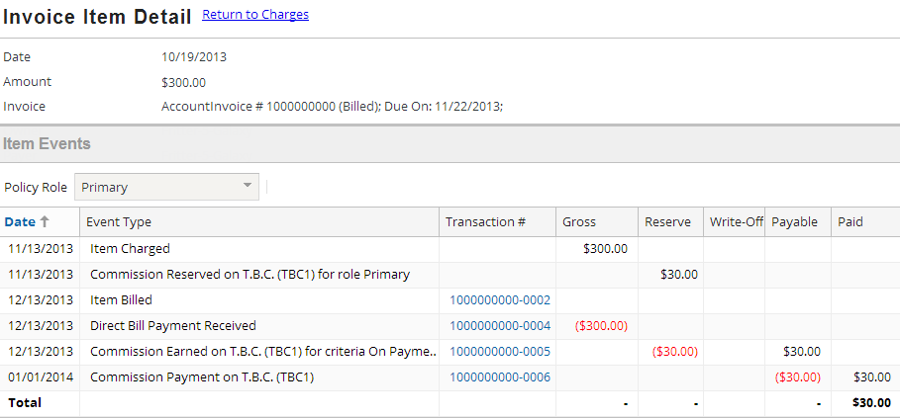
Commission for each role tracked separately Item Events screen
Policy or Account tab→Charges→Item Event Date link
You can filter events by producer role
Notes:
The Item Events screen provides a convenient place to view the history of an item. Notice the Policy Role filter, which allows you to view the commission events for a selected producer role.

Slide 23
Active and inactive producers are tracked
Maximum of one active producer code for a given role on a given item
Policy
Charge
Items for the charge
#1
#2
#3
Role
Producer code
A
inactive
Primary
B
Secondary
C
inactive
inactive
inactive
D
Referrer
E
Notes:
In the example, when the billing instruction was received, producer code A was primary, producer code C was secondary, and producer code E was referrer for the policy. This means that these three producers were the active producers for all items (#1, #2, and #3). Later, item #2’s primary producer code was changed from A to B. Notice that BillingCenter retains the relationship of producer code A as an inactive primary producer of item #2. This is important for audit purposes, assuming B has earned some commission.
Similarly, all three items started with producer code C as secondary, and at some point the secondary role on the policy was changed from producer code C to producer code D. This resulted in producer code D becoming the active secondary producer for all three items.
The same referrer remained active for items #1, #2, and #3.
Other combinations are possible. For example, the same producer code can be primary, secondary, and referrer for an item. Also, an item can have no associated primary, secondary, or referrer producer code.

Slide 24
Demo
6

Slide 25
Provide demo details and link to the demo video
7

Slide 26
Lab
6

Slide 27
Please finish following exercise in BC10_CONF_E_StudentWorkbook
Lesson 5 Earning and Tracking Commission
7

Slide 28
Review
6

Slide 29
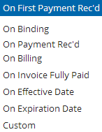
Review questions
How does BillingCenter determine which commission subplan applies to a given policy period?
Which of the commission earning criteria are earned:
All at once?
Pro-rata?
When CmsnPayable batch process runs?
What four item properties make up the total commission for an item?
Notes:
The conditional subplans have availability criteria, which BillingCenter checks against the policy (LOB code), policy period (term number, assigned risk, state), and account (evaluations, customer segments). If no conditional subplan satisfies the criteria, then the Default subplan is used.
All at once: On First Payment Rec'd, On Binding Pro-rata: On Payment Rec'd, On Billing, On Invoice Fully Paid CmsnPayable batch process: On Effective Date, On Expiration Date, On Expiration Date, Custom [Custom also is evaluated when policy is bound.]
Reserve, Payable, Paid, and WriteOff. (The actual property names are CommissionReserve, CmsnPayableAmount, PaidCommission, and WrittenOffCommission.)

