Slide 1

Workflow Types and Processes
Editable List View

Slide 2
Lesson objectives
By the end of this lesson, you should be able to:
Describe the role of workflow in BillingCenter
Describe how workflows are managed
Create workflow processes (versions)
Create workflow types
Search for and view workflow instances
Identify various workflow elements
This lesson uses the notes section for additional explanation and information. To view the notes in PowerPoint, choose View→Normal or View→Notes Page. If you choose to print the notes for the lesson, be sure to select “Print hidden slides.”

Slide 3
Lesson outline
Workflow basics
Creating new workflow processes
Creating new workflow types
Initiating and viewing workflow instances
Using the workflow editor

Slide 4
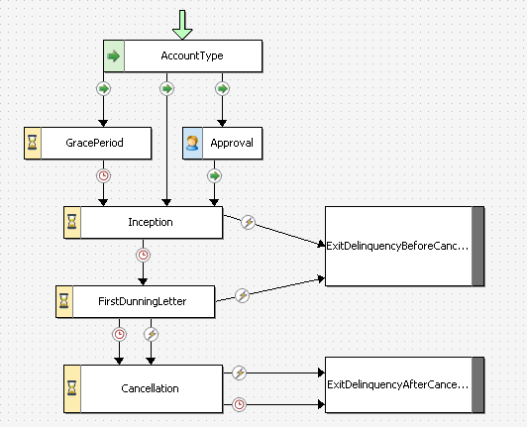
Workflows
A workflow is a multi-step system process designed to manage a complex business process
A delinquency workflow
Notes:
The workflow in the example is a modified version of a workflow in the base application. It is used here solely for instructional purposes. In a workflow:
Logic exists in a network of steps.
Steps execute synchronously or asynchronously.
Steps can involve users with differing permissions.
Workflow can access logic created in rule sets.
Workflows simplify process management because they:
Contain a network of steps that can be traversed differently depending on complex conditions.
Execute steps immediately, wait for a certain time period to pass, and/or wait for an external event to occur.
Can manage processes that involve different types of users with differing permissions.
Can cause business rules to be execute and execute Gosu code.

Slide 5
Benefits of workflow
All logic for a business process in single file
A delinquency workflow
Branch depending on account type
Wait for approval and then continue
Exit if user clicks a button
Wait for a specified time
Notes:
Unlike business rules, workflows can easily:
Execute one set of actions only after another set of actions are complete
Execute one set of actions at a given point in time
Define flows of logic with branches and loops
Identify to an administrator which step is active (this is, where in the workflow instance processing is now taking place)
Encapsulate all logic for a business process in one place
An additional benefit of workflow over rules is that workflow instances run independently of any user transaction. Therefore, an exception in a user function invocation will not crash a workflow process instance.

Slide 6
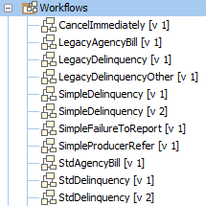
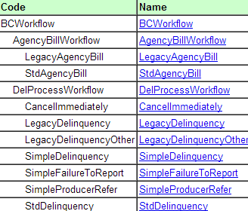
Workflow types and processes
A workflow type is a business process managed by the workflow engine
Whenever a workflow instance is started, it is started as an instance of a given workflow type
A workflow process is a script that stores one version of the workflow type
Processes (versions)
Types
Types
Notes:
There are nine workflow types in the base application, as shown in the screenshot from the data dictionary on the right. Each workflow type corresponds to a subtype of the BCWorkflow entity.
Workflow types are covered later in this lesson.
In the base application, every workflow type has a single process script, which is numbered "1".
Every workflow process has a unique version number. Its primary purpose is to allow for multiple versions of the same workflow type to run simultaneously. This functionality allows you to make changes to a workflow process without disrupting active workflow instances that must finish using the same version of the process they started with.
During server startup, workflow processes are loaded by the server automatically from the deployed application’s config directory. You can also reload scripts at runtime by invoking "Reload Workflow Scripts" from an Internal Tools web page.

Slide 7


Processes are used to "version" workflows
A new workflow instance uses the most recent version
An existing workflow instance uses the same version throughout its life, even if a newer version is created
Started 03/08/13
Loaded 03/03/13
Started 06/09/13
Started 7/12/13
Loaded 7/11/13
Started 8/13/13
Benefit: you can add new workflow versions on a live system
Notes:
After a workflow process has been customized and deployed, there may be several hundred (or thousand) instances of that workflow process running at any given time. However, you may discover errors in the original workflow process, or the nature of the business may change over time, requiring changes to the workflow process. Without versioning, this would present a significant problem. You typically wouldn't want all the existing instances to use the new version. (It would be similar to rewriting a program halfway through its execution. The side effects would be unpredictable and potentially catastrophic.) However, you do want newly created instances to use the new version of the process.
To simplify the approach to workflow editing, all workflow processes are referenced by their type and an integer version number starting from 1. (The higher the number, the more recent the version.) The Workflow Engine respects the following rules with version numbers:
When a new workflow instance is created for a given workflow type, the process with the highest version number is used. This number is saved on the WorkflowInstance as the "ProcessVerson" field.
The workflow instance always uses that version of the process. (This includes circumstances where a workflow is waiting for a timeout or trigger or errors out and is restarted.)
If a workflow instance cannot find a process with the right type and version number (if, for example, the file was deleted or failed to load), then it will fail with an error and drop immediately into the Error state.
You cannot have two workflow processes with the same type and version number. If you do, the server will fail to start.

Slide 8
Lesson outline
Workflow basics
Creating new workflow processes
Creating new workflow types
Initiating and viewing workflow instances
Using the workflow editor

Slide 9

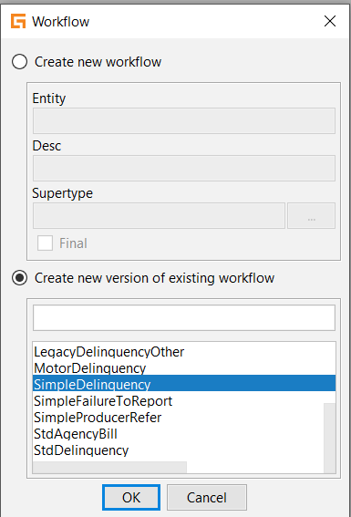
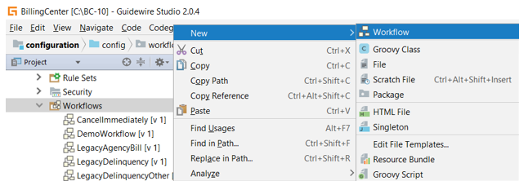
Creating a new process of an existing type
Version number is incremented by 1
Workflow contents copied from most recent version
Notes:
To create a new process for an existing workflow type:
Right-click the Workflows node.
Select New → Workflow.
Select New workflow process.
Choose the workflow type.
Click OK.
Studio automatically creates a new version with the name workflowtype.integer. The value of integer is automatically one greater than the current greatest value. The contents of the most recent version are copied into the new process.

Slide 10
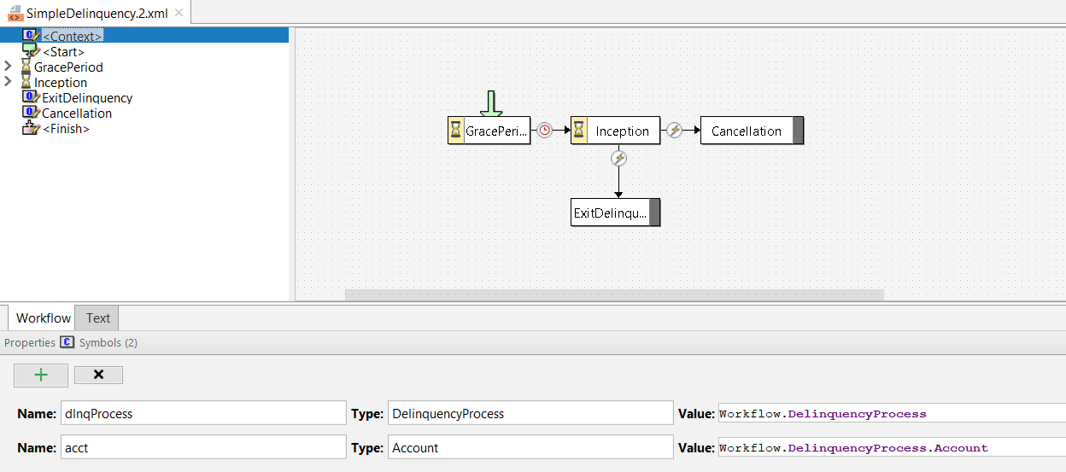
Context element
A non-procedural element that lists the objects known to workflow instance (including the instance itself)
Notes:
The Context element lists the workflow process object itself and any other objects associated with the instance (such as an account for delinquency workflow or a statement invoice for agency bill workflow). Typically, you do not need to modify the information in the Context element when creating a new process of an existing workflow type.
The root object for delinquency workflow is always the delinquency process. The root object for agency bill workflow is always the agency cycle process.
All workflows have at least one process context entity.
Typically, delinquency workflows have two context entities: DelinquencyProcess and Account.
Typically, agency bill workflows have two context entities: AgencyCycleProcess and StatementInvoice.

Slide 11
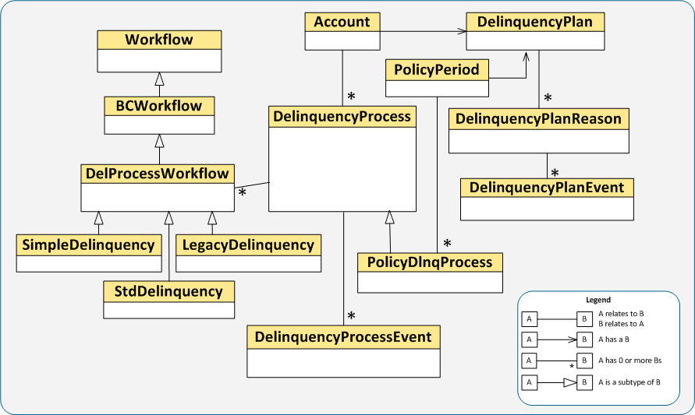
Entities that workflow code can reference
Delinquency workflow data model
Primary business object
Root object
Notes:
You need to know the workflow data model in order to know what you can reference in the workflow’s Gosu code.
DelinquencyProcess is the root object for any delinquency workflow. Its array key (Workflows), which references DelProcessWorkflow, is virtual because of the multiple versions that can exist for that subtype.
Account is the primary business object for a delinquency workflow. There can be multiple delinquency processes on one account. PolicyDlnqProcess is a subtype of DelinquencyProcess, which is relevant whenever a policy is the delinquency target.
Note: Some subtypes of DelProcessWorkflow are not shown in the diagram.

Slide 12
Two types of workflow variables
Step variables are local to a step
Variable destroyed when step is complete
Cross-step variables are available to every step in instance
To create a cross-step variable, add a column to your workflow entity to store variable information
Extended workflow entity
CheckOn Order
RequestReport Workflow
if Order Attempt < 5
OrderAttempt (int)
Send Failed
Retry Order
increment OrderAttempt
Notes:
In the example, RequestReportWorkflow entity has been extended with a column that implements the OrderAttempt variable. OrderAttempt is then available to all steps in the RequestReportWorkflow process.
Workflow steps can also have their own locally defined variables, but the variable is destroyed when the step is complete.

Slide 13
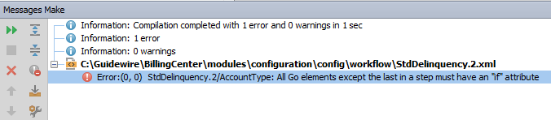
Workflow errors can prevent server startup
Workflow is validated when project is compiled
If there are workflow errors, you may not be able to start the server successfully

Slide 14
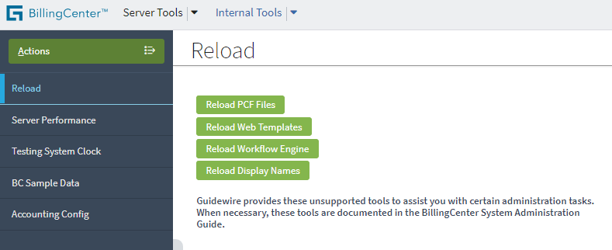
Deploying process changes
Whenever you modify a process, you must reload Workflow engine to deploy changes
Restarting the server also reloads Workflow engine
Notes:
To reload the Workflow engine, you can either:
Go to InternalTools and click the "Reload Workflow Engine" button on the Reload page, or
Restart the server
There is no keyboard shortcut for reloading the workflow engine files. An on-demand reload can be performed only by clicking the button in the Internal Tools application.

Slide 15
Lesson outline
Workflow basics
Creating new workflow processes
Creating new workflow types
Initiating and viewing workflow instances
Using the workflow editor

Slide 16
Workflow entity and its subtypes
Every workflow type corresponds to a subtype of Workflow
Information about the workflow status is stored at the top level of the Workflow entity
New BillingCenter workflow types are created as subtypes of BCWorkflow or any of its subtypes
Workflow
currentStep handler state ...
Notes:
A new workflow type can have additional fields and foreign keys that are not in the base application Workflow entity. For example, if a workflow was designed to process the producer commission for an account, then in addition to passing the account to the workflow process, you might also want to pass a contact (that is, the specific producer whose commission is to be processed).

Slide 17
Steps to create a workflow type
Create workflow type
Add foreign keys as needed
Add non-foreign key columns
Restart the server
Specify the context objects
Add and define workflow elements

Slide 18
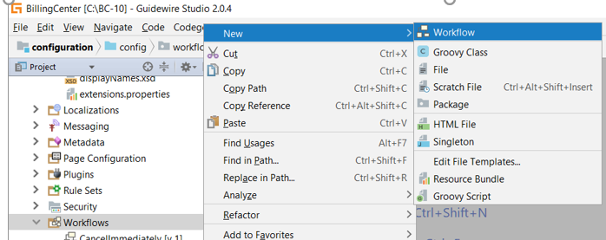
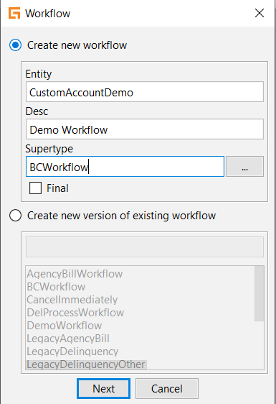
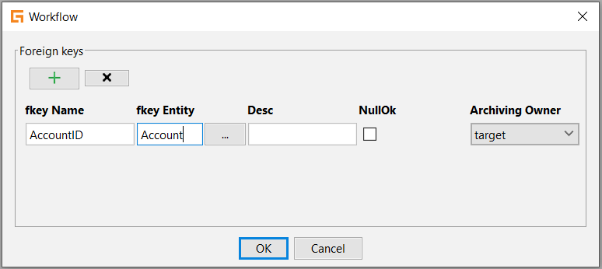
Step 1: Create workflow type
2
1
Define foreign keys on second screen
3
4
Notes:
Studio provides a tool for creating a subtype of a workflow entity. You specify the name of the subtype (entity) you want to create, its supertype, and description. You can also add foreign key columns.
To create a workflow type:
Right-click the Workflows node and select New→Workflow.
With New workflow subtype entity selected, enter the entity name, description, and supertype. In this case, we're defining a subtype of BCWorkflow.
Define any foreign keys.
Click OK.

Slide 19
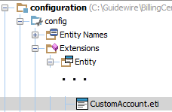
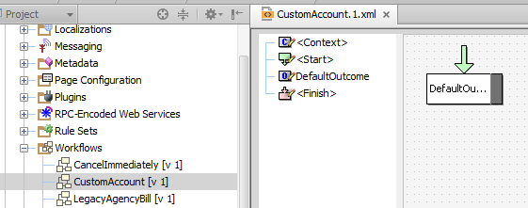
Results of step 1
Entity definition and starter workflow script are created
Notes:
Studio creates the initial workflow process (that is, version 1) with a single DefaultOutcome and names the new process <workflow type>.1. The new workflow process is listed under Workflows on the Project tab.

Slide 20
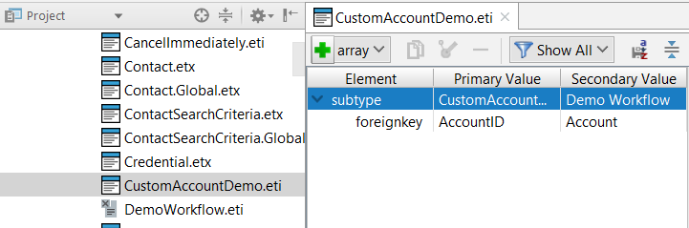
Step 2: Add non-foreign key columns
Add columns as needed to the .eti file
Notes:
In the example, we're adding a RetryCount column. The .eti file is already created. You simply add columns to it.

Slide 21
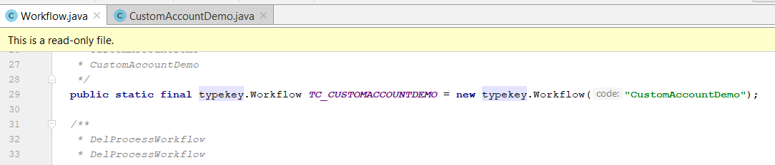
Step 3: Restart the server
Data model has changed so server restart is required
First regenerate data dictionary to check for errors
On server startup, new Typekey is added to Workflow class

Slide 22
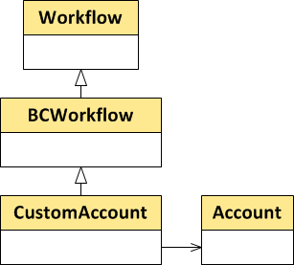
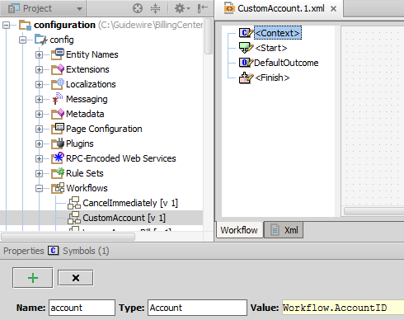
Step 4: Specify context objects
Select <Context> in Outline and add the symbols
Notes:
Context objects are objects that the workflow knows about. Notice that “Workflow” is the label given to the subtype that you’ve implemented. In our example, the CustomAccount subtype has a foreign key to the Account entity. By defining "account" as a context symbol, you can use the symbol in your workflow code to reference the account associated with the workflow.
Note: If you define a new delinquency workflow, you do not need to include a foreign key to Account because the foreign key to Account is inherited from the DelinquencyProcess supertype.

Slide 23
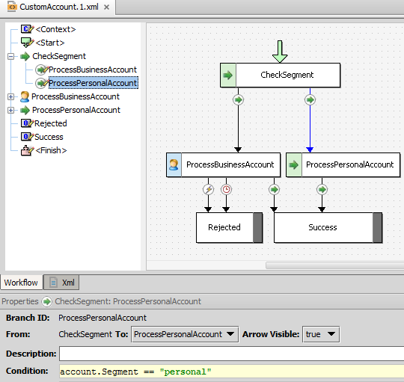

Step 5: Add and define workflow elements
Start
Steps
Branches
Outcomes
Gosu code
Context symbols
Notes:
The next lesson discusses the workflow elements in detail.
In the example, notice that the workflow can test for the account segment because "account" was defined as a context symbol.

Slide 24
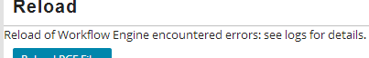
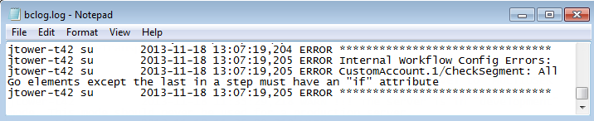
Reloading the Workflow engine
Reload fails if workflow has an error
Notes:
To reload the Workflow engine, you can either:
Go to InternalTools and click the Reload page's "Reload Workflow Engine" button.
Restart the server
There is no keyboard shortcut for reloading the workflow engine files. You can perform an on-demand reload by clicking the button in the Internal Tools application.

Slide 25
Lesson outline
Workflow basics
Creating new workflow processes
Creating new workflow types
Initiating and viewing workflow instances
Using the workflow editor

Slide 26

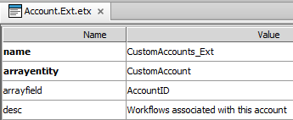
Starting a workflow instance from a rule (1 of 2)
Prerequisite: entity needs to know about the workflow type
Define an array on the related entity
Notes:
Note that arrayfield is optional if the workflow type has only one foreign key that points to the related entity (in this case, Account).
The CustomAccount workflow type does not exist in the BillingCenter base application and is used here to provide a simple example of creating and starting a workflow.

Slide 27
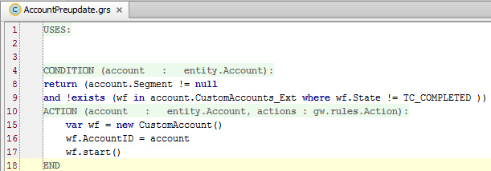
Starting a workflow instance from a rule (2 of 2)
Create a new workflow object using appropriate subtype
Assign context objects to new workflow object
Start workflow instance
Notes:
Check to see if there is a relevant workflow instance already in progress.
If there is no relevant workflow in progress:
Create a new workflow object using the appropriate subtype.
Assign the context objects to the new workflow object.
Start the workflow.
In the BillingCenter base application, agency bill workflows are initiated by a batch process. Delinquency workflows are initiated by one of two methods, which are discussed in the Delinquency Workflow lesson.

Slide 28
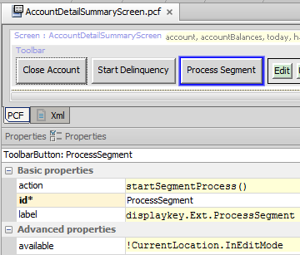
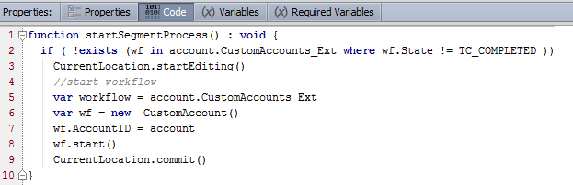
Starting a workflow instance from a PCF
Call CurrentLocation.commit() to perform a commit
Button not available in edit mode
Notes:
To start a workflow from a PCF element, you need to commit the action after the code to start the workflow. Without the commit, the action is never performed. Notice in that the Process Segment button is not available in edit mode. Trying to put a location into edit mode when it already is in edit mode causes an error.

Slide 29
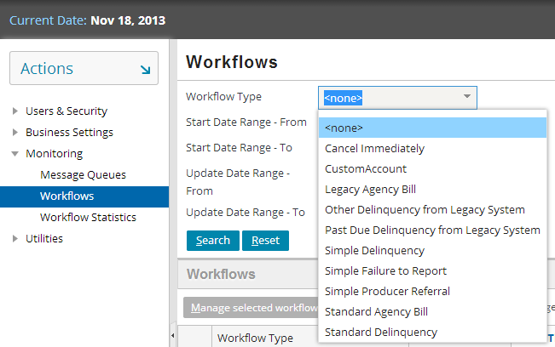
Searching for a workflow
Notes:
After you have launched the workflow, you can search for it. Access to workflows is from the Administration tab.

Slide 30
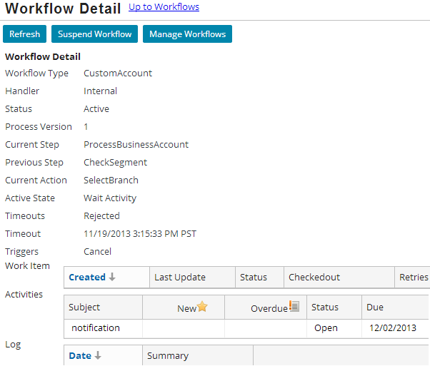
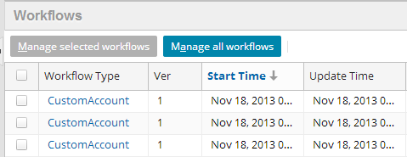
Viewing workflow instances
Instances
Click an instance to view its details
Notes:
Workflow Detail provides valuable information for debugging a workflow.

Slide 31
Lesson outline
Workflow basics
Creating new workflow processes
Creating new workflow types
Initiating and viewing workflow instances
Using the workflow editor

Slide 32
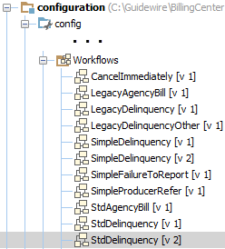
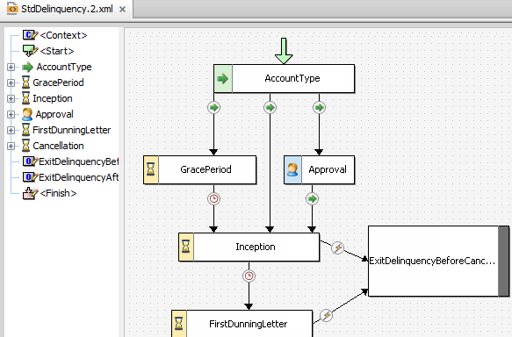
Opening a workflow script
Notes:
To access the workflow editor, select Workflows from the Studio Project tree, then select a workflow. Within the workflow editor, there are multiple work areas, each of which performs a specialized function.

Slide 33
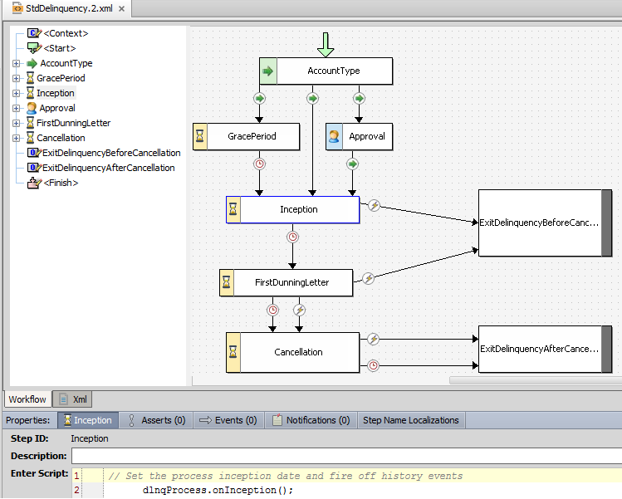
Workflow editor: Workflow tab
Outline view
Layout view
Workflow tab
Property view of selected step/branch
Notes:
Outline view - Studio displays an outline of the selected workflow process in the Outline pane. This outline lists all the steps and branches for the workflow in the order that they actually appear in the workflow XML file. You can reorder these steps as desired. You can also reorder the branches within a step. First, select an item, then right-click and select the appropriate menu item.
Layout view - Studio displays a graphical representation of the workflow in the workflow pane. You use this representation to visualize the workflow. You also use it to edit the defining values for each step and branch.
Property view - Studio displays detailed properties for the selected step or branch, much of which you can modify.

Slide 34
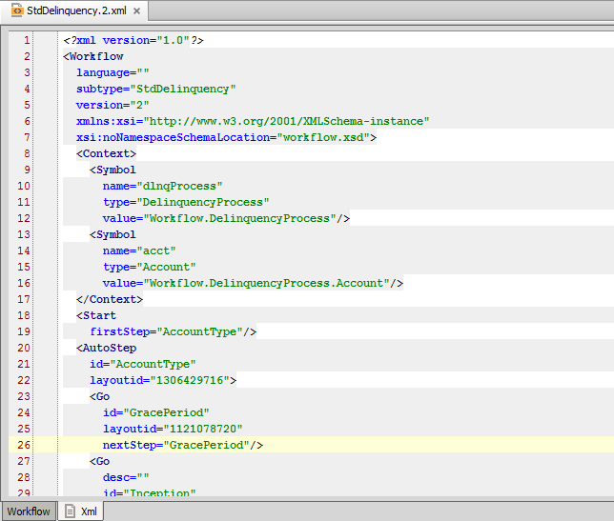
Workflow editor: XML tab
XML tab
Notes:
Workflow scripts are ultimately stored as XML files. They are located in modules\configuration\config\workflow. Theoretically, a developer could design a workflow entirely within XML and, assuming that the XML is well formed, the script could be used by the Workflow engine. However, there is a tremendous advantage to creating workflows in the Workflow editor, as the editor is capable of checking syntax to make sure that all objects are known, that all script conditions are well formed, and that there are no structural errors.
The XML editor provides a read-only view of the XML script for a workflow. XML scripts provide an easy means for searching the entire workflow.

Slide 35
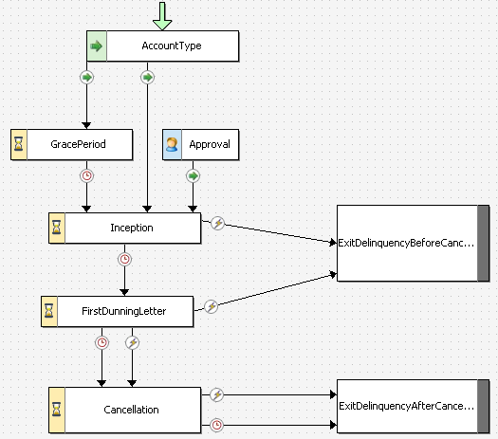
Workflow steps
Start points to step that begins workflow execution
Auto step completes a task and immediately goes on to next step
Activity step creates one or more "blocking" activities, which suspend workflow until all are terminated
Outcome indicates a possible finish of workflow
Manual step completes a task and requires time passing or external action to go to next step
Notes:
Each step type has its own behavior. The icon on the left side of a step identifies the step type. Every workflow has just one start, but it can have multiple outcomes. Every outcome inherently executes any code in the Finish step. The Finish step is not represented graphically in the canvas. However, it is represented by <Finish> in the outline view.
Note: Message steps are not represented in the example. They are typically used for integration messages.

Slide 36
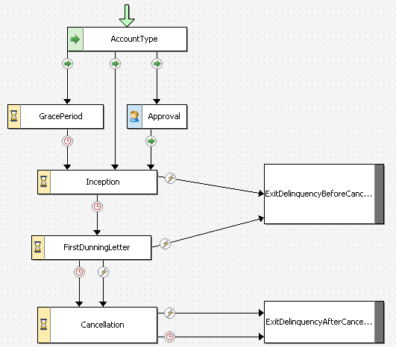
Step branches
Go branch can specify a condition, used here to implement if-then-else logic
Trigger branch requires specified trigger to be invoked
Timeout branch requires specified time to elapse
Notes:
A branch is a transition from one step to another. There are three kinds of branches that link a step to another step or two an outcome. The workflow editor indicates a branch by linking two steps with a line and placing an icon on the line to indicate the branch type. How a workflow decides which branch to take depends entirely on the type of the branch.

Slide 37
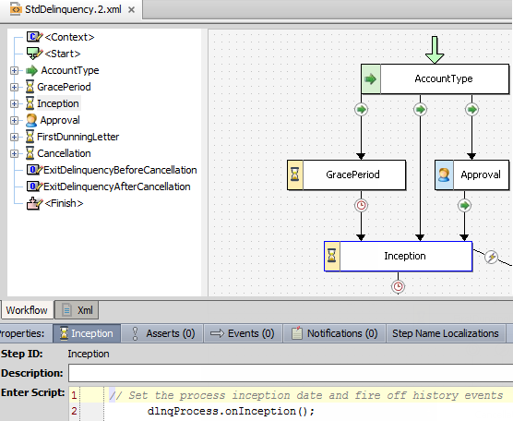
Selecting and manipulating elements
In both outline and canvas:
Click an element to select it
Use shortcut menu to create, delete, rename, and move elements and change step type
In canvas, you can also use drag and drop to resize and reposition elements
Notes:
In the workflow editor, you can select a workflow element in either the outline view or the layout view. If you select a step or branch in either place, then:
The item becomes selected/highlighted in both places.
Details about the item appear in the bottom pane.
You can resize a step (both horizontally and vertically) by mousing over the edge of the step. When a two-headed diagonal arrow appears, click and drag the mouse until the step has the desired dimensions.
You can move a step by mousing over the middle of the step. When a four-headed arrow appears, click and drag the mouse until the step is in the desired location.
You can move a branch by mousing over the branch and clicking and dragging the mouse until the branch is in the desired position. You can also move the point at which one end of the branch meets a step (without moving the entire branch) by mousing over the area where the branch and step meet.
You can add anchors to a branch. Anchors break a branch down into two or more segments. Anchors can help the visual presentation of a workflow by having a branch navigate around a step. To add an anchor, right-click the branch and select "Add Line Anchor". This causes a point to appear on the branch. Then, move the point to the desired position. To remove an anchor, right-click the point and select "Remove Line Anchor“.

Slide 38
Demo
6

Slide 39
Provide demo details and link to the demo video
7

Slide 40
Lab
6

Slide 41
Complete the exercises listed in “Create a new workflow” chapter in the “BillingCenter 10 Configuration: Kickstart“ work book
7

Slide 42
Review
6

Slide 43
Review questions
What is the difference between a workflow type and a workflow process?
What is the primary purpose of the version number of a workflow process?
When is it acceptable to modify an existing workflow process (instead of creating one with a new version number)?
What are a workflow's context objects?
If you create a variable in a step, when is that variable destroyed?
Notes:
ANSWERS
A workflow type maps to a general business process. A workflow process is one specific version of a workflow type. It may later be superseded by newer processes.
The primary purpose of the version number is to allow two (or more) versions of a workflow type to execute simultaneously. This is usually needed when a workflow process needs to be changed, but there are active or errored out workflow instances that need to continue using the original version.
The general answer is when the change will not cause problems for any in-progress workflow instances. The more specific answer is either when there are no in-progress instances, or when the change is simple enough that it won't affect any in-progress instances, or when it's a development system and there is no consequence to upsetting the execution of in-progress instances.
The context objects are the objects that a given workflow instance must know about to do its work.
The variable is destroyed when the step is complete. If you want to have data persist across steps, you must extend the workflow entity and store the data within that object.

Slide 44
Notices
Copyright © 2001-2014 Guidewire Software, Inc. All rights reserved.
Guidewire, Guidewire Software, Guidewire ClaimCenter, Guidewire PolicyCenter, Guidewire BillingCenter, Guidewire Reinsurance Management, Guidewire ContactManager, Guidewire Vendor Data Management, Guidewire Client Data Management, Guidewire Rating Management, Guidewire InsuranceSuite, Guidewire ContactCenter, Guidewire Studio, Guidewire Product Designer, Guidewire Live, Guidewire DataHub, Guidewire InfoCenter, Guidewire Standard Reporting, Guidewire ExampleCenter, Guidewire Account Manager Portal, Guidewire Claim Portal, Guidewire Policyholder Portal, ClaimCenter, BillingCenter, PolicyCenter, InsuranceSuite, Gosu, Deliver Insurance Your Way, and the Guidewire logo are trademarks, service marks, or registered trademarks of Guidewire Software, Inc. in the United States and/or other countries.
All other trademarks are the property of their respective owners.
This material is confidential and proprietary to Guidewire and subject to the confidentiality terms in the applicable license agreement and/or separate nondisclosure agreement.
This file and the contents herein are the property of Guidewire Software, Inc. Use of this course material is restricted to students officially registered in this specific Guidewire-instructed course, or for other use expressly authorized by Guidewire. Replication or distribution of this course material in electronic, paper, or other format is prohibited without express permission from Guidewire.
Guidewire products are protected by one or more United States patents.

