Slide 1

Configuring Workflow
Editable List View

Slide 2
Lesson objectives
By the end of this lesson, you should be able to:
Distinguish among auto, manual, and activity steps
Distinguish among go, timeout, and trigger branches
Create and edit steps and branches
Create and edit Start element, outcomes, and Finish element
Describe how to create and invoke a trigger
This lesson uses the notes section for additional explanation and information. To view the notes in PowerPoint, choose View→Normal or View→Notes Page. If you choose to print the notes for the lesson, be sure to select “Print hidden slides.”

Slide 3
Lesson outline
Step behaviors and branches
Auto steps and go branches
Starts, outcomes, and finishes
Activity steps
Timeouts
Triggers

Slide 4
Workflow elements
Workflow elements include these building blocks:
Branches connect workflow elements
Start
Auto Step
Manual Step
Activity Step
Message Step
Outcome
Trigger
Timeout
Go
Finish

Slide 5
Steps and their behaviors
An auto step accomplishes one portion of the workflow process and then execution immediately goes on to another step
A manual step accomplishes one portion of the workflow process and requires either time passing or an external action to resume workflow
An activity step creates one or more blocking activities and suspends execution of the workflow until all activities have completed, a trigger is executed, or timeout branch expires
Auto
Manual
Activity
Notes:
Each step type has specific behaviors.
An auto step is a step that accomplishes one portion of the workflow process, and then execution immediately continues on to some other step. All steps, including auto steps, accomplish their work by executing Gosu code, which may involve objects inherently available to the workflow, rule sets, and/or Gosu classes.
An manual step is a step that accomplishes one portion of the workflow process, but execution is suspended until one of the following occurs: (1) A certain period of time elapses, or (2) something external to the workflow process (such as the user clicking a button) executes a trigger that resumes the workflow.
An activity step is an element that can create blocking activities. These activities can be assigned to users within the activity step code itself, or normal activity assignment rules can be invoked. Execution proceeds when all of the blocking activities generated by this step have been completed. However, if the activity step has a trigger or timeout branch, execution may proceed before the blocking activities have been completed.
Note: Message steps are not covered in this course.

Slide 6
Allowable branches for step types
Auto Step
if then...
NOW!
default
Manual Step
later...
Activity Step
later...
default
After blocking activities complete
For auto steps, workflow advances immediately
For manual and activity steps, workflow waits for something to happen
Notes:
Branches connect steps to each other and to outcome. The allowable branch types depend on the type of step.
Auto steps can have only Go branches, and one Go branch must have no condition. This guarantees that the workflow will not have to wait.
Manual steps can have only timeout and/or trigger branches, so a manual step must wait until a trigger is invoked or a timeout expires. Manual activities are discussed in the next lesson.
Activity steps can have all three types of branches. An activity step must create at least one blocking activity. An activity step waits for something to happen:
A trigger to be invoked, or
A timeout to expire, or
All its blocking activities to be completed

Slide 7
Step functionality
All steps allow you to add Gosu code to:
Enter scripts
Exit scripts
Assert conditions
All steps allow you to create:
Events
Notification activities
Only activity steps can create blocking activities
Activity
Blocking activity
Notes:
A blocking activity suspends the workflow until BillingCenter marks the activity as completed (which includes being approved or rejected), skipped, or canceled. An activity step can create multiple blocking activities. In this case, the step waits until all of the activities have terminated.

Slide 8
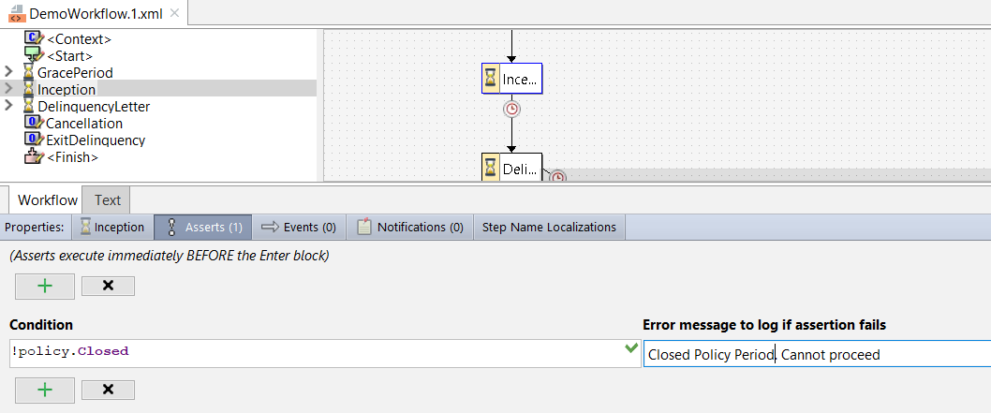
Assert conditions
If any assert condition fails, processing for the step stops
Notes:
An assert is a condition with an optional message. When the workflow engine begins execution of any step, it first evaluates all the assert conditions. If any are untrue, then the step is not processed any further and an error message is written to the log. Asserts are designed to ensure that the business data is in an appropriate state and to give the workflow an opportunity to discontinue processing gracefully if the data is not in an appropriate state.
To add a new assert:
Click the plus button.
Specify the condition in the left field.
Optionally specify a message to log if the condition is untrue in the right field.
To remove an assert, click in one of its fields and then click the X button.

Slide 9
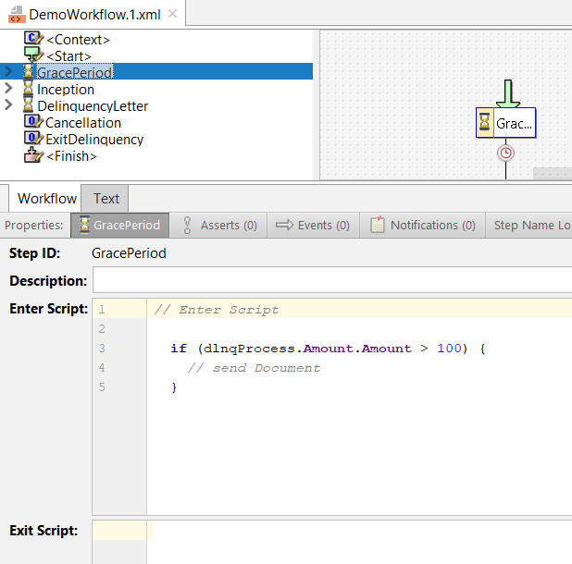
Enter and exit scripts
A block of Gosu that does the work of a step
Notes:
The Enter script is typically where the step does its work. It is simply a block of Gosu that is executed after the step's asserts and before anything else.
All steps also have an Exit script, which is executed after all other processing for the step is done. In practice, this script is rarely used.

Slide 10
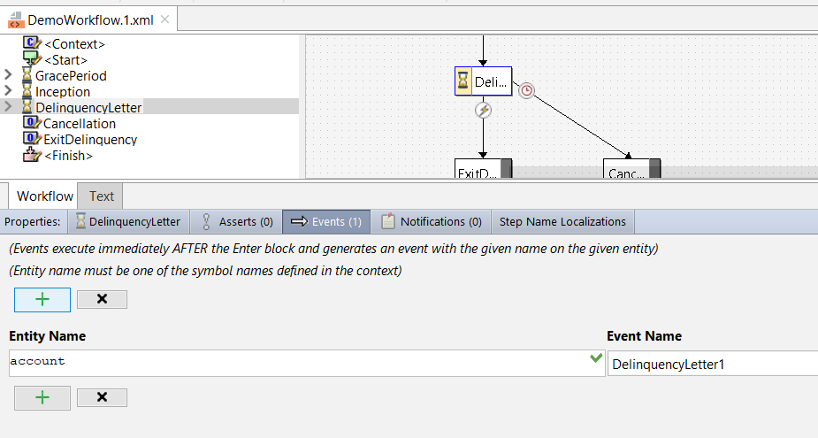
Events
Events allow a workflow to interact with third party systems
Events defined on Events tab do not suspend the workflow
Notes:
A workflow can interact with third-party systems in one of two ways:
A step or outcome can have one or more events listed on its Events tab (as shown in the slide). The execution of a workflow event triggers the Event Message rule set. Events tab events do not suspend the workflow.
A Message Step workflow element also executes a named event, much like the events defined on the Events tab. However, a Message Step suspends execution of the workflow until a response is received from the third-party system.
Ultimately, these two aspects of workflow functionality pertain to application integration and are beyond the scope of this course.
Note: These events are unrelated to the delinquency events that are shown in the BillingCenter application (such as Send Notice of Intent to Cancel).

Slide 11
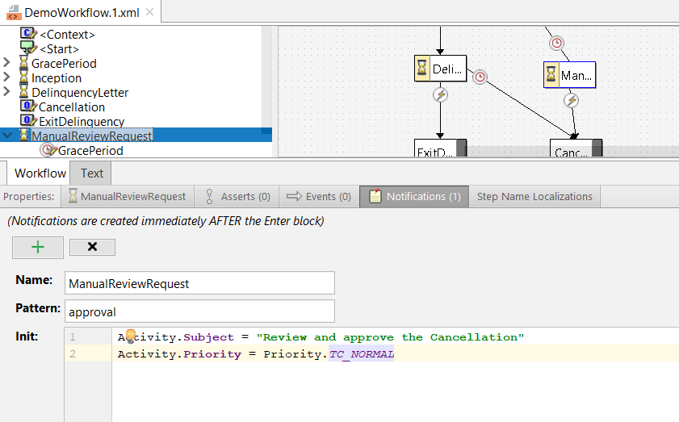
Notifications
A notification is an activity that alerts users to workflow activity without blocking workflow progress
Notes:
A notification is a non-blocking activity that is created within the workflow. Notifications are designed to let users know about important events in the lifecycle of the workflow instance.

Slide 12
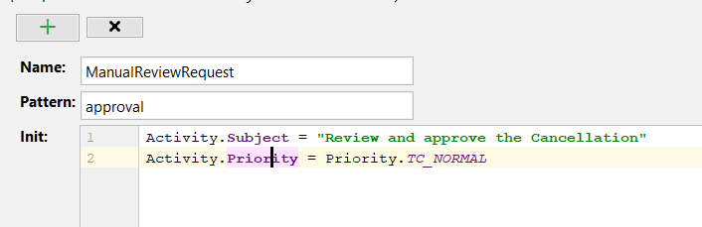
Adding a notification
Click + to add a notification activity
Activity is the root object
Specify activity name and pattern
Use Init field to initialize the fields on new activity
Notes:
Pattern is a required field and must be a valid activity pattern.
Notice that the root object for notifications is Activity.
Workflow steps can also create other activities. The advantage to defining notification activities is that you do not need to write Gosu code to create the activity, add an activity pattern, and initialize the activity fields.

Slide 13
Order of code execution (steps and branches)
Conditions on Asserts tab
Step’s Enter script
Events
Notifications
Activities (activity steps only)
Branches are evaluated in order they are listed in Outline tab
Step’s Exit script
Branch’s Execution script
Notes:
Branches are evaluated in the order they are listed in the Outline tab. For go branches, the first branch with a true condition is the branch that will be executed. If no true condition is found (or if there are no conditional go's), the default go (if any) will be executed.

Slide 14
Workflow steps compared
Go | Y | - | Y
Timeout | - | Y | Y
Trigger | - | Y | Y
Asserts | Y | Y | Y
Events | Y | Y | Y
Notifications | Y | Y | Y
Activities | - | - | Y
Step
Auto
Manual
Activity
Component
Branches
Tabs

Slide 15
Lesson outline
Step behaviors and branches
Auto steps and go branches
Starts, outcomes, and finishes
Activity steps
Timeouts
Triggers

Slide 16

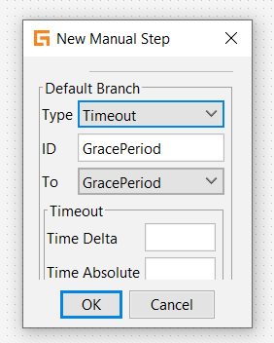
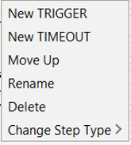
Creating steps and branches
To create a step, right-click the empty canvas and choose the step type
To create a branch, do one of these:
Specify the branch when creating a new step
Right-click the source step and select the branch type
Select branch type

Slide 17
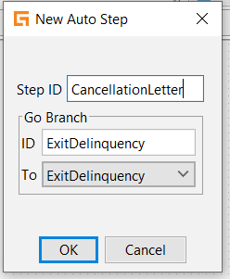
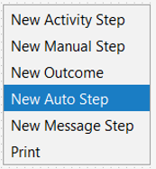
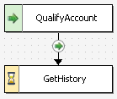
Creating an auto step
Right click
Default go branch ID is name of target step
Notes:
To create a new auto step, right-click the workflow editor canvas and select "New AutoStep" from the popup menu.
In the New Auto Step dialog box, you must specify a step ID and the workflow element that will be the target of the default go branch. Typically, you do not need to specify a branch ID for a branch. If the branch ID is not specified, then the workflow editor uses the name of the next step as the branch ID. (In the example above, the branch goes to the GetHistory step. Therefore, the branch ID will default to "GetHistory ".) Be aware that, if you create a branch and then change the step to which the branch points, the ID does not change. Therefore, it is possible to get a duplicate name error if you create a branch pointing to step A, then move it to point to step B (though it still has the default name of step A), and then create a second branch pointing to step A.
You can rename a branch ID. To do this, right-click the branch and select Rename.

Slide 18
"Go" branches
Start
A go branch indicates where execution should continue when an auto step is complete
It consists of:
A condition
An optional execution script
A next step
Qualify Account
if then...
default
Manual Review
Get History
Acct Rep Approval
if then...
default
Approved
Denied
Finish

Slide 19
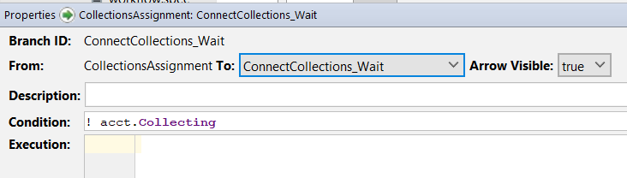
Go branch conditions
Every branch must have condition except the last one listed in the Outline view
Last branch is the default and cannot have condition
Notes:
The branch condition is expressed as a simple boolean expression in the Condition field.
Every auto step has one "default" go branch, which is created when step is created. The workflow engine evaluates go branches in the order that they are listed in the Outline view, and selects the first one that has a true condition. The last go branch (called the default branch) cannot have a condition because it is always used if none of the branches above it has a true condition.

Slide 20
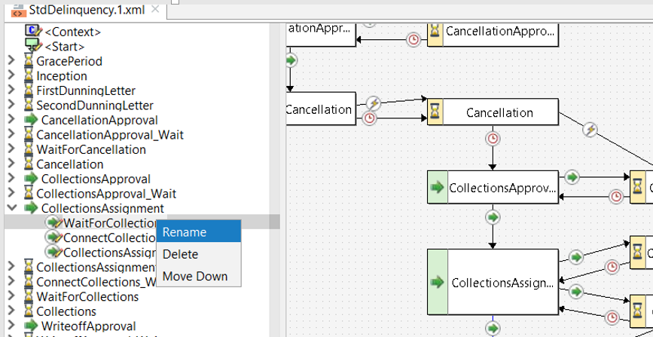
Changing order of branch evaluation
Right-click
Go branches are evaluated Outline view sequence
Default branch must be last
Notes:
You can reorder branches by right-clicking the branch and selecting "Move Up" or "Move Down". (Either option may not be visible if the branch is the first or the last.)
If a step has more than one go branch, you should make sure that the default go branch (that is, the branch that has no condition) is the last go branch listed for the step in the Outline view. The workflow editor does not enforce this rule, but you will get a compile error when you attempt to load the workflow engine if a workflow violates the rule. To detect errors such as this, you should verify your workflows periodically.

Slide 21
Branch scripts
Qualify Account
//Code to // qualify account
// no code
Manual Review
//Code to create // note that no // manual review // was needed
Get History
Branches for all steps can have code in Execution script
Code in step’s Enter script is always executed
Code in a branch’s Execution script is executed only if that branch is traversed

Slide 22
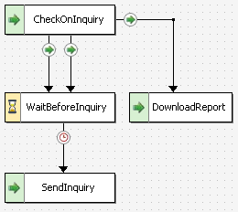
Branches that traverse the same route
Two or more branches can have the same initial step and next step
Useful when you want:
Administrator to know which branch was traversed (and therefore which condition was true)
Different branch execution scripts to be run under different conditions, although you always want to go to the same next step
status = pending
status = error
(default)
Notes:
In the example above, the CheckOnInquiry step has two possible next steps: WaitBeforeInquiry and DownloadReport. If the status value equals either pending or error, then the next step is WaitBeforeInquiry. (If neither condition is true, then the workflow advances to the DownloadReport step.) However, there are separate branches for each condition. This could be because:
When reviewing the workflow detail, an administrator may want to know whether the status was "pending" or "error". The workflow detail shows the steps were executed and the branches that were traversed.
There is one branch execution script to execute if the status is pending, and a different branch execution script to execute if the status is error.
When you create a branch, you typically do not need to explicitly provide an ID. The workflow editor uses the destination step as the ID. However, if you have more than one branch with the same initial and next steps, then you must explicitly specify a branch ID for each branch after the first.

Slide 23
Lesson outline
Step behaviors and branches
Auto steps and go branches
Starts, outcomes, and finishes
Activity steps
Timeouts
Triggers

Slide 24
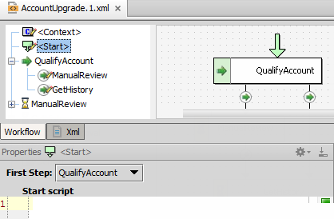
Start
Start
Start indicates which step in the workflow is the first step
Also executes any required initialization code
Start identifies first step in workflow
Qualify Account
if then...
default
Manual Review
Get History
Acct Rep Approval
if then...
default
Approved
Denied
Finish
Notes:
The Start element:
Specifies which step is the first step. (The first step can be an auto step, manual step, activity step, or outcome. However, any workflow process that has an outcome as a first step will end immediately after it starts.)
Specifies any code that should be executed at the beginning of the workflow. (This would typically be initialization code that the workflow requires.)
To access the Start element, simply click the Start element in the Outline view.

Slide 25
Outcomes
Start
An outcome indicates that the workflow has been finished
May have an enter script
Has no next steps
Outcomes have almost the same components as steps, including:
Enter script
Asserts
Events
Notifications
Qualify Account
if then...
default
Manual Review
Get History
Acct Rep Approval
if then...
default
Approved
Denied
Finish

Slide 26
Finish
Start
The Finish contains any code to execute when the workflow is complete, regardless of which outcome was reached
Every workflow has a Finish, but it can be blank
Qualify Account
if then...
default
Manual Review
Get History
Acct Rep Approval
if then...
default
Approved
Denied
Finish
Notes:
The Finish is the one element in the workflow that has no visual representation in the canvas.
To access the Finish element, click the Finish element in the Outline view.

Slide 27
Lesson outline
Step behaviors and branches
Auto steps and go branches
Starts, outcomes, and finishes
Activity steps
Timeouts
Triggers

Slide 28

Workflow activity functionality
Like non-workflow activities, workflow activities:
Are created from activity patterns
Can be assigned via assignment rules
Acct Rep Approval
Approval
AutoAssign()
Aaron Applegate
Notes:
Within an activity step, you specify one or more activities. You can use the standard AutoAssign method to assign activities that your workflow creates.

Slide 29
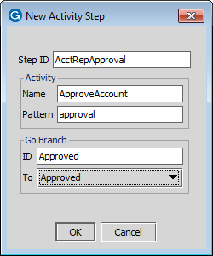
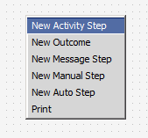
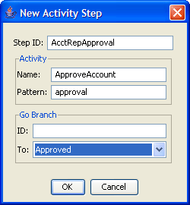
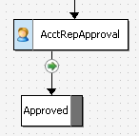
Creating activity steps
Right click
1
2
Notes:
When you create an activity step, you must specify the pattern for the first (and possibly only) blocking activity generated by the step.
The BillingCenter base application workflows do not have activity steps, but you can add activity steps to any workflow type.

Slide 30
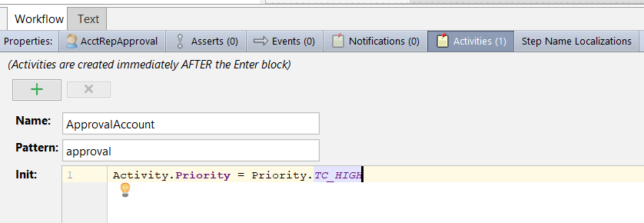
Configuring blocking activities
An activity step must have one or more blocking activities
Execution of the workflow resumes when all blocking activities are terminated
Notes:
You can initialize activity fields in the Init field on the Activities tab.

Slide 31
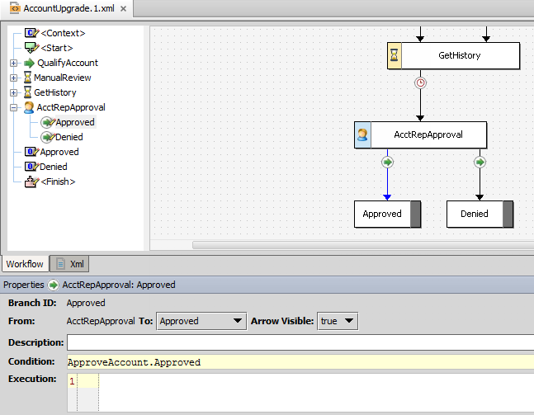
Activity step: go branch example
Must have a condition
Can't have a condition
Name of blocking activity
Notes:
An activity step can have any combination of branches: go, timeout, and trigger.
In the example, the AcctRepApproval activity step has only go branches. When the last open blocking activity is closed, the go branches are evaluated in the order that they appear in the Outline tab. The workflow advances down the first true branch. Note that because the Denied go branch is the default branch, it cannot have a condition. So, if the ApproveAccount branch fails, the Denied branch is taken.

Slide 32
Activity step: all branch types example
Activity Step
if … then…
default
Activity step waits until any one of these happens:
Trigger is invoked
Timeout expires
All blocking activities are terminated
If all blocking activities are terminated, go branches are evaluated
Order of branches is significant only with multiple go branches
Notes:
The activity step has the advantage of not requiring any code to test whether the activity has been completed.
The Workflow engine creates each defined activity as it enters the step. (This occurs immediately after the Workflow engine executes the Enter Script block, if there is one.) The activity is available on all steps.
The only difference between an activity and a notification within a workflow is that an activity pauses the workflow until all the activities in the step terminate. A notification does not block the workflow from continuing.
If more than one activity exists on an activity step, then the Workflow engine generates all of them immediately after the Enter block (along with any events or notifications). The step then waits for all of the activities to terminate. An activity step can also contain timeout and trigger branches. In this case, if a timeout or a trigger on the step occurs, then the workflow does not wait for all the activities to complete before leaving the step.

Slide 33
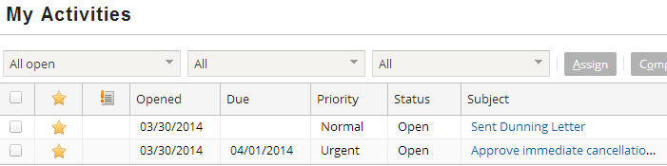
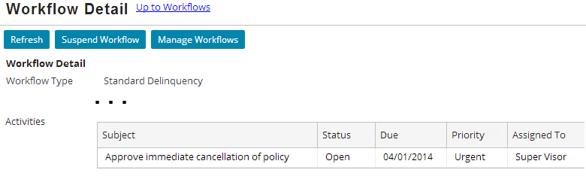
Blocking activities in the UI
Activity owner’s desktop
Administrator’s perspective
Notes:
The blocking activity appears in the assigned owner's desktop activity list along with non-workflow activities.
The administrator’s Workflow Detail screen lists the all currently open blocking activities.

Slide 34
Lesson outline
Step behaviors and branches
Auto steps and go branches
Starts, outcomes, and finishes
Activity steps
Timeouts
Triggers

Slide 35
Timeouts
Start
A timeout is a mechanism used to automatically resume execution of a workflow that is stopped at a manual or activity step
Execution resumes when the time specified on the timeout is reached
Qualify Account
if then...
default
Manual Review
Get History
Acct Rep Approval
if then...
default
Approved
Denied
Finish

Slide 36
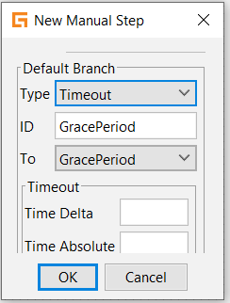
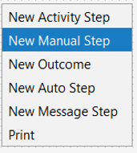
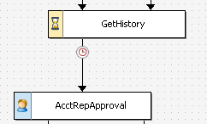
Creating a step with timeout branch
Right click
You must provide a value for one of the Timeout fields
Notes:
When you create a timeout, you must specify either a Time Delta value or a Time Absolute value. You cannot specify both in the same timeout. In the example, the step is a manual step. You can also add a timeout branch to an activity step.

Slide 37
Two ways to specify time for a timeout
Time delta is the time that must pass after Enter script (if any) for step and before advancing to next step
Can be specified using any combination of days (d), hours (h), minutes (m), seconds (s)
Example:
Time absolute specifies the time at which execution should continue to the next step
Examples:
Notes:
Time delta
Use the following syntax for specifying the length of time in the Time Delta field:
Xd - X days
Xh - X hours
Xm - X minutes
Xs - X seconds
...where X is an integer value.
You can use more than one unit of time when specifying the Time Delta. 90 minutes could be specified as 90m or as 1h30m. The screenshot above shows a delta time of 2 days, 5 hours, 3 minutes, and 15 seconds.
The integer values of a time may be negative. For example "-30s" is negative 30 seconds (which could be used in the expression "1d-1h" to represent 23 hours).
Time absolute
A timeout can be set to an "absolute" time. The field specifies the time at which execution should continue to the next step. This value can be a date value stored in one of the objects available to the workflow, or it could be the result of a calculation using one of those values. (In the example above, the Account object has an EnteredDelinquencyDate field, and the time specified is 15 days after the value of this field.)
The absolute time can be expressed as a date value or as a datetime value (if it is relevant to tie time of day to the continuation of the step).
If the absolute date has already passed when the step has completed execution, then execution continues immediately with the next step.
Do not use the current time in a Time Absolute expression. Time Absolute is re-evaluated each time the workflow engine checks the timeout. An expression such as "gw.api.util.DateUtil.addDays(Libraries.Date.currentDate(), 1)" will never be reached, because today will never be tomorrow.

Slide 38
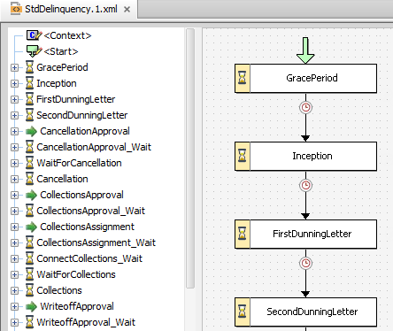
Testing workflows with timeouts
Workflows with timeouts can involve wait periods longer than a day
Developers need mechanism for testing timeouts
Two methods
Manually advancing down timeout branch
Advancing system clock
5 days
1 day
7 days

Slide 39
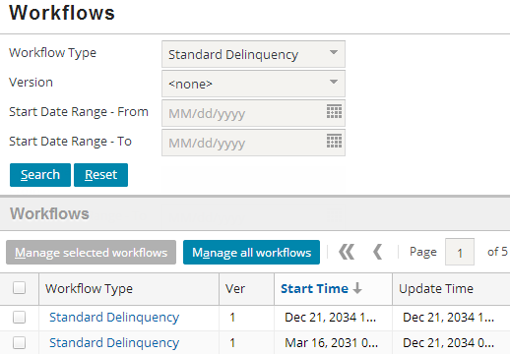
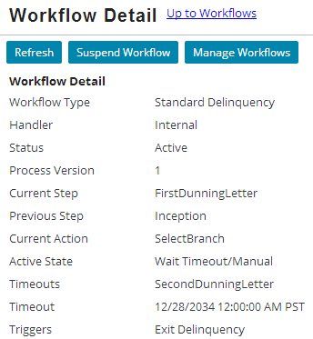
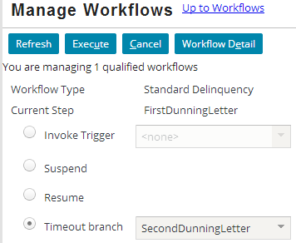
Manually advancing a timeout branch
Find relevant workflow instance
Click Manage Workflows
1
2
3
Select Timeout branch and click Execute
Notes:
The Manage Workflows screen displays information for one or more workflows. From this screen, you can force the workflow to advance down a specific Timeout branch.
After step 3, BillingCenter displays a confirmation message such as "Executed Set Timeout against 2 applicable workflows".

Slide 40
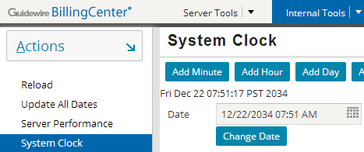
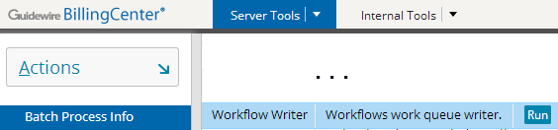
Advancing system clock
You can also test timeouts by advancing system clock
After advancing clock, you typically need to manually run workflow batch process
workflow writer
Notes:
Running the Workflow Writer batch process essentially wakes up the workflow engine to look at the clock after you’ve advanced the time.

Slide 41
Lesson outline
Step behaviors and branches
Auto steps and go branches
Starts, outcomes, and finishes
Activity steps
Timeouts
Triggers

Slide 42
Triggers
Start
A trigger is a mechanism used to resume execution of a workflow that is stopped at a manual or activity step
A trigger can be invoked by anything that executes Gosu, but is most commonly done by:
Gosu function
Business rule
API call from an external system
Qualify Account
if then...
default
Manual Review
Get History
Acct Rep Approval
if then...
default
Approved
Denied
Finish
Notes:
A trigger does nothing until it is explicitly invoked from outside of the workflow. Once invoked, execution proceeds to the trigger's next step.
The Example Workflow
The diagram above is a partial drawing of a simple workflow for a business process in which an account is upgraded to premium status. (This workflow does not represent any real out-of-box workflow and is used here solely for instructional purposes.)
In the workflow, the Manual Review step has a trigger tied to a "Review Complete" button on the user interface. When the button is clicked, the associated trigger is executed and the workflow continues on to the Get History step.

Slide 43
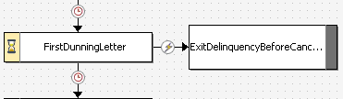
Creating a trigger
ExitDelinquency
If new trigger name, add trigger to WorkflowTriggerKey typelist
Create the trigger branch
Create the code to invoke the trigger
Notes:
None of the agency bill workflows in the base application use triggers. For that reason, all the trigger examples in this lesson are from delinquency workflows.

Slide 44
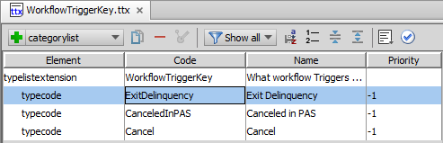
Step 1: Extend WorkflowTriggerKey typelist
Add new trigger to typelist
A trigger is named by its code value
Notes:
Note: ExitDelinquency is a trigger key in the BillingCenter base configuration.

Slide 45
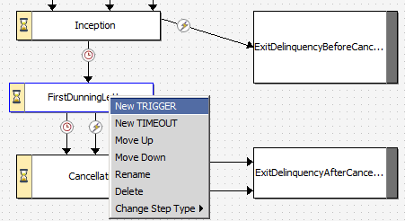
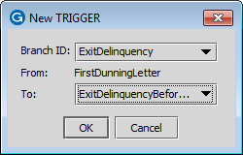

Step 2: Create the trigger branch
Branch ID is code value in WorkflowTriggerKey typelist
Notes:
Trigger codes that are already used by the step are hidden to avoid duplicate triggers.

Slide 46
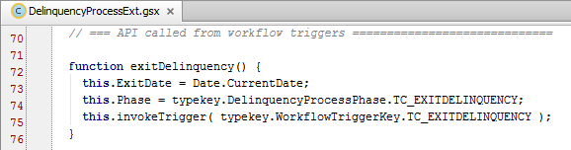
Step 3: Create code to invoke the trigger from a rule or class
Syntax: processObject.invokeTrigger ( triggerTypecode )
Method executed from workflow's process context object (such as DelinquencyProcess)
Recommended method for referencing typecodes is: typekey.TypelistName.InternalTypecodeName
Example:
Notes:
The code example in the slide is found in DelinquencyProcessExt.gsx.
You can invoke a trigger from a rule, a class, or a PCF. The example in the slide is appropriate for rules and classes but not for PCFs. The next slide shows how to invoke a trigger from a PCF.
Line 116 above could be written either as:
this.invokeTrigger( typekey.WorkflowTriggerKey.TC_EXITDELINQUENCY );
or
this.invokeTrigger( "ExitDelinquency");
The first method references the typecode by its internal name. The second method references the typecode by its localized name. If a given typecode is configured for only one locale, the two are identical. However, if a typecode is configured for multiple locales, then code references to the localized name can have unpredictable behavior.
The WorkflowTriggerKey typelist is used only by developers, so it is unlikely that localization would ever pose a problem. However, the general best practice is to reference all typecodes by their internal names.

Slide 47
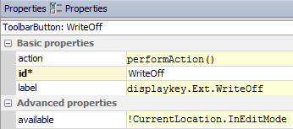
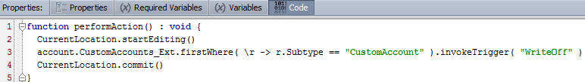
Step 3: Create code to invoke the trigger from a PCF
For PCFs:
Use processObject.invokeTrigger( triggerTypecode )
Call CurrentLocation.commit() to perform a commit
Example:
Notes:
To invoke a trigger from a PCF element, you need to commit the action after the trigger is invoked. Without the commit, the action is never performed. Note: The WriteOff button does not exist in the base application and is shown here to demonstrate the use of <processObject>.invokeTrigger() in a PCF. The Account entity has been extended with an arraykey called “CustomAccounts_Ext” because an account can have any number of workflows. In the example, the code looks for a workflow with the subtype CustomAccount.

Slide 48
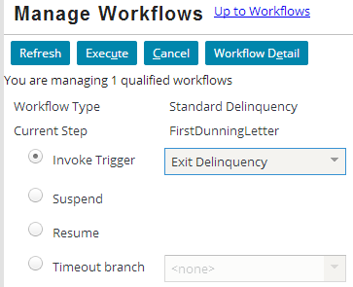
Manually invoking a trigger
Manage Workflows screen displays information for one or more workflows
Select this option to advance down selected trigger branch

Slide 49
Timeouts and triggers
Click Escalate button
Assign to SIU
Fraud Evaluation
Click Approve Payment button
Process Payment
Click Withdraw button
Escalate to Mangmnt
Legal Consult.
Wait 48 hours
File Lawsuit
Notes:
A manual step must have at least one timeout or trigger. However, a manual step can have any combination of timeouts and triggers.
Example 1: Multiple Triggers
A manual step can have two (or more) triggers when there are two or more external actions, each of which advances the workflow in a different direction. The example above is from a hypothetical payment workflow. When the payment is at the "Fraud Evaluation" step, it must be reviewed by a user. The user could click an Escalate button (which advances the workflow to the "Assign to SIU" step) or the user could click an Approve Payment button (which advances the workflow to the "Process Payment" step). The workflow will not advance until one of the two buttons is clicked.
Example 2: Combination of a Trigger and Timeout
A manual step can have a trigger and a timeout. This is typical when there is an action from a user or external system which could advance the workflow in one direction, but if no intervention occurs then the workflow eventually advances in another direction. The example above is from a hypothetical litigation workflow. After the "Legal Consultation" step, a user could click the "Withdraw" button, which advances the workflow to the "Escalate to Management" step. However, if the user does not click this button within the next 48 hours, then the workflow automatically advances to the "File Lawsuit" button.
Multiple Timeouts
Theoretically, a manual step can have two or more timeouts. This would be necessary only if there are two or more timeframes, each of which is defined in a different way and either of which could come first. In practice, there are very few business scenarios where two timeouts are needed to enforce the requirements. But technologically, this can be done.

Slide 50
Lesson objectives review
You should now be able to:
Distinguish among auto, manual, and activity steps
Distinguish among go, timeout, and trigger branches
Create and edit steps and branches
Create and edit Start element, outcomes, and Finish element
Describe how to create and invoke a trigger

Slide 51
Review questions
What determines the order in which Go branches are evaluated?
Why would you create two branches going from a given step to the same next step?
What is the difference between an activity defined on the Activities tab and a notification activity?
How does the workflow engine identify the first step to execute?
List all the places where you can add code to a workflow.
Notes:
Answers
The order in which the branches are listed in the Outline tab.
This can be desirable when you want to track which condition was true when the workflow went from one step to the next, or when you have different branch code to execute even though both branches need to end in the same next step.
Activities that are created on the Activities tab are blocking activities and can be created only by activity steps. Notification activities do not halt workflow execution and can be created by any type of workflow step.
The value of the First Step field of the Start component
Start script, conditions on Asserts, Enter and Exit scripts on steps, Notifications tab, Activities tab, Conditions on branches, Execution code for branches, Finish script

Slide 52
Demo
6

Slide 53
Provide demo details and link to the demo video
7

Slide 54
Lab
6

Slide 55
Complete the exercises listed in “Workflow Elements” chapter in the “BillingCenter 10 Configuration: Kickstart“ work book
7

Slide 56
Review
6

Slide 57
Notices
Copyright © 2001-2014 Guidewire Software, Inc. All rights reserved.
Guidewire, Guidewire Software, Guidewire ClaimCenter, Guidewire PolicyCenter, Guidewire BillingCenter, Guidewire Reinsurance Management, Guidewire ContactManager, Guidewire Vendor Data Management, Guidewire Client Data Management, Guidewire Rating Management, Guidewire InsuranceSuite, Guidewire ContactCenter, Guidewire Studio, Guidewire Product Designer, Guidewire Live, Guidewire DataHub, Guidewire InfoCenter, Guidewire Standard Reporting, Guidewire ExampleCenter, Guidewire Account Manager Portal, Guidewire Claim Portal, Guidewire Policyholder Portal, ClaimCenter, BillingCenter, PolicyCenter, InsuranceSuite, Gosu, Deliver Insurance Your Way, and the Guidewire logo are trademarks, service marks, or registered trademarks of Guidewire Software, Inc. in the United States and/or other countries.
All other trademarks are the property of their respective owners.
This material is confidential and proprietary to Guidewire and subject to the confidentiality terms in the applicable license agreement and/or separate nondisclosure agreement.
This file and the contents herein are the property of Guidewire Software, Inc. Use of this course material is restricted to students officially registered in this specific Guidewire-instructed course, or for other use expressly authorized by Guidewire. Replication or distribution of this course material in electronic, paper, or other format is prohibited without express permission from Guidewire.
Guidewire products are protected by one or more United States patents.

