Slide 1

Configuring Delinquency Workflow
Editable List View

Slide 2
Lesson objectives
By the end of this lesson, you should be able to:
Describe the relationship between workflow steps and delinquency events
Add a new delinquency reason to a delinquency plan
Define delinquency events for a delinquency reason
Initiate delinquency workflow instances
Be familiar with the delinquency data model
This lesson uses the notes section for additional explanation and information. To view the notes in PowerPoint, choose View→Normal or View→Notes Page. If you choose to print the notes for the lesson, be sure to select "Print hidden slides."

Slide 3
Lesson outline
Overview
Delinquency plan
Target dates
Initiating and exiting delinquency workflow

Slide 4
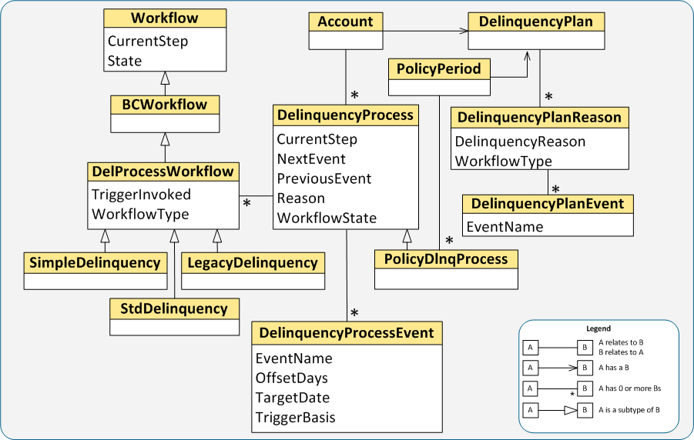
Delinquency data model overview
Notes:
Note: Some subtypes of DelProcessWorkflow are not shown in the diagram.

Slide 5
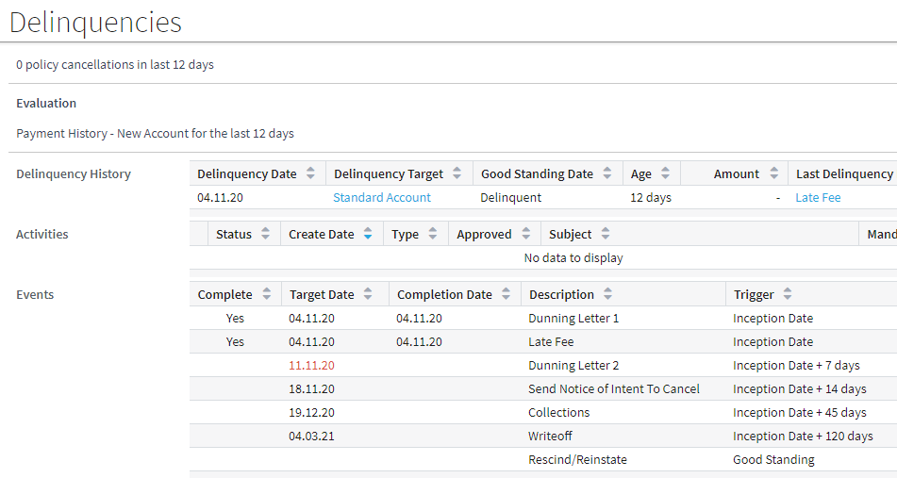
Users track delinquency through events
A delinquency event provides a way for a BillingCenter user to track the progress of a delinquency
Delinquency events
Completed flag
Notes:
An event is a business-level description of what is happening in the workflow. Because the user doesn’t need to know every step that the workflow is executing, the Delinquencies screen lists the events for a delinquency (not the workflow steps) and completion date and status of each delinquency event.
Delinquency events are not natively part of workflow—they are specific to BillingCenter delinquency workflows.

Slide 6
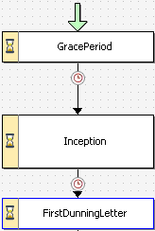
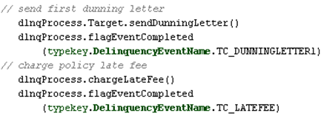
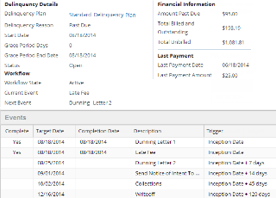

Gosu communicates workflow progress
Delinquency events are programmatically associated with workflow
Workflow
Gosu
BillingCenter User
Notes:
Delinquency events provide visual feedback to the BillingCenter representative on the status of the delinquency for an account or policy period. In the example, the FirstDunningLetter step executes two delinquency events: Dunning Letter 1 and Late Fee. In the StdDelinquency workflow, FirstDunningLetter is the only step that executes more than one delinquency event.
Any workflow step can execute one or more delinquency events or no delinquency events. The only relationship between a workflow step and a delinquency event is established using Gosu, which you as the configurator control.

Slide 7



Every account must have a delinquency plan
A policy period can also have a delinquency plan
Delinquency plan associates each delinquency reason with a workflow type and 0 or more delinquency events
Account
Delinquency plan
Notes:
The example shows the delinquency reason, workflow type, and delinquency events defined in the Standard Delinquency Plan. The Failure to Report delinquency reason has no associated delinquency events, whereas the Past Due reason has several. Each reason has a different workflow type.

Slide 8
Which delinquency plan is used?
Policy period’s delinquency plan is used if:
Policy period has a delinquency plan, and
Charge is for policy period
Owner account’s delinquency plan is used if:
Policy period has no delinquency plan, or
Charge is account level
Premium Taxes Installment fee
Invoice fee Late fee Payment reversal fee
Notes:
When an item on a policy period is past due, the delinquency plan on the policy period (if specified) takes precedence over the delinquency plan specified for the account.

Slide 9

Delinquency reason and workflow type
Delinquency reason on delinquency plan identifies the delinquency workflow process to run
Standard Delinquency
Notes:
In the base configuration, the DelinquencyReason typelist defines a set of reasons for why the delinquency process started in. Guidewire provides a base configuration workflow for many of the base configuration delinquency reasons.
The example code checks to see if the account has any active past due delinquency process. If not, it starts a past due delinquency.

Slide 10

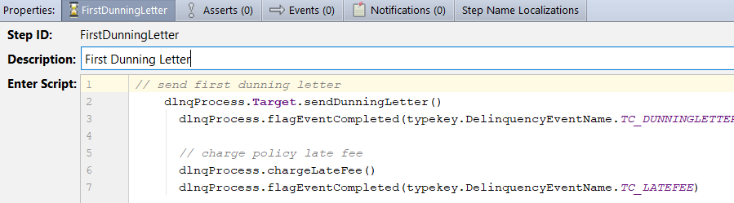
Flagging delinquency events
After any logic for delinquency event is executed …
… code in workflow step calls method to flag delinquency event as completed
Notes:
The FirstDunningLetter workflow step in the StdDelinquency workflow contains the Gosu code in the Enter script to perform two events (send dunning letter and charge late fee) and to flag each event as completed. The completion of these two events signals that the workflow is ready to move to the next step.
Note that tasks involved in carrying out a given delinquency event could involve multiple workflow steps, for example sending, approving, and cancelling the Dunning Letter. The user is simply informed when the workflow has completed a specific delinquency event.

Slide 11
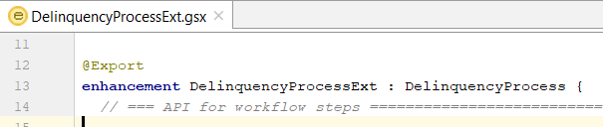
APIs for delinquency workflow
DelinquencyProcessExt defines the APIs
Functions include:
onInception()
sendDunningLetterFromTarget()
cancelTarget()
addCancellationActivity()
resetStagingDelinquencyPlanIfPossible()
rescindOrReinstateTarget()
exitDelinquency()
onChargesPaid()
pushForwardHeldEvents()
flagEventCompleted()
getApprovalDate()
createApprovalActivity()
createAssignCAActivity()
getTargetDate()
AssignCAActivity()
cancelTomorrow()
Notes:
DelinquencyProcessExt is available in Guidewire Studio so that you can view and edit the existing delinquency workflow methods and add any new ones as required.
Note: A "CA" activity is a collection agency activity.

Slide 12
Lesson outline
Overview
Delinquency plan
Target dates
Initiating and exiting delinquency workflow

Slide 13
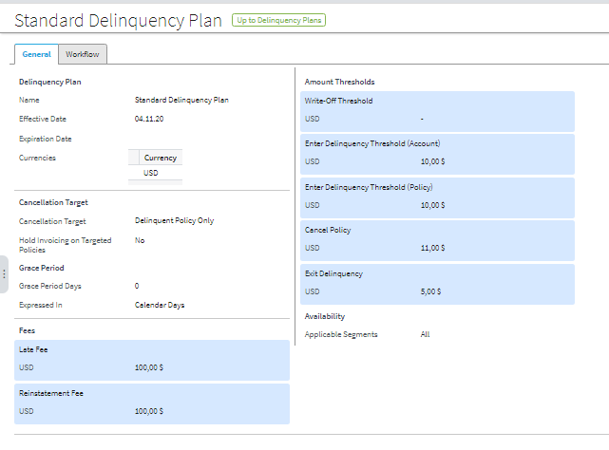
General tab of delinquency plan
Information on the General tab applies to all delinquency workflows associated with the plan

Slide 14
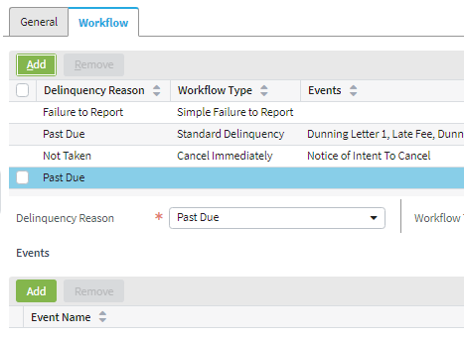
Adding a reason to a delinquency plan
On Workflow tab, click Edit, then click Add
Select Delinquency Reason and Workflow Type
Add events (if any)
An existing reason is preselected—change the selection to the new reason
Notes:
If the delinquency plan is in use (that is, it is associated with an account, a policy period, or both), you will get a warning message when you click edit.

Slide 15
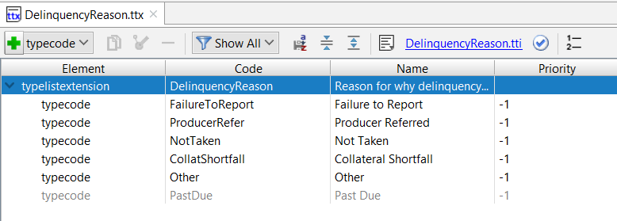
Specifying delinquency reasons
Delinquency Reason
DelinquencyReason typelist contains available delinquency reasons
You can add new reasons by extending the typelist in the data model
Notes:
To refer to the value of a delinquency in Gosu, use typekey.DelinquencyReason.TC_<reason>; for example, typekey.DelinquencyReason.TC_PASTDUE.

Slide 16
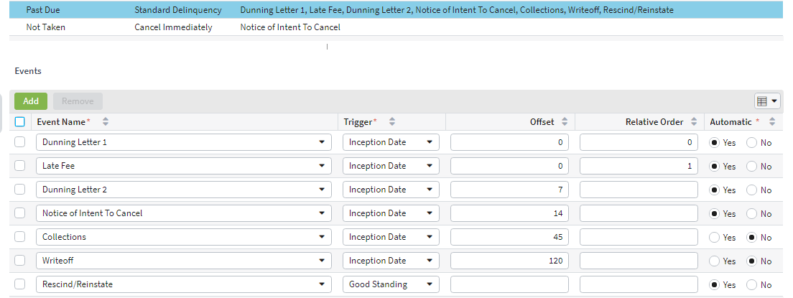
Adding events to delinquency plan
Delinquency EventName
Event must be in DelinquencyEventName typelist
Associated workflow must implement the event

Slide 17
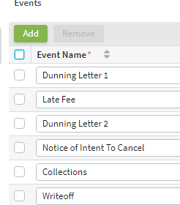
How to add events to delinquency plan (1 of 2)
Open delinquency plan in edit mode
On Workflow tab, select the delinquency reason
Click Add button under Events

Slide 18
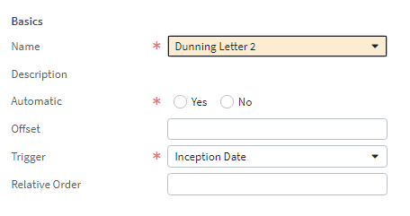
How to add events to delinquency plan (2 of 2)
Define the event
Delinquency EventName
Usually set to Yes
Delinquency Trigger Basis
Trigger + Offset = target date, when workflow can move to next step
Determines sequence of events in OrderedEvents list when multiple events have same target date
Notes:
The Trigger and Offset values are used to calculate the target date for the event. "Trigger" refers to the trigger basis specified in the DelinquencyTriggerBasis typelist. "Offset" refers to the number of days to add to the trigger basis in the calculation of the target date. The meaning of each trigger basis ("Inception Date", for example) is established programmatically in the workflow. The topic of "Target Dates" is discussed later in this lesson.
If you have more than one delinquency event with the same target date (that is, with the same values for trigger and offset, then you need to set the relative order in which the event occurs. The relative order value determines the sequence of events in the OrderedEvents list of delinquency process events, which in turn controls the display order of events in the Delinquencies screen.
Automatic is a switch used in the StdDelinquency workflow that controls whether a step that creates a notification activity needs to wait for approval. Set this value to yes unless you have provided additional logic to handle the approval process. See Guidewire BillingCenter Configuration Guide for more information.
Note that the Trigger field on the delinquency plan is not related to trigger branches in workflow.

Slide 19
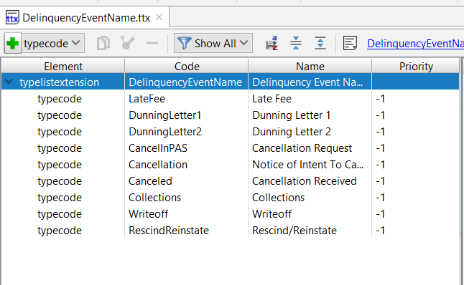
Specifying delinquency events
Delinquency EventName
DelinquencyEventName typelist contains available delinquency events
You can add new events by extending the typelist in the data model
Code value is used in Gosu
Name value is what user sees in BillingCenter

Slide 20
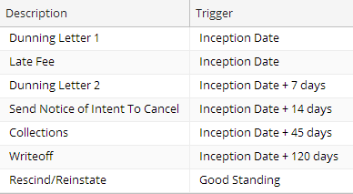
Order of delinquency events
Events are ordered by target date
DelinquencyProcess.OrderedEvents is ordered list of delinquency process events
Relative order is important only for events with same target date
OrderedEvents is used to:
Determine current event and next event
Populate the list of events on Delinquencies screen
Relative order:
0 1
These have unique target dates
Notes:
DelinquencyProcess has a virtual property called OrderedEvents which contains a list of delinquency process events. The Delinquencies screen shows the workflow’s "Current Event" and "Next Event". Current Event is actually the last event to have been flagged complete. Next Event is the next one found in OrderedEvents. If the target date is identical for two events, the relative order determines the order of the events in the OrderedEvents list.
On the delinquency plan, the order of events is insignificant. Delinquency events are simply listed in the order they were added to the plan.

Slide 21
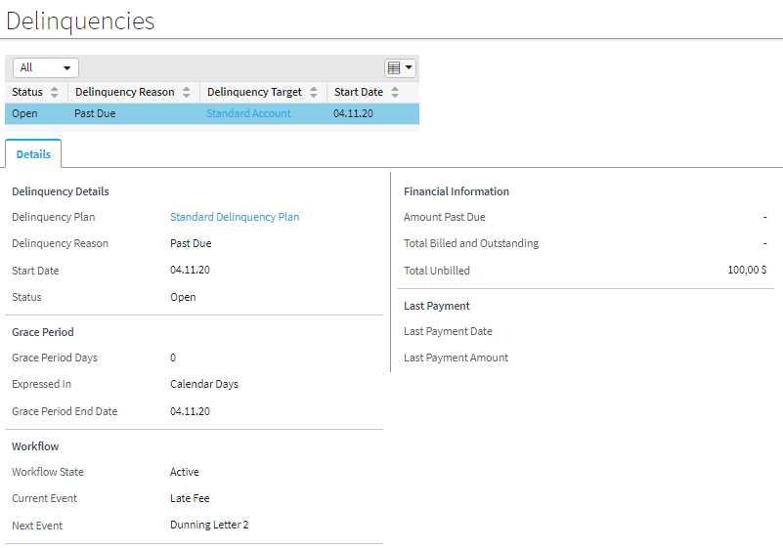

Current event and next event
Current event is the last event that was flagged competed
Next event is next event in OrderedEvents
Delinquencies screen shows both events
Notes:
The Delinquencies screen shows the workflow’s "Current Event" and "Next Event". Current Event is actually the last event to have been flagged complete. Next Event is the next one found in OrderedEvents.
Note: The value for "Current Event" comes from the Previous Event property in the OrderedEvents list. There is no Current Event property in OrderedEvents.

Slide 22
Delinquency plan checklist
Prepare the data model: add new delinquency reasons, events, triggers, and trigger bases to the data model
In delinquency plan and corresponding workflows:
For each delinquency reason, all associated delinquency events are completed in corresponding workflow
Display order of events mirrors sequence of event completions in workflow
Relative order is specified for events that have same target dates
Delinquency event names generally match name of corresponding workflow step

Slide 23
Lesson outline
Overview
Delinquency plan
Target dates
Initiating and exiting delinquency workflow

Slide 24
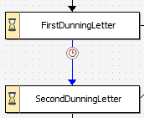

Calculating the target date
Target date is the date on which a workflow can move to the next step
Used as Time Absolute for timeout branch
getTargetDate() returns event.TargetDate
Generally calculated as Trigger Basis + Offset
getApprovalDate() adds -7 to calculated target date
Notes:
Notice that the Workflow engine adds the offset to the trigger basis to calculate the event date. The offset value can be any positive or negative integer.
A second method (getApprovalDate) in DelinquencyProcessExt also calculates a target date. This method always adds -7 days to the calculated target date. This usually ensures that a given timeout happens immediately. For example, the StdDelinquency workflow calls getApprovalDate() from the timeout branch that goes from the Inception step to the FirstDunningLetter step. This means that there is no delay between the end of inception and the start of sending the first dunning letter.
Technically, a timeout can use any value for delta or absolute time. However, best practice is to calculate target dates from the trigger bases and offsets defined in the delinquency plan.

Slide 25
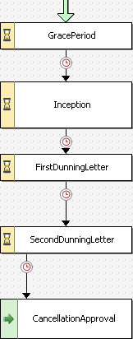
Where to put the timeout branch?
Timeout value references target time of the event that will be performed by the next step
dlnqProcess.GracePeriodEndDate
dlnqProcess.getApprovalDate (typekey. DelinquencyEventName.TC_DUNNINGLETTER1)
dlnqProcess.getTargetDate (typekey. DelinquencyEventName.TC_DUNNINGLETTER2)
dlnqProcess.getApprovalDate (typekey. DelinquencyEventName.TC_CANCELLATION)
Notes:
The example is part of the StdDelinquency workflow type.
In the BillingCenter base application, both getTargetDate() and getApprovalDate() return the event date

Slide 26
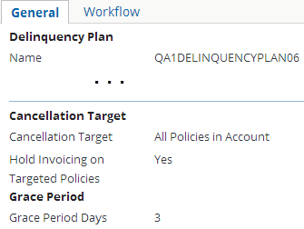

Grace period
Grace period is set on General tab of delinquency plan
Applies to all workflows in the plan that implement a grace period
If implemented, the Grace Period step should have timeout branch set to grace period end date
Notes:
A grace period is a period of time before an action (such as processing a delinquency) is taken.
In the example, Grace Period Days is set to 1, and the GracePeriod step will be executed when the target date for the Grace Period event is reached. Unlike other delinquency events, Grace period target date has no offset.
Note: GracePeriod can be defined by the delinquency plan, but it is only relevant and used in the event target date calculations if the workflow has a step that implements the grace period timeout to delay the call to inception until it is reached.

Slide 27
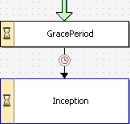
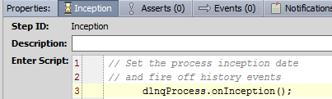
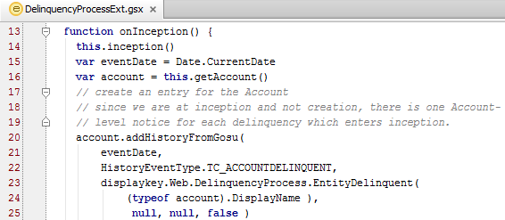
Inception
Inception date is set when Inception step is reached
Sets inception date
Notes:
The inception date isn’t set until the Inception step is reached. If there is a non-zero grace period specified on the delinquency plan and the GracePeriod step is implemented in the workflow, then the inception date occurs after the end of the grace period.
As with other delinquency events, you must coordinate the Inception workflow step with the Inception delinquency event.
Note: The "eventDate" variable in the function is used in the entry that is added in the history log for the account. It does not have special significance for delinquency workflow.

Slide 28
Lesson outline
Overview
Delinquency plan
Target dates
Initiating and exiting delinquency workflow

Slide 29
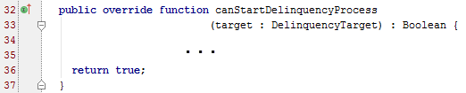

Before delinquency process starts
EventHandler.gs
BillingCenter calls two plugin methods before starting a delinquency process
canStartDelinquencyProcessing() is called when policy or account is past due, but there is no associated active delinquency process
beforeStartDelinquencyProcessing() is called before starting delinquency processing
Notes:
The EventHandler plugin has two methods that BillingCenter calls before starting a delinquency process.
BillingCenter calls the canStartDelinquencyProcess method to determine whether to start a delinquency. It takes an account or policy period object (that is already past due but does not yet have an active delinquency process) and returns true or false. This method confirms whether to start the delinquency process for the account or policy.
Before starting delinquency processing of newly delinquent policies and/or accounts, BillingCenter calls the beforeStartDelinquencyProcessing method. It takes an array of delinquency targets.

Slide 30

Methods for initiating a delinquency workflow
Method to use depends on number of targets
Delinquency target is the account or policy period that caused the delinquency
For a single, specific target, use target.startDelinquency( reason )
For multiple targets, use DelinquencyUtil.startDelinquencies( target[ ] , reason )
Notes:
When a delinquency is launched, a target object of type Account or PolicyPeriod must be set to identify the object that has caused the delinquency. This will be held in the field DelinquencyProcess.Target, which is of type DelinquencyTarget. If a delinquency is launched against multiple targets (as can happen when the user clicks the Start Delinquency button), you must establish the array of targets and pass this to the startDelinquency() method.
In the single target example, the code:
Checks whether a relevant workflow is already in progress for this account
If no relevant workflow is in progress, launches the workflow using startDelinquency() method

Slide 31
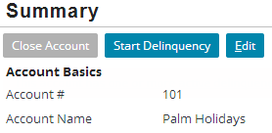

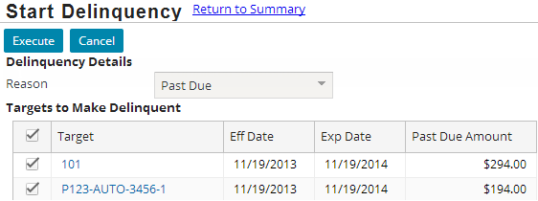
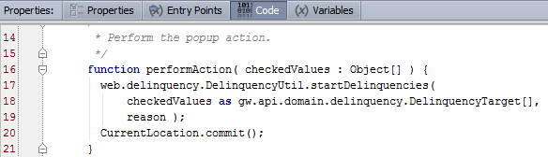
Initiating a delinquency, multiple targets
1
StartDelinquencyProcessPopup Toolbar
2
3
StartDelinquency ProcessPopup
Notes:
You can manually initiate a delinquency for an account and its policy periods starting from the account Summary screen or the policy Summary screen. Click Start Delinquency, which calls the StartDelinquencyProcessPopup. After you select the targets for delinquency, click the Execute button, which calls the performAction () method to initiate a delinquency process for each of the selected targets.
In the BillingCenter base application, the Start Delinquency button functionality provides a good example of initiating a delinquency with multiple targets. The code calls the startDelinquencies method, passing it an array of delinquency targets and associated reasons. Recall that each delinquency reason is mapped to a workflow type.

Slide 32
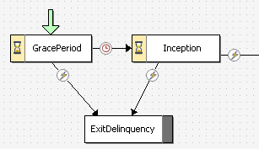
Exiting a delinquency
Invoke the ExitDelinquency trigger
From a rule or class, use DelinquencyProcess.exitDelinquency()
From a PCF, use DelinquencyUtil.invokeTrigger(), which performs a commit after invoking trigger
ExitDelinquency trigger

Slide 33
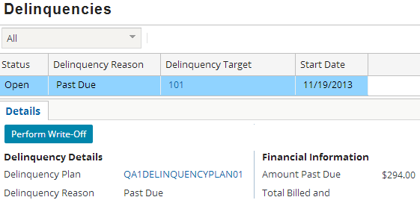
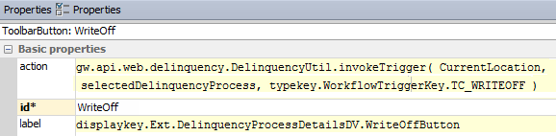
Example: invoking a workflow trigger from a PCF
Notes:
In the example, the Perform Write-Off button uses DelinquencyUtil.invokeTrigger() to invoke the WriteOff workflow trigger. The Perform Write-Off button does not exist in the base application and is shown here to demonstrate the use of DelinquencyUtil.invokeTrigger().
To invoke a trigger from a PCF element, you need to commit the action after the trigger is invoked. Without the commit, the action is never performed. There are two ways you can do this:
Use the invokeTrigger method on DelinquencyUtil, which executes a commit after the trigger is invoked (see example on the slide)
Invoke the trigger using <ProcessObject>.invokeTrigger() and then call CurrentLocation.commit() explicitly.
Note:

Slide 34
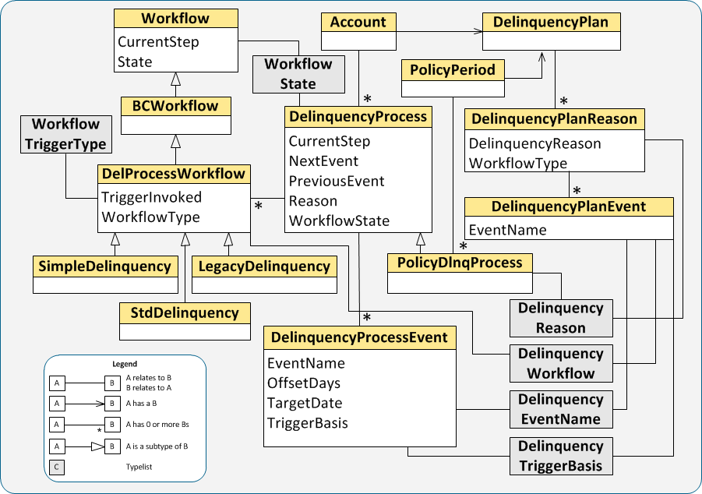
Delinquency data model revisited
Notes:
The side provides a detailed look at the delinquency data model. For even more detail, consult the BillingCenter Data Dictionary.

Slide 35
Lesson objectives review
By the end of this lesson, you should be able to:
Describe the relationship between workflow steps and delinquency events
Add a new delinquency reason to a delinquency plan
Define delinquency events for a delinquency reason
Initiate delinquency workflow instances
Be familiar with the delinquency data model
This lesson uses the notes section for additional explanation and information. To view the notes in PowerPoint, choose View→Normal or View→Notes Page. If you choose to print the notes for the lesson, be sure to select "Print hidden slides."

Slide 36
Demo
6

Slide 37
Provide demo details and link to the demo video
7

Slide 38
Lab
6

Slide 39
Complete the exercises listed in “Configuring Delinquency Workflow” chapter in the “BillingCenter 10 Configuration: Essentials“ work book
7

Slide 40
Review
6

Slide 41
Review questions
What is the purpose of a delinquency event?
Where would you put the logic that determines when to send the second dunning letter?
When is the inception date set in the Standard Delinquency workflow?
From a PCF element, how would you invoke a trigger to exit a delinquency?
Describe two ways the OrderedEvents list is used.
Notes:
Answers
Delinquency events allow a BillingCenter user to track the progress of the delinquency workflow. An event is a business-level description of what’s happening in the workflow.
In the timeout branch that precedes the SecondDunningLetter step.
When the Inception step is reached (and the inception() function is executed).
Call DelinquencyUtil.InvokeTrigger("ExitDelinquency"), which performs a commit after it invokes the workflow trigger.
It provides the "Current Event" and "Next Event" values for the Delinquencies screen, and it determines the display sequence of delinquency events at the bottom of that screen.

Slide 42
Notices
Copyright © 2001-2014 Guidewire Software, Inc. All rights reserved.
Guidewire, Guidewire Software, Guidewire ClaimCenter, Guidewire PolicyCenter, Guidewire BillingCenter, Guidewire Reinsurance Management, Guidewire ContactManager, Guidewire Vendor Data Management, Guidewire Client Data Management, Guidewire Rating Management, Guidewire InsuranceSuite, Guidewire ContactCenter, Guidewire Studio, Guidewire Product Designer, Guidewire Live, Guidewire DataHub, Guidewire InfoCenter, Guidewire Standard Reporting, Guidewire ExampleCenter, Guidewire Account Manager Portal, Guidewire Claim Portal, Guidewire Policyholder Portal, ClaimCenter, BillingCenter, PolicyCenter, InsuranceSuite, Gosu, Deliver Insurance Your Way, and the Guidewire logo are trademarks, service marks, or registered trademarks of Guidewire Software, Inc. in the United States and/or other countries.
All other trademarks are the property of their respective owners.
This material is confidential and proprietary to Guidewire and subject to the confidentiality terms in the applicable license agreement and/or separate nondisclosure agreement.
This file and the contents herein are the property of Guidewire Software, Inc. Use of this course material is restricted to students officially registered in this specific Guidewire-instructed course, or for other use expressly authorized by Guidewire. Replication or distribution of this course material in electronic, paper, or other format is prohibited without express permission from Guidewire.
Guidewire products are protected by one or more United States patents.

