Slide 1

BillingCenter 10 Configuration
Configuring Charge Invoicing Plugins

Slide 2
Lesson objectives
You should be able to:
Identify which plugin to configure in order to modify these aspects of charge invoicing:
Creating invoice items for new charges
Assigning event dates to invoice items
Controlling invoice stream selection for invoice placement
Defining a custom periodicity for a payment plan
Configure a plugin to modify a set of invoice items
This lesson uses the notes section for additional explanation and information. To view the notes in PowerPoint, choose View→Normal or View→Notes Page. If you choose to print the notes for the lesson, be sure to select "Print hidden slides."

Slide 3
Lesson outline
Invoicing plugin points
Invoice streams
Configuring a charge and its invoice items
Configuring date sequences and invoice streams

Slide 4
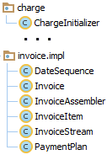
Overview of invoicing plugins
Invoicing plugins allow you to customize the invoicing process:
Plan invoice items, create invoices
Create invoice streams
Convert invoice item entries into invoice items
Plugin | Purpose
ChargeInitializer | Plans invoice items and creates invoices
DateSequence | Creates a date sequence that contains an anchor date and a given periodicity
InvoiceStream | Determines invoice stream for charges
PaymentPlan | Sets item event dates for installments and returns full set of invoice items for a charge
Invoice | Called by Invoice batch process to handle various invoicing tasks
InvoiceItem | Handles agency bill payment and promise exception statuses
Used in charge invoicing
Notes:
The four plugins that are highlighted in the slide are covered in this lesson. The InvoiceAssembler plugin, which is another invoice plugin, is used for modified charges only. It is not called during the processing of new charges.

Slide 5
Invoicing flow for pro rata charges
New policy billing instruction received
For each charge
Does payment plan specify a down payment?
yes
Create down payment invoice item entry
?
no
Create dates for installment invoice item entries
Create installment invoice item entries, one per date
Decide which invoice stream to use
Create all invoice item entries and attach to invoices
No configuration beyond this point
Convert entries to actual invoice items and execute billing instruction
Finished
Notes:
The text in the boxes for each charge describes the processing performed by BillingCenter when a billing instruction is received.
Pro-rata charges (that is, those charges that are split into multiple invoice items) are the primary reason for configuring charge invoicing. One-time charges (that is, those charges that are invoiced as a single item) are easily assigned to an invoice.

Slide 6
Charge invoicing plugin points
BillingInstruction.gs Allow charges to be added to BI
New policy billing instruction received
For each charge
Does payment plan specify a down payment?
yes
Create down payment invoice item entry
?
no
Create dates for installment invoice item entries
PaymentPlan.gs Configure item event dates
Create installment invoice item entries, one per date
Decide which invoice stream to use
InvoiceStream.gs Select an invoice stream
Create all invoice item entries and attach to invoices
ChargeInitializer.gs Configure amounts, dates, placements
No configuration beyond this point
Convert entries to actual invoice items and execute billing instruction
Finished
Notes:
The red box surrounds the charge invoicing steps that take place for each new charge. The plugin points represent places where you can modify (or completely replace) the output of each step. The PaymentPlan and ChargeInitializer plugins provide override methods for this purpose.
The BillingInstruction plugin provides hooks for configuring logic related to billing instructions. BillingInstruction.gs is not within the scope of this lesson.
The flowchart shows a new policy billing instruction as the input. Until the last step, the charge handling code is working with invoice item entries (that is, planned invoice items), which are converted into invoice items in the last step. The ChargeInitializer plugin is used to configure invoice item entries before they become actual invoice items.

Slide 7
Lesson outline
Invoicing plugin points
Invoice streams
Configuring a charge and its invoice items
Configuring date sequences and invoice streams

Slide 8

Invoice streams
An invoice stream is a container for a non-ending series of invoices that occur with a given frequency
Owned by an account
Invoice items for a policy period are placed on invoices in same invoice stream
Payment Interval in payment plan determines which invoice streams are eligible to be used
Invoice stream
Set of invoices
Date sequence
. . .
. . .
3/1
4/1
5/1
. . .
Payment Interval (also called periodicity)
Notes:
An invoice stream is a mechanism for grouping invoices so that the invoices are billed at regular intervals, are paid by the same payment method (such as credit card or ACH/EFT), and (typically) have the same payer. The use of invoice streams allows for a clean separation between the various date sequences.

Slide 9
Invoice streams support billing levels for direct bill and list bill billing
Account-level billing
Policy-level billing
Invoice streams
. . .
. . .
. . .
. . .
Notes:
BillingCenter supports both account-level and policy-level billing for direct bill and list bill invoicing. When placing invoice items on invoices, BillingCenter first determines which invoice stream to use. This decision is based on information contained in the payment plan associated with the policy period. It also depends on whether the account uses account-level or policy-level billing.
Account-level billing means that BillingCenter combines charges for policies that have the same account payer. Assuming the same periodicity for the policies (such as monthly or twice a month), only one invoice stream is used for the account’s policies. So the account receives a single invoice for multiple policies and pays for the policies using the same payment instrument such as a credit card.
Policy-level billing means that each policy has its own set of invoices that are contained within a dedicated invoice stream. From the UI, you can customize each stream to have different bill and due dates, a different paying account, and a different payment instrument.
Invoice streams make it easy to implement both billing levels without any configuration needed.
When a held invoice item is carried over to the next invoice, only the next invoice in the same stream is considered.

Slide 10
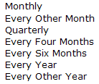
Four invoice stream periodicities
Account
Account-level charges
Monthly
Twice per month
Every week
Every other week
15 Jan 2010
31 Jan 2010
15 Feb 2010
28 Feb 2010
15 Mar 2010
31 Mar 2010
15 Apr 2010
Day of month = 15
Days of month = 15, 31
Day of week = Friday
Anchor date = 15 Jan 2010
Notes:
The account contains all invoice streams that are used for the account that is the payer. Accounts using account-level billing have up to four invoice streams – a monthly stream, a weekly stream, a twice-a-month stream, and an every-other-week stream. This provides appropriate streams for all of the account’s charges, regardless of the payment intervals of their payment plans. Accounts using policy-level billing have a separate invoice stream for each policy. You can create custom invoice streams in the UI or through configuration. Through configuration, you can create custom periodicities and invoice streams that support your custom periodicities.
BillingCenter creates invoice streams "lazily"—that is, each stream is created only when there is a charge to be invoiced in that stream. Every invoice must be within a stream—an invoice cannot be associated directly with an account.
Each invoice stream has a base interval (weekly, every other week, monthly, and twice monthly). Notice that any interval that is a multiple of "Monthly" uses the monthly stream. The monthly stream is also used for all account-level charges.
"Every Other Week" and "Twice per Month" require different invoice streams because there is a requirement to synchronize the dates with a carrier’s payroll. "Twice per month" requires two dates (such as 15 and 31) for establishing invoice dates whereas "every other week" has simply a day of week such as Friday.
Note: "31" is used to indicate the last day of the month. This date is automatically adjusted for the number of days in the month. In the case of February, "31" can mean 28 Feb or 29 Feb depending on the year.

Slide 11
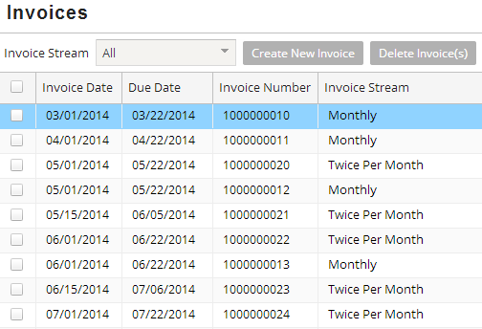
Multiple invoice streams example
These invoices are from two policies
One is billed monthly, the other is billed twice every month
Separate invoices are created for each stream even if invoices have same bill and due dates
Notes:
The Account→Invoices screen has an Invoice Stream filter that allows you to view a selected stream.

Slide 12
Ad hoc (off sequence) invoices
All invoices must be contained in an invoice stream
But what about a charge that must be billed today?
If today is an invoice bill day, then BillingCenter uses today's "on sequence" invoice
Otherwise, BillingCenter places item on an "off sequence" invoice
Off sequence invoices are placed in an invoice stream according to periodicity of the payment plan
Bill me now!
Notes:
The ad hoc invoice is placed on the invoice stream specified by the periodicity of the payment plan. (Recall that all invoices must be contained in a stream.) An ad hoc invoice that is created when an existing invoice is not available is off sequence, but it is still a part of the stream.
Suppose BillingCenter receives two billing instructions for charges on the same day but several hours apart, and both charges need to be billed immediately. In this case, BillingCenter would place the items for both charges on the same ad hoc invoice as long as the invoice is not yet billed.

Slide 13
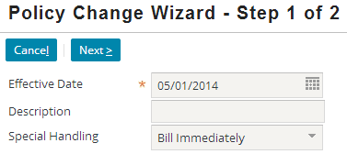
Invoicing a charge immediately
A billing instruction can request Bill Immediately special handling for a charge
Useful for several purposes, such as:
Premium report received with no payment
Final audit with no policy renewal
Policy change after policy has expired
Policy change for which carrier insists on immediate billing

Slide 14



Immediate invoicing attributes
These attributes support immediate billing:
Invoice
InvoiceItem
AdHoc tells BillingCenter to make an off sequence invoice
AdHoc invoice is used in base application:
If invoice item's BillToday is true, or
If needed for a "catchup" invoice when reassigning item payer
If BillToday is true, place item on an invoice that is billed immediately
Create an ad hoc invoice if required
Notes:
The BillToday attribute on an invoice item, when set to true, tells BillingCenter not to wait for the next planned invoice, but instead to bill the item today. If today is an invoice bill day, then BillingCenter uses the regularly scheduled invoice. Otherwise, it creates an "ad hoc" invoice.
Ad Hoc Invoices
The InvoiceStream sets an invoice to be AdHoc only if the invoice it is making is "off sequence" (that is, the invoice date does not match any date in the date sequence of the invoice stream). In the base application, off-sequence invoices are made in the following cases:
A policy change billing instruction requests "bill immediately" special handling
BillingCenter is creating a catch up invoice, such as when the payer of charge is reassigned (for example, changing from direct bill to agency bill)
BillingCenter treats ad hoc invoices differently from other invoices. For example, a held charge will not be placed on an ad hoc invoice. Instead, the item is placed on the next planned invoice in the invoice stream.
If you want an AdHoc invoice to be treated like a regular invoice by BillingCenter, simply set AdHoc to false: newInvoice.AdHoc = false.

Slide 15
Lesson outline
Invoicing plugin points
Invoice streams
Configuring a charge and its invoice items
Configuring date sequences and invoice streams

Slide 16
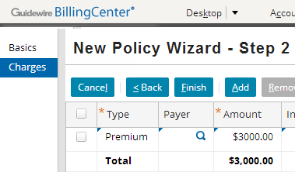
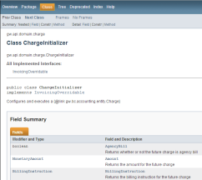
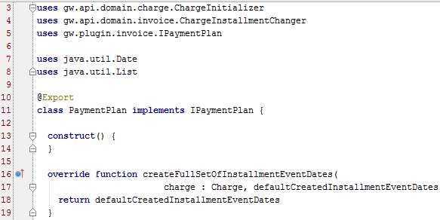
Role of ChargeInitializer
There are several ways to create a charge in BillingCenter:
ChargeInitializer centralizes charge creation in one streamlined piece of code
Ties charge and invoice item creation with billing instruction execution
Serves as an intermediary between actual charge and configuration code
plugin
batch process
UI
API
core code
Notes:
In BillingCenter 8.0, instead of modifying a charge directly, you use an intermediary class (ChargeInitializer) that provides consistent handling of charge and invoice item creation no matter how the charge was initiated.
BillingCenter separates code that creates a charge from code that modifies a charge. A second plugin, ChargeInstallmentChanger, is used to modify an existing charge.

Slide 17
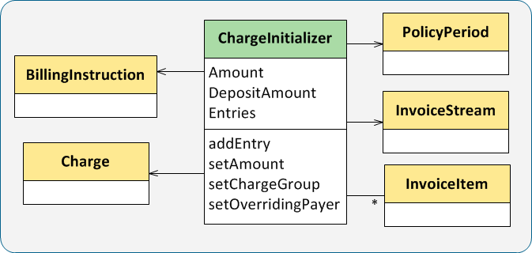
Building new charges
ChargeInitializers are used to plan future charges
Each charge is built on unexecuted billing instruction
ChargeInitializer creates invoice item entries
Charge and actual invoice items are created when billing instruction is executed
Notes:
ChargeInitializer methods allow you to configure a future charge. Each ChargeInitializer entry is a blueprint for an invoice item.

Slide 18

Charge slicing
When a billing instruction is received, BillingCenter slices each charge into one or more invoice items
Invoice items are then placed on invoices
Charge
Premium $600
Invoice items
- $60
- $60
- $60
- $60
Invoices
Notes:
When a billing instruction is received by BillingCenter, BillingCenter "slices" each charge into one or more invoice items according to the payment plan. A premium charge is typically sliced into a single down payment invoice item and one or more installment invoice items. BillingCenter generates the required invoices, places the invoices in the appropriate invoice stream, and assigns each invoice item to one of the invoices.

Slide 19



Where to configure charge slicing
It depends on the charge type
Allows you to configure "future" charge and invoice items
Does charge slicing for all new charges
Allows you to configure:
Account-level charges
Collateral charges
Collateral requirement charges
Calls ChargeInitializer to perform charge slicing
Allows you to configure special handling specified on a billing instruction
Calls ChargeInitializer to perform charge slicing

Slide 20
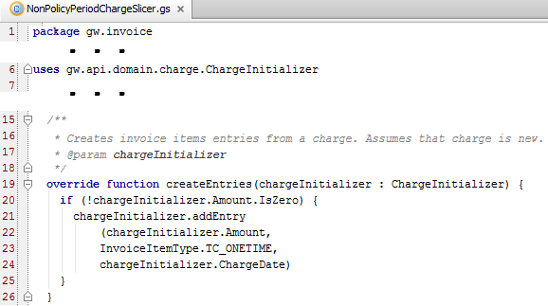
Charge slicer example
ChargeInitializer.Entry represents an invoice item that will be created when billing instruction is executed
Notes:
The screenshot shows unconfigured NonPolicyPeriodChargeSlicer code. SpecialHandlingChargeSlicer makes a similar call to ChargeInitializer.

Slide 21

Working with ChargeInitializer plugin
To create a new invoice:
initializer.InvoiceStream.createAndAddInvoice(date)
To add an invoice item to an invoice:
Reference to initializer.Charge causes runtime error
initializerEntry.setInvoice( invoice )
A charge doesn't exist until ChargeInitializer is executed
Notes:
The next slide shows a coded example of creating a new invoice and adding an invoice item to the invoice.

Slide 22
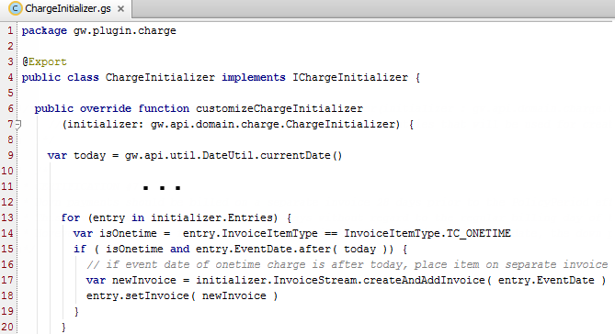
Example: adding an item to a new invoice
Create invoice
Add entry to new invoice

Slide 23
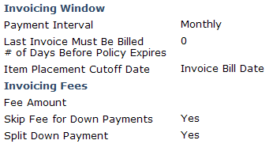
Example: configuring set of invoice items (1)
Requirement: If down payment is 20% or more and payment plan allows splitting of down payment, bill half of down payment on first invoice and half on second invoice
Solution:
Add SplitDownpayment column to PaymentPlan entity
Add Split Down Payment field to Payment Plan screen
Configure method in ChargeInitializer.gs to implement logic
Notes:
This simple requirement provides the opportunity to write code that illustrates how to modify an invoice item in a set of invoice items, create a new invoice item, and add the new invoice item to the set.

Slide 24
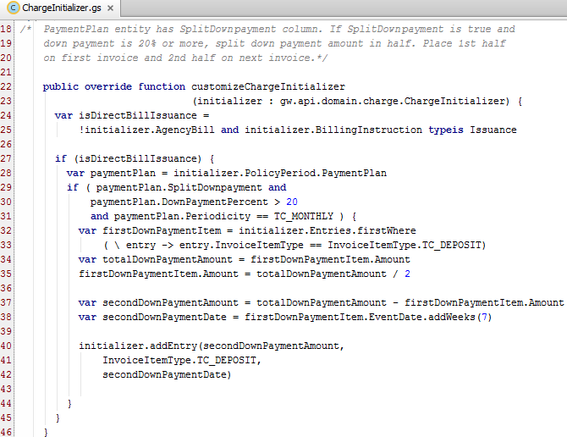
Example: configuring set of invoice items (2)
Finds down payment item entry and amount
Calculates amount, event date for second half of down payment
Adds second down payment item entry to charge initializer

Slide 25
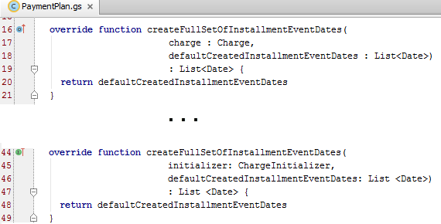
Configuring invoice item event dates
PaymentPlan plugin allows you to override item event dates before item entries are placed on invoices
Allows you to change, add, remove dates used for installment items
deprecated
Notes:
The createFullSetOfInstallmentEventDates() method allows you to modify item event dates for installment items only. If you add or remove dates, the amount of the charge (minus the down payment) is distributed evenly across the list of installment dates. Generally, configuring this method is relatively simple because you are dealing exclusively with event dates and allowing BillingCenter to adjust item amounts, if required.
Note that the first declaration of createFullSetOfInstallmentEventDates(), method which accepts a Charge, is deprecated.The second declaration, which accepts a ChargeInitializer instead of a Charge, is called when a new charge is being processed. ChargeInitializers were introduced in BillingCenter 8.0 to provide an intermediary class for modifying invoice items. ChargeInitializers provide a consistent way of handling charge creation regardless of where the charge is created.
The createFullSetOfInvoiceItems() method (not shown on the slide) is used for only for refactoring payment plans and not for processing new charges. ChargeInitializer is used instead.
The PaymentPlan plugin has two types of methods:
Create methods are called when:
A new charge is received from a billing instruction
"Refactor all invoice items" is selected on payment plan change
Recreate methods are called when:
"Refactor planned invoice items" is selected on payment plan change

Slide 26
Lesson outline
Invoicing plugin points
Invoice streams
Configuring a charge and its invoice items
Configuring date sequences and invoice streams

Slide 27
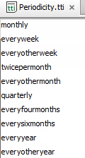

Date sequences
3/1
4/1
5/1
. . .
. . .
A date sequence is an unbounded series of dates
Typically based on a set interval ("periodicity")
Periodicities are defined in a typelist
An anchor date is a date used as basis for generating a date sequence of a given periodicity
These periodicities use one anchor date
This periodicity requires two anchor dates
Date sequences can be combined to form a new composite sequence
Notes:
All date sequences used in the BillingCenter base application are based on periodicity, but it is possible to define a custom date sequence of arbitrary dates with no set interval.

Slide 28
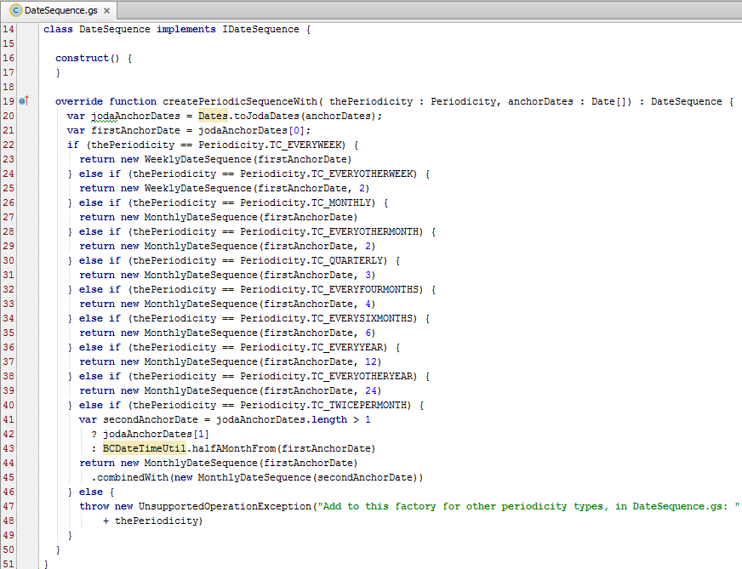
DateSequence plugin
DateSequence
Each date sequence is instantiated with an anchor date and a multiple of the base period
Notes:
The DateSequence plugin creates a date sequence that contains the anchor date and that has the given periodicity. You can configure the plugin to return a different date sequence than the default date sequence. Two other plugins, PaymentPlan and InvoiceStream, use the DateSequence plugin.
Anchor dates
The first anchor date is one date that is in the sequence. It determines:
Day of month for monthly sequences
Days of month for twice-per-month sequences
Day of week for weekly sequences
A particular day for every other week sequences.
If the periodicity is twice-per-month and there is only one anchor date supplied, the plugin assumes that the second anchor date is half a month (that is, 14 days) from the given first anchor date. If the first anchor date is 29, 30, or 31, then 15 is used for the (unspecified) second anchor date.

Slide 29
Combining date sequences
First anchor day of month = 1:
1 Aug
1 Sep
1 Oct
1 Nov
1 Dec
15 Jul
15 Aug
15 Sep
15 Oct
15 Nov
Result of combining sequence 1 and 2:
15 Jul
1 Aug
15 Aug
1 Sep
15 Sep
1 Oct
15 Oct
1 Nov
15 Nov
1 Dec
Notes:
The diagram provides a visual explanation of how the "combinedWith" method works. An example of the method is shown on the next slide.

Slide 30
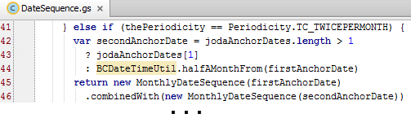
Composite date sequence example combinedWith() method
To create a date sequence from two existing sequences, use combinedWith( ) creation method
Returns a new date sequence that combines receiving date sequence and the argument
DateSequence plugin uses combinedWith( ) to generate date sequence for twice monthly invoice stream
Notes:
The code example was taken from the createPeriodicSequenceWith() override function in the DateSequence plugin. Notice that it uses Joda, which is an open source project for date and time processing. BillingCenter ships with the Joda libraries.
The "combinedWith" method means that you can use this syntax:
var the1stAnd2ndOfEveryMonth = the1stOfEveryMonth.combinedWith(the2ndOfEveryMonth)
instead of:
var the1stAnd2ndOfEveryMonth = new CompositeDateSequence( { the1stOfEveryMonth, the2ndOfEveryMonth } )
Note: There is also a CompositeDateSequence() method, which is a constructor. However, the combinedWith() method is simpler to use and makes your code more self descriptive.

Slide 31
InvoiceStream plugin
Used to determine invoice stream for a set of charges
Method | Description and Purpose
getInvoiceStreamPeriodicityFor() | Returns the periodicity for a given payer and payment plan. Override this method to direct charges to an invoice stream with a different periodicity than the default or to specify the stream to use for a custom periodicity
getExistingInvoiceStreamFor() | Returns the default invoice stream for the payer, charge, and periodicity. Override this method if payer can have more than one invoice stream for the same periodicity
customizeNewInvoiceStream() | (2 methods) Allows you to customize the default configuration of a newly created invoice stream.
getAnchorDatesForCustomPeriodicity() | Returns a list of anchor dates for custom periodicities. Invoice streams with custom periodicities and no overriding anchor dates call this method to compute their anchor dates
Notes:
The InvoiceStream plugin returns an invoice stream onto which invoice items (and therefore the invoices) will be placed according to the given payment plan.
Note there are two customizeNewInvoiceStream() methods:
customizeNewInvoiceStream(InvoicePayer payer, Charge charge, InvoiceStream newInvoiceStream)
customizeNewInvoiceStream(InvoicePayer payer, InvoiceStream newInvoiceStream)

Slide 32
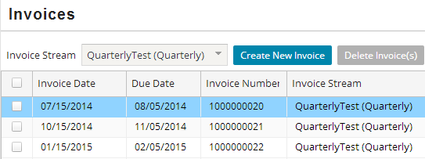
InvoiceStream example: Quarterly periodicity
Requirement: Place policies with quarterly payment plans on a separate invoice stream from policies with monthly payment plans. Set billing dates for quarterly policies to 15th of January, April, July, October.
Sample output:
Notes:
Recall that the Monthly invoice stream is used for policy periods with several periodicities such as quarterly and monthly. Placing quarterly invoices on an invoice stream that is separate from the stream used by any monthly invoices does not require configuration because you can create multiple monthly streams and associate a quarterly policy with a specific stream. However, configuration is necessary to implement the requirement to set billing dates to specific calendar dates.

Slide 33
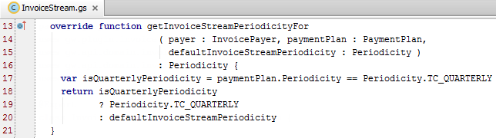
InvioceStream example: step 1
What’s the periodicity for this payer and charge?
Get the periodicity
In base application, items resulting from charges with quarterly payment plan are placed in monthly stream
Configured method directs quarterly invoices into special quarterly periodicity
Configuration is required to set up invoice stream and specify anchor date
BillingCenter understands quarterly periodicity, so no need to define a custom date sequence
Notes:
BillingCenter knows about several periodicities including quarterly, but the base application places invoice items for charges with a quarterly payment in the Monthly stream.
In our example, we want to handle quarterly charges differently from other "monthly" periodicities.
Line 20 in the code example shows what the unconfigured method returns.

Slide 34
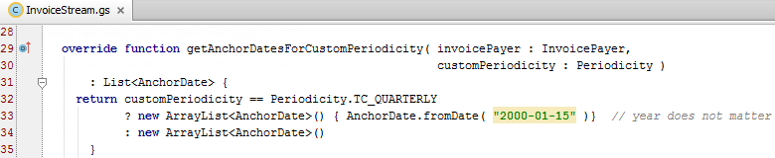
InvioceStream example: step 2
Get anchor dates
If this is a custom stream with quarterly periodicity, return a list of anchor dates starting with January 15
InvoiceStream.gs
Notes:
The getAnchorDatesForCustomPeriodicity() method is called only for custom periodicities. In our example, we want the quarterly stream to start with a specific anchor date (January 15). Note that the year of the from date does not matter.

Slide 35
Lesson objectives review
You should now be able to:
Identify which plugin to configure in order to modify these aspects of charge invoicing:
Creating invoice items for new charges
Assigning event dates to invoice items
Controlling invoice stream selection for invoice placement
Defining a custom periodicity for a payment plan
Configure a plugin to modify a set of invoice items

Slide 36
Demo

Slide 38
Lab

Slide 39
Complete the exercises in below chapter in the “BC10_CONF_K_StudentWorkbook“ work book​
​
Lesson 3 = > Configuring Invoice Streams

Slide 40
Review

Slide 41
Review questions
Match the plugin with the method(s):
What purpose does ChargeInitializer serve?
Why will this code cause a runtime error?
What code could you use instead of the above?
Describe how BillingCenter handles invoicing when InvoiceItem.BillToday is true.
1. PaymentPlan 2. InvoiceStream 3. DateSequence 4. ChargeInitializer
a. createPeriodicSequenceWith b. customizeChargeInitializer c. getInvoiceStreamFor d. createFullSetOfInstallmentEventDates
var currency = initializer.Charge.Currency
Notes:
(1) PaymentPlan → (d) createFullSetOfInstallmentEventDates, (2) InvoiceStream → (c) getInvoiceStreamFor (3) DateSequence → (a) createPeriodicSequenceWith (4) ChargeInitializer → (b) customizeChargeInitializer
ChargeInitializer is an intermediary between configuration code for modifying a charge and the charge itself. It insulates a charge from invalid operations by configuration code. It also provides consistent handling of charge and invoice item creation no matter how the charge was initiated.
The charge doesn't exist yet because ChargeInitializer hasn't been executed.
var currency = initializer.BillingInstruction.Currency
If there is an invoice in the same invoice stream that is to be billed today, BillingCenter places the item on that invoice. Otherwise, it creates an "off sequence" invoice in the same stream and BillingCenter places the item on that invoice.

Slide 42
Notices
Copyright © 2001-2014 Guidewire Software, Inc. All rights reserved.
Guidewire, Guidewire Software, Guidewire ClaimCenter, Guidewire PolicyCenter, Guidewire BillingCenter, Guidewire Reinsurance Management, Guidewire ContactManager, Guidewire Vendor Data Management, Guidewire Client Data Management, Guidewire Rating Management, Guidewire InsuranceSuite, Guidewire ContactCenter, Guidewire Studio, Guidewire Product Designer, Guidewire Live, Guidewire DataHub, Guidewire InfoCenter, Guidewire Standard Reporting, Guidewire ExampleCenter, Guidewire Account Manager Portal, Guidewire Claim Portal, Guidewire Policyholder Portal, ClaimCenter, BillingCenter, PolicyCenter, InsuranceSuite, Gosu, Deliver Insurance Your Way, and the Guidewire logo are trademarks, service marks, or registered trademarks of Guidewire Software, Inc. in the United States and/or other countries.
All other trademarks are the property of their respective owners.
This material is confidential and proprietary to Guidewire and subject to the confidentiality terms in the applicable license agreement and/or separate nondisclosure agreement.
This file and the contents herein are the property of Guidewire Software, Inc. Use of this course material is restricted to students officially registered in this specific Guidewire-instructed course, or for other use expressly authorized by Guidewire. Replication or distribution of this course material in electronic, paper, or other format is prohibited without express permission from Guidewire.
Guidewire products are protected by one or more United States patents.

