Slide 1

BillingCenter 10 Configuration
Configuring Payment Allocation

Slide 2
Lesson objectives
By the end of this lesson, you should be able to:
Configure a payment allocation plan in the UI
Create custom filters and priorities for payment allocation plans
Describe how the Direct Bill Payment screen interacts with the DirectBillPayment plugin
Configure the DirectBillPayment plugin to modify payment distribution
This lesson uses the notes section for additional explanation and information. To view the notes in PowerPoint, choose View→Normal or View→Notes Page. If you choose to print the notes for the lesson, be sure to select “Print hidden slides.”

Slide 3
Lesson outline
Payment allocation basics
Configuring payment allocation in the UI
Configuring payment allocation in Gosu
Executing payments

Slide 4
Payment and allocation/distribution definitions
A payment is a sum of money sent to a carrier to apply to a BillingCenter account
An payment allocation plan specifies which invoice items should be paid in which order
A distribution describes how money has been applied towards a set of invoice items
A distribution item ("dist item") refers to the portion of a payment that is applied to a specific invoice item
Amount distributed is the total amount of money applied across all distribution items on a distribution
Distribution
Payment
Money Received
Distribution Items
Notes:
The terms allocation and distribution have the same meaning in BillingCenter.

Slide 5


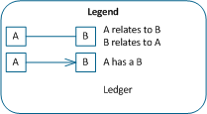
Direct bill payment and allocation example
Money Received
Payment
Distribution Items
Account Cash
Account Default Unapplied
100
100
Account Default Unapplied
PolicyPeriod Premium Due
40
40
Account Default Unapplied
PolicyPeriod Tax Due
60
60
Notes:
The slide shows a simplified example of the payment data model and how it relates to the allocation of a direct bill payment. In the example, a direct bill payment of $100 is received and is credited to Account Default Unapplied. The payment is distributed to two T-accounts: PolicyPeriod: Premium Due and PolicyPeriod: Tax Due.
The DirectBillMoneyRcvd entity holds details about the payment itself including the account that made the payment. The DirectBillPayment entity tracks the amount of money that has been distributed (if any) and the amount available to distribute. It has an array of distribution items (DirectBillPaymentItem entity). Each DirectBillPaymentItem contains details of distribution amounts for the invoice item (such as gross amounts owed, gross amounts to apply, commission amount owed, commission amount to apply) and points to the invoice item that is being paid by this item.
In summary, for each payment there is a payment item that targets an invoice item and indicates how much gross and commission money should be applied to the invoice item.
The account in the example does not use cash separation and so owns only one unapplied T-account. All payments to the account pass through the account's Default Unapplied T-account. Payment allocation with cash separation is discussed on the next slide.

Slide 6

Direct bill payment allocation and cash separation
An account that uses cash separation owns multiple unapplied T-accounts:
One Default Unapplied to hold cash for account-level payments
A separate Designated Unapplied to hold cash for each policy
Automatic payment allocation respects unapplied boundaries
Payments targeted for a policy are allocated from designated unapplied T-account for the policy
Payments for account-level items are allocated from Default Unapplied
Notes:
Payment allocation for policy-level billing without cash separation is the same as for account-level billing. All payments go through the account's Default Unapplied.

Slide 7
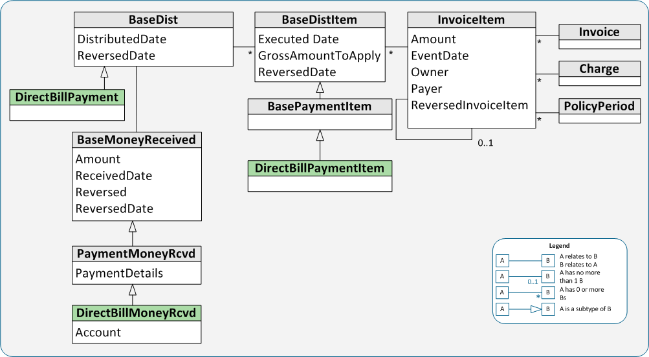
Direct bill payment data model
Notes:
The relationship of InvoiceItem to BaseDistItem is one-to-many because a customer may partially pay an invoice item initially and then later pay the remaining amount owed. Each partial payment results in a separate payment item against the one invoice item.
The same payment data model is used for both direct bill and agency bill payments and allocation. The agency bill entities are not shown in the slide. They are:
AgencyCycleDist, which is a subtype of BaseDist
AgencyBillMoneyRcvd, which is a subtype of PaymentMoneyReceived
AgencyPaymentItem, which is a subtype of BasePaymentItem
AgencyPromiseItem, which is a subtype of BaseDistItem
Note: The diagram also does not show the entities related to direct bill suspense payment items.

Slide 8
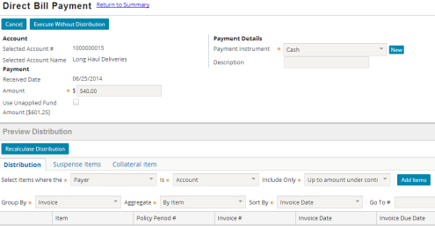
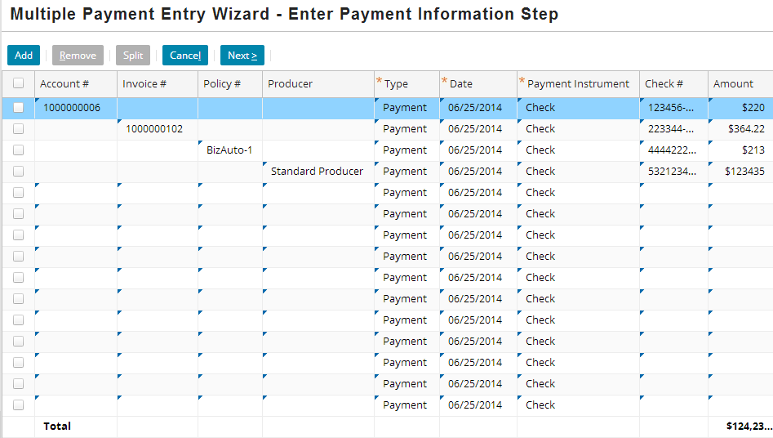
Entering and allocating payments
Direct Bill Payment
Payment
Money Received
Distribution Items
Multiple Payment Entry
Payment
Money Received
Distribution Items
Payment API
New Payment
Notes:
There are three ways to enter a direct bill payment in BillingCenter:
From the application using the Direct Bill Payment screen
From the application using the Multiple Payment Entry screen
Programmatically through the Payment API.
The Execute button on the Direct Bill Payment screen saves the payment and distributes it. The Execute Without Distribution button saves the payment but does not create the distribution items. Payments that are entered using the Multiple Payment Entry screen or through the API are not immediately distributed.
Undistributed payments are put in an Unapplied T-account. When the New Payment batch process runs, it distributes undistributed funds. There are three other batch processes that also perform this function in addition to their primary functions. These are discussed later in this lesson.
Note: The terms "allocate" and "distribute" have the same meaning in BillingCenter.

Slide 9
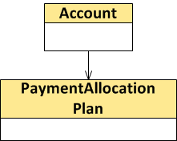
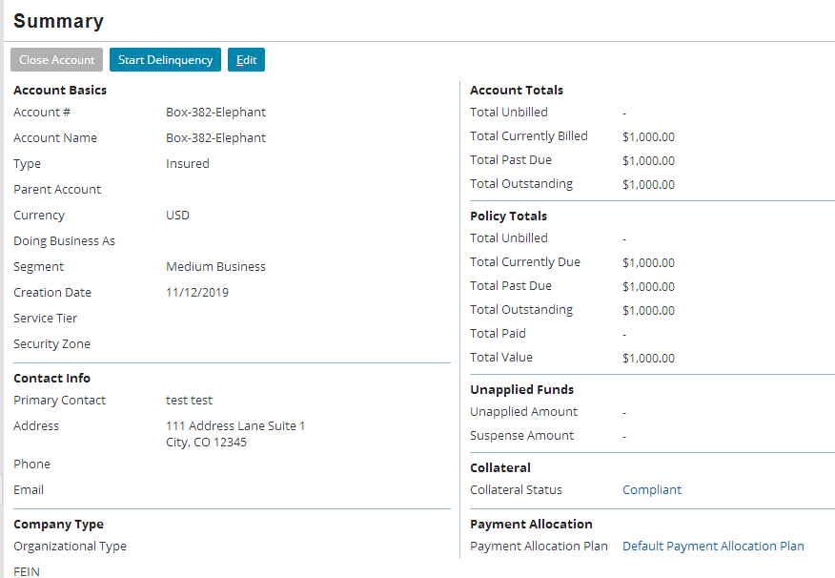

Payment allocation plans
Every account has a payment allocation plan that manages automatic processing of:
Direct bill payments
Money in unapplied T-accounts
Payment allocation plan specifies:
Invoice items to pay
Order of paying items
Account Summary
Notes:
A payment allocation plan centralizes the logic for all incoming automatic payments.

Slide 10
Batch processes that allocate payments
New Payment
Invoice Due
Invoice
Automatic Disbursement
Make invoices due
Bill invoices
Process all negative items to create credit "payments" using return premium plan
Allocate money using payment allocation plan
Create disbursements
Notes:
Each of the four batch processes has a different purpose, but they all allocate payments using the payment allocation plan.
Automatic Disbursement batch process fully allocates available money, and then creates disbursements if excess money remains.
Invoice batch process makes invoices billed, then processes any negative items, and finally fully allocates available money.
Invoice Due batch process makes invoices due, then processes any negative items, and finally fully allocates available money.
New Payment batch process fully allocates available money.
The batch processes are listed on the slide (reading left to right) in the same order that they are scheduled to run in the base application. Of course, you can reschedule batch processes.
Allocating credits
A credit is an amount the carrier owes the policyholder. Sources of credit include negative charges, over payments, and ad hoc credits. Most carriers prefer to allocate a credit immediately rather than waiting until an invoice becomes billed or due. For this reason, the payment allocation batch processes typically have no negative items to process.

Slide 11
Lesson outline
Payment and allocation basics
Configuring payment allocation in the UI
Configuring payment allocation in Gosu
Executing payments

Slide 12
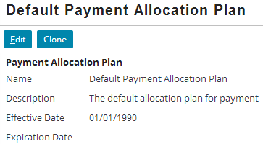
Payment allocation plans
Every account has a payment allocation plan, which is used whenever a batch process:
Allocates a payment where the account is payer
Allocates money from an unapplied T-account owned by the account or policies where the account is payer
Default Payment Allocation Plan is shipped with BillingCenter
You can update it, clone it, or define a new plan
Batch processes allocate money based on current version of applicable payment allocation plan

Slide 13
Steps for allocating a payment
Payment allocation plan centralizes logic for allocating payments
Plan specifies how to filter and partition invoice items
1. Filter
2. Partition & Rank
3. Pay
Identify a set of unsettled invoice items to target for payments
Partition items from step 1 by priority
Pay items in each partition until you run out of money
Notes:
Assume that BillingCenter has received a payment. The basic steps for allocating the payment are:
Filter – Identify the set of unsettled invoice items that are eligible to be paid according to the payment allocation plan.
Partition and Rank – Group the invoice items according to the priorities specified in the payment allocation plan.
Pay – Allocate the money to the eligible invoice items in each partition until no more money is available. Invoice items within the same partition have equal rank. If there is not enough money to fully pay all the items in a given partition, BillingCenter pays the items pro rata according to their amounts.
Leave excess money (if any) in the relevant unapplied T-account.

Slide 14
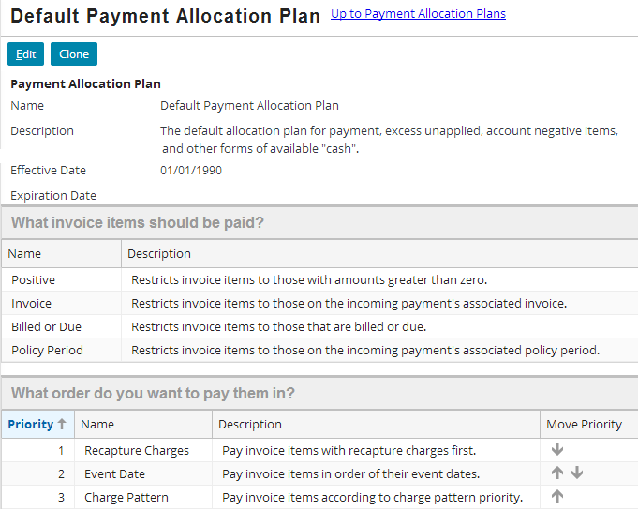


Payment allocation plan filters, then prioritizes
Adminstration→Business Settings→Payment Allocation Plan
1. Filters determine eligible invoice items
2. Eligible invoice items are paid in priority order
Notes:
Money that comes into BillingCenter is stamped with a payment receipt that points to the invoice and the policy period that are the target of the payment. When the New Payment batch process is run, it applies the relevant payment allocation plan. First it identifies which invoice items should be paid (according to the plan). Then it determines the order in which to pay the eligible items. Only items that were selected by the filter in the first step are available for prioritizing.
What invoice items should be paid?
Invoice items are filtered according to the account's payment allocation plan. In the example, only positive, billed or due items that are on the invoice associated with the payment and belong to the policy period associated with the payment are eligible to be paid automatically.
What order do you want to pay them in?
The next step establishes the order in which to pay the eligible items. This step groups the eligible items according to the priorities in the plan. Invoice items in each group are paid pro rata based on their unpaid amounts.
Positive filter
The Positive filter means that only positive invoice items are eligible to be paid. Applying this filter during payment allocation makes sense because payments aren't actually allocated to negative invoice items. A negative invoice item represents an amount the carrier owes to the insured. "Paying" a negative invoice item means releasing the credit for the amount of the negative invoice item and applying it elsewhere. BillingCenter provides a separate credit allocation plan for handling negative invoice items and the resulting credit. See the Configuring Credit Handling lesson for details.

Slide 15
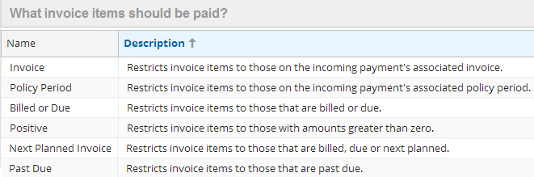
Determining eligible invoice items
1. Filter
Invoice items are filtered using 2 implicit filters plus configured filters from payment allocation plan
Account payer
Unsettled (invoice item is not fully paid)
Filters are logically ANDed when applied
Implicit filters are always applied
These filters refer to payments
These filters refer to invoice items
Notes:
Invoice and Policy Period are the only filters that refer to a payment rather than to invoice items. If any allocation batch process is allocating a payment, it applies the Invoice and Policy Period filters (if specified on the payment allocation plan). However, if a batch process is allocating excess money from an unapplied account and there is no payment to process, the batch process will ignore the Invoice and Policy Period filters.

Slide 16

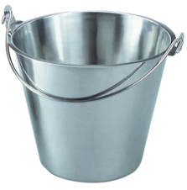

Example: Filtering by policy period
1. Filter
Given these filters:
New Payment
$500
Planned 500
800
$800
Billed 250
Fred Gardner
$300
Due 250
Account Unapplied
Auto policy
Planned 700
Billed 120
Due 240
Home policy
Notes:
In the example, Fred Gardner has two policies, both of which have billed and due invoice items. He makes an $800 payment targeted to Auto policy. Initially the money is placed in Account Unapplied. Subsequently, the New Payment batch process runs. The associated payment allocation plan filters on two criteria: Billed or Due and Policy Period. New Payment allocates the money to all billed and due invoice items on the policy that was designated on the payment. It cannot allocate to invoice items belonging to a different policy because only invoice items on Auto policy were selected by the filter. For this reason, the excess $300 remains in Unapplied.

Slide 17
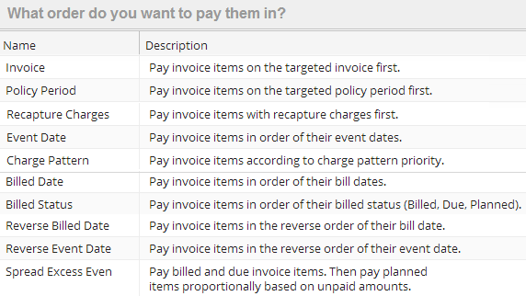
Prioritizing invoice items to be paid
2. Partition & Rank
These priorities refer to payments
These priorities refer to invoice items
Notes:
Invoice and Policy Period are the only priorities that refer to a payment rather than to invoice items. If any allocation batch process is allocating a payment, it uses the Invoice and Policy Period criteria (if specified on the payment allocation plan) to prioritize what gets paid. However, if a batch process is allocating excess money from an unapplied account and there is no payment to process, the batch process will ignore the Invoice and Policy Period priorities.

Slide 18


Example: Prioritizing by policy period
2. Partition & Rank
Given these filters and these priorities
New Payment
$500
Planned 500
800
$800
Billed 250
Fred Gardner
Due 250
Account Unapplied
Auto policy
$300
Planned 700
Billed 150
Due 150
Home policy
Notes:
This example is similar to the one in the previous example. However, in this case the payment allocation plan will prioritize on Policy Period. The filter on policy period has been removed.
Fred Gardner has two policies, both of which have billed and due invoice items. He makes an $800 payment targeted to Auto policy. Initially the money is placed in Account Unapplied. Subsequently, the New Payment batch process runs. It allocates the payment to all the billed and due items belonging to Auto policy first. It then allocates the excess $300 to the billed and due items on Home policy.

Slide 19
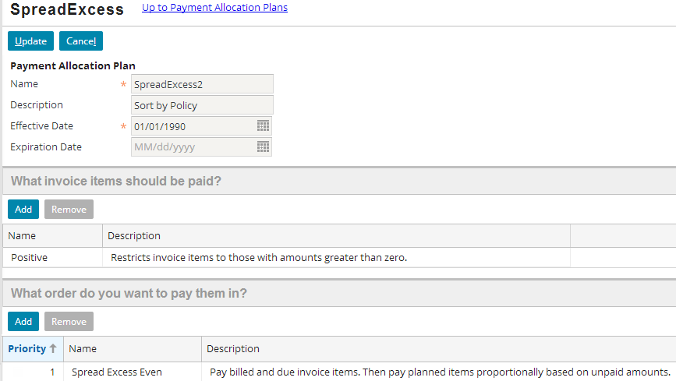
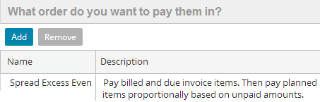
Spread Excess Even as a priority
2. Partition & Rank
Allocates excess money pro rata across remaining items
July
August
September
October
Payment
400
200
200
200
billed
planned
planned
planned
Notes:
In the example, a payment of $700 is targeted for Auto policy. After $400 is allocated to pay the billed items for the policy, an excess of $300 remains. The payment allocation plan has a payment priority of Spread Excess Even. This tells BillingCenter to allocate the $300 pro rata to the three planned invoice items.
Spread Excess Even is a priority, not a filter. This means that it can only prioritize eligible invoice items. For example, if the Billed or Due filter is set in the payment allocation plan, there will never be any planned invoice items that are eligible for allocation. In this case, Spread Excess Even has no effect.

Slide 20

Example: Allocating money from unapplied
Given these filters
…only Positive and Billed or Due can be applied because there is no invoice or policy period associated with money that resides in Default Unapplied
Refer to fields on a direct bill payment
New Payment
Auto policy
Planned 500
$500
Billed 250
$800
Due 250
Default Unapplied
$300
Home policy
Planned 700
Billed 150
Due 150
Notes:
Money sits in Unapplied for various reasons such as an overpayment, an unallocated return premium, or an ad hoc credit. There is no association between the money and a particular payment. The Invoice and Policy Period filters reference the Invoice and Policy Period fields on a payment. Therefore, Invoice and Policy Period filters as well as Invoice and Policy Period priorities in the payment allocation plan have no meaning when a batch process is distributing excess funds from any Unapplied T-account.
Money allocated from an unapplied fund never crosses unapplied boundaries. In the case of a designated unapplied fund, the money can be allocated only to eligible invoice items for that policy. For example, any excess money in Designated Unapplied (Policy_A) cannot be allocated to invoice items belonging to Policy_B. Given the filters shown on the slide, the batch process will distribute money from each designated unapplied T-account to any positive, billed or due invoice items for the policy period named on the designated unapplied fund.

Slide 21
Lesson outline
Payment allocation basics
Configuring payment allocation in the UI
Configuring payment allocation in Gosu
Executing a payment

Slide 22
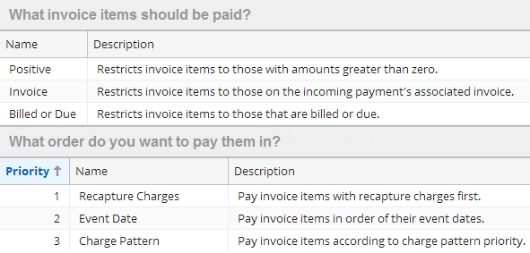

What can you configure in Gosu?
Implement a custom filter or custom priority to use in a payment allocation plan
Configure allocatePayments( ) method in DirectBillPayment plugin, which performs the allocation
Notes:
There are other payment allocation configurations you can make in Gosu, but the ones listed in the slide are the most commonly requested changes.

Slide 23


Basic recipe for a custom filter or priority
Add a typecode to relevant typelist
Create a class based that implements DistributionFilterCriterion interface
Configure the new class
Register your class in LinkedImplementationLoaderImpl.gs
Notes:
Configuring the new class involves creating a getter to return the correct typecode and writing Gosu code to implement your logic.
Every class that implements a filter or priority ("ordering") must be registered in LinkedImplementationLoaderImpl.gs. This class ensures that every typecode in the relevant typelist has one and only one implementing class.

Slide 24
Code for filtering items uses restriction builders
RestrictionBuilder allows you to use Gosu to modify queries specifically for payment targets
The Restriction defines a search that uses a query and a predicate to search both database and in-memory data
Elements of restriction builders:
Property reference | Reference to a property that uses type#feature syntax (example: Person#FirstName)
Path | List of property references. Use Paths.make() to create a path.
Restriction | Object that is either a query (searches database) or predicate (searches in-memory cache and uncommitted changes).
RestrictionBuilder | Class to create a new Restriction object. Use RestrictionBuilder.make() to create a new restriction.
Notes:
You need to be familiar with RestrictionBuilder to understand the code that implements payment allocation filters. RestrictionBuilder is an abstract class that was added to BillingCenter 8.0 to support the filtering of items that are eligible to be paid. RestrictionBuilder was designed to allow users to add restrictions to a query without having to write the query.
RestrictionBuilder makes it easy to create queries that use less memory, run faster, and are less error prone. RestrictionBuilder can combine database and memory results. This means that the caller doesn’t need to worry about where the data is located. If there’s something in the database that was removed in memory, it will be removed in the results. Similarly if something was added in memory but not yet committed to the database, it will be returned. Essentially, differences that have occurred due to any edits are reconciled. The result is a set of invoice items that satisfy your requirements without having written a query or predicate.
The syntax and examples presented in this lesson show only part of the functionality provided by RestrictionBuilder. For more information, see the BillingCenter Configuration Guide.

Slide 25
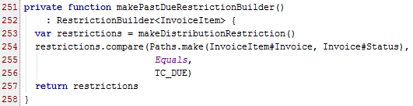


RestrictionBuilder examples
You can compare the result of a path to a specified value using compare()
You can combine RestrictionBuilders with union()
Notes:
The examples in the slide show how RestrictionBuilder is used to build a set of restrictions for filtering items to be paid.
The compare() method creates and adds a comparison restriction for the specified path. It takes three parameters: the path to traverse during the comparison, the relational operator ("relop") for the comparison, and the value for the comparison. The compare() example in the top screenshot uses the Equals relational operator. Other supported relational operators are NotEquals, LessThan, GreaterThan, LessThanOrEquals, and GreaterThanOrEquals.
Notice the syntax on line 254. The intention is to create a path from InvoiceItem to Status. However, property references are always two parts, so you can't simply say InvoiceItem#Invoice#Status. Instead, you simply provide a second parameter on the method call (entity.Invoice#Status), which is used to create the path.
The union() method returns a new RestrictionBuilder rather than modifying the original RestrictionBuilder objects in the union.

Slide 26
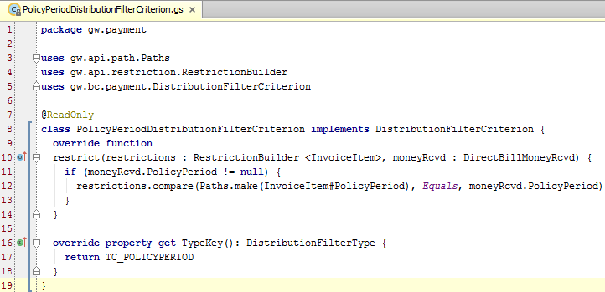
PolicyPeriod filter example (1 of 2)
Every payment allocation plan filter has a class that implements DistributionFilterCriterion, a typekey, and registration as a linked implementation
Unconfigured code
Notes:
PolicyPeriodDistributionFilterCriterion.gs is the class that implements the Policy Period filter. The typekey and registration code are shown on the next slide.

Slide 27
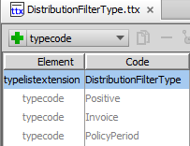
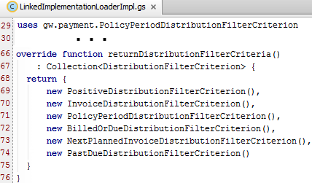
PolicyPeriod filter example (2 of 2)
Each filter has a typecode defined in DistributionFilterType typelist
Each filter is registered in LinkedImplementationLoaderImpl
Notes:
The LinkedImplementationLoader class ensures that every typecode in the DistributionFilterType typelist has one and only one implementing DistributionFilterCriterion class. It returns a collection of DistributionFilterCriterion objects, each of which is associated with a unique typekey and defines its own restrict() method.

Slide 28
Creating a custom priority
2. Partition and rank
Desired priority: Pay items according to their charge pattern category: premium first, then taxes, then fees
Steps:
Add a typecode for new priority to InvoiceItemOrderType typelist
Create a class that implements two methods:
Getter for TypeKey property
compare() method
Add new class to list of ordering classes in LinkedImplementationLoaderImpl
Notes:
The next few slides show each step in detail.

Slide 29
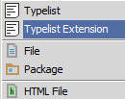
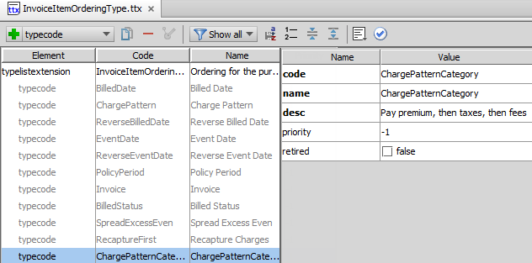
Step 1: Add typecode for new priority
Extend InvoiceItemOrderType
Define code, name, and description

Slide 30
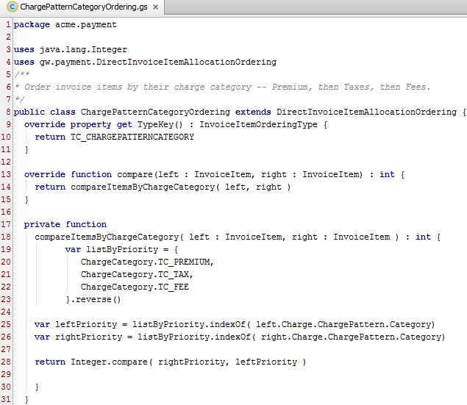
Step 2: Create class to implement priority
1
2
3
Notes:
Every class that implements a priority must have:
A getter that returns the associated typecode
A compare() method
In the example, a private function is used to order the invoice items by charge category (#3).

Slide 31
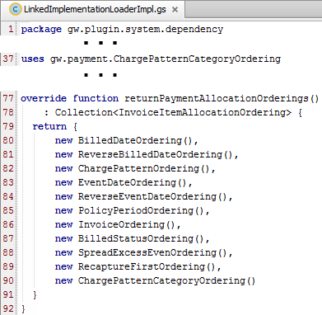
Step 3: Update LinkedImplementationLoaderImpl
Add the new priority to the list of payment allocation orderings

Slide 32
Lesson outline
Payment allocation basics
Configuring payment allocation in the UI
Configuring payment allocation in Gosu
Executing the payment

Slide 33
Executing the payment
allocatePayment() method in DirectBillPayment.gs performs the distribution
allocatePayment() is called from:
All allocation batch processes
Direct Bill Payment screen
Direct Bill Payment
Payment
DirectBillPayment
Money Received
Distribution Items
allocatePayment( )
Batch process
Notes:
Regardless of how payments are made, BillingCenter uses the allocatePayement() method in the DirectBillPayment plugin to process payments.

Slide 34
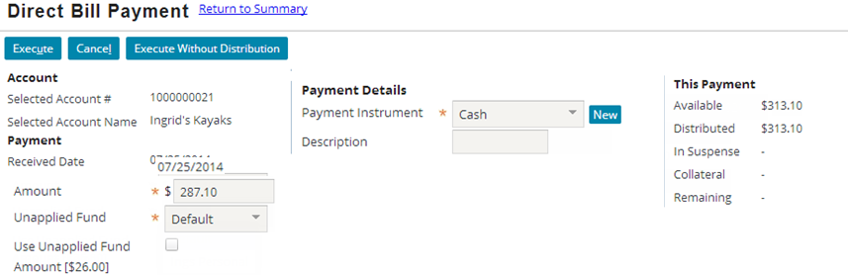
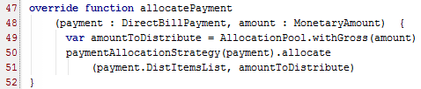
Making a payment: executing allocation
Account tab→New Payment→New Direct Bill Payment
Calls allocatePayment() method in plugin
Passes amount available to distribute
Uses payment allocation plan
Array of items to be paid
Notes:
The Direct Bill Payment screen is a good place to see how payment allocation works.
In the base application, when the user makes a payment from the Direct Bill Payment screen and does not choose to override the allocation, the UI calls the allocatePayment() method and passes the DirectBillPayment object and the amount available for allocation. The DirectBillPayment object includes a list of "dist items" based on the payer account's payment allocation plan. The dist items are displayed in the Preview Distribution listview (not shown in the slide).
In the example, the amount is the value the user entered in the Amount field. If Use Unapplied Fund Fund Amount is checked and there are unapplied funds available, the UI passes the sum of the payment and unapplied amounts.
You can configure allocatePayment() by modifying the list of distribution items and/or the amount to distribute. There is an example of a configuration on the next slide.

Slide 35
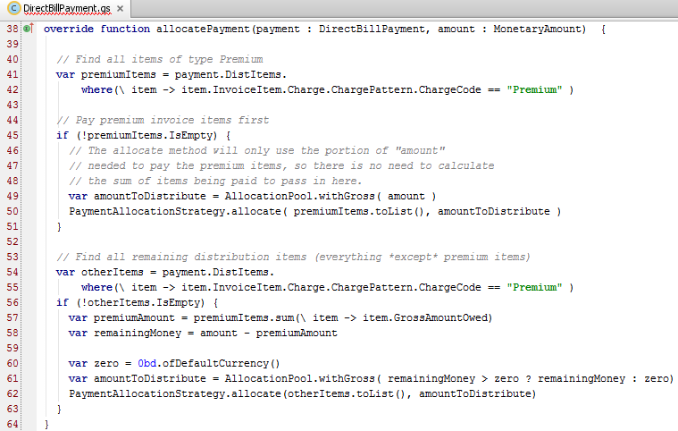
Configuring allocatePayment() example
Requirement: Pay eligible premium items first
Create an array of just the premium items
Distribute payment to premium items first ...
Create an array of all remaining items
… then distribute any leftover money to remaining items
Notes:
The default behavior of allocatePayment() is to call paymentAllocationStrategy(payment).allocate(), passing it an array of items to distribute. Most payment allocation requirements are satisfied by configuring the payment allocation plan. In some cases, however, you may need to configure the allocationPayment() method. The example in the slide is easily satisfied by defining a priority for the payment allocation plan (refer to the custom priority slides earlier in this lesson). It is shown here to show how you can approach a more complex requirement that cannot be addressed by custom filters or priorities.
In the configured example, instead of having a single array of distribution items to pass to allocate(), the code first creates an array of the distribution items that are for a premium charge. Because the allocate() method allocates only the amount needed to pay the items passed in, it is not necessary to calculate the total amount of the premium items being paid; we pass the entire amount of the payment, along with the array of premium items, and paymentAllocationStrategy(payment).allocate() will use the amount needed.
A second array is created for all other (non-premium) items. The remaining funds are calculated by summing premiumItems, and subtracting that (previously allocated) total from the amount passed into this method. The remaining (non-premium) item array and the remaining funds are then passed to paymentAllocationStrategy(payment).allocate() .
Notice that the configured code uses the same distribution strategy that the base application uses. The configured code simply groups items depending on their charge type.
Note: BillingCenter uses AllocationPool (see line 49) to track the amount to distribute. AllocationPool has two properties: GrossAmount and Commission. AllocationPool.Commission is used in agency bill allocation only. It is ignored in direct bill allocation.

Slide 36
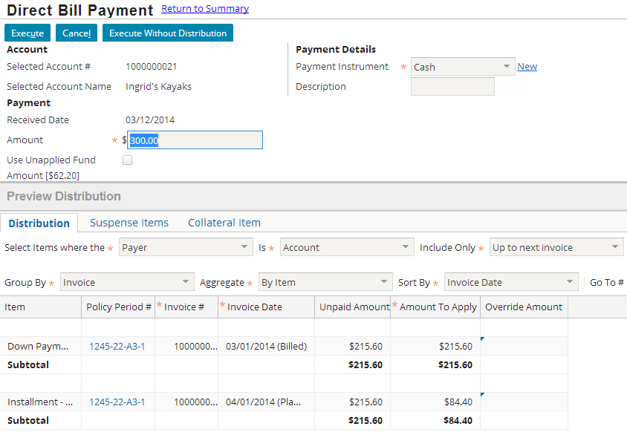
Overriding a default allocation
Override toolbar
Override Amount field
Notes:
When you open the Direct Bill Payment screen, the payment allocation plan filters are applied immediately. For example, let's assume the Default Payment Allocation Plan is associated with the current account. Then all billed or due positive invoice items for which the current account is the payer are automatically displayed in the Preview Distribution area.
To override the distribution, click Override Distribution (button is not shown in the screenshot). This causes the Override toolbar and Override Amount field to be displayed. The toolbar provides facilities to select items based on the payer. You can also include items that are not automatically included for allocation. In the example, the selected value for Include Only is "Up to next invoice". This means that items for the next planned invoice are available for allocation.
After you enter amounts in the Override Amounts fields. Click Execute to save your payment and allocation. The allocateWithOverrides() method is called. The method call varies depending on the aggregation type. In this slide, aggregation is By Item so the third argument passed to the method is a map of invoice items and override amounts.
If you click Execute Without Distribution, your payment is saved to the applicable unapplied account and not distributed.

Slide 37
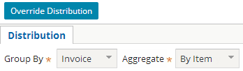

Allocating with overrides
If you override a distribution from Direct Bill Payment screen, an allocateWithOverrides method is called
When overrides are at item level, this method is called
When overrides are at summary level, this method is called
Handles groups of items
Notes:
allocateWithOverrides
If BillingCenter needs to allocate payments with overrides for specific invoice items, BillingCenter calls the DirectBillPayment plugin’s allocateWithOverrides method. In addition to the payment (a DirectBillPayment object) and an amount to distribute (a MonetaryAmount value), this method takes an additional argument that contains the list of overrides.
Two signatures
There are two method signatures for this method:
First version specifies the overrides as individual invoice items and the value to override the allocation for each item.
Second version specifies the overrides as a list of direct bill payment distribution item groups. The exact syntax of this type is List<DBPaymentDistItemGroup>. A DBPaymentDistItemGroup object is a group of payment distribution items for the Direct Bill Payment screen. Each group contains:
A list of the individual distribution items
Information about the group as a whole, such as the group’s display name and the total unbilled amount of the group

Slide 38
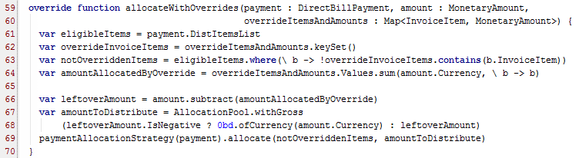
allocateWithOverrides(): detail
Default implementation of both versions of the method
Add overrides based on the method parameters
Call paymentAllocationStrategy(payment).allocate() to allocate remaining amount (if any) to non-overridden items
Notes:
The code in the slide is from the first allocateWithOverrides() method in DirectBillPayment.gs.

Slide 39

Summary: user-plugin interaction
User
BillingCenter
Enters Direct Bill Payment screen
Enters payment amount
On UI, amounts to apply are populated
Clicks Override Distribution and exposes editable override amounts fields
Uses dropdown to select what to include
Enters override amounts and clicks out of the field
Creates list of distribution items on new payment entity using payment allocation plan
Calls allocatePayment passing (db payment object which includes payment and dist item list, amount), which calls paymentAllocationStrategy (payment).allocate()
Calls allocateWithOverrides passing (db payment object, amount, map of invoice items and amounts)
Calls allocateWithOverrides again

Slide 40
Lesson objectives review
You should now be able to:
Configure a payment allocation plan in the UI
Create custom filters and priorities for payment allocation plans
Describe how the Direct Bill Payment screen interacts with the DirectBillPayment plugin
Configure the DirectBillPayment plugin to modify payment distribution

Slide 41
Demo

Slide 43
Lab

Slide 44
Complete the exercises in below chapter in the “BC10_CONF_K_StudentWorkbook“ work book​
​
Lesson 8 = > Configuring Payment Allocation

Slide 45
Review

Slide 46
Review questions
Name the four batch processes that make payment allocations.
How does RestrictionBuilder streamline the process of filtering invoice items for payment allocation?
What are the steps for creating a custom filter?
What are the steps for creating a custom priority?
Why are there two signatures for the allocateWithOverrides method?
Notes:
New Payment, New Disbursement, Invoice, and Invoice Due batch processes all distribute funds.
RestrictionBuilder allows you to add restrictions to the query that filters eligible invoice items. You do not need to write the query itself.
To create a new filter:
Add a typecode for the new filter.
Create a class to implement the filter. The class must contain a getter that returns the typecode and a restrict() method.
Register the filter with LinkedImplementationLoaderImpl.
To create a new priority:
Add a typecode for the new priority.
Create a class to implement the priority. The class must contain a getter that returns the typecode and a compare() method.
Register the priority with LinkedImplementationLoaderImpl.
One signature is used for processing individual items; the other is for processing groups of items (when the user has selected to aggregate by Summary instead of item).

Slide 47
Notices
Copyright © 2001-2014 Guidewire Software, Inc. All rights reserved.
Guidewire, Guidewire Software, Guidewire ClaimCenter, Guidewire PolicyCenter, Guidewire BillingCenter, Guidewire Reinsurance Management, Guidewire ContactManager, Guidewire Vendor Data Management, Guidewire Client Data Management, Guidewire Rating Management, Guidewire InsuranceSuite, Guidewire ContactCenter, Guidewire Studio, Guidewire Product Designer, Guidewire Live, Guidewire DataHub, Guidewire InfoCenter, Guidewire Standard Reporting, Guidewire ExampleCenter, Guidewire Account Manager Portal, Guidewire Claim Portal, Guidewire Policyholder Portal, ClaimCenter, BillingCenter, PolicyCenter, InsuranceSuite, Gosu, Deliver Insurance Your Way, and the Guidewire logo are trademarks, service marks, or registered trademarks of Guidewire Software, Inc. in the United States and/or other countries.
All other trademarks are the property of their respective owners.
This material is confidential and proprietary to Guidewire and subject to the confidentiality terms in the applicable license agreement and/or separate nondisclosure agreement.
This file and the contents herein are the property of Guidewire Software, Inc. Use of this course material is restricted to students officially registered in this specific Guidewire-instructed course, or for other use expressly authorized by Guidewire. Replication or distribution of this course material in electronic, paper, or other format is prohibited without express permission from Guidewire.
Guidewire products are protected by one or more United States patents.

