Slide 1

BillingCenter 10 Configuration
Configuring Credit Handling

Slide 2
Lesson objectives
By the end of this lesson, you should be able to:
Describe how the Default Return Premium Plan influences credit distribution
Describe the role of RestrictionBuilder filtering eligible items for credit distribution
List the steps for creating a custom credit allocation
This lesson uses the notes section for additional explanation and information. To view the notes in PowerPoint, choose View→Normal or View→Notes Page. If you choose to print the notes for the lesson, be sure to select "Print hidden slides."

Slide 3
Lesson outline
Credit handling basics
Credit allocation examples
Return premium plan
Configuring credit handling
Filtering
Allocation

Slide 4

Cash versus credit
Cash is money that is received by the carrier and is immediately available to pay receivables
BillingCenter term for cash is DirectBillMoney
A credit is an amount the carrier owes the insured
Negative endorsements (usually for return premium) are the source of credit
A credit distribution allows a carrier to credit an insured's account to clear an item previously charge to the insured
Funds from credit distribribution can be used to "pay" for items the insured owes the carrier
Premium charge
-600
(PAS)
Notes:
A credit involves no new money entering the system.

Slide 5

Credit allocation happens after charge slicing
When a billing instruction is received, BillingCenter slices each charge (negative or positive) into one or more invoice items
Invoice items are then placed on invoices
Charge
Premium - $600
Invoice items
- $60
- $60
- $60
- $60
. . .
Invoices
Notes:
When a billing instruction is received by BillingCenter, BillingCenter "slices" each charge into one or more invoice items according to the payment plan. A premium charge is typically sliced into a single down payment invoice item and one or more installment invoice items. BillingCenter generates the required invoices, places the invoices in the appropriate invoice stream, and assigns each invoice item to one of the invoices. In terms of charge slicing, a negative charge is handled in the same way as a positive charge.
Credit allocation happens after charge slicing has taken place. This means that before any credit is allocated, each negative item has been placed on an invoice according to its event date and the policy's payment plan.

Slide 6
Steps for allocating credits
After a negative charge has been sliced into invoice items, the credits are allocated
1. Filter
2. Partition & Rank
3. Pay
Identify a set of (positive) invoice items to target for payments
Partition items from step 1 by event date. If method is either First to Last or Last to First, rank items by charge pattern priority
Pay items in each partition until you run out of money
Notes:
Assume that BillingCenter has received a negative charge. The basic steps for allocating the credit are:
Filter – Identify the set of positive invoice items that are eligible to be paid by the credit from the negative charge.
Partition and Rank – Group the invoice items by event date. For non-proportional credit distribution, rank the invoice items by charge pattern priority.
Pay – Allocate the credits to the eligible invoice items until no more credit is available.
More about ranking
Ranking occurs when BillingCenter prioritizes one set of invoice items above another. Priority is based on invoice item event date first. However, if multiple invoice items share the same date, BillingCenter pays the invoice items with highest priority charge pattern first.
For example:
Invoice item 1 has event date of 1/1/2012, a Charge Pattern Priority of High, and an unpaid amount of $500
Invoice item 2 has event date of 1/1/2012, a Charge Pattern Priority of Medium, and an unpaid amount of $100
If an incoming credit is for -400, then only item 1 will be paid.

Slide 7
Return premium plan controls credit handling
-100
Return premium plan exposes common credit handling requirements as options in the UI
Business user can easily control when and how credits are released
No coding is required to implement rules for most credit handling requirements
Default Return Premium Plan is shipped with BillingCenter
Business user can create new return premium plans in the UI
Methods for configuring custom filters and allocation strategies are in DirectBillPayment plugin
Notes:
The return premium plan was designed to cover the majority of carrier credit requirements. In cases where the return premium plan does not satisfy a requirement, the return premium plan facilitates conversation between a business user and configuration developer about what needs to be configured.

Slide 8
Return premium plan: 3 allocation strategies
Proportional allocates credits according to percentage specified in the return premium plan
First to Last allocates credit to each item fully, starting with earliest eligible item
Last to First allocates credit to each item fully, starting with latest eligible item
1000 $
Charges
- 600 $
240
120
120
120
400
200
200
200
400
200
200
400
200
200
200
400
200
200
200
Time
Notes:
The three available allocation strategies are:
Proportional, which spreads credit proportionally over the unsettled positive invoice items based on the original amount of each item. If there is not enough unpaid balance for any of the proportional amounts (that is, an item has excess to allocate), the excess is carried forward to the next invoice with an unpaid balance.
First to Last, which pays the oldest invoice item (the one with the earliest event date) in full before paying the next invoice item.
Last to First, which pays the newest invoice item first (the one with the latest event date) before paying the previous invoice items.
Proportional allocation honors the payment plan. The other two allocation methods are not influenced by the payment plan. They fully allocate to each item in turn until there is no more credit to allocate.
Let's assume the charges and invoice items for all three examples. When a credit for -600 is received:
If the method is Proportional, BillingCenter allocates credit from the down payment item and each of the installments according to the event dates of both the positive and negative invoice items. A positive invoice item can be "paid" by credit from a negative item only if the event date for the positive item is less than or equal to event date of the negative item.
If the method is First to Last, BillingCenter fully allocates credit to the $400 item and the first $200 item. No credit remains to allocate to the remaining two invoice items.
If the method is Last to First, BillingCenter fully allocates credit to the last three $200 items. No credit remains to allocate to the remaining $400 invoice item.

Slide 9
Lesson outline
Credit handling basics
Credit allocation examples
Return premium plan
Configuring credit handling
Filtering
Allocation

Slide 10
Scenario – missing discount
Fred Bliss buys two policies:
Auto policy Home policy
But sales rep forgets to apply good driver discount to auto policy
Sales rep issues policy change
Premium 1,000
Premium 1,200
Taxes 50
Taxes 80
Oops, I forgot his good driver discount. I'll fix that right now.
Premium - 600
Notes:
In this scenario, the customer will get the good driver discount on the full premium only, not on the taxes for that premium. The tax is still based on the original price of the product.
The next slides use the scenario presented here to illustrate how proportional credits are applied.

Slide 11
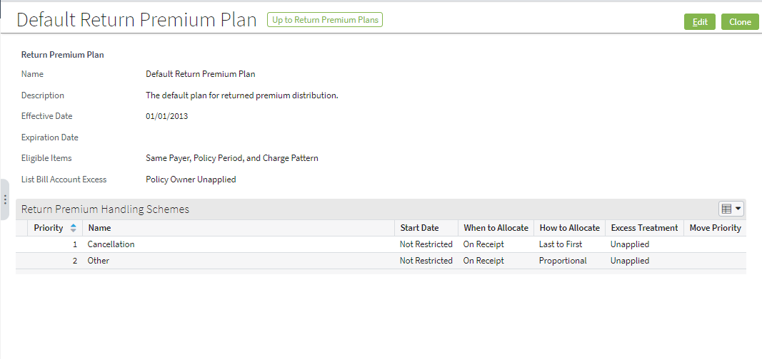
Scenario uses Default Return Premium Plan
Same Policy Period and Charge Pattern means that eligible items must belong to same policy period and have same charge pattern code as negative charge being processed.
Allocate credits now Use proportional allocation
Notes:
The Default Return Premium Plan is in effect. The charge type being processed is Policy Change. Because there is no scheme defined for Policy Change, BillingCenter uses the scheme defined for Other context.

Slide 12
Step 1: Find eligible items
1. Filter
2. Partition & Rank
3. Pay
BillingCenter applies two filters:
Implicit: Must be unsettled positive items with same payer Explicit (return premium plan): Same policy period and charge pattern
Premium charge
Auto
1000
Taxes charge
400
200
200
200
50
Home
Premium charge
50
1200
Taxes charge
80
480
240
240
240
Notes:
In the base application, BillingCenter automatically applies the implicit filters that restrict eligible items to:
Unsettled items (that is, either unpaid or partially paid items)
With unpaid amounts greater than 0
With the same payer as the negative charge that is being credited
The return premium plan has an explicit filter called Positive Item Qualifier. In the example, the explicit filter is Same Policy Period and Charge Pattern, which is the default setting on the Default Return Premium Plan for a context of Policy Change. The explicit filter excludes the following:
Taxes charge because its charge pattern doesn't match the charge pattern of the negative Premium charge that is supplying the credit
Premium Charge for the Home policy because Home is not the same policy period as Auto
Through configuration, you can define custom positive item qualifiers. In addition, you can write your own logic to replace or augment the code that filters the invoice items.

Slide 13
Step 2: Partition & rank
1. Filter
2. Partition & Rank
3. Pay
Eligible invoice items are partitioned according to their event dates
If more than one item has the same event date and distribution method is Last to First or First to Last, items are ranked according to charge pattern priority
Auto
Premium charge
1000
400
200
200
200
Jul 22
Oct 22
Jan 22
Apr 22
Event Dates
Notes:
In our simple example, ranking does not occur because there is only one item for each event date. Also, the example is based on proportional allocation, as illustrated on the next slide.

Slide 14
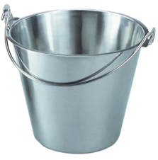
Step 3: Pay
2. Partition & Rank
3. Pay
1. Filter
Allocate Timing: On Receipt Payment plan: Quarterly, 40% down Method: Proportional 3 max installments
July
October
January
April
Premium charge
1000
400
200
200
200
Premium charge
-600
-240
-120
-120
-120
1
22
1
22
1
22
1
22
Event dates
Unapplied
Notes:
On the same day the policy was issued, the sales rep realized his omission of the discount and issued a policy change. For this reason, the event dates in our example are nicely aligned. This means that proportional allocation works as intended with the down payment and all its installments being reduced by a proportional amount. Each negative invoice item is used to "pay" eligible positive items. For example, the down payment item of -240 is applied as a payment to the $400 down payment item.
In a later slide, you'll see the significance of event dates in proportional allocation.

Slide 15
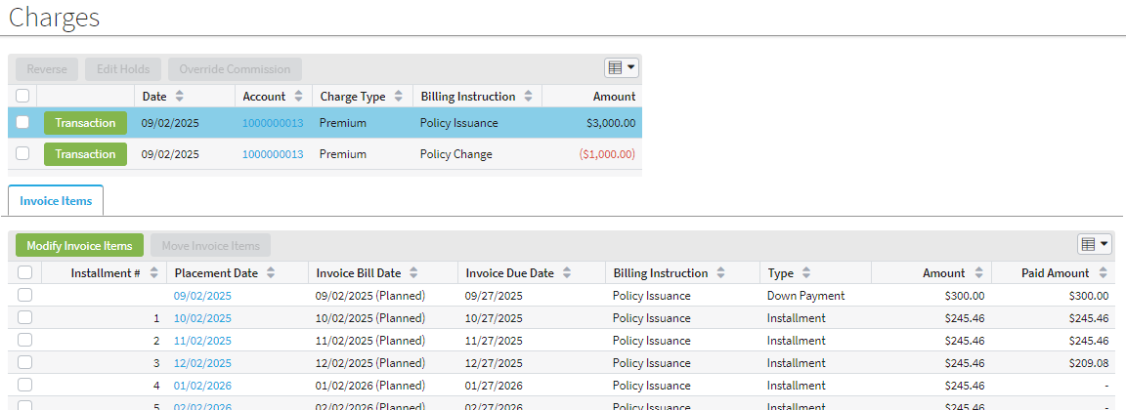
Missing discount - invoice items
Screenshot shows invoice items for initial premium charge
Credit from discounted premium was applied proportionally
Policy→Charges
Pays
Notes:
Another place to view the allocation of credit is the Funds Tracking screen for the account (funds tracking must be enabled). The negative charge is a funds source and the allocated items are funds uses.

Slide 16

Role of event dates in credit allocation (1 of 2)
Every positive and negative invoice item is assigned an event date according to the payment plan
You can specify different handling for issuance and policy change
Down payment
First installment
2nd installment
Event Dates
Policy Effective Date -25
Policy Effective Date
1 interval after Policy Effective Date
2 intervals after Policy Effective Date
Notes:
The payment plan controls how charges are sliced into invoice items and how event dates are assigned to the invoice items. An invoice item’s event date determines which invoice will hold the invoice item. You can override the handling of down payments, installments, and one time charges for specific types of charges on the payment plan.

Slide 17
Role of event dates in credit allocation (2 of 2)
A positive invoice item can be "paid" by credit from a negative item only if its event date >= negative item's event date
- $54.55
- $54.55
- $54.55
. . .
$375
$112.50
$112.50
. . .
Jul 09
Aug 05
Sep 03
Sep 05
Oct 03
Oct 05
Event Dates
Notes:
Event dates are significant in credit allocation as illustrated in the slide. The event date for the first negative invoice item is August 05, which is later than the event date for the positive $375 invoice item. This means that the credit for first negative item will be applied to the September 03 positive invoice item. Similarly, because September 05 is later than September 03, the second invoice item will be used to pay for the Oct 03 positive invoice item, and so on. If excess credit remains after the all eligible positive items have been paid, the remaining money is placed in the applicable unapplied T-account.
Note that credit allocation is influenced by each invoice item's event date, not by the placement of invoice items on invoices.
The next slide shows screenshots that illustrate the scenario on this slide.

Slide 18

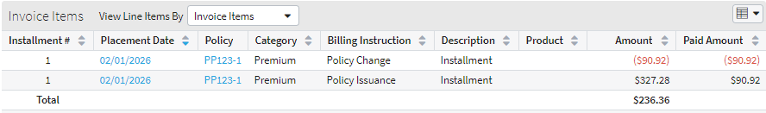
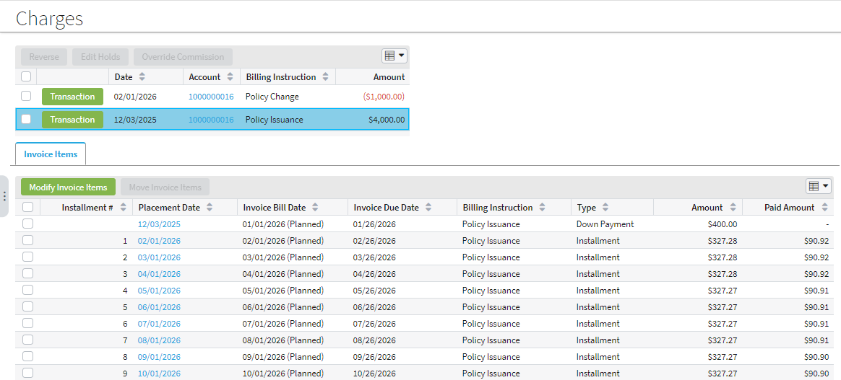
Role of event dates in credit allocation worked example
Account → Invoices
Policy → Charges
Policy → Charges
Notes:
The top screenshot shows that the event date of the negative item is later than the event date of the positive item on the same invoice. For this reason, the credit for the negative item was not applied to that positive item. Instead, the credit was applied to a positive invoice item on the next invoice. The middle screenshot shows that each installment in turn has received a credit from the negative charge. The bottom screenshot shows that the final installment of -$54.54 is placed in the applicable unapplied T-account.

Slide 19
Lesson outline
Credit handling basics
Credit allocation examples
Return premium plan
Configuring credit handling
Filtering
Allocation

Slide 20
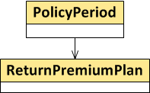
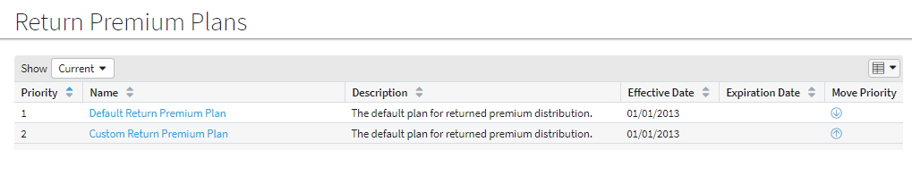
Return premium plans
When a policy is created, the return premium plan with lowest priority number is associated with the policy period
On renewal, same return premium plan is associated with new policy period
Any edits to a return premium plan are effective immediately
Administration→Business Settings→Return Premium Plans
Notes:
When a policy is created, the return premium plan with the lowest priority number is associated with the policy period. When a policy is renewed, the renewal logic associates the same return premium plan with the new policy period. This return premium plan is called every time BillingCenter receives a negative charge for the same policy.
You can edit a return premium plan at any time. When a negative charge is received, BillingCenter allocates the credit using the current settings in the return premium plan associated with the policy period.
Default Return Premium Plan is part of the BillingCenter bootstrap data, not the sample data, so it will always be available in BillingCenter. Most carriers will probably agree on a single return premium plan that they are unlikely to change over time. However, you can modify the Default Return Premium Plan or clone it and make changes to the cloned plan.

Slide 21
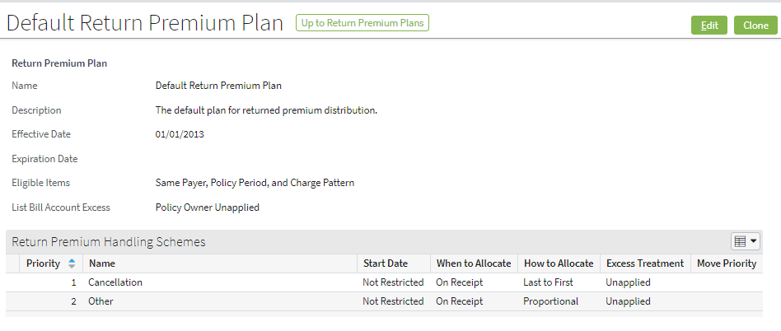
Return premium plan: overview of fields
How to match negative items with items to be paid
(List bill only) Where to place excess funds
Each scheme applies only to specified Billing instruction type
Effective date
Billing instruction type When to allocate credits Where excess goes Allocation strategy

Slide 22
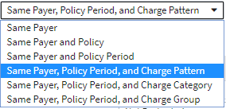
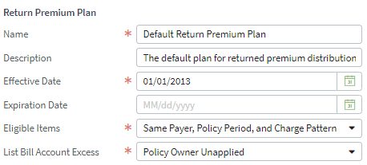
Positive Item Qualifier field
1. Filter
2. Partition & Rank
3. Pay
Eligible Items are used to determine items that are eligible to be paid by available credit
Same eligible items apply to all credit distributions, regardless of billing instruction type
Notes:
The Eligible Items are defined on the return premium plan, not on the individual return premium handling schemes. This means that the same eligible items are used for every credit distribution.
When a negative charge is received, BillingCenter uses the eligible items to match the relevant attributes between negative and positive charges. It filters out all remaining (non-matching) invoice items under a payer account that a negative charge should not target.

Slide 23
Eligible items and invoicing model
Eligible Items
Invoicing Object Model
Payer Account
Policies
Invoices
Policy Periods
Invoice Items
Policy Periods
Billing Instructions
Charges - Pattern - Category - Group
23
Notes:
The slide shows a simplified version of the BillingCenter invoicing object model. You can see how the predefined eligible items reflect the invoicing object model.
Charges have three attributes that are relevant to filtering:
Charge Pattern – unique name of charge
Charge Category – type of charge such as Premium, Fee, General, Taxes, and Collateral
Charge Group – a freeform text field on a charge in a billing instruction. The charge group provides a means for grouping related charges such as charges for a specific vehicle on a personal auto policy.

Slide 24
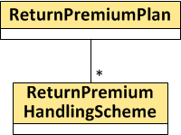
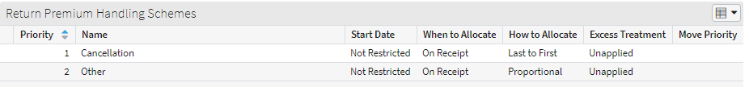
Return premium handing schemes
A return premium plan has an array of return premium handling schemes
Each scheme specifies how credits are allocated for its specific context
When handling a negative charge, BillingCenter looks for scheme context that matches the billing instruction type
Search is in priority order
Other context used if no matching name is found
Notes:
Because Other is the catchall context that will be used if there is no matching context, it must always have the highest priority number. The UI prevents you from repositioning Other above any other scheme in the list.

Slide 25
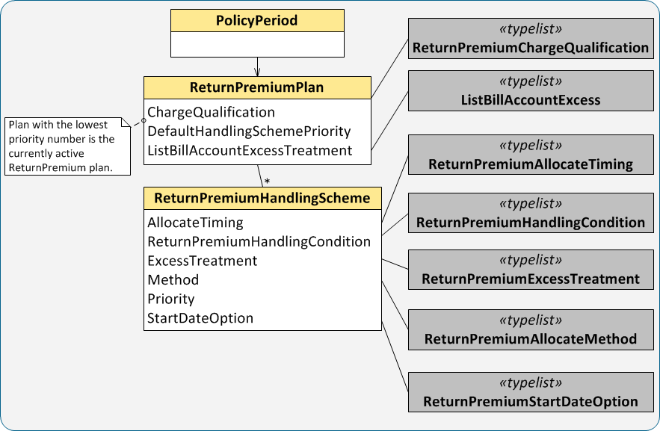
ReturnPremiumPlan data model
Notes:
Each return premium handling scheme defines a set of rules for a particular context. Each rule is associated with a typelist. You can add a custom code to any of the CreditHandlingScheme typelists to implement a custom rule.
Each policy period is associated with a return premium plan, which means that policy-level charges always have an associated return premium plan. However, there is no association between an account and a return premium plan, so account-level charges such as fees have no associated return premium plan.

Slide 26
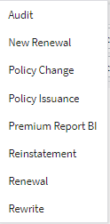
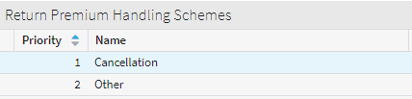
Scope of return premium plan rules
Each return premium handling scheme has a context that restricts the scheme by billing instruction type
other applies to all types not explicitly covered by a scheme
Context allows business users to define a separate rule for each type of billing instruction
Notes:
In the shipped Default Return Premium Plan, only two credit handling schemes are defined: Cancellation and Other. This is because generally cancellations require a last-to-first allocation of credit, whereas all other contexts usually have a requirement for proportional allocation. A business user can add a separate return premium handling scheme for each context listed on the slide.
You can think of each context as an "if" condition. Through configuration, you can build an if condition that is not restricted to billing instruction context.

Slide 27
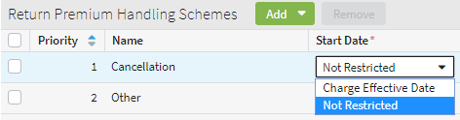
Start Date field
1. Filter
2. Partition & Rank
3. Pay
Start Date field on credit scheme specifies when a credit can go into effect
Serves as an additional filter for determining eligible positive items to pay
Useful for back-dating credits
Notes:
"Not Restricted" means the earliest date possible. This setting means that credit can be allocated to an item on an invoice with a bill date that is earlier than the charge effective date. The Charge Effective Date is known as the Policy Modification Date in a PAS.

Slide 28
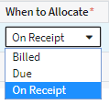
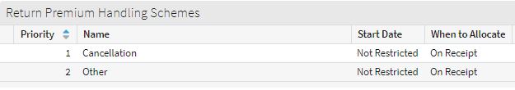
Allocate Timing field
On Receipt means allocate the credit when charge is received
Typically, carriers want to allocate credits as early as possible
Billed and Due delay credit allocation until invoice item becomes billed or due
Invoice and InvoiceDue batch processes make credit allocation
Notes:
The Allocate Timing field controls when BillingCenter allocates the credit. The options are:
On Receipt - As soon as a billing instruction is saved, BillingCenter allocates the credit.
Billed – The credit is allocated when an invoice containing the credit item is billed. If there is a negative invoice item on a billed or due invoice, the credit is allocated immediately.
Due - The credit is allocated when an invoice containing the credit item is due. If there is a negative invoice item on a due invoice, the credit is allocated immediately.
You cannot extend the ReturnPremiumAllocateTiming typelist.

Slide 29
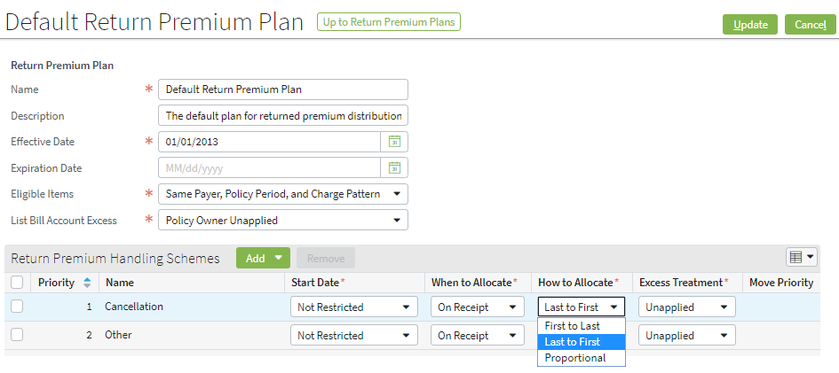
How to Allocate field
How to Allocate field specifies the allocation strategy for the context
Notes:
Through configuration, you can code additional allocation strategies and add entries to the ReturnPremiumAllocateMethod typelist.

Slide 30

Which unapplied T-account?
An account can have multiple Unapplied T-accounts
After a credit distribution, any excess money goes to an unapplied T-account
The Unapplied associated with invoice stream containing the negative items being processed
After excess money from credit is placed in Unapplied, it is treated as cash
. . .
Default Unapplied
Designated Unapplied (Auto)
Designated Unapplied (Home)
Designated Unapplied (Auto-1)
. . .
Notes:
Every invoice stream has one and only one associated Unapplied T-account.
After excess money from credit is placed in Unapplied, BillingCenter does not distinguish it from other cash. Cash in Unapplied can be:
Distributed to unsettled invoice items by a batch process
Disbursed to the payer
Transferred to another account
If payer account uses cash separation, payments and disbursements are managed at policy level.

Slide 31
Lesson outline
Credit handling basics
Credit allocation examples
Return premium plan
Configuring credit handling
Filtering
Allocation

Slide 32
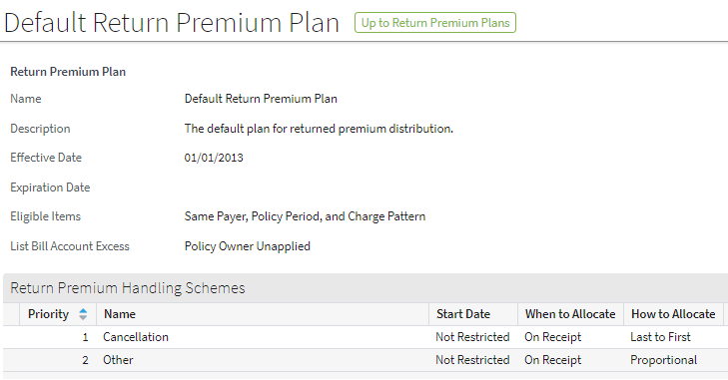
What can you configure in credit handling?
In the UI:
Edit Default Return Premium Plan or create a new one
In Gosu:
Implement a custom filter for eligible positive invoice items
Modify a preconfigured filter for eligible positive invoice items
Implement a custom allocation method
Modify a preconfigured allocation method
Notes:
There are other credit-handling configurations you can make in Gosu, but the ones listed in the slide are the most commonly requested changes.
One example that is not illustrated here is adding a context that is not a billing instruction type.

Slide 33

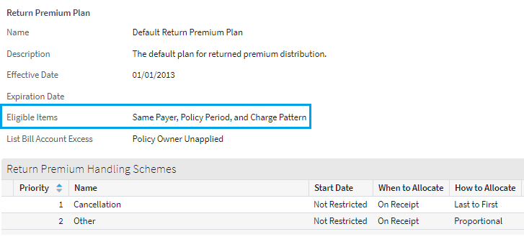
Filtering eligible positive items
1. Filter
BillingCenter
What items do you want to target for payment?
DirectBillPayment.gs
1. Start credit allocation
2. Execute filter
3. Distribute
addPositiveItemsDistributionCriteria()
.
.
.
Target the items that match these restrictions
return restrictions
What's my credit qualifier?
Return premium plan
Same Policy Period and Charge Pattern
Notes:
In the diagram, the addPostiveItemsDistributionCriteria method asks the return premium plan what for the positive item qualifier value. That restriction is added to any other restrictions in the method and then returned to BillingCenter. BillingCenter can then use the restrictions to filter the positive items to receive the credit allocation.

Slide 34
Overview: filtering eligible positive items
BillingCenter always applies these filters:
No holds on invoice item
Item is on direct bill invoice
Payer is same as payer of negative items being processed
DirectBillPayment plugin adds these filters:
Item must be positive
Item must be unsettled (that is, not fully paid)
addPositiveItemsDistributionCriteria() method in DirectBillPayment plugin does additional filtering
Uses RestrictionBuilder facility that allows you to add restrictions to a query
Notes:
Currently the code that requires all eligible items to be positive and unsettled is exposed in the DirectBillPayment plugin and can be configured. However, it is extremely unlikely that a carrier would want to modify either of these requirements.

Slide 35
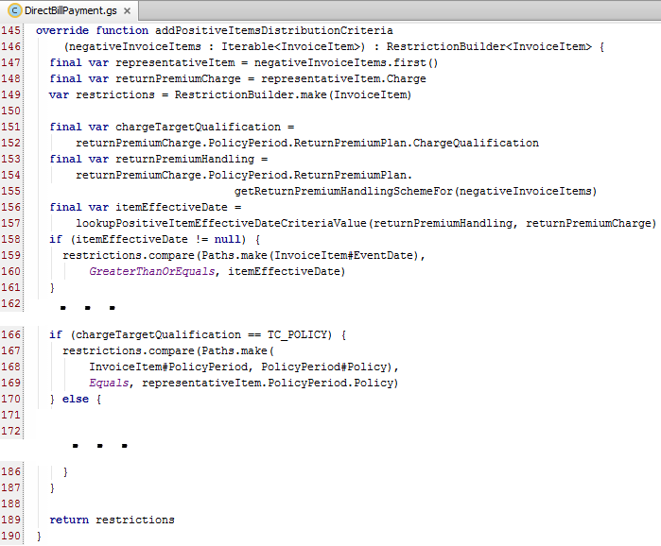
Filtering eligible items (unconfigured code)
1
2
3
4
5
6
7
Notes:
The addPositiveItemsDistributionCriteria() method in the DirectBillPayment plugin does the following:
Accepts a set of negative invoice items to allocate.
Declares the representativeItem variable to get the related charge.
Creates a new restriction builder for type InvoiceItem.
Finds the charge qualification and the first credit handling scheme that applies to the negative invoice items being processed.
Gets the itemEffectiveDate, which is the Start date on the credit handling scheme.
Looks for a matching qualification type. Most of this code has been edited out of the screenshot because of limited real estate on the slide. When a match is found, adds a requirement to RestrictionBuilder to compare the policy of the eligible positive item with policy of the representative negative item.
Returns RestrictionBuilder.

Slide 36
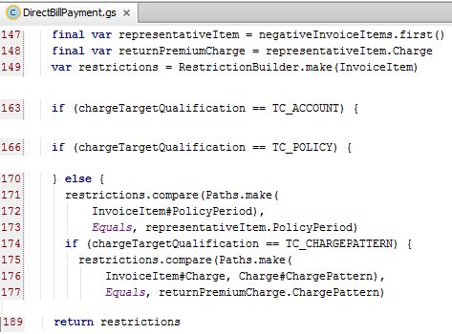
Filtering eligible items—a closer look
addPositiveItemsDistributionCriteria() method
Notes:
The slide shows a simplified version of the unconfigured method you saw on an earlier slide. If the chargeTargetQualification is neither Account or Policy, the code starting on line 170 adds a restriction to RestrictionBuilder that compares the policy period of the positive invoice item with the policy period of the negative item ("representativeItem"). If the chargeTargetQualification is Charge Pattern, then a second restriction is added. This restriction compares the charge pattern of the invoice item's charge with the charge pattern of the credit charge.
Notice the syntax on line 174 and 175. The intention is to create a path from InvoiceItem to ChargePattern. However, property references are always two parts, so you can't simply say InvoiceItem#Charge#ChargePattern. Instead, you simply provide a second parameter on the method call (Charge#ChargePattern), which is used to create the path.

Slide 37
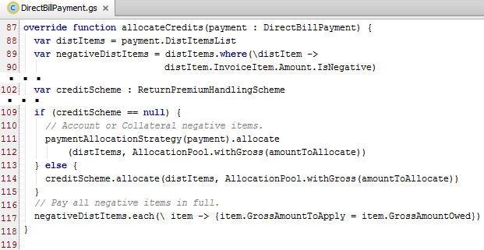
Overview: allocating credits
2. Partition and rank
BillingCenter allocates credits by calling allocateCredits() in DirectBillPayment plugin
Payment passed to method includes eligible positive items and negative credit items
If negative item has return premium scheme, call its allocate() method
Notes:
The allocateCredits() method determines how to distribute an amount of credit (negative distItems) across a set of invoice items (positive distItems). The allocate() method for the applicable credit scheme is called to perform the allocation. Note that a credit scheme handles only policy-period level items. Account-level items are not associated with any return premium plan, so they have no applicable credit scheme. In the base application, account-level items are always distributed according to the paying account's payment allocation plan.

Slide 38
Creating a custom allocation strategy
2. Partition & Rank
Desired strategy: Pay items from same policy period as negative charge first. Distribute remaining funds (if any) first to last
Steps:
Add typecode for new strategy to ReturnPremiumAllocateMethod typelist
Create a class that implements two methods:
Getter that returns TypeKey property
allocate() method
Add new class to list of credit allocation strategies in LinkedImplementationLoaderImpl
Notes:
The next few slides show each step in detail.

Slide 39
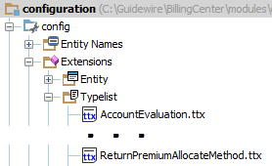
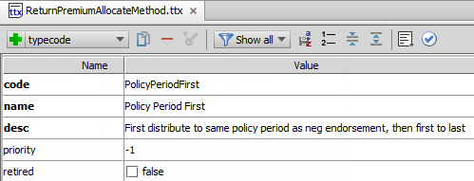
Step 1: Add typecode for new strategy
Either add to existing .ttx file or create a new one
Define code, name, and description

Slide 40
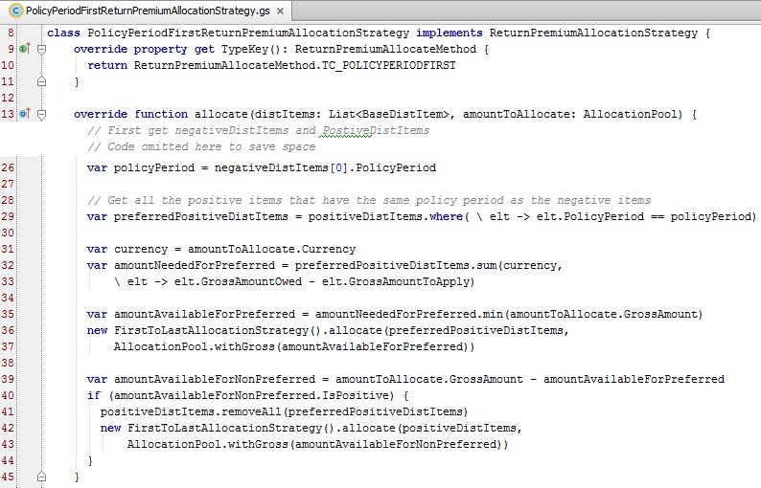
Step 2: Create class to implement strategy
1
2
3
4
5
Notes:
To get started with your custom allocation strategy, use ProportionalReturnPremiumStrategy.gs as an example. Name the new class using the convention <StrategyName>AllocationStrategy.
The code for separating the positive and negative invoice items has been omitted in the example to save space, but you can find it in ProportionalReturnPremiumStrategy.gs.
The following happens in the example code:
Get all the positive items in the payment (not shown).
Get all the negative items in the payment (not shown).
Get the policy period from one of the negative items.
Partition the positive items into two sets: the ones that belong to the policy period and those that don't.
Figure out how must money is needed to pay the items that belong to the same policy period as the negative items ("preferredPositiveDistItems").
Allocate money (first to last) to positive items that belong to the policy period.
Allocate any remaining money (first to last) to positive items that do not belong to the policy period.
More about typekeys and strategies
Each new strategy that you implement must implement get TypeKey() so that it is associated with a typecode.
Note that you cannot have two strategies that claim to implement the same typekey. On startup, BillingCenter gives an error if:
More than one strategy has the same typekey
A typecode has no associated strategy

Slide 41
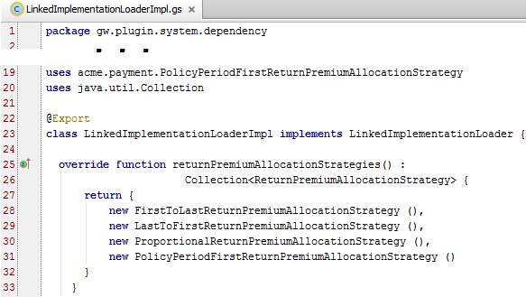
Step 3: Update LinkedImplementationLoaderImpl
Add the new strategy to the list of credit allocation strategies
Notes:
The LinkedImplementationLoader class ensures that every typecode in the CreditAllocateMethod typelist has one and only one implementing CreditAllocationStrategy class. It returns a collection of CreditAllocationStrategy objects, each of which is associated with a unique typekey and defines its own allocate() method.

Slide 42
Lesson objectives review
You should now be able to:
Describe how the Default Return Premium Plan influences credit distribution
Describe the role of RestrictionBuilder filtering eligible items for credit distribution
List the steps for creating a custom credit allocation

Slide 43
Demo

Slide 45
Lab

Slide 46
Complete the exercises in below chapter in the “BC10_CONF_E_StudentWorkbook“ work book​
​
Lesson 4 = > Configuring Policy Transactions After
Issuance

Slide 47
Review

Slide 48
Review questions
Given the DefaultReturnPremiumPlan, how does credit handling for a cancellation differ from other contexts?
If there is excess money remaining after credits have been allocated to all eligible invoice items, which Unapplied T-account receives the funds?
What are the steps for creating a custom credit allocation?
Notes:
Answers
The start date for credit allocation is Policy Effective Date (instead of Charge Effective Date for other contexts) and the method of allocation is Last to First (instead of Proportional for other contexts).
The Unapplied T-account that is associated with the invoice stream that contains the negative items resulting from the credit.
The steps are:
(a) Add the strategy name to the typelist.
(b) Create a class to implement the new strategy.
(c) Add an entry to LinkedImplementationLoaderImpl.

Slide 49
Notices
Copyright © 2001-2014 Guidewire Software, Inc. All rights reserved.
Guidewire, Guidewire Software, Guidewire ClaimCenter, Guidewire PolicyCenter, Guidewire BillingCenter, Guidewire Reinsurance Management, Guidewire ContactManager, Guidewire Vendor Data Management, Guidewire Client Data Management, Guidewire Rating Management, Guidewire InsuranceSuite, Guidewire ContactCenter, Guidewire Studio, Guidewire Product Designer, Guidewire Live, Guidewire DataHub, Guidewire InfoCenter, Guidewire Standard Reporting, Guidewire ExampleCenter, Guidewire Account Manager Portal, Guidewire Claim Portal, Guidewire Policyholder Portal, ClaimCenter, BillingCenter, PolicyCenter, InsuranceSuite, Gosu, Deliver Insurance Your Way, and the Guidewire logo are trademarks, service marks, or registered trademarks of Guidewire Software, Inc. in the United States and/or other countries.
All other trademarks are the property of their respective owners.
This material is confidential and proprietary to Guidewire and subject to the confidentiality terms in the applicable license agreement and/or separate nondisclosure agreement.
This file and the contents herein are the property of Guidewire Software, Inc. Use of this course material is restricted to students officially registered in this specific Guidewire-instructed course, or for other use expressly authorized by Guidewire. Replication or distribution of this course material in electronic, paper, or other format is prohibited without express permission from Guidewire.
Guidewire products are protected by one or more United States patents.

