Slide 1

BillingCenter 10 Configuration
Configuring Commission

Slide 2
Lesson objectives
By the end of this lesson, you should be able to:
Describe how BillingCenter selects an applicable subplan
Configure a custom earning criterion
Override the commission rate for a charge type
Describe the functionality of the three types of policy transfer

Slide 3
Lesson outline
Selecting the applicable subplan
Implementing custom payable criteria
Overriding commission rates
Commission override example: policy transfers

Slide 4
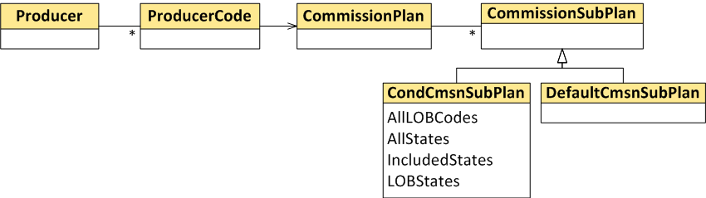
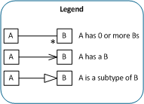
Review: Which subplan will be used?
Every commission plan has a default subplan and 0 or more conditional subplans
Conditional subplans have availability criteria
Conditional subplan availability criteria are evaluated in priority order against account, policy, policy period, and producer
First matching subplan is used
If no match, default subplan is used
Notes:
The conditional subplans have availability criteria, which are checked against the policy (LOB code), policy period (term number, assigned risk, state), and account (evaluations, customer segments). The allowed UW Companies are checked against the producer associated with this commission plan. Every commission plan must have a default commission subplan, which is used if none of the conditional subplans satisfy the evaluation.

Slide 5
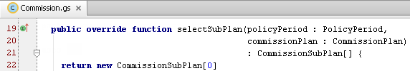
Selecting subplans
Commission plugin method selectSubPlan() provides configuration point for subplan selection
Unconfigured method returns an empty array
Subsequently, internal code selects the first applicable subplan
You can configure method to return only those subplans that you want to considered for selection

Slide 6
Selecting the applicable subplan
Execute selectSubplan()
1 subplan returned?
no
>1 subplan returned?
yes
Applicable conditional subplan found?
Search returned set of subplans
yes
yes
?
?
no
no
Empty array returned?
yes
Search all subplans of the commission plan
Applicable conditional subplan found?
yes
?
?
no
Use default subplan
Use that subplan
Notes:
After BillingCenter executes the selectSubplan() method, it uses the getApplicableSubPlan() domain method on the CommissionPlan entity to determine which subplan to use. During the search for an applicable commission subplan, the getApplicableSubPlan() domain method checks the subplan availability criteria on each conditional subplan of the given commission plan to find the first subplan that satisfies criteria. Searching stops when the first applicable subplan is found. If no applicable subplan is found, the default plan is used. Notice that if only one subplan is returned by the selectSubplan() method, that subplan is used (the subplan availability criteria are ignored).
In the unlikely event that no subplan is found, an InvalidCommissionPlanStateException is thrown.

Slide 7
Lesson outline
Selecting the applicable subplan
Implementing custom payable criteria
Overriding commission rates
Commission override example: policy transfers

Slide 8

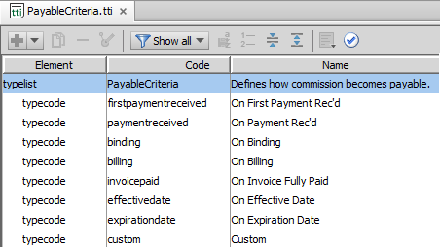
"Custom" payable criterion
Commission subplan
Custom payable criterion allows you to use your own logic to determine when commission becomes payable
For example: For certain policies, allocate all commission two months after policy effective date
Criteria are predefined in PayableCriteria typelist, which is not extensible
Notes:
PayableCriteria is a field on every commission subplan. It is used to determine when commissions that are governed by that plan will become payable.

Slide 9
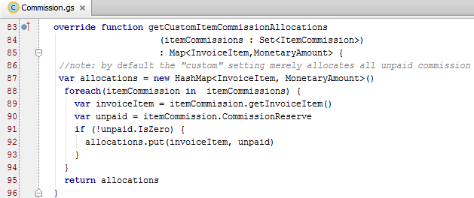
Unconfigured "Custom" payable criterion
Commission plugin method getCustomItemCommissionAllocations() handles Custom criterion processing
Method is called (1) on bind, and (2) by Commissions Payable batch process for every policy that uses Custom payable criterion
Commissions Payable Calculation
Unconfigured method always allocates all unpaid commission
Notes:
When the Commissions Payable Calculation batch process encounters a policy commission with an earning criterion of "Custom", BillingCenter calls the Commission plugin's getCustomItemCommissionAllocations method. The method returns a map of amounts to be made payable for the corresponding invoice item.
Note: A hashmap is a data structure that associates keys with values. Typically, hashmaps are used for efficient lookups.

Slide 10
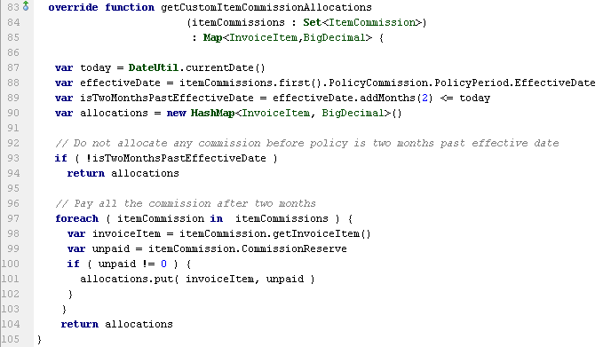
Implementing "Custom" payable criterion Example
Configured method allocates 100% of unpaid commission two months after policy effective date
Notes:
The example shows an implementation of the Custom payable criterion. The requirement is to pay all commission two months after the policy effective date.
The getCustomItemCommissionAllocations method is called whenever the Commissions Payable batch process runs. It looks each time to see whether the 2 month cutoff has been reached. If not, then it does nothing; in other words, no Commission Items are made payable.
Note that the code for making the commission items payable is identical to the code in the unconfigured method.

Slide 11
Lesson outline
Creating a custom subplan
Implementing custom payable criteria
Overriding commission rates
Commission override example: policy transfers

Slide 12
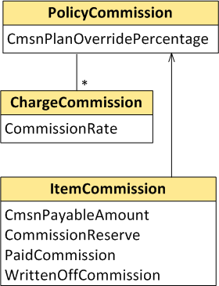
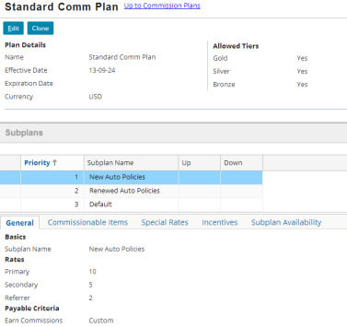

Storing and calculating commission rates
Actual commission rate is calculated from all item commissions
Rates for policy are specified in commission subplan
If PolicyCommission.CmsnPlanOverridePercentage is not null, its value overrides rate for specified role in subplan
Applicable commission subplan
Sum of these divided by item amount = actual item commission rate
Notes:
If PolicyCommission.CmsnPlanOverridePercentage is not null, it overrides the base percentage on the commission plan when new charges are created and associated with this policy commission. CmsnPlanOverridePercentage is set when you choose to override the commission plan by specifying a percentage. Refer to the "Overriding commission in the UI" slide.
ChargeCommission.CommissionRate is a derived property that returns the current value of the Commissions Expense T-account for the producer code for the charge on the policy.

Slide 13
Why override a commission rate?
Reasons for overriding commission rate can include:
Increasing commission rate based on total volume of business for a given producer
Lowering commission rate when premium increases on assigned risk policies
Adjusting commission rate when transferring a policy to a different producer
Notes:
The incentives feature of the commission plan allows a carrier to add a bonus percentage for policies over a specified threshold. The bonus is based on individual policies, however, and not on the total business that a particular producer has brought to the carrier. Increasing commission rate based on a producer's volume of business requires configuration.
Recall that "assigned risk" is liability coverage for certain individuals (such as reckless drivers) who cannot buy conventional insurance policies due to their adverse record. A state can require that insurance carriers take on some of these bad risks. When a premium for an assigned risk policy increases, the risk to the carrier also increases. For this reason, the carrier may wish to lower the commission rate on these policies.
The topic of adjusting the target producer's commission rate during policy transfer is covered later in this lesson.

Slide 14
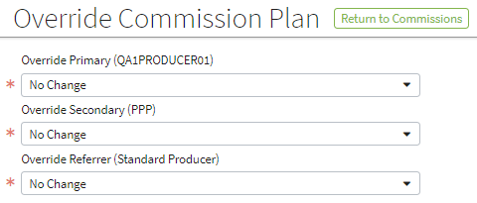

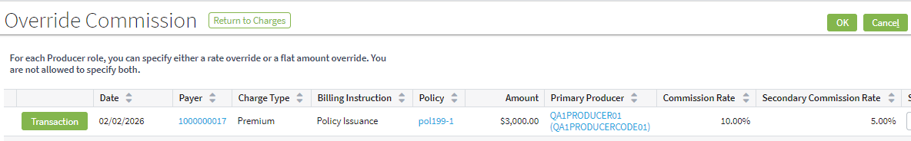
Overriding commission in the UI
On policy level, you can override percentage or choose a different commission plan
On charge level, you can override percentage
Item-level override is not available in base application UI
You can configure this functionality
Policy tab→Commissions→Override Plan
Policy tab→Charges→Override Commission
Notes:
Internally, BillingCenter uses item-level override for the following situations:
When transferring a policy from a producer to no producer (to set the reserves to 0)
When transferring a policy to another producer where some of the items have been reassigned to a different producer

Slide 15
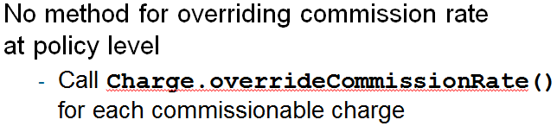
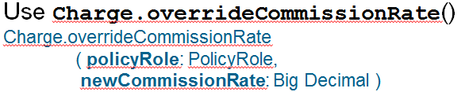
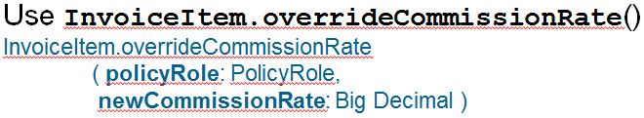
Methods for overriding commission rate
Policy Commission
Charge Commission
Item Commission
Use these methods in preupdate rules, Commission plugin override functions, and PCFs

Slide 16
Impact of commission rate change
Overriding commission rate adjusts commission reserves to match new commission percentage
Acts on reserves only for active producer code for specified role
Policy Commission | Rate propagates to charge and item commission New charges use new rate instead of subplan rate
Charge Commission | Rate propagates to item commission Commission remainder writeoff (if any) is reversed New commission remainder writeoff is added (if needed) Commission Expense and Reserve adjusted
Item Commission | Changes commission reserve for that item only Commission remainder writeoff is not reversed
Notes:
You can store the commission override rate for the primary producer on the PolicyCommission level using PolicyCommission.setCmsnPlanOverridePercentage().

Slide 17
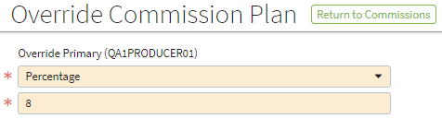
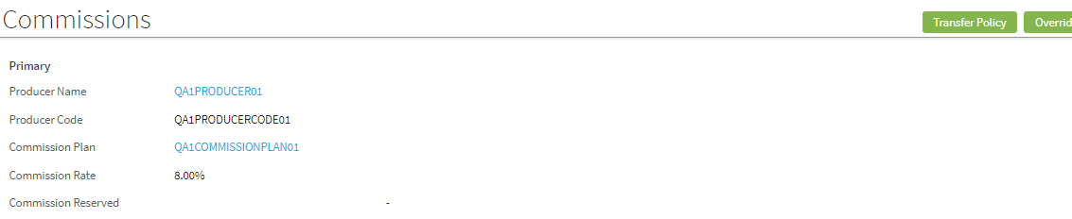
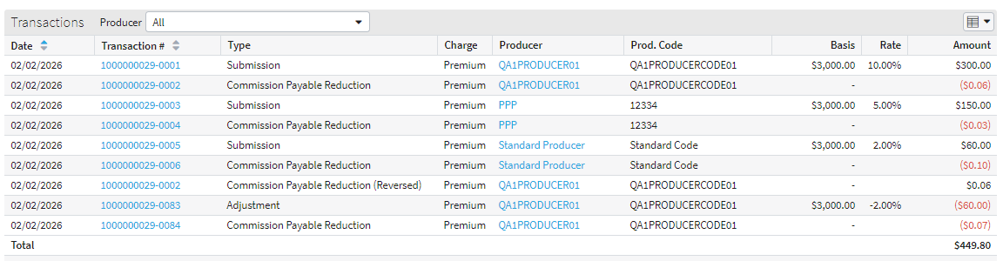
Policy commission override example
Policy tab→Commissions
Adjustment item for rate change
Notes:
In the example, the commission for the primary producer was changed from 10% to 8%. The Adjustment item accounts for the reduction in commission.

Slide 18

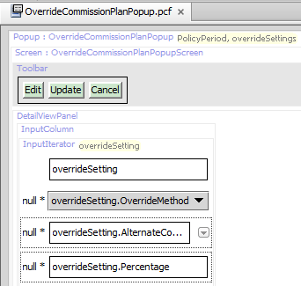

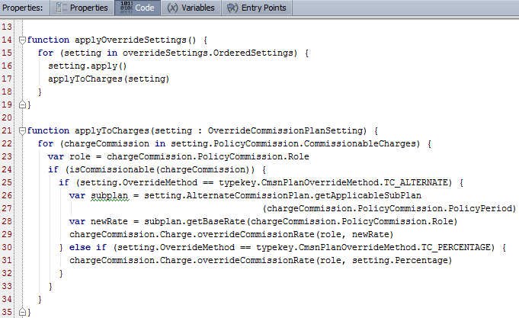
Policy commission override code in base application
Loop through commissionable charges
If overriding the rate If overriding the commission plan
Notes:
The slide shows the Code tab in the OverrideCommissionPlanPopup. This popup is called when you click Override Plan from the Policy tab→Commissions screen. When overriding the commission plan, the getApplicableSubPlan () method returns the correct subplan for the policy period.

Slide 19
Lesson outline
Selecting the applicable subplan
Implementing custom payable criteria
Overriding commission rates
Commission override example: policy transfers

Slide 20
Policy transfers
Transfer means changing the producer code associated with the policy period in a specific role
For a role (primary, secondary, referrer) on a policy, you can transfer to:
Different producer
Same producer, different code
A01
A02
No producer
Add a producer
Notes:
To transfer an agency bill policy to a producer, the target producer must have an agency bill plan. Policy transfer never changes the billing method on a policy.

Slide 21
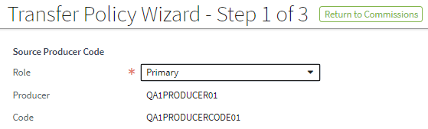
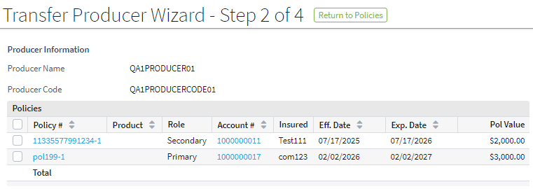
Transferring policies manually
Transfer Policy wizard lets you transfer 1 role on 1 policy to a different producer or producer code
Transfer Producer wizard lets you transfer multiple roles on multiple policies to a different producer or producer code
Policy→Commissions→Transfer Policy
Producer→Policies→Transfer Policy
Notes:
In the second screenshot, producer Everyman, Inc. is both Primary and Secondary producer for policy SPQR58. When the transfer is executed, both roles will be transferred to the destination producer.

Slide 22

Commission options for policy transfer
This option … | Transfers ...
All future commissions | Commissions on all future charges, but does not affect any existing charges on the policy period
Retroactive transfer | All commissions associated with the policy period
Point-in-time transfer | All commissions that are unearned at the time of transfer
Typical reason for transfer is original producer retires or goes out of business Typical reason for transfer is wrong producer
BillingCenter transfers commission at the rate it was earned
Notes:
When transferring a policy to another producer, BillingCenter transfers the commission at the rate it was earned. You can configure BillingCenter to recalculate commission at the new producer’s rate. Finding the commission rates for the source and target producers is discussed later in this section.
The commission options for policy transfer are:
All future charges: Existing charges (and their reserves) remain unaffected. For all new (future) charges on the policy period, the reserve (for the transferred role) will be created for the new producer code.
Point-in-time: Only those commission items that have not been earned or paid are transferred.
Retroactive: For all existing charges, the reserve is moved from the old producer code to the new producer code. And in addition, all future reserves on the policy period go to the new producer code.

Slide 23

Point-in-time transfer
Use case: Producer is retiring and a new producer is responsible for existing policies
In the base application, all billed and planned items are transferred
For each item to transfer, BillingCenter:
Moves remaining commission reserve balance to new producer code
Adjusts commission total for old and new producer codes
(Agency bill only) If role is primary, sets new producer code as payer

Slide 24

Point-in-time transfer example
Item for $1000 created (reserve established)
$600 payment made – primary and secondary earn partial commission
Commission paid to primary and secondary
$250 payment made – primary and secondary earn partial commission
Primary transferred from producer code X to Z
150 | - | - | - | 50 | - | - | -
60 | - | 90 | - | 20 | - | 30 | -
60 | - | - | 90 | 20 | - | - | 30
22.50 | - | 37.50 | 90 | 7.50 | - | 12.50 | 30
22.50 | - | 37.50 | 90 | 7.50 | - | 12.50 | 30
- | - | 37.50 | 90 | 7.50 | - | 12.50 | 30
- | - | - | -
- | - | - | -
- | - | - | -
- | - | - | -
22.50 | - | - | -
22.50 | - | - | -
Primary
Secondary
New Primary
Producer X
Producer Y
Producer Z
Res.
Write off
Payable
Paid
Res.
Write off
Payable
Paid
Res.
Write off
Payable
Paid
1.
2.
3.
4.
5.
Balance
Notes:
In steps 1 through 4 in the slide, producer X is primary and producer Y is secondary on a policy period. The policy period has a single item. Both producers earn commission prorata. Each numbered entry in the table indicates how values have changed for that step. For example, in step 2, the primary commission reserve is reduced by 90, and primary commission payable (earned) is 90. The balance shows the end values after step 5.
In step 5, the policy period's primary producer code is changed using a point-in-time transfer from producer X to producer Z. Producer code X’s reserve is moved to B. The total commission for producer code Z (primary) is 22.50 (all of which is in reserve). Note that it doesn’t matter what the commission rate is for Producer Z. The amount of commission reserve determines the commission rate that Z can earn for this item.
Notice that the commission amounts in every row total to the same amount (200), which is the sum of the initial commission reserves for the primary and secondary producers.

Slide 25

Retroactive transfer
Use case: Policy period issued with wrong producer code
For role being transferred:
Reverses all payable and paid commission
Moves all reserve (if any) to new producer code
(Agency bill only) If role is primary, sets new producer code as payer
Notes:
In a retroactive transfer, for all existing charges, the reserve is moved from the old producer code to the new producer code. In addition, all future reserves on the policy period go to the new producer code.

Slide 26

Retroactive transfer example
Item for $1000 created (reserve established)
$600 payment made – primary and secondary earn partial commission
Commission paid to primary and secondary
$250 payment made – primary and secondary earn partial commission
Primary transferred from producer code X to Z
150 | - | - | - | 50 | - | - | -
60 | - | 90 | - | 20 | - | 30 | -
60 | - | - | 90 | 20 | - | - | 30
22.50 | - | 37.50 | 90 | 7.50 | - | 12.50 | 30
150 | - | (37.50) | (90) | 7.50 | - | 12.50 | 30
- | - | (37.50) | (90) | 7.50 | - | 12.50 | 30
- | - | - | -
- | - | - | -
- | - | - | -
- | - | - | -
150 | - | - | -
150 | - | - | -
Primary
Secondary
New Primary
Producer X
Producer Y
Producer Z
Res.
Write off
Payable
Paid
Res.
Write off
Payable
Paid
Res.
Write off
Payable
Paid
1.
2.
3.
4.
5.
Balance
Notes:
This example uses the same steps as in the point-in-time transfer example except that step 5 involves a retroactive transfer. Notice that all payable and paid commission for the original producer are reversed. Then the entire reserve of $150 is transferred to Producer Z. Note that it doesn’t matter what the commission rate is for Producer Z. Z’s rate is determined by the amount of his commission reserve.
If Producer Z's commission earning criterion is "On Payment Rec'd", then the next time the CmsnPayable batch process runs, his payable commissions will be 90 and 37.50. If instead Producer Z's commission earning criterion is "On Bind", the entire $150 commission becomes immediately payable.

Slide 27
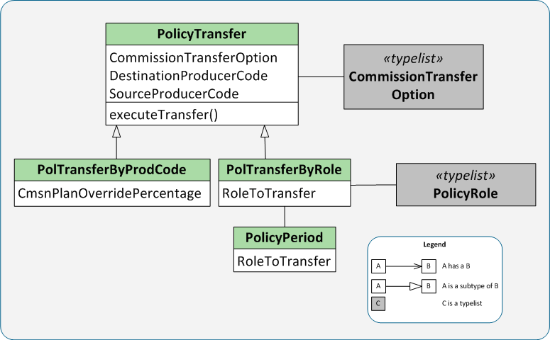


PolicyTransfer entity
CommissionTransferOption codes
PolicyRole codes
Notes:
The ProducerTransfer entity is used whenever a policy is transferred between producers. The entity always knows the source and target producer codes and the type of transfer. The executeTransfer() method, which takes no parameters, performs the transfer. It does nothing if the transfer has already happened.

Slide 28
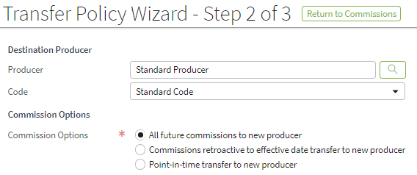
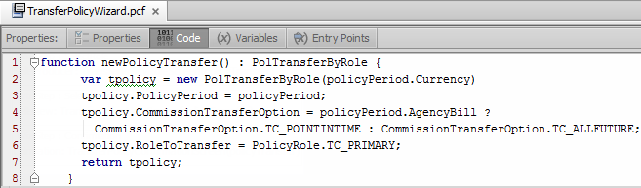

Policy transfer example: TransferPolicyWizard
Policy→Commissions→Transfer Policy
Notes:
The (unconfigured) Policy Transfer Wizard provides an example of using the PolTransferByRole subtype. The newPolicyTransfer () method sets the default role to Primary and the default commission option to "Point-in-Time" for an agency bill policy and "All Future" for a direct bill policy.
The Transfer Producer Policies Wizard (not shown) uses the PolTransferByProdCode subtype. The following example is the newPolicyTransfer () method in this wizard:
function newPolicyTransfer() : PolTransferByProdCode {
var tpolicy = new PolTransferByProdCode( producer.Currency );
tpolicy.CommissionTransferOption = CommissionTransferOption.TC_POINTINTIME;
return tpolicy;
}

Slide 29
Finding rates for source and target producers
To get the commission rate from the correct subplan for the role:
PolicyTransfer.SourceProducerCode.CommissionPlan .getApplicableSubPlan(policyPeriod) .getBaseRate(roleToTransfer)
PolicyTransfer.DestinationProducerCode.CommissionPlan .getApplicableSubPlan(policyPeriod) .getBaseRate(roleToTransfer)
Base rate from applicable commission subplan for the role
Notes:
Recall that when transferring a policy to another producer, BillingCenter transfers the commission at the rate it was earned. You can configure BillingCenter to recalculate commission at the new producer’s rate. The ProducerTransfer entity stores both the source and target producer rates for use in this calculation.
The getBaseRate() method returns the rate that is specified for the role on the General tab of the applicable commission subplan. This rate isn't necessarily the commission rate that will be used for a given policy. The subplan could specify a special rate for a given charge pattern. Also, it is possible to override the commission rate for an individual policy.

Slide 30
Lesson objectives review
By the end of this lesson, you should be able to:
Describe how BillingCenter selects an applicable subplan
Configure a custom earning criterion
Override the commission rate for a charge type
Describe the functionality of the three types of policy transfer

Slide 31
Demo

Slide 33
Lab

Slide 34
Complete the exercises in below chapter in the “BC10_CONF_E_StudentWorkbook“ work book​
​
Lesson 6 = > Configuring Producer Commission
Lesson 7 = > Overriding Policy Commission
Lesson 8 = > Configuring Policy Transfer

Slide 35
Review

Slide 36
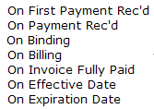
Review questions
Which of these payable criteria describes the unconfigured behavior of the Custom earning criterion?
Does overriding the charge rate propagate to the charge’s items?
What is the difference between point-in-time and retroactive transfers?
When a policy is transferred using retroactive transfer, what determines the commission rate for the new producer? Is this also true of point-in-time transfers?
Notes:
On Binding—in other words, the commission is considered earned immediately.
Yes, it does. And the charge rate is not persisted.
Point-in-time transfer transfers planned and billed items only and no payments are reversed. Retroactive transfers first reverses all payments and then transfers all items to the new producer.
The amount of the commission reserve that is transferred. Yes, the same is true of point-in-time transfer.

Slide 37
Notices
Copyright © 2001-2014 Guidewire Software, Inc. All rights reserved.
Guidewire, Guidewire Software, Guidewire ClaimCenter, Guidewire PolicyCenter, Guidewire BillingCenter, Guidewire Reinsurance Management, Guidewire ContactManager, Guidewire Vendor Data Management, Guidewire Client Data Management, Guidewire Rating Management, Guidewire InsuranceSuite, Guidewire ContactCenter, Guidewire Studio, Guidewire Product Designer, Guidewire Live, Guidewire DataHub, Guidewire InfoCenter, Guidewire Standard Reporting, Guidewire ExampleCenter, Guidewire Account Manager Portal, Guidewire Claim Portal, Guidewire Policyholder Portal, ClaimCenter, BillingCenter, PolicyCenter, InsuranceSuite, Gosu, Deliver Insurance Your Way, and the Guidewire logo are trademarks, service marks, or registered trademarks of Guidewire Software, Inc. in the United States and/or other countries.
All other trademarks are the property of their respective owners.
This material is confidential and proprietary to Guidewire and subject to the confidentiality terms in the applicable license agreement and/or separate nondisclosure agreement.
This file and the contents herein are the property of Guidewire Software, Inc. Use of this course material is restricted to students officially registered in this specific Guidewire-instructed course, or for other use expressly authorized by Guidewire. Replication or distribution of this course material in electronic, paper, or other format is prohibited without express permission from Guidewire.
Guidewire products are protected by one or more United States patents.

