Slide 1

Multicurrency
Editable List View

Slide 2
Lesson objectives
By the end of this lesson, you should be able to:
Describe BillingCenter support for multicurrency
Work with monetary amounts
This lesson uses the notes section for additional explanation and information. To view the notes in PowerPoint, choose View→Normal or View→Notes Page. If you choose to print the notes for the lesson, be sure to select "Print hidden slides."

Slide 3
Lesson outline
Supporting multiple currencies
MonetaryAmount data type

Slide 4
Scope of multicurrency support
Multicurrency support means that you can maintain different currencies within the same BillingCenter instance
Multicurrency feature allows carriers to:
Set up single-currency accounts and single-currency producers in a variety of currencies
Continue using single-currency setup if desired
Integrate with PolicyCenter and its more complex multicurrency functionality using custom configuration

Slide 5



All transactions limited to assigned currency
CHF
CHF
EUR
EUR
USD
USD
Producer for a policy period must have same assigned currency as owning account
Policy transfers require same assigned currency for source and target producer or account
Invoice items must be assigned to payers with same assigned currency
Payment in one currency can be applied only to items of same currency

Slide 6
Each currency is in its own silo
CHF
EUR
USD
Account
Account
Account
Producer
Producer
Producer
Policy
Policy
Policy
No transactions between silos
No transactions between silos
Notes:
Guidewire enforces restrictions to ensure that monetary values of different currencies in T-accounts are never mixed. These restrictions effectively create silos within BillingCenter, and nearly all financial activity is confined to these silos. There is no provision for any transaction that spans more than one currency.
You will notice in the Data Dictionary that all financial entities implement the entity delegate InCurrencySilo. For example:
BaseDist (bc_basedist) (delegates to InCurrencySilo, Retireable, Validatable)

Slide 7
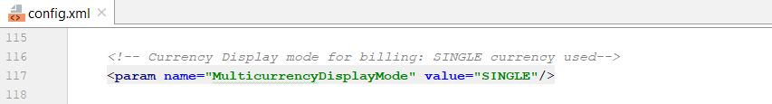
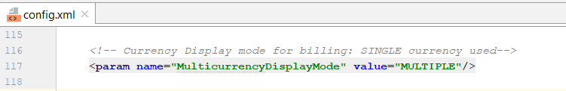
Configure Multi Currency
In the base configuration, multicurrency is disabled.
The MulticurrencyDisplayMode parameter can be set to one of the following values in config.xml:
SINGLE
MULTIPLE
Notes:
The multicurrency feature is enabled using the config.xml parameter MulticurrencyDisplayMode. The
parameter's name references only multicurrency display, but the parameter enables all multicurrency behaviors.
IMPORTANT The MulticurrencyDisplayMode configuration parameter setting is semi-permanent.
You can change the value of this parameter only once, from SINGLE to MULTIPLE. If you have changed
the value and started the application, you must not later change it back. If you do change the value of
MulticurrencyDisplayMode back to SINGLE, subsequent attempts to start the server fail.
IMPORTANT When you integrate the core applications in Guidewire InsuranceSuite, you must set the
value of MulticurrencyDisplayMode to be the same in each application.

Slide 8
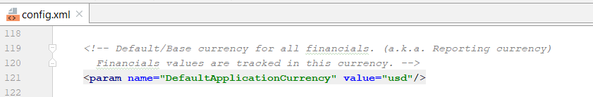
Default Base Currency
Each BillingCenter instance has a default base currency, as set in config.xml
Default base currency is used to populate the Currency property for new accounts and producers unless a currency is explicitly specified

Slide 9
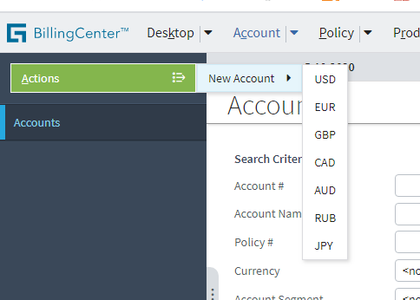
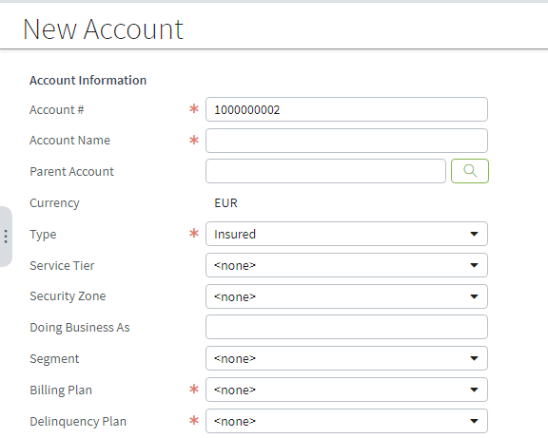
Each account has one assigned currency
Currency cannot be modified after account is created
Associated plans need not to be same assigned currency
Notes:
All transactions involving the account and its policies are limited to the assigned currency.
A parent account can have an assigned currency that is different from its child accounts.
Associated plans need not to be same assigned currency because some Plans are support multi currency out of Silo . Explained in next slide

Slide 10
Multiple currencies per Plan
There are five plans in BillingCenter that store MonetaryAmount values:
Agency bill plan
Billing plan
Commission plan
Delinquency plan
Payment plan
Unlike Account and policies, this plans have been moved out of the currency silos.
If an insurer has enabled multicurrency, a given instance of these plans can support multiple currencies and can be assigned to multiple accounts, policies, or producers across multiple currency silos. These plans are collectively referred to as the multicurrency plans.

Slide 11
Multiple currencies per Plan.. cont
As of the current release, the MonetaryAmount values for all plans are stored as arrays.
This is true whether a giveninstance of BillingCenter is in single-currency mode or multicurrency configured in config.xml
When Single Currency mode configured, this let default Currency populated when Financial Plans are created.
When Single Currency mode configured, this let to choose the Currency populated when Plans are created.
Notes:
In previous releases, the MonetaryAmount values on these plans were stored as individual fields. As of this release,
the MonetaryAmount values are stored as arrays. This gives a plan the ability to have multiple values in different
currencies for a given monetary amount. For example, the billing plan's Low Balance Threshold was previously a single
field. Now, it is an array that can have a value in US Dollars, a value in Canadian Dollars, a value in Euros, and so
on.

Slide 12
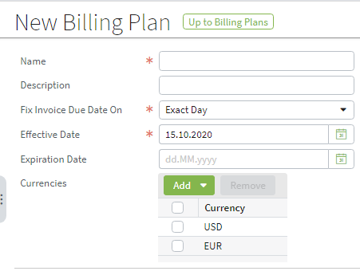
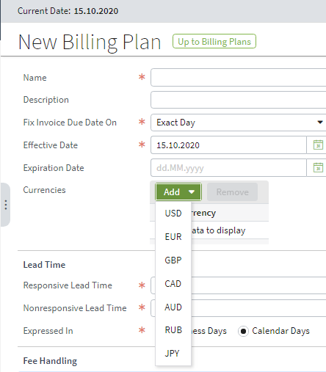
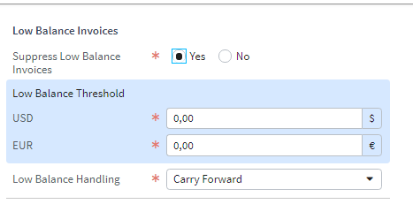
Billing Plan Multiple Currency Mode

Slide 13
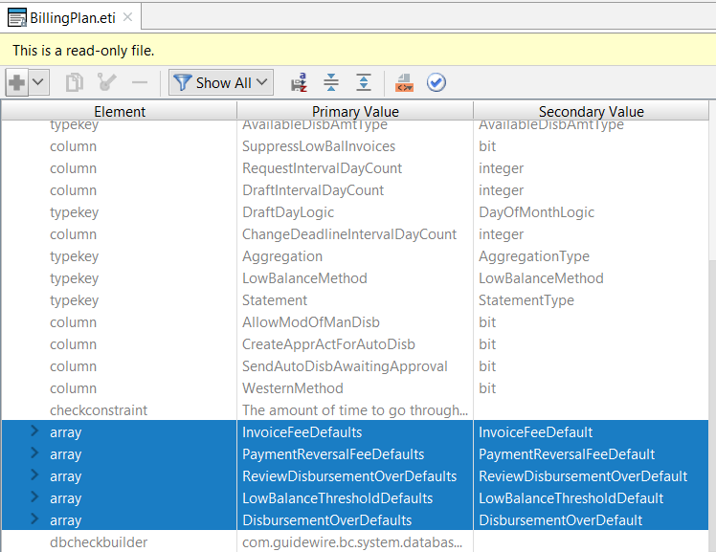
Billing Plan Multiple Currency Mode
MonetaryAmount values in plans are stored as arrays.
Notes:
Multicurrency plan consistency checks
There are new consistency checks dedicated to multicurrency plans. These checks ensure that:
• Every multicurrency plan has at least one currency.
• For a given MonetaryAmount value, there is one FeeThresholdDefault for each currency the plan supports.
• For a given MonetaryAmount value, there is no FeeThresholdDefault for any currency the plan does not
support.

Slide 14
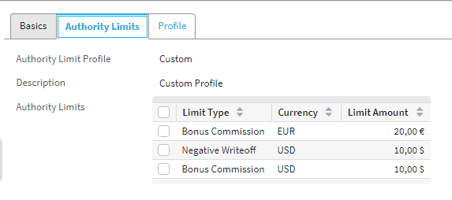
Authority limit profiles
A single authority limit profile can support multiple currencies
Each user can be assigned only one authority limit profile
User can have same authority limit for different currency
Notes:
Any transaction subject to an authority limit must consider the currency of the limits in the user's authority limit profile and the currency of the transaction to determine whether it will be allowed.

Slide 15
Lesson outline
Supporting multiple currencies
MonetaryAmount data type

Slide 16
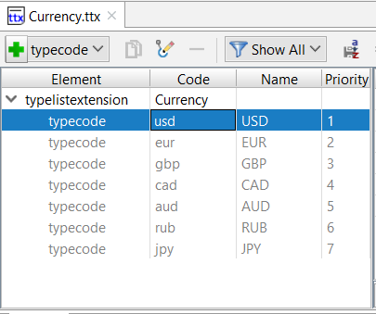
MonetaryAmount data type replaces money
MonetaryAmount corresponds to two database columns
Ensures that currency is always tracked with amount
In calculations involving MonetaryAmount values, values must be of same currency
MonetaryAmount
Amount
Currency
Notes:
From 8.0, the MonetaryAmount data type replaces the money data type. MonetaryAmount is different from other data model fields in that it corresponds to two columns in the database: one representing the amount and another representing the currency. A new class, gw.pl.currency.MonetaryAmount defines it. The money data type is being deprecated.
You can perform computations using monetary amounts provided they are of the same currency. Calculations prior to persisting the result are done using high-precision arithmetic, and then the final amount is rounded and saved as a MonetaryAmount.
Setup and configuration
Setting up multicurrency involves setting up a currency typelist and adding currency information to several platform XML files.

Slide 17
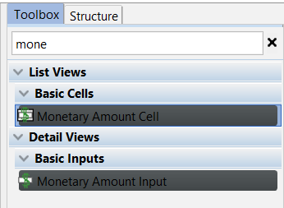
Monetary Amount widgets
Two new widgets display both currency and monetary value of a field
Use to display MonetaryAmount values
Use to accept MonetaryAmount values

Slide 18
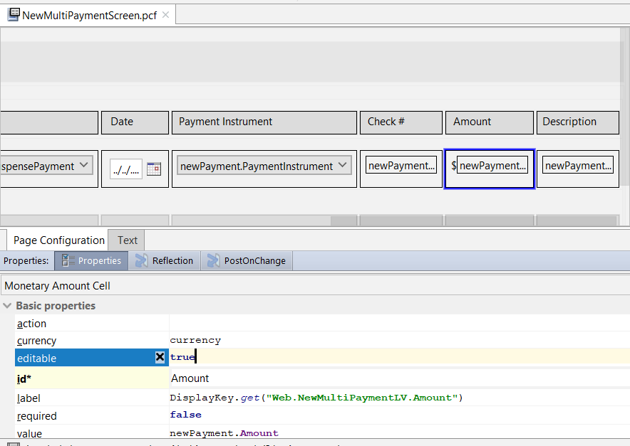

Using Monetary Amount widget Multiple Payment Entry wizard
Notes:
For simplicity, the Multiple Payment Entry wizard is based on a single currency at a time. On calling the wizard, you are prompted to select a currency. The MonetaryAmountInput widget is used for the Amount field. Any attempt to enter a payment for an account or producer with a different assigned currency results in an error.
The screenshot shows another currency-related widget (Multicurrency Amount Input), which is not used by BillingCenter. A similarly named widget (Multicurrency Amount Cell) is also not used by BillingCenter.

Slide 19


Working with monetary amounts
Even in a single currency system, a MonetaryAmount values have two parts: currency and amount
Every MonetaryAmount field has these boolean properties:
IsNegative
IsNotZero
IsPositive
IsZero
For Big Decimal literals, you can either of these methods:
Replace invoice with relevant reference

Slide 20
Lesson objectives review
You should now be able to:
Describe BillingCenter support for multicurrency
Work with monetary amounts

Slide 21
Demo
6

Slide 22
Provide demo details and link to the demo video
7

Slide 23
Lab
6

Slide 24
Provide the lab and solutions here
7

Slide 25
Review
6

Slide 26
You should now be able to:
Describe BillingCenter support for multicurrency
Work with monetary amounts

Slide 27
Notices
Copyright © 2001-2014 Guidewire Software, Inc. All rights reserved.
Guidewire, Guidewire Software, Guidewire ClaimCenter, Guidewire PolicyCenter, Guidewire BillingCenter, Guidewire Reinsurance Management, Guidewire ContactManager, Guidewire Vendor Data Management, Guidewire Client Data Management, Guidewire Rating Management, Guidewire InsuranceSuite, Guidewire ContactCenter, Guidewire Studio, Guidewire Product Designer, Guidewire Live, Guidewire DataHub, Guidewire InfoCenter, Guidewire Standard Reporting, Guidewire ExampleCenter, Guidewire Account Manager Portal, Guidewire Claim Portal, Guidewire Policyholder Portal, ClaimCenter, BillingCenter, PolicyCenter, InsuranceSuite, Gosu, Deliver Insurance Your Way, and the Guidewire logo are trademarks, service marks, or registered trademarks of Guidewire Software, Inc. in the United States and/or other countries.
All other trademarks are the property of their respective owners.
This material is confidential and proprietary to Guidewire and subject to the confidentiality terms in the applicable license agreement and/or separate nondisclosure agreement.
This file and the contents herein are the property of Guidewire Software, Inc. Use of this course material is restricted to students officially registered in this specific Guidewire-instructed course, or for other use expressly authorized by Guidewire. Replication or distribution of this course material in electronic, paper, or other format is prohibited without express permission from Guidewire.
Guidewire products are protected by one or more United States patents.

