Slide 1

Reinstatement from pre-cancellation Invoicing Terms

Slide 2
Lesson Outline
You should be able to:
Understand the use of Cancellation snapshots
Purpose of Match Cancellation Snapshot Charge Slicer
6

Slide 3
Pre Version 10 - Cancellation
Policy Issued
1st Invoice Billed
Charge Group is group of related charges.
When policy is issued, each charge is divided into three instalments in this example.
After first invoice is paid, say if manual adjustment are made to allow the customer to pay little lesser amount on second instalment and more amount on third as shown in example
A
$100
$100
Issuance
Charge A
$300
B
$100
$100
C
$100
$100
2nd Invoice
Manual Adjustment made
A
$100
$80
Issuance
Charge B
$300
B
$100
$80
C
$100
$80
3rd Invoice
A
$100
$120
Issuance
Charge C
$300
B
$100
$120
C
$100
$120

Slide 4
Pre Version 10 – Cancellation contin
Policy Issued
1st Invoice Billed
Policy Cancelled
Now policy is cancelled.
2nd and 3rd Invoice will be collapsed to the next invoice
A
$100
$100
$100
Issuance
Charge A
$300
B
$100
$100
$100
C
$100
$100
$100
Manual Adjustment made
2nd Invoice
2nd Invoice
$80
A
$100
$80
$80
Issuance
Charge B
$300
B
$100
$80
$80
C
$100
$80
$120
3rd Invoice
3rd Invoice
$120
A
$100
$120
$120
Issuance
Charge C
$300
B
$100
$120
C
$100
$120

Slide 5
Pre Version 10 – Cancellation
Subsequently, the policy is reinstated, billingcenter uses the payment plan to determine how the reinstatement charges are sliced and the resulting invoice items are assinged to invoices. The billed invoice remains unchanged.
The reinstatement charges are for $200 each because each charge was reduced by the $100 amount on the billed invoice.
Notice the adjustments to invoice have been lost. This is because BC no longer has the pre-cancellation invoices
BillingCenter uses the payment plan charge slicer to slice reinstatement charges and the same places the invoices according to the payment plan

Slide 6
Pre Version 10 –Reinstatement
Policy Issued
1st Invoice
Billed
Policy Cancelled
Policy Reinstated
Reinstatement didn’t retain the changes made manually
A
$100
$100
$100
Issuance
Charge A
$300
Reinstatement
Charge A
$200
B
$100
$100
$100
$100
C
$100
$100
$100
$100
Manual Adjustment made
$100
2nd Invoice
$80
Reinstatement
Charge B
$200
A
$100
$80
$80
Issuance
Charge B
$300
B
$100
$80
$80
$100
C
$100
$80
$120
$100
3rd Invoice
$120
Reinstatement
Charge C
$200
$100
A
$100
$120
$120
Issuance
Charge C
$300
B
$100
$120
C
$100
$120

Slide 7
Version 10 – Reinstatement Handling
Policy Issued
1st Invoice
Billed
Same scenario in Version 10. Issue a policy with three different charge group . Each charge is of amount, $300. The same is sliced into three installments as per the payment plan - $100 Each installment.
The first invoice is billed
User has modified to pay less in second and more in Third. so, second installments is made as $80 and third as $120.
A
$100
$100
Issuance
Charge A
$300
B
$100
$100
C
$100
$100
Manual Adjustment made
A
$100
$80
Issuance
Charge B
$300
B
$100
$80
C
$100
$80
A
$100
$120
Issuance
Charge C
$300
B
$100
$120
C
$100
$120

Slide 8
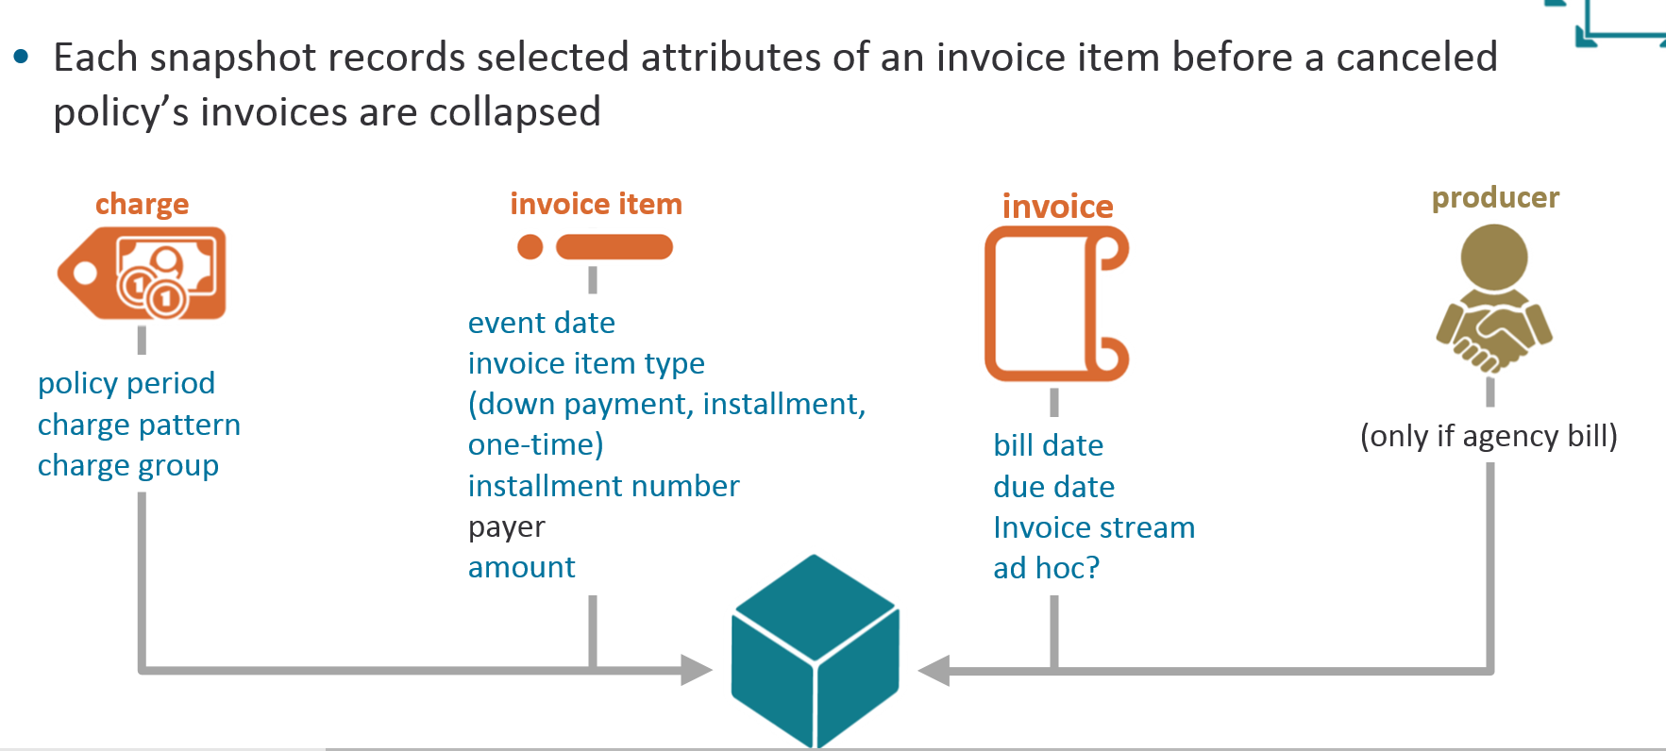
Version 10 – Reinstatement Handling
PAS sends a cancellation request to BC.
In version 10, BillingCenter takes snapshot of the invoice items on a planned invoices before collapsing into single invoice.
The purpose is to enable BillingCenter to restore the invoice items as it is prior to cancellation.
Snapshots are required as all the invoice items are collapsed during cancellation

Slide 9
Version 10 –Reinstatement
Policy Issued
1st Invoice
Billed
Policy Cancelled
Policy Reinstated
Reinstatement retain the changes made manually
A
$100
$100
$100
Issuance
Charge A
$300
Reinstatement
Charge A
$200
B
$100
$100
$100
$80
C
$100
$100
$100
$80
Manual Adjustment made
$80
2nd Invoice
$80
Reinstatement
Charge B
$200
A
$100
$80
$80
Issuance
Charge B
$300
B
$100
$80
$80
$120
C
$100
$80
$120
$120
3rd Invoice
$120
Reinstatement
Charge C
$200
$120
A
$100
$120
$120
Issuance
Charge C
$300
B
$100
$120
C
$100
$120

Slide 10
Version 10 – Reinstatement Handling
 | Charge Pattern | Charge Group | Reinstatement Charge Amount | Resulting Reinstatement Invoice items
Charge 1 | Premium |  | $300 | The Charge Amount Equals the sum of the snapshots. Two invoice items are created for $100 and $200
Charge 2 | Premium | Region A | $30 | The Charge Amount is less than Sum of the snapshot amounts ( the snapshots are $100 + $200 , or $300, but the charge is only $30). The Charge Amount is distributed proportionally. Two invoice items are created for $10 and $20
Charge 3 | Premium | Region B | $250 | The Charge amount is greater than the sum of snapshots. One invoice items is created for the original Amount ($200). one additional invoice item is created for $50. The invoice items type is reinstatement Adjustment.

Slide 11
Version 10 – Configuring Reinstatement 10
To disable cancellation invoice items behavior
Set CreateInvoiceItemCancellationSnapshots to false in config.xml
"Charge Slicer Selector" Plugin can be configured.
"Match Cancellation Snapsots Charge Slicer" can be configured.
Cannot configure "Payment Plan Charge Slicer"

