Slide 1

BillingCenter 10 Configuration
Flat Amount Commission Override

Slide 2
Lesson objectives
You should be able to:
Describe functionality and scope of the flat amount commission override feature
This lesson uses the notes section for additional explanation and information. To view the notes in PowerPoint, choose View→Normal or View→Notes Page. If you choose to print the notes for the lesson, be sure to select "Print hidden slides."

Slide 3
Flat amount commission overview
Overriding commission in the UI
APIs that support overriding commission by a flat amount
New getter methods on Charge and ChargeCommission
Other changes related to commission

Slide 4
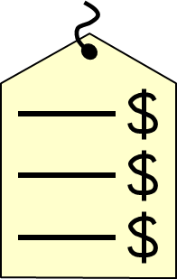

Flat amount commission overview
BillingCenter 10.0 provides the ability to specify the exact amount of commission for a charge instead of specifying a commission rate that is used for calculating the commission amount
Flat amount commission overrides are created at the charge level only
Override is used for all commission earned on a given charge for a given role
BillingCenter supports three ways to specify the flat amount commission override
Through the BillingCenter UI In a Billing Instruction In Gosu

Slide 5
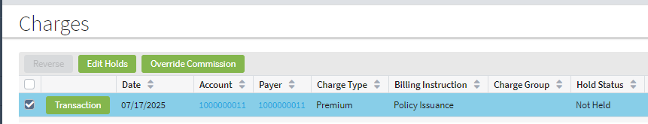
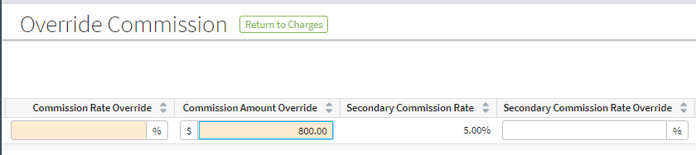
Overriding commission in the UI
For a charge, a flat amount can be specified as a commission override
Go to the charges screen and select the charge → Click override commission → To override the commission for the primary producer, either a percentage in the Commission Rate Override field or a flat amount in the Commission Amount Override field →Click OK to save the changes
When a rate is overridden with a flat amount, BillingCenter makes positive or negative adjustments across invoices depending on the producer’s earning criterion
Charges screen on the account or policy tab
Commission Override Amount fields are available for primary, secondary and referrer producers

Slide 6
APIs that support overriding commission by a flat amount
New methods in 9.0.2 allow to override the commission on the charge for a particular producer role by a flat amount
To override the commission by a flat amount on a new (uninitialized) charge
ChargeInitializer.overrideCommissionAmount(PolicyRole, MonetaryAmount)
To override the commission by a flat amount on an existing charge
Charge.overrideCommissionAmount(PolicyRole, MonetaryAmount)
As with all commission overrides, the later override replaces any existing overrides that impact the charge’s commission
Any commission remainders are reversed and new remainders are created if needed

Slide 7
New getter methods on Charge and ChargeCommission
This method | On this entity | Returns
getTypeOfOverrideIfAny(PolicyRole) | Charge | A typecode from ChargeCommissionOverrideType – that is, Rate or Amount or Null if no override exists
getChargeLevelCommissionAmountOverride(PolicyRole) | Charge | MonetaryAmount – the flat amount override, if it exists; NULL if rate override or no override exists
getCommissionAmunt() | ChargeCommission | MonetaryAmount – the flat amount override, if it exists; otherwise amount calculated using the rate

Slide 8
Other changes related to commission
The plugin method ICommission.getCommissionRate() has been deprecated
Use ChargeInitializer.overrideCommissionRate() or ChargeInitializer.overrideCommissionAmount()
to override a charge’s commission on charge creation
An exception is thrown on InvoiceItem.overrideCommissionRate()
If there is a flat amount override on the invoice item’s parent charge, or
If the commission rate is negative
The CommissionRateOverride entity has a new amount field of type MonetaryAmount
This field maps to an amount column and a currency column in the database table

Slide 9
Lesson objectives review
You should now be able to:
Functionality and scope of the flat amount commission override feature

