Slide 1

Billing Process Overview

Slide 2
Lesson Outline
Billing process basics
BillingCenter demonstration
6

Slide 3
Main players in policy billing
A carrier is the insurance company that provides the policy
Carrier
An account is an entity that either
owns the policy and typically is the insured and payer of the policy
or is a business partner of the carrier
Account
A producer is an intermediary who brings business to the carrier
Producer
Notes:
The carrier is the insurance company that provides the policy.
The account is the entity who owns the policy (and is typically the insured and the payer of the policy). The account could also be a business partner, such as a collection agency or an attorney. One other possibility is that the account is an employer or a financial institution that pays for the policies of its employees or mortgage holders. These accounts are called "list bill accounts".
The producer is an intermediary who:
Helps accounts find carriers that will underwrite policies for them.
Helps carriers find accounts for whom they want to underwrite policies.

Slide 4
The Billing Process
Policy
Payment
Carrier
Account
The billing process is the process in which the carrier manages the financial transactions required to keep policies in force
Notes:
The fundamental role of BillingCenter is the intake of billing instructions from a policy administration system and the generation of two types of outputs: invoices to accounts (or statements to producers) and commissions to producers.
The billing process does not typically concern claims. A claim is an event in which a potentially covered loss occurs (such as an auto accident involving a person and car covered on an auto policy). Claims often result in payments being made (such as medical payments to someone injured in the accident or payments to an auto repair shop for damage done to the car), but these payments are not required to keep the policy in force, and therefore they do not fall under the realm of Billing Process Overview.

Slide 5
Billing lifecycle for a policy
Policy
Receive billing instructions
Close the policy
Create items from a charge
Handle exceptions
Handle delinquency & collections
Pay commissions
Schedule items on invoices
Process payments
Notes:
BillingCenter automates the entire policy billing lifecycle from initial receipt of a billing instruction through collections and renewals and policy closure. In addition to invoicing and payment processing, other processes are built into the BillingCenter lifecycle that handle scheduling, commission processing, exception handling, and delinquency processing. The slides that follow summarize policy billing lifecycle processes.
Note: Usually the billing lifecycle for a policy ends with policy closure. However, occasionally after a policy is closed, the policy is reinstated. This can happen when the first payment for a policy was received late, after the policy was closed.
Also, BillingCenter can receive a billing instruction for a revised final audit after a policy is closed. A revised final audit can happen because of a statistical reporting error. Or possibly the government has done a test audit and found an error that requires a revised final audit.

Slide 6

Billing instruction components
PAS
Which policy period is involved?
What account owns the policy?
What account should be billed for each charge?
What are the charges?
Which producers are responsible for the policy?
What is the policy payment plan?
. . .
What invoice stream to place invoices on?
Notes:
The policy billing lifecycle begins with the receipt of a billing instruction from the policy administration system. There are several types of billing instruction (for example, issuance, policy change, and cancellation). A billing instruction always contains at least one charge.
A policy issuance (also known as a policy submission) and a policy renewal create a new policy with a new policy period or extend an existing policy for a new policy period. In this case, the billing instruction must specify:
Which policy period the billing instruction is for
Who owns the policy (an account)
Who gets billed for each charge (an account, which is usually the owner but could be a different account)
Who gets the commission (the producer or producers)
What to charge (the charges)
How to break the charges down into invoice items (the payment plan)
What invoice stream to place the invoices on (the invoice stream determines the scheduling of the invoices)
The payment plan and charge types must already be known to BillingCenter. The billing instruction simply references which known payment plan to use and the known charge types of each of the charges. Typically, the producer and account are also known to BillingCenter. The handling of an unknown producer or account depends on the integration between the PAS and BillingCenter.

Slide 7
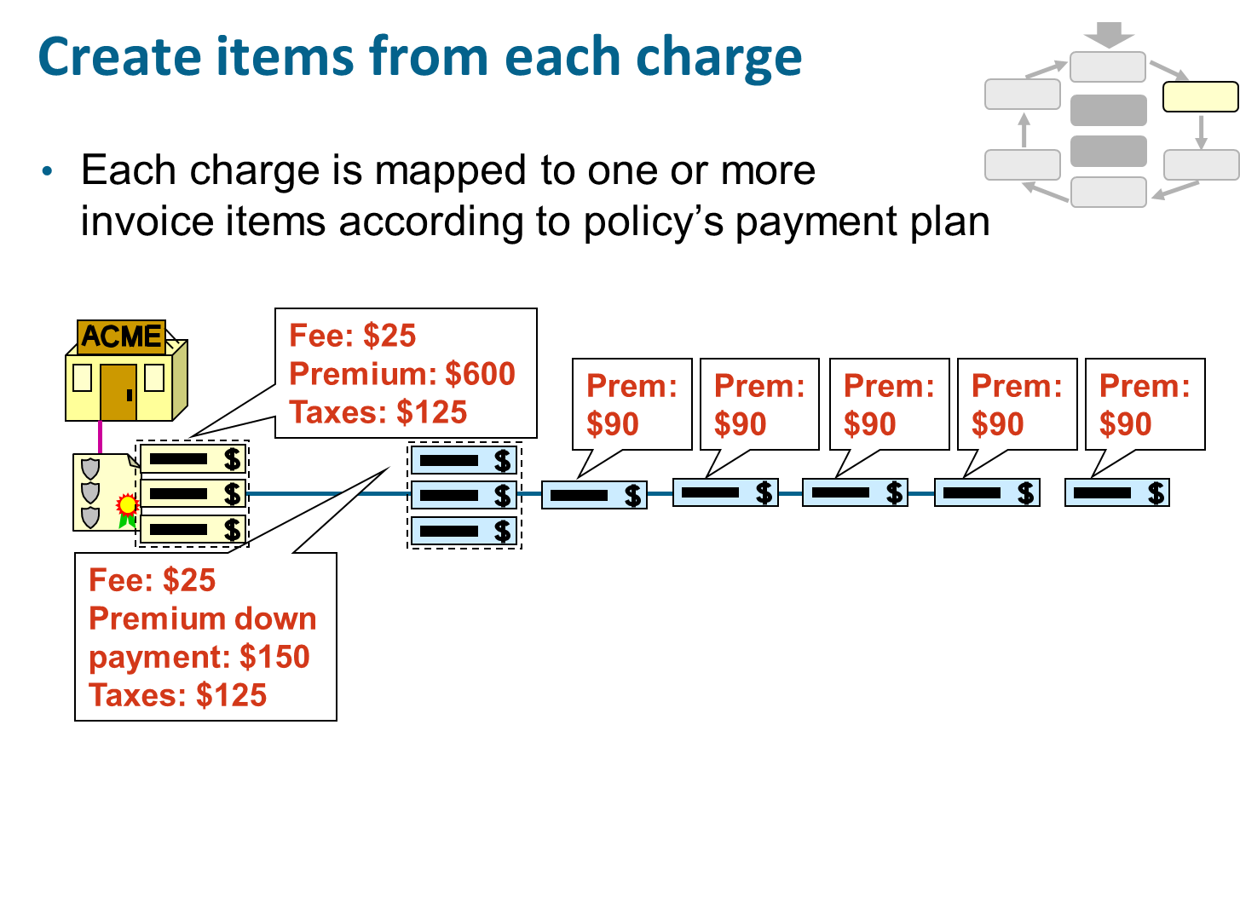
Notes:
When a billing instruction is received by BillingCenter, BillingCenter breaks each charge down into one or more invoice items. In the base application, an immediate charge (such as a fee) or a pass-through charge (such as a tax, which must be "passed through" to another agency, such as the government) is typically broken down into a single invoice item. A premium charge is often broken down into a single down payment invoice item and one or more installment invoice items. BillingCenter also generates the required invoices and assigns each invoice item to one of the invoices. The policy's payment plan identifies how the charges are to be distributed across invoices.
In the example above, the account has a policy that is to be billed a total of $750 consisting of 3 charges: a $600 premium charge, a $125 tax charge, and a $25 processing fee charge. The $600 premium is split into one down payment of $150 and five $90 invoice items. The tax and fee charges are each mapped to a single invoice item.

Slide 8
Schedule items on invoices
Each invoice item is assigned to an invoice
Invoices are scheduled according to account's billing info and billing plan
Fee: $25 Premium: $600 Taxes: $125
Prem: $90
Prem: $90
Prem: $90
Prem: $90
Prem: $90
Installments
Fee: $25 Premium down payment: $150 Taxes: $125
Bill on: Due on:
2 Feb 20 Feb
2 Mar 20 Mar
2 Apr 20 Apr
2 May 20 May
2 Jun 20 Jun
2 Jul 20 Jul
Notes:
BillingCenter generates the required invoices and assigns each invoice item to one of the invoices. The status of each invoice is automatically updated as the bill and due dates are reached.

Slide 9
Process payments
Payment process manages payments coming from accounts
Automatic or "responsive" (account is billed)
$450 payment
Billed
$450
Notes:
Before the invoice is due, the insured should send the payment. The payment is applied to the invoice and the charges are marked off as paid. There could be several different forms of payment collection, such as check, credit card payments over the phone, or direct debit from a bank account.
For automatic payments, the carrier has a token, which is a string that identifies a financial asset held by the account (such as a bank account). When the invoice process is run, the carrier initiates the process to collect the money from a third party payment system. The token is passed to the third party payment system to identify the financial asset that is associated with the account (bank account or credit card). It is possible that a physical invoice will also be generated in this situation (there are legal requirements to send notification if the amount to be collected has changed from the previously agreed to amount). This process to collect the money requires an integration so that the bank or credit card company is ‘told’ to send the money for the payment, and then it is sent and deposited into the carrier’s bank account. Additionally, the carrier may do the accounting for the payment at various times – sometimes, it is assumed to be received on the due date or it may not be created until the actual money is received.
For responsive payments, the carrier invoices the account and then waits to receive payment. When payment is received, it is processed and credited as appropriate.
Payments made to the policy or invoice are ultimately applied to billed but unpaid charges for that policy or invoice. Payments are always allocated to individual charges.
Where a payment is received and the target of that payment is not immediately obvious (or no billing instruction has yet reached BillingCenter), the payment is posted as a suspense payment for later allocation. Suspense payments are listed on the Suspense Payments screen on the Desktop.
BillingCenter provides both single payment entry and bulk payment entry. The latter helps a receivables clerk enter a collection of payments quickly and easily.

Slide 10
Pay commission
$25
$300
Producer
$150
$450 payment
Billed
$450
Notes:
Commissions may be payable to one or more producers involved in selling the policy. Commissions can be calculated for each policy transaction based on the charges. For example, a commission could be paid only on premiums and not on other charges such as tax. Commissions are paid at various times depending on the carrier. Commission can be paid at the time the client has paid the premium. Some carriers pay the commission up front when the policy is bound or issued or when the carrier bills the insured. The timing of the release of commission is defined by the terms of the producer's contract. A statement is produced detailing all commission earned that is included in the payment.
When the producer collects the account's premiums on behalf of the carrier, the producer deducts the commission from the payments and submits the net payment (total payment minus commission) to the carrier. These agents do not receive commission statements and separate commission payments.
Typically, commission becomes earned ("payable") as soon as the earning criterion of the producer's contract is met. However, for certain earning criteria (such as "On Effective Date" of policy), the commission is not made payable until the commission payable batch process is run.
Note: The example in the slide is for a direct bill producer receiving commission for two policies owned by the same account.

Slide 11
Close the policy
A policy is automatically closed when:
Policy expiration date is in the past, and
Remaining balance is zero, and
All premium has been earned
Most BillingCenter processes ignore closed policies
So load on system is minimal
Closed
Notes:
When a policy is closed, its T-accounts can be rolled up. The policy is flagged as closed so that it does not become an unnecessary load on the system.
Earned premium is the portion of the premium that the carrier considers "earned" by the insurer, based on the part of the policy period that the insurance has been in effect.

Slide 12
Handle delinquency & collections
Delinquency is a process in which BillingCenter identifies an account with overdue payments
Delinquency process can trigger assignment of past due invoices to collection agency
due: $350
Delinquency Process
Send overdue notice 1
Send overdue notice 2
Cancel policy
Assign to collections
Notes:
Delinquency occurs when the invoice items become overdue either because the payment has not been received or the received payment was dishonored. The delinquency process typically involves sending one or more reminder notices (known as “dunning letters"). The delinquency process cannot make a decision to cancel the policy. Instead, BillingCenter sends notification to the PAS (or a person) to initiate the cancellation in the PAS. The PAS then sends the cancellation amount to BillingCenter in a billing instruction. At that point, the insured is either billed what is owed or sent the amount to be refunded. The delinquency process may also include a step to write off trivial amounts if that is what the carrier wants to define. For smaller amounts, the carrier may chose to cancel the policy without attempting to recover the unpaid amount.
A collection agency is a third-party organization that a carrier uses to collect unpaid funds. If an account becomes delinquent, an event in the delinquency process can trigger the assignment of a collection agency as the payer of past due invoices. In BillingCenter, a collection agency is an account type.

Slide 13
Handle exceptions
This policy is credited to the wrong producer!
$25
$350
The bank account is closed!
$100
$450
You billed me the wrong amount!
billed
$450
Notes:
Throughout the billing process cycle, issues can occur. For example, the premium amount for a transaction may be disputed or the way the charges have been spread between a deposit and installments may be incorrect. There may be invalid bank account or credit card details that must be investigated. Ideally, all accounts are processed automatically and BillingCenter users work only on the issues that require user action.

Slide 14
Handle exceptions trouble tickets, activities, holds
Trouble ticket
Cathy Cartwright
HOLD
A trouble ticket is a process that identifies and tracks an insured’s complaint
An activity allows multiple users to track and escalate an issue
A hold stops automated processing
Activity
HOLD
Activity
HOLD
Activity
Notes:
A user can create a trouble ticket at any time. Rules can be defined that create trouble tickets automatically when an exception event occurs.
Each trouble ticket has an owner that is responsible for ensuring the trouble ticket is closed. However, activities needed to resolve the issue can be created and allocated to other users. Rules can be defined to automatically allocate trouble tickets to appropriate users within teams. Activities can also be automatically allocated in this way.
Trouble tickets and activities have due dates and can be escalated if not complete within the expected time. They can also be used to hold processing on the account and/or the commission for the producer. A hold is the method BillingCenter provides for stopping an automated process while an account or policy is in dispute. Depending on the type of hold, the hold can affect an account, a producer, and/or a policy.

Slide 15
DEMO

Slide 16
Provide demo details<The video creator to fill this slide>

Slide 17
LAB

Slide 18
Complete the exercises in below chapter in the “BC10_Intro_E_StudentWorkBook “ work book
Lesson 2 Handling Policy Transactions After Issuance
Lesson 4 Billing at Account Level

Slide 19
Review questions
How are policy transactions entered into BillingCenter?
What type of charge is typically split into multiple invoice items?
What determines how invoices are scheduled?
What happens if a payment is overdue?
How do you temporarily suspend billing on an account?
What is the benefit of policy closure in BillingCenter?
Notes:
Answers
Policy transactions are entered into an external PAS, where billing instructions are created. The PAS sends them to BillingCenter via the billing instruction API.
Premium.
Policy’s payment plan
The account becomes delinquent. The delinquency process can assign the past due invoices to a collection agency.
Put a hold on the account.
The policy presents less of a load on the system because most BillingCenter processes ignore closed policies.

