Slide 1

Account Producers

Slide 2
Lesson Objective
By the end of this lesson, you should be able to:
Describe the primary objects of the account data model
Create an account
Describe the primary objects of the producer data model
Create a producer
Use run commands to create sample accounts and producers
6

Slide 3
Lesson Outline
Account basics
Creating an account
Producer basics
Creating a producer
Creating sample data
6

Slide 4
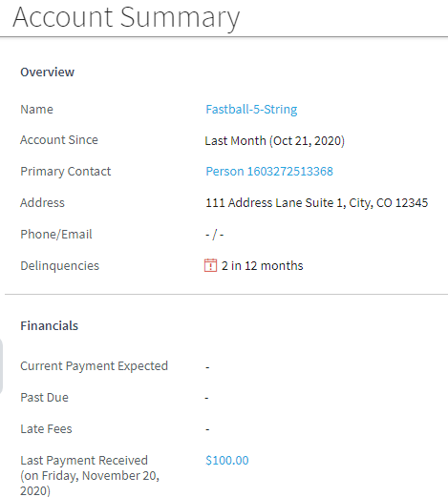
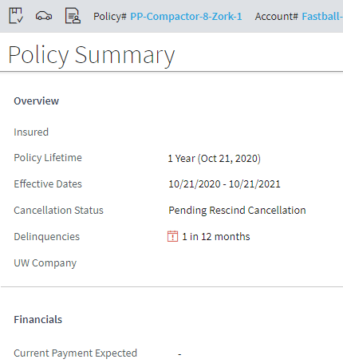
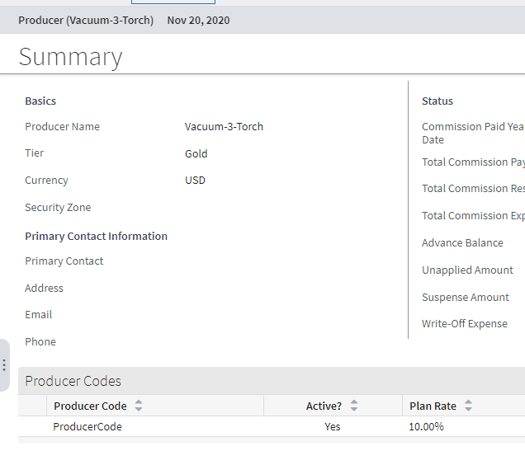
Primary entities in BillingCenter
Policy
Account
Producer

Slide 5
Accounts
Carrier
Policy
Account
An account is a person or organization that is the owner and/or payer of one or more policies
An owner is the legally responsible party for all policies on the account
A payer receives invoices for charges
6

Slide 6
Account contacts
An account contact is a person or organization who has a relationship to the account, such as:
Owner of policies
Primary payer
Primary insured
Contact type is either company or person
Account
Contact
Notes:
As noted before, contact information would be sent along with the policy information as part of the billing instructions for a new policy submission.
There are three types of contacts in BillingCenter: account contacts, policy period contacts, and producer contacts, each of which can be a person or a company. Each type of contact has a its own set of characteristics and behaviors. For example, an account contact can be a primary payer, a policy period contact is associated directly with a policy period, and a producer contact can be the primary contact for a producer.
The primary account payer contact is used as an object legally liable for paying the account invoices so this information most likely to come from PAS (or is at least kept synchronized with the PAS). Contact name, address, and other information can be shared among accounts, policy periods, and producers.

Slide 7
Policies
A policy is a written contract for insurance between a carrier and a policyholder (account)
When PAS informs BillingCenter of a new policy, the owner and payer accounts are also identified
Contacts can also be associated with policies
Account
Contact
Policy
Notes:
A policy is a written contract for insurance between an insurance company and policyholder stating details of coverage. The policy defines what items or risks are being covered, what set of coverages has been purchased, and the time period of coverage. For example, a personal auto policy lists a set of vehicles and covered drivers. It also lists a set of coverages for: collision, comprehensive, towing, rental car, uninsured/under-insured motorist, medical payments, and liability.

Slide 8
Charges
A charge is a cost associated with a policy or account transaction that must be processed and/or tracked as a unit
Costs must be different charges if they are:
Billed or refunded differently
Require different handling by downstream systems
Account
Contact
Policy
Charge
Notes:
“Costs" (a PAS term which means "the amount of money charged for something on a policy, such as a coverage”) must be represented as different charges if:
They are billed differently. (For example, if one line item must be collected at the start of the policy term and another can be collected in installments through the policy term, then the two line items must be different charges.)
They are refunded differently. (For example, if one line item is refunded on a prorated basis when the policy is cancelled, and another line item is not refunded at all when the policy is cancelled, then the two lines items must be different charges.)
They have different implications for commissions. (For example, if one line item is considered for commissions (such as premium line items) and another is not (such as taxes), then the two line items must be different charges.)
Downstream systems (for example, the general ledger or reporting), may require certain line items to have different charges.
Most charges relate to a specific policy, but there are also account-level charges to bill accounts for generic activity that does not pertain to a specific policy such as a payment reversal fee.
Each charge is posted to its appropriate T-account using double entry bookkeeping principles.

Slide 9
Invoices
An invoice is a request for money sent to an account
You can think of an invoice as a bill
Account
Contact
Policy
Charge
Invoice
Notes:
Note: Invoices apply to direct bill (and list bill, which is a variant of direct bill) only.

Slide 10
Payments
A payment is money sent to a carrier
In direct bill, money is sent directly to the carrier
In agency bill, money is sent through the producer
Account
Contact
Policy
Charge
Invoice
Payment
Notes:
Payments received by the carrier are for one or more charges. Payments can be directed towards the whole account, an invoice, or a policy.
Payments received are posted initially to the “unapplied” T-account associated with the account. Automatic distribution rules then apply the payment to outstanding charges on billed invoices. Manual distribution can override the automated process.

Slide 11
Delinquencies
Delinquency is a process for handling overdue payments
Account
Contact
Delinquency
Policy
Charge
Invoice
Payment
Notes:
The delinquency process is used primarily when an insured hasn’t paid their premium in a timely manner. The delinquency plan allows for designating whether the delinquency process should target the delinquent policy only or the entire account. When a delinquency occurs, an alert bar is displayed on both the account and the policy causing the delinquency.

Slide 12
Lesson outline
Account basics
Creating an account
Producer basics
Creating a producer
Creating sample data

Slide 13
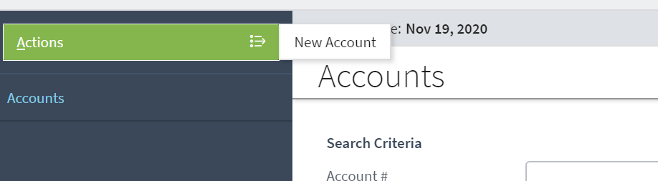
Creating Accounts
Accounts are typically created through the integration with a PAS when a billing instruction is received
During development and testing, users can create accounts manually or use a data builder to create them
You can create a new account from the Account tab
PAS
User
Notes:
If a billing instruction is received and it references an existing account, then the billing instruction is associated with that account.

Slide 14
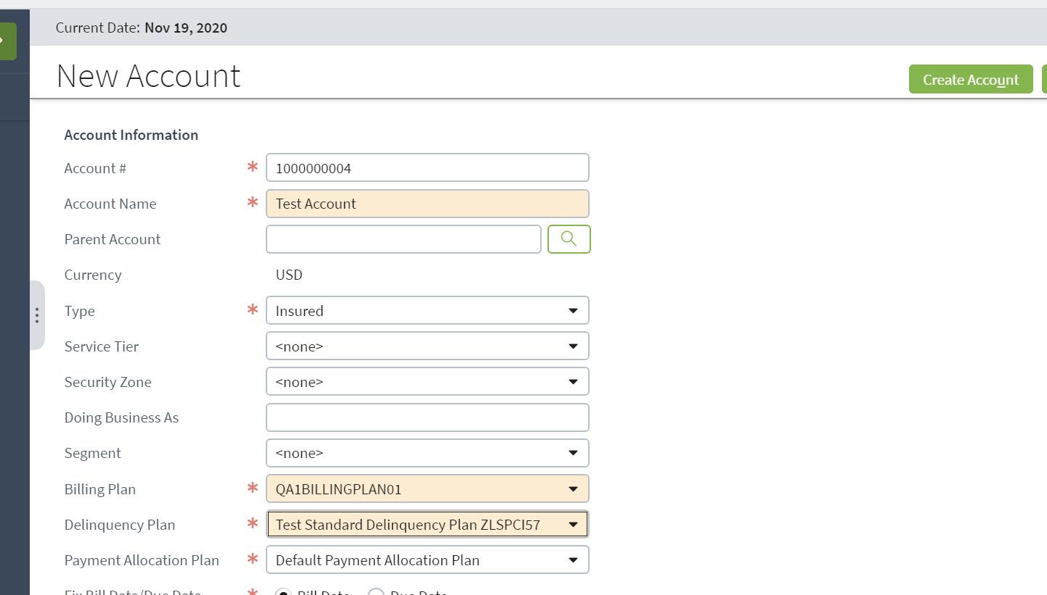
General and delinquency fields
General account information
Delinquency plan
Notes:
BillingCenter auto-generates an account number for every new account, although a BillingCenter user can enter an account number of their own choosing.
Account number generation is configurable.
Account Type defaults to "Insured". Other possible values are "Payer", "List Bill", and "Collection Agency". List bill accounts are discussed later in this lesson. The other account types are strictly for documentation in the base application.
Delinquency plans are discussed in the Configuring Delinquency Workflow lesson.

Slide 15
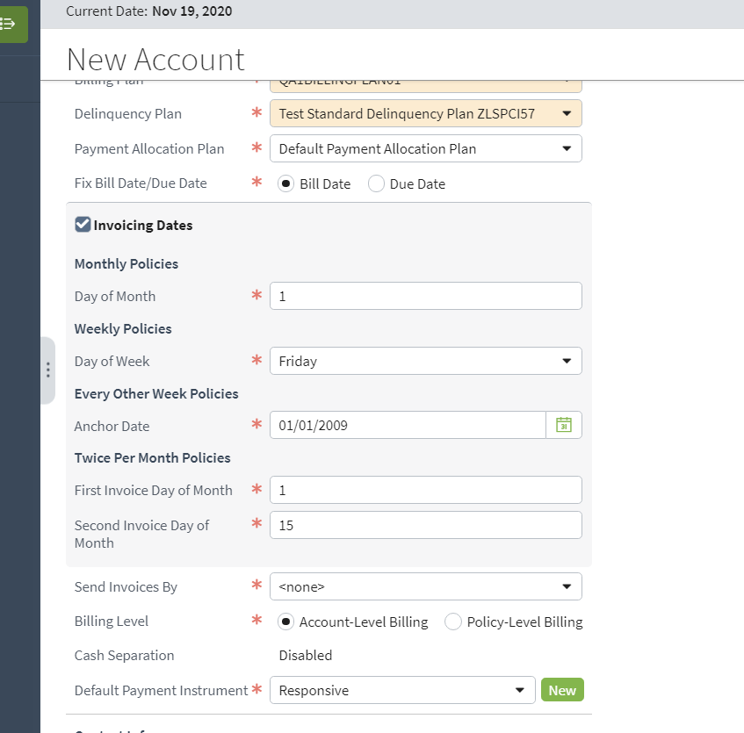
Invoicing and payment fields
Invoicing fields
Payment fields
Notes:
Invoicing fields are used for determining how and when invoices are sent and become due. The bottom three fields in the screenshot are discussed next. In this lesson. The other invoicing fields are covered in the Configuring Charge Invoicing lesson.

Slide 16
Billing level options — direct bill policies
Account-level billing means invoice can have items from more than one policy
Fewer invoices and incoming payments
All policies paid using same payment instrument
Policy-level billing means separate invoices for each policy
Can have different bill dates and due dates
Allows separate payment instrument for each policy
$
$
$
$
$
$
Account Level
Policy Level
. . .
. . .
. . .
. . .
Notes:
When you create an account, you must specify whether the account will be invoiced separately for each policy.
BillingCenter supports two types of billing level for direct bill policies:
Account-level billing means that BillingCenter combines charges for policies that have the same account payer. Assuming the same periodicity for the policies (such as monthly or twice a month), only one invoice stream is used for the account’s policies. So the account receives a single invoice for multiple policies and pays for the policies using the same payment instrument such as a credit card.
Policy-level billing means that each policy has its own set of invoices that are contained within a dedicated invoice stream. Each stream can be customized to have different bill and due dates, a different paying account, and a different payment instrument.

Slide 17

Handling unapplied funds
Every account owns one or more T-accounts ("unapplied funds") that are used to hold undistributed money
All money coming into BillingCenter passes through an unapplied fund
Excess money remains in an unapplied fund until it's distributed or disbursed
1350
Premium
Tax
Payment
Fees
Unapplied fund
Home policy
150
Disbursement

Slide 18




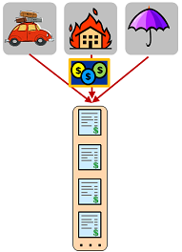
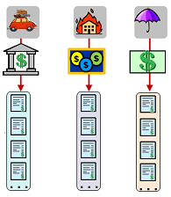
Controlling billing level and unapplied funds
A pair of fields on an account control billing level and placement of unapplied funds
Default Unapplied
Default Unapplied
Default Unapplied
Auto
Home
Umbr
Designated Unapplied
Notes:
Every account owns an unapplied fund called Default Unapplied. If the account uses account-level billing, Default Unapplied is the only unapplied fund belonging to the account. If an account uses policy-level billing, the account has the option for owning multiple unapplied funds—one for each policy—in addition to Default Unapplied. Having separate unapplied funds for each policy is sometimes called "cash separation".

Slide 19
Example of designated unapplied funds
Excess money from a payment is placed in the unapplied fund for the policy, where it can be managed separately from other money
Premium
638
Tax
Fees
Payment 1
Designated Unapplied (Auto)
Auto policy
1350
Premium
Tax
Account
Payment 2
Fees
Designated Unapplied (Home)
Home policy
150
Disbursement
150
Deductible
Payment 3
Member fee
Default Unapplied
Account charges

Slide 20

Payment instruments How the account plans to pay invoices
No sensitive payment information is entered or stored in BillingCenter
Instead, BillingCenter connects to a third party system to enter payment information
A payment instrument is an object that represents payment information such as credit card or bank details
Payment Method can be credit card, ACH/EFT, wire, misc, and responsive
Token is returned from external system to identify payment instrument
An account can have multiple payment instruments
It must have a default payment instrument
Payment instrument
Notes:
A payment instrument in BillingCenter represents payment information without actually storing any sensitive payment details. This approach means that the customer’s payment data is kept secure in the carrier’s external payment system.
After the billing representative enters the payment instrument into the external payment system, the payment system returns a "token" that BillingCenter can use to identity the payment instrument subsequently to request money from it. However, the details passed back to BillingCenter vary depending on the payment system. For example, one system might send back a masked card number, an expiration date, a nickname for the card, and a token to send back to them to request money from the card. Another payment system might return the actual credit card number instead of returning a token. The token serves as a "payment gateway" that facilitates the coordination of communicating a payment transaction between external payment systems and BillingCenter. The payment gateway is used for electronically transmitting payments. You can think of it as a prebuilt integration to an external financial world that gives you the ability to perform financial tasks such as manage credit card expiration, draft a bank account or credit card, and send payments.

Slide 21
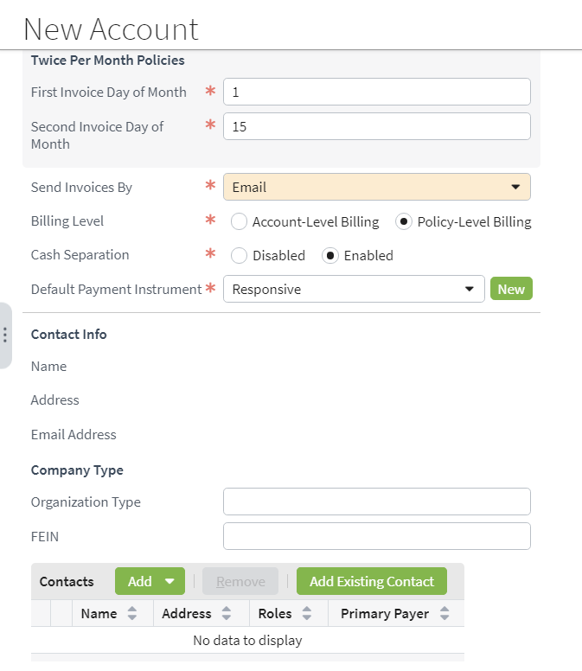
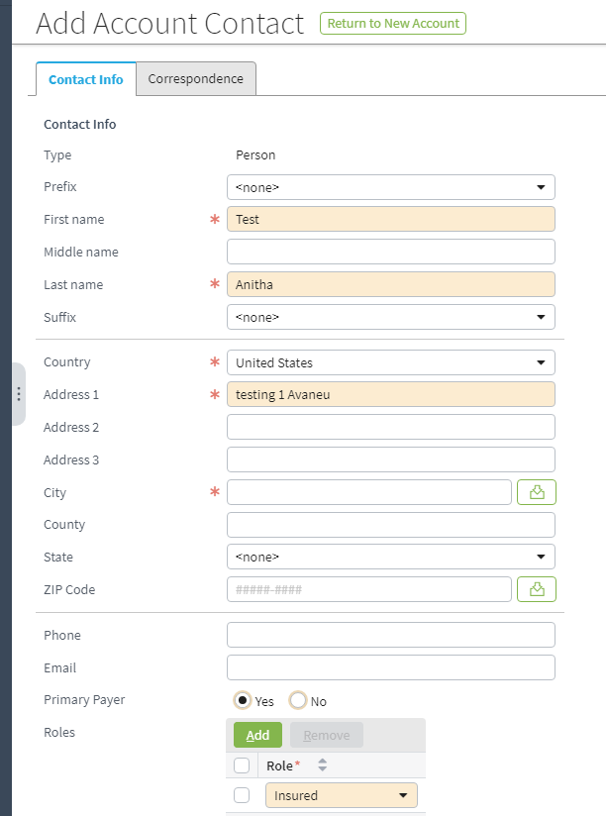
Account primary payer, primary contact
Every account must have one primary payer contact
Primary contact is optional and requires "Insured" role
Notes:
Notice that you can define a new contact when you create a new account, or you can add an existing contact. Contacts can be shared among accounts, producers, and policies. Often carriers have external contact management systems. Connecting to these requires integration.
An account must have a contact that is designated as the primary payer. An account can also have a primary contact. The primary contact is listed on the account’s Summary screen. To make a contact the primary contact, add the Insured role to the contact. In the example, Long Haul Deliveries is both the primary payer and the primary contact.

Slide 22
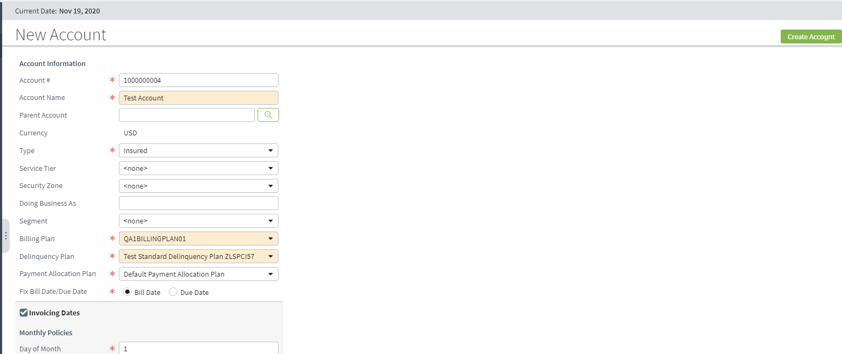
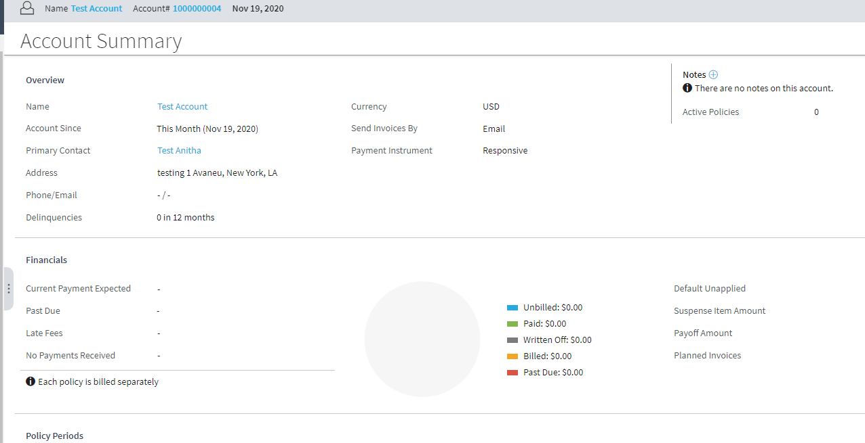
Completing the new account

Slide 23
Lesson outline
Account basics
Creating an account
Producer basics
Creating a producer
Creating sample data

Slide 24
Producers
Carrier
Account
Producer
The producer is an intermediary who:
Helps accounts find carriers who will underwrite policies for them
Helps carriers find accounts for whom they want to underwrite policies
Producers typically are paid commissions for each policy underwritten through their assistance
Notes:
A producer is a person or organization that has one or more agreements to sell business on behalf of the carrier. A producer can be responsible for many, one, or no policies.
In the insurance industry, producers are typically referred to as agents, brokers, or internal sales force. All different types of producers are treated as generic producers in BillingCenter.
The carrier may hold the account directly (the insurer contacts the account directly), in which case there may not be a producer.

Slide 25
Producer codes
A producer code is a code that ties a given policy transaction to a specific producer and commission plan
Tracks who is credited for policy transaction and how much to credit them
Producer
Code
001
002

Slide 26
Contacts
A producer contact is a person or organization who has a relationship to the producer, such as:
Individual that holds producer agreement
Contacts within organization that holds agreement
Contact type is either company or person
Producer
Code
Contact
001
002
Notes:
Contact information is typically supplied by the policy administration system and/or an agency management system.
The primary producer contact is used as a recipient of commission statements and checks so this information most likely to come from Producer Management System (or is at least kept synchronized with the PMS).

Slide 27
Policies and producer codes
When PAS informs BillingCenter of new policy, that policy typically has a producer code associated with it
Policy is then associated with producer with given producer code
Producer
Code
Contact
001
002
Policy
Notes:
There are various approaches the PAS can take regarding billing instructions and unknown producers. If the PAS is the system of record for your producers:
The PAS could inform BillingCenter of a new producer as soon as it is created in the PAS, even if there are no policies connected to the producer, or
The PAS could query BillingCenter just before sending the billing instruction to determine whether the producer exists, and then direct BillingCenter to create the producer if needed.
The system of record for a producer can be an Agency Management System (AMS). If this is the case,
The AMS could inform BillingCenter of a new producer as soon as it is created in the AMS, or
The AMS could provide the PAS with the producer information. Subsequently, the PAS provides BillingCenter with this information either when the billing instruction is sent or just before it is sent.
If BillingCenter is the system of record for your producers, all the producers will already exist in BillingCenter. The producer details would be replicated in your PAS.
Regardless of the approach, the creation of a new producer is not considered an official part of the billing instruction.

Slide 28
Commission
Commission is a fee paid to a producer, usually as a percentage of the policy premium
Producer
Code
Contact
001
002
Policy
Commission
Notes:
Usually commission is calculated as a percentage of the premium, but there are situations where the commission is a flat amount. Implementing flat-rate commissions requires configuration in BillingCenter Preupdate rules.

Slide 29
Commission statements
A commission statement shows commissions payable and payment activity for a producer
Produced automatically through a batch process
Producer
Code
Contact
001
002
Policy
Commission
Statement
Notes:
A commission statement captures all the commissions payable and payment activity for a producer since the previous statement.

Slide 30
Documents
A document is an electronic file that contains information relevant to an account, producer, or policy
Producer
Code
Contact
001
002
Policy
Commission
Statement
Document
Notes:
Two examples of BillingCenter producer documents are agency bill statements and commission statements. Typically, most documents are stored in a document management system that is integrated with BillingCenter.

Slide 31
Lesson outline
Account basics
Creating an account
Producer basics
Creating a producer
Creating sample data

Slide 32
Creating producers
External agency management system
New Producer Wizard
User
Producers are typically created automatically through periodic batch process
A user with sufficient permissions can create a producer using the New Producer wizard
Notes:
Producers are typically imported from and synchronized with a carrier’s agency management system (or the PAS). The periodic batch process would be used to kick off that interaction.
If BillingCenter is integrated with PolicyCenter, users create producer organizations and producer codes in PolicyCenter, which are then pushed into BillingCenter. Public IDs provide the means for matching a PolicyCenter Organization entity with the corresponding BillingCenter Producer entity. At the time the PolicyCenter producer organization is created, PolicyCenter obtains valid agency bill plan choices from BillingCenter. When producer codes are created in PolicyCenter, PolicyCenter obtains valid commission plans from BillingCenter. After PolicyCenter sends a producer to BillingCenter, these plan assignments become the responsibility of BillingCenter. PolicyCenter also sends contact information for producer contacts and sends updates whenever contact details are subsequently changed in PolicyCenter. BillingCenter does not send updates back to PolicyCenter if producer details are changed within BillingCenter.

Slide 33
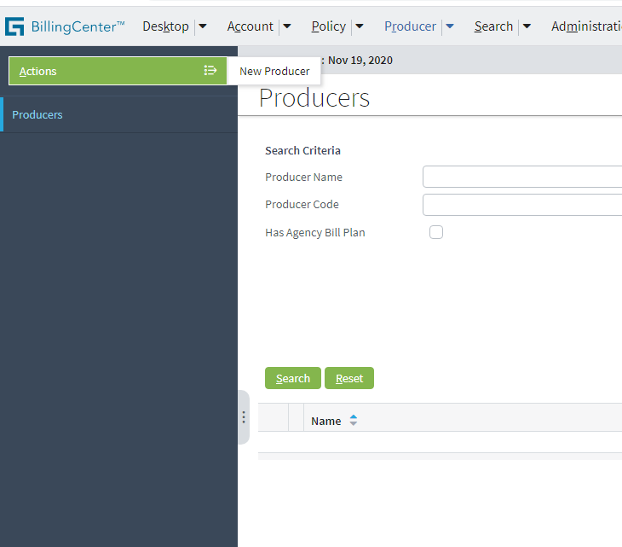
Starting the New Producer wizard
Producer tab→Actions→New Producer
Wizard steps:
Specify basic producer information
Specify producer codes

Slide 34
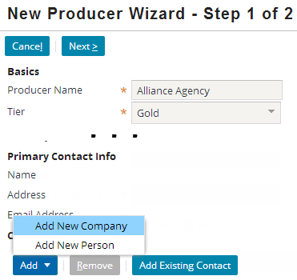
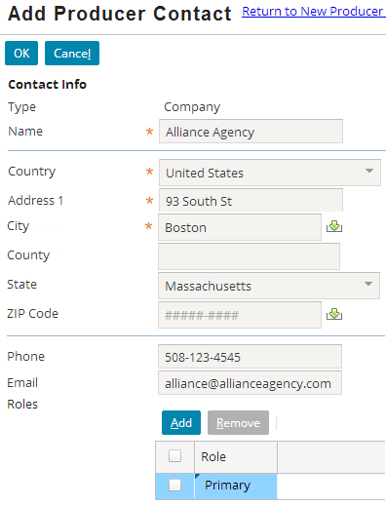
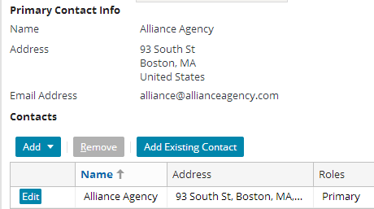
Producer primary contact
Every producer must have one contact with role of Primary
#1
1
2
Notes:
Every producer must have at least one contact who is designated as the primary contact.
Contact information is established beforehand as part of the import of the Producer information (or as part of adding a producer with the New Producer wizard). Often it will be synchronized with an external producer management, contact management, or policy system.
Notice that you can define a new contact when you create a new producer, or you can add an existing contact. Contacts can be shared among producers, accounts, and policies.

Slide 35
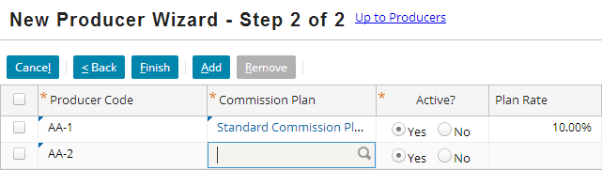
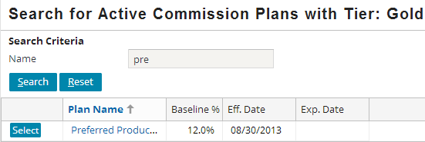
Step 2: Add producer codes
001
002
A producer must have at least one producer code
Think of the producer code as the commission earner
1
2
Notes:
The producer code is used to identify a commission plan. When a policy is added for a producer, the producer code is used to associate the policy with a commission plan.

Slide 36
Why producer codes?
The code associates a producer with a commission plan and allows different commission rates to be paid
Producer codes can:
Identify the sales office that sold the policy
Apply a different commission rate depending on the line of business
Enable better tracking of money, better security
Policy
Producer
Commission Plans
5%
001
002
4%
003
6%
Notes:
Here are some examples of how producer codes can be used:
A producer can have multiple sales offices so each producer code identifies the office that sold the policy, but the commission statement can be produced for the producer as a whole.
In agency bill, a producer can have a number of agency agreements through which the producer sells different lines of business. Separate codes can be used to identify the producer contract under which the business was written (these contracts could have different commission rates).

Slide 37
Lesson outline
Account basics
Creating an account
Producer basics
Creating a producer
Creating sample data

Slide 38
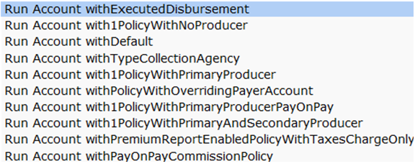
Generating test data quickly
Data builders are methods developers use to create test entities such as accounts and producers
Require Super User login
Available in development environment only
Executed using run command in QuickJump field
List auto-reduces as you type
Notes:
Commands for running data builders to create direct bill producers include the following:
Run Producer withDefault
Run Producer with2Policies
Run Producer withPolicyOf2Charges
Run Producer withMultipleProducerCodes
There are also several agency bill producer data builders.
Note: The commands are not case sensitive.

Slide 39

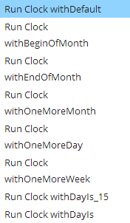
Using the QuickJump field
Press Alt + / to move cursor to the QuickJump field or click in the field
Enter a command:
To advance the system clock:
To run a batch process:
Press Enter.
As you type, a progressively narrowing list of possible selections is displayed for you to select from
batchProcessType
Notes:
You do not need to be Super User to run a batch process. Simply type RunBatchProcess followed by the process name (a progressively narrowing list of batch processes is displayed as you type).
To advance the system clock from the QuickJump field, enter the command (such as run clock addweeks), press the spacebar, and then enter the number of days, weeks, or months to advance the clock. For example, Run Clock addDays 1 advances the BillingCenter clock one day.

Slide 40
DEMO

Slide 41
Provide demo details<The video creator to fill this slide>

Slide 42
LAB

Slide 43
Complete the exercises in below chapter in the “BC10_INTRO_E_StudentWorkBook “ work book
Lesson 5 = > Designating an Alternate Payer

Slide 44
Lesson objectives review
You should be now able to:
Describe the primary objects of the account data model
Create an account
Describe the primary objects of the producer data model
Create a producer
Use run commands to create sample accounts and producers

Slide 45
Review questions
Accounts are not linked directly to producers. By what means are accounts associated with producers?
Why do some producers have multiple producer codes?
Notes:
Answers
The association is established through the Policy entity. An account is associated with a producer by virtue of having a policy which is associated to the producer.
A producer may have more than one code if policies need to be credited to the same producer but in different ways, or if policies need to be associated to the same producer but different commission plans. Also, different producer codes facilitate better financial tracking.

