Slide 1

Policies and Invoices

Slide 2
Lesson Objective
By the end of this lesson, you should be able to:
Manually create a billing instruction
Describe how invoices are processed
Simulate BillingCenter automatic behavior by:
Advancing the system clock
Running batch processes
6

Slide 3
Lesson Outline
Creating a billing instruction
Invoicing lifecycle
Simulating BillingCenter automation
6

Slide 4

Billing instructions
Account in PAS
PAS
Billing instruction
Policy transaction (submission)
Most policy transactions have billing requirements
Submissions initiate need for billing
Changes may involve an increase or decrease in premium
Cancellations may involve refunds
When policy transaction has billing requirements, PAS sends a billing instruction to BillingCenter

Slide 5
Billing instruction components
Billing instruction
PAS
Which policy period is involved?
What account owns the policy?
What are the charges?
What account should be billed for each charge?
. . .
Which producers are responsible for the policy?
What is the policy payment plan?
What invoice stream to place invoices on?
Notes:
A policy issuance (also known as a policy submission) creates a new policy with a new policy period. A policy renewal extends an existing policy for a new policy period. In both cases, the billing instruction must specify:
Which policy period the billing instruction is for
Who owns the policy (an account)
Who to bill for each charge (an account, which is usually the owner but could be a different account)
Who earns the commission (the producer or producers)
What to charge (the charges)
How to break the charges down into invoice items (the payment plan)
How to schedule the invoices that are created (invoice stream)
The payment plan and charge types must already be known to BillingCenter. The billing instruction simply references a known payment plan to use and a known charge type for each charge. Typically, the producer and account are also known to BillingCenter. How BillingCenter handles an unknown producer or account depends on the integration between the PAS and BillingCenter.
An invoice stream is a container for a series of invoices that occur with a given frequency. For example, an invoice stream called Monthly could be set to monthly billing with a billing date of the fifteenth of every month. This stream can accommodate invoices that are sent monthly or every other month or quarterly, but it cannot accommodate invoices that are sent every other week or twice a month. For those requirements, BillingCenter would create separate invoice streams.

Slide 6
Creating billing instructions
Policy Admin. System
Billing instructions are almost always received through an integration point with the PAS
For demonstration purposes, billing instructions can also be created manually by user for a:
New policy
Policy change
Policy renewal

Slide 7

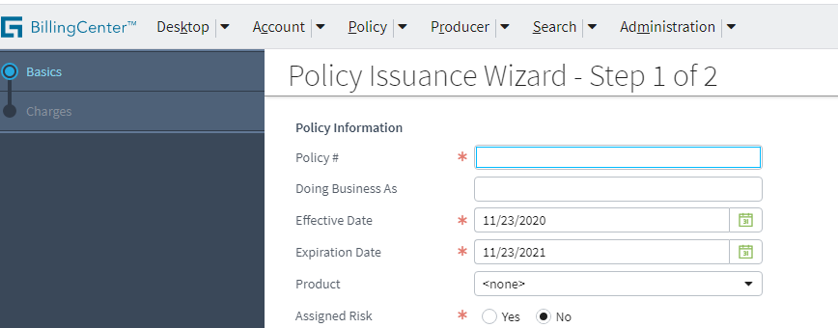
Starting the New Policy wizard
Start New Policy wizard started from Account tab's Actions menu with account in focus
Account is owner of resulting policy
Two steps:
Specify basic policy information
Add charges

Slide 8
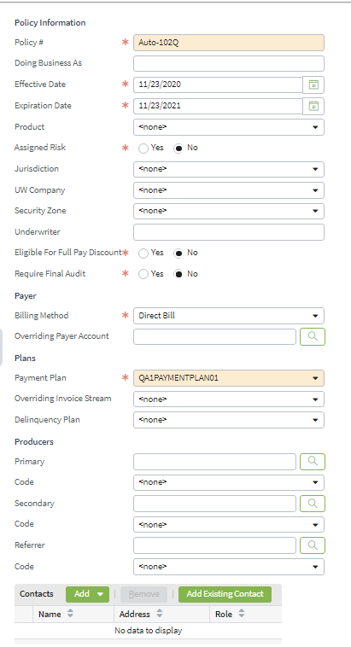
Step 1: Define basic information
General policy information
Billing and payment information
. . .
Producers
Contacts
Notes:
The screenshot has been edited to fit on the slide. Specifically, the fields for secondary and referrer producers have been removed.
"Assigned risk" is liability coverage for certain individuals (such as reckless drivers) who cannot buy conventional insurance policies due to their adverse record. A state can require that insurance carriers take on some of these bad risks. The carrier is allowed to apply higher rates and can impose tighter credit and delinquency terms to assigned risk policies.
Multiple producers can be involved with a single policy. The three levels of producer (primary, secondary, and referrer) allow different commission rates to be applied to three different producers.
A primary producer would typically have a higher commission rate than a secondary producer. Referrers can be given an even smaller rate as they do not actively service the policy holder.
Note: When selecting a producer, be sure to also select a producer code if the code is not preselected for you.
BillingCenter does not require that every policy has a producer.
A policy contact, which is optional, is typically used to communicate notices in policy status changes (for example, cancellation or reinstatement) so this information is most likely to come from PAS (or is at least kept synchronized with the PAS).

Slide 9
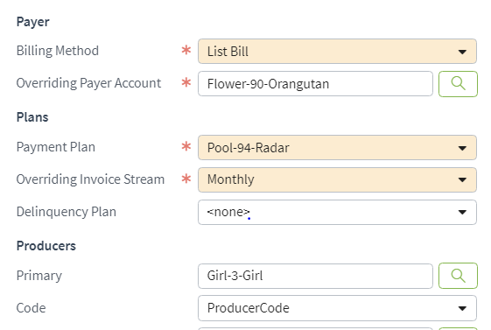
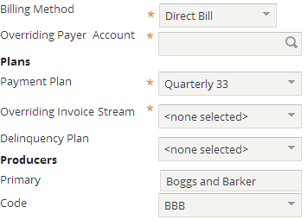
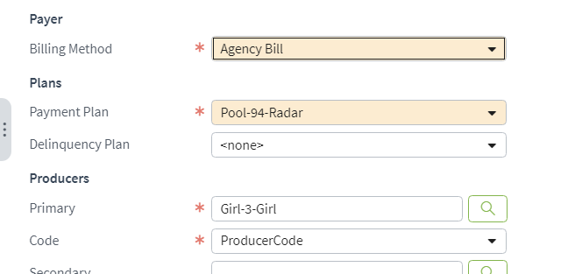
Billing method choices for new policy
Direct Bill
List Bill
Agency Bill
Notes:
A direct bill policy must have a payment plan. Overriding payer account, overriding invoice stream, and primary, secondary, and referrer producer information are optional.
A list bill policy requires both an overriding payer and overriding invoice stream in addition to a payment plan:
The payment plan must already be associated with the list bill account.
The overriding payer must be an account of type "List Bill".
The overriding invoice stream must exist already, be owned by the list bill account, and have a periodicity that is compatible with the selected payment plan.
An agency bill policy requires a primary producer and producer code in addition to a payment plan. Recall that an agency bill policy is paid by the primary producer. Agency bill policies use only one invoice stream: Monthly. Fields for overriding payer account and overriding invoice stream are hidden for agency bill policies. Agency bill policies are discussed in detail later in this course.
"Overriding Payer Account" allows you to specify an account that is not the policy owner as the policy payer. If a policy is owned by one account and has a different account as the overriding payer, the policy will be listed on the Policies screen for both accounts.

Slide 10
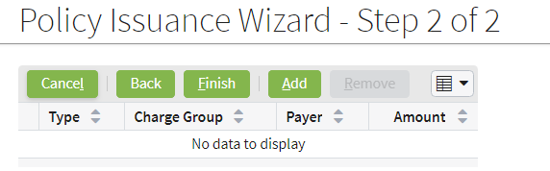
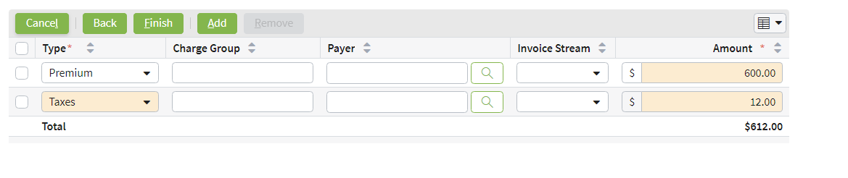
Step 2: Add charges
Charge type as defined by a charge pattern
Notes:
On the second step, you specify the individual charges for the billing instruction. For each charge, you must specify a type of charge and an amount.
There are three optional fields:
Charge Group is a text field that allows you to group charges. Charge groups are discussed later in this lesson.
Payer allows you to select a payer that is an account other than the policy owner. For example, the parent of a teenager can be the payer of a policy owned by the teenager.
Invoice Stream allows you to select an invoice stream belonging to the account that is the policy payer (if the Payer field is blank, then this is the account that owns the policy). This feature allows you to select a custom invoice stream for containing the policy’s invoices.
In the base application, BillingCenter New Policy Wizard is configured to allow new charges of the charge types allowable for the policy period T-Account owner; namely:
Premiums (billable by installment, included in equity dating and earned monthly),
Taxes (billable as a one-time charge and passed through to a third party) and
Reinstatement fees (billable as a one time charge).
Any number of additional charge types may be configured to suit a carrier’s requirements such as different taxes, different policy fees, and so on.
Charges and charge types are discussed in detail in a later lesson.

Slide 11
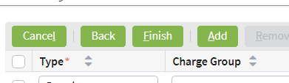
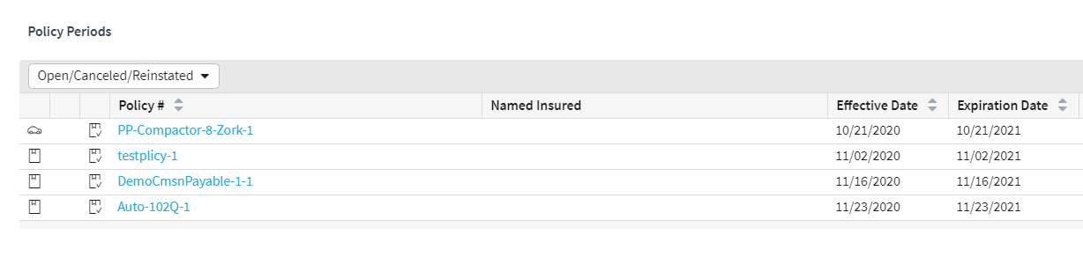
Completing a new policy billing instruction
Term number–this is the first policy period for the policy
Policy number
Notes:
In the base application, BillingCenter appends a -1 to the policy number to indicate the first term number of the policy period. The suffix increases from 1 to 2 upon the first renewal. Upon the second renewal, it increases from 2 to3. The policy term number continues to increase with each renewal.

Slide 12
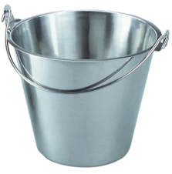
Data generated from billing instruction
From billing instructions, BillingCenter receives and generates:
Policy-centric data
Account-centric data
Policy
Charges
Transactions
Invoices
Account
Unapplied funds
Invoice streams
. . .
. . .
Notes:
The invoices are generated for the payer account. Depending on the periodicity of the invoices and the billing level of the account payer, a billing instruction can result in a new invoice stream. For example, if policy-level billing is in effect for the account payer, every policy gets its own dedicated invoice stream.
If the paying account uses cash separation, a designated unapplied is created for the policy if one doesn't already exist.

Slide 13
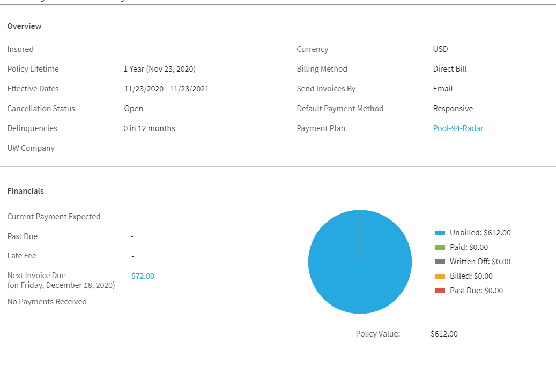
Policy – Summary screen
Policy tab→Summary
Includes information on earnings
and policy equity
Notes:
Earnings includes the earning totals for the policy, which include Earned Premium, Other Earnings, Total Earned, and Percentage Earned. Other earned items can include charges such as taxes and fees. Depending on the charge pattern associated with these items, BillingCenter’s accounting substructure creates a counter expense. For example, taxes are pass-through-charges, so if a policy is assessed a tax, both revenue and expense charges are created to balance the charge.
Equity relates to equity dating, which allows BillingCenter to track that payments are collected from accounts prior to providing them with services. For policies that have premium installment payments, equity is earned periodically. Policy equity indicates difference between how much of the premium has been paid and how much of the policy’s services have been provided. So, equity is positive when the carrier has provided less in services than the amount the insured has already paid.
Equity dating allows you to monitor the difference between payment received and services provided on a daily basis by tracking the date the insured has paid through to (Paid Through Date) for the policy period. Through configuration, you can use this calculated date as a trigger for delinquency events. In the event that the insured does not make a payment on time, you can initiate the cancellation process so that it completes on or before the Paid Through Date. The "Include in Equity Dating" property of the charge pattern controls whether a given charge type is included in the equity dating calculation. For example, Premium charges are included whereas Taxes charges are not.

Slide 14
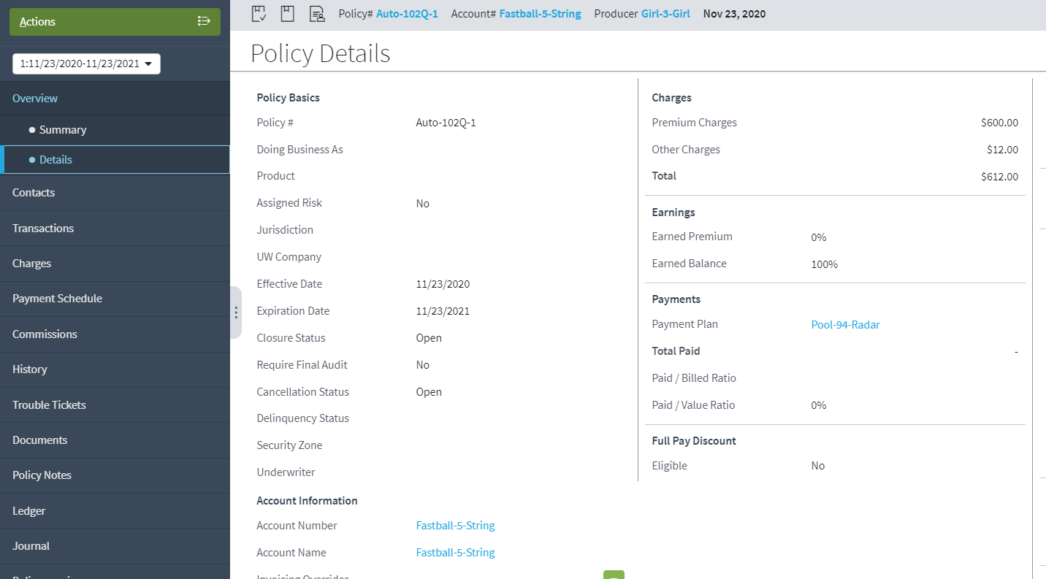
Policy – Detail screen
Policy tab→Detail
Policy Charges
Notes:
Earnings includes the earning totals for the policy, which include Earned Premium, Other Earnings, Total Earned, and Percentage Earned. Other earned items can include charges such as taxes and fees. Depending on the charge pattern associated with these items, BillingCenter’s accounting substructure creates a counter expense. For example, taxes are pass-through-charges, so if a policy is assessed a tax, both revenue and expense charges are created to balance the charge.
Equity relates to equity dating, which allows BillingCenter to track that payments are collected from accounts prior to providing them with services. For policies that have premium installment payments, equity is earned periodically. Policy equity indicates difference between how much of the premium has been paid and how much of the policy’s services have been provided. So, equity is positive when the carrier has provided less in services than the amount the insured has already paid.
Equity dating allows you to monitor the difference between payment received and services provided on a daily basis by tracking the date the insured has paid through to (Paid Through Date) for the policy period. Through configuration, you can use this calculated date as a trigger for delinquency events. In the event that the insured does not make a payment on time, you can initiate the cancellation process so that it completes on or before the Paid Through Date. The "Include in Equity Dating" property of the charge pattern controls whether a given charge type is included in the equity dating calculation. For example, Premium charges are included whereas Taxes charges are not.

Slide 15
Lesson outline
Creating a billing instruction
Invoicing lifecycle
Simulating BillingCenter automation

Slide 16
A billing instruction generates invoices
Each charge is mapped to one or many invoice items
Each invoice item is assigned to an invoice
Charges: Fee: $25 Premium: $600 Taxes: $125
Invoice items
Prem: $90
Prem: $90
Prem: $90
Prem: $90
Prem: $90
Policy payment plan
Installments
Invoice items: Fee: $25 Premium (down payment): $150 Taxes: $125
planned
planned
planned
planned
planned
planned
$300
$90
$90
$90
$90
$90
Notes:
When a billing instruction is received by BillingCenter, BillingCenter breaks each charge down into one or more invoice items. In the base application, an immediate charge (such as a fee) or a pass-through charge (such as a tax, which must be "passed through" to another agency, such as the government) typically becomes a single invoice item. A premium charge is often split into an optional single down payment invoice item and one or more installment invoice items. BillingCenter generates the required invoices, places the invoices in the appropriate invoice stream, and assigns each invoice item to one of the invoices.
In the example above, the account has a policy that is to be billed a total of $750 consisting of 3 charges: a $600 premium charge, a $125 tax charge, and a $25 processing fee charge. The $600 premium is split into a $150 down payment and 5 $90 invoice items. The tax and fee charges are each mapped to a single invoice item that is placed on the first invoice along with the down payment.
The payment plan associated with the policy specifies how a charge is split into invoice items.

Slide 17
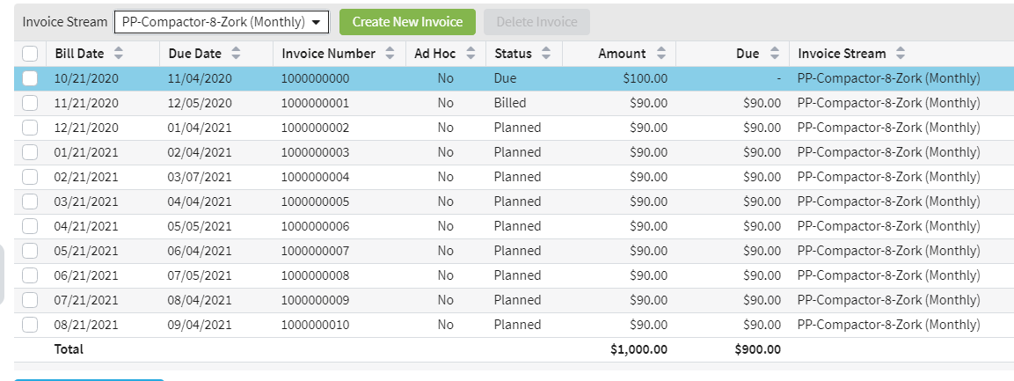
Account→Invoices screen
Past
Present
Future
Notes:
Invoices are added to the account as required when billing instructions create charges for an invoice period. The part of a charge added to an invoice is known as an invoice item.
The Invoices screen shows all invoices. These have a status that changes over the lifetime of an invoice from planned to billed to due.

Slide 18
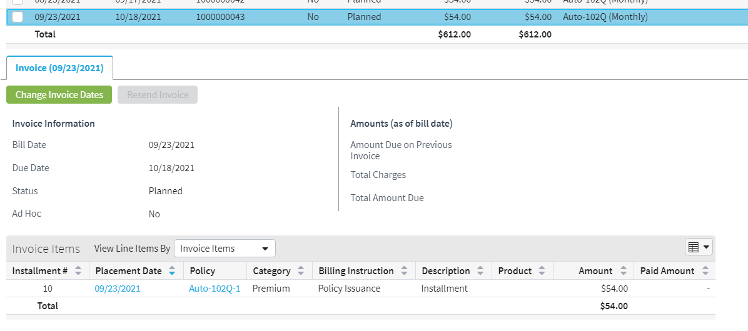
Account→Invoices screen: charges
When invoice is selected, charges for invoice are displayed below the list...
Notes:
When you select an invoice line, the detailed charges for that invoice (the invoice items) are shown in the tab below. This example shows that the top invoice included a charge for tax and a charge for premium.

Slide 19
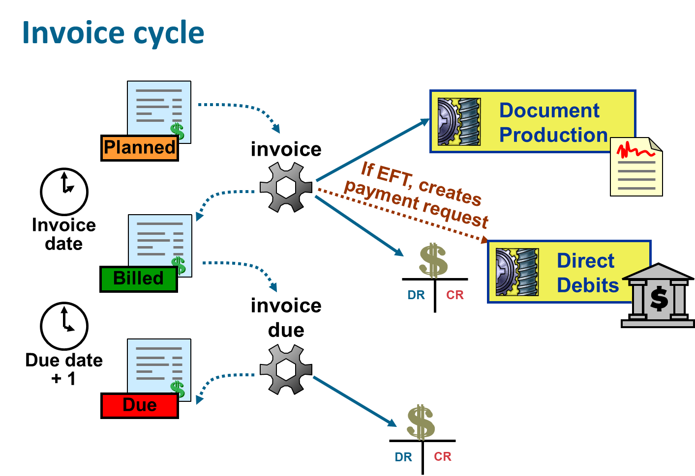
Notes:
When invoice bill date arrives, the invoice batch process:
Changes the invoice status to Billed.
Creates accounting transactions that move charges from unbilled to billed.
Creates a payment request to manage a direct debit collection if the account’s payment method collects by direct debit. This is not actually creating the EFT ("electronic funds transfer") request yet.). This is only for “non-responsive” payment methods, where “responsive” means that the insured must respond to a sent invoice. The “non-responsive” payment methods are managed entirely by the carrier, and the insured does not need to respond to the notice unless a change is needed.
Sends invoice details to a document production system to produce and send an invoice document (such as a physical piece of paper or an email). (This integration point is not configured in the base application and must be configured during implementation.)
On the day after the due date for a billed invoice, the invoice due batch process:
Changes the invoice status to Due.
Creates accounting transactions that move charges from Billed T-account to Due T-account.

Slide 20
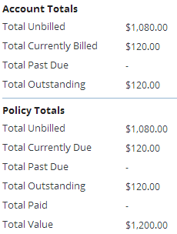
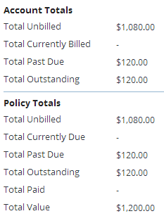
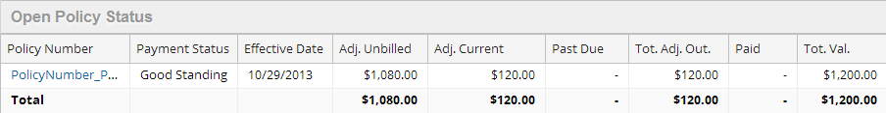
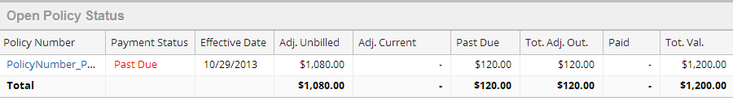
Account Summary screen
invoice
invoice due
Notes:
When the invoice process is run, the amount invoiced is moved from unbilled to current.
When the invoice due process is run and the invoice has not been paid, the amount is moved from current to past due, and the payment status changes to "Past Due".
Adjusted Unbilled and Current Amounts
There are two "adjusted" fields on the Open Policy Status listview: Adj. Unbilled and Adj. Current. The adjustment is a calculation that BillingCenter makes so that the field values reflect the amounts that the customer actually owes the carrier rather than simply showing the unbilled amounts (or billed and due amounts) on the invoices. The calculation includes any credits (that is, negative values due to a discount such as a premium refund) and payments made against applicable invoice items. If the calculation returns a negative amount, the field is set to null.

Slide 21
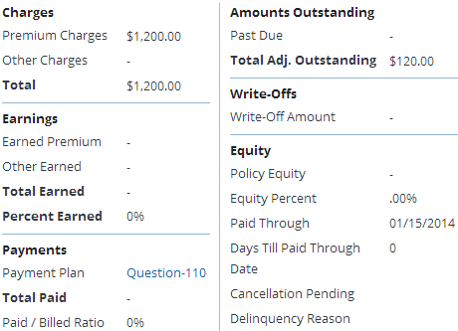
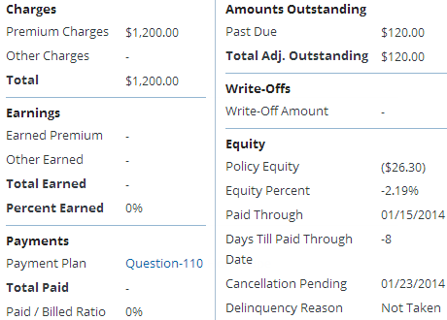
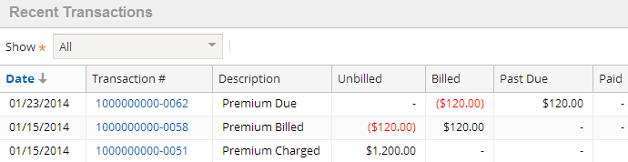
Policy Summary screen
invoice
invoice due
Notes:
The policy summary shows the current amount outstanding. This is updated by the Invoice batch process, which also posts from unbilled to billed. Notice that the outstanding amount has been adjusted, so any credits and payments have been applied.
When the policy becomes past due, this amount is updated on the policy summary by the Invoice Due batch process, and the amount now past due is posted from billed to past due. Note that this posting is always done as payments post from past due into paid (which is discussed later in this lesson).
In this example, the premium is configured to be subject to equity dating. When the Invoice batch process was run, the policy has been in force for 0 days and no money was received. The Invoice Due batch process was run 8 days later. Notice that the negative policy equity has increased and that a cancellation is pending because the policy is past due.
Note that this type of policy has strict terms with a monthly premium and, like a monthly policy, will cancel if the premium is not paid. (Delinquency is configurable and covered in detail in a later lesson.)

Slide 22
Lesson outline
Creating a billing instruction
Invoicing lifecycle
Simulating BillingCenter automation

Slide 23

Simulating BillingCenter automation
Developers (and students) need to simulate BillingCenter automation
Simulation involves:
Advancing the BillingCenter system clock
Add days, weeks, or months
Set a specific date and time
Manually running batch processes to perform BillingCenter functionality such as:
Billing invoices on their bill date
Distributing payments to T-accounts
Checking for commissions that are payable
Generating commands to simulate PAS integration
Notes:
A T-account is a financial account containing money that is in a given state or designated for a given use. A T-account is so called because it has the form of a letter T. An entry on the left side is called a debit and on the right side is called a credit. T-accounts are covered in a later lesson.

Slide 24
Advancing the clock
Why advance the clock?
Effective testing involves running through the billing cycle
Billing cycles can run over several months
Advancing the system clock changes the date and time that BillingCenter sees, but not the server clock
You should only advance the clock as going backwards will cause errors with existing data
To go backwards, drop the database and restore a database backup
Two ways to advance the clock:
Using Guidewire Internal Tools
Using QuickJump field (requires Super User login)
Notes:
If you change the BillingCenter clock to an earlier (rather than later) date, you will receive FieldFutureDateException error messages when you try to access existing accounts.

Slide 25
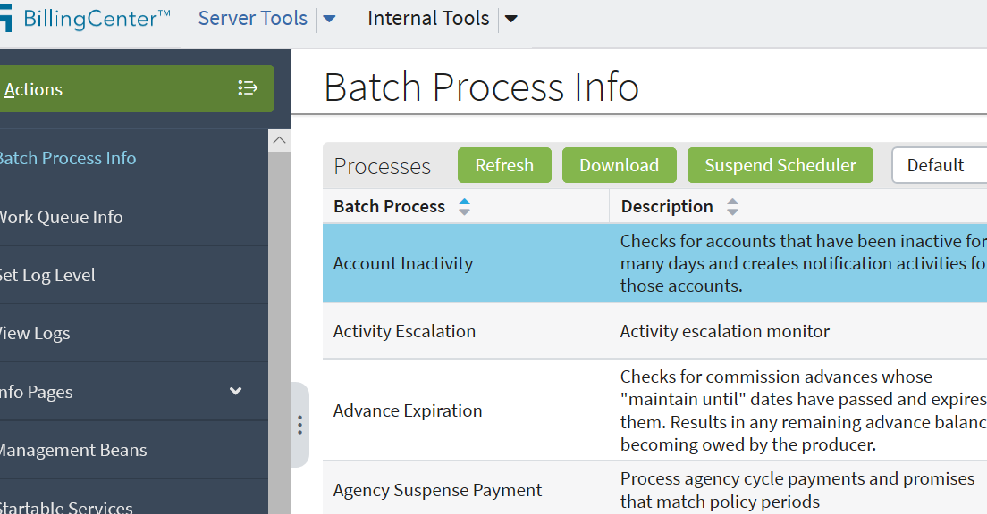
Using Server Tools and Internal Tools
Allow you to advance the clock, run batch processes, and more
Press Alt + Shift + T to access
Super User not required
Available in development environments only
Notes:
The Server and Internal Tools functionality is typically disabled in production instances.

Slide 26
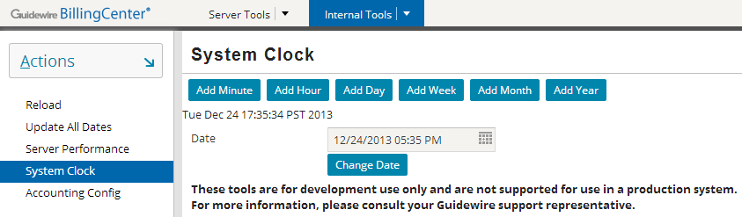
Using Internal Tools to advance clock
On Internal Tools tab, click System Clock
Click a system clock button or update the Date field and click Change Date

Slide 27
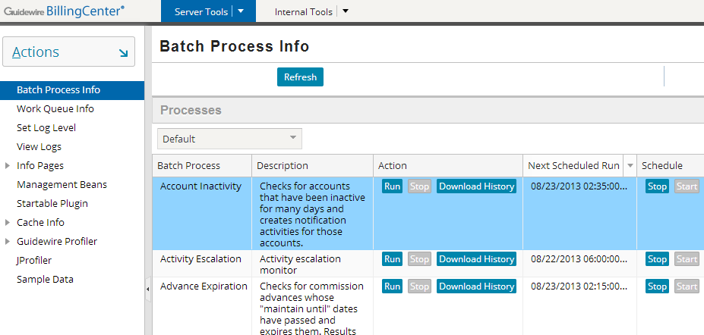
Using Server Tools to run batch processes
On Batch Process Info screen, click Run on the relevant batch process row
Notes:
Batch processes are listed in alphabetical order. You can click a column header to reorder them. It is up to the tester to run them in a logical order. (The next scheduled run time could be used to help with determining a logical order.)

Slide 28
Lesson objectives review
You should now be able to:
Manually create a billing instruction
Describe how invoices are processed
Simulate BillingCenter automatic behavior by:
Advancing the system clock
Running batch processes

Slide 29
Review questions
What are the different statuses an invoice can have?
What are the five primary pieces of information in a billing instruction?
Notes:
Answers
Planned, Billed, and Due (also Carry Forward and Written Off).
Policy, account, producer, charges, payment plan.

Slide 30
DEMO

Slide 31
Provide demo details<The video creator to fill this slide>

Slide 32
LAB

Slide 33
Complete the exercises in below

