Slide 1

Payments and Commissions

Slide 2
Lesson Objective
You should be able to:
Manually enter a payment for an invoice
Generate a commissions statement for a producer
6

Slide 3
Lesson Outline
Paying an invoice
Earning and paying commission
6

Slide 4
Payment and distribution
A direct bill payment is a sum of money sent to a carrier to apply to a BillingCenter account
A distribution describes how money is applied towards a set of invoice items
A distribution item refers to the portion of a payment that is applied to a specific invoice item
Amount distributed is the total amount of money applied across all distribution items on a distribution

Slide 5
Steps for manually posting a direct bill payment
Go to Direct Bill Payment screen for the account owner or payer
Enter payment amount and payment method details
Make decisions regarding unapplied fund
Choose which unapplied fund if account has more than one unapplied
Choose whether to use money (if any) in selected unapplied fund
View the default distribution
Execute the payment with or without distribution
Most payments are posted automatically using BillingCenter's Payment API, invoked from an external payment processing system
Notes:
You can enter an individual payment on the Direct Bill Payment screen, which is accessible from the Actions menu item on the account itself.

Slide 6
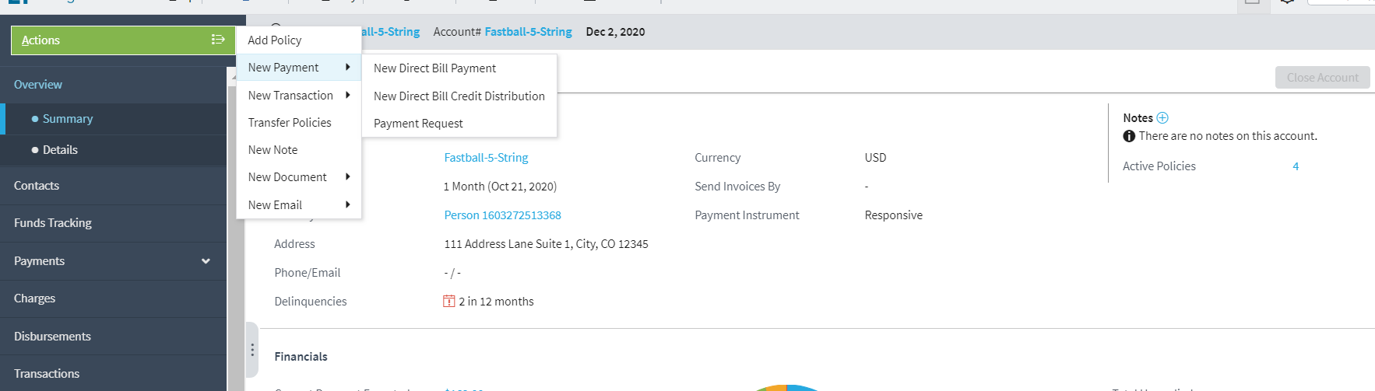
Step 1: Go to New Payment screen
From the Account tab of owner or payer account, select Actions→New Payment→New Direct Bill Payment

Slide 7
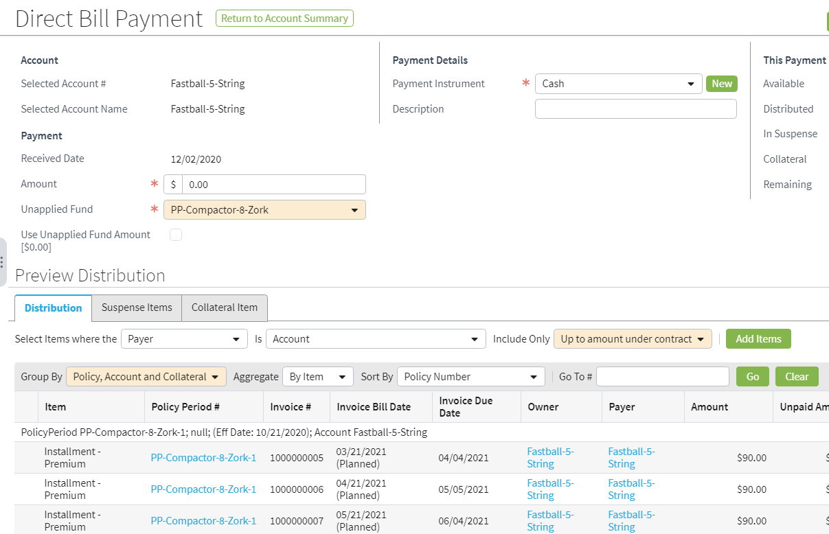
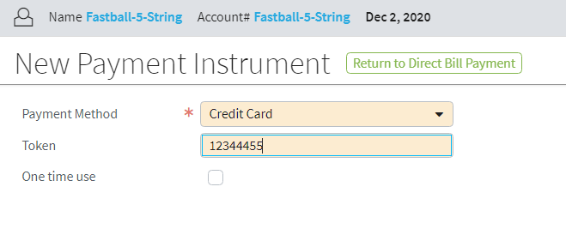
Step 2: Enter payment amount and details
Choose account payer’s payment instrument or define a new one
Notes:
On entry to this screen, the "Use Unapplied Funds" checkbox is selected and the amount of money in Account Unapplied is indicated. Unselect the checkbox if you do not want to include Account: Unapplied funds in this payment. You can select a payment instrument associated with the current account or create a new payment instrument. For a new payment instrument, you can select the "One time use" checkbox to indicate that the payment instrument should not be saved for reuse.

Slide 8
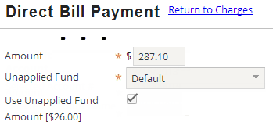

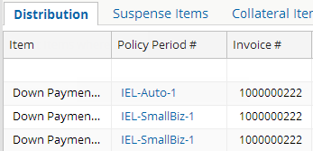
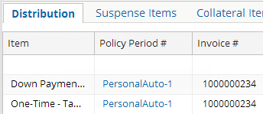
Step 3: Make decisions about unapplied fund
If paying account has multiple unapplieds, you must select unapplied fund before entering a payment
Selected unapplied fund determines the invoice items that are displayed initially
You can also choose whether to include existing unapplied funds
Notes:
On entry to this screen, the Default unapplied fund is selected and the amount of money in Default Unapplied is indicated. If the account has more than one unapplied T-account, you can select a different unapplied fund to use. The unapplied fund that you select restricts the invoice items that are listed on the Distribution tab. It displays the items on the invoice stream associated with the selected unapplied fund.
In the example on the right, Ings Personal is the selected unapplied fund. Assume that PersonalAuto is the only policy associated with the invoice stream that is associated with the Ings Personal unapplied fund. This means that the only items that are displayed for distribution are items from the PersonalAuto policy.
In the example on the left, Default is the selected unapplied fund. IEL-Auto and IEL-SmallBiz policies are associated with an invoice stream that is associated with the Default Unapplied account. So their items are displayed for distribution. Also, any items related to account-level charges would be displayed when the selected unapplied fund is Default.
Use Unapplied Fund Amount
You can select the Use Unapplied Fund Amount checkbox if you want to include any unapplied money residing in the selected unapplied fund in the distribution.

Slide 9
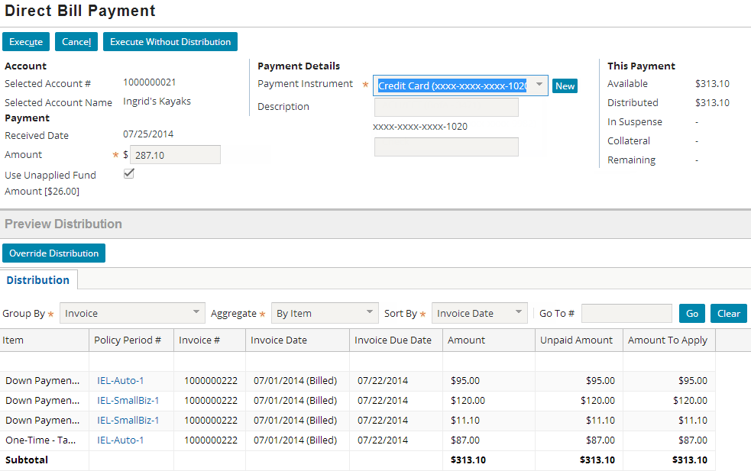
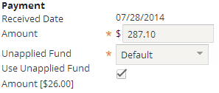
Step 4: View the default distribution
You can choose how to distribute the payment
Default distribution
Notes:
As soon as you navigate out of the Amount field after entering an amount, you can see the default distribution proposed by BillingCenter. The default distribution is controlled by the account's Distribution Method setting.

Slide 10
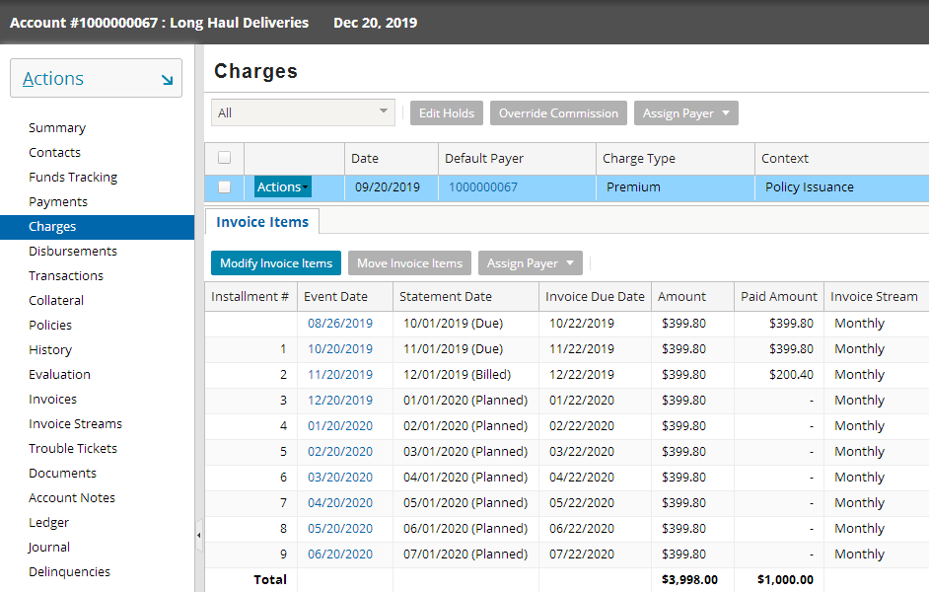
Paid Amount on Charges screen
Account→Charges

Slide 11
Lesson outline
Paying an invoice
Earning and paying commission

Slide 12
Typical commission scenario
Issuance billing instruction is received
BillingCenter creates commission reserve
Commission reserve immediately becomes earned and payable*
When date of producer commission is reached, a batch process:
Rolls up all commission owed the producer from all policies
Kicks off commission payment
* When commission is earned depends on Earn Commissions field of commission subplan
Notes:
The scenario outlined in the slide assumes that the payable criterion on the relevant commission subplan is "On Binding".

Slide 13

Commissions and commission plans
A commission is a fee paid to a producer, usually as a percentage of the policy premium
A commission plan specifies which items are commissionable and determines the rate of commission paid to a producer (or producers) for selling or renewing a policy
Commission
Producer
5%
001
002
4%
003
6%
Notes:
BillingCenter bases commissions on a percentage of policy premium (and any other charges that the carrier defines as commissionable). BillingCenter does not support flat commissions. However, you can pay a flat amount to a producer as a bonus and optionally associate the bonus with a policy period.

Slide 14
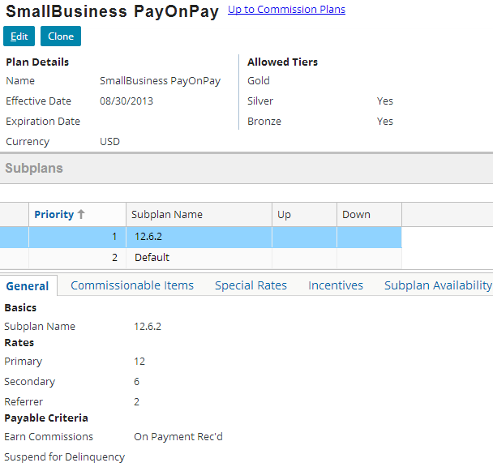
Commission plan example
Restricted to producers in Silver or Bronze tiers
Commission subplans
General tab of 12.6.2 subplan
Notes:
If a commission plan is in use, it cannot be changed. Instead, you can clone the plan and make your changes to the cloned plan.
A commission plan belongs to one or more tiers. In this example, the commission plan is available to producers in the silver or bronze tiers, but not to those in the gold tier.
Commission rates are defined in subplans. A commission plan always has a default subplan.
When calculating commission, BillingCenter works through the subplans in sequence and uses the first subplan for which the policy matches the availability criteria in the subplan. The Default subplan is always the last subplan checked. It has no specific criteria. You can reorder plans using the up and down options located to the right of the Subplan Name field.

Slide 15
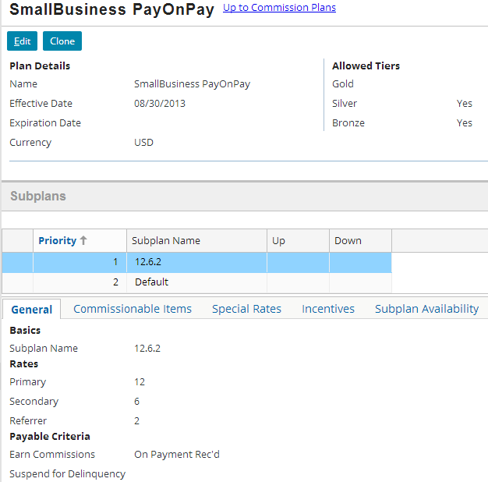
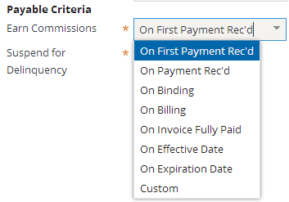
Specifying when commission will be earned
General tab of commission plan
Earned all at once
Earned pro-rata
Earned after event occurs and Commission Payable Calculation batch process is run
Evaluated when policy is bound and also whenever Commission Payable Calculation batch process runs
Notes:
In most cases, commission is earned and becomes payable as soon as the payable criterion occurs. The criterion such as receiving a payment or billing an invoice serves as a triggering event to make commission immediately payable. Other criteria do not automatically trigger commission earning. For these, the Commission Payable Calculation ("CmsnPayable") batch process is required to move the relevant commission amount from the policy’s Commissions Reserve to Commissions Payable T-account.
The Custom earning criterion provides configuration developers a way to configure a custom approach to releasing commission. For example, a carrier could have policies that are effective for two years. They want to pay half the commission in the first year and the other half on the anniversary of the policy on the following year. The Custom criterion is evaluated on bind, in case the custom logic indicates the commission should be earned immediately. After that, it is evaluated only when the Commission Payable Calculation batch process is run.

Slide 16
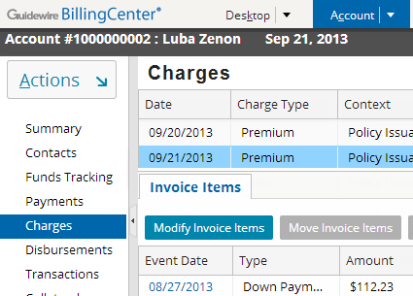
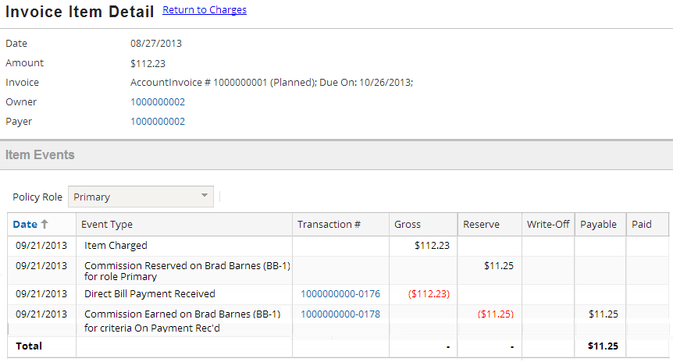
Commissions are tracked at item level
Account tab→Charges
Amounts for reserve, write-off, payable, and paid are tracked
Notes:
The Invoice Item Detail popup shows how commission is tracked at item level. Elsewhere in BillingCenter, charge-level commissions are shown, which are simply rollups of item-level commission.

Slide 17

Creating a commission statement
producer payment
When producer's commission day of month is reached, producer payment sweeps Commissions Payable for all the producer's direct bill policies
Commissions Payable
Commissions Payable
Cash
CR
CR
CR
DR
producer payment
DR
Relevant producer Summary fields
Commission statement
Notes:
No commission transactions are displayed for the producer until the producer's "commission day of month" is reached. At that time, the Producer Payment batch process sweeps the Commissions Payable T-accounts for all the policies for which the producer has at least one role, and then moves the amounts from each policy’s Commissions Payable T-account to the producer's Commissions Payable T-accounts. The batch process then moves the total amount from Producer: Commissions Payable to Producer: Cash. The Producer: Cash T-account reflects the amount the producer will be paid. The actual payment of the producer (that is, writing a check or transferring funds) requires integration.
The Producer Payment batch process also creates the commission statement, which lists the commissions payable to the producer.

Slide 18
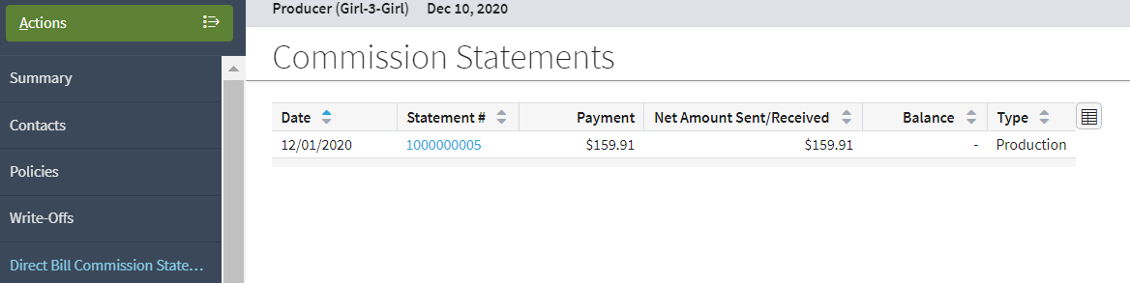
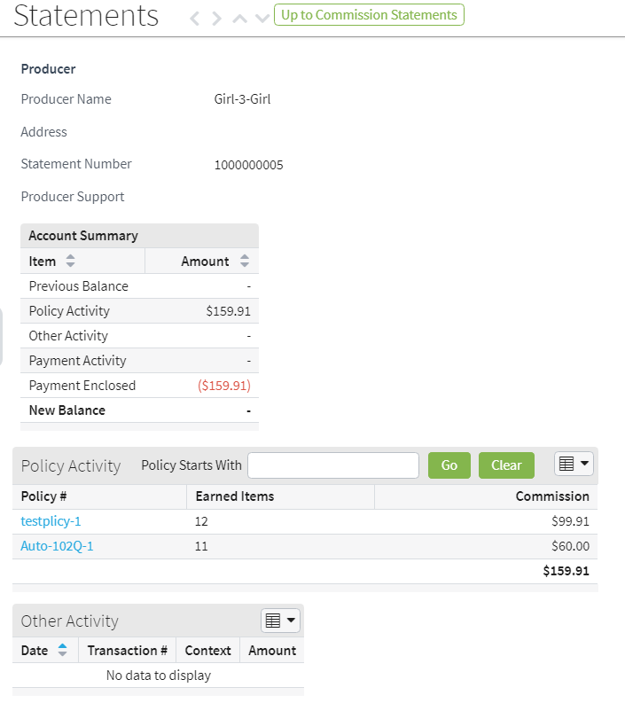
Commission statements
You can navigate from statement to statement
Shows online commission statement
Click policy link to view activity details
Notes:
The Statements screen shows the transactions from the Payables transaction tab grouped into commission or statement periods.
You can navigate backward and forward through the statements using the arrows on the top left of the screen.

Slide 19
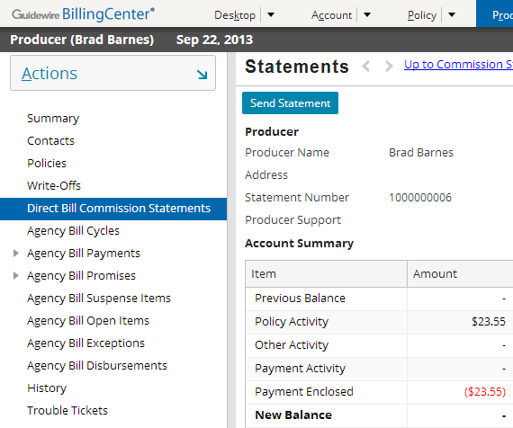
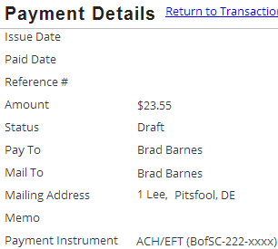
Automatic commission payments
producer payment
Producer→Transactions
Whenever a producer statement has a credit balance, the payment is automatically created when the statement is produced
Notes:
This process is fully automated and requires no user authorization or intervention. The Producer Payment process produces the statement and creates the payment.
(In the example, the details are incomplete because configuration is required to add EFT details.)
The producer payment batch process sweeps the policy Commissions Payable T-accounts for all the producer’s producer codes and moves the earned commission to Commissions Payable on the producer’s T-accounts.

Slide 20
Lesson objectives review
You should now be able to:
Manually enter a payment for an invoice
Generate a commissions statement for a producer

Slide 21
DEMO

Slide 22
Provide demo details<The video creator to fill this slide>

Slide 23
LAB

Slide 24
Complete the exercises in below chapter in the “BC10_Intro_E_StudentWorkBook “ work book
Lesson 1 Managing Producers and Commissions

Slide 25
Review questions
How does selecting an unapplied fund on the Direct Bill Payment screen influence the behavior of the screen?
How would you set up a producer’s separate sales offices within BillingCenter when the producer receives a single statement?
When commission cannot be distributed evenly across all commission payments, what happens to the extra pennies?
Notes:
Answers
The unapplied fund you select restricts the invoice items that are listed on the Distribution tab. Only the items on the invoice stream associated with the selected unapplied fund are shown.
Each sales office would have a different producer code set up within the overall producer details.
By default, the pennies are written off, but this behavior is configurable.

