Slide 1
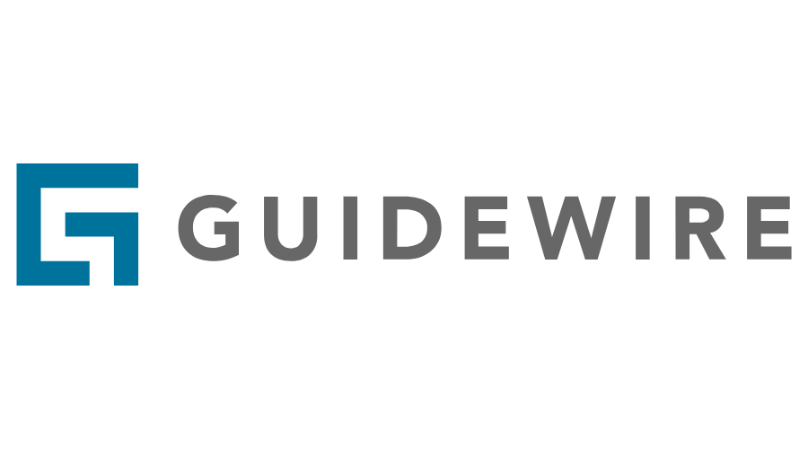
Trouble Tickets and Delinquency

Slide 2
Lesson Objective
You should be able to:
Describe how issues are identified and managed in BillingCenter
Add, view, and release charge holds
Explain why an account and its policies become delinquent
6

Slide 3
Lesson Outline
Using trouble tickets to handle issues
Holding and releasing charges
Handling delinquencies
6

Slide 4
How trouble tickets handle billing issues
Trouble ticket
Cathy Cartwright
HOLD
A trouble ticket is a process that identifies and tracks an insured’s complaint
An activity allows multiple users to track and escalate an issue
A hold stops automated processing
Activity
HOLD
Activity
HOLD
Activity
Notes:
A user can create a trouble ticket at any time. Rules can be defined that create trouble tickets automatically when an exception event occurs.
Each trouble ticket has an owner that is responsible for ensuring the trouble ticket is closed. However, activities needed to resolve the issue can be created and allocated to other users. Rules can be defined to automatically allocate trouble tickets to appropriate users within teams. Activities can also be automatically allocated in this way.
Trouble tickets and activities have due dates and can be escalated if not complete within the expected time. They can also be used to hold processing on the account and/or the commission for the producer. A hold is the method BillingCenter provides for stopping an automated process while an account or policy is in dispute. Depending on the type of hold, the hold can affect an account, a producer, and/or a policy.

Slide 5
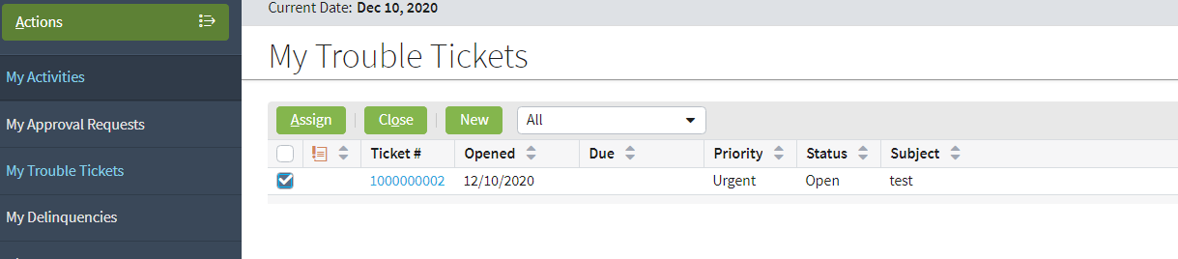
Trouble tickets
Provide central management for tracking issues that relate to accounts, policies, and producers
Often created in response to a customer inquiry
Can be created and assigned automatically in response to processing exceptions
Notes:
BillingCenter configuration developers can write business rules that automatically create trouble tickets.

Slide 6
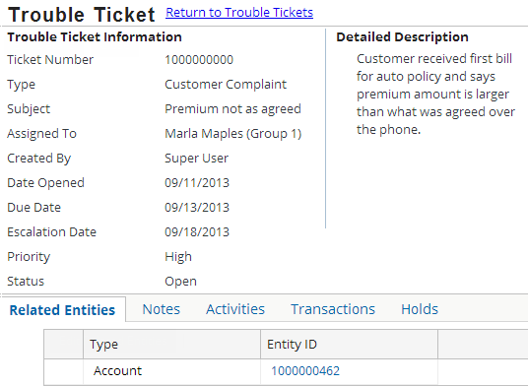
Inside a trouble ticket
Other related entities could be policy periods and producers
A trouble ticket can
Be related to many entities and transactions
Have notes and activities to advance the issue
Hold processing until the issue is resolved
Notes:
Entities that can be associated with a trouble ticket are accounts, policies, policy periods, and producers.
Only transactions from the accounts associated with the trouble ticket may be attached to it.
Processing that can be held includes invoicing, paying commission, and delinquency.

Slide 7
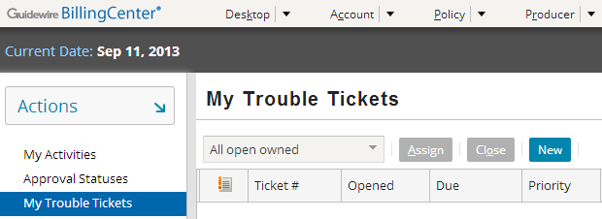
Adding a new trouble ticket
You can add trouble tickets from Desktop, Account, Policy, and Producer tabs
Click (My) Trouble Tickets in sidebar, then click New

Slide 8
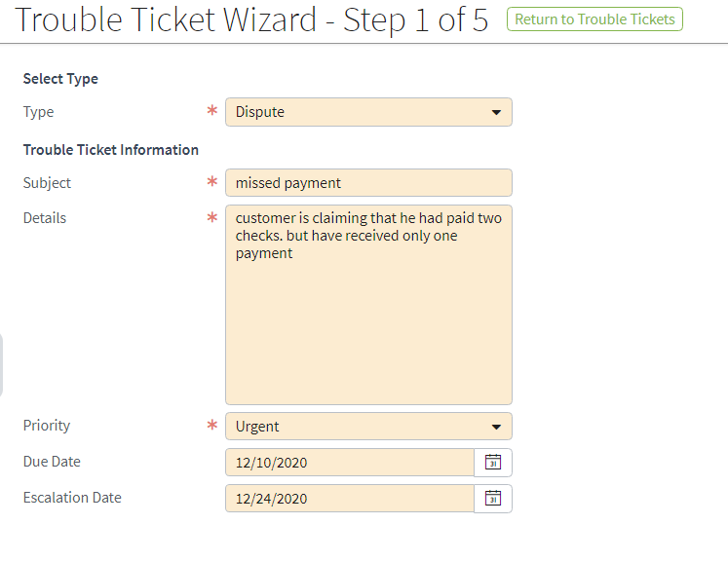
Step 1: Enter details about the issue
Priority, due, and escalation dates are used to manage service of the issue
Type can be used to help automate handling
Notes:
Through configuration, you can automate trouble ticket assignment based on the trouble ticket type (and other factors). You can also automate the creation of standard activities associated with the trouble ticket.

Slide 9
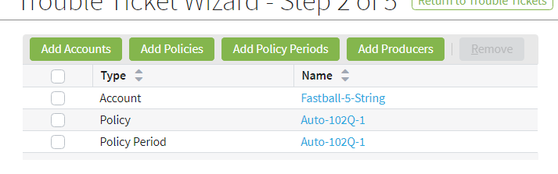
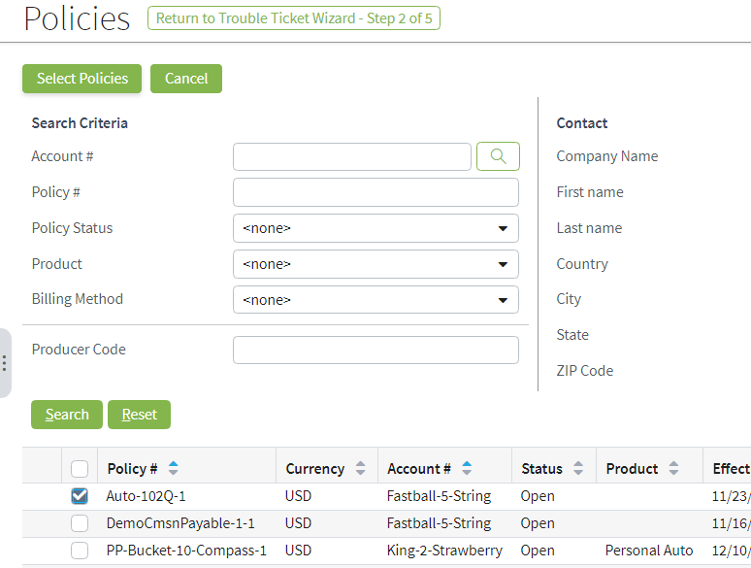
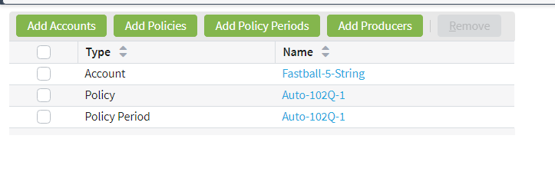
Step 2: Define the context accounts, policies, policy periods, producers
Current entity (account, producer, policy) is automatically added
1
3
These entities will display an alert that there’s an associated trouble ticket
2
Notes:
In this example, the trouble ticket is being added from the Account tab, so the current account is automatically included within the trouble ticket’s context (similarly, producers and policies are automatically included when trouble tickets are added from their tabs).
The trouble ticket in the example shows a dispute over a specific policy. In this case, you would click Add Policies. The policy search opens, allowing you to select one or more policies to add to the trouble ticket.
You may also add producers, specific policy periods, and other accounts.
If you have added any unwanted entities, check them and click Remove.

Slide 10
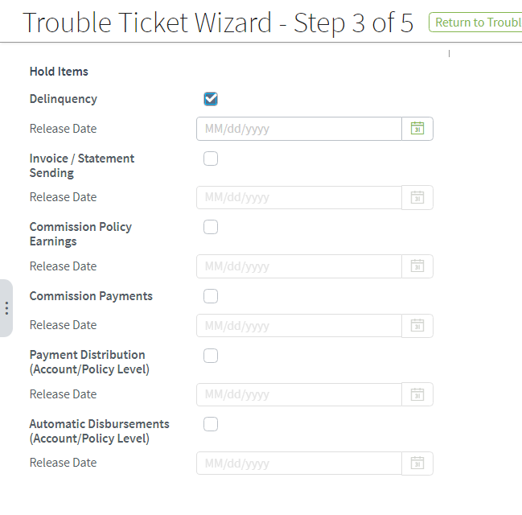
Step 3: Hold automated processing
A process hold blocks automated BillingCenter behavior while a carrier investigates and corrects a billing problem
Why hold a delinquency? Agent thinks customer has already paid what carrier should have billed
Automated processing that you can place on hold
Hold automatically ends on release date (if specified)
Otherwise, the hold must be released manually
Notes:
Trouble tickets allow you to set and release holds on whole blocks of accounts, producers, policy periods, and so on. In the example, a hold is placed on invoice sending to avoid billing the customer until the dispute is resolved. The hold will be automatically released on the specified release date. Closing a trouble ticket before the release date is reached automatically releases any holds.
In general, a "hold" in BillingCenter refers to holds on automated processes, but manual actions are unaffected. However, you can configure BillingCenter to prevent manual actions in the presence of a hold.
Note: You can place a hold on individual charges from the Charges screen for either an account or policy, but a trouble ticket provides the only way to hold a block of charges.

Slide 11
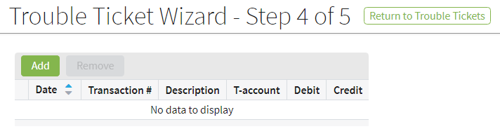
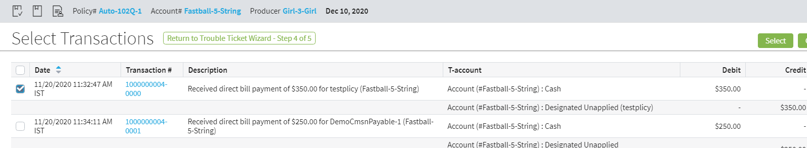
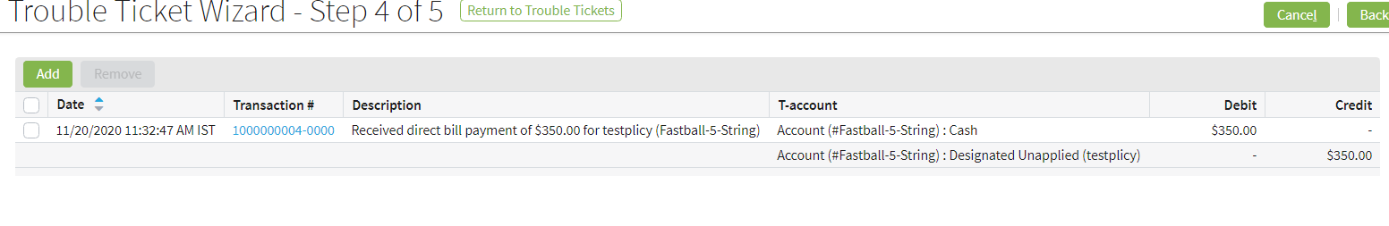
Step 4: Identify the transactions
Adding transactions is for reference only
Notes:
You can add transactions to a trouble ticket for informational purposes. Adding transactions does not cause BillingCenter to take any special action.
In our example, the dispute is about the premium charged. The charge transaction (which was created from the billing instruction) is selected and referenced by the trouble ticket.
You can select any number of transactions and add them to the trouble ticket (the transactions list scrolls). If you have erroneously add a transaction to the trouble ticket, check the transaction and click Remove.

Slide 12
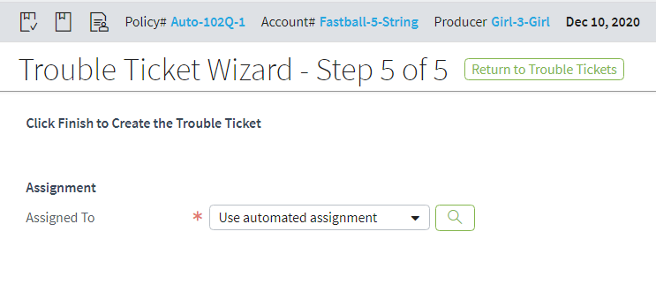
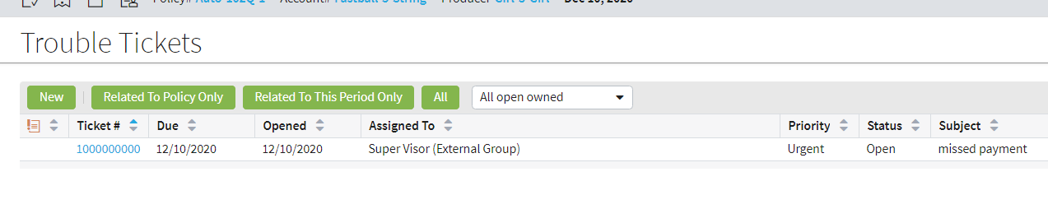
Step 5: Assign responsibility
A user is assigned ownership of each trouble ticket
Default action is to assign ticket through automated rules
You can configure assignment based on type, attached account, priority, current user, or other criteria
Notes:
Assignment of responsibility completes the setup of a new trouble ticket.
After being assigned, the trouble ticket appears on the assigned user’s desktop.
Although the default action is automatic assignment, you can choose to explicitly assign the ticket to yourself or to any user with permission to own a trouble ticket.

Slide 13
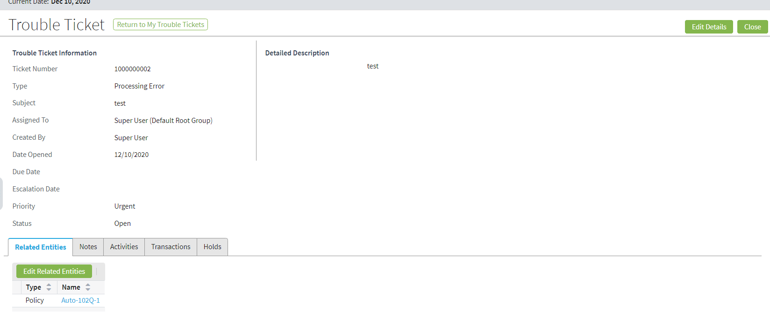
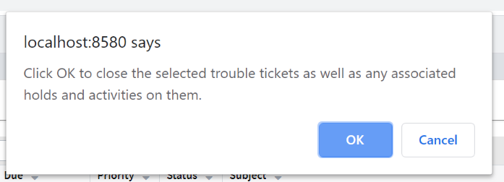
Closing the trouble ticket
Closing a trouble ticket automatically closes associated holds and activities
Notes:
From the desktop, you can select and close multiple trouble tickets. From the Account, Policy, or Producer tab, you need to display the trouble ticket to close it.
After you click Close (from either location), a message prompts you to confirm the closure. You cannot reopen a closed trouble ticket.
It is good practice to ensure all activities are complete before closing a trouble ticket.

Slide 14
Lesson outline
Handling issues with trouble tickets
Holding and releasing charges
Handling delinquencies

Slide 15
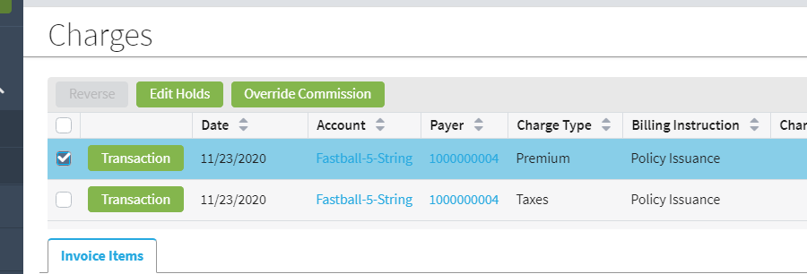
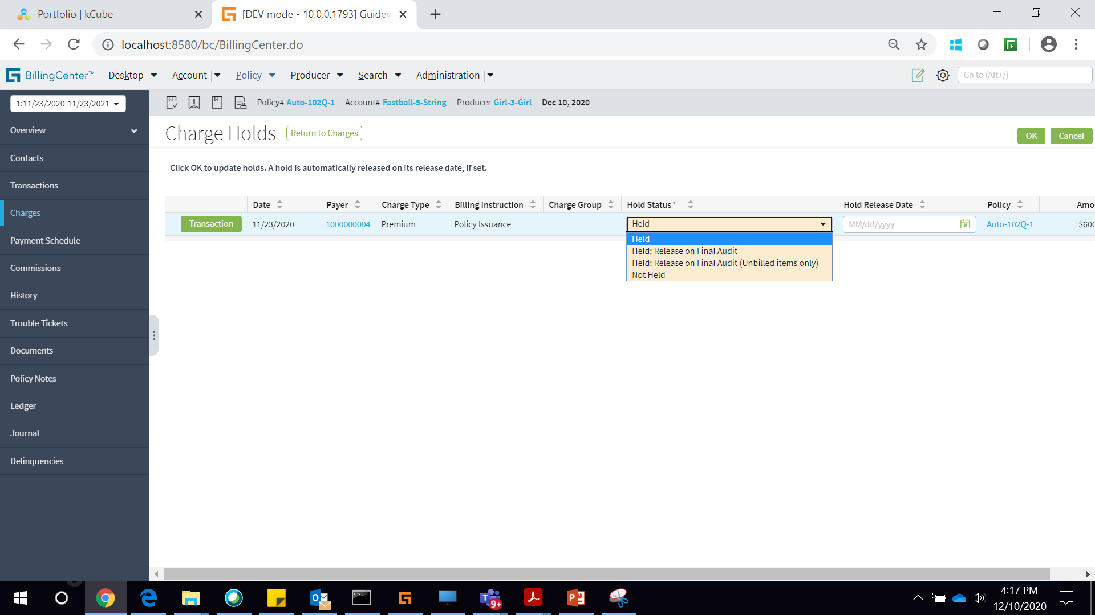
Charge holds
A charge hold moves items for the charge from a billed invoice to a future (planned) invoice
A general charge hold remains in place until:
Its release date is reached, or
It is released manually or programmatically
Premium reporting charge holds are released:
When final audit billing instruction is received, or
Its release date is reached
Notes:
General charge holds: When a charge is held, any items for that charge that are on a billed invoice are "carried forward" to the next planned invoice. When the planned invoice becomes billed, the items are carried forward to the next planned invoice, and so on until the hold is released or the release date is reached.
Premium reporting charge holds: With premium reporting, the actual amount of the premium is not known until the final audit. As a policy period approaches the end of its term, it makes sense to hold all remaining items for the final audit rather than billing items with amounts that are subject to change. Two premium report-related holds are available for handling this use case.

Slide 16
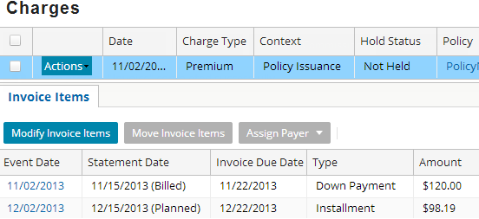
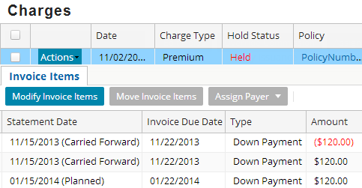
Example of a charge hold
Before the hold
After the hold
Billed down payment item is carried forward to next planned invoice
Notes:
If an invoice item for a held charge is planned, it remains on the planned invoice until the invoice is billed. Then is carried forward to the next planned invoice.

Slide 17
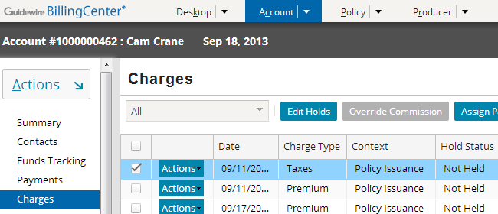
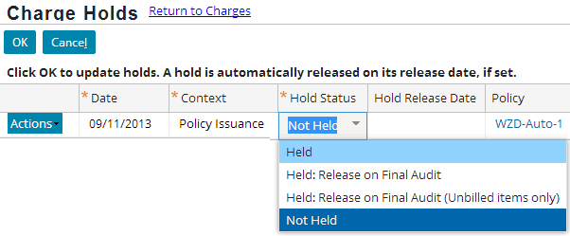
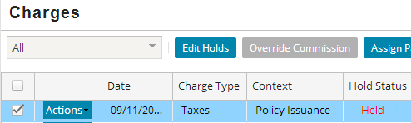
Creating a simple charge hold
2
1
3
Notes:
To hold a charge, select the charge line and click Edit Holds. Change the Held status and optionally enter a release date. If no release date is specified, the charge is held indefinitely.
You can select several items and edit them at the same time. If you select the heading, all charges are selected.
In the base application, only supervisors have the authority to change account details such as holding charges.

Slide 18
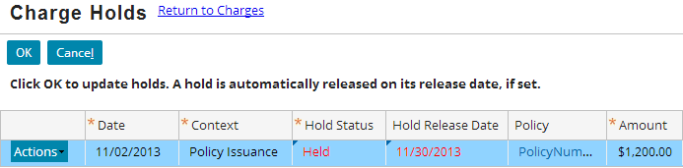
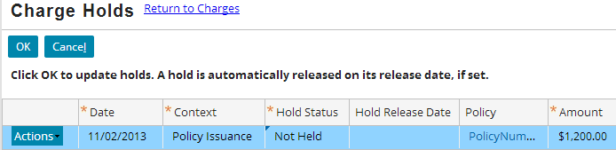
Releasing the hold on a charge
Release manually
Release by date
Release charge holds
Notes:
To explicitly release a hold, select the charge line and click Edit Holds. Then change the Hold Status to "Not Held".
The Release Charge Holds batch process automatically releases held charges when their release date is reached.
In the base application, only supervisors have the authority to release holds.

Slide 19
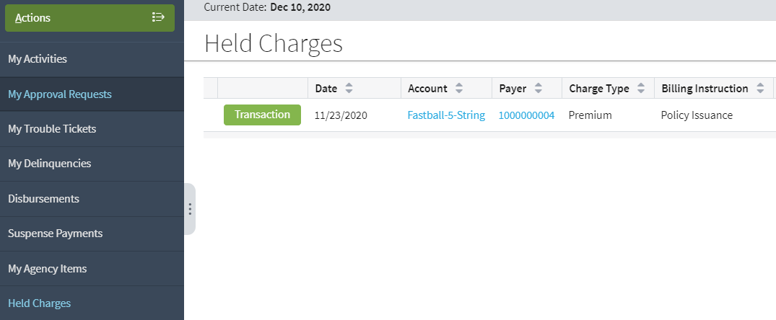
Viewing held charges
Charges screen on Account and Policy tabs has Hold Status field
Held charges are also listed on desktop of authorized users

Slide 20
Lesson outline
Using trouble tickets to handle issues
Holding and releasing charges
Handling delinquencies

Slide 21
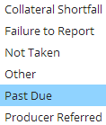
Delinquency
Delinquency is a process that launches and coordinates the steps necessary to handle an overdue amount
Handling can include initiating cancellation or reinstating the delinquent entity
Handling can also involve writing off the delinquent amount
Delinquency is automatically triggered when an invoice is past due
Both account and policy become delinquent
Delinquency can be started manually for various reasons:
Notes:
You can manually start a delinquency from the Account Summary and the Policy Summary screens. The list of available reasons for the delinquency is restricted by the set of delinquency reasons supported by the account's or policy's delinquency plan.

Slide 22
Delinquency is handled by workflow
Delinquency is managed by BillingCenter workflow and can involve:
Sending dunning (past due notice) letters
Sending cancellation letter
If payment is not received, initiating cancellation of the policy
If payment is received, changing account and policy status
If account returns to good standing, initiating reinstatement of a previously cancelled policy or rescinding a pending cancellation

Slide 23
Delinquency plan
The delinquency behaves according to the delinquency plan, which:
Defines a grace period during which no action is taken
Defines the events that make up the delinquency process and when they occur
Controls the workflow to be used for each delinquency reason
Specifies cancellation and reinstatement fees
Specifies threshold amounts for entering delinquency
So that deliquency is not triggered for trivial amounts
Reason
Workflow Type
Events

Slide 24
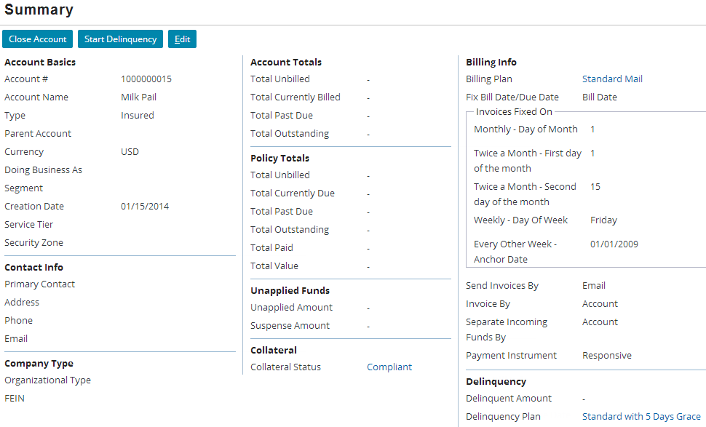
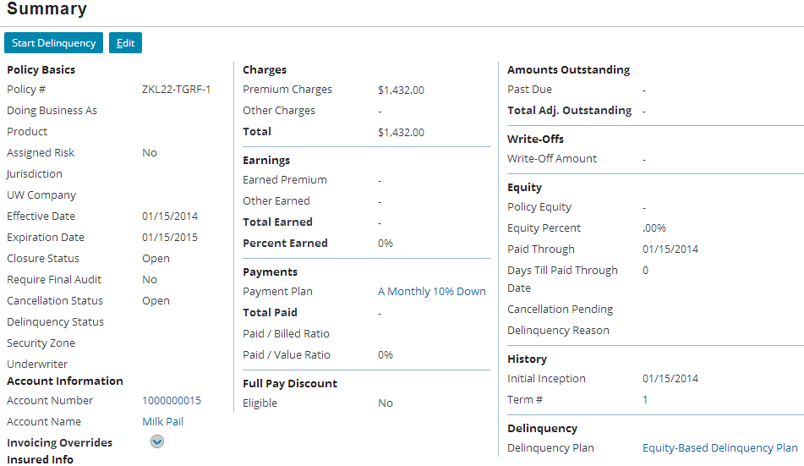


Using a delinquency plan
You can associate a delinquency plan with an account or a policy period
Account Summary
Policy Summary
Notes:
An account must have a delinquency plan. A delinquency plan is optional for a policy. The delinquency plan on the policy takes precedence over the delinquency plan on the account.

Slide 25
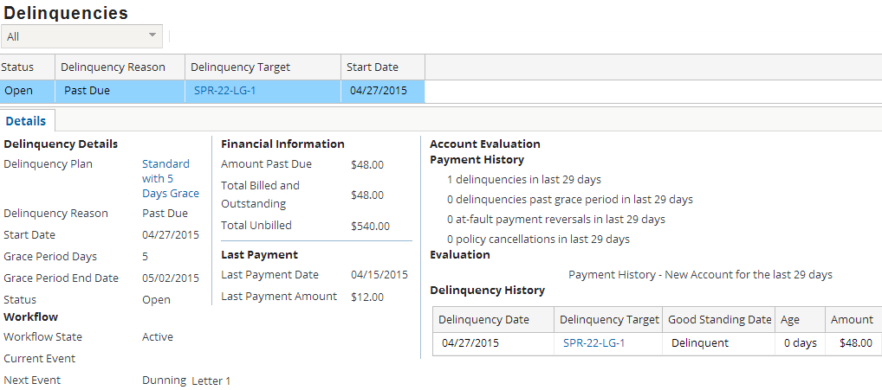
A new delinquency
Current date: 4/27/2015
Account tab→Delinquencies
Delinquency is still in its grace period
A delinquency is automatically created when a payment becomes past due
Notes:
You can access delinquency details from the desktop (previous slide), the account, or the policy. The slide shows the Delinquencies screen for a account. (The same information is available on the policy's Delinquency screen.)
The delinquency behaves according to the delinquency plan, which:
Defines a grace period before action is taken
Defines the events that make up the delinquency process and when they occur
Can limit delinquency so that it is not triggered for trivial amounts
In this example, the delinquency is still within the grace period.
If a trouble ticket is then raised against the account, the delinquency processing can be held while the issue is resolved (discussed in a later lesson).

Slide 26
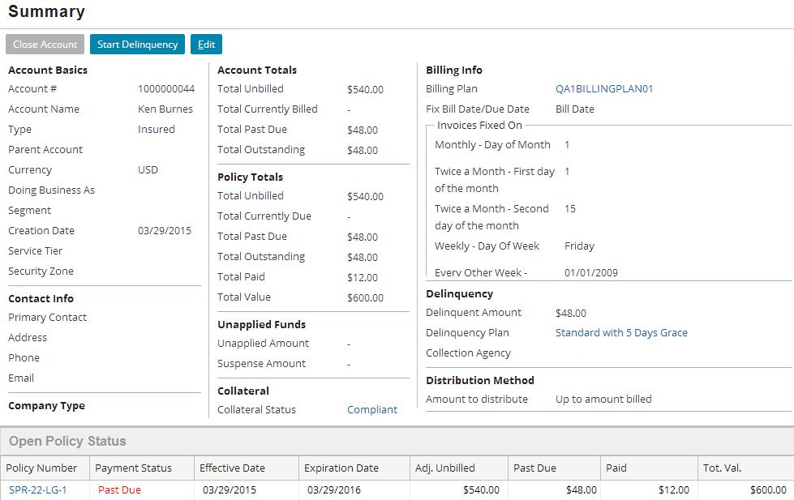
A delinquent account
Current date: 4/27/2015
Account tab→Summary
Notes:
While in the grace period, the account summary shows the past due details and highlights the payment status of all delinquent policies for the account.

Slide 27
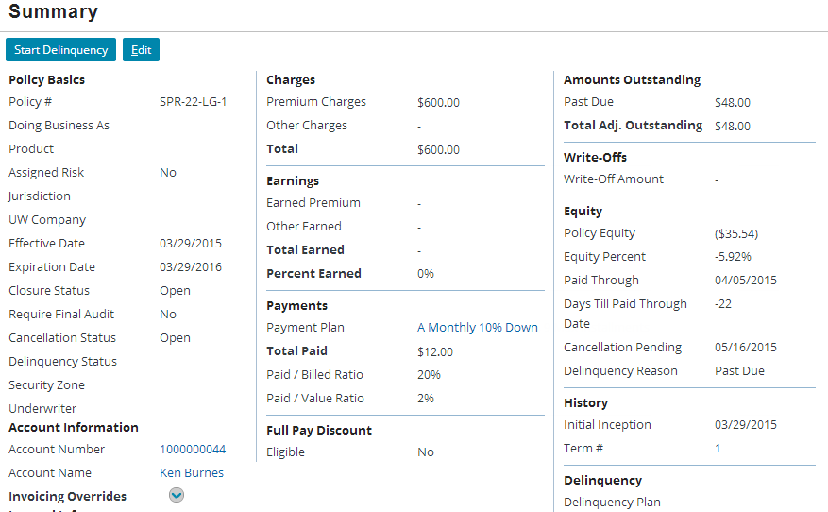
A delinquent policy
Current date: 4/27/2015
Policy tab→Summary
No delinquency status because this is grace period
Date policy may be cancelled and reason
Notes:
The Summary screen for the policy shows the reason cancellation is pending and the date the policy will be cancelled if the Past Due delinquency is not resolved.
The delinquency status is currently blank because the delinquency is in its grace period, and no delinquency events have been executed. Assuming the delinquency has not been resolved, a delinquency alert will be displayed on both the account and policy Summary screens when the grace period is over.

Slide 28
Lesson objectives review
You should now be able to:
Describe how issues are identified and managed in BillingCenter
Add, view, and release charge holds
Explain why an account and its policies become delinquent

Slide 29
Review questions
What are the primary entities that can be associated with a trouble ticket? What is the result of associating an entity with a trouble ticket?
What is the purpose of a charge hold?
Describe what happens to a billed item when a hold is put on the item’s charge.
How do you resume commission payments that were held?
When does an account automatically become delinquent?
Notes:
Answers
The unapplied fund you select restricts the invoice items that are listed on the Distribution tab. Only the items on the invoice stream associated with the selected unapplied fund are shown.
Each sales office would have a different producer code set up within the overall producer details.
By default, the pennies are written off, but this behavior is configurable.

Slide 30
DEMO

Slide 31
Provide demo details<The video creator to fill this slide>

Slide 32
LAB

Slide 33
Complete the exercises in below chapter in the “BC10_Conf_E_StudentWorkBook “ work book
Lesson 5 : Configuring Trouble Tickets

